Slide 1
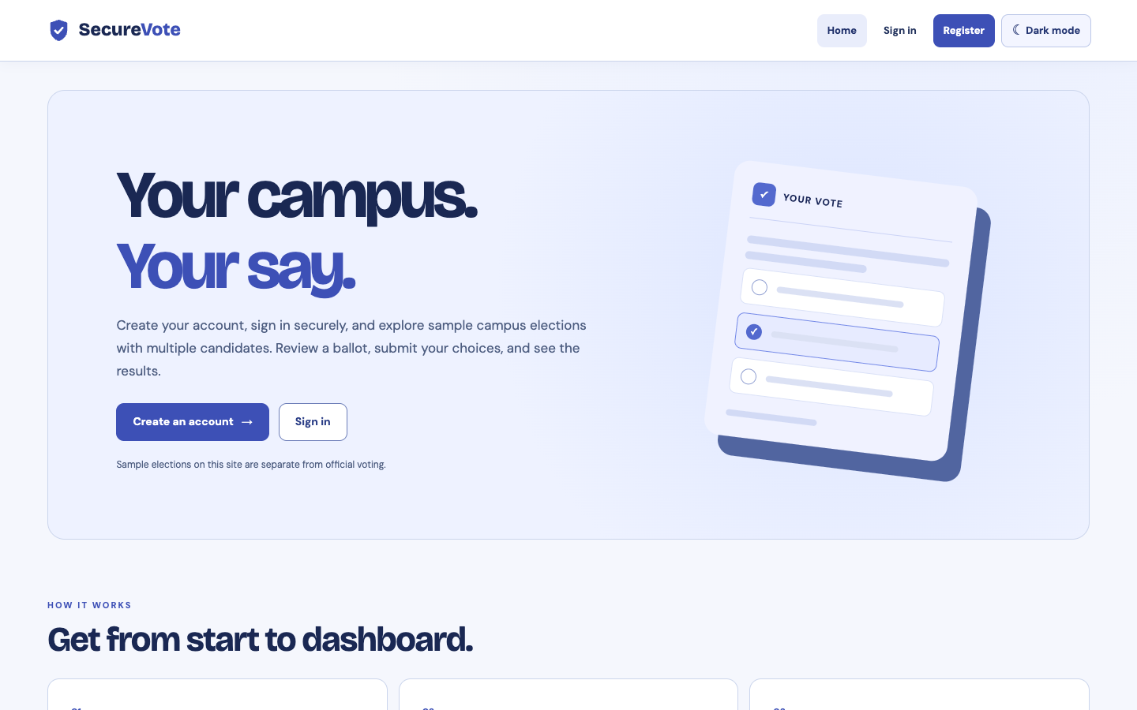
SecureVote
Authentication and voter dashboard
Group presentation with a live website walkthrough
securevote/demo
01 / 09
Notes:
Good morning. Our group will present SecureVote authentication: account registration, sign-in, and the voter dashboard. We will finish with a live walkthrough of the separate SecureVote demo site.

Slide 2
SECUREVOTE
Today’s scope
01
Registration
02
Login
03
Voter dashboard
The ballot and results appear in the sample site, but the live walkthrough stops at the dashboard.
02 / 09
Notes:
The required presentation scope is authentication and the landing dashboard. The sample site also has election features, but we will only point out where they appear on the dashboard.

Slide 3
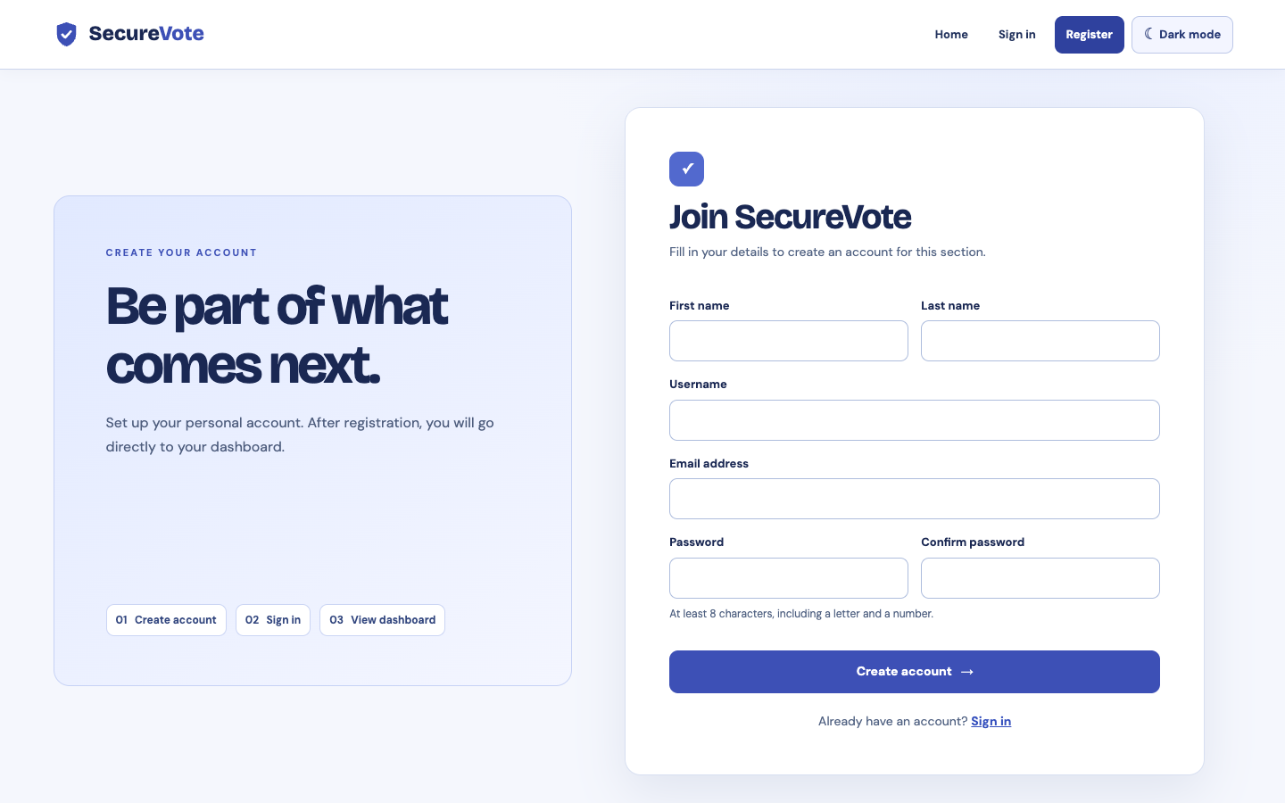
REGISTRATION
Create an account
The form collects a name, username, email address and password.
A successful submission opens the voter dashboard immediately.
securevote/demo/register.php
03 / 09
Notes:
Open Register. Show the identity and password fields. Explain that a successful registration creates an account and signs the voter in, taking them directly to the dashboard. Use a fresh sample account in the live demo.

Slide 4
SECUREVOTE
Registration checks
Identity
Password
Account
Required names, a valid email address, and a unique username.
At least 8 characters with a letter and a number. Confirmation must match.
The server stores a password hash and creates the account only after validation.
Invalid fields receive specific feedback before the account is created.
04 / 09
Notes:
The checks run on the server. Names have length limits, usernames use permitted characters, email addresses are validated, and usernames and emails must be unique. Passwords need a letter and number and must match confirmation. SecureVote stores a password hash, not the entered password.

Slide 5
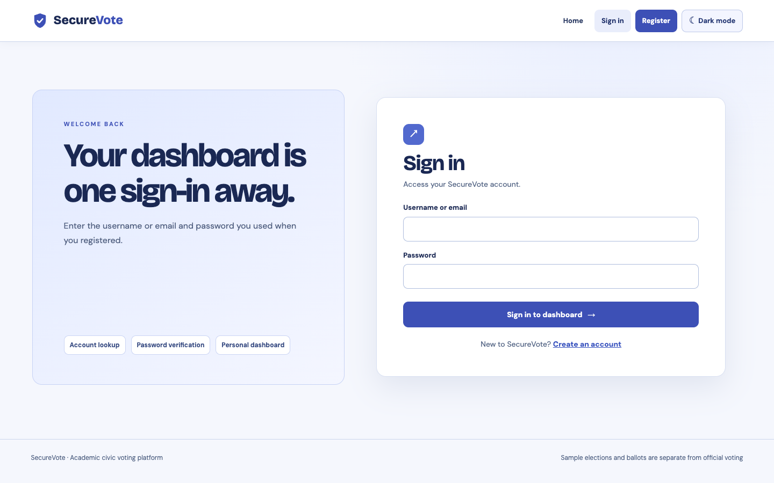
LOGIN
Return to your account
Enter the registered username or email and password.
Valid credentials start a session and open the dashboard.
securevote/demo/login.php
05 / 09
Notes:
Show the Sign in page. A voter can use their username or email address. If the credentials match, the application starts a session and sends them to the dashboard.

Slide 6
SECUREVOTE
Login safeguards
Password verification
Failed attempt limit
The entered password is checked against the stored hash.
Five failed attempts trigger a 15-minute wait for that identifier.
Session protection
Form protection
The session ID changes after a successful login.
A CSRF token is checked when the form is submitted.
06 / 09
Notes:
SecureVote verifies the password against a stored hash. The login route tracks failed attempts per identifier and applies a 15-minute wait after five failures. It checks a CSRF token and regenerates the session ID after successful authentication.

Slide 7
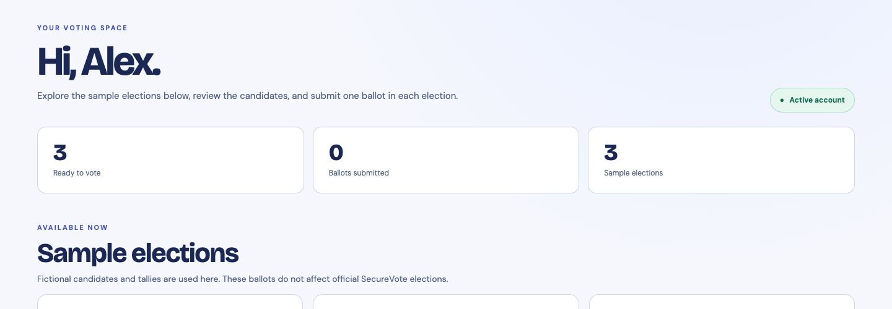
AUTHENTICATED LANDING PAGE
Voter dashboard
Account status, sample elections and participation are visible after sign-in.
Sample accounts and ballots are separate from official voting.
07 / 09
Notes:
After authentication the voter lands here. Point to the account status and the three sample elections. These sample accounts and ballots are separate from the official SecureVote election data.

Slide 8
LIVE WALKTHROUGH
Four steps on the website
1
Open the /demo site
2
Register a new voter
3
Show the dashboard
4
Sign out, then sign back in
08 / 09
Notes:
Open https://darkblue-hummingbird-464264.hostingersite.com/securevote/demo/. Register a fresh sample voter, show the redirect to the dashboard, sign out, and sign back in with the new account. Do not reveal the password on the projector.

Slide 9
SECUREVOTE
Questions?
Authentication, registration and voter dashboard
darkblue-hummingbird-464264.hostingersite.com/securevote/demo/
09 / 09
Notes:
Thank the audience. Invite questions about registration, login, or what appears on the dashboard. If needed, return to the live site to show a specific step.

