Slide 2

ACI Automation
https://github.com/jcoeder/aci-automation
Private Repository, can share if you wish.
https://www.youtube.com/playlist?list=PLPbh8iLKDGisuUUphWgqc7uGLObJfIDTN
Public
Notes:
Please ask for access to git repo. Requires a GitHub account.
Secret management has fallen second to speed.
Not ready to publish just yet

Slide 3

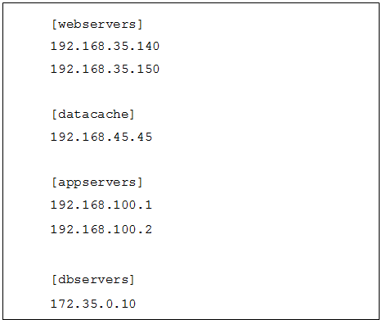
ACI Automation
Python and Ansible stored in Git allowing for collaboration.
Virtual Environments
Infrastructure-as-Code
Notes:
Git allows us to collaborate
Python virtual environments are used to help make code portable and reliable. A learning curve for the customer but will save them headaches in the future when Ansible decides to introduce breaking changes in minor versions as they have been known to do.
Building blocks for Infrastructure as code

Slide 4

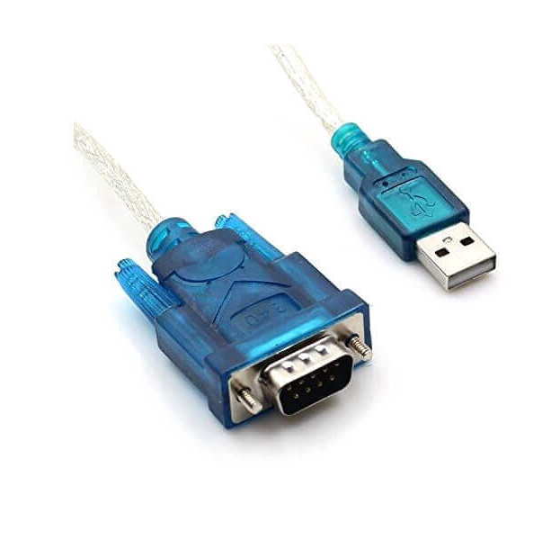
ACI Switch Deployment
Switches configured via serial interface driven by Python.
Allows DC tech to simply smash buttons.
Repetitive, error prone task becomes a repeatable, efficient process.
Ansible uploads ACI image and reboot switches.
https://youtu.be/JFwSlsRekYk (1:22 minutes)
Notes:
Top down, pause and wait code.
~40 seconds per device, still faster than doing it manually and less error prone
Configures management IP address and subnet mask, management default route, SCP feature

Slide 5

ACI APIC Deployment
Initial setup is of the APIC manual.
Python transforms data from excel to YAML.
APIC(s) are then configured with reference variables. (1 minute)
Master playbook runs a collection.
Notes:
Python extracts data from Excel sheet and formats it into Ansible usable YAML files. These files are then referenced for variables.
A master playbook which imports smaller playbooks is used for deployment. Smaller playbooks can be used individual for changes.

Slide 6

MSO Deployment
deploy_mso_ova.yml will upload 3 copies of the OVA while the user is at lunch.
Usually a 10-30 minute process for each and a lot of button clicking.
Only need to manually set IP addresses on each of the appliances.
Notes:
Uploading OVAs is pretty easy to accomplish from a code perspective but will save us a lot of time in the future. Just need username and password
Don’t have to keep browser open.
I accidentally close out of tabs I should not all the time.
(Might get brave and try PowerShell inside Ansible)

Slide 7

MSO Deployment
Under the hood Ansible is executing shell, command, and script modules.
Executing scripts and capturing secret keys to be “Copy and Pasted” to other nodes to join the cluster.
After cluster formation, the MSO application is deployed via Docker Swarm.
Password reset.
With an IP address, Ansible will deploy MSO from scratch. (4 minutes)
Notes:
After the OVA is deployed and IP addresses are set; we use a variety of Ansible modules to build MSO.
shell, command, script execute python and bash
file writes a file to disk for temporary storage of keys and other data that would normally be copy and pasted between nodes.
docker cluster is built
application is deployed via docker swarm

Slide 8

BUILT!
Small fabric takes 3-4hrs to full deployment.
Large fabric built is nearly flat in time vs linear.
Notes:
Saves us, the partner, time and improves the customers experience by placing them in a go-live ready state faster.
Each switch does not have to be manually provisioned then discovered. Give the customer a sneak peak at the power of automation.

Slide 9
ACI and MSO Configuration
With both sites/fabric configured we move on to MSO. (1 minutes)
Using some of the same data generated with the Python script Ansible adds each site to MSO.
Ansible then configures the IPN interfaces and routing.
Ansible then deploys tenants, schema, and templates.
Notes:
Configuration of MSO is very similar to APIC. Data from excel is transformed into YAML then referenced by Ansible.
Given a complete excel sheet MSO can be fully deployed with sites and IPN fully configured

Slide 10
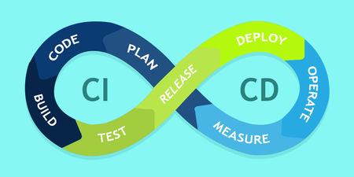
Lab Tools
Started developing simple scripts to speed up lab deployments.
Fabric discovery – Once you have done it once, you remember.
Simply loops over available devices until there are no more.
Eventually part of CICD pipeline.
Notes:
Scripts that we used to speed up our development time will eventually become part of the build process in a CICD pipeline.
This helps the customer develop and test faster.

Slide 11

Day 2 Operations
Build focused.
Adds, Changes, Deletes.
Compares.
Monitoring.
Notes:
So far we have been very build focused in our automation.
Playbooks and scripts focus on building something given raw inputs
Playbooks can be broken apart and used for Add, Changes and Deletes
Add bridge domain by running a single playbook and updating a few in-playbook variables
Checks – After changes are made, check health status

Slide 12
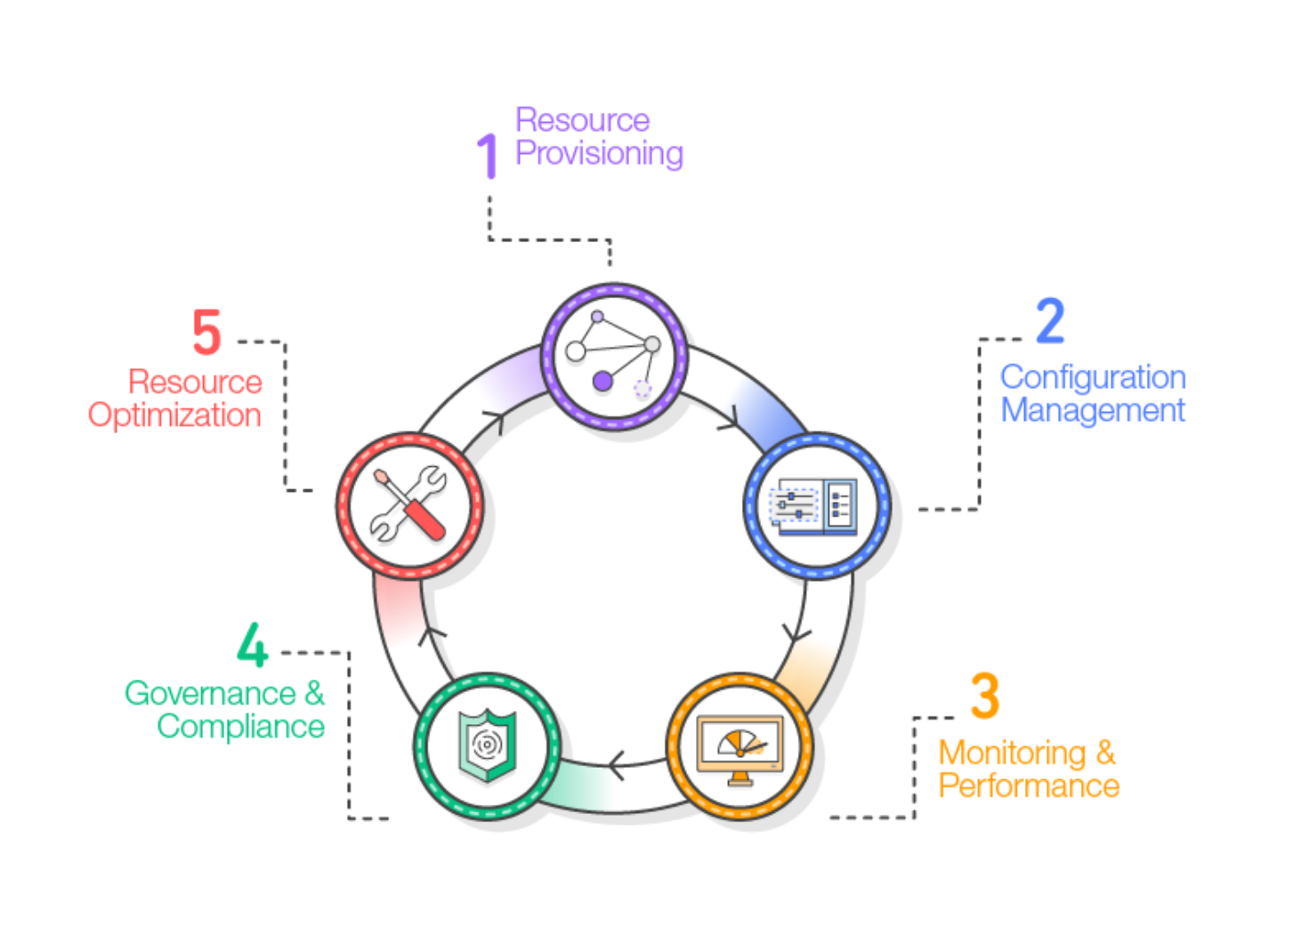
Source of Truth
Database
SQL
Service-Now
NetBox - Postgres
No SQL
Elasticsearch / Mongo
Self-Generated YAML
Infrastructure-as-code
Notes:
Source of truth, in this case, excel, will generate YAML files. These YAML files become the base for Infrastructure as code
Desired change in Excel document.
YAML is generated
Stored in config management
Applied to devices
Tests and checks are run
State is validated
ALL DEPENDANT ON
ACI presents interesting challenges as it is consumed differently and models data very different than what any Source of Truth offers today.
Service-Now is flexible but expensive.
NetBox in a network centric mode. No method to model contracts
NoSQL as a place to dump and compare data.

Slide 13

Reusable Tools
Micro scripts/playbooks to be used as part of larger scripts and playbooks.
MSO Bearer Token
MSO Backup and Rollback
APIC Backup and Rollback
Notes:
Keeping to DRY principles smaller scripts, functions, and playbooks are imported into larger ones to prevent repeating code

Slide 14
Questions.
www.encore.tech

