Slide 1
The briefing you will prepare should mirror the sections in the SAGE Article (E02, E03). There is no slide limit on this presentation, please use your best judgment in creating slides that showcase your work for CYSE 493 instructors and Sage Judges.

Slide 2


Eo4 Sage Presentation: LM Windows Packer and Loader
Mitchell Palmer Andrew Chapin Carl Bai Hunter Rowlette Andre Herrera

Slide 3
Problem Statement
How do we deploy and execute PE files remotely onto Windows 7, 8, & 10 OS’s securely?

Slide 4
Required Objectives
Required Objectives
Ability to compress and encrypt a Windows based binary executable
Encryption should be password based
Portable Executable (PE) file format binary executables must be supported
Packer
Compression/Encryption capability must output to a single file
Support dynamic linking against libraries
Loader
Take Packer output and decrypt it
Output Packer file contents based on user defined, configurable parameters
Identify when Packer file contents are executables and run them
Running of executables by the Loader capability must be configurable, allowing user to toggle between an automatic run and a prompt during decryption/decompression
Run executables in memory as a separate thread/process

Slide 5
Desired Objectives
Desired Objectives
Compression and encryption of multiple files at a time to a single file
PE32+ file format binary executables supported
Ability to also run in Linux/compress and encrypt a Linux based binary executable
ELF file format binary executables supported
Ability to also run in macOS/compress and encrypt a macOS based binary executable
Mach-O file format binary executables supported
Packer
Supports both static and dynamic linking against libraries
Loader
Never touches disk (e.g. everything happens in memory: decryption, decompression, and execution)

Slide 6
Technical Approach Overview
Requirements
Challenges / Design Constraints
CONOPS
Architecture (components, modules, interfaces)
Data Model
Verification Method
Tasks
Risks

Slide 7
Tasks
2 Research & Design
2.1 Existing Tools
2.2 General Architecture
2.3 Design
3 Implementation / Coding
3.1 Packer Dev.
3.2 Loader Dev.
3.3 P/L Networking Dev.
3.4 P/L Networking Integration
3.5 Deployment Mechanism Dev.
4 Testing & Quality Assurance (Q.A.)
4.1 Packer Q.A.
4.2 Loader Q.A.
4.3 Networking Integration Q.A.
4.4 Customer Deployment
4.5 Final Development
GNATT Chart

Slide 8
Requirements
A packer and a loader, two separate pieces of software
The packer shall compress and encrypt a Windows binary executable
The loader shall listen for incoming packed data and decrypt it
The loader shall be able to detect executables and run them in memory as a separate thread/process; toggles between autorun
The packer and loader shall support PE format (with PE32+, ELF, Mach-O desired)
The encryption shall be AES-256 and password-based

Slide 9
Risks
Network Restrictions
If the network architecture of the sponsor contains firewall rules or networking segmentation that we do not account for, then the packer will not be able to establish a connection with the loader and we will not be able to meet our project requirements. As such, additional time will be required to allow the packer to communicate in more restricted networks, and we will need to adjust the schedule accordingly.
System Requirements
If the machine where the loader is deployed does not meet our code’s expected requirements, then it will not be able to function properly. Additional time would be required to redesign parts of the loader to get around these restrictions

Slide 10
Challenges
Our combined knowledge and skillsets
While the team has extensive experience in software development, some of the particulars of creating a packer and loader combined with network file distribution are outside of members’ area of expertise.
Limited to open source software
Without adding a budget to the project to purchase expensive proprietary software, the team can only use free open source software. Additionally, with free closed source software, the team would be unable to determine its inner workings and as such would be unable to guarantee the software does what it claims to do. Similarly, the team would be unable to guarantee that the software only does what it claims to do.
Time allocated to the project
With the hard time constraints imposed by completing this project as a senior capstone, any requirements needing more time than the two combined semesters will be impossible to complete.

Slide 11
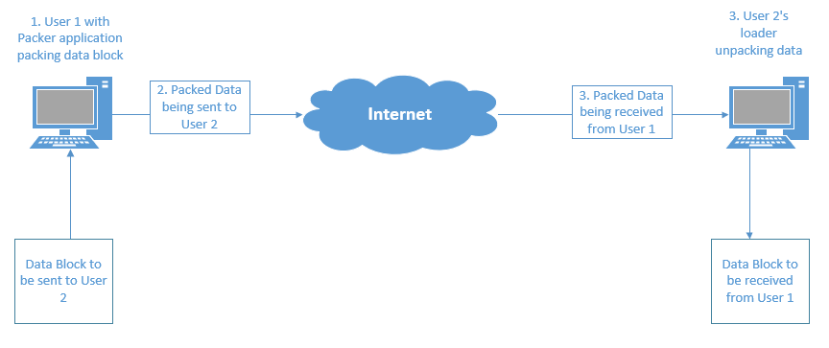
CONOPS
Step 1: A data block (e.g. executable file) is selected by a user and sent to the packer application where it is packed.
Step 2: The now-packed data block is sent over the internet to the remote host.
Step 3: The remote host receives the packed data with the running loader service.
Step 4: The loader decrypts the data block and will either run it or make it available on the system.

Slide 12
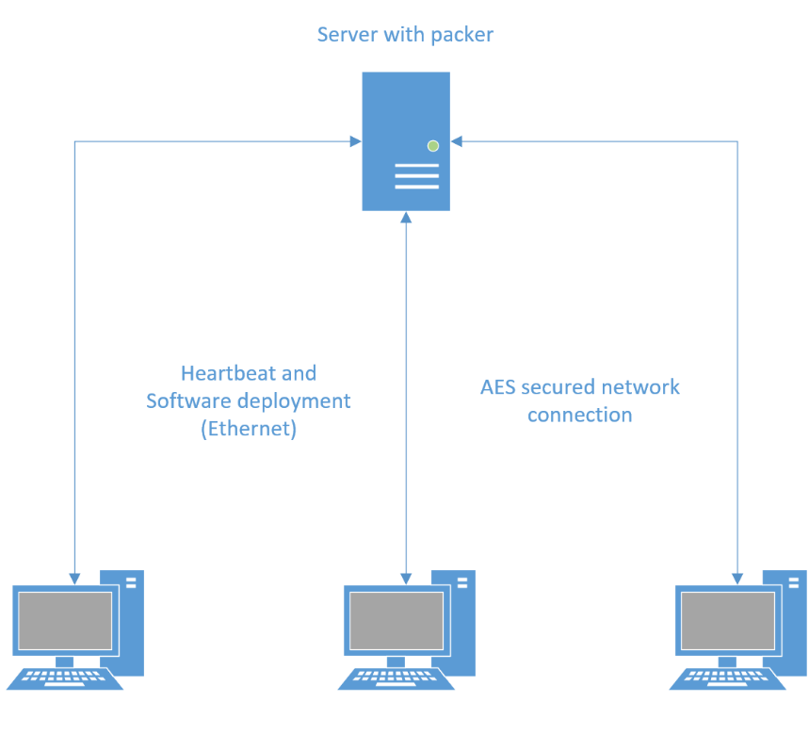
Architecture
The project has two major components: a server containing the packer application and client nodes containing a loader.
The server and nodes will be connected via a network, allowing for bi-directional data transition.
The nodes have a heartbeat with the server to inform it that they are available for data to be pushed or the status of the data received.
The data sent to the nodes is transmitted over an AES encrypted tunnel on the network.
The AES cryptographic operations are handled in-software on both ends, thus allowing the network traffic to be standard packets.

Slide 13
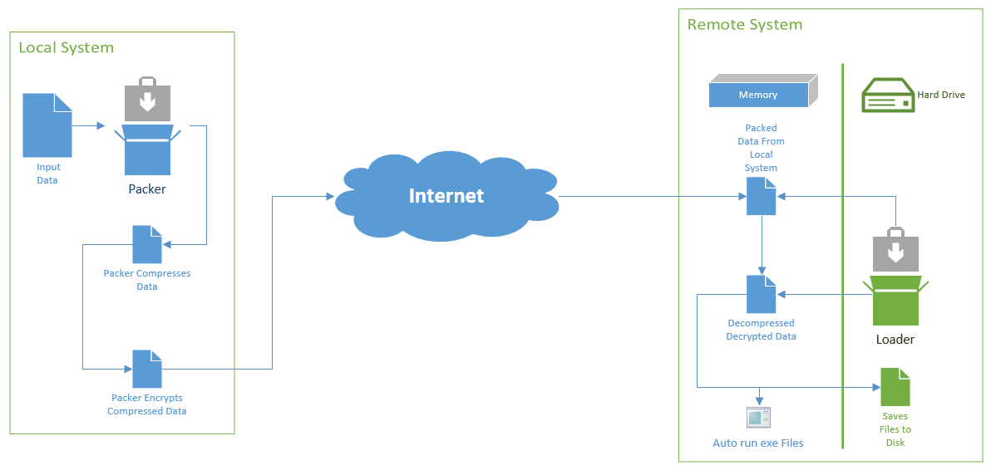
Data Model
Input data to our project will be sent to the packer server, where the packer application will package it by compressing and encrypting the data.
When a package needs to be pushed to a client node, the packer server will transmit this encrypted data over an arbitrary network to the node.
When the node receives the data, it will be loaded into memory where the loader stored on the hard drive will decrypt it into memory.
This decrypted data will then be checked to see if it is an executable.
If it is an executable, it will be run in memory.
This program will then be able to write files to the hard drive.
If the data pack is not a program, it will be written to the hard drive.

Slide 14
Verification Method
Q.A. through integration and unit tests of the packer and loader software products.
Final confirmation from the sponsor of the functionality of the product.
Customer testing in the environment which will provide user confirmation and feedback of product function
Alterations made as requested.
Final packaging to meet sponsor and customer requests.

Slide 15
Key Deliverables
CLIN-1 Customer Reporting “Quad -Pack”
CLIN-2 Weekly Activity/Time Sheet
CLIN-3 Color Team Briefing
CLIN-4 Proposal (as a response to this RFP)
CLIN-5 Design Review Briefing
CLIN-6 Poster Paper
CLIN-7 Encryption and Compression Design and Techniques Report
CLIN-8 Final Report and Team Presentation
CLIN-9 Product Specifications
CLIN-10 Packer/Loader Source Code and Completed/Compiled Tool

Slide 16
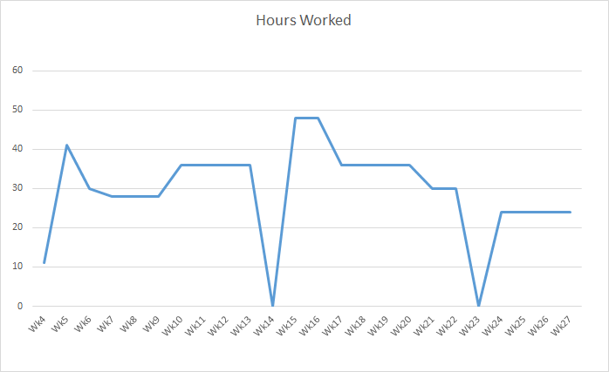
Cost / Management
No costs are attributed to this project outside of labor.
Labor costs are outlined in graph with hours worked by all group members each week of the projects span.
The two weeks with no hours worked correspond to holiday breaks.

