Slide 1
Executive Summary
Date:4/1/20
Project Name: Windows Packer/Loader
Team Name: BluSh3ll
Deliverables:
CLIN-1 Customer Reporting “Quad -Pack” – 2/7/20, 3/6/20
CLIN-2 Weekly Activity/Time Sheet – Due every Friday
CLIN-3 Poster Paper – 4/30/20
CLIN-4 Final Report and Team Presentation – 4/3/20
CLIN-5 Product Specifications – TBD
CLIN-6 Packer/Loader Source Code and Completed/Compiled Tool – 4/24/20
Key Accomplishments:
Packer complete. Loader almost complete. Networking is progressing slowly due to setbacks but once its ironed out the we feel the project will almost be complete. Issues: We are not as far into development as stated by our critical milestones, but we are confident in delivering the product by the specified date.
Schedule Status: We feel that we will have a feature complete prototype in a week/week and a half. And a finished product in 2-3 weeks.
Cost Status: No monetary cost, 679 hours contributed to date

Slide 2
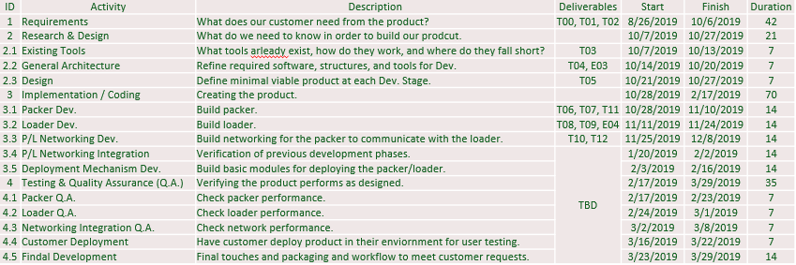
Issues/Future Plans
Critical Milestone Dates:
Return to “Green” Plan (if Issues)”
We now have more time to work on the project due to classes moving online so we feel confident in finishing the project.
Plans for Next Reporting Period:
Complete through 4.5 (everything).

Slide 3
Schedule
Comments:
Red line was projected we are currently still in 3.5, 4.1, and 4.2.

Slide 4
Customer Satisfaction Survey Date:
Customer Satisfaction
SPONSOR: to provide Ratings and Comments
IMPORTANT: be sure to request well in advance of due date

