Slide 1
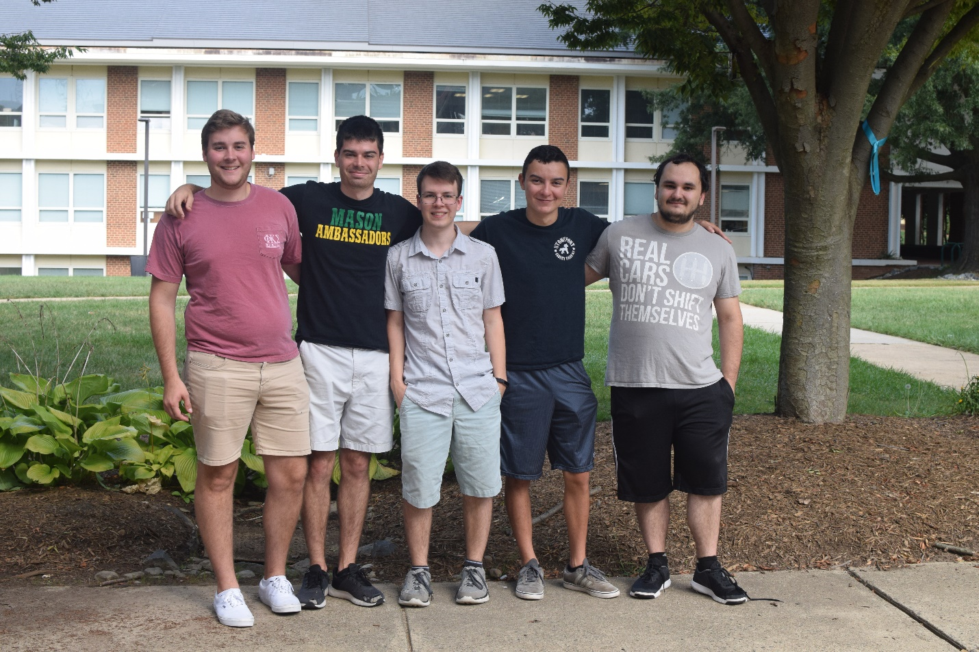
Windows Packer/Loader System
Lockheed Martin
Allison Elfring
Produce a software tool which can perform
compression and then encryption
operations on files and binary executables.
Hunter Rowlette Stafford, VA
Cyber Security Engineering, B.S.
Looking to work my way to becoming a penetration tester in the field of Cyber Security.
Hunter Rowlette, Mitchell Palmer, Andrew Chapin, Andre Herrera, Carl Bai
This capstone project really helped introduce me into the real world of working with customers.
Mitchell Palmer Richmond, VA
Enter text here
Cyber Security Engineering, B.S.
Andre Herrera Bayville, NJ
Enter text here
Looking to make the world a safer place
through cybersecurity.
Cyber Security Engineering, B.S.
Looking to work in government contracting
This class introduced me to agile
development and c++.
This class helped me practice time management in a year long project
Carl Bai Southborough, MA
Cyber Security Engineering, B.S.
Andrew Chapin Fairfax, VA
Enter text here
Looking to work for a large private sector
corporation or financial institution.
Cyber Security Engineering, B.S.
I just like playing with computers
and solving puzzles.
This capstone project introduced me to
agile planning and project management.
“I have not failed. I've just found 10,000
ways that won't work.” - Thomas A. Edison

