Slide 1


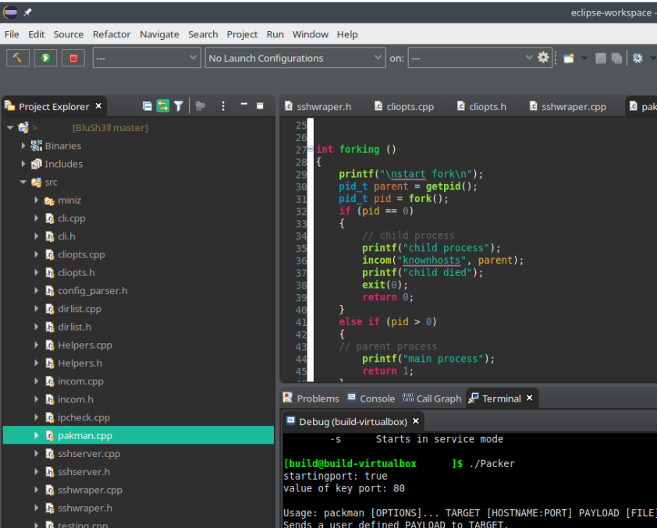
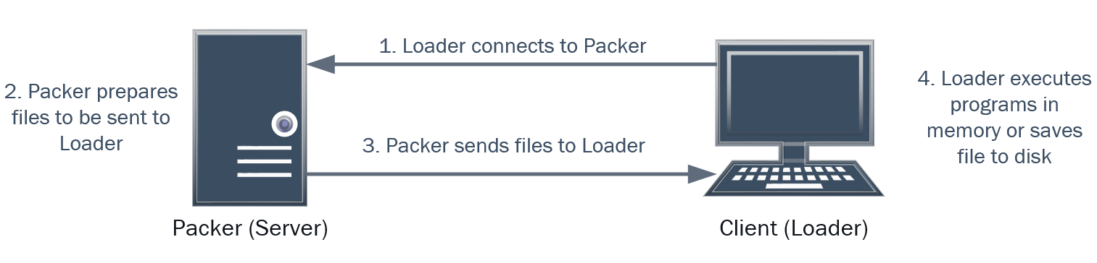
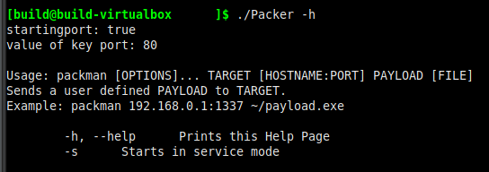
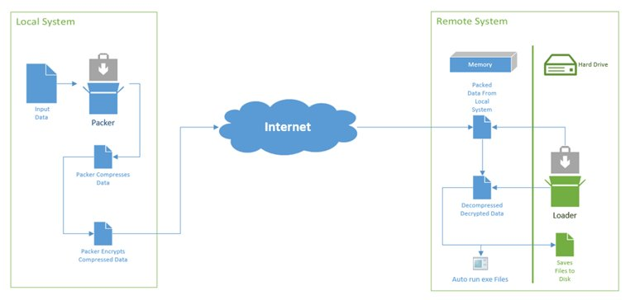
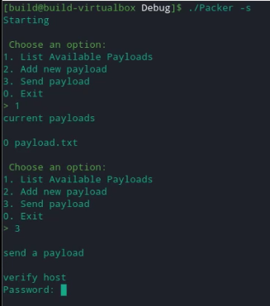
Windows Packer | Loader
Team BluSh3ll
Andrew Chapin (achapin2@gmu.edu), Andre Herrera (aherre12@gmu.edu),
Carl Bai (cbai2@gmu.edu), Hunter Rowlette (hrowlet2@gmu.edu),
Mitch Palmer (mpalmer7@gmu.edu)
Allision Elfring, Lockheed Martin
School of Cybersecurity Engineering, George Mason University
Background
Our project fulfills a request to produce a software toolkit that allows for remote code execution completely in RAM and file transfer via a service running on a remote host. The goal of our stakeholder, Lockheed Martin Corp. (LM), is for our research to identify a unique way to accomplish this task.
Packers are generally used to encrypt, compress, and sometimes obfuscate executables/files that are fed to them. Our packer also connects to a loader for remote delivery of these files.
Loaders read program instructions into memory. They are designed to be small and reliable with minimal functionality are often difficult to detect.
Our deployment of a loader is as follows:
Loader is deployed on a client system
Loader connects back to the server (C&C)
Loader fetches files/executables from the server
Loader, on the client system, executes PE files in memory or saves the files to disk.
This project is useful for discrete delivery and execution of files to remote systems.
LM Requirements:
The toolkit must be comprised of two separate executables – a “packer” and a “loader”
The “packer” runs locally on Linux, compresses, then encrypts with AES via a user-provided password before sending data to remote hosts
The “loader” runs on a Windows remote host as a service, receives incoming packed data, decrypts/decompresses, and executes any PE files entirely in RAM (i.e. without touching disk). Other loader operating systems were desired.
Implementation
Both tools were written in the C++ programming language. We choose C++ because it allowed us to perform low-level memory management and it contained the functionality via standard or external libraries to achieve the requirements set forth. Also, by writing both the Packer and Loader in the same programming language, we were able to duplicate effort (e.g. the encryption function could be easily ported into the decryption function for the loader). For our development environment, we utilized a Manjaro Virtual Machine (VM) running Eclipse to code the Packer and part of the Loader development. By sharing this VM, our development team was able to ensure that the code would build and compile without having to worry about "it worked on my system" problems. For most of the loader development, we utilized Microsoft Visual Studio – since the loader was meant to run on Windows Operating Systems (OS).
We utilized external C++ libraries that supported our needs for compression (miniz library – which implements zlib (RFC 1950) and Deflate (RFC 1951) compressed data format specification standards); AES-256 encryption (openSSL library) and networking (libSSH and libSSL libraries). To communicate with the loader, the SSH protocol was utilized. We choose SSH for our design because it handled the management of encryption keys reducing our development requirements for a keystore.
Our packer was designed to accept both command line arguments and direct user interface input. The unistd.h library is used with the getopt() function to parse through passed arguments and set key options flags in the program. If the program is run with improper arguments or the “-h” flag, the help page will be displayed. Once all command line arguments are properly parsed, the program calls the CLI code which presents the user with an interactive command line interface.
The loader was also written in C++ so we did not have to duplicate effort (e.g. once compression/encryption was coded, the decompression/decryption could be ported with minor changes). Also, C++ allowed us to utilize the .NET framework in Windows to interact with the operating system (OS). It also performed code execution entirely in memory.
Results
A delivered product! Our packer and loader tool combo was delivered to our stakeholder. Our product helped enable their mission and objectives. We also provided the research we conducted along with the product. As our assignment was both to conduct the research into the technology and develop the product, both we equally valuable. We found that R&D of such a product is quite difficult, especially in the area of executing code completely in memory. We researched products that delivered similar solutions to ours. From what we found, most only delivered a portion of our entire system. E.g. one product advertises receiving data from remote systems and another specializes in code execution in memory. Our product contained a lot of subsystems. By researching the best methods specialized programs succeeded in building these subsystems, we were able to aggregate a successful full product.
We met the required spec from our stakeholders. Very few of the desired objectives were met though, due to constrains such as a quick timeline and barriers in development
Lessons Learned
- A standard development environment is essential
- Test cases make development easier and quicker
- Time management is essential (both for development and the business end of assignments)
-Large scale software development is hard
-Time Management is essential
-Met spec/didn't
-TBD
A screenshot of the Manjaro development environment.
A screenshot of our help page.
References
[1] “libssh 0.9.3,” libssh. [Online]. Available: http://api.libssh.org/stable/. [Accessed: 16-Mar-2020]. [2] R. Geldreich, “richgel999/miniz,” Github, 09-Mar-2020. [Online]. Available: https://github.com/richgel999/miniz. [Accessed: 16-Mar-2020]. [3] “Filesystem library,” cppreference.com, 15-Jun-2018. [Online]. Available: https://en.cppreference.com/w/cpp/experimental/fs. [Accessed: 16-Mar-2020]. [4] “Payload Types in the Metasploit Framework,” PAYLOAD TYPES IN THE METASPLOIT FRAMEWORK. [Online]. Available: https://www.offensive-security.com/metasploit-unleashed/payload-types/. [Accessed: 16-Mar-2020].
[5] arno0x0x, “Windows oneliners to download remote payload and execute arbitrary code,” Windows oneliners to download remote payload and execute arbitrary code, 18-Apr-2018. [Online]. Available: https://arno0x0x.wordpress.com/2017/11/20/windows-oneliners-to-download-remote-payload-and-execute-arbitrary-code/. [Accessed: 16-Mar-2020].
Design Overview
In the planned design, the packer program on a Linux system receives files from a user. The packer takes this arbitrary data, compresses the data, and then encrypts the data. These "payloads" are stored on the system in a single file. Then, a user can select a payload to send to known hosts containing a loader. The user can choose one or more hosts. The payload is sent over the internet. On the remote Windows host, the loader is running as a Windows service. It waits on a preconfigured port for incoming data. When it receives a payload, it will decrypt and decompress the data entirely in memory. Then, depending on user-defined, configurable conditions it will either execute the program completely in memory as a separate thread/process or save the file to the disk.
A screenshot of our help page.
A screenshot of our home page command line interface in action.
Acknowledgements
We would like to thank Professor Sabetto for believing in us when we didn’t believe in ourselves.
We would like to thank Allision Elfring for her consistent advice
A screenshot of our help page.

