Slide 1
Executive Summary
Date:2/7/20
Project Name: Windows Packer/Loader
Team Name: BluSh3ll
Deliverables:
CLIN-1 Customer Reporting “Quad -Pack” – 2/7/20, 3/6/20
CLIN-2 Weekly Activity/Time Sheet – Due every Friday
CLIN-3 Poster Paper – 4/30/20
CLIN-4 Encryption and Compression Design and Techniques Report – TBD
CLIN-5 Final Report and Team Presentation – 4/3/20
CLIN-6 Product Specifications – TBD
CLIN-7 Packer/Loader Source Code and Completed/Compiled Tool – 4/24/20
Key Accomplishments:
Packer almost complete. Loader started. Networking started and strong progress made. 3.1-3.5 progressing simultaneously.
Issues: We are not as far into development as stated by our critical milestones, but we are confident in delivering the product by the specified date.
Schedule Status: To complete 3.1-3.5 by week 24.
Cost Status: No monetary cost, 490 hours contributed to date

Slide 2
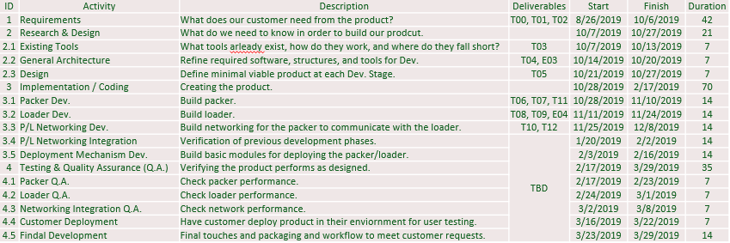
Issues/Future Plans
Critical Milestone Dates:
Return to “Green” Plan (if Issues)”
Work over spring break to catch up.
Plans for Next Reporting Period:
Complete through 4.5 (everything).

Slide 3
Schedule
Comments:
Schedule adjusted for 3.1-3.5 to be completed co-currently. Behind schedule, to complete 3.1-3.5 by week 24 and then begin deployment.

Slide 4
Customer Satisfaction Survey Date:
Customer Satisfaction
SPONSOR: to provide Ratings and Comments
IMPORTANT: be sure to request well in advance of due date

