Slide 1
Opto-Mechatronics
Chopper Control Design
Jonathan Chandra, Judith Oeben, Emma Langeveld
16-06-2023

Slide 2
Content
System Identification
Feedforward control design
Application & Limitations
Addition of Feedback Control
Second Order

Slide 3
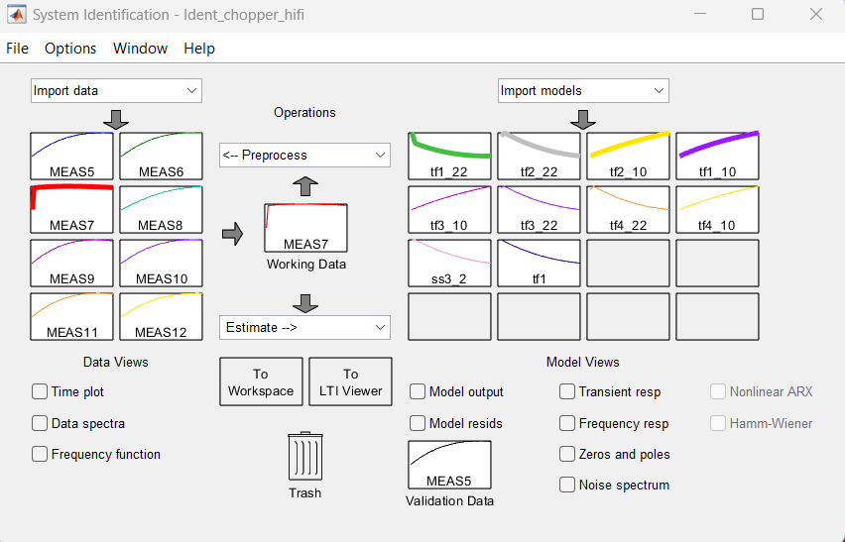
System Identification
Matlab System Identification Toolbox
Step-Data reference
Reference frequency
Final first order transfer function:
H(z) = -0.07888z⁻¹ / (1 + 0.9709z⁻¹)
Accuracy: 93%

Slide 4
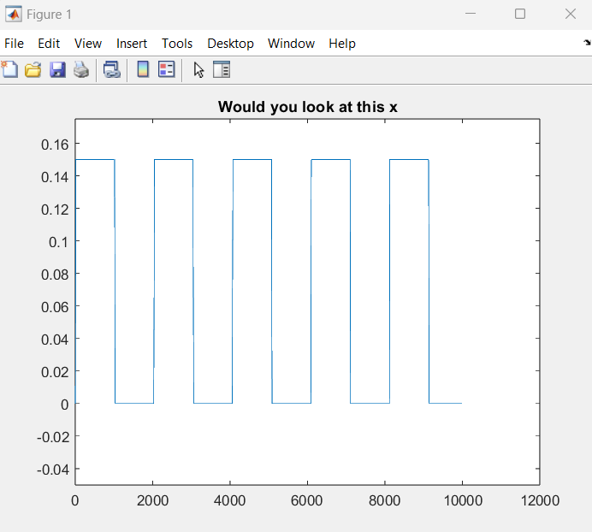
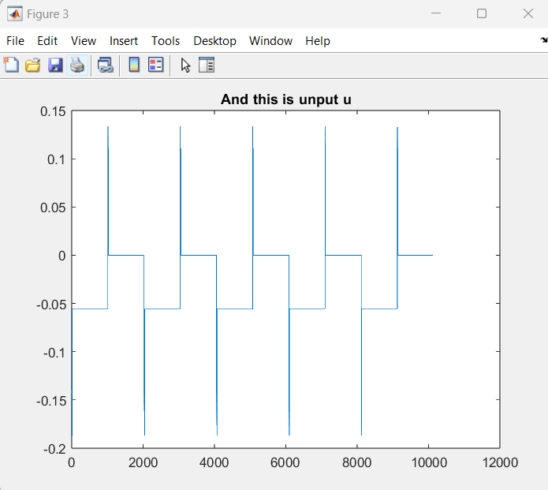
Feedforward Control Design
Calculating steady state input (U optimal)
Use tf from 0->0.15
Hold SS input for 1000ms
Use tf from 0.15->0
Hold SS input for 1000ms

Slide 5
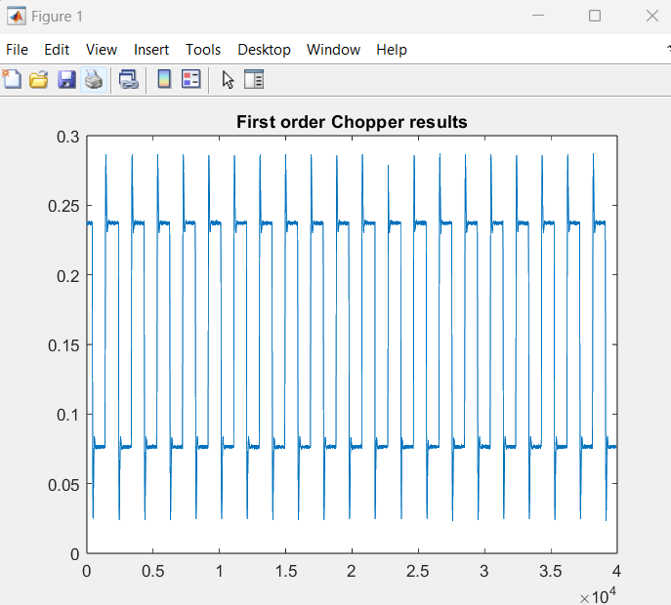
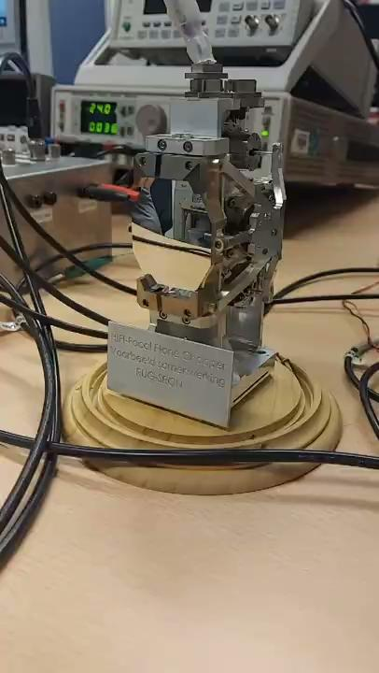
Application &
Limitations
Tested on Chopper
Bias
Desired amplitude: 0.15

Slide 6
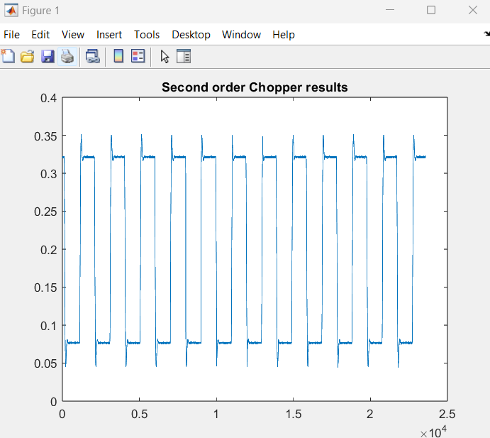
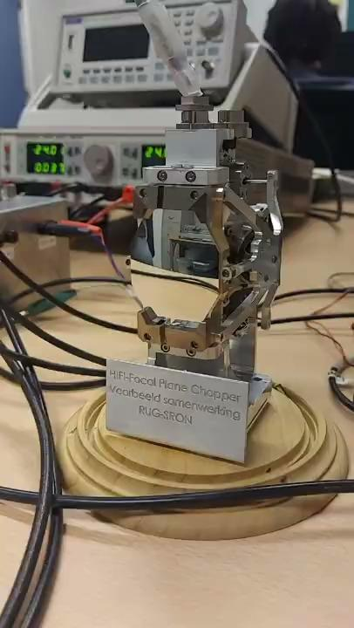
Second Order
Identical steps
Bias
0.05 deviation
H(z) = (-0.00373z^-1) / (1 - 1.96z^-1 + 0.9616z^-2), 89% Accurate

Slide 7
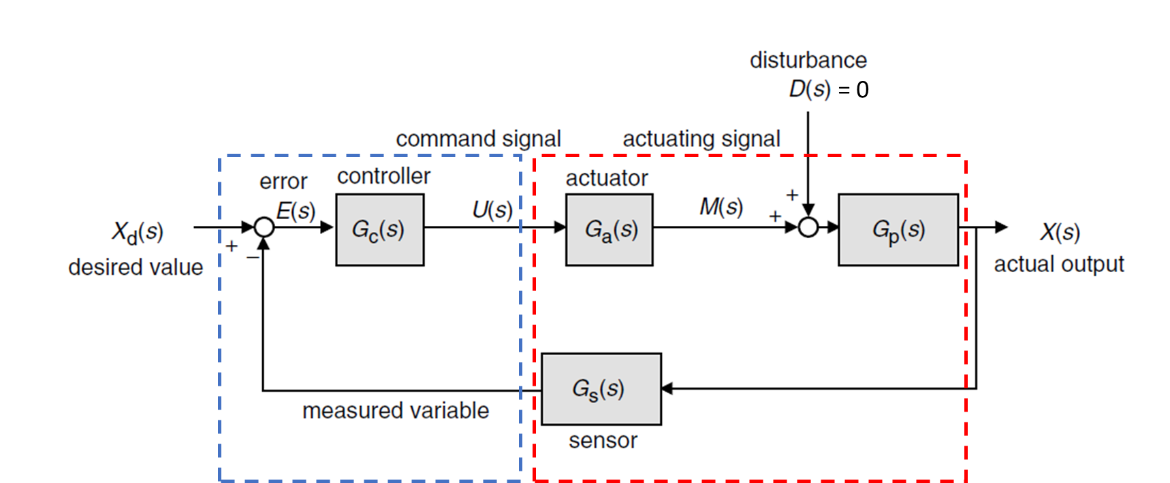
General Feedback Control Scheme
We implement PI/PID control scheme for the feedback control
Figure 1. A General Feedback Control Block (red dashed line box is HIFI Chopper and blue dashed line box is Controller).

Slide 8



Controllability Test
We have our system defined as
One may create 𝒞 matrix to test the controllability
The system is controllable if
we simply use MATLAB’s function

Slide 9
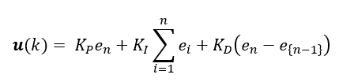
PID Control
We implement PID controller in discrete time
Keep in mind that u(k) are saturated within -0.25:0.25 range
The PID gains are acquired from Trial and Error

Slide 10
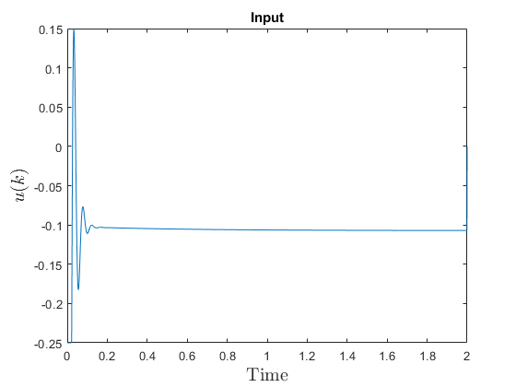
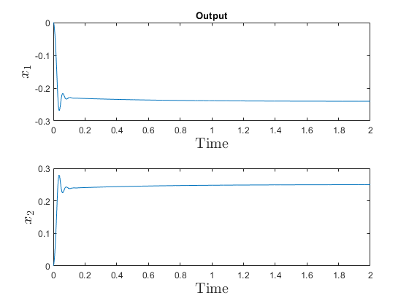
Addition of Feedback Control
Desired State : [x1 x2] = [-0.2404 0.25]
Gains : [Kp Ki Kd] = [5 1e-2 20]

Slide 11
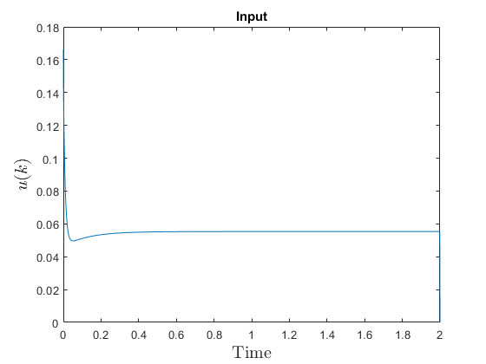
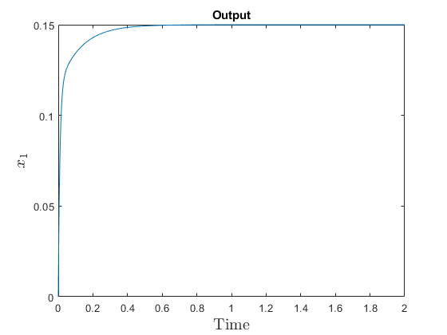
Addition of Feedback Control
Desired State : [x] = [0.15]
Gains : [Kp Ki Kd] = [1 1e-2 0]

Slide 12
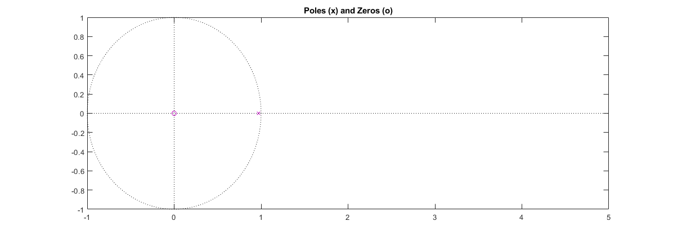
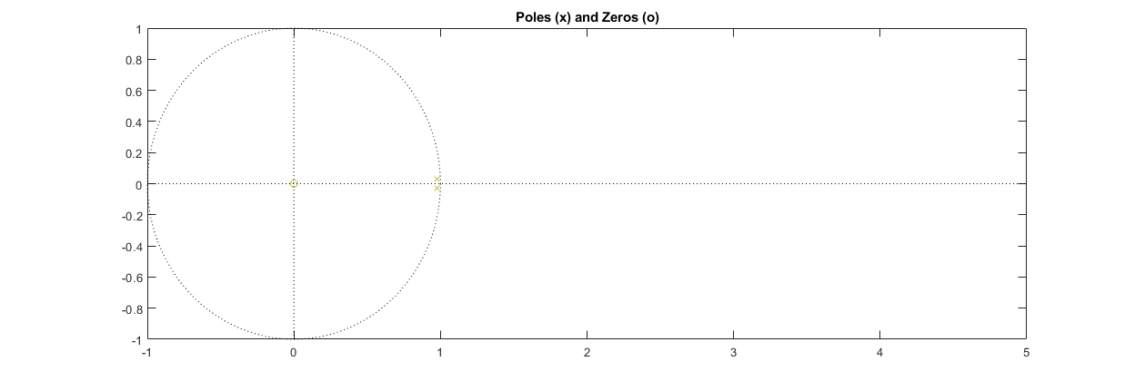
System Identification - Model Stability

Slide 13
That was all
Thank you for listening

