Slide 1
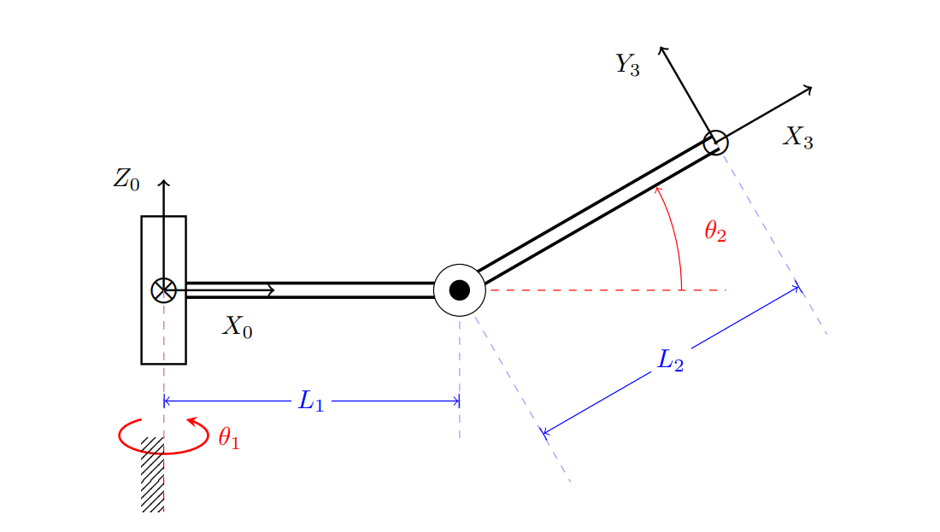






$$Z_{1}$$
$$Y_{2}$$
$$X_{2}$$
$$X_{1}$$
$$Z_{2}$$

Slide 2
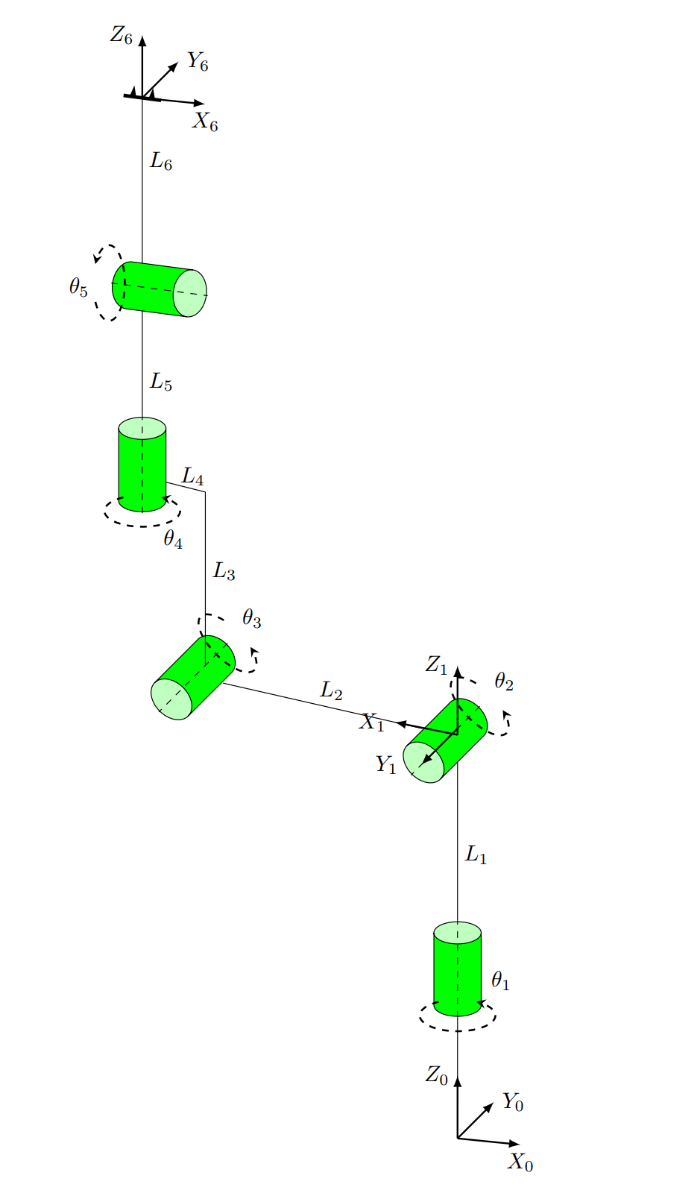









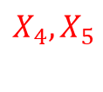
$$Z_{4}$$
$$Y_{4},Z_{5}$$
$$X_{4},X_{5}$$
$$Y_{5}$$
$$X_{3}$$
$$Z_{3}$$
$$Y_{3}$$
$$X_{2},$$
$$Z_{2},$$
$$Y_{2}$$

Slide 3
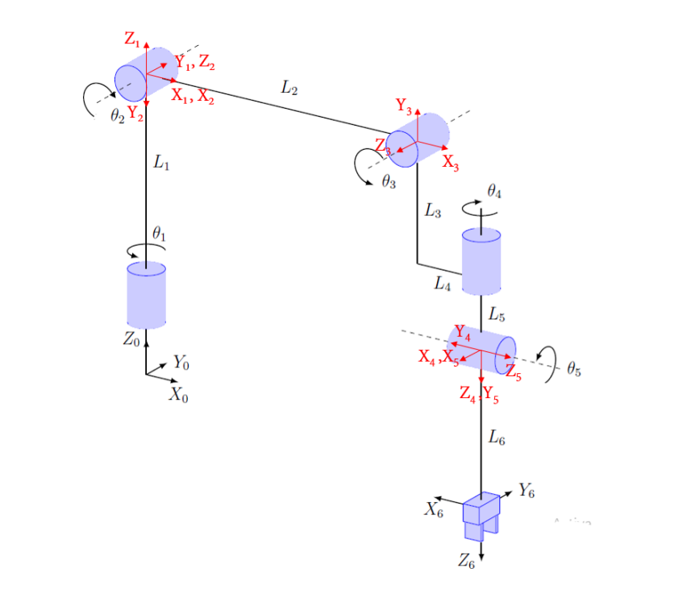

Slide 4



Slide 5
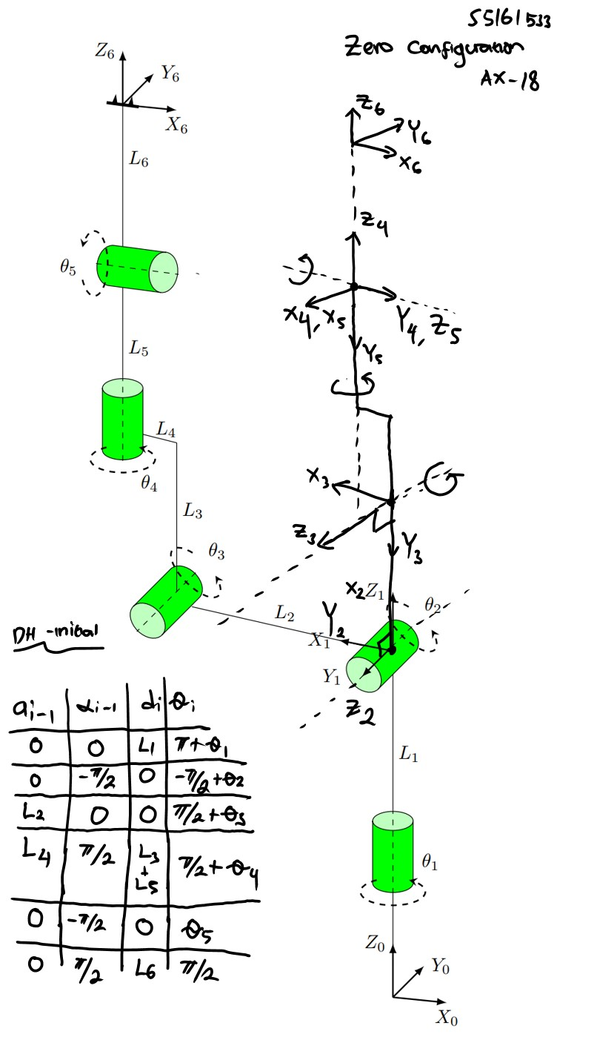

Slide 7



