Slide 1
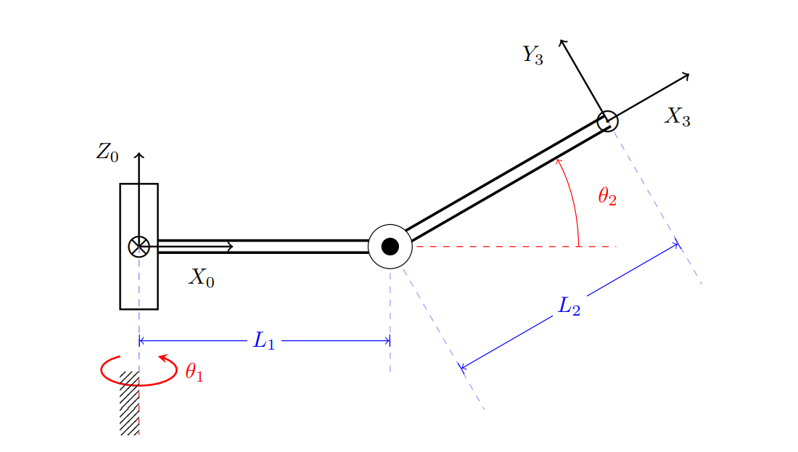






$$Y_{2}$$
$$Z_{1}$$
$$X_{2}$$
$$X_{1}$$
$$Z_{2}$$

