Slide 1

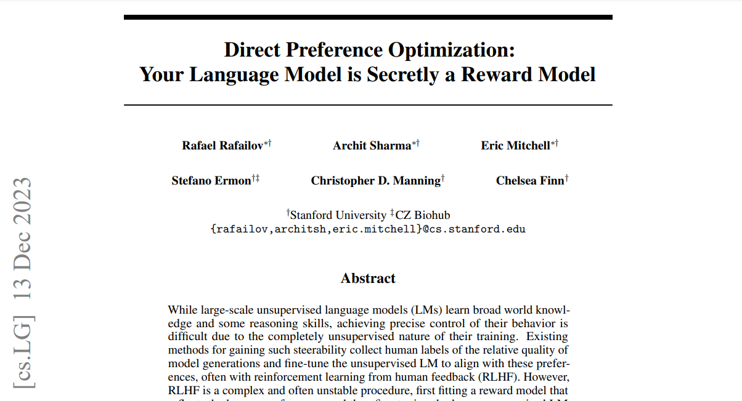
DPO Direct Preference Optimization
MLBootcamp.AI
Juan Olano – Feb 2024
https://arxiv.org/pdf/2305.18290.pdf

Slide 2
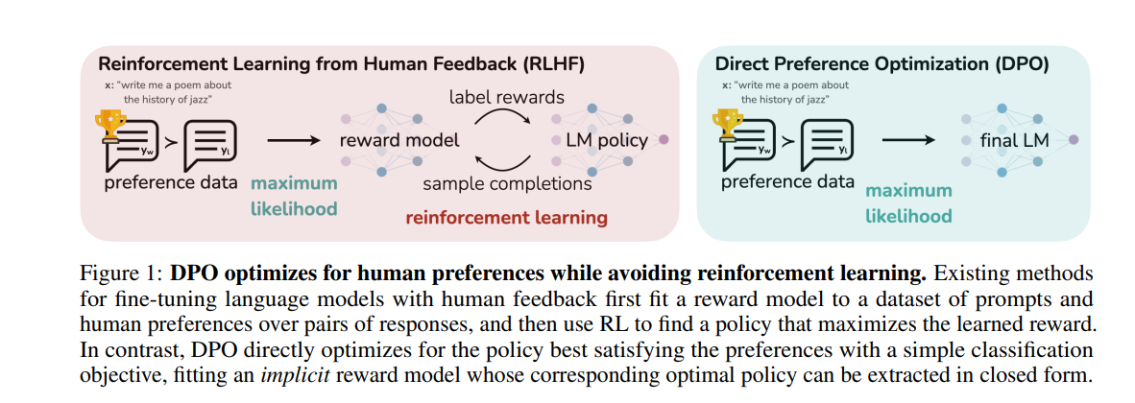
DPO optimizes for human preferences without Reinforcement Learning
MLBootcamp.AI
Ref. https://arxiv.org/pdf/2305.18290.pdf page 2

Slide 3
DPO vs RLHF/RLAIF
MLBootcamp.AI
Common Objective:
Align a model with human preferences, or more generally, with some preferences.
Requirements:
An SFT model that we want to align
A dataset with a Chosen (preferred) and a Rejected output per sample
RLHF/RLAIF
Policy model and Reference model
Dataset with 2 options (chosen/rejected)
Reward model
PPO (Proximal Policy Optimization) for RL
KL divergence (constraint to avoid big changes)
DPO
Policy model and Reference model
Dataset with 2 options (chosen/rejected)
Reward model
DPO Loss
KL divergence (constraint to avoid big changes)
KL (Kullback-Leibler) divergence measures difference between 2 probability distributions

Slide 4
DPO Loss:
MLBootcamp.AI
Ref. https://arxiv.org/pdf/2305.18290.pdf page 6
1
2
3
4
5
Loss function of policy model with respect to reference model.
Expectation of the dataset with ‘x’ samples of ‘yw’ winner (chosen) and ‘yl’ loser (rejected) outputs.
The logarithmic of the sigmoid applied to the argument. In torch: ‘F.logsigmoid’
This will scale the result between 0 and 1, providing a probabilistic interpretation.
Beta: Hyperparameter that weights the importance of the deviation between the policy model and the reference model.
Log Probability (in torch: log_softmax) ratio of the policy model’s probability of choosing the same ‘yw’ given the input ‘x’, divided by the reference model’s probability of choosing the same ‘yw’ given the same input ‘x’.
These rations indicate how much more or less likely the policy model is to choose a particular action compared to the reference model.
The formula calculates the difference between the log probability rations for the chosen and rejected actions, scaled by Beta, and then applies the sigmoid function to this difference.
The expectation ‘E’ of this value across the dataset provides a measure of how well the policy model aligns with the human preferences as exhibited by the chosen and rejected outputs.
The loss function ‘L’ is then minimized during training to adjust the parameters of the policy model so that it more closely aligns with the human-labeled preferences. By doing this, the policy model’s behavior should become more similar to the desired behavior as indicated by the reference model and the human choices in the dataset. The use of the sigmoid function ensures that the loss is bounded and that the optimization process is stable.

Slide 5
MLBootcamp.AI
def dpo_loss(
self,
policy_chosen_logps: torch.FloatTensor,
policy_rejected_logps: torch.FloatTensor,
reference_chosen_logps: torch.FloatTensor,
reference_rejected_logps: torch.FloatTensor,
) -> Tuple[torch.FloatTensor, torch.FloatTensor, torch.FloatTensor]:
"""
Compute the DPO loss for a batch of policy and reference model log probabilities.
"""
# Reference: https://arxiv.org/pdf/2305.18290.pdf
# Compute the log probability ratios
chosen_ratio = policy_chosen_logps - reference_chosen_logps
rejected_ratio = policy_rejected_logps - reference_rejected_logps
# Apply beta to the log probability ratios
chosen_ration_scaled = self.beta * chosen_ratio
rejected_ratio_scaled = self.beta * rejected_ratio
# Compute the loss for each instance
losses = F.logsigmoid(chosen_ration_scaled) - F.logsigmoid(rejected_ratio_scaled)
chosen_rewards = self.beta * (policy_chosen_logps - reference_chosen_logps).detach()
rejected_rewards = self.beta * (policy_rejected_logps - reference_rejected_logps).detach()
return losses, chosen_rewards, rejected_rewards
Code:
https://github.com/jcolano/DPO

Slide 6
The Dataset – Part 1
MLBootcamp.AI
Response 1
prompt
Response 2
Response1 and Response2 can be generated initially from the model. Then via humans or a robust LLM we can classify them into Chosen and Rejected
prompt | chosen | rejected
# Concatenate prompt with chosen and rejected
concat_chosen = pad_sequence([torch.cat([item['prompt'], item['chosen']]) for item in batch], batch_first=True, padding_value=self.pad_token_id)
concat_rejected = pad_sequence([torch.cat([item['prompt'], item['rejected']]) for item in batch], batch_first=True, padding_value=self.pad_token_id)
concat_chosen | concat_rejected

Slide 7
The Dataset – Part 2
MLBootcamp.AI
concat_chosen | concat_rejected
reference_chosen_logps, reference_rejected_logps = [], []
for batch in tqdm(data_loader, desc="Computing reference log probabilities"):
batch = {k: v.to(self.device) for k, v in batch.items()}
reference_chosen_logp, reference_rejected_logp, _, _ = self.model_ref.compute_log_probs(batch, avg_log_prob=False)
# Detach the tensors before converting to NumPy arrays
reference_chosen_logps.append(reference_chosen_logp.cpu().detach().numpy())
reference_rejected_logps.append(reference_rejected_logp.cpu().detach().numpy())
# Concatenate all log probabilities
all_reference_chosen_logps = np.concatenate(reference_chosen_logps)
all_reference_rejected_logps = np.concatenate(reference_rejected_logps)
# Ensure the length of log probabilities matches the dataset length
assert len(dataset_dicts) == len(all_reference_chosen_logps) == len(all_reference_rejected_logps)
# Add the log probabilities as new columns
for i, item in enumerate(dataset_dicts):
item['reference_chosen_logps'] = all_reference_chosen_logps[i]
item['reference_rejected_logps'] = all_reference_rejected_logps[i]
concat_chosen | concat_rejected | reference_chosen_logps | reference_rejected_logps

Slide 8
Calculating the logprobs
def compute_log_probs(self, model, batch, avg_log_prob: bool = False ):
# RESOLVE FOR CHOSEN
# ===================
# Perform forward pass and get logits
chosen_targets = torch.roll(batch['concat_chosen'], shifts=-1, dims=1)
chosen_targets[:, -1] = 0 # Replace the last token of each sequence with the padding token
_chosen_logits = model.forward(batch['concat_chosen'], chosen_targets) # Shape: (batch_size, seq_len, vocab_size)
# Since target is shifted one position to the left we sync the positions of the targets and the logits.
chosen_targets = chosen_targets[:, 1:].clone()
chosen_logits = _chosen_logits[:, :-1, :]
# Create a mask to make sure we look only at valid tokens (exclude pad tokens)
chosen_loss_mask = chosen_targets != 0 # Matrix of True and False
chosen_per_token_logps = torch.gather(chosen_logits.log_softmax(-1), dim=2, index=chosen_targets.unsqueeze(2)).squeeze(2)
if avg_log_prob:
chosen_log_probs = (chosen_per_token_logps * chosen_loss_mask).sum(-1) / chosen_loss_mask.sum(-1)
else:
chosen_log_probs = (chosen_per_token_logps * chosen_loss_mask).sum(-1)
# REPEAT FOR REJECTED
# ===================
# . . . . .
return chosen_log_probs, rejected_log_probs, _chosen_logits, _rejected_logits

Slide 9
Question
Can this be used for Distillation? (Harpreet)

