Slide 1

“What to do when it all goes to hell”
Escape Factory Post-Mortem
James Gwertzman
CEO, Escape Factory Ltd
Managing Director, Sprout Games, LLC

Slide 2

Agenda
Key milestones & history
Demos
Best practices to repeat
Mistakes to avoid
Looking ahead
Q & A

Slide 3
Company Founders
James
  5 years at Microsoft prior to EF in program mgmt; marketing
  College theatre background
  Key role: build the company
Ed
  5 years in Silicon Valley (SGI, Liquid Audio) as software engineer
  Music background
  Key role: build the games
Good:
    Very “process & systems” oriented
    Strong team management background
    Professional software development skills
    Great relationship between two founders
Bad:
    No experience fostering creativity or managing creative employees
    No experience managing external clients
    Took for granted a certain level of corporate professionalism
    Fairly naïve about the game industry

Slide 4
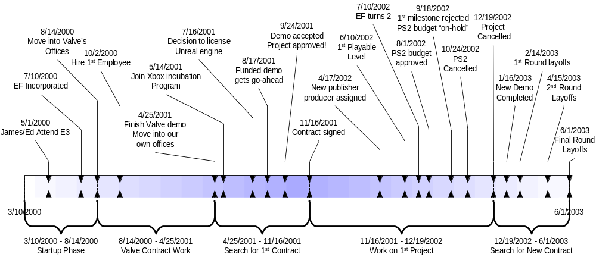
Company Milestones

Slide 5
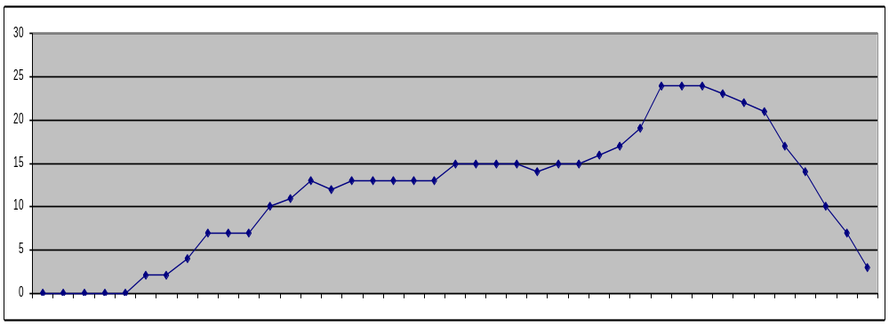
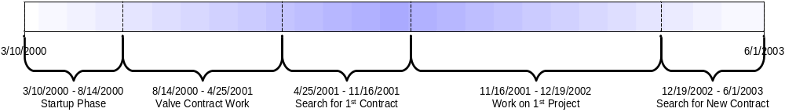
Escape Factory Headcount

Slide 6
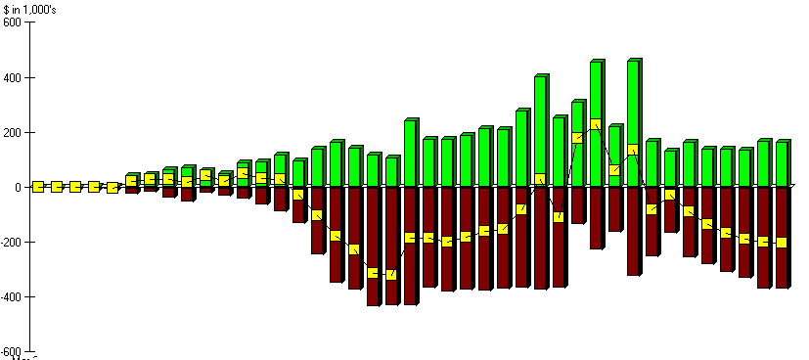
Escape Factory Net Worth

Slide 7
Best Practices

Slide 8
Lots of Passion
Passion & energy are sexy
  People want to be inspired
  Employees, partners, bankers, etc
  An alternative to the “mundane”
Create “Skywalker Ranch of Gaming”
Controversial Call to Action
Downside: hard to maintain…

Slide 9
Call To Action
…So what's our dream?
That we'll be the studio that finally elevates the video game into an art form where it rightfully belongs alongside film and theatre. An art form that unites epic stories, beautiful cinematography, and rich drama with the forgotten magic of childhood play.
We can't wait for the rest of the industry to do it because most developers are too deeply sunk into the culture of "by hardcore gamers, for hardcore gamers" and most publishers are too busy chasing whatever sold the most last year…

Slide 10
Exciting Clear Vision
Unique time to enter game industry
  Internet: disrupts channel, allows multiplayer games
  Mass-market potential
  High powered hardware = greater creative freedom
Company goals:
  Break new ground, inspire copy-cat imitators
  Look back as most fun, creative, productive times in our lives
  Entertain millions of people of all ages & interests
  Cultural impact on par with Star Wars
Build games that:
  Suck the player in through great stories, compelling characters, addictive game-play, intuitive UI, and breathtaking worlds.
  Encourage and reward players to think and be creative.
  Provide a social game experience with competition and collaboration.
  Offer players an escape from the mundane with the opportunity to be the hero.

Slide 11
Company Culture
Reward great ideas ahead of ego or rank
Zero tolerance for mediocrity
Close collaboration
Disciplined approach to development
Ridiculous amount of fun
Hire & retain best people in industry

Slide 12
People
Rigorous (MSFT) hiring process
  Candidates had 1:1 interviews with 6+ people
  Everyone else met candidate over lunch or cake
  Consistent & simple criteria:
    Passion
    Effectiveness
    Horsepower
    Cultural Fit
  Company-wide wrap-up – anyone could veto
Built talented & loyal team

Slide 13
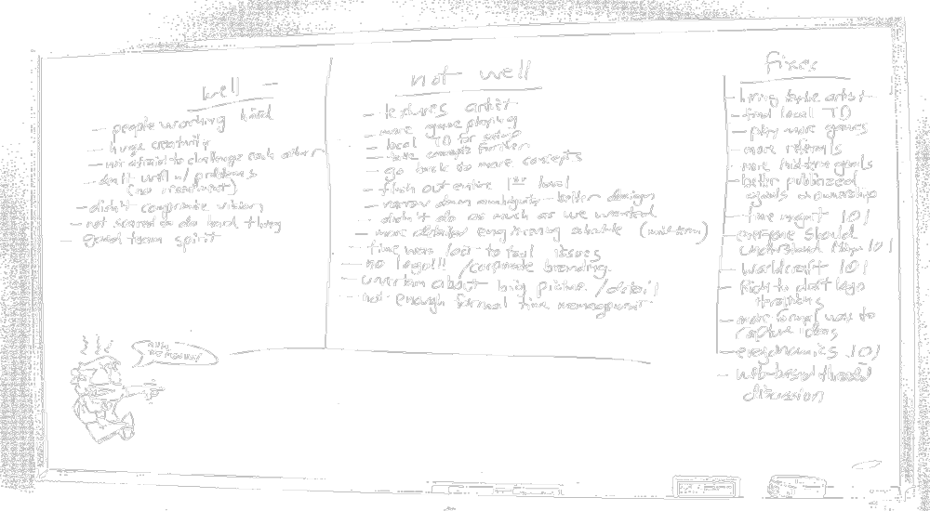
Regular Post-Mortems

Slide 14
Mistakes to Avoid

Slide 15
People
Startups can’t afford hand holding
  In some cases we choose potential over experience
  Strategy was hit or miss… and misses are expensive
Startups can’t afford personality conflicts
Startups can’t afford to change people
  Changing people takes a very long time
  Instead you can either:
    Change job to match person
    Replace person
  Focus of performance reviews was on self-improvement
  Should have been focused on finding right job
Too slow to fire people when it didn’t work
  Impact of a negative person on team was tremendous

Slide 16
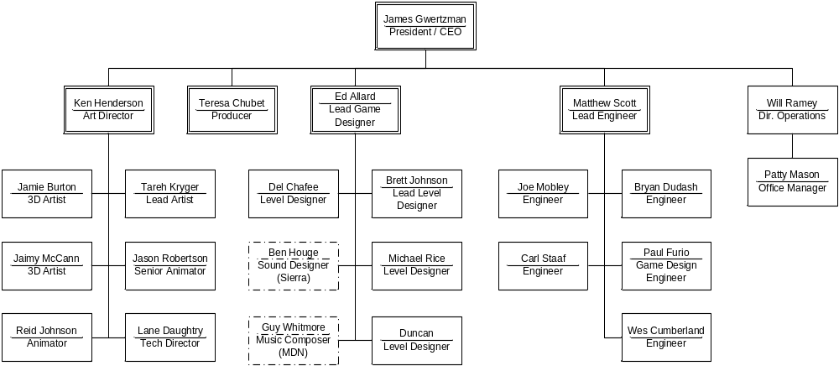
Organization Structure
Wrong org structure is very expensive
  Primary symptom: too many meetings
What was wrong with our org? (discuss)

Slide 17
Too much debt
Starting a company requires enormous optimism, faith, and self-belief
  Money is place where that’s inappropriate
  Must be total pessimist when managing finances
No debt unless you KNOW you can pay it off
  Line-of-credit to bridge milestone payments: OK
  Long leases for expensive h/w, s/w: not OK
  Line-of-credit to build demo for possible deal: not OK

Slide 18
Hire Admin Assistant Early
Founders’ time is simply too valuable
Good assistants are relatively cheap
Ideally you will find someone who can:
  Keep your financial books & pay your bills
  Manage your office
  Play “mom” (or “dad”) to your employees
  Sort through incoming resumes
  Free you to focus on building a great game

Slide 19
Didn’t Feed the Dragon
Publisher investment driven by P&L forecast
P&L forecast based on sales-force forecast
Sales-force forecast based on… what?
  Developer’s reputation
  Great playable demo
  Sexy art & videos
  Target platform & genre
  Enthusiastic marketing team
  Passionate & committed producer
Didn’t produce enough “demo” materials
  Seemed like a waste of time…

Slide 20
Too much effort growing company vs. game
We invested a lot in the company
  Ladder levels
  Endless process discussions
  Performance reviews
  Profit-sharing plan
  401K plan
  Highly automated build tools
Made a big bet on success of first game.
Much of that can come later…

Slide 21
Why was project cancelled?
“Perfect Storm” of events
  Weak P&L
  Platform choice: Xbox vs. PS2
  Target Demographic: 10-12 vs. GTA3
  Genre: “platformer” vs. Ratchet & Clank
  Publisher slipping other projects
  Poorly managed publisher expectations
    “It’s the funny game”
  Being too honest? (forecast slip very early)
  1st time producer on publisher’s end

Slide 22
What to do after cancellation?
Figure out accurate financial picture
  How much money do you owe?
  How much do you have?
  You may already be out of business…
What is best way to spend remaining $$$?
  Start a new project?
  Marketing/Sales blitz?
Do you have the right team to restart?
Do you have the energy to restart?

Slide 23
EF Mistakes
Assumed we would find another project…
  Didn’t really consider alternative
Assumed team was most valuable asset
  “20 person team ready-to-go”
  Didn’t really check market value
  Should have gotten bids
  We were too expensive for available projects
Started shopping new concepts
  LONG, expensive process we couldn’t afford
Didn’t really slash costs
  Deferred salaries: illegal; ended up paying it anyway
  Rent: still owe $30K+; should have bargained up-front
Took on new debts
  Ran up line-of-credit to pay for team

Slide 24
No deals on table
CEO’s primary job is bringing in business
  The time to sign projects is when you don’t need them
  I should have been far more actively networking while SQ was under development
Instead I was too head’s down working with the team
  Trying to solve too many problems
  Let the team solve more of their own issues

Slide 25
Looking forward
Sprout Games
  Casual game studio
  True “mass market” games
  www.sproutgames.com
New philosophy:
  Spend no money… Unless truly critical
  Revenue = Profit
  Very small partnership
Personally satisfying
  Actually making games vs. building company

Slide 26




Games for WildTangent
(EF’s first & only published titles)

Slide 27






Reading Recommendations
http://www.gamasutra.com/
  Read every article; invaluable background & “best practices”
Organizing Genius, Warren Bennis
  Insights into creating “Great Groups” (such as Disney, Apple)
Software Development, A Legal Guide, NOLO
  Critical to reducing your legal bills
Employer’s Legal Handbook, NOLO
  Eventually you’ll need to fire someone… Are you covered?
Managing the Professional Service Firm,
David Maister
  Written for the traditional service firms, but highly relevant
Built to Last, James Collins
  Great survey of great companies to imitate

Slide 28
Thanks To:
Gabe Newell, Valve
Rick Goodman, Stainless Steel Studios
Tony Goodman, Ensemble Studios
Chris Taylor, GPG
Ron Moravek, Relic
Brian Fleming, Sucker Punch
Mike Ryder, (formerly) Sierra
Josh Davidson

Slide 29
Call To Action!
Don’t be afraid to take risks
Don’t be afraid of failing
Pay someone to be paranoid
  And listen to them!
An articulate vision is your best asset
  Will help hire team, attract $$$, attract deals
Know your competition
  If you can’t beat them, get out

Slide 30
Q&A

