Slide 1
“What to do when it all goes to hell”
Lessons learned shutting down a studio
James Gwertzman
Former CEO, Escape Factory Ltd
Managing Director, Sprout Games, LLC
Notes:
Everyone loves to talk about success stories. Few things are as much fun as boasting about the wonderful things you’ve done to a rapt audience. The problem, however, with success stories is that they’re not always that helpful if you’re trying to be successful yourself. It’s hard to figure out sometimes why exactly something was a success – was it skill? Was it luck? Was it timing? Sometimes it’s hard to tell.
Failure, on the other hand, failure can be very educational. With failure it’s usually possible to figure out exactly what went wrong, and then avoid making that same mistake again in the future. In the airline industry, for example, when a plane crashes investigators swarm all over the crash site figuring out what went wrong hoping to prevent another airplane from crashing for the same reason.
It’s a shame in our industry that we don’t talk more about our failures. In many ways we have the equivalent of planes crashing all around us, and yet we rarely try to figure out what went wrong. If we’re going to really move forward as an industry, I think we have to pay more attention to the things that aren’t working.
It’s in that spirit that I am up here today talking about my experience starting up then shutting down Escape Factory. I think we did a lot of things right at Escape Factory, but that’s not what I’m talking about today. Instead of talking about everything that I think we could have done better, that I plan on doing differently next time I do this.

Slide 2
Goals for Talk
Share lessons we learned the hard way
  Prevent your deal from being cancelled
  If cancelled, prevent your studio from closing
Notes:
So with that, let’s jump in. I’ve divided the talk into three sections….
Never enough money or time in startups, so a number of things to boost productivity
Specific lessons about preventing deal cancellation
Things you can do in advance to prevent closure
One thing you’re going to notice as I go – I’m coming at this from the perspective of the president taking full responsibility for the failure of Escape Factory. I know I have a very different view from my employees who may very well have other ideas as to what went wrong.
Talk focused on business issues; not on actual mechanics of making games
That’s what the rest of GDC is for – I assume everyone on your team knows what they’re doing

Slide 3
Why was our project cancelled?
Weak P&L
  Low sales forecast
Project looking late
  Probably slip past Christmas 2003

Slide 4
Didn’t Feed the Dragon
Mistakenly thought our job was build great game
  Actually, convince publisher we’re building great game
Sales forecast based on… what?
  Great demos
  Sexy art & videos
  Target genre & platform
  Excited “Buzz” within publisher
Didn’t produce enough “demo” materials
  Seemed like a waste of time…
  Should have dedicated more resources

Slide 5
Dropped our “USP’s”
Marketing needs “Unique Selling Propositions”
Our “USP’s” were:
  Two player collaborative networked play
  Very original character (Wilger)
  Humor: “it’s the funny game!”
But expectations too high
  Networked play cut early due to budget
  We put off Wilger till later to focus on other character
  Very hard to make “ha-ha!” game
Demonstrates lack of understanding publisher

Slide 6
Lost PS2 Platform
Game P&L based on Xbox & PS2
We built on top of Unreal engine
  Middleware: only way to do <2 year game
  Unreal had promised PS2 support
Unreal support for PS2 disappointing
We became Xbox exclusive
  But Microsoft wouldn’t sponsor because no Xbox live support

Slide 7
Why were we late?
Pre-production was largely wasted
  Team not yet fully staffed up
    Engineering team especially understaffed
  Game-design focused on writing massive design doc vs. prototyping & iteration
  Should have continued on “demo” platform
Licensed engine – no free lunch
  Unless you’re making identical genre game
  Biggest advantage – faster prototype

Slide 8
People Issues
Hired “bad cultural fits” & kept too long
  Created rift between teams
  Wasted lots of time dealing with fallout
  Lower productivity from people involved
Had some people in wrong jobs
  Kept trying to fit person to job
  Lost some good talent due to frustration
Startups cannot afford to change people

Slide 9
No Full-Time Producer
Producer is absolutely a full-time job
Finding great producer took 18+ months
  Great producers are very hard to find
  Joined team 2 months before project cancelled
During search, president was also producer
  But president and producer are both full-time jobs
  President (optimist) not good fit for producer (pessimist)
Lack of full-time producer caused:
  Production pipeline inefficiencies
  Communication gaps
  Overly optimistic schedules
Notes:
This is just embarassing because we KNEW how important it was
Tried to hire someone – didn’t work out. Hardest job to fill
All I can say is – never allow president to take a full-time job

Slide 10
Wrong Organization Structure
Wrong org structure is very expensive
  Symptom: too many meetings
Org must match core values & personalities
Core values stressed collaboration & independence
  Reward great ideas ahead of ego or rank
  Close collaboration
  Ridiculous amount of fun
  Hire & retain best people in industry
Notes:
I love talking about org structures because I see the org structure as a tangible thing
Designing an org structure is like writing code – how you organize your team has a big impact
Org structure must match your team, but your team generally matches your core values
Our core values were as follows… very collaborative, very open to ideas from across the organization, assumes high-powered individuals who can be trusted with lots of responsibiliity

Slide 11
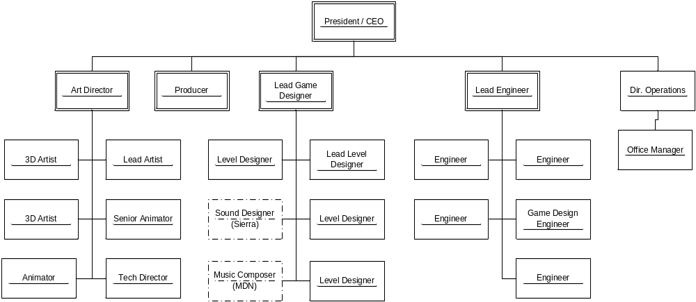
Actual Org Structure
Notes:
But our actual org structure didn’t match that. Our actual org structure was fairly standard and based on functional roles. Problem – didn’t encourage cross-team collaboration. Relied on people working cross team independently or lots of meetings

Slide 12
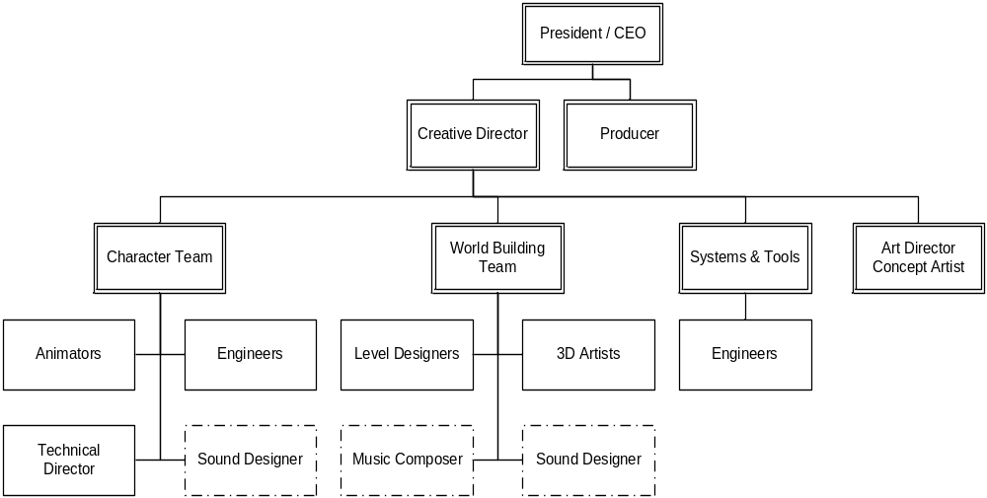
Idealized Org Structure
Notes:
Better org structure (I think) – task focused teams.

Slide 13
Company vs. Game
Invested too much in the company?
  Ladder levels
  Endless process discussions
  Performance reviews
  Profit-sharing plan
  401K plan
  Highly automated build tools
Made a big bet on success of first game.
Much of that can come later…
Notes:
Don’t expect too many other companies to make this mistake – but it’s something to be aware of when you move from a big company to a small one.

Slide 14
Why did we shut down?
Assumed we would find another project…
  Market much more competitive 2nd time around
Assumed team was most valuable asset
  “20 person team ready-to-go”
  Didn’t really check market value; should have gotten bids
  We were too expensive for available projects (ports, etc)
Started shopping new concepts
  Morale boost, but LONG, expensive process we couldn’t afford
Didn’t really slash costs
  Deferred salaries: illegal; ended up paying it anyway
  Rent: still owe $30K+; should have bargained up-front
Took on new debts
  Ran up line-of-credit to pay for team

Slide 15
Pay Yourself First
Founders took minimal salary and repeatedly went without pay
  Allowed us to hire one extra person
  But burned through founder savings
When crisis hit, no safety net for founders
  Limited options in dealing with cancelled project
Once deal is signed, pay yourself first
  Just don’t be greedy…
If money tight, better to lay-off weakest employees than starve your strongest
  Saves money, demonstrates high-standards
  Often increases productivity

Slide 16
Minimize Long-term Debt
Starting a company requires enormous optimism, faith, and self-belief
  Money is place where that’s inappropriate
  Must be total pessimist when managing finances
No debt unless you KNOW you can pay it off
  Line-of-credit to bridge milestone payments: OK
  Long leases for expensive h/w, s/w: not OK
  Line-of-credit to build demo for possible deal: not OK
Debt reduces your options

Slide 17
Always have deals on table
CEO’s primary job is bringing in business
  Time to sign projects is when you don’t need them
  I should have been far more actively networking while SQ was under development
Instead I was too head’s down with game
  Acting as producer for over a year
  Trying to solve too many problems, write code, etc
  Let the team solve more of their own issues
  Ideal CEO: “No aptitudes, high vocabulary”

Slide 18
Be Realistic
Natural impulse is to find another deal
  “We’re bigger & better now… We should have no problem finding another deal!”
But the market may be very different
  Publisher more willing to bet on hungry startup than unsuccessful studio
    Startup is blank slate for publisher to fill with hopes & dreams
    “Project cancellation” smacks of failure despite: team, technology, lessons learned
  Team probably more expensive now
  Different point in console life-cycle

Slide 19
Console Life Cycle Affects Deals
2nd Wave: Publishers approve many new projects. No teams have prior experience.
Unit Sales
Deal Signing Ease
3rd Wave: Bar goes up; Publishers prefer teams who published in wave 1.
Launch Titles
2nd Wave Titles
3rd Wave Titles

Slide 20
Be Open with Employees
Be honest about what’s going on
  Smartest thing we did at Escape Factory after project was cancelled
  Anxiety is bad enough without rumors
  People will want to know how they can help
We promised to tell people when to start sending out resumes
We also helped employees get jobs

Slide 21

Have Disaster Plan Ready
Figure out accurate financial picture
  How much money do you owe?
  How much do you have?
  You may already be out of business…
What is best way to spend remaining $$$?
  Start a new project?
  Marketing/Sales blitz?
Do you have the right team to restart?
What projects are realistic?
Do you have the energy to restart?

Slide 22
Looking forward
Sprout Games
  Casual game studio
  True “mass market” games
  www.sproutgames.com
New philosophy:
  Spend no money… Unless truly critical
  Revenue = Profit
  Very small partnership
Personally satisfying
  Actually making games vs. building company

Slide 23






Reading Recommendations
http://www.gamasutra.com/
  Read every article; invaluable background & “best practices”
Organizing Genius, Warren Bennis
  Insights into creating “Great Groups” (such as Disney, Apple)
Software Development, A Legal Guide, NOLO
  Critical to reducing your legal bills
Employer’s Legal Handbook, NOLO
  Eventually you’ll need to fire someone… Are you covered?
Managing the Professional Service Firm,
David Maister
  Written for the traditional service firms, but highly relevant
Built to Last, James Collins
  Great survey of great companies to imitate

Slide 24
Thanks To:
Gabe Newell, Valve
Rick Goodman, Stainless Steel Studios
Tony Goodman, Ensemble Studios
Chris Taylor, GPG
Ron Moravek, Relic
Brian Fleming, Sucker Punch
Mike Ryder, Buena Vista Games
Josh Davidson

Slide 25
Call To Action!
Don’t be afraid to take risks
Don’t be afraid of failing
Pay someone to be paranoid
  And listen to them!
An articulate vision is your best asset
  Will help hire team, attract $$$, attract deals
Know your competition
  If you can’t beat them, get out

Slide 26
Q&A

Slide 27
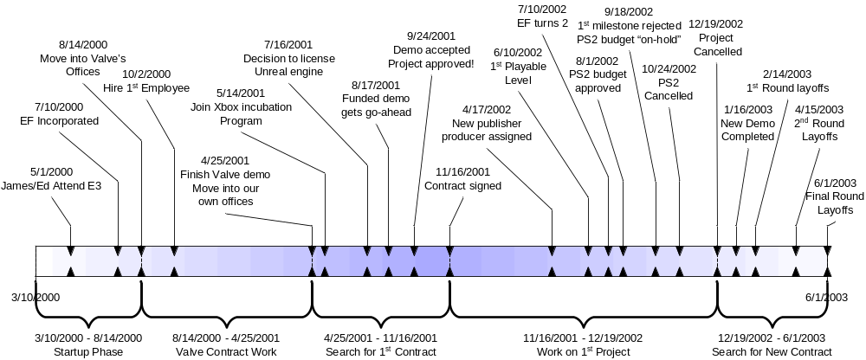
Company Milestones

Slide 28
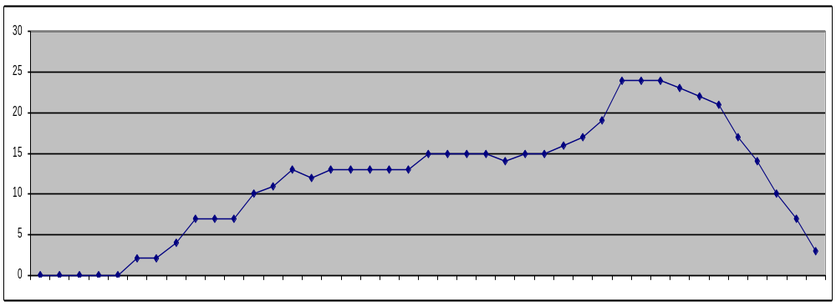
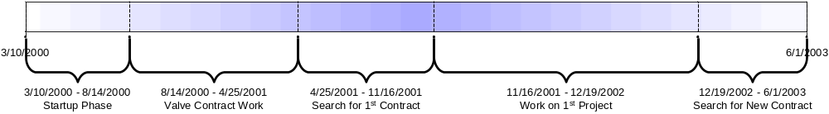
Escape Factory Headcount

Slide 29
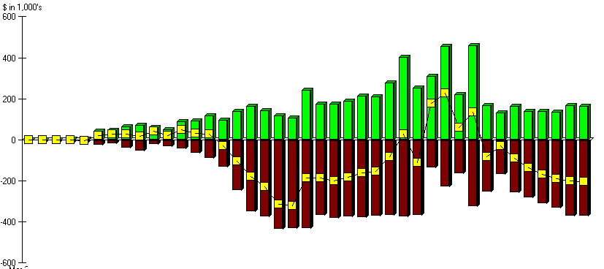
Escape Factory Net Worth

Slide 30
Office Space
Mistakes:
  Leased more space than we needed (initially)
Results & Symptoms:
  Lowered energy & passion than before
  Private offices meant less looking over shoulders (“hey, that looks cool. What is that?”)
  Longer walks between offices = less random visits
Solution:
  Keep office slightly too crowded; cram together

Slide 31
Not violating values is hard
Reward great ideas ahead of ego or rank
Close collaboration
  Requires great professionalism & maturity, especially in a creative organization
Zero tolerance for mediocrity
  How to balance with “disciplined development” and schedules? Okay to rush to hit milestone?
Disciplined approach to development
  How to reconcile with above points?
Ridiculous amount of fun
  If work isn’t fun is something wrong?
Hire & retain best people in industry
  Hard to do as a startup
  Room for junior team members?

