Slide 1
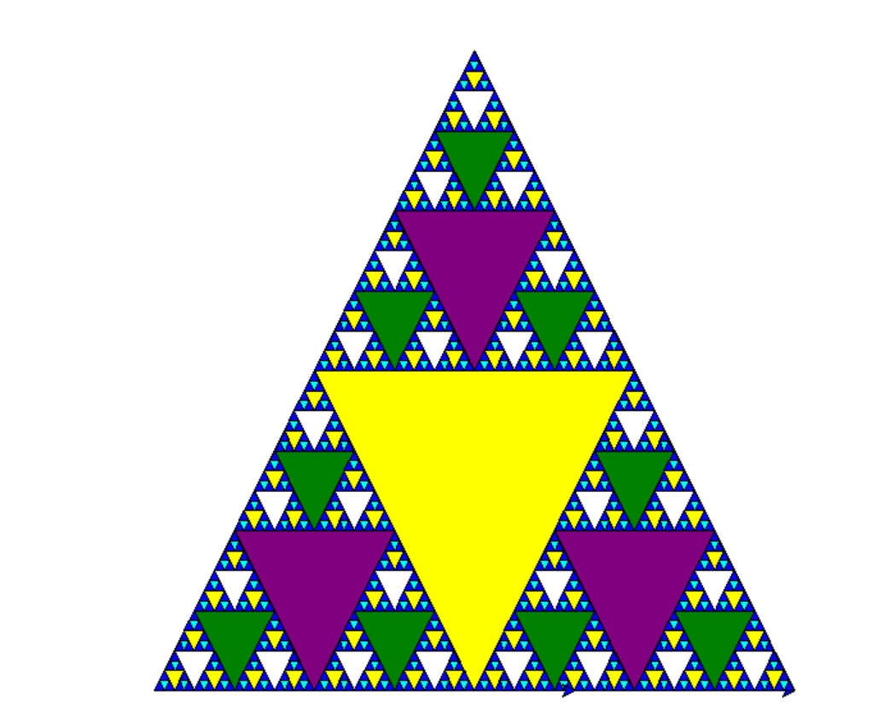
colormap = ['blue','cyan','yellow','white','green',
'purple','yellow']

Slide 2
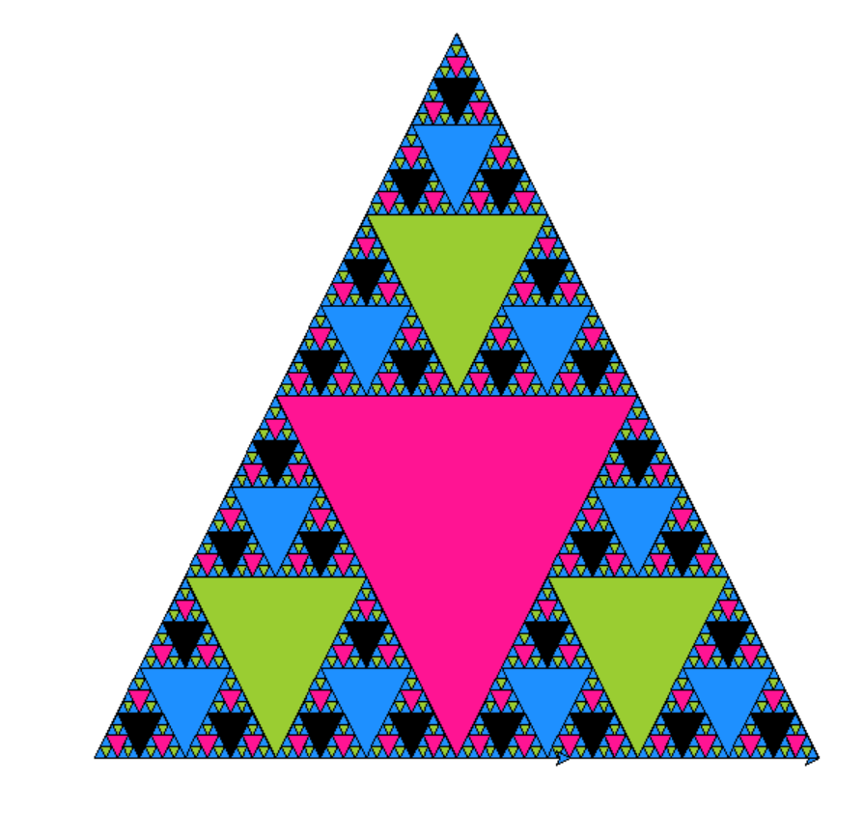
colormap = ['DodgerBlue','YellowGreen','DeepPink','black','DodgerBlue’, 'YellowGreen','DeepPink']

Slide 3
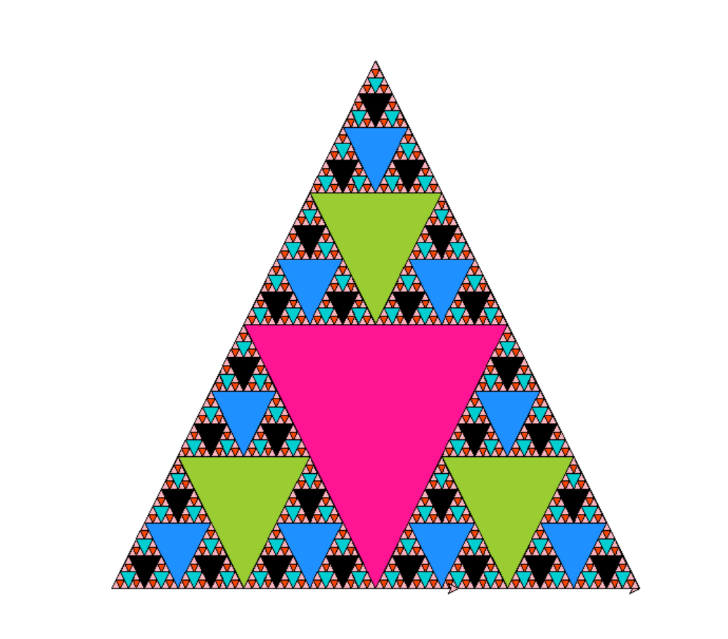
colormap = ['LightPink','OrangeRed','DarkTurquoise','black','DodgerBlue’, 'YellowGreen','DeepPink']

Slide 4
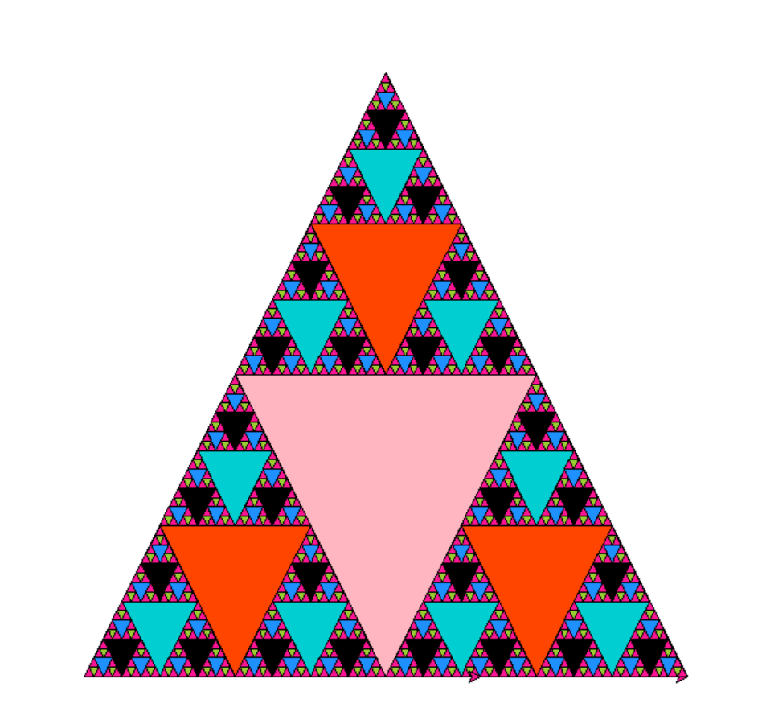
colormap = ['DeepPink', 'YellowGreen','DodgerBlue', 'black','DarkTurquoise','OrangeRed', 'LightPink']

