Slide 1
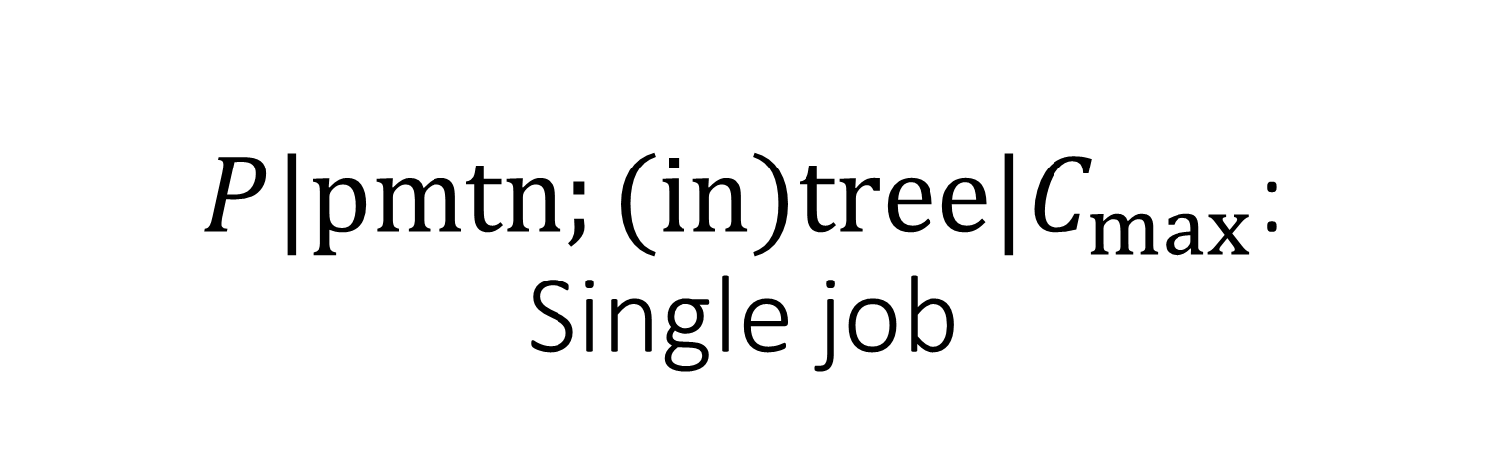
$P|pmtn;(in)tree|C_{max}$: Single job
Goal: Minimize the job’s completion time.
Job environment: $n$ tasks, with a (in)tree of precedence constraints, preemptions allowed.
Machine environment: $m$ identical parallel processors

Slide 2
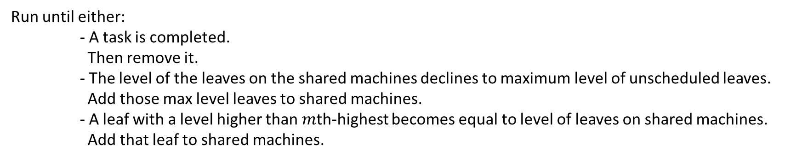
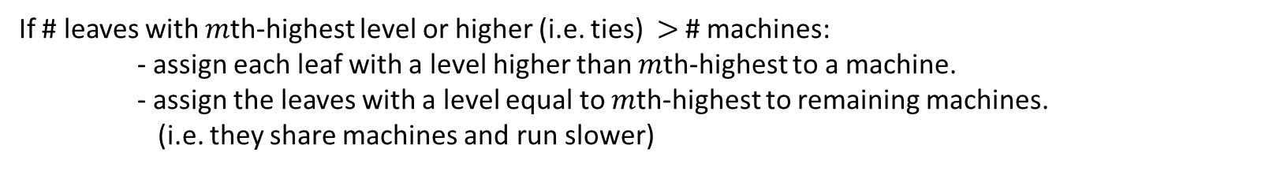
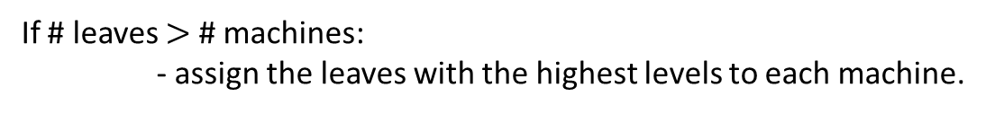
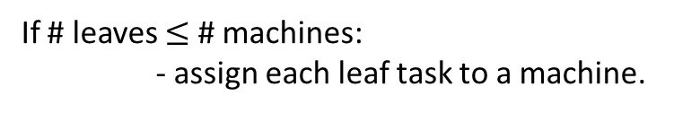
Algorithm #1: recursively schedule from leaves to root, $O\left(n^{2}\right)$ running time, $O\left(mn\right)$ preemptions.
Muntz RR, Coffman Jr EG. Preemptive scheduling of real-time tasks on multiprocessor systems. Journal of the ACM (JACM). 1970 Apr 1;17(2):324-38.
Level of task $j$ = sum of execution times of tasks on path from task $j$ to root (including $j$’s remaining execution time).
If # leaves $≤$ # machines:
- assign each leaf task to a machine.
(largest defines current critical path)
If # leaves $>$ # machines:
- assign the leaves with the highest levels to each machine.
If # leaves with $m$th-highest level or higher (i.e. ties) $>$ # machines:
- assign each leaf with a level higher than $m$th-highest to a machine.
- assign the leaves with a level equal to $m$th-highest to remaining machines.
(i.e. they share machines and run slower)
Run until either:
- A task is completed.
Then remove it.
- The level of the leaves on the shared machines declines to maximum level of unscheduled leaves.
Add those max level leaves to shared machines.
- A leaf with a level higher than $m$th-highest becomes equal to level of leaves on shared machines.
Add that leaf to shared machines.
Repeat until all tasks have been scheduled.

Slide 3
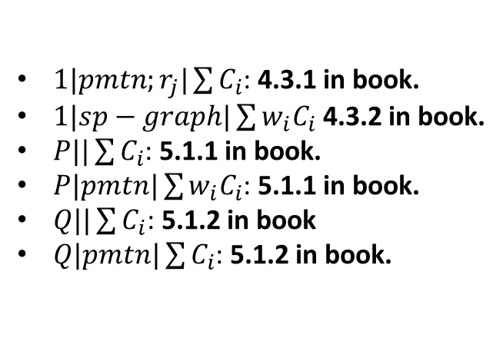
Next steps for multiple jobs(trees)
Prove that the previous algorithm is still optimal for machines that are not available at time 0. Direction to prove this:
If changing the number of machines during certain time intervals, then OPT and ALG must have the same increase/decrease in schedule length.
Investigate algorithms for independent jobs are scheduled on single/multiple machines with the objective to minimize average completion time. See polynomial time algorithms:
$1|pmtn;r_{j}|\sum{C_{i}}$: 4.3.1 in book.
$1|sp−graph|\sum{{w_{i}C}_{i}}$ 4.3.2 in book.
$P||\sum{C_{i}}$: 5.1.1 in book.
$P|pmtn|\sum{{w_{i}C}_{i}}$: 5.1.1 in book.
$Q||\sum{C_{i}}$: 5.1.2 in book
$Q|pmtn|\sum{C_{i}}$: 5.1.2 in book.
Combine ideas from Steps 1 and 2 so that we minimize the sum of completion times for each job (in-tree).

Slide 4
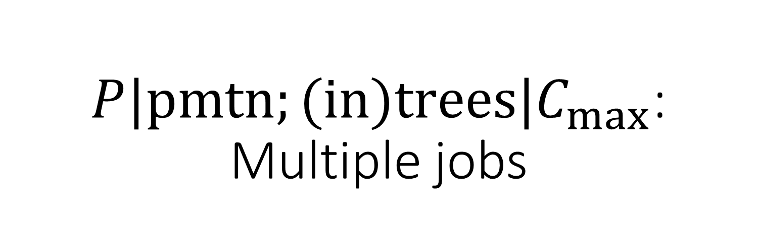
$P|pmtn;(in)trees|C_{max}$: Multiple jobs
Goal: Minimize the job’s completion time.
Job environment: $n$ total tasks, with $r$ (in)trees of precedence constraints (each a separate job), preemptions allowed.
each tree is assumed to be initially rooted (essentially turning each tree into a chain
Machine environment: $m$ identical parallel processors

Slide 5

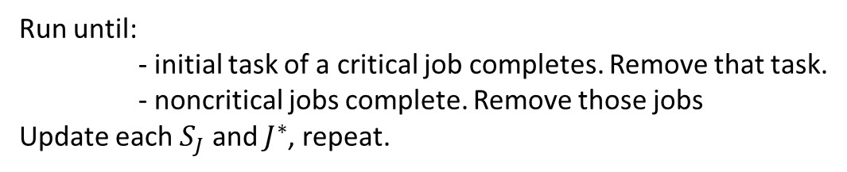
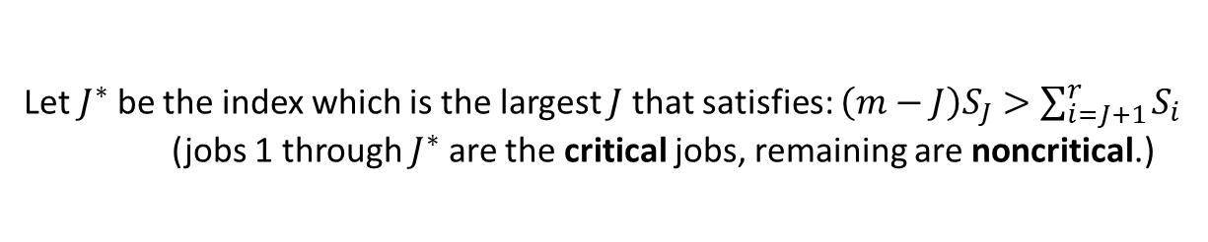
Algorithm #2: ,$O\left(n^{2}\right)$running time, $O\left(mn\right)$preemptions.
Gonzalez TF, Johnson DB. A new algorithm for preemptive scheduling of trees. Journal of the ACM (JACM). 1980 Apr 1;27(2):287-312.
Weight of job $J$, $S_{J}$is current sum of current remaining execution times of its tasks.
(indexed by increasing weights)
Let $J^{∗}$ be the index which is the largest $J$ that satisfies: $\left(m−J\right)S_{J}>\sum_{i=J+1}^{r}{S_{i}}$
(jobs 1 through $J^{∗}$ are the critical jobs, remaining are noncritical.)
Schedule initial tasks of critical jobs, giving each one a machine.
Schedule noncritical jobs on remaining machines.
Run until:
- initial task of a critical job completes. Remove that task.
- noncritical jobs complete. Remove those jobs
Update each $S_{J}$ and $J^{∗}$, repeat.
Algorithm can be sped up to: $O\left(nm\right)$ running time with $2nm−4n−m+3$ preemptions
$O\left(n\log{m}\right)$ running time with $n−2$ preemptions

