Slide 1

$P|pmtn;intree|C_{max}$ with arbitrary machine ready times.
Algorithm and Proofs
Based on: Muntz, Richard R., and Edward G. Coffman Jr. "Preemptive scheduling of real-time tasks on multiprocessor systems." Journal of the ACM (JACM) 17.2 (1970): 324-338.

Slide 2
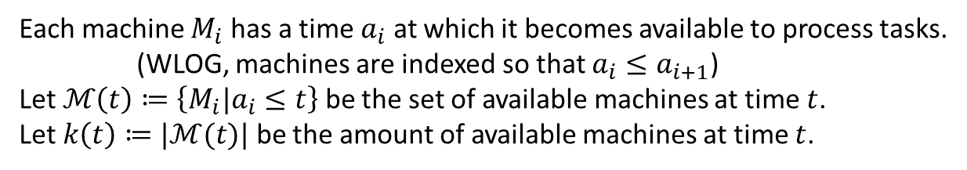


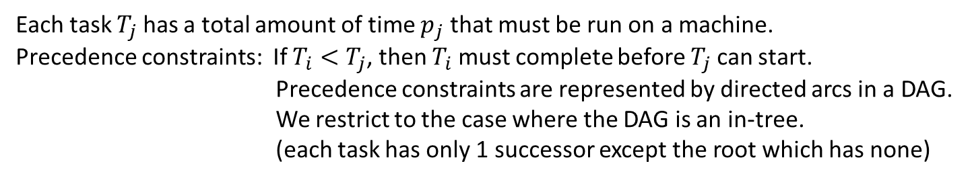

Model and Notation
$m$ identical machines: $M_{1},…,M_{m}$
Each machine $M_{i}$ has a time $a_{i}$ at which it becomes available to process tasks.
(WLOG, machines are indexed so that $a_{i}≤a_{i+1}$)
Let $ℳ\left(t\right)≔\left\{M_{i}|a_{i}≤t\right\}$ be the set of available machines at time $t$.
Let $k\left(t\right)≔|ℳ(t)|$ be the amount of available machines at time $t$.
$n$ tasks for a single job: $T_{1},…,T_{n}$
Each task $T_{j}$ has a total amount of time $p_{j}$ that must be run on a machine.
Precedence constraints: If $T_{i}<T_{j}$, then $T_{i}$ must complete before $T_{j}$ can start.
Precedence constraints are represented by directed arcs in a DAG.
We restrict to the case where the DAG is an in-tree.
(each task has only 1 successor except the root which has none)
The completion time of each task $C_{i}$.
Each task can only be worked on by one machine at a time.
The goal is to find a schedule that minimizes the completion time of the in-tree which is $C_{root}$.

Slide 3

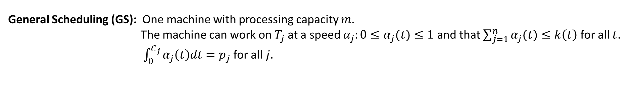
Scheduling Disciplines
Basic Scheduling (BS): Each machine can only work on one task at a time.
A machine can not be interrupted to work on a different task.
Preemptive Scheduling (PS): Each machine can only work on one task at a time.
A machine can be interrupted to work on a different task.
General Scheduling (GS): One machine with processing capacity $m$.
The machine can work on $T_{j}$ at a speed $α_{j}:0≤α_{j}(t)≤1$ and that $\sum_{j=1}^{n}{α_{j}(t)}≤k\left(t\right)$ for all $t$.
$\int_{0}^{C_{j}}{α_{j}\left(t\right)dt}=p_{j}$ for all $j$.
PS is a special case of GS where $α_{j}∈\{0,1\}$.

Slide 4
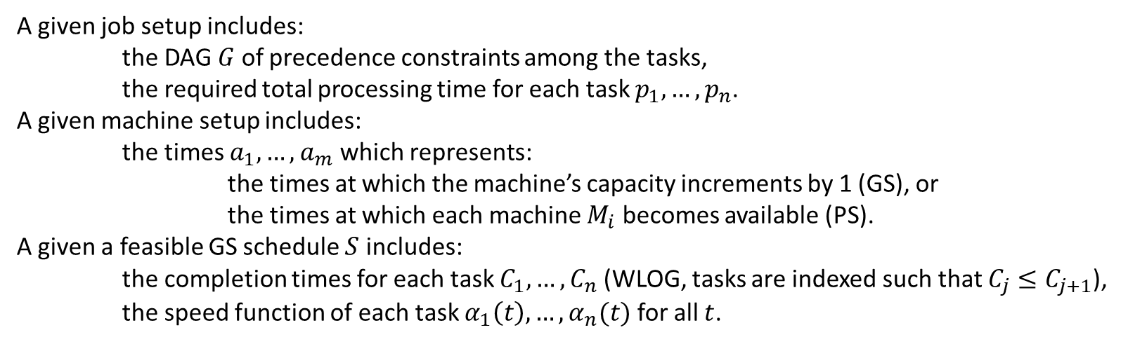
Equivalence of GS and PS
Algorithm 1: Convert a GS schedule $S$ into a PS schedule $S′$ for a given job and machine setup.
Input:
A given job setup includes:
the DAG $G$ of precedence constraints among the tasks,
the required total processing time for each task $p_{1},…,p_{n}$.
A given machine setup includes:
the times $a_{1},…,a_{m}$ which represents:
the times at which the machine’s capacity increments by 1 (GS), or
the times at which each machine $M_{i}$ becomes available (PS).
A given a feasible GS schedule $S$ includes:
the completion times for each task $C_{1},…,C_{n}$ (WLOG, tasks are indexed such that $C_{j}≤C_{j+1}$),
the speed function of each task $α_{1}\left(t\right),…,α_{n}(t)$ for all $t$.
Output:
Schedule $S′$ with the time intervals that each task runs on each machine.

Slide 5
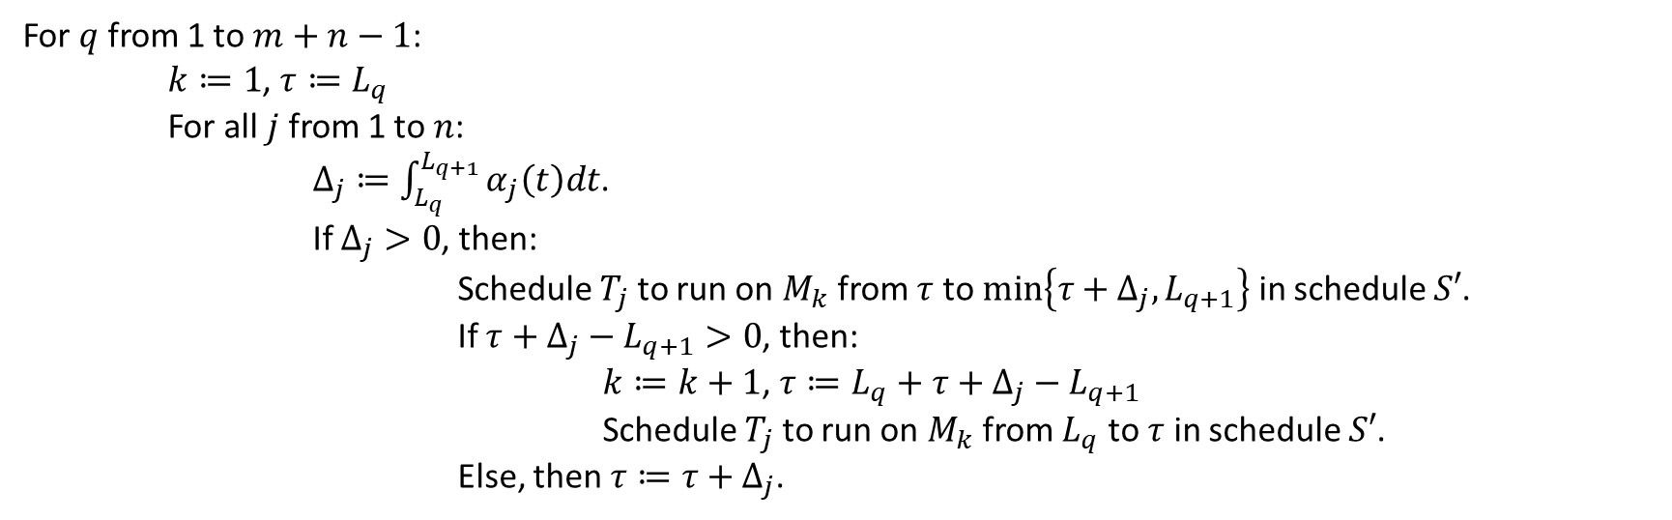
Initialize:
Merge sort the times $a_{1},…,a_{m}$ and $C_{1},…,C_{n}$ into list $L$.
Procedure:
For $q$ from 1 to $m+n−1$:
$k≔1$, $τ≔L_{q}$
For all $j$ from 1 to $n$:
$Δ_{j}≔\int_{L_{q}}^{L_{q+1}}{α_{j}\left(t\right)dt}$.
If $Δ_{j}>0$, then:
Schedule $T_{j}$ to run on $M_{k}$ from $τ$ to $min\left\{τ+Δ_{j},L_{q+1}\right\}$ in schedule $S′$.
If $τ+Δ_{j}−L_{q+1}>0$, then:
$k≔k+1$, $τ≔L_{q}+τ+Δ_{j}−L_{q+1}$
Schedule $T_{j}$ to run on $M_{k}$ from $L_{q}$ to $τ$ in schedule $S′$.
Else, then $τ≔τ+Δ_{j}$.

Slide 6
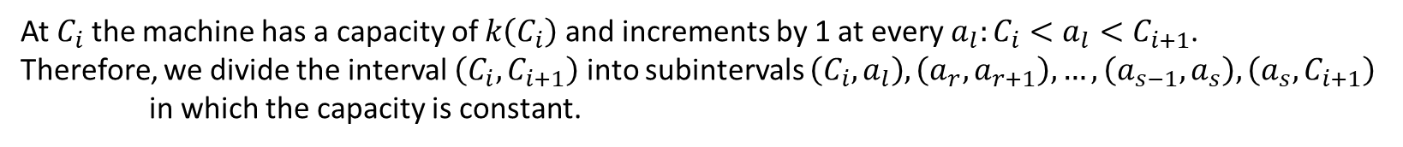
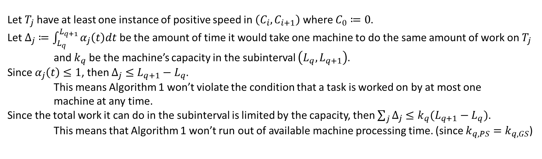

Lemma 1: Algorithm 1 constructs a feasible PS schedule $S′$ from a given feasible GS schedule $S$ which has a completion time that is less than or equal to that of $S$.
Proof:
Since $S$ is feasible: if $T_{i}<T_{j}$, then $C_{i}<C_{j}$.
Within any one interval from the set $\left(0,C_{1}\right),\left(C_{1},C_{2}\right),…,\left(C_{n−1},C_{n}\right)$,
all tasks with any instance of a positive speed must be mutually independent.
Otherwise, then one of the tasks must complete within the interval which contradicts the definition of $C$.
At $C_{i}$ the machine has a capacity of $k\left(C_{i}\right)$ and increments by 1 at every $a_{l}:C_{i}<a_{l}<C_{i+1}$.
Therefore, we divide the interval $\left(C_{i},C_{i+1}\right)$ into subintervals $\left(C_{i},a_{l}\right),\left(a_{r},a_{r+1}\right),…,\left(a_{s−1},a_{s}\right),\left(a_{s},C_{i+1}\right)$ in which the capacity is constant.
Let $T_{j}$ have at least one instance of positive speed in $\left(C_{i},C_{i+1}\right)$ where $C_{0}≔0$.
Let $Δ_{j}≔\int_{L_{q}}^{L_{q+1}}{α_{j}\left(t\right)dt}$ be the amount of time it would take one machine to do the same amount of work on $T_{j}$ and $k_{q}$ be the machine’s capacity in the subinterval $\left(L_{q},L_{q+1}\right)$.
Since $α_{j}\left(t\right)≤1$, then $Δ_{j}≤L_{q+1}−L_{q}$.
This means Algorithm 1 won’t violate the condition that a task is worked on by at most one machine at any time.
Since the total work it can do in the subinterval is limited by the capacity, then $\sum_{j}{Δ_{j}}≤k_{q}(L_{q+1}−L_{q})$.
This means that Algorithm 1 won’t run out of available machine processing time. (since $k_{q,PS}=k_{q,GS}$)
Since the scheduled tasks are independent within an interval, Algorithm 1 won’t violate any precedence constraints.
Thus, a GS schedule can be converted into a PS schedule within each interval.
So in total, the completion time of $S′$ is less than or equal to that of $S$.

Slide 7
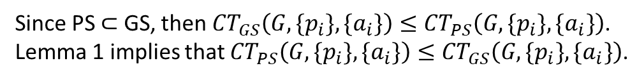
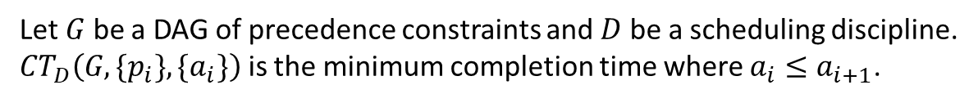
Let $G$ be a DAG of precedence constraints and $D$ be a scheduling discipline.
${CT}_{D}\left(G,\{p_{i}\},\{a_{i}\}\right)$ is the minimum completion time where $a_{i}≤a_{i+1}$.
Theorem 1: For all $G,p$ and $a$, ${CT}_{GS}\left(G,\{p_{i}\},\{a_{i}\}\right)={CT}_{PS}\left(G,\{p_{i}\},\{a_{i}\}\right).$
Proof:
Since PS $⊂$ GS, then ${CT}_{GS}\left(G,\{p_{i}\},\{a_{i}\}\right)≤{CT}_{PS}\left(G,\{p_{i}\},\{a_{i}\}\right)$.
Lemma 1 implies that ${CT}_{PS}\left(G,\{p_{i}\},\{a_{i}\}\right)≤{CT}_{GS}\left(G,\{p_{i}\},\{a_{i}\}\right)$.
Remark: With additional overhead, the same algorithm and proofs can be generalized for machines that are only available during specific time intervals.

Slide 8
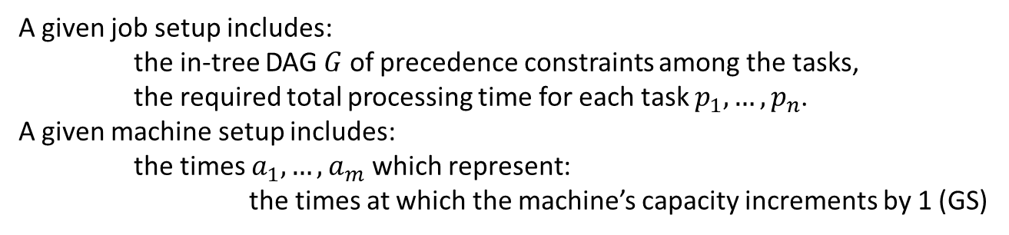
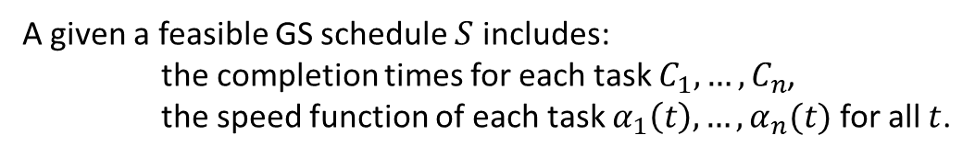
Optimal GS Scheduling Algorithm
Let the height $h_{i}(t)$ of $T_{i}$ be the sum of the remaining processing times from $T_{i}$ to $T_{root}$ at time $t$.
Algorithm 2: Construct a an minimal length GS.
Input:
A given job setup includes:
the in-tree DAG $G$ of precedence constraints among the tasks,
the required total processing time for each task $p_{1},…,p_{n}$.
A given machine setup includes:
the times $a_{1},…,a_{m}$ which represent:
the times at which the machine’s capacity increments by 1 (GS)
Output:
A given a feasible GS schedule $S$ includes:
the completion times for each task $C_{1},…,C_{n}$,
the speed function of each task $α_{1}\left(t\right),…,α_{n}(t)$ for all $t$.

Slide 9
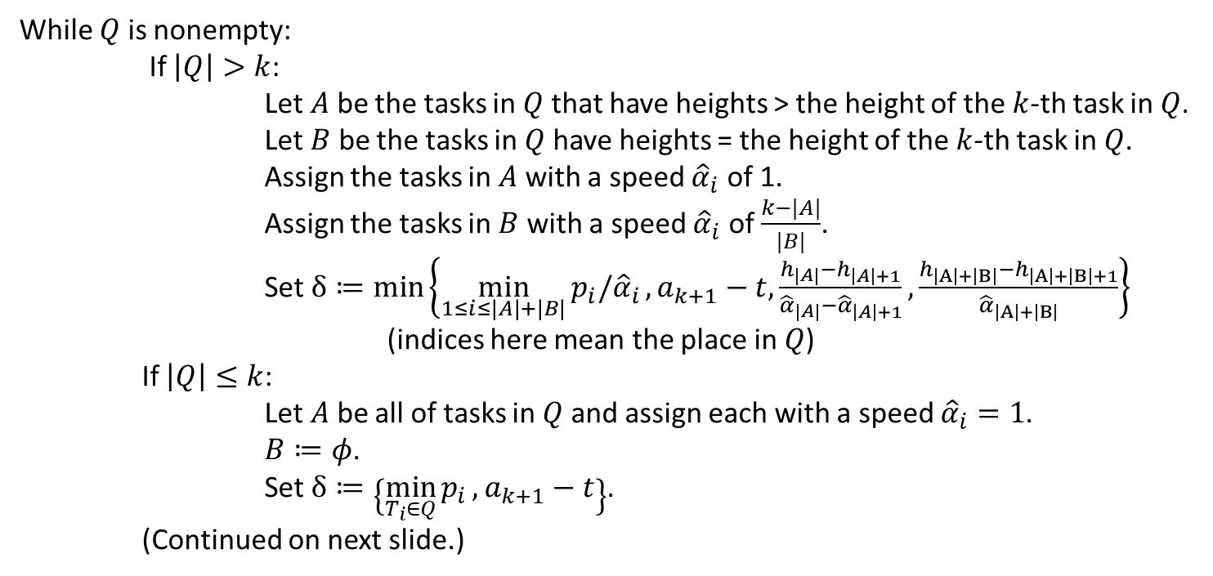
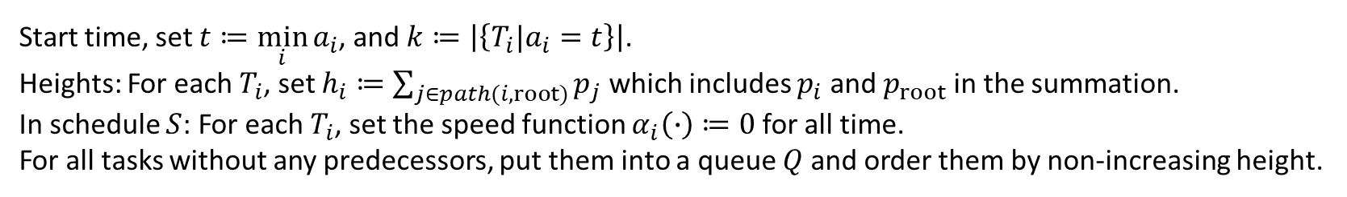
Initialize:
Start time, set $t≔\min_{i}{a_{i}}$, and $k≔\left|\left\{T_{i}|a_{i}=t\right\}\right|$.
Heights: For each $T_{i}$, set $h_{i}≔\sum_{j∈path(i,root)}{p_{j}}$ which includes $p_{i}$ and $p_{root}$ in the summation.
In schedule $S$: For each $T_{i}$, set the speed function $α_{i}\left(∙\right)≔0$ for all time.
For all tasks without any predecessors, put them into a queue $Q$ and order them by non-increasing height.
Procedure:
While $Q$ is nonempty:
If $\left|Q\right|>k$:
Let $A$ be the tasks in $Q$ that have heights > the height of the $k$-th task in $Q$.
Let $B$ be the tasks in $Q$ have heights = the height of the $k$-th task in $Q$.
Assign the tasks in $A$ with a speed ${\hat{α}}_{i}$ of 1.
Assign the tasks in $B$ with a speed ${\hat{α}}_{i}$ of $\frac{k−|A|}{|B|}$.
Set $δ≔min\left\{\min_{1≤i≤|A|+|B|}{p_{i}/{\hat{α}}_{i}},a_{k+1}−t,\frac{h_{|A|}−h_{\left|A\right|+1}}{{\hat{α}}_{|A|}−{\hat{α}}_{\left|A\right|+1}},\frac{h_{\left|A\right|+\left|B\right|}−h_{\left|A\right|+\left|B\right|+1}}{{\hat{α}}_{\left|A\right|+\left|B\right|}}\right\}$
(indices here mean the place in $Q$)
If $\left|Q\right|≤k$:
Let $A$ be all of tasks in $Q$ and assign each with a speed ${\hat{α}}_{i}=1$.
$B≔φ$.
Set $δ≔\left\{\min_{T_{i}∈Q}{p_{i}},a_{k+1}−t\right\}$.
(Continued on next slide.)

Slide 10
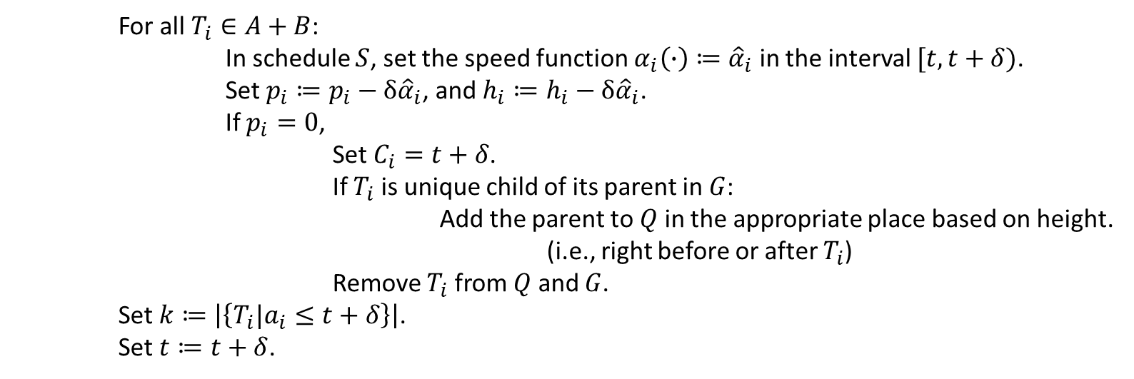
For all $T_{i}∈A+B$:
In schedule $S$, set the speed function $α_{i}\left(∙\right)≔{\hat{α}}_{i}$ in the interval $[t,t+δ)$.
Set $p_{i}≔p_{i}−δ{\hat{α}}_{i}$, and $h_{i}≔h_{i}−δ{\hat{α}}_{i}$.
If $p_{i}=0$,
Set $C_{i}=t+δ$.
If $T_{i}$ is unique child of its parent in $G$:
Add the parent to $Q$ in the appropriate place based on height.
(i.e., right before or after $T_{i}$)
Remove $T_{i}$ from $Q$ and $G$.
Set $k≔\left|\left\{T_{i}|a_{i}≤t+δ\right\}\right|$.
Set $t≔t+δ$.

Slide 11
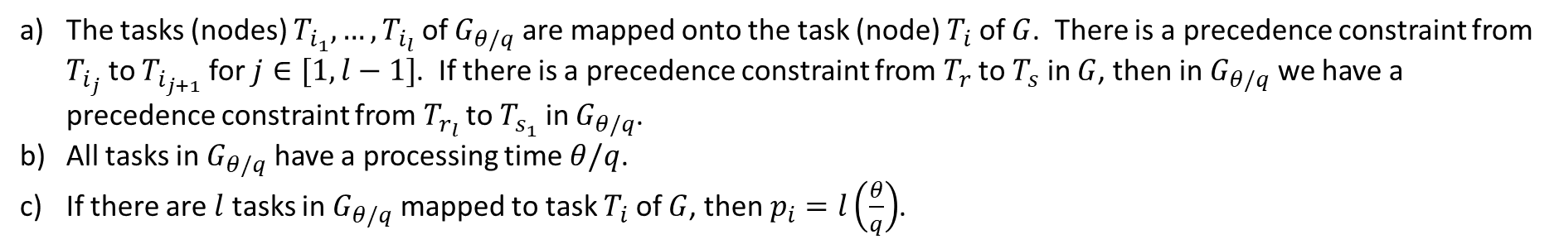
Let $θ$ be the largest value which all processing times $\{p_{i}\}$ and availability times $\{a_{i}\}$ are a multiple of.
For any integer $q$ and graph $G$, let $G_{θ/q}$ be a graph for which there exists a homomorphic mapping of $G_{θ/q}$ onto $G$ which satisfies:
The tasks (nodes) $T_{i_{1}},…,T_{i_{l}}$ of $G_{θ/q}$ are mapped onto the task (node) $T_{i}$ of $G$. There is a precedence constraint from $T_{i_{j}}$ to $T_{i_{j+1}}$ for $j∈[1,l−1]$. If there is a precedence constraint from $T_{r}$ to $T_{s}$ in $G$, then in $G_{θ/q}$ we have a precedence constraint from $T_{r_{l}}$ to $T_{s_{1}}$ in $G_{θ/q}$.
All tasks in $G_{θ/q}$ have a processing time $θ/q$.
If there are $l$ tasks in $G_{θ/q}$ mapped to task $T_{i}$ of $G$, then $p_{i}=l\left(\frac{θ}{q}\right)$.
An assignment interval $(t_{1},t_{2})$ is defined as having no machine changes within but at least one machine change at $t_{1}$ and one at $t_{2}.$ Within an interval, work being done can be described by the $m$-tuple $(b_{1},…,b_{m})$ where $b_{i}=T_{j}$ if machine $M_{i}$ is working on $T_{j}$ or $b_{i}=φ$ if $M_{i}$ is idle or unavailable.

Slide 12
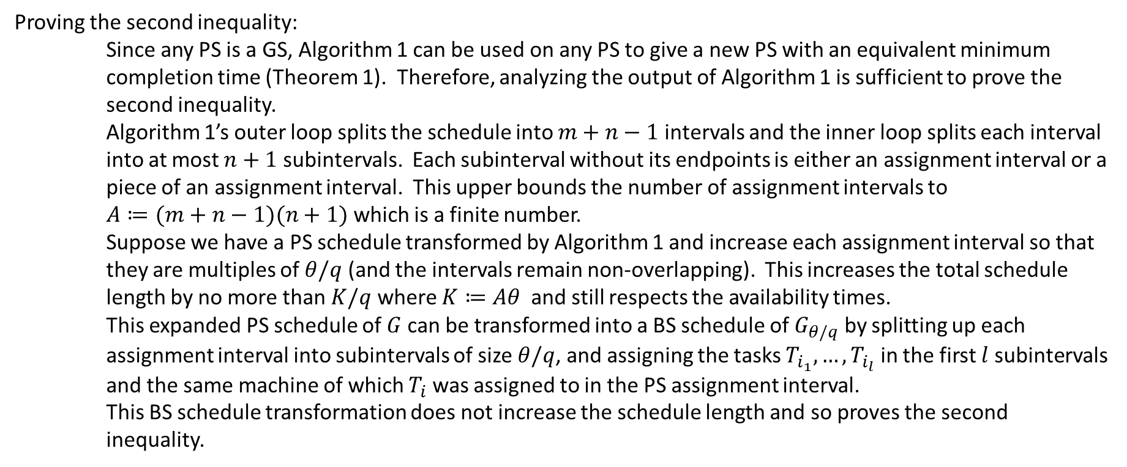
Lemma 2: Given $G,\{p_{i}\},\{a_{i}\}$, we can find a constant $K$ such that:
${CT}_{PS}\left(G,\{p_{i}\},\{a_{i}\}\right)≤{CT}_{BS}\left(G_{θ/q},\{p_{i}\},\{a_{i}\}\right)≤{CT}_{PS}\left(G,\{p_{i}\},\{a_{i}\}\right)+K/q$, $q=1,2,…$
Proof:
Since BS for $G_{θ/q}$ can be directly used as a PS for $G$, then ${CT}_{PS}\left(G,\{p_{i}\},\{a_{i}\}\right)≤{CT}_{BS}\left(G_{θ/q},\{p_{i}\},\{a_{i}\}\right)$.
Proving the second inequality:
Since any PS is a GS, Algorithm 1 can be used on any PS to give a new PS with an equivalent minimum completion time (Theorem 1). Therefore, analyzing the output of Algorithm 1 is sufficient to prove the second inequality.
Algorithm 1’s outer loop splits the schedule into $m+n−1$ intervals and the inner loop splits each interval into at most $n+1$ subintervals. Each subinterval without its endpoints is either an assignment interval or a piece of an assignment interval. This upper bounds the number of assignment intervals to
$A≔(m+n−1)(n+1)$ which is a finite number.
Suppose we have a PS schedule transformed by Algorithm 1 and increase each assignment interval so that they are multiples of $θ/q$ (and the intervals remain non-overlapping). This increases the total schedule length by no more than $K/q$ where $K≔Aθ$ and still respects the availability times.
This expanded PS schedule of $G$ can be transformed into a BS schedule of $G_{θ/q}$ by splitting up each assignment interval into subintervals of size $θ/q$, and assigning the tasks $T_{i_{1}},…,T_{i_{l}}$ in the first $l$ subintervals and the same machine of which $T_{i}$ was assigned to in the PS assignment interval.
This BS schedule transformation does not increase the schedule length and so proves the second inequality.

Slide 13
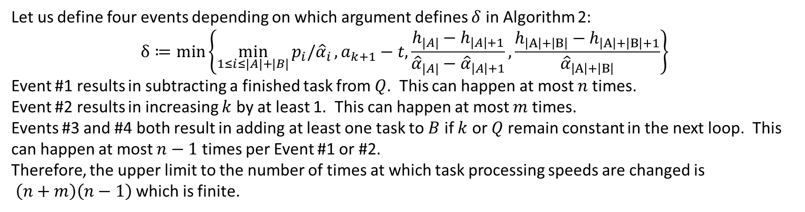
Lemma 3: Given a finite number of tasks and machines, then there is a finite number of times at which task processing speeds are changed in Algorithm 2.
Proof:
Let us define four events depending on which argument defines $δ$ in Algorithm 2:
$$δ≔min\left\{\min_{1≤i≤|A|+|B|}{p_{i}/{\hat{α}}_{i}},a_{k+1}−t,\frac{h_{|A|}−h_{\left|A\right|+1}}{{\hat{α}}_{|A|}−{\hat{α}}_{\left|A\right|+1}},\frac{h_{\left|A\right|+\left|B\right|}−h_{\left|A\right|+\left|B\right|+1}}{{\hat{α}}_{\left|A\right|+\left|B\right|}}\right\}$$
Event #1 results in subtracting a finished task from $Q$. This can happen at most $n$ times.
Event #2 results in increasing $k$ by at least 1. This can happen at most $m$ times.
Events #3 and #4 both result in adding at least one task to $B$ if $k$ or $Q$ remain constant in the next loop. This can happen at most $n−1$ times per Event #1 or #2.
Therefore, the upper limit to the number of times at which task processing speeds are changed is
$\left(n+m\right)\left(n−1\right)$ which is finite.

Slide 14
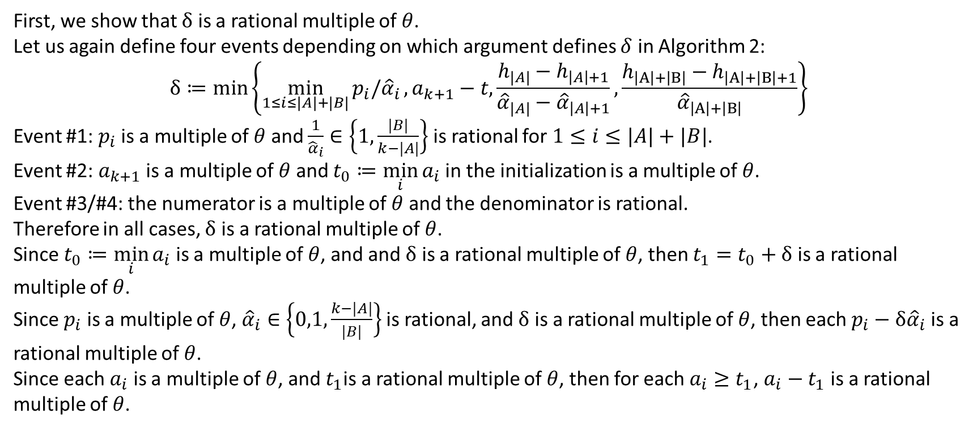
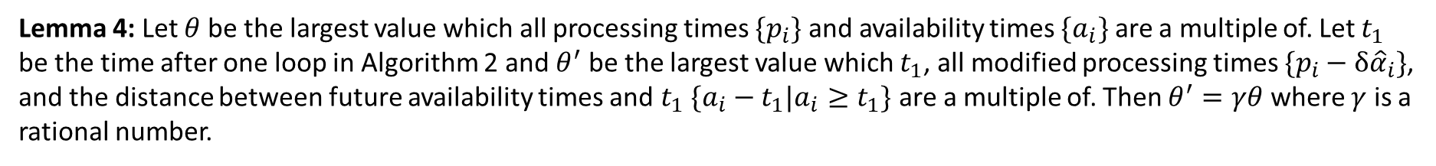
Lemma 4: Let $θ$ be the largest value which all processing times $\{p_{i}\}$ and availability times $\{a_{i}\}$ are a multiple of. Let $t_{1}$ be the time after one loop in Algorithm 2 and $θ^{′}$ be the largest value which $t_{1}$, all modified processing times $\{p_{i}−δ{\hat{α}}_{i}\}$, and the distance between future availability times and $t_{1}$ $\{a_{i}−t_{1}|a_{i}≥t_{1}\}$ are a multiple of. Then $θ^{′}=γθ$ where $γ$ is a rational number.
Proof:
First, we show that $δ$ is a rational multiple of $θ$.
Let us again define four events depending on which argument defines $δ$ in Algorithm 2:
$$δ≔min\left\{\min_{1≤i≤|A|+|B|}{p_{i}/{\hat{α}}_{i}},a_{k+1}−t,\frac{h_{|A|}−h_{\left|A\right|+1}}{{\hat{α}}_{|A|}−{\hat{α}}_{\left|A\right|+1}},\frac{h_{\left|A\right|+\left|B\right|}−h_{\left|A\right|+\left|B\right|+1}}{{\hat{α}}_{\left|A\right|+\left|B\right|}}\right\}$$
Event #1: $p_{i}$ is a multiple of $θ$ and $\frac{1}{{\hat{α}}_{i}}∈\left\{1,\frac{|B|}{k−|A|}\right\}$ is rational for $1≤i≤|A|+|B|$.
Event #2: $a_{k+1}$ is a multiple of $θ$ and $t_{0}≔\min_{i}{a_{i}}$ in the initialization is a multiple of $θ$.
Event #3/#4: the numerator is a multiple of $θ$ and the denominator is rational.
Therefore in all cases, $δ$ is a rational multiple of $θ$.
Since $t_{0}≔\min_{i}{a_{i}}$ is a multiple of $θ$, and and $δ$ is a rational multiple of $θ$, then $t_{1}=t_{0}+δ$ is a rational multiple of $θ$.
Since $p_{i}$ is a multiple of $θ$, ${\hat{α}}_{i}∈\left\{0,1,\frac{k−|A|}{|B|}\right\}$ is rational, and $δ$ is a rational multiple of $θ$, then each $p_{i}−δ{\hat{α}}_{i}$ is a rational multiple of $θ$.
Since each $a_{i}$ is a multiple of $θ$, and $t_{1}$is a rational multiple of $θ$, then for each $a_{i}≥t_{1}$, $a_{i}−t_{1}$ is a rational multiple of $θ$.

Slide 15
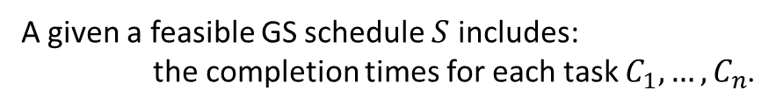
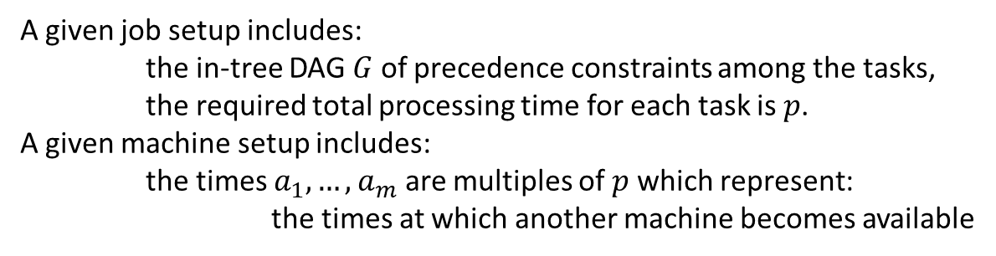
Optimal BS Scheduling Algorithm for equally sized tasks
Algorithm 3: Construct a an minimal length BS. (Needs to be proved Optimal, See Hu[5] to do this.)
Input:
A given job setup includes:
the in-tree DAG $G$ of precedence constraints among the tasks,
the required total processing time for each task is $p$.
A given machine setup includes:
the times $a_{1},…,a_{m}$ are multiples of $p$ which represent:
the times at which another machine becomes available
Output:
A given a feasible GS schedule $S$ includes:
the completion times for each task $C_{1},…,C_{n}$.

Slide 16
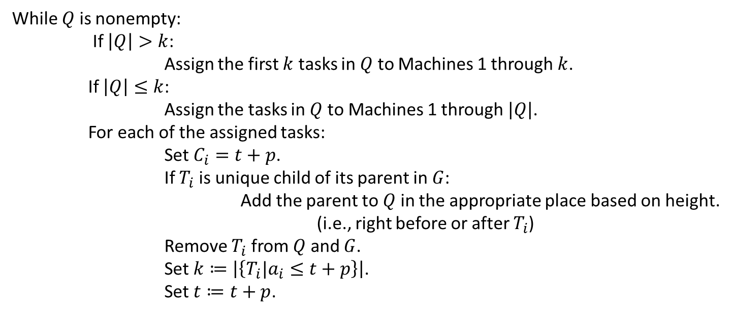
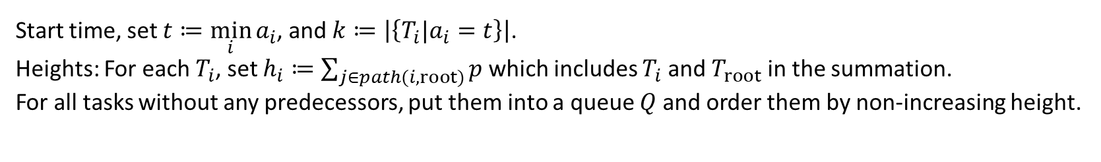
Initialize:
Start time, set $t≔\min_{i}{a_{i}}$, and $k≔\left|\left\{T_{i}|a_{i}=t\right\}\right|$.
Heights: For each $T_{i}$, set $h_{i}≔\sum_{j∈path(i,root)}{p}$ which includes $T_{i}$ and $T_{root}$ in the summation.
For all tasks without any predecessors, put them into a queue $Q$ and order them by non-increasing height.
Procedure:
While $Q$ is nonempty:
If $\left|Q\right|>k$:
Assign the first $k$ tasks in $Q$ to Machines 1 through $k$.
If $\left|Q\right|≤k$:
Assign the tasks in $Q$ to Machines 1 through $|Q|$.
For each of the assigned tasks:
Set $C_{i}=t+p$.
If $T_{i}$ is unique child of its parent in $G$:
Add the parent to $Q$ in the appropriate place based on height.
(i.e., right before or after $T_{i}$)
Remove $T_{i}$ from $Q$ and $G$.
Set $k≔\left|\left\{T_{i}|a_{i}≤t+p\right\}\right|$.
Set $t≔t+p$.

Slide 17
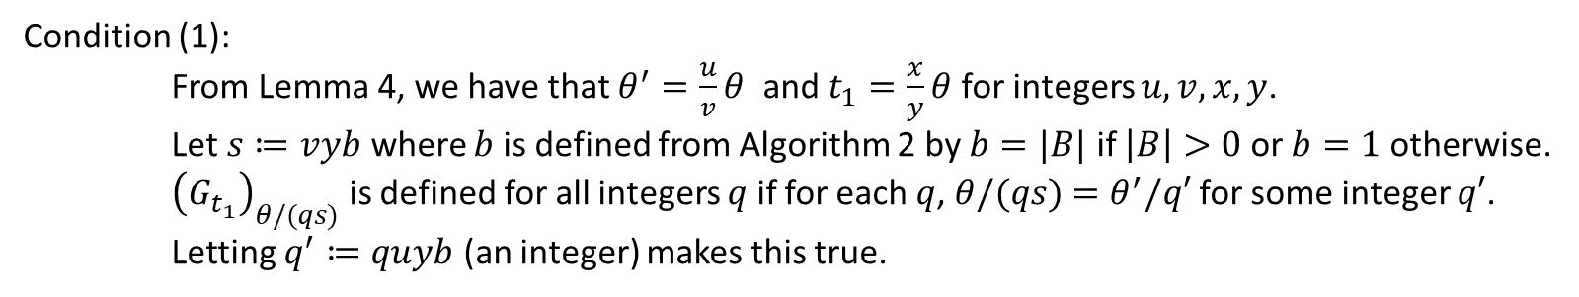
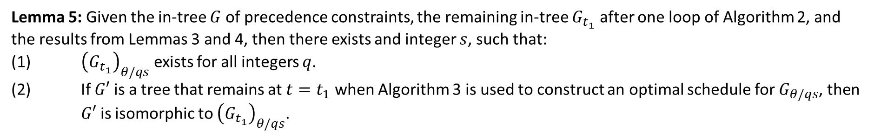
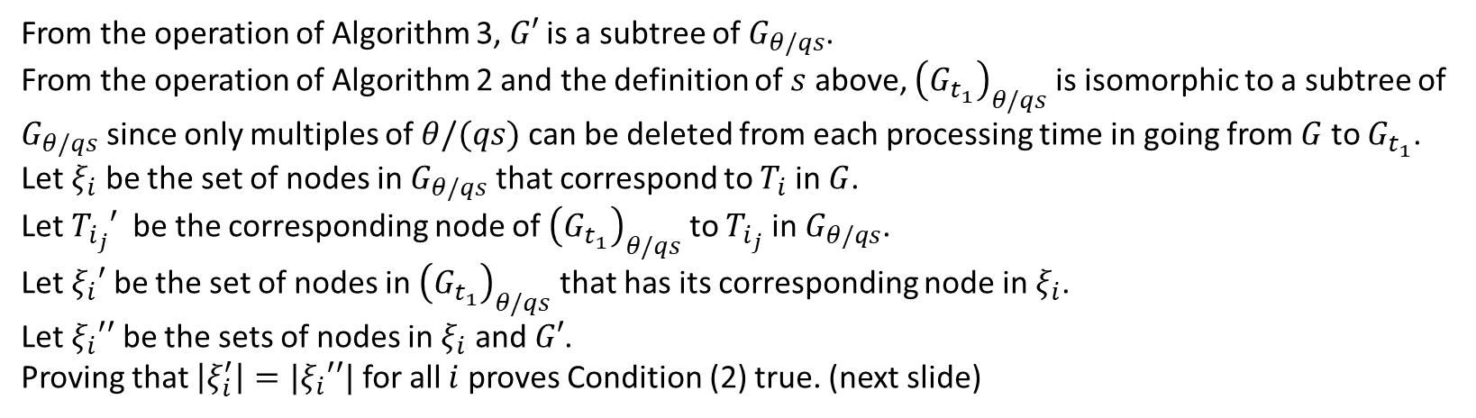
Lemma 5: Given the in-tree $G$ of precedence constraints, the remaining in-tree $G_{t_{1}}$ after one loop of Algorithm 2, and the results from Lemmas 3 and 4, then there exists and integer $s$, such that:
(1) ${\left(G_{t_{1}}\right)}_{θ/qs}$ exists for all integers $q$.
(2) If $G′$ is a tree that remains at $t=t_{1}$ when Algorithm 3 is used to construct an optimal schedule for $G_{θ/qs}$, then $G′$ is isomorphic to ${\left(G_{t_{1}}\right)}_{θ/qs}$.
Proof:
Condition (1):
From Lemma 4, we have that $θ^{′}=\frac{u}{v}θ$ and $t_{1}=\frac{x}{y}θ$ for integers $u,v,x,y$.
Let $s≔vyb$ where $b$ is defined from Algorithm 2 by $b=|B|$ if $\left|B\right|>0$ or $b=1$ otherwise.
${\left(G_{t_{1}}\right)}_{θ/(qs)}$ is defined for all integers $q$ if for each $q$, $θ/(qs)$ $=θ^{′}/q′$ for some integer $q′$.
Letting $q^{′}≔quyb$ (an integer) makes this true.
Condition (2):
From the operation of Algorithm 3, $G′$ is a subtree of $G_{θ/qs}$.
From the operation of Algorithm 2 and the definition of $s$ above, ${\left(G_{t_{1}}\right)}_{θ/qs}$ is isomorphic to a subtree of $G_{θ/qs}$ since only multiples of $θ/(qs)$ can be deleted from each processing time in going from $G$ to $G_{t_{1}}$.
Let $ξ_{i}$ be the set of nodes in $G_{θ/qs}$ that correspond to $T_{i}$ in $G$.
Let $T_{i_{j}}′$ be the corresponding node of ${\left(G_{t_{1}}\right)}_{θ/qs}$ to $T_{i_{j}}$ in $G_{θ/qs}$.
Let $ξ_{i}′$ be the set of nodes in ${\left(G_{t_{1}}\right)}_{θ/qs}$ that has its corresponding node in $ξ_{i}$.
Let $ξ_{i}′′$ be the sets of nodes in $ξ_{i}$ and $G′$.
Proving that $\left|ξ_{i}^{′}\right|=|ξ_{i}′′|$ for all $i$ proves Condition (2) true. (next slide)

Slide 18
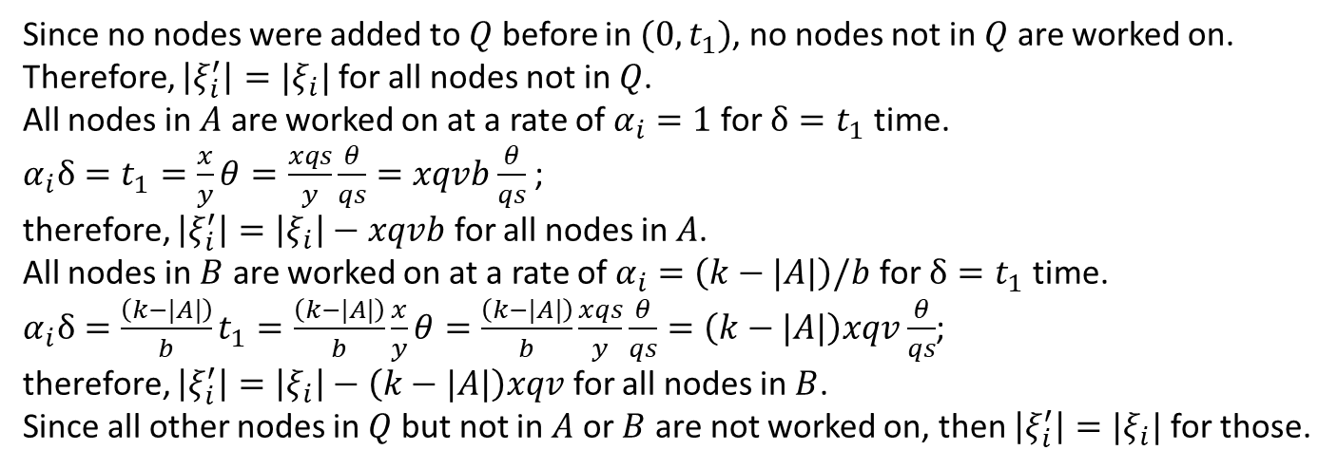

Proving that $\left|ξ_{i}^{′}\right|=|ξ_{i}′′|$ for all $i$:
Since no nodes were added to $Q$ before in $(0,t_{1})$, no nodes not in $Q$ are worked on.
Therefore, $\left|ξ_{i}^{′}\right|=|ξ_{i}|$ for all nodes not in $Q$.
All nodes in $A$ are worked on at a rate of $α_{i}=1$ for $δ=t_{1}$ time.
$α_{i}δ=t_{1}=\frac{x}{y}θ=\frac{xqs}{y}\frac{θ}{qs}=xqvb\frac{θ}{qs}$ ;
therefore, $\left|ξ_{i}^{′}\right|=\left|ξ_{i}\right|−xqvb$ for all nodes in $A$.
All nodes in $B$ are worked on at a rate of $α_{i}=\left(k−|A|\right)/b$ for $δ=t_{1}$ time.
$α_{i}δ=\frac{\left(k−|A|\right)}{b}t_{1}=\frac{\left(k−|A|\right)}{b}\frac{x}{y}θ=\frac{\left(k−|A|\right)}{b}\frac{xqs}{y}\frac{θ}{qs}=\left(k−|A|\right)xqv\frac{θ}{qs}$;
therefore, $\left|ξ_{i}^{′}\right|=\left|ξ_{i}\right|−\left(k−|A|\right)xqv$ for all nodes in $B$.
Since all other nodes in $Q$ but not in $A$ or $B$ are not worked on, then $\left|ξ_{i}^{′}\right|=|ξ_{i}|$ for those.
Let $Q′$, $A′$, $B′$ be the set subsets of nodes in $G_{θ/qs}$ for which each of its corresponding node is in $Q$, $A$, $B$ respectively.

