Slide 1
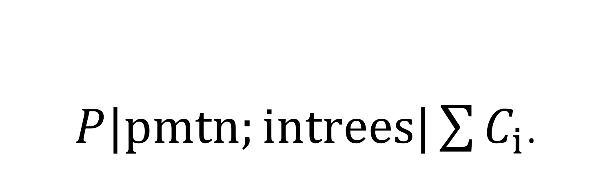
$P|pmtn;intrees|\sum{C_{i}}$.
NP-hardness construction

Slide 2
Classic NP-complete problems: Interdependence
Satisfiability / 3-SAT:
Changing a variable affects all clauses that contain that variable or its compliment.
0-1 Integer Linear Programming:
Changing a variable affects all equations that have a non-zero constant in front of that variable.
Clique:
If a node is decided to belong in the clique, it affects which other nodes (its neighbors) can be in it.
Set Packing:
If a set is decided to be part of the packing, it affects which other sets (no overlapping elements) must not be part of it.
Node Cover:
If a node is decided not to be part of the covering, then all of its neighbors must be part of it.
Set Covering:
If a set is decided not to be part of the covering, a subfamily of the sets that overlap with it must be part of the covering.

Slide 3
Feedback Node Set:
If a node is decided to not be part of the set, then every directed cycle it is part of must have a node in the set.
Feedback Arc Set:
If an arc is decided to not be part of the set, then every directed cycle it is part of must have an arc in the set.
Directed/Undirected Hamilton Circuit:
If two arcs/edges with a shared node are decided to be part of the circuit, it determines which other arcs/edges can not be part of the circuit.
Chromatic Number:
If a node is decided to be a specific color, its neighbors can not be that color.
Clique Cover:
Exact Cover:
If a set is decided to be part of the covering, it affects which other sets (no overlapping elements) must not be part of it. If a set is decided not to be part of the covering, a subfamily of the sets that overlap with it must be part of the covering.

Slide 4
Hitting Set:
If an element is decided to be in the hitting set, all elements that share a set with it must not be part of the hitting set.
Steiner Tree:
3-D Matching:
Knapsack:
Job Sequencing:
Partition:
Max Cut:

Slide 5
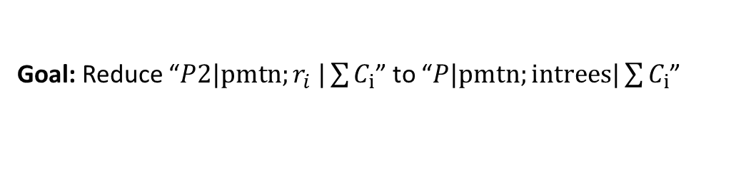
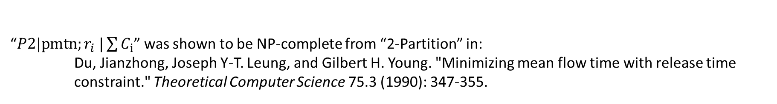
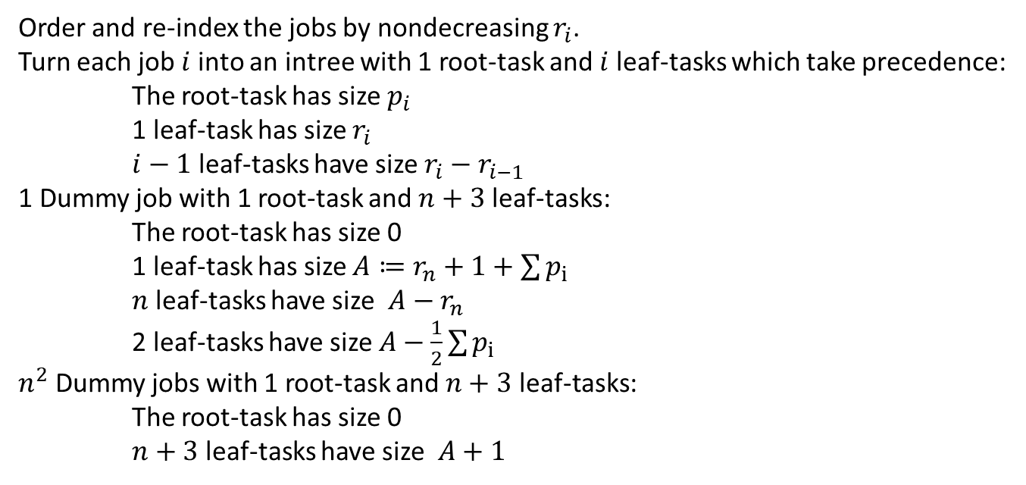
Problem Reduction for NP-hardness
“$P2|pmtn;r_{i} |\sum{C_{i}}$” was shown to be NP-complete from “2-Partition” in:
Du, Jianzhong, Joseph Y-T. Leung, and Gilbert H. Young. "Minimizing mean flow time with release time constraint." Theoretical Computer Science 75.3 (1990): 347-355.
Goal: Reduce “$P2|pmtn;r_{i} |\sum{C_{i}}$” to “$P|pmtn;intrees|\sum{C_{i}}$”
Idea (not yet proved): Structure an intree so that the root-task cannot start until $r_{i}$ and has an execution time of $p_{i}$
Order and re-index the jobs by nondecreasing $r_{i}$.
Turn each job $i$ into an intree with 1 root-task and $i$ leaf-tasks which take precedence:
The root-task has size $p_{i}$
1 leaf-task has size $r_{i}$
$i−1$ leaf-tasks have size $r_{i}−r_{i−1}$
1 Dummy job with 1 root-task and $n+3$ leaf-tasks:
The root-task has size 0
1 leaf-task has size $A≔r_{n}+1+\sum{p_{i}}$
$n$ leaf-tasks have size $A−r_{n}$
2 leaf-tasks have size $A−\frac{1}{2}\sum{p_{i}}$
$n^{2}$ Dummy jobs with 1 root-task and $n+3$ leaf-tasks:
The root-task has size 0
$n+3$ leaf-tasks have size $A+1$
(Stack around the previous job)
(Stack around the main jobs)
(Stack on top of main jobs to push root-tasks onto two machines)

Slide 6
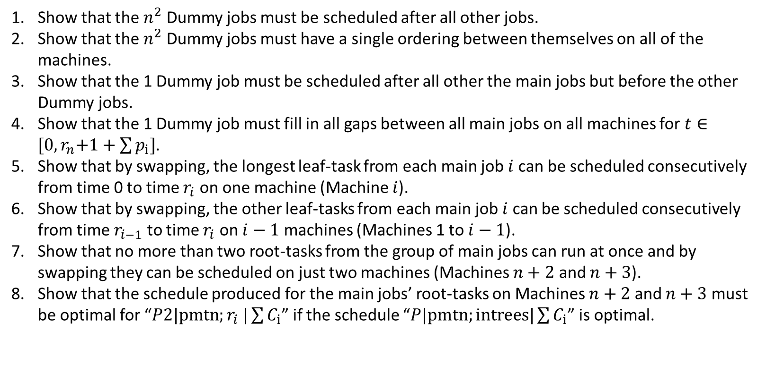
Run these jobs on $n+3$ parallel machines.
Turn the resulting schedule into an equivalent one where all root tasks run on last 2 machines.
Challenge: Show that only two root-tasks can be run at one time (or change the construction to do this if it doesn’t)
Proof items to do:
Show that the $n^{2}$ Dummy jobs must be scheduled after all other jobs.
Show that the $n^{2}$ Dummy jobs must have a single ordering between themselves on all of the machines.
Show that the 1 Dummy job must be scheduled after all other the main jobs but before the other Dummy jobs.
Show that the 1 Dummy job must fill in all gaps between all main jobs on all machines for $t∈{[0,r}_{n}+1+\sum{p_{i}}]$.
Show that by swapping, the longest leaf-task from each main job $i$ can be scheduled consecutively from time 0 to time $r_{i}$ on one machine (Machine $i$).
Show that by swapping, the other leaf-tasks from each main job $i$ can be scheduled consecutively from time $r_{i−1}$ to time $r_{i}$ on $i−1$ machines (Machines 1 to $i−1$).
Show that no more than two root-tasks from the group of main jobs can run at once and by swapping they can be scheduled on just two machines (Machines $n+2$ and $n+3$).
Show that the schedule produced for the main jobs’ root-tasks on Machines $n+2$ and $n+3$ must be optimal for “$P2|pmtn;r_{i} |\sum{C_{i}}$” if the schedule “$P|pmtn;intrees|\sum{C_{i}}$” is optimal.

Slide 7
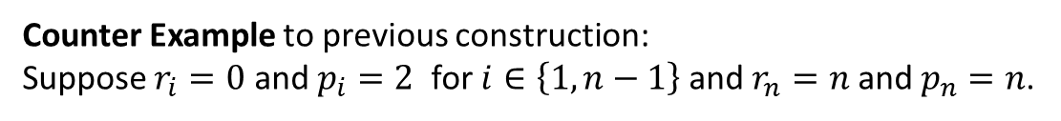
Counter Example to previous construction:
Suppose $r_{i}=0$ and $p_{i}=2$ for $i∈\left\{1,n−1\right\}$ and $r_{n}=n$ and $p_{n}=n$.
If the construction is set up as intended, then moving the small jobs to the $n−1$ previous machines would save much more time than the increase to job $n$. This is facilitated by using Dummy-0 shaving away its latest job execution and moving that to Machines $n+2$ and $n+3$ to replace the small jobs that were originally there.

Slide 8
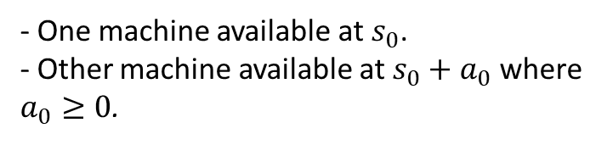




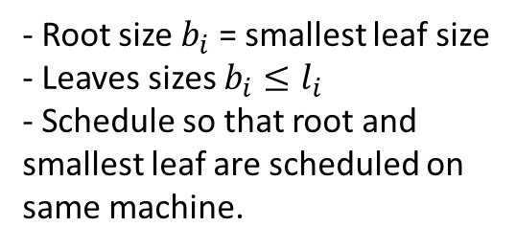

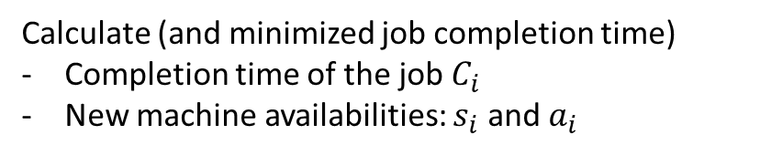
Goal: Reduce the knapsack or partition problem for the integers $\left\{b_{1},b_{2},…,b_{n}\right\}$ to the problem of minimizing the sum of in-tree processing completion times on identical multiple machines.
Two machines and a job with two leaves
$$b_{i}$$
$$b_{i}$$
- Root size $b_{i}$ = smallest leaf size
- Leaves sizes $b_{i}≤l_{i}$
- Schedule so that root and smallest leaf are scheduled on same machine.
$$l_{i}$$
$$s_{0}$$
$$a_{0}$$
- One machine available at $s_{0}$.
- Other machine available at $s_{0}+a_{0}$ where $a_{0}≥0$.
Calculate (and minimized job completion time)
Completion time of the job $C_{i}$
New machine availabilities: $s_{i}$ and $a_{i}$

Slide 9






































$$−\left(a_{0}+b_{i}−l_{i}\right)$$
Case 1: $0≤a_{0}<l_{i}−b_{i}$
If $a_{0}<min\left\{\frac{1}{2}l_{i}l_{i}−b_{i}\right\}$, then $a_{0}<a_{i}$.
$$s_{0}$$
$$a_{0}$$
$$b_{i}$$
$$b_{i}$$
$$s_{i}=s_{0}+a_{0}+b_{i}$$
If $\frac{1}{2}l_{i}<a_{0}<l_{i}−b_{i}$, then $a_{0}>a_{i}$.
$$a_{i}=l_{i}−a_{0}$$
$$C_{i}=s_{i}+a_{i}=s_{0}+l_{i}+b_{i}$$
$$s_{0}$$
$$a_{0}+b_{i}$$
Case 2: $l_{i}−b_{i}<a_{0}≤l_{i}+b_{i}$
If $l_{i}−b_{i}<a_{0}<b_{i}$, then $a_{0}<a_{i}$.
$b_{i}−\frac{1}{2}\left(a_{0}+b_{i}−l_{i}\right)$
If $b_{i}<a_{0}≤l_{i}+b_{i}$, then $a_{0}>a_{i}$.
$s_{i}=s_{0}+a_{0}+b_{i}−\frac{1}{2}(a_{0}+b_{i}−l_{i})$
$$s_{0}$$
$$a_{0}$$
$$a_{i}=l_{i}−a_{0}+\left(a_{0}+b_{i}−l_{i}\right)$$
$$a_{0}+l_{i2}=l_{i1}+b_{i}$$
$C_{i}=s_{i}+a_{i}=s_{0}+l_{i}+b_{i}+\frac{1}{2}\left(a_{0}+b_{i}−l_{i}\right)$
$$l_{i1}+l_{i2}=l_{i}$$
$$s_{0}$$
$$b_{i}$$
$$b_{i}$$
$a_{0}−\frac{1}{2}\left(a_{0}+b_{i}−l_{i}\right)$
Case 3: $l_{i}+b_{i}≤a_{0}≤2b_{i}+l_{i}$
$$s_{i}=s_{0}+a_{0}+b_{i}−\left(b_{i}\right)$$
$$s_{0}$$
$$a_{0}$$
It is always true that $a_{0}>a_{i}$.
$$a_{i}=l_{i}−a_{0}+\left(2b_{i}\right)$$
$$C_{i}=s_{i}+a_{i}=s_{0}+l_{i}+b_{i}+\left(b_{i}\right)$$
$$s_{0}$$
$$l_{i}$$
$$b_{i}$$
$$b_{i}$$

Slide 10










Case 4: $2b_{i}+l_{i}≤a_{0}<∞$
$$s_{i}=s_{0}+a_{0}+b_{i}−\left(a_{0}−b_{i}−l_{i}\right)$$
$$s_{0}$$
$$a_{0}$$
$$a_{i}=l_{i}−a_{0}+2\left(a_{0}−b_{i}−l_{i}\right)$$
It is always true that $a_{0}>a_{i}$.
$$C_{i}=s_{i}=s_{0}+l_{i}+b_{i}+\left(b_{i}\right)$$
$$s_{0}$$
$$l_{i}$$
$$b_{i}$$
$$b_{i}$$

Slide 11
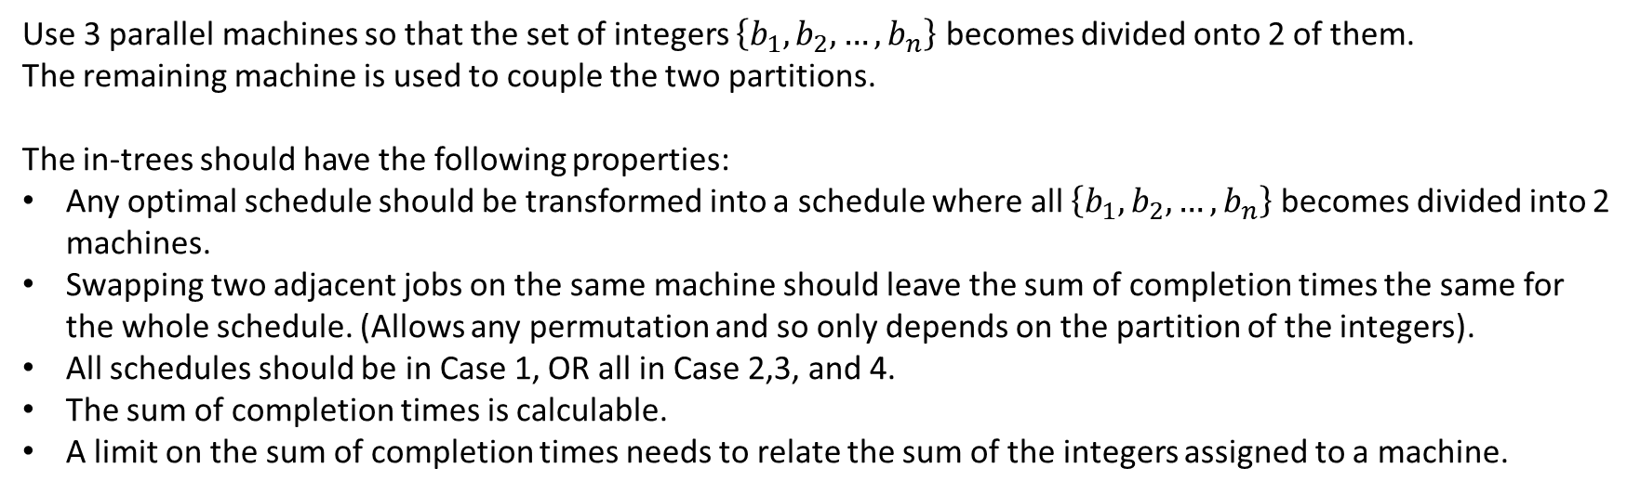
Next Steps:
Use 3 parallel machines so that the set of integers $\left\{b_{1},b_{2},…,b_{n}\right\}$ becomes divided onto 2 of them.
The remaining machine is used to couple the two partitions.
The in-trees should have the following properties:
Any optimal schedule should be transformed into a schedule where all $\left\{b_{1},b_{2},…,b_{n}\right\}$ becomes divided into 2 machines.
Swapping two adjacent jobs on the same machine should leave the sum of completion times the same for the whole schedule. (Allows any permutation and so only depends on the partition of the integers).
All schedules should be in Case 1, OR all in Case 2,3, and 4.
The sum of completion times is calculable.
A limit on the sum of completion times needs to relate the sum of the integers assigned to a machine.

Slide 12
Hidden Old Work

Slide 13
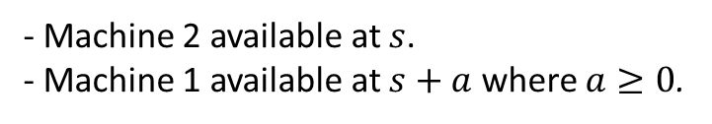




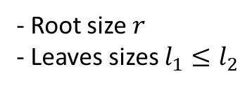

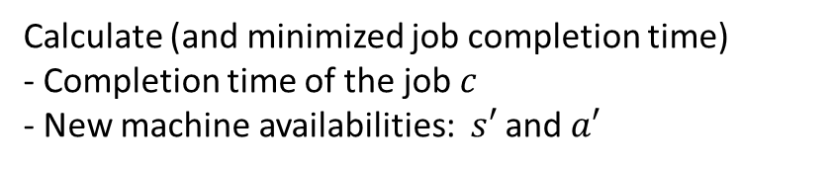
Two machines and a job with two leaves
$$l_{1}$$
$$r$$
- Root size $r$
- Leaves sizes $l_{1}≤l_{2}$
$$l_{2}$$
$$s$$
$$a$$
- Machine 2 available at $s$.
- Machine 1 available at $s+a$ where $a≥0$.
Calculate (and minimized job completion time)
- Completion time of the job $c$
- New machine availabilities: $s′$ and $a′$

Slide 14































Case 1: $l_{1}+l_{2}+r≤a<∞$
$$s$$
$$a$$
$$c=s+l_{1}+l_{2}+r$$
$$s′=s+l_{1}+l_{2}+r$$
$$a^{′}=a−l_{1}−l_{2}−r$$
$$l_{2}$$
$$l_{1}$$
$$r$$
Case 2: $l_{1}+l_{2}{≤a<l}_{1}+l_{2}+r$
$$s$$
$$a$$
$$r$$
$$c=s+l_{1}+l_{2}+r$$
$$s^{′}=s+a$$
$$a^{′}=−a+l_{1}+l_{2}+r$$
$$l_{2}$$
$$l_{1}$$
Case 3: $l_{2}−l_{1}≤{a<l}_{1}+l_{2}$
$$s$$
$$a$$
$$l_{1}$$
$$r$$
$c=s+\frac{1}{2}(a+l_{1}+l_{2})+r$
$$l_{21}+l_{11}=a$$
$$l_{22}=l_{12}$$
$s^{′}=s+\frac{1}{2}(a+l_{1}+l_{2})$
$$l_{2}$$
$$l_{21}+l_{22}=l_{2}$$
$$a^{′}=r$$
$$l_{11}+l_{21}=l_{1}$$

Slide 15





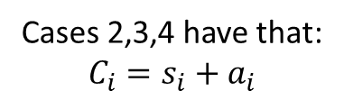




Case 4: $0≤{a<l}_{2}−l_{1}$
$$s$$
$$a$$
$$l_{1}$$
$$r$$
$$c=s+l_{2}+r$$
$$s^{′}=s+a+l_{1}$$
$$a^{′}=r−a+l_{2}−l_{1}$$
$$l_{2}$$
Cases 2,3,4 have that:
$$C_{i}=s_{i}+a_{i}$$

Slide 16
















Case 4: $0≤{a<l}_{2}−l_{1}$
Case 3: $l_{2}−l_{1}≤{a<l}_{1}+l_{2}$
Case 2: $l_{1}+l_{2}{≤a<l}_{1}+l_{2}+r$
Case 1: $l_{1}+l_{2}+r≤a<∞$
$$c=s+r+l_{2}$$
$c=s+r+\frac{1}{2}(a+l_{1}+l_{2})$
$c=s+r+l_{1}+l_{2}$
$c=s+r+l_{1}+l_{2}$
$$s^{′}=s+a+l_{1}$$
$s^{′}=s+\frac{1}{2}(a+l_{1}+l_{2})$
$$s^{′}=s+a$$
$$s′=s+l_{1}+l_{2}+r$$
$$a^{′}=r+(l_{2}−l_{1}−a)$$
$$a^{′}=r$$
$$a^{′}=r+(\left(l_{1}+l_{2}\right)−a)$$
$$a^{′}=−(r+(\left(l_{1}+l_{2}\right)−a))$$
$c=s+r+\frac{1}{2}\left(l_{2}+max\left\{l_{2},min\left\{a,l_{1}+l_{2}\right\}+l_{1}\right\}\right)$
$s^{′}=s+min\left\{\frac{1}{2}\left(a+max\left\{l_{1}+min\left\{l_{1}+a,l_{2}\right\},a\right\}\right),l_{1}+l_{2}+r\right\}$
$$a^{′}=\left|r+\max\left\{0,(l_{2}−l_{1})−a\right\}+min\left\{0,\left(l_{1}+l_{2}\right)−a\right\}\right|$$

Slide 17






















How can we have that interchanging two tasks does not change the $\sum{C_{i}}$?
Special Case: What conditions are sufficient that interchanging two tasks does not change the $C_{1}+C_{2}$ and $a^{′′}$ (and $a^{′′}$)?
1 First
2 First
$$s$$
$$a$$
$$s$$
$$a$$
$$l_{12}$$
$$l_{11}$$
$$r_{1}$$
$$l_{22}$$
$$l_{21}$$
$$r_{2}$$
$$l_{22}$$
$$l_{21}$$
$$r_{2}$$
$$l_{12}$$
$$l_{11}$$
$$r_{1}$$
Conditions:
Total sizes are equal:
$$l_{11}+l_{12}+r_{1}=l_{21}+l_{22}+r_{2}$$
Sum of subset of sizes is less than $a$:
$$l_{11}+l_{12}+r_{1}+l_{21}+l_{22}≤a$$
$$l_{21}+l_{22}+r_{2}+l_{11}+l_{12}≤a$$
Results:
1 First
2 First
$$C_{1}+C_{2}=2s+2\left(l_{11}+l_{12}+r_{1}\right)+\left(l_{21}+l_{22}+r_{2}\right)=2s+\left(l_{11}+l_{12}+r_{1}\right)+2\left(l_{21}+l_{22}+r_{2}\right)$$
$$a^{′′}=\left|\left(l_{11}+l_{12}+r_{1}+l_{21}+l_{22}+r_{2}\right)−a\right|$$
(abs is for if $a$ is too large)
$$s^{′′}=a$$

Slide 18




















1 First
2 First
$$s$$
$$a$$
$$r_{2}$$
$$s$$
$$a$$
$$r_{1}$$
$$l_{12}$$
$$l_{11}$$
$$r_{1}$$
$$l_{22}$$
$$l_{21}$$
$$l_{22}$$
$$l_{21}$$
$$r_{2}$$
$$l_{12}$$
$$l_{11}$$
Conditions:
Total leaf sizes are equal:
$$l_{11}+l_{12}=l_{21}+l_{22}$$
Root sizes are equal:
$$r_{1}=r_{2}$$
Sum of subset of sizes is less/greater than $a$:
$$max\left\{l_{11}+l_{12}+r_{1}+\left(l_{22}−l_{21}\right),l_{21}+l_{22}+r_{2}+\left(l_{12}−l_{11}\right)\right\}≤a<l_{11}+l_{12}+r_{1}+l_{21}+l_{22}=l_{21}+l_{22}+r_{2}+l_{11}+l_{12}$$
Results:
$$C_{1}+C_{2}=2s+2\left(l_{11}+l_{12}+r_{1}\right)+\frac{1}{2}(a+l_{21}+l_{22})+r_{2}=2s+\frac{1}{2}(a+l_{11}+l_{12})+r_{1}+2\left(l_{21}+l_{22}+r_{2}\right)$$
$$a^{′′}=r_{2}=r_{1}$$
$$s^{′′}=s+\frac{1}{2}\left(a+l_{11}+l_{12}+r_{1}+l_{21}+l_{22}\right)=s+\frac{1}{2}\left(a+l_{11}+l_{12}+l_{21}+l_{22}+r_{2}\right)$$

Slide 19




















$$min\left\{l_{11}+l_{12}+r_{1}+\left(l_{22}−l_{21}\right),l_{21}+l_{22}+r_{2}+\left(l_{12}−l_{11}\right)\right\}≤a<max\left\{l_{11}+l_{12}+r_{1}+\left(l_{22}−l_{21}\right),l_{21}+l_{22}+r_{2}+\left(l_{12}−l_{11}\right)\right\}$$
WLOG Suppose $\left(l_{22}−l_{21}\right)>$ $\left(l_{12}−l_{11}\right)$
1 First
2 First
$$s$$
$$a$$
$$l_{21}$$
$$r_{2}$$
$$s$$
$$a$$
$$r_{1}$$
$$l_{12}$$
$$l_{11}$$
$$r_{1}$$
$$l_{22}$$
$$l_{22}$$
$$l_{21}$$
$$r_{2}$$
$$l_{12}$$
$$l_{11}$$
Conditions:
$$a=2r_{2}+2l_{22}−r_{1}$$
$$l_{11}+l_{12}+r_{1}=l_{21}+l_{22}+r_{2}$$
$$2l_{21}+r_{2}≤2r_{2}−r_{1}+l_{22}+l_{21}−\left(l_{12}−l_{11}\right)<2l_{11}+r_{1}$$
Which means if $r_{1}=r_{2}$, then $l_{21}≤l_{11}$

Slide 20























$$s$$
$$a$$
$$l_{11}$$
$$r_{1}$$
$$l_{21}$$
$$r_{2}$$
$$s$$
$$a$$
$$l_{21}$$
$$r_{2}$$
$$l_{11}$$
$$r_{1}$$
$$l_{12}$$
$$l_{22}$$
$$l_{22}$$
$$l_{12}$$
Conditions:
$$l_{12}+r_{1}=l_{22}+r_{2}$$
$$a≤l_{12}−l_{11}$$
$$a≤l_{22}−l_{21}$$
$$l_{21}=l_{11}$$
$$r_{1}≤a$$
$$r_{2}≤a$$
$$max\left\{r_{1},r_{2}\right\}≤a≤min\left\{l_{12}−l_{11},l_{22}−l_{21}\right\}$$
$$C_{1}+C_{2}=2s+a+l_{11}+l_{12}+r_{1}+l_{22}+r_{2}=…$$
$$a^{′′}=a$$
$$s^{′′}=s+l_{21}+l_{12}+r_{1}=s+l_{11}+l_{22}+r_{2}$$

Slide 21









Conditions that guarantee each job is in Case 4 for any permutation:
Case 4: $0≤a≤l_{2}−l_{1}$
$$s$$
$$a$$
$$l_{1}$$
$$r$$
$$c=s+l_{2}+r$$
$$s^{′}=s+a+l_{1}$$
$$a^{′}=r+l_{2}−l_{1}−a$$
$$l_{2}$$
This would require that $r=0$ and $l_{i2}−l_{i1}=l_{j2}−l_{j1}$ for all pairs $(i,j)$.
The problem means that each job can only have different $l_{i1}$ (which implies $l_{i2}$) and always puts $l_{i1}$ on Machine 1.

Slide 22
































Conditions that guarantee each job is in Case 3 or 4 for any permutation:
For some integer $b$:
$$max\left\{r+l_{2}−l_{1}\right\}≤b≤min\left\{l_{1}+l_{2}\right\}$$
Case 4 can put $l_{1}$ on Machine 1
Case 4 can put $l_{1}$ on Machine 2
Case 4: $0≤a≤l_{2}−l_{1}$
$$s$$
$$a$$
$$l_{1}$$
$$r$$
$$s$$
$$a$$
$$r$$
$$c=s+l_{2}+r$$
$$s^{′}=s+a+l_{1}$$
$$a^{′}=r+l_{2}−l_{1}−a$$
$$l_{2}$$
$$l_{2}$$
$$l_{1}$$
Case 3 can put $l_{1}$ on Machine 2
Case 3: $l_{2}−l_{1}≤a≤l_{1}+l_{2}$
$$s$$
$$a$$
$$l_{1}$$
$$r$$
$$s$$
$$a$$
$$r$$
$c=s+\frac{1}{2}(a+l_{1}+l_{2})+r$
$s^{′}=s+\frac{1}{2}(a+l_{1}+l_{2})$
$$l_{2}$$
$$l_{2}$$
$$l_{1}$$
$$a^{′}=r$$

Slide 23





Conditions that guarantee each job is in Case 3 or 4 for any permutation $r=0$:
For some integer $b$:
$$max\left\{l_{2}−l_{1}\right\}≤b≤min\left\{l_{1}+l_{2}\right\}$$
Case 4 can put $l_{1}$ on Machine 1
Case 4 can put $l_{1}$ on Machine 2
Case 4: $0≤a≤l_{2}−l_{1}$
$$s$$
$$a$$
$$l_{1}$$
$$s$$
$$a$$
$$c=s+l_{2}=s^{′}+a′$$
$$s^{′}=s+a+l_{1}$$
$$a^{′}=l_{2}−l_{1}−a$$
$$l_{2}$$
$$l_{2}$$
$$l_{1}$$
Case 3 can put $l_{1}$ on Machine 2
Case 3: $l_{2}−l_{1}≤a≤l_{1}+l_{2}$
$$s$$
$$a$$
$$l_{1}$$
$$s$$
$$a$$
$c=s+\frac{1}{2}(a+l_{1}+l_{2})$
$s^{′}=s+\frac{1}{2}(a+l_{1}+l_{2})$
$$l_{2}$$
$$l_{2}$$
$$l_{1}$$
$$a^{′}=0$$
Each “block” starts with a Case 4 and ends with a Case 3.
Case 4 always follows a Case 3.
Ex. Block ---3)-4-4-4-4-4-4-3-(4---

Slide 24













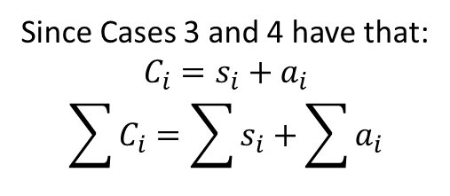



Properties of a block
Each “block” starts with a Case 4 and ends with a Case 3 because Case 3 ends with both machines being available at the same time.
Case 4 always follows a Case 3.
Ex. Block ---3)-4-4-4-4-4-4-3-(4---
Since Cases 3 and 4 have that:
$$C_{i}=s_{i}+a_{i}$$
$$\sum{C_{i}}=\sum{s_{i}}+\sum{a_{i}}$$
Suppose job $i$ follows job $j$:
Case 4 to 4:
$$0≤a_{0}≤l_{i2}−l_{i1}$$
$$a_{0}≤l_{i2}−l_{i1}≤l_{j2}−l_{j1}+a_{0}$$
$$C_{i}=s_{0}+l_{i2}$$
$$C_{j}=s_{0}+a_{0}+l_{i1}+l_{j2}$$
$$s_{i}=s_{0}+a_{0}+l_{i1}$$
$$s_{j}=s_{0}+l_{i2}+l_{j1}$$
$$a_{i}=\left(l_{i2}−l_{i1}\right)−a_{0}$$
$$a_{j}=a_{0}+\left(l_{j2}−l_{j1}\right)−\left(l_{i2}−l_{i1}\right)$$
Case 4 to 3:
$$l_{j2}−l_{j1}+a_{0}≤l_{i2}−l_{i1}≤l_{j1}+l_{j2}+a_{0}$$
$$0≤a_{0}≤l_{i2}−l_{i1}$$
$$C_{j}=s_{0}+\frac{1}{2}(l_{i2}+l_{i1}+a_{0}+l_{j1}+l_{j2})$$
$$C_{i}=s_{0}+l_{i2}$$
$$s_{i}=s_{0}+a_{0}+l_{i1}$$
$$s_{j}=s_{0}+\frac{1}{2}(l_{i2}+l_{i1}+a_{0}+l_{j1}+l_{j2})$$
$$a_{i}=l_{i2}−l_{i1}−a_{0}$$
$$a_{j}=0$$

Slide 25

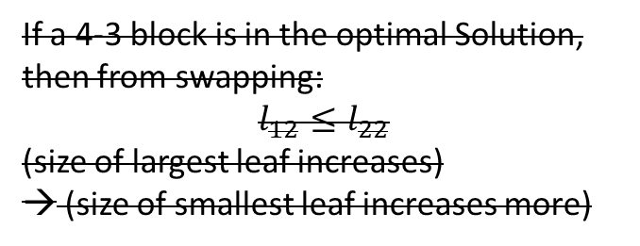
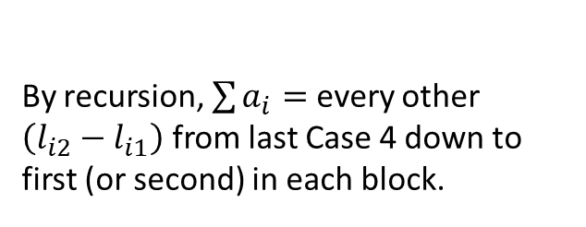














By recursion, $\sum{a_{i}}=$ every other $\left(l_{i2}−l_{i1}\right)$ from last Case 4 down to first (or second) in each block.
Suppose job 1 follows job 2 and so on and that we start at the beginning of a block:
Case 4 (job 1):
Case 4 (job 2):
Case 4 (job 3):
(increasing difference between leaves)
$$l_{12}−l_{11}≤l_{22}−l_{21}$$
$$\left(l_{22}−l_{21}\right)−\left(l_{12}−l_{11}\right)≤\left(l_{32}−l_{31}\right)$$
$$C_{1}=s_{0}+l_{12}$$
$$C_{2}=s_{0}+l_{11}+l_{22}$$
$$C_{3}=s_{0}+l_{12}+l_{21}+l_{32}$$
$$s_{1}=s_{0}+l_{11}$$
$$s_{2}=s_{0}+l_{12}+l_{21}$$
$$s_{3}=s_{0}+l_{11}+l_{22}+l_{31}$$
$$a_{1}=\left(l_{12}−l_{11}\right)$$
$$a_{2}=\left(l_{22}−l_{21}\right)−\left(l_{12}−l_{11}\right)$$
$$a_{3}=\left(l_{32}−l_{31}\right)−\left(l_{22}−l_{21}\right)+\left(l_{12}−l_{11}\right)$$
Case 3 (job 2):
(decreasing difference between leaves)
Case 3 (job 3):
$$l_{22}−l_{21}≤l_{12}−l_{11}≤l_{21}+l_{22}$$
$$C_{2}=s_{0}+\frac{1}{2}(l_{12}+l_{11}+l_{21}+l_{22})$$
$$l_{32}−l_{31}≤\left(l_{22}−l_{21}\right)−\left(l_{12}−l_{11}\right)≤l_{31}+l_{32}$$
$$s_{j}=s_{0}+\frac{1}{2}(l_{12}+l_{11}+l_{21}+l_{22})$$
$C_{3}=s_{0}+\frac{1}{2}(l_{11}+l_{12}+l_{21}+l_{22}+l_{31}+l_{32})$
$s_{3}=s_{0}+\frac{1}{2}(l_{11}+l_{12}+l_{21}+l_{22}+l_{31}+l_{32})$
$$a_{j}=0$$
$$a_{3}=0$$
If a 4-3 block is in the optimal Solution, then from swapping:
$$l_{12}≤l_{22}$$
(size of largest leaf increases)
→ (size of smallest leaf increases more)

Slide 26


































Conditions that guarantee each job is in Case 3 or 4 for any permutation:
Make $r=l_{1}$
For some integer $b$:
$$max\left\{l_{2}\right\}≤b≤min\left\{l_{1}+l_{2}\right\}$$
Case 4 can put $l_{1}$ on Machine 1
Case 4 can put $l_{1}$ on Machine 2
Case 4: $0≤a≤l_{2}−l_{1}$
$$s$$
$$a$$
$$l_{1}$$
$$r=l_{1}$$
$$s$$
$$a$$
$$r=l_{1}$$
$$c=s+l_{1}+l_{2}$$
$$s^{′}=s+l_{1}+a$$
$$a^{′}=l_{2}−a$$
$$l_{2}$$
$$l_{2}$$
$$l_{1}$$
Case 3 can put $l_{1}$ on Machine 2
Case 3: $l_{2}−l_{1}≤a≤l_{1}+l_{2}$
$$s$$
$$a$$
$$l_{1}$$
$$r=l_{1}$$
$$s$$
$$a$$
$$r=l_{1}$$
$c=s+l_{1}+l_{2}+\frac{1}{2}(a+l_{1}−l_{2})$
$s^{′}=s+l_{1}+a−\frac{1}{2}(a+l_{1}−l_{2})$
$$l_{2}$$
$$l_{2}$$
$$l_{1}$$
$$a^{′}=l_{2}−a+\left(a+l_{1}−l_{2}\right)$$

Slide 27
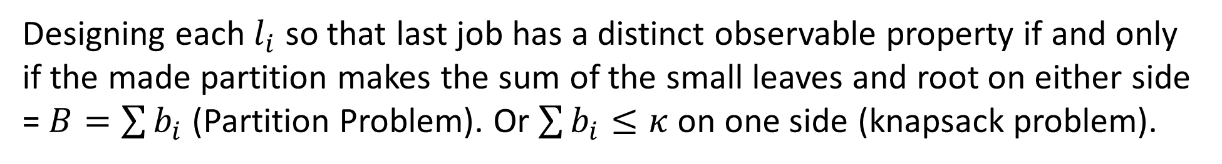
Designing each $l_{i}$ so that last job has a distinct observable property if and only if the made partition makes the sum of the small leaves and root on either side = $B=\sum{b_{i}}$ (Partition Problem). Or $\sum{b_{i}}≤κ$ on one side (knapsack problem).

