Slide 1
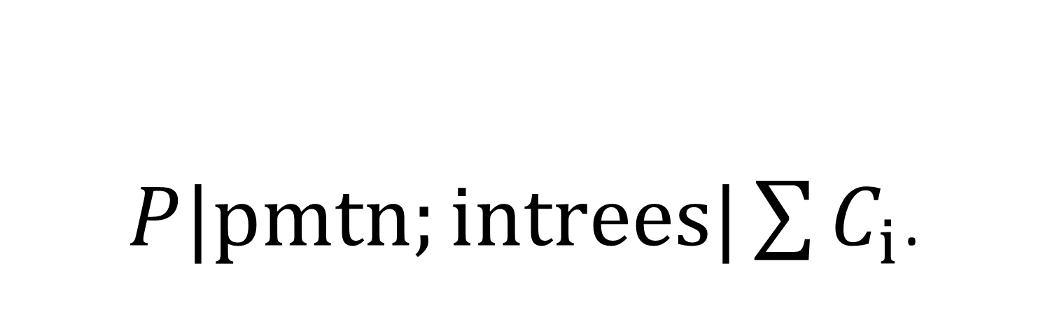
$P|pmtn;intrees|\sum{C_{i}}$.
Shortest Remaining Processing Time (SRPT)
Counter-Example and Lower Bound

Slide 2
One in-tree, with machine availabilities:
Already solved by:
Liu, Zhen, and Eric Sanlaville. "Preemptive scheduling with variable profile, precedence constraints and due dates." Discrete Applied Mathematics 58.3 (1995): 253-280.
which is based on:
Muntz, Richard R., and Edward G. Coffman Jr. "Preemptive scheduling of real-time tasks on multiprocessor systems." Journal of the ACM (JACM) 17.2 (1970): 324-338.
Uses the scheduling rule: Longest Remaining Path (LRP) – dynamic priority scheduling
Optimal for minimizing the makespan of an in-tree when the machine availability is an increasing “zigzag”.

Slide 3






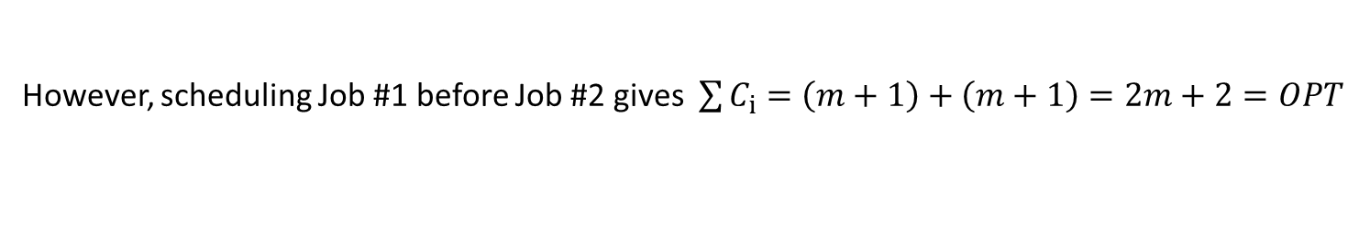

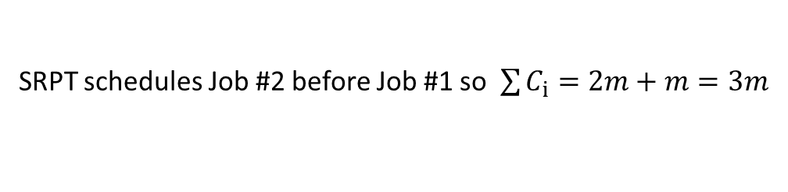
SRPT bad example, metric = height
$m≥2$ identical machines
2 jobs: each with in-tree precedence constraints between tasks. Unit size tasks (except last one of Job #2).
Job #1:
$$m$$
$$m$$
Height = $m+1$ = min time to process
Job #2:
$$m−1$$
(Size = 0)
Height = $m$ = min time to process
$$m$$
SRPT schedules Job #2 before Job #1 so $\sum{C_{i}}=2m+m=3m$
However, scheduling Job #1 before Job #2 gives $\sum{C_{i}}=\left(m+1\right)+\left(m+1\right)=2m+2=OPT$
Therefore, Approximation Ratio $≥\frac{3m}{2m+2}=\frac{3}{2}\left(1−\frac{1}{m+1}\right)$ which approaches $\frac{3}{2}$ as $m→∞$.

Slide 4
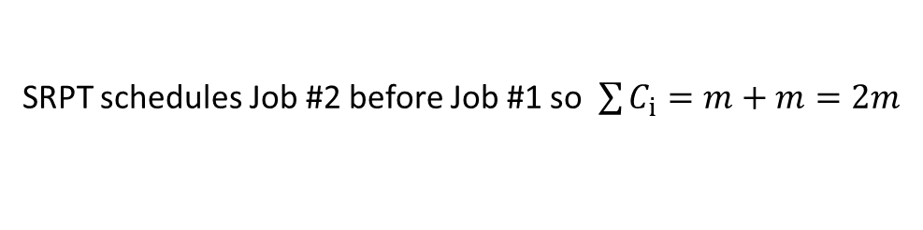



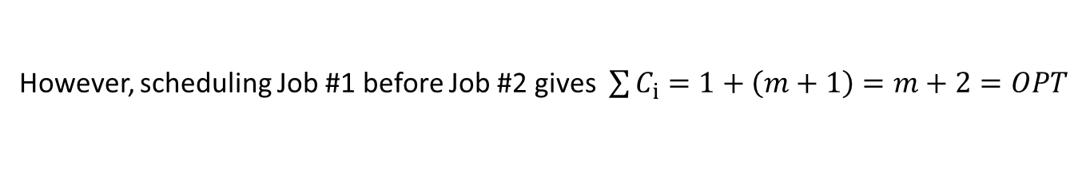
SRPT bad example, metric = width
$m≥2$ identical machines
2 jobs: each with in-tree precedence constraints between tasks. Unit size tasks except the last task.
Job #1:
(Size = 0)
$$m$$
Width = $m$
Job #2:
$$m−1$$
(Size = 0)
Width = $m−1$
$$m$$
SRPT schedules Job #2 before Job #1 so $\sum{C_{i}}=m+m=2m$
However, scheduling Job #1 before Job #2 gives $\sum{C_{i}}=1+\left(m+1\right)=m+2=OPT$
Therefore, Approximation Ratio $≥\frac{2m}{m+2}=2\left(1−\frac{2}{m+2}\right)$ which approaches 2 as $m→∞$.

Slide 5
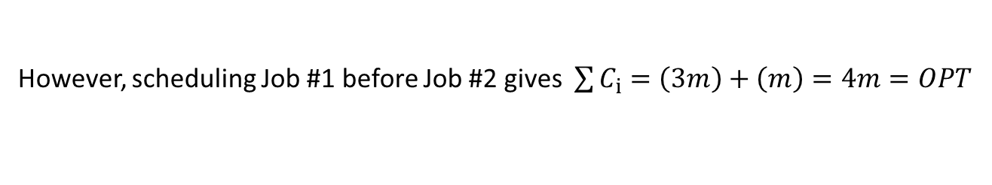
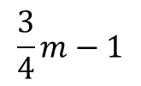
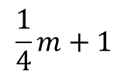
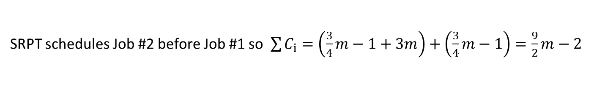






SRPT bad example, metric = total processing time
$m≥4$ identical machines, $m$ is a multiple of 4, Unit size tasks (except last task of the jobs)
Job #1:
Height = $3m$ = min time to process
$$\frac{1}{4}m+1$$
(Size = 0)
Total processing time = $\frac{3}{4}m^{2}+3m$
Job #2:
$$3m$$
Height = $\frac{3}{4}m−1$= min time to process
(Size = 0)
Total processing time = $\frac{3}{4}m^{2}−m$
$$m$$
$$\frac{3}{4}m−1$$
SRPT schedules Job #2 before Job #1 so $\sum{C_{i}}=\left(\frac{3}{4}m−1+3m\right)+\left(\frac{3}{4}m−1\right)=\frac{9}{2}m−2$
However, scheduling Job #1 before Job #2 gives $\sum{C_{i}}=\left(3m\right)+\left(m\right)=4m=OPT$
Therefore, Approximation Ratio $≥\frac{\frac{9}{2}m−2 }{4m}=\frac{9}{8}−\frac{1}{2m}$ which approaches $\frac{9}{8}$ as $m→∞$.

Slide 6
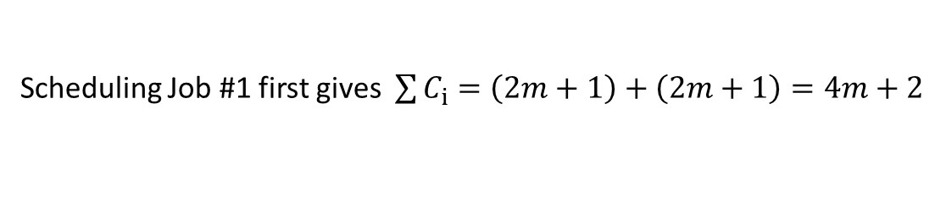



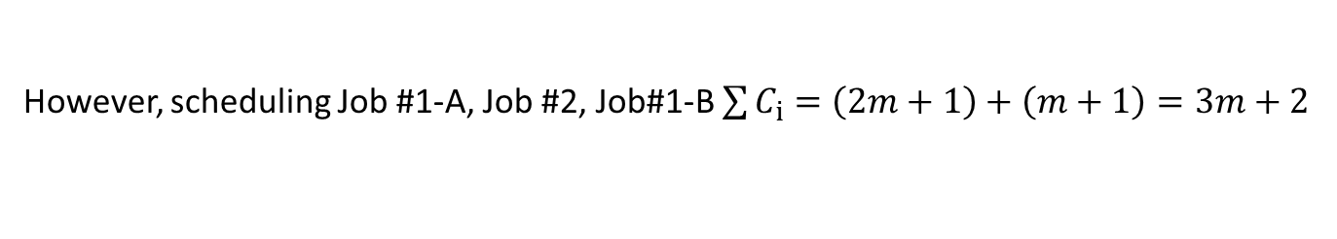


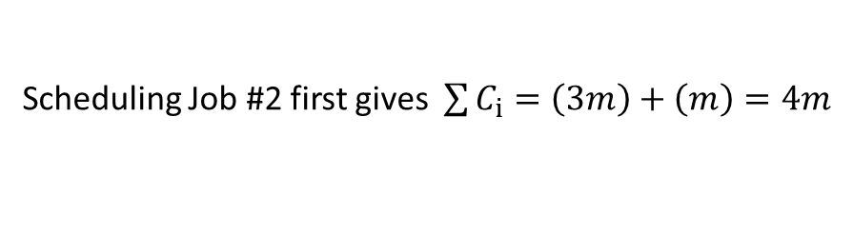
Job ordering bad example
$m≥2$ identical machines, Unit size tasks (except last task of the jobs)
Section A:
Section B:
Job #1:
$$m$$
(Size = 0)
$$m$$
Job #2:
$$m$$
$$m−1$$
(Size = 0)
$$m$$
Scheduling Job #1 first gives $\sum{C_{i}}=\left(2m+1\right)+\left(2m+1\right)=4m+2$
Scheduling Job #2 first gives $\sum{C_{i}}=\left(3m\right)+\left(m\right)=4m$
However, scheduling Job #1-A, Job #2, Job#1-B $\sum{C_{i}}=\left(2m+1\right)+\left(m+1\right)=3m+2$
Therefore, Approximation Ratio $≥\frac{4m+2 }{3m+2}=\frac{4}{3}\left(1−\frac{1}{2\left(3m+2\right)}\right)$ which approaches $\frac{4}{3}$ as $m→∞$.

Slide 7




Star in-trees,
$h_{j}^{i}$ = height of branch $i$ of job $j$
(Size = 0)
Convert into boxes with increasing (integer) widths:
$$l_{j}^{1}$$
$$l_{j}^{2}$$
$$l_{j}^{b_{j}}$$
The boxes when scheduled can be split into slices and put in any order but no two slices can be scheduled at the same time.

Slide 8


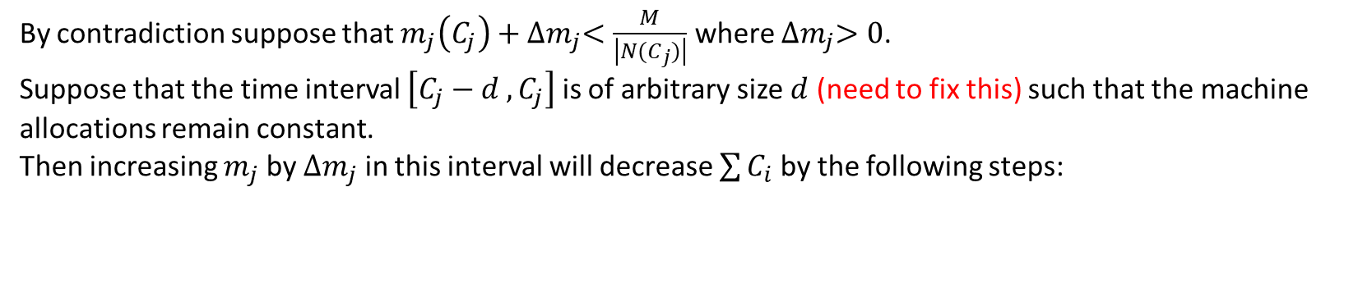
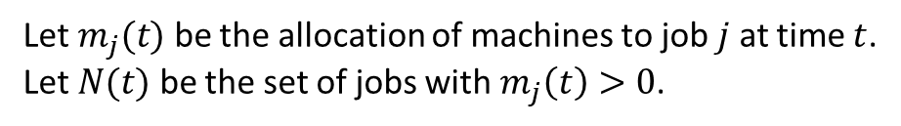
In-trees with box shape:
$$w_{j}$$
(Size = 0)
$$l_{j}$$
Let $m_{j}(t)$ be the allocation of machines to job $j$ at time $t$.
Let $N(t)$ be the set of jobs with $m_{j}\left(t\right)>0$.
Theorem 1: In an optimal schedule, for job $j$ such that $m_{j}\left(C_{j}\right)<w_{j}$, then
$m_{j}\left(C_{j}\right)≥\frac{M}{\left|N\left(C_{j}\right)\right|}$.
Proof:
By contradiction suppose that $m_{j}\left(C_{j}\right)+{∆m}_{j}<\frac{M}{\left|N(C_{j})\right|}$ where ${∆m}_{j}>0$.
Suppose that the time interval $\left[C_{j}−d ,C_{j}\right]$ is of arbitrary size $d$ (need to fix this) such that the machine allocations remain constant.
Then increasing $m_{j}$ by ${∆m}_{j}$ in this interval will decrease $\sum{C_{i}}$ by the following steps:

Slide 9

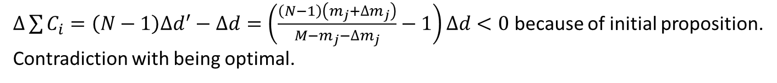



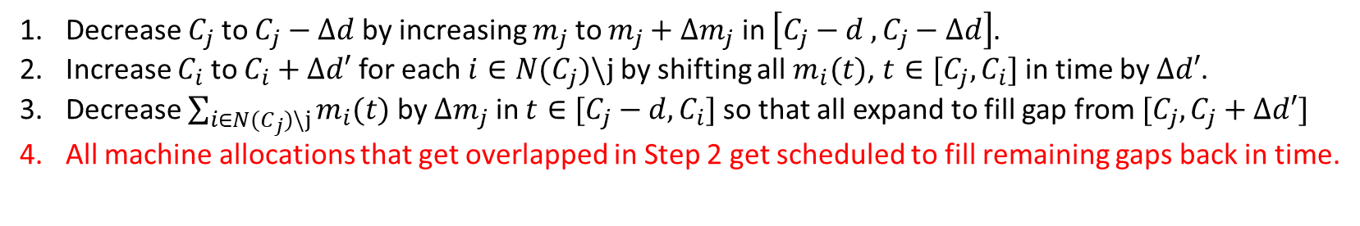






Decrease $C_{j}$ to $C_{j}−∆d$ by increasing $m_{j}$ to $m_{j}+{∆m}_{j}$ in $\left[C_{j}−d ,C_{j}−∆d\right]$.
Increase $C_{i}$ to $C_{i}+∆d′$ for each $i∈N(C_{j})\backslash j$ by shifting all $m_{i}(t)$, $t∈[C_{j},C_{i}]$ in time by $∆d′$.
Decrease $\sum_{i∈N(C_{j})\backslash j}{m_{i}(t)}$ by ${∆m}_{j}$ in $t∈[C_{j}−d,C_{i}]$ so that all expand to fill gap from $[C_{j},C_{j}+∆d′]$
All machine allocations that get overlapped in Step 2 get scheduled to fill remaining gaps back in time.
$$d$$
$$C_{j}$$
Because the areas must remain equal:
$$m_{j}$$
$$Md=\left(d−∆d\right)\left(m_{j}+{∆m}_{j}\right)+(d+∆d^{′})(M−m_{j}−{∆m}_{j})$$
Which becomes:
$$∆d\left(m_{j}+{∆m}_{j}\right)=∆d^{′}(M−m_{j}−{∆m}_{j})$$
$$d−∆d$$
$$∆d$$
$$∆d′$$
$$m_{j}+{∆m}_{j}$$
$$∆d′$$
$$∆d′$$
$∆\sum{C_{i}}=\left(N−1\right)∆d^{′}−∆d=\left(\frac{\left(N−1\right)\left(m_{j}+{∆m}_{j}\right)}{M−m_{j}−{∆m}_{j}}−1\right)∆d<0$ because of initial proposition.
Contradiction with being optimal.

Slide 10








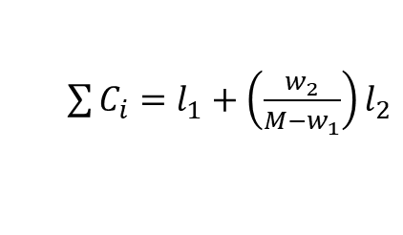


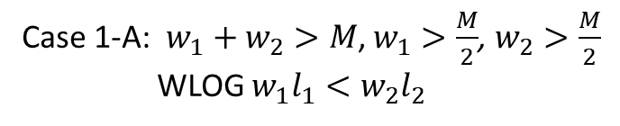
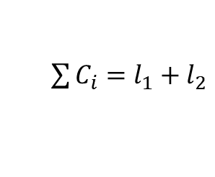
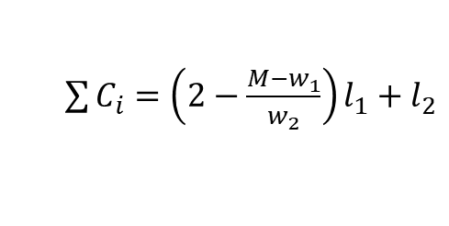
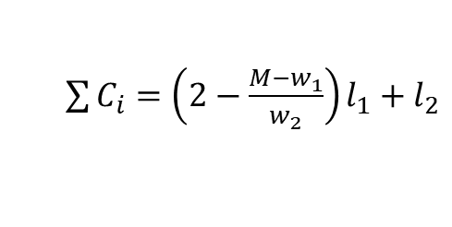



In-trees with box shape:
$$w_{i}$$
(Size = 0)
Case 2: $w_{1}+w_{2}<M$
2 jobs, $M$ machines:
$$l_{i}$$
$\sum{C_{i}}=l_{1}+l_{2}$
Case 1-A: $w_{1}+w_{2}>M$, $w_{1}>\frac{M}{2}$, $w_{2}>\frac{M}{2}$
WLOG $w_{1}l_{1}<w_{2}l_{2}$
(priority given to jobs with smaller total processing time)
$$w_{1}$$
1
1
$$w_{2}$$
2
$$w_{1}$$
$\sum{C_{i}}=\left(2−\frac{{M−w}_{1}}{w_{2}}\right)l_{1}+l_{2}$
2
$$w_{2}$$
Case 1-B: $w_{1}+w_{2}>M$, $w_{1}<\frac{M}{2}$, $w_{2}>\frac{M}{2}$
(priority given to jobs that require less machines than equal allocation)
$$w_{1}$$
1
$$w_{1}$$
1
$\sum{C_{i}}=\left(2−\frac{{M−w}_{1}}{w_{2}}\right)l_{1}+l_{2}$
$\sum{C_{i}}=l_{1}+\left(\frac{w_{2}}{{M−w}_{1}}\right)l_{2}$
2
2
$$M−w_{1}$$
$$w_{2}$$

Slide 11




Next step, in-trees with staircase shape:
(leaves still all have same height)
$$l_{i}^{1}$$
$$w_{i}$$
$$l_{i}^{j}$$
$$l_{i}^{w_{i}}$$
Extend analysis for box in-trees to find optimal scheduling rules related to priority of jobs, e.g.:
require less machines than equal allocation
smaller processing time

Slide 12
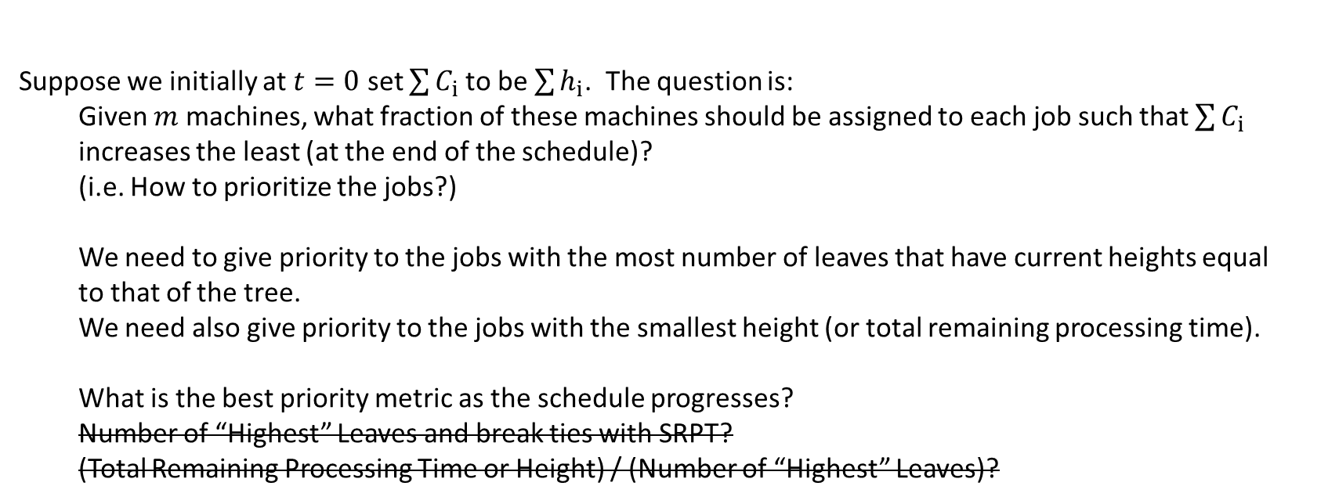
Plan for multiple in-trees:
Suppose we initially at $t=0$ set $\sum{C_{i}}$ to be $\sum{h_{i}}$. The question is:
Given $m$ machines, what fraction of these machines should be assigned to each job such that $\sum{C_{i}}$ increases the least (at the end of the schedule)?
(i.e. How to prioritize the jobs?)
We need to give priority to the jobs with the most number of leaves that have current heights equal to that of the tree.
We need also give priority to the jobs with the smallest height (or total remaining processing time).
What is the best priority metric as the schedule progresses?
Number of “Highest” Leaves and break ties with SRPT?
(Total Remaining Processing Time or Height) / (Number of “Highest” Leaves)?

Slide 13
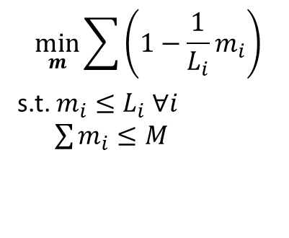
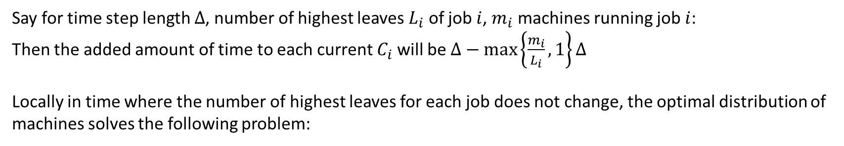
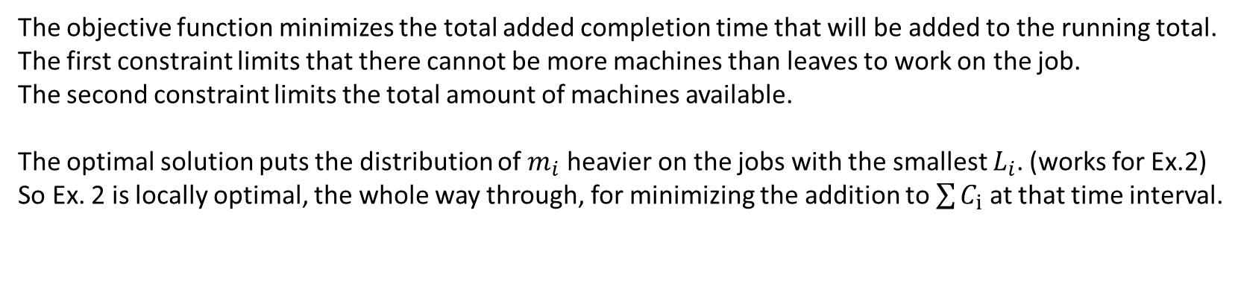
Say for time step length $∆$, number of highest leaves $L_{i}$ of job $i$, $m_{i}$ machines running job $i$:
Then the added amount of time to each current $C_{i}$ will be $∆−max\left\{\frac{m_{i}}{L_{i}}, 1\right\}∆$
Locally in time where the number of highest leaves for each job does not change, the optimal distribution of machines solves the following problem:
$$\min_{m}{\sum{\left(1−\frac{1}{L_{i}}m_{i}\right)}}$$
s.t. $m_{i}≤L_{i} ∀i$
$\sum{m_{i}}≤M$
The objective function minimizes the total added completion time that will be added to the running total.
The first constraint limits that there cannot be more machines than leaves to work on the job.
The second constraint limits the total amount of machines available.
The optimal solution puts the distribution of $m_{i}$ heavier on the jobs with the smallest $L_{i}$. (works for Ex.2)
So Ex. 2 is locally optimal, the whole way through, for minimizing the addition to $\sum{C_{i}}$ at that time interval.

