Slide 1
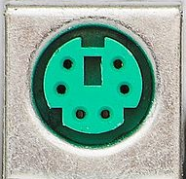

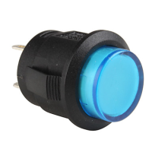
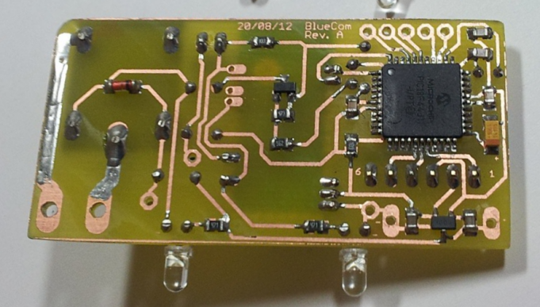
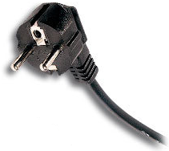
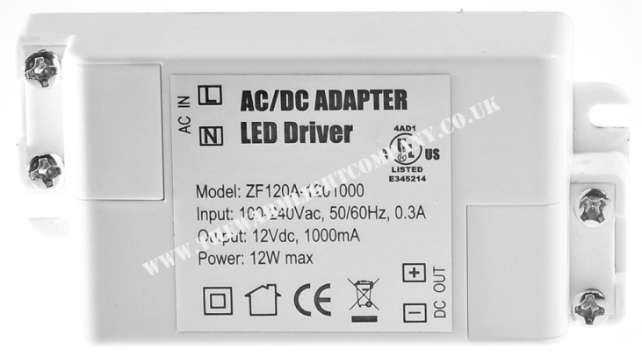
Connector for RGB LED projector
12 V
230V Output
3 pwm output (RGB)
10K
10K
3,3V
Relay cmd
Manual cmd for relay output
Manual cmd for RGB LED output
230V input
12->5V (7805)
5V
12V

Slide 2
1
+3,3V
Connecteur barrette male 8pts
10K
10K
PIC IN : RC2
2
Push button Sortie 1
Push button Sortie 2
PIC IN : RC3
3
GND
4
Led blue bluetooth
BC846 Collector
5
Led green Sortie 2 (RGB LED )
680
PIC OUT : RB3
6
7
+5V
BLUETOOTH LED
8
Led green Sortie 1 (220V)
470

