Slide 1
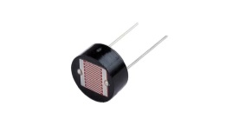
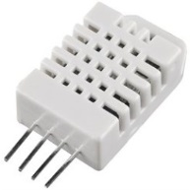
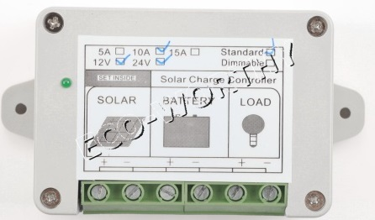
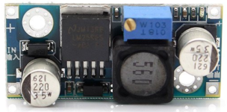
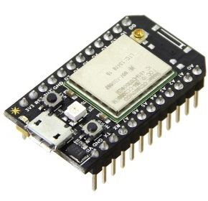
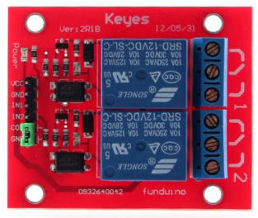
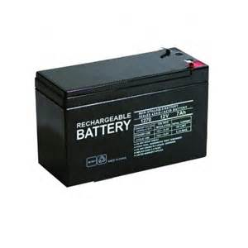
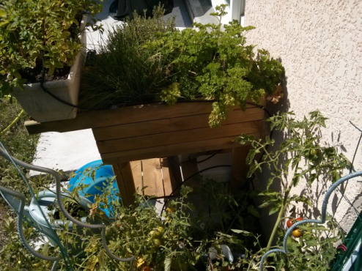
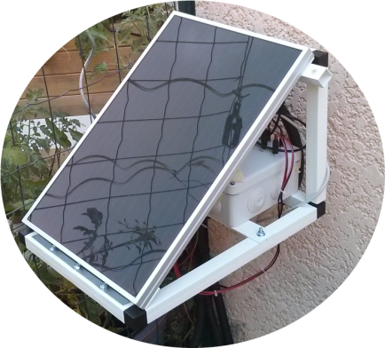
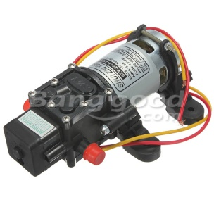
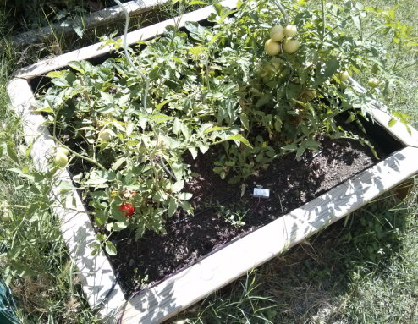
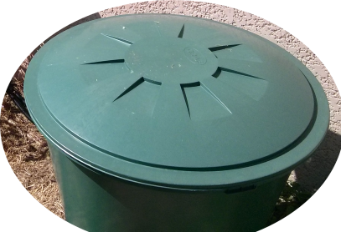
Light sensor (Photoresistor)
Temperature/humidity sensor (DHT22)
10A Solar regulator
DC/DC Converter
5V
Battery level
2 Soil moisture sensor
12V
5V
Spark core module + electronic board
Double relay board
Battery 12V 7Ah
12V Water Pump
Tomato
12V Solar Panel
Water
Water Reserve
Water Temperature + Water Level (MCP9700 + 2 wires)
©www.jc-omega.com 22-07-2014

