Slide 1
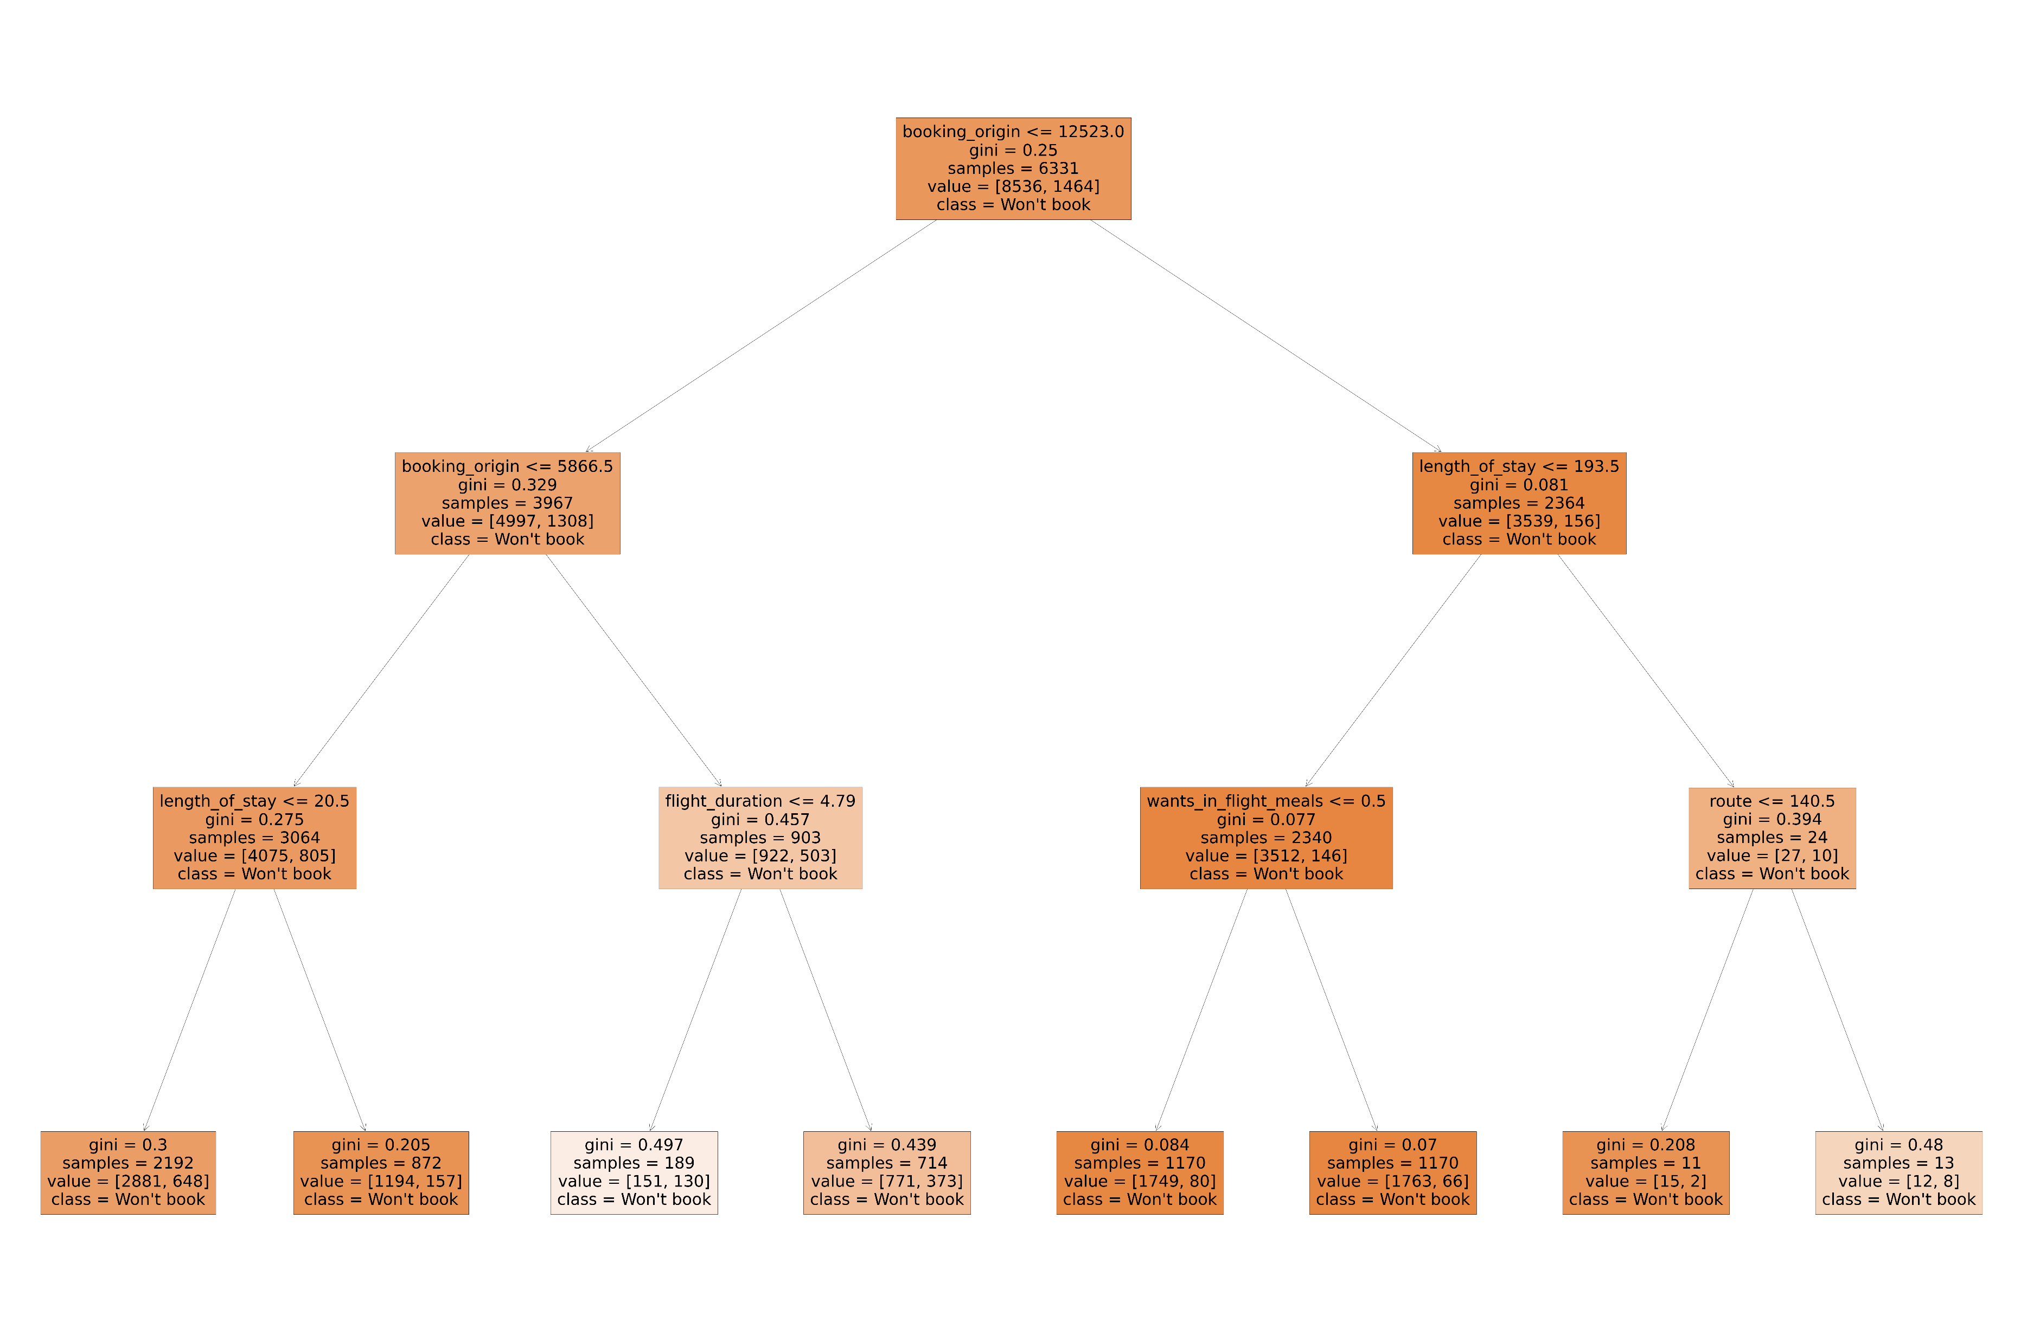
Task 2 Findings
The plot tree shows the conditions on which a customers are most likely to book or not book. As you can see almost all customers are likely to not too book, however, the opacity of the colour orange represents the likeliness not to book.
The model shows that people who whose length of stay is less than 193.5 days and those who don’t want in flight meals are less likely to book, and those who have flight durations under 4.79 hours and book in a country with less that 5867 instances in the data set are most likely to book a flight.
We can expand the depth of the RandomForest tree to draw more meaningful conclusions.

