Slide 1
Oliver Wyman Food Waste Data Challenge

Slide 2
How is food waste data presented in the UK?
First it may be beneficial to understand how food waste data is presented in the UK.
The ONS defines “food as any substance (whether processed, semi-processed, or raw) that is intended for human consumption. “Inedible parts” are components associated with a food that, in a particular food supply chain, are not intended to be consumed by humans. It is estimated that 70% of this total was intended to be consumed by people with the other 30% classified as inedible parts”.
One problem I can see here is a large minority of the food waste is “inedible parts” such as bones and egg shells which will be near impossible to avoid going to waste so it is important for the UK to try and decrease the proportion of their food waste.

Slide 3
Estimating Food Waste for 2030
According to the ONS, there was a decrease in food waste per person per year from 181kg per person in 2007 to 143kg per person per year. This is equivalent to 2.12% decrease per year.
Assuming we maintain this rate until 2030, this would put the food waste per person to 111kg.
The UK is part of the United Nations SDG (set out in September 2015) which is to halve food waste per capita by 2030. I think it may be more beneficial to use the rates of food waste decrease since this was set out since there have been more initiatives to reduce food waste since then [insert some examples]. I think this makes our previous assumed rate of decrease inaccurate.
Between 2015 and 2018, the decrease was 7% or per 2.23% per year on average (according to WRAP) which is a slight increase from the rate of 2.08% (2007 to 2015) before the UN SDG was set out.
Therefore using the 2.23% decrease per year from 2018 to 2030, we get 109kg per person. Using the ONS mid-2030 population estimate of 69.2 million, this would gives us an expected total food waste of 7.5428 million tonnes

Slide 4
Calculations for our estimate

Slide 5
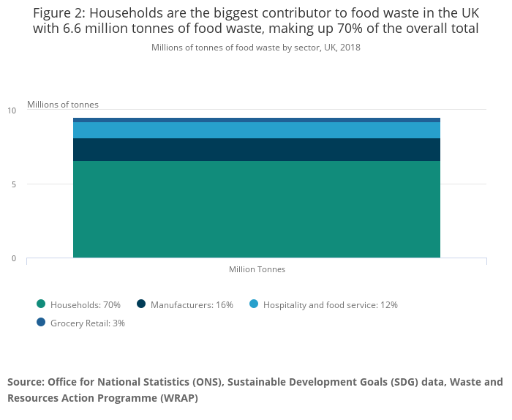
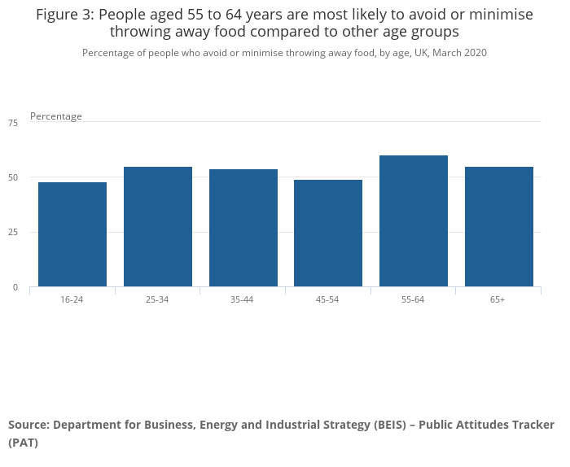
Understanding our food waste
First, let’s understand the problem of food waste in the UK and where the biggest areas of food waste are by looking at the figures provided on the ONS “Household behaviour in relation to food waste, recycling, energy use and air travel”.
Clearly, from figure 2 we can see that 70% of the food waste comes from household waste so it is going to be important to change householders’ attitudes towards food waste while grocery retailers (such as Greggs) forms a small minority to the UK’s food waste.
Another finding from the data, is that the older generations particularly the 55-64 years range avoid minimising food waste the least with 60% compared to the youngest generation of 16-24 with 48%
Therefore, the best areas to target to immediately reduce food waste is households and particularly the older generation. However, we want there to be longevity in the food waste reduction (especially given the UK is part of the UNSDG) so it is equally important we do not forget to target the younger generations as 48% is still a very large minority.

Slide 6
Ways to reduce Food Waste among the older generation
According to the ONS “Household behaviour in relation to food waste”, 15% of 65 years and older named climate change as there main reason for minimising food waste. Therefore, a more effective strategy for minimising food waste is to promote food waste campaigns that focus more on cost of food waste or for health reasons.
Despite, climate change being the reason for only 15% of 65+ year olds, it may be beneficial to use a more emotional route pertaining to grandchildren’s futures when raising awareness about food waste.

Slide 7
Ways to reduce Food Waste among the younger generation
A much more significant percent of 16-24 year olds (39%) say that climate change is the main reason for minimising their food waste.
Social media campaigns that emphasise the impact of not minimising food waste on gloabal warming may be an effective strategy as it seems that the younger generation care more about climate change.
Also, the government could make food waste more heavily involved into school’s curricula to raise awareness.

