Slide 1
Class 4: THE GRID AWAKENS

Slide 2
Today:
Making your GMT scripts re-usable
Grdview
an inset map
Caveat: I did not write instructions in this presentation
This presentation is not wordy at all

Slide 3
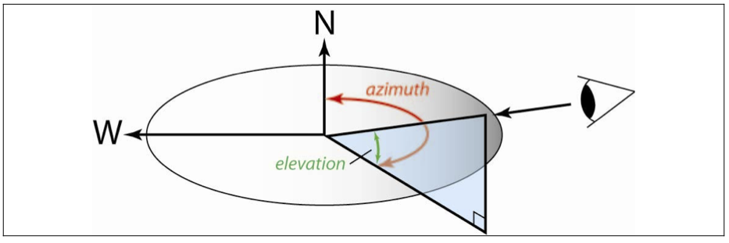
grdview
parameters with the –E flag, which has the syntax:
–Eazimuth/elevation

