Slide 2
sled
rigid truss
hitch
bladder

Slide 3





































$$Y$$
$$b$$
$$φ$$
$$x_{2}$$
$$R_{L}$$
$$F_{L}$$
$$y_{1}$$
$$x_{1}$$
$$L_{TA}$$
$$x_{1}$$
$$R_{lLF}$$
$${90}^{ο}−φ$$
$$y_{1}$$
$$x_{2}$$
$$y_{2}$$
$$x_{3}$$
$$F_{R}$$
$$L_{A}$$
$$y_{2}$$
$$R_{R}$$
$$x_{3}$$
$$x_{1}$$
$$y_{3}$$
$$R_{lRF}$$
$$R_{lLR}$$
$$y_{1}$$
$$ψ$$
$${90}^{ο}−ψ$$
$$L_{TS}$$
$$R_{lRR}$$
$$y_{3}$$
$$l$$
pin connection
$$R_{SD,X}$$
$$R_{SD,Y}$$
$$L_{SD}$$
$$θ$$
$$X$$

Slide 4

Bulldozing + Compaction Resistance
Driver
torque
Compaction
Resistance
Traction Force

Slide 5
Vehicle Weight
Driver
Torque
Compaction
Resistance
Traction Force
Lateral Resistance Force

Slide 6

Clutch Engagement Command
$$Γ$$
Engine Torque
Transmission Torque
Clutch Pack

Slide 7
Final Drive
Pump Command
Throttle
Differential
Motor
Pump
Transmission
Engine
Differential
Gear
Selection
Final Drive

Slide 8











$$+$$
$$Σ$$
PI
Tractor
10 Hz
$$−$$
10 Hz
$$+$$
$$Σ$$
PI
Tractor
1 Hz
10 Hz
$$−$$

Slide 9
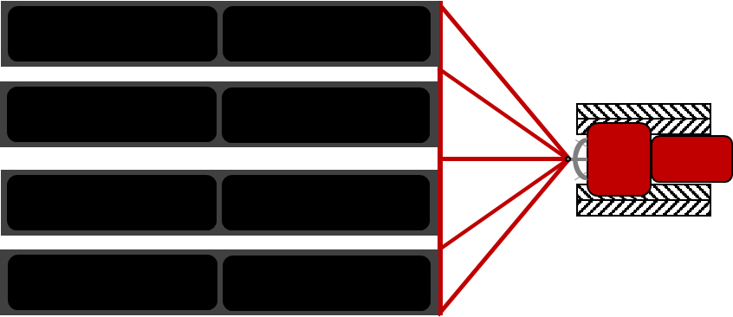
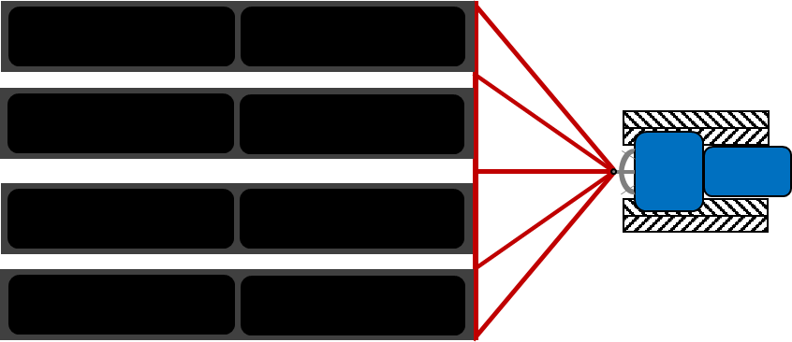
lateral
offset
leader trajectory
look ahead distance
heading
error
follower waypoints

