Slide 1
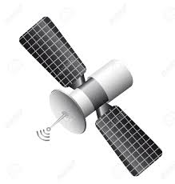

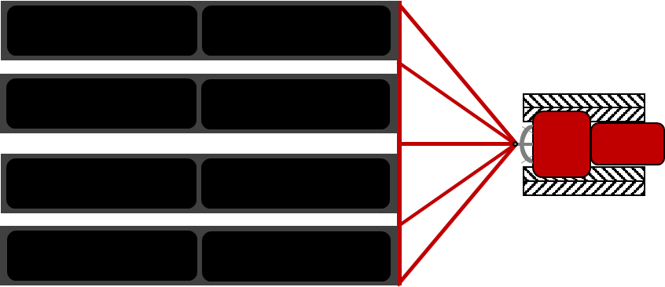
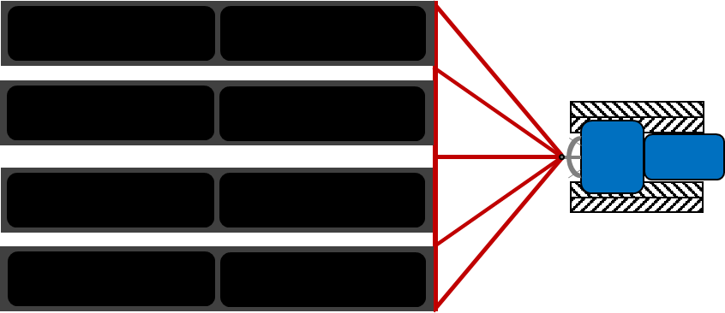
GPS
lateral
offset
CAN data
leader trajectory
look ahead distance
heading
error
follower waypoints

