Slide 1
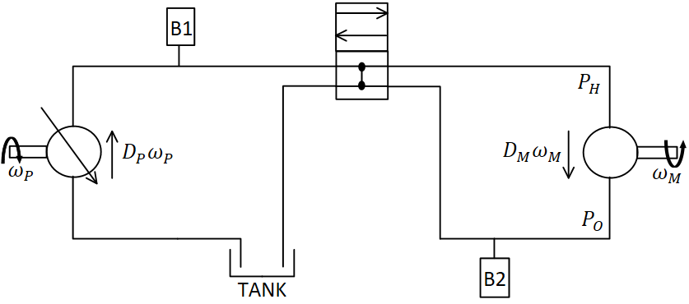










$$P_{H}$$
B1
$$D_{M}ω_{M}$$
$$D_{P}ω_{P}$$
B2
$$ω_{P}$$
$$ω_{M}$$
$$P_{O}$$
TANK
$$P_{H}$$
B1
$$D_{M}ω_{M}$$
$$D_{P}ω_{P}$$
B2
$$ω_{P}$$
$$ω_{M}$$
$$P_{O}$$
TANK

