Slide 1
Connected Car Delivering Real-Time Insights with an Enterprise Data Hub
Jonathan Cooper-Ellis

Slide 2
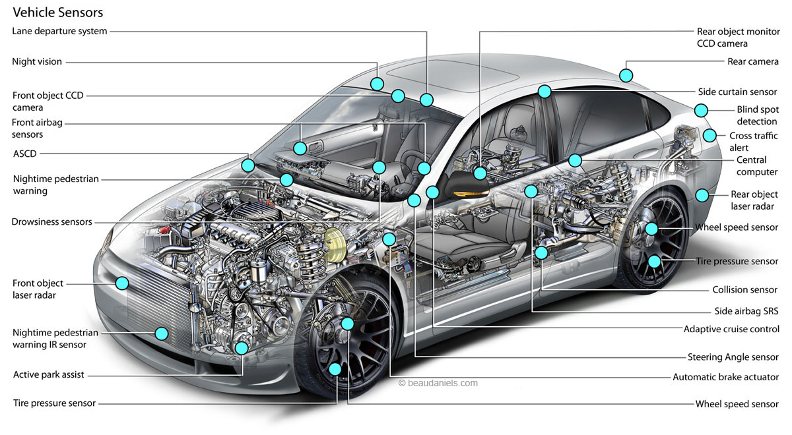
The Connected Car Paradigm
By 2020, there will be 250 Million connected vehicles on the road globally
– Gartner & Connected Vehicle Trade Association
75% of new cars shipped in 2020 will have internet connectivity
- Business Intelligence
Vehicles currently on the road have 60 – 100 sensors onboard. This number is projected to increase to 200+ by the year 2020.
- Sources: Gartner, Strategy&, Mems Journal
Notes:
The Connected cars segment presents a tremendous market opportunity– one of the leading growth areas within the IoT domain.
Sources:
Image: http://automotive-engineering-illustration.com/Vehicle-sensors.html
Sensor Numbers are from Mems Journal 2015

Slide 3


Connected Car - Key Segments/Use Cases
Vehicle Management
Functions that reduce overall costs and improve comfort
Mobility Management
Functions that enable drivers to reach a destination quickly & effectively
Vehicle condition & performance, service reminders, remote mgmt., telematics etc.
Real-time traffic information displays, parking lot or garage assistance etc.
Safety
Functions that warn drivers of external hazards
Autonomous Driving
Operation of the vehicle without a human driver at the controls
Collision avoidance, hazard warning signals and emergency call functions
Self-parking cars, self driving mode, motorway assistance etc.
Driver Well-Being
Functions that improve drivers comfort and ability to drive
Entertainment
Functions involving entertainment of driver and passengers
Fatigue detection & alerting and other forms of individual assistance
Smartphone interfaces, streaming videos & access to social networks
Source: Strategy&, 2015
Notes:
Vehicle management: Support for minimizing operating cost and increasing comfort. Examples include vehicle condition & service reminders, remote monitoring/ operations, telematics etc.
Mobility management: Guidance on faster, safer, more economical, and more fuel-efficient driving, based on data gathered for the vehicle. Examples include real-time traffic information displays, parking lot or garage assistance etc.
Safety: The ability to warn the driver of road problems and automatically sense and prevent potential collisions. Examples include collision avoidance features, danger warning signals and emergency call functions
Autonomous driving: Operation of the vehicle without a human driver at the controls, existing only on a partial basis. Examples include self-parking cars, auto driving mode, motorway assistance, and the transportation of goods by trucks on well-delineated routes.
Well-being: Optimization of the driver’s health and competence. Examples include electronic alerts that detect or mitigate fatigue, fatigue detection & alerting and other forms of individual assistance.
Entertainment: Functions that provide music and video to passengers and the driver. Examples include smartphone interfaces, Wi-Fi or Local Area Network hotspots, access to social networks, and the “mobile office.”
Home integration: Links to homes, offices, and other buildings. Examples include the integration of the automobile into home alarms or energy monitoring systems.

Slide 4










Data from Connected Cars
25GB
Significant Data Volumes
25 GB per hour per car
130 TB per year per car
per hour
Data Variety
Streaming (Real-Time)
Batch
Multiple Formats
Diverse Data Types
Data from ECUs
RPM, Speed, Fuel Efficiency, Temp, Pressure, Braking…
Location Data
Safety Data
V2V and V2I
Video
130TB
Data Sources
ECU (Electronic Control Units)
Vehicle Plug-ins
Head units
Cameras
per car, per year
Notes:
Characteristics of Data from connected cars:
Data Volumes: According to experts, the connected car of the future will send 25 Gigabytes of data to the cloud every hour, representing up to 130 Terabytes of primary data storage per car, per year.
Read more: http://telematicswire.net/every-connected-car-will-send-130tb-of-data-per-year-in-future-actifio/
Diverse data types: V2V stands for Vehicle to vehicle communication & V2I is Vehicle to Infrastructure
Safety Data relating to collisions, lane departures, or any hazards

Slide 5





Cloudera Enterprise – The Data & Analytics Platform for IoT
BI Solutions
Search
Discover
EDW
Machine Learning
Real-Time Apps
Cloud
Data Ingest
Data Storage
Data Processing
Machine Learning
Real-time Analytics
Data Center
Customer (CRM), Manufacturing, Dealer Data
Internal Systems
External Sources
Notes:
Let’s take a look at how Cloudera’s EDH fits into the IoT Ecosystem
Can ingest data from multiple sources including real-time streaming sensor data
You can deploy EDH on prem (in your data center) or on hybrid cloud environments and still be able to manage it centrally
You can combine the sensor data with data other internal and external sources to drive business insights – For example if you want to combine that with weather data or real-time traffic info.
And you can serve and analyze the data in a number of different ways - integrate it with existing BI solutions, do search or machine learning or integrate it with real time applications

Slide 6



Connected Car – Demo Architecture
Connected Car Simulator
MQTT - Kafka Bridge
Streaming Data:
Time
VIN
Location
Mileage
Acceleration
Speed
Brakes applied?
Turn signal on?
Lane departed?
Collision detected?
Hazard detected?
StreamSets
Data Collector
Data Ingest & Pipeline
Cloudera Enterprise Data Hub
Enterprise Data Hub
BI & Visualization
Notes:
For our demonstration today we wont be using live vehicle data.
Instead we will be using a data generator which simulates messages and data commonly collected from vehicles. Such as vehicle position, speed, lane departure readings.
This data will be sent to Apache Kafka where it is then picked up by StreamSets.
StreamSets is an open source Data collector which allows you to easily build out & manage data pipelines for ingestion into Hadoop
One of our partners

Slide 7





Connected Car – Demo Architecture
Connected Car Simulator
#1
MQTT - Kafka Bridge
Interactive SQL Engine
Streaming Data:
Time
VIN
Location
Mileage
Acceleration
Speed
Brakes applied?
Turn signal on?
Lane departed?
Collision detected?
Hazard detected?
Search
StreamSets
Data Collector
#2
Pub-Sub Messaging System
Real-Time Processing Engine
Data Storage Layer
Data Ingest & Pipeline
Cloudera Enterprise Data Hub
Enterprise Data Hub
BI & Visualization
Notes:
What components are being used;

Slide 8

Key Use Cases Highlighted
OEMs
Insurance
Public Services
Predictive Maintenance
Usage Based Insurance
Public Services
Provide specific service recommendations based on vehicle usage and driving habits
Provide specific Insurance coverage based on specific driving habits & risk profiles
Understand traffic patterns, public safety hazards and provide recommendations accordingly

Slide 9
Thank You
Jonathan Cooper-Ellis
jce@cloudera.com

