Slide 1
DSC 530 Final
Joaquin Cordero

Slide 2
Variables
Hypothesis?
Having a lower body fat percentage determines how fit someone is by working out, I believe working out more results in a lower fat percentage.
The variables I chose to support my hypothesis are:
Age
Gender
Weight
Height
Workout Type
Fat Percentage
Workout Frequency

Slide 3
Variable Meaning
Age: This is the samples age
Gender_ID: This is the samples gender(male/female) originally ‘Gender’, however I added another column ‘Gender_ID’ for quantifiable data. ‘0’ for Male and ‘1’ for Female
Weight_lbs: Originally ‘Weight (kg)’ but I converted/added a new column ‘Weight_lbs ‘
Height_ft: Originally Height (m) but I converted/added a new column ‘Height_ft’
Workout_Type_ID: Originally Workout_Type, but I added another column to quantify the data
Strength = 0
Cardio = 1
Yoga = 2
HIIT = 3
else = -1
Fat_Percentage: This is the samples fat percentage
Workout_Frequency: This is how often the sample would workout at the gym per week

Slide 4
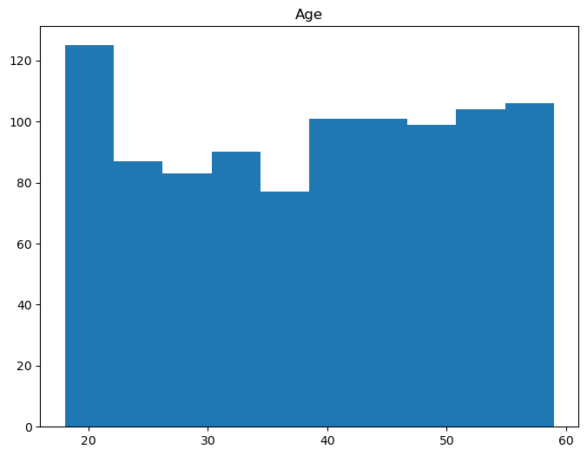
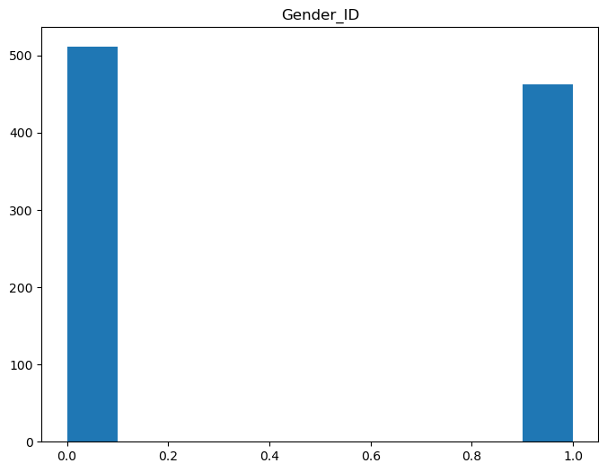
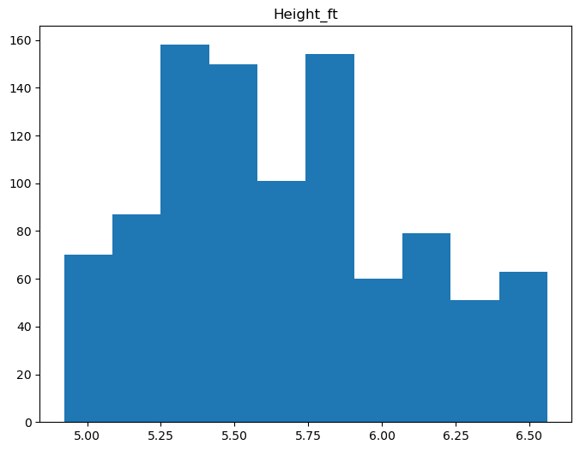
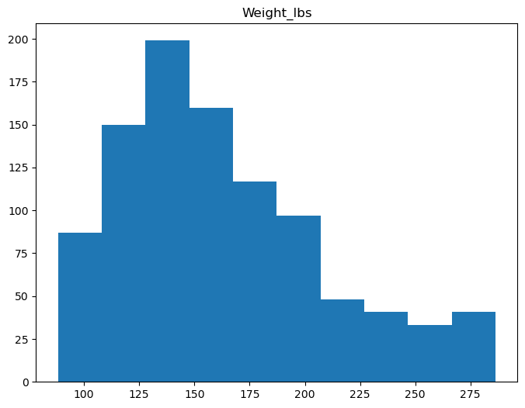
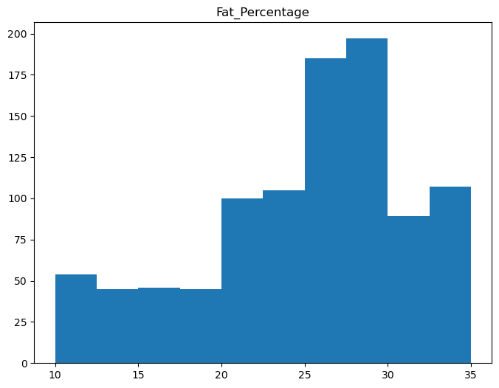
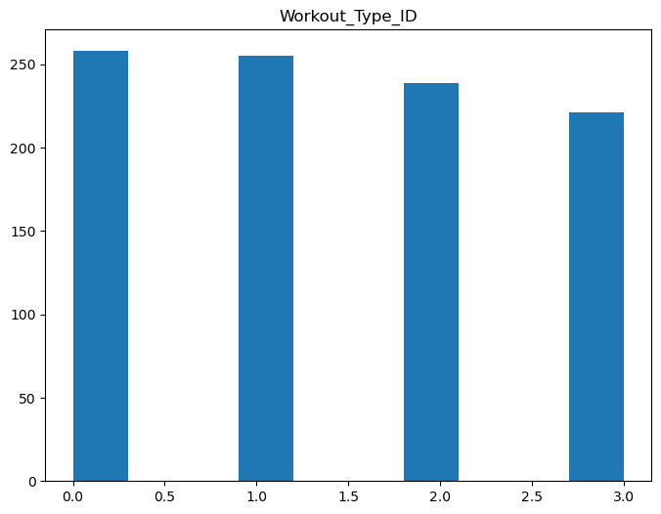
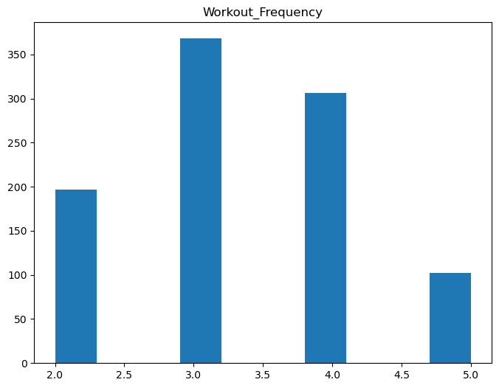
Histograms for each variable
Only minimal data cleaning was involved in the process, I checked for null values for the variables chosen and there were none. No outliers as far as the histograms shows.

Slide 5
Descriptive Characteristics of the variables
Age Mean: | 38.68
Age Mode: | 43
Age Variance: | 148.38
Age STD: | 12.18
Age Skewness: | -0.08
Age Kurtosis: | -1.22
Gender_ID Mean: | 0.47
Gender_ID Mode: | 0
Gender_ID Variance: | 0.25
Gender_ID STD: | 0.5
Gender_ID Skewness: | 0.1
Gender_ID Kurtosis: | -1.99
Weight_lbs Mean: | 162.82
Weight_lbs Mode: | 127.206574
Weight_lbs Variance: | 2185.98
Weight_lbs STD: | 46.75
Weight_lbs Skewness: | 0.77
Weight_lbs Kurtosis: | -0.02
Height_ft Mean: | 5.65
Height_ft Mode: | 5.3149608
Height_ft Variance: | 0.18
Height_ft STD: | 0.42
Height_ft Skewness: | 0.34
Height_ft Kurtosis: | -0.72
Workout_Type_ID Mean: | 1.43
Workout_Type_ID Mode: | 0
Workout_Type_ID Variance: | 1.23
Workout_Type_ID STD: | 1.11
Workout_Type_ID Skewness: | 0.08
Workout_Type_ID Kurtosis: | -1.33
Fat_Percentage Mean: | 24.98
Fat_Percentage Mode: | 28.1
Fat_Percentage Variance: | 39.18
Fat_Percentage STD: | 6.26
Fat_Percentage Skewness: | -0.64
Fat_Percentage Kurtosis: | -0.34
Workout_Frequency Mean: | 3.32
Workout_Frequency Mode: | 3
Workout_Frequency Variance: | 0.83
Workout_Frequency STD: | 0.91
Workout_Frequency Skewness: | 0.15
Workout_Frequency Kurtosis: | -0.81

Slide 6
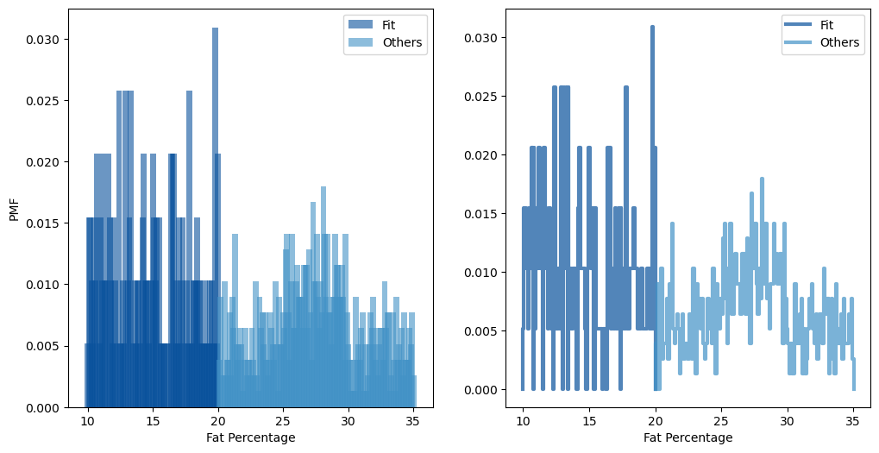
PMF of ‘Fat_Percentage’

Slide 7
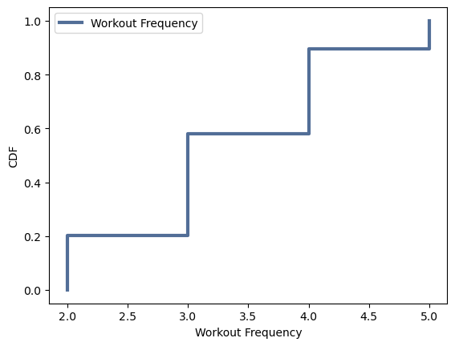
CDF of ‘Workout_Frequency’
The CDF shows that the sample’s often work out 3 or more days out the week and less of the sample's workout less than 3 days out the week.

Slide 8
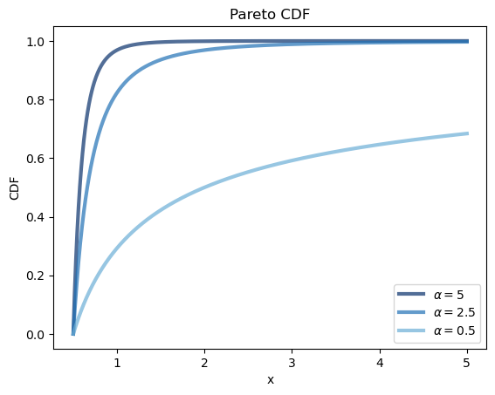
Analytical Distribution
Using Pareto CDF, the data does not follow a heavy-tailed pattern, and the distribution of values in the dataset does not support many extreme values.

Slide 9
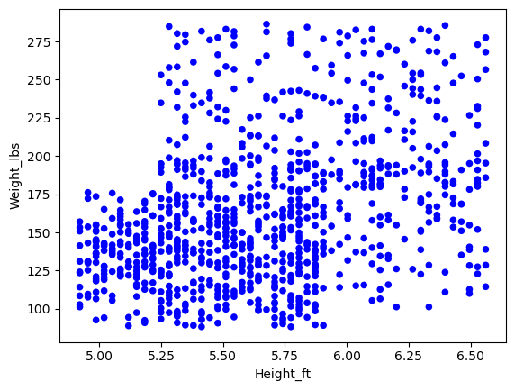
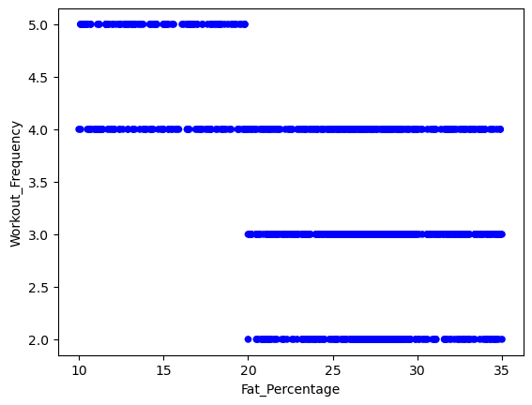
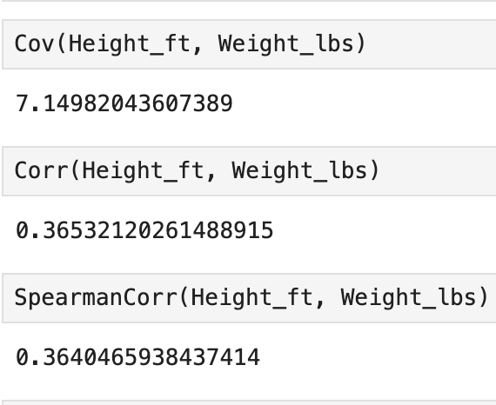
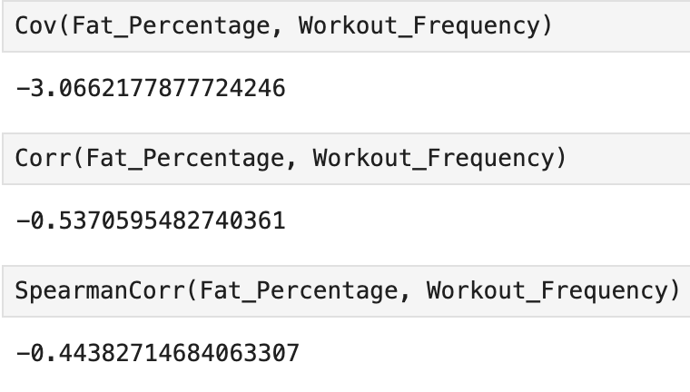
Scatter Plots, Correlation, Causation
For Height and Weight no real correlation can be determined. Where as, Fat percentage and workout frequency, we see samples that workout more frequent have lower fat percentage and samples with lower workout frequency have higher fat percentage.

Slide 10
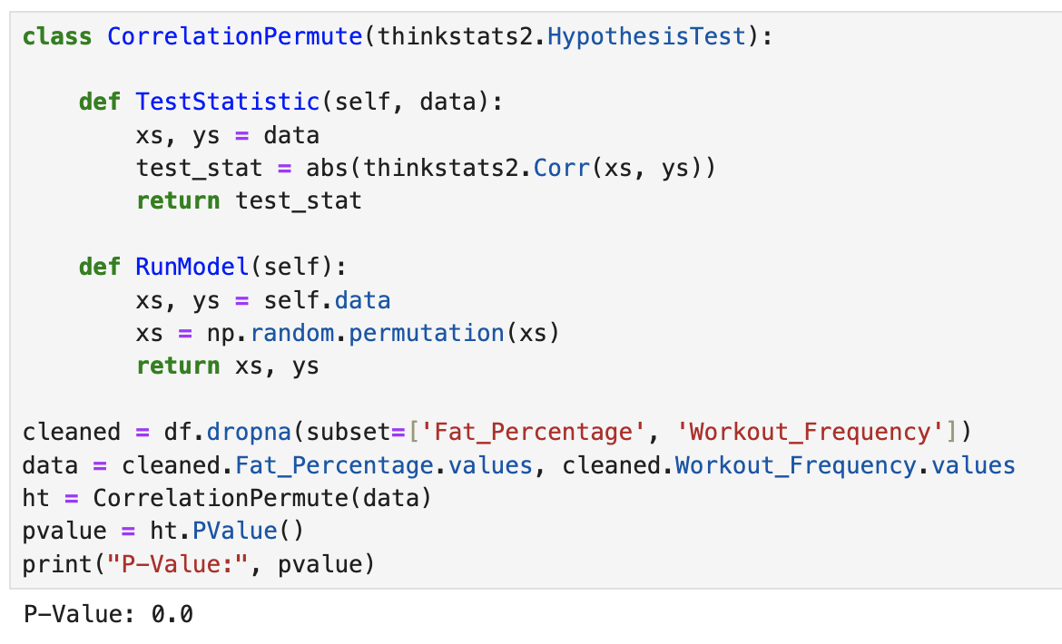
Permutation Test
Using a permutation test and having a P-Value of 0.0, we can conclude that the observed correlation is statistically significant.

Slide 11
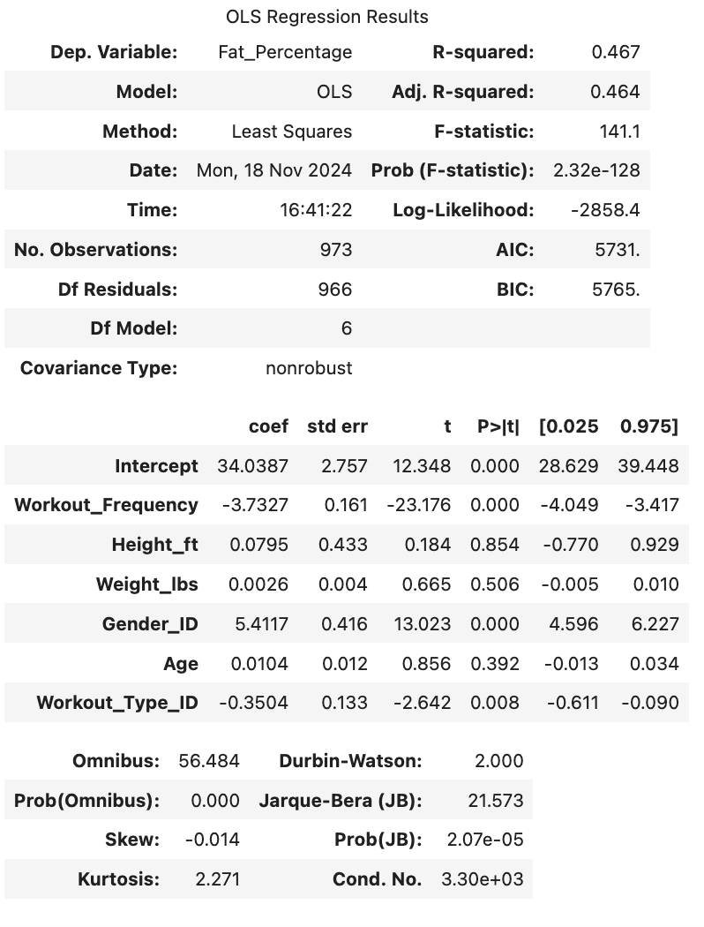
Regression Analysis
Using a regression with multiple independent variables we get a result of 0.467 R-squared, meaning that the independent variables used to predict the dependent variable fits the model. But it does not necessarily capture a good model. Other variables could have made the prediction better.

