Slide 1

Governance and Compliance with Microsoft Purview A getting started guide – 3 - Unified catalog
If you think compliance is complicated, feel free to try incompliance!
Jan Cordtz, Snr. Cloud Solution Architect
Microsoft Denmark
Note – in this document the name Purview – if not otherwise
stated - is used for the Data Governance part of Purview.

Slide 2
Get Purview Data Governance running

Slide 3
The Purview “Process”
Installation
Establish Domains
Data Map
Unified Catalog
Establish Governance Domains
Establish Collections
Establish Data Products
Register Sources
Connect assets to Data Products -> Governed assets
Establish assets
Scan
API
Enhance assets
Descriptions (scan?)
Owners
Lineage (scan?)
Glossaries
Classification (scan?)
Sensitivity
Enhance data product
Owners
Glossaries
OKR
Critical Data elements
Data Access
Advanced
Api’s
Workflows
Enforcement of rights

Slide 4
Establish the Unified Catalog
Unified Catalog

Slide 5
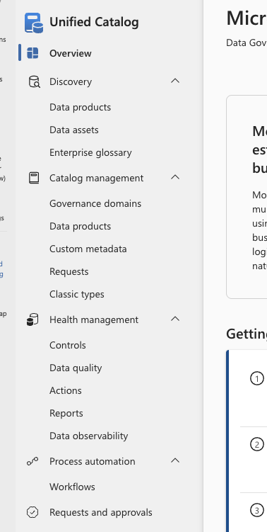
The Unified Catalog Purview menu
Discovery contains the search options for Purview. Note that data assets from the Data Map is in this menu part
Under Catalog management you will find what is the
Unified catalog and its content.
Health management has the reporting and quality items for
the Unified catalog and its content.
Note : Data quality is addressed in slide deck number 4
Process automation has one item being workflow where you can assign approval workflows etc.
Request and approvals is where you will find any request needed to be handled along with the request already processed.

Slide 6
Discovery
Search capabilities

Slide 7
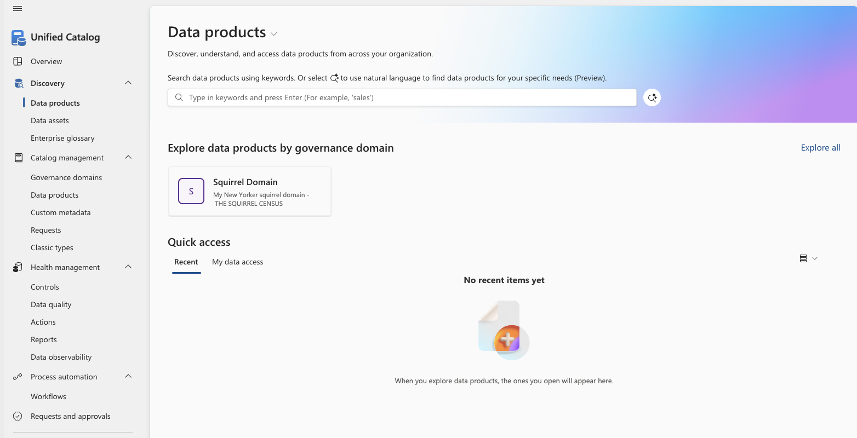
Discovery – data products
Here you can search your data products.
This can either be done using words,
clicking a published governance domain or
using natural language.
To use natural language, you need to click here.
Clicking a governance domain brings you to the data products in the domain.

Slide 8
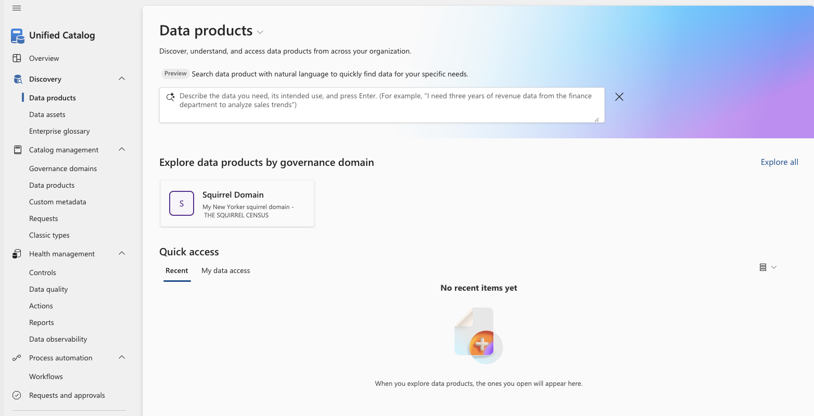
Discovery – data products – natural language
When using natural language for your search, you formulate in your words what it is your looking for.
So, instead how having an idea about what a data product might be called you instead write what it is you are really looking for.
Example (as shown): I need three years of revenue data from the finance department to analyze sales trends.

Slide 9
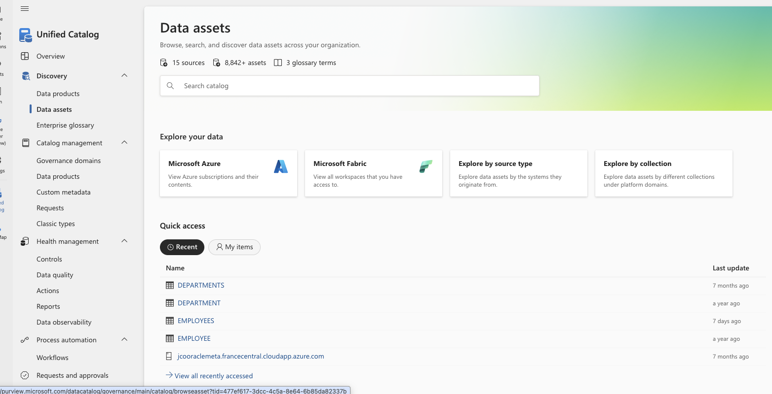
Discovery – data assets from the data map
The search for data assets is also located in the discovery menu under Unified catalog.
Here you search using words.
You can also click the explore options where you can find assets related to one the following option
Azure
Fabric
Source type
Collection
Purview also show recent found data assets under Quick access.

Slide 10
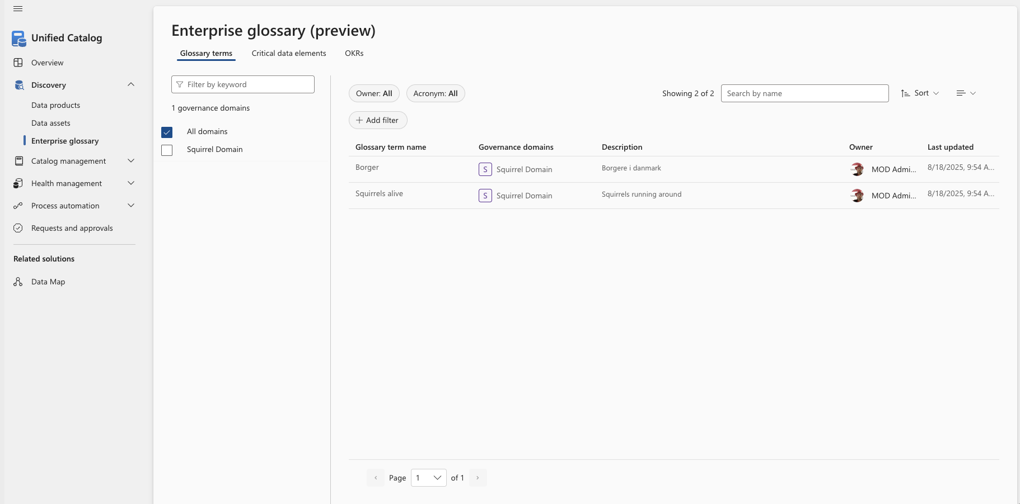
Discovery – Enterprise glossary – Glossary terms
The Enterprise glossary search provides access to searching glossary terms, critical data elements as well as objectives and key results (OKRs).
This screen show the glossary terms search.
You can add filters or “just” search by the name you are looking for.

Slide 11
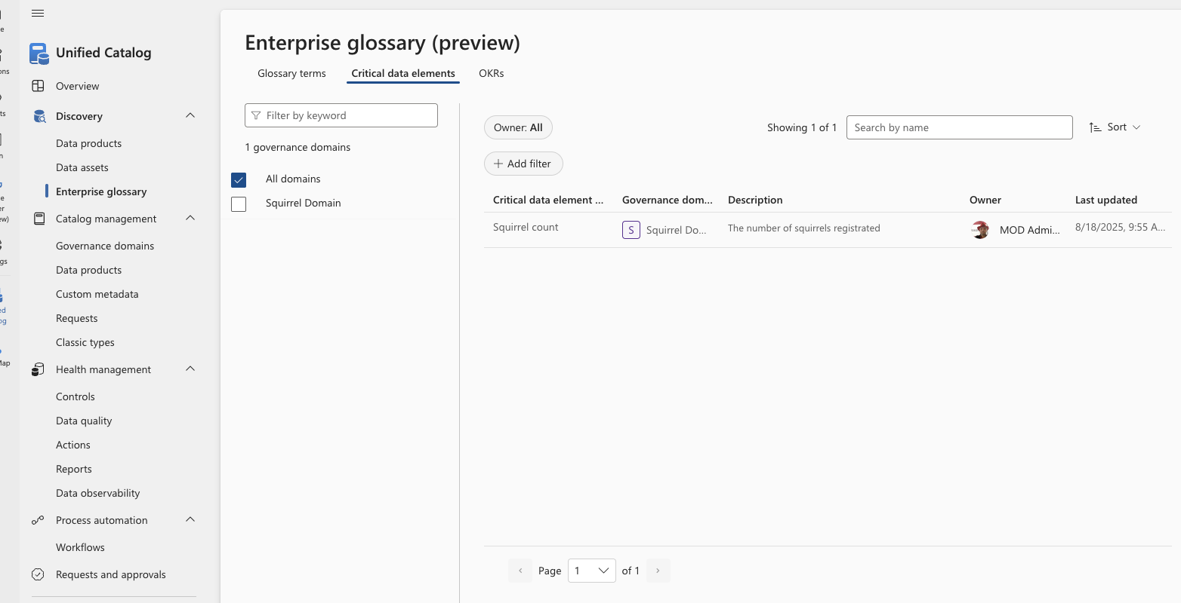
Discovery – Enterprise glossary – Critical data elements
The Enterprise glossary search provides access to searching glossary terms, critical data elements as well as objectives and key results (OKRs).
This screen show the Critical data elements search.
You can add filters or “just” search by the name you are looking for.

Slide 12
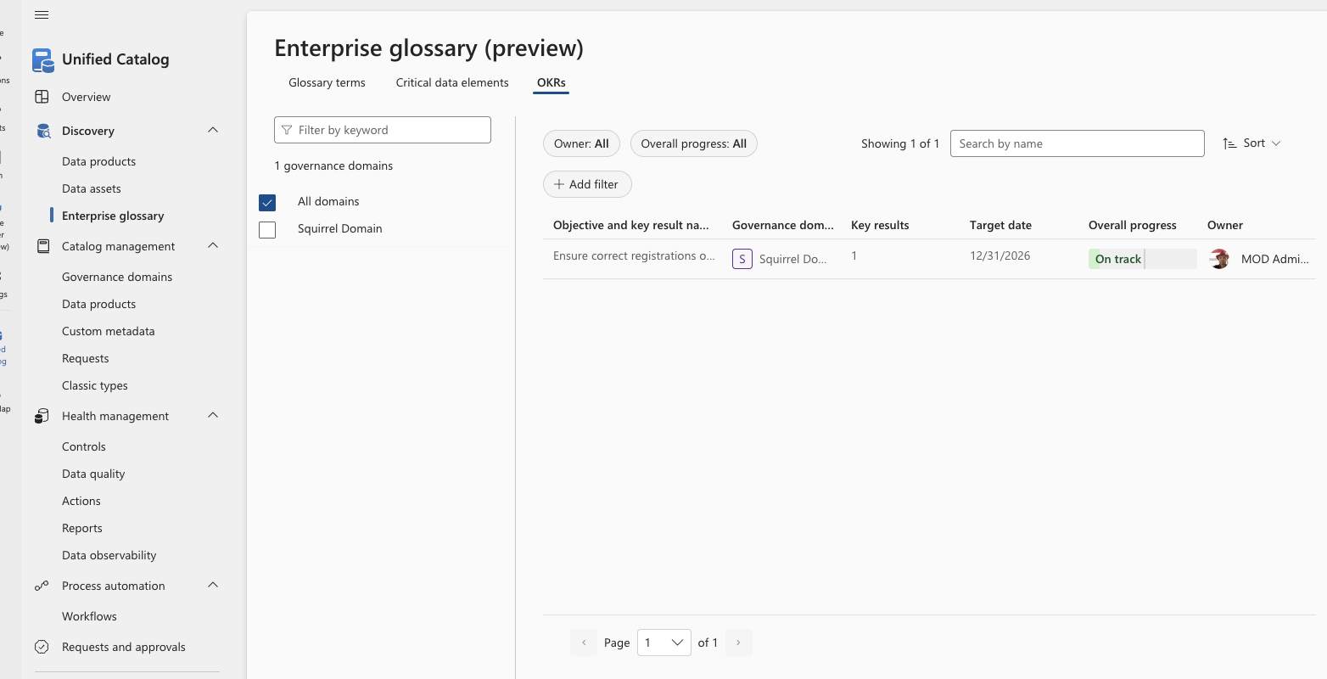
Discovery – Enterprise glossary – OKRs
The Enterprise glossary search provides access to searching glossary terms, critical data elements as well as objectives and key results (OKRs).
This screen show the objectives and key results (OKRs) search.
You can add filters or “just” search by the name you are looking for.

Slide 13
Catalog management
Governance domains

Slide 14
Governance Domains - overview
Governance domains provides a logical and organizational structure for managing data governance at scale.
They act as boundaries that align data assets, policies, roles, and ownership to business areas, rather than to purely technical systems.
Governance domains are designed to reflect business concepts such as departments, functions, programs, or data subject areas (for example: Finance, HR, Customer Data, Public Sector Case Management).
Governance Domains can be a created as a hierarchy
Governance domains allow organizations to assign domain‑specific roles (such as data owners and data stewards) within each domain. This supports:
Distributed ownership without losing central oversight
Clear accountability for data quality, classification, and usage decisions
Scalable governance across large or federated organizations
Governance domains define where governance actions apply, including:
Data assets associated with a domain
Business metadata and definitions
Data quality rules and ownership context
This helps avoid “one‑size‑fits‑all” governance and instead supports domain‑appropriate governance controls while still using a common platform.

Slide 15
Governance Domains - elements
Governance domains can contain the following elements
Strategic Objectives (OKRs / KPIs)
Governance domains are designed to connect strategy → data → outcomes.
OKRs (Objectives & Key Results)
You can describe domain‑level OKRs, for example:
Objective: Improve customer trust and regulatory compliance
Key Results:
100% of customer identifiers classified
Data quality score ≥ 95% on critical attributes
GDPR access request SLA < 14 days
Data Products (Core Concept)
Governance Domains often act as the home for related Data Products.
Data product connects business logical with physical representation using the data assets
Critical Data Elements (CDEs)
What are the most important governance artifacts in a domain.
CDE definitions
Business definition
Why it is critical (risk, reporting, regulation)
Allowed values / meaning
Sensitivity
Glossary terms
Governance Domains often has a need for own terms related to the business handling the domain.

Slide 16
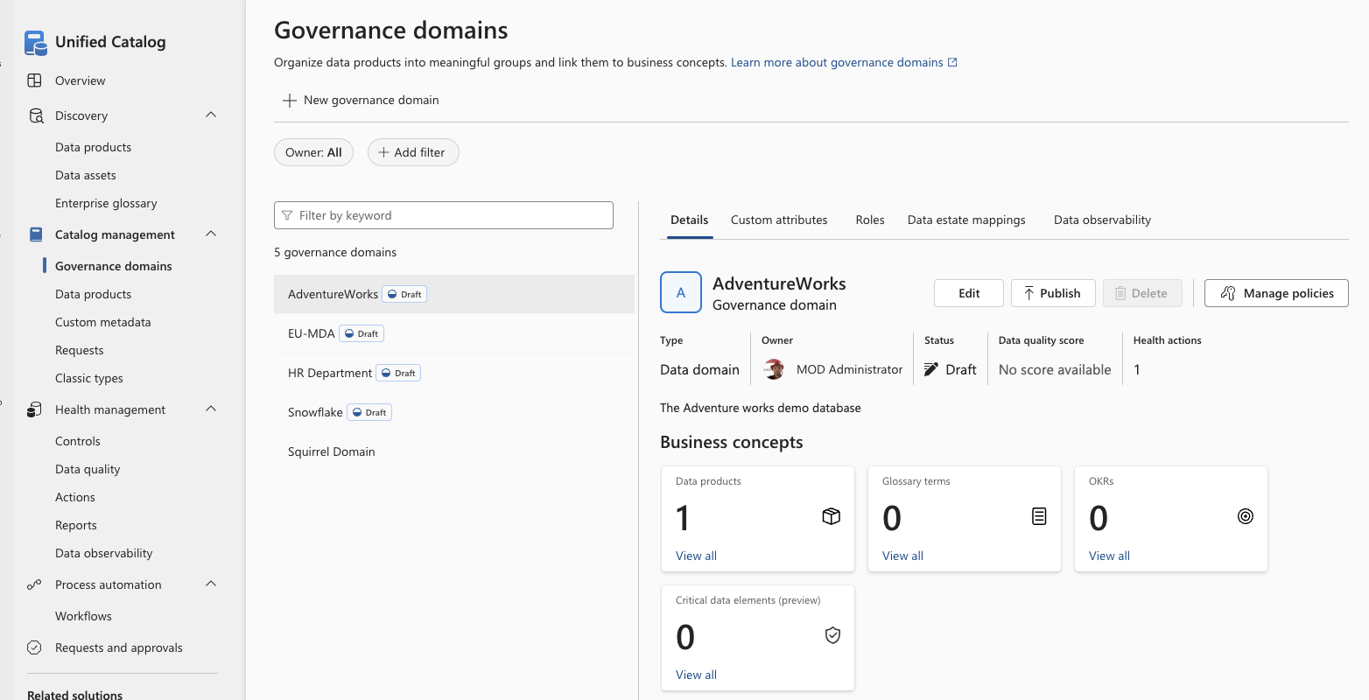
Governance Domains - creation
Governance domains can be created by clicking New Governance Domain
-or-
Be maintained by click Edit

Slide 17
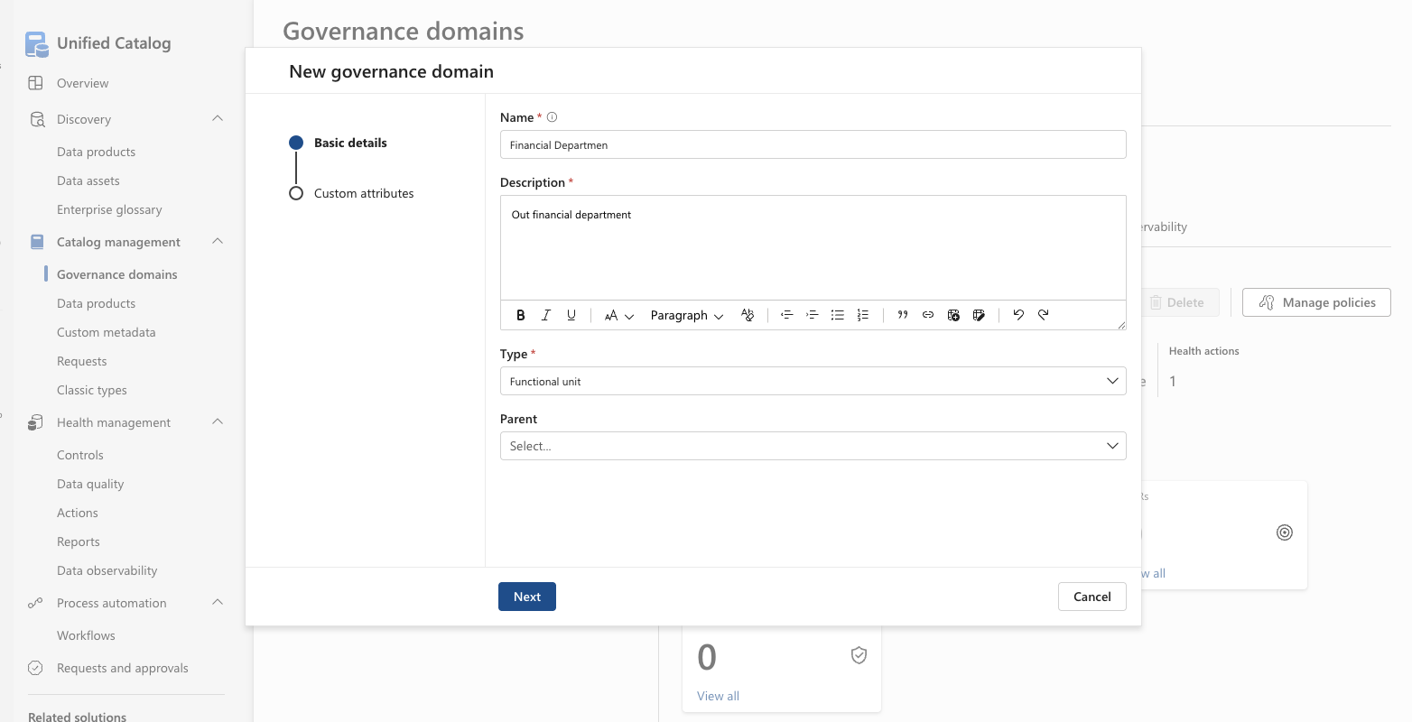
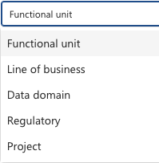
Governance Domains – creation screen - 1 of 2
A Governance domain has a required name and description.
Also, the type need to be specified and can be one of:
Functional Unit
Line of Business
Data Domain
Regulatory
Project
If this Governance Domain belongs under another Governance Domains, this parent can be selected.

Slide 18
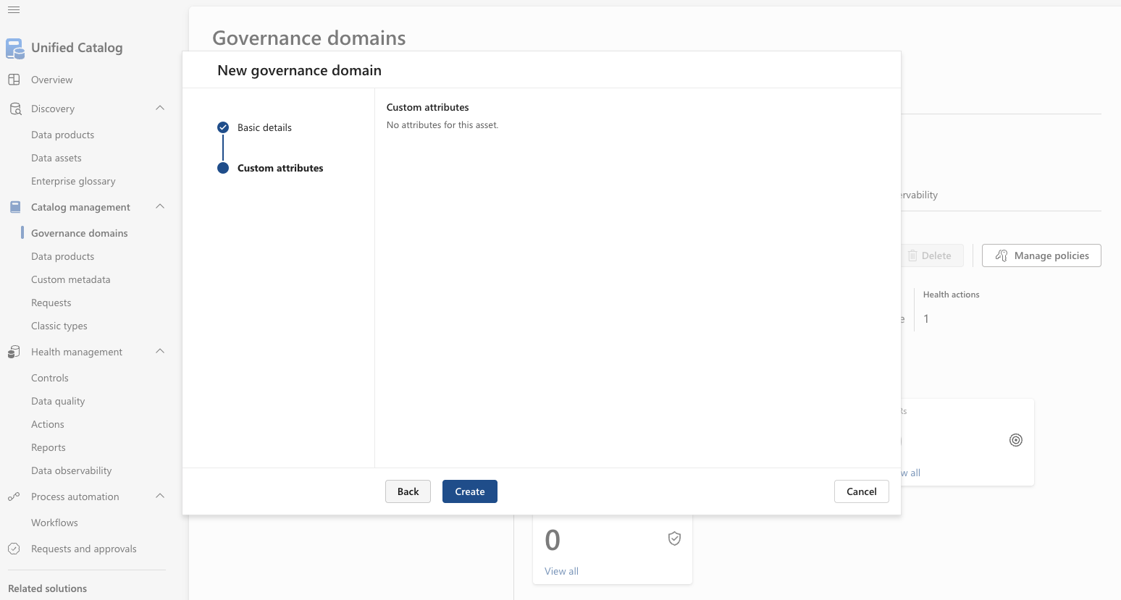
Governance Domains – creation screen - 2 of 2
If any custom attributes is available at the Governance domain level, these will be shown on the second screen.
And appropriate values can be assigned.
Click Create to create the Governance Domain.

Slide 19
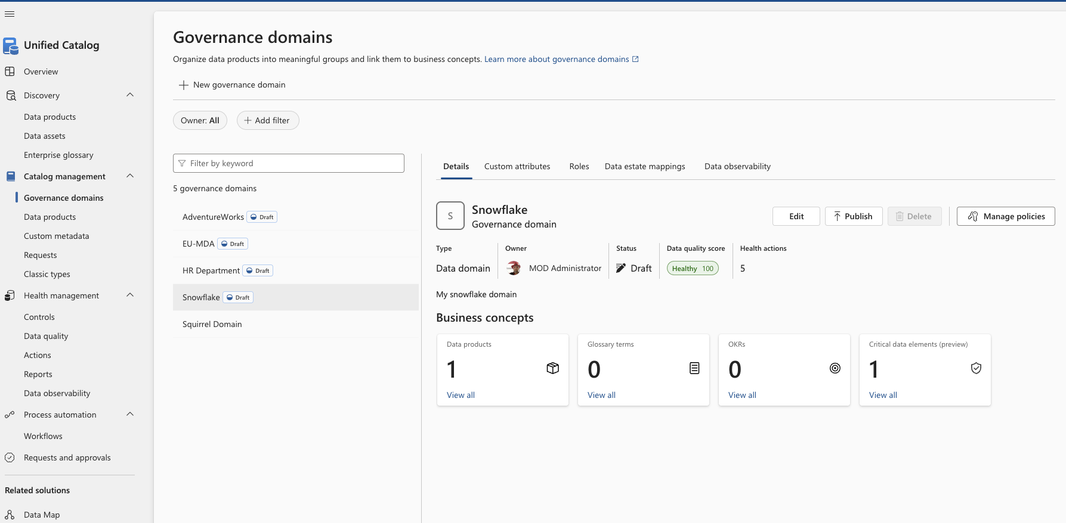
Governance Domains – Overview screen - details

Slide 20
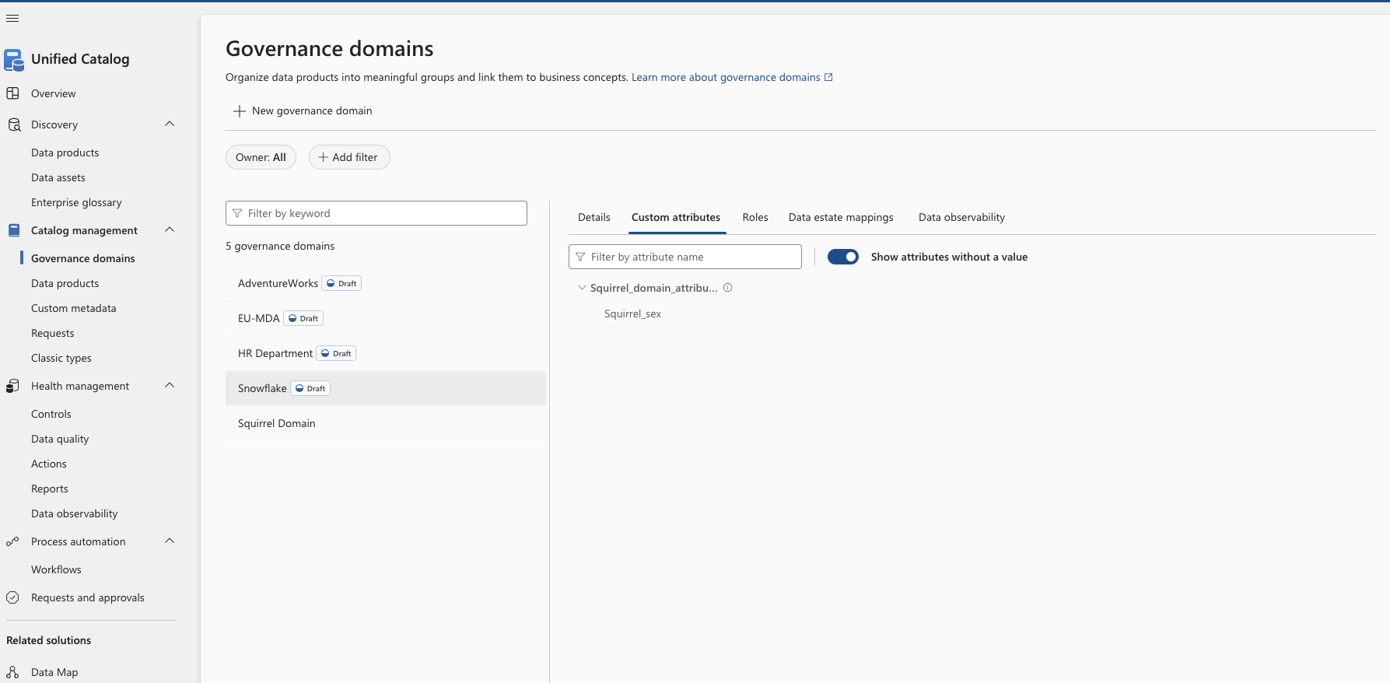
Governance Domains – Overview screen – custom attributes
If any custom attributes is available at the Governance domain level, these will be shown on this screen.
And appropriate values can be assigned.

Slide 21
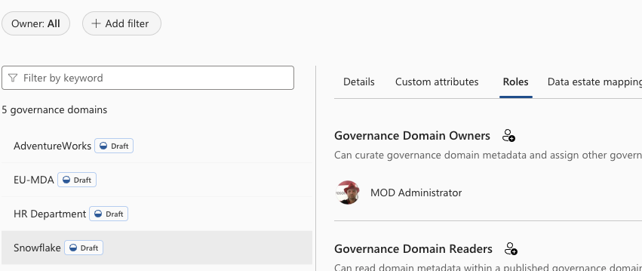
Governance Domains – Overview screen - roles
You can control the access to the individual Governance Domains based on these Roles:
Governance Domain Owners Can curate governance domain metadata and assign other governance domain permissions.
Governance Domain Readers Can read domain metadata within a published governance domain.
Data Product Owners Can create and update data products within a governance domain.
Data Steward Can create and update business concepts and policies within a governance domain.
Local Catalog Reader Can view published concepts only in the governance domain they are explicitly added to.
Data Quality Stewards This role will have required permission to use all data quality features like data profiling, data quality rule management, data quality scanning, browsing data profiling and data quality insights, Data quality scheduling, Job monitoring, configuring threshold and alerts.
Data Quality Readers This role will have required permission to browse all data quality insight, data quality rules definition, and data quality error files. This role can't run data quality scanning and data profiling job, and this role will not have access to data profiling column level insight as column level insight.
Data Quality Metadata Readers This role will have required permission to browse data quality insights (except profiling results column level insight), data quality rule definition and rule level scores. This role will not have access to error records and cannot run profiling and DQ scanning job.
Data Profile Stewards This role will have required permission to run data profiling job and have access to browse profiling insight details. This role can also browse through all data quality insights and can monitor profiling job. This role can't create rules and can't run Data Quality scanning.
Data Profile Readers This role will have required permission to browse all DQ insight and can drill down the profiling results to browse the statistics in column level.
Further details : https://learn.microsoft.com/en-us/purview/data-governance-roles-permissions

Slide 22
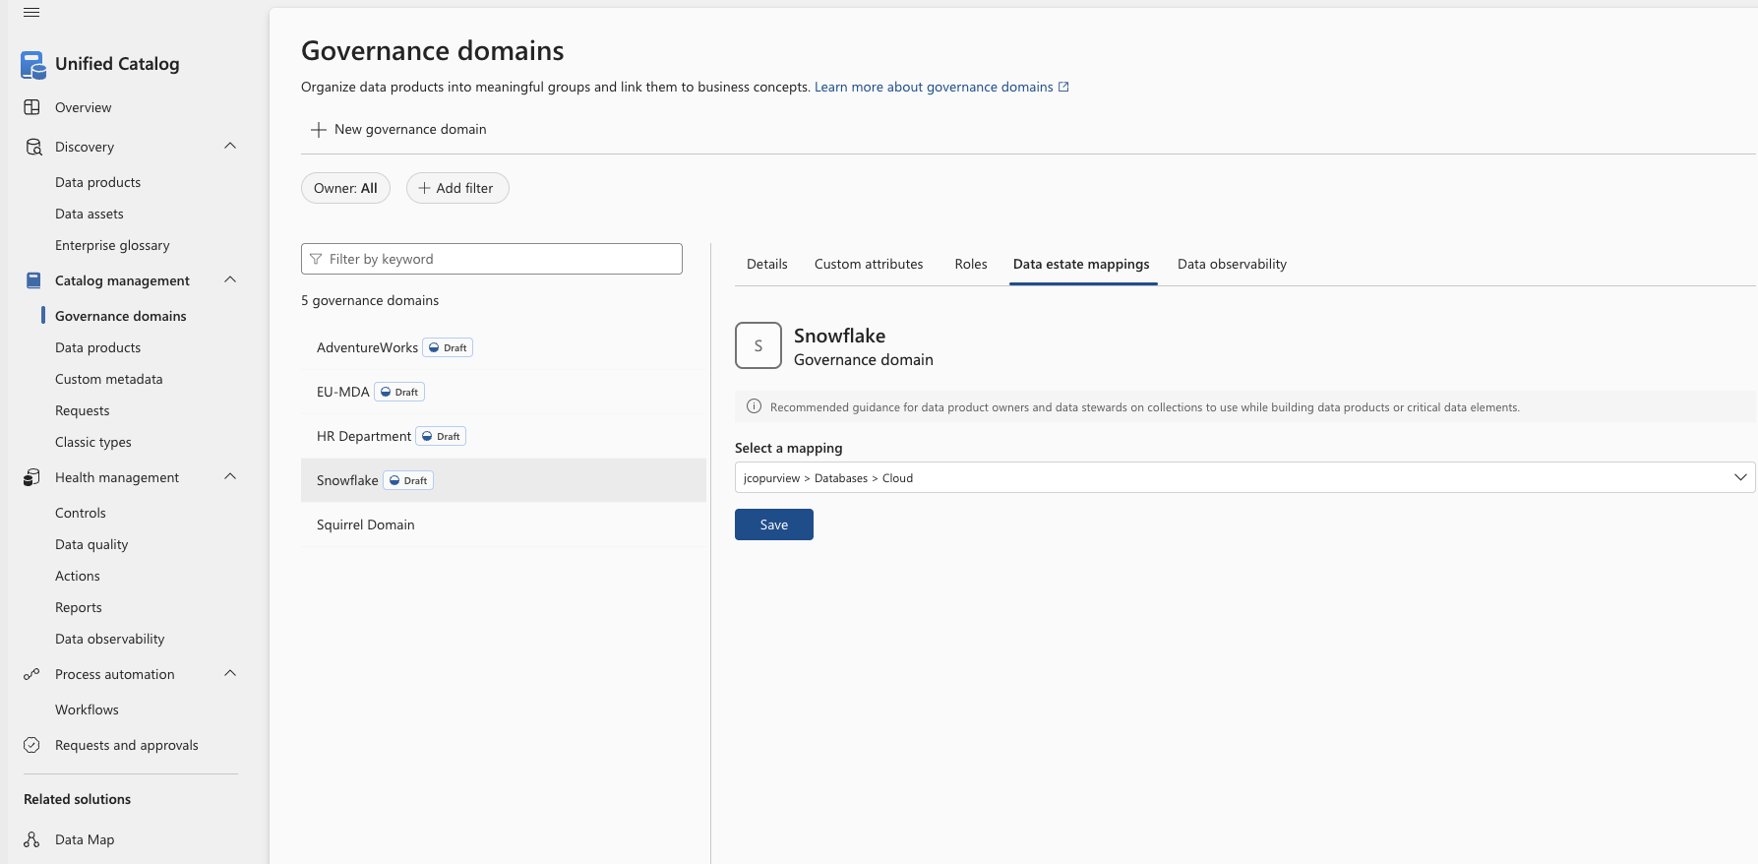
Governance Domains – Overview screen – Data Estate mappings
On the data estate mappings page, you can register any recommended mapping to the collection where the “original” data can be found. This can be used to guide the persons creating Data products to where they can inspect the “real data”.

Slide 23
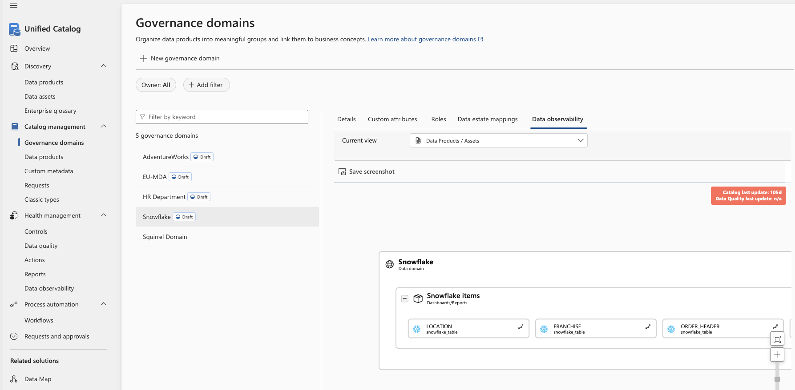
Governance Domains – Overview screen – Data observability
On the data observability page, a single view helps users understand where data starts and ends, what the issues are, and where there might be an effect on reporting obligations.

Slide 24
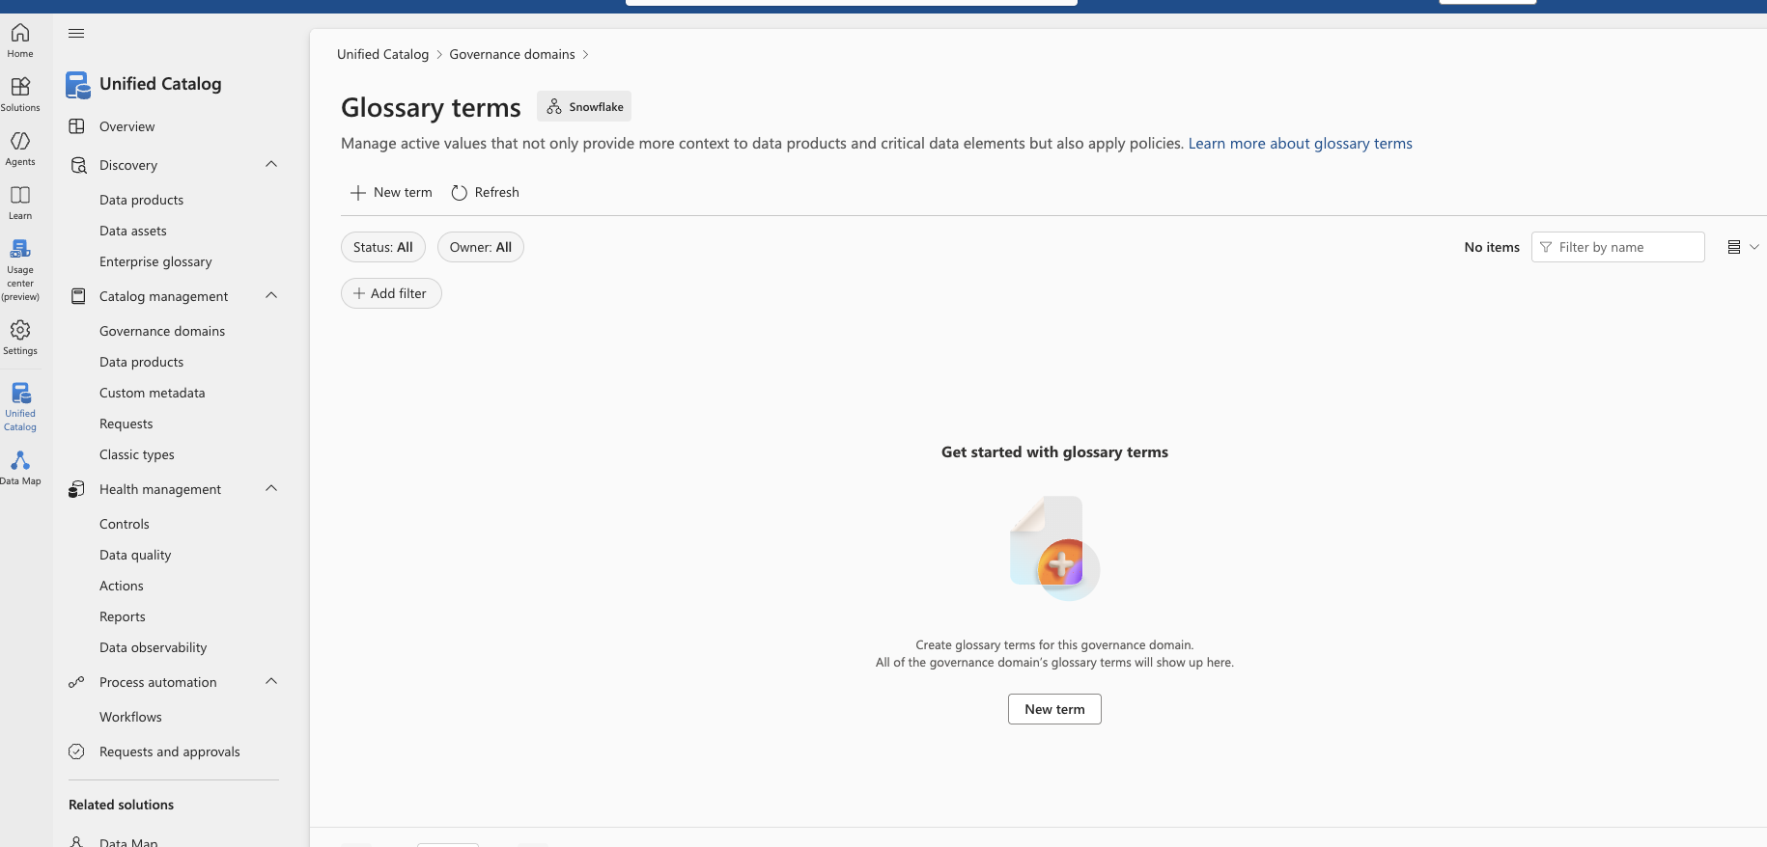
Governance Domains – Glossary terms – 1 of 5
From the Governance domains page under Business concepts, you can navigate to Glossary terms.
On this screen you can edit/add new Glossary terms belonging to this Governance domain.

Slide 25
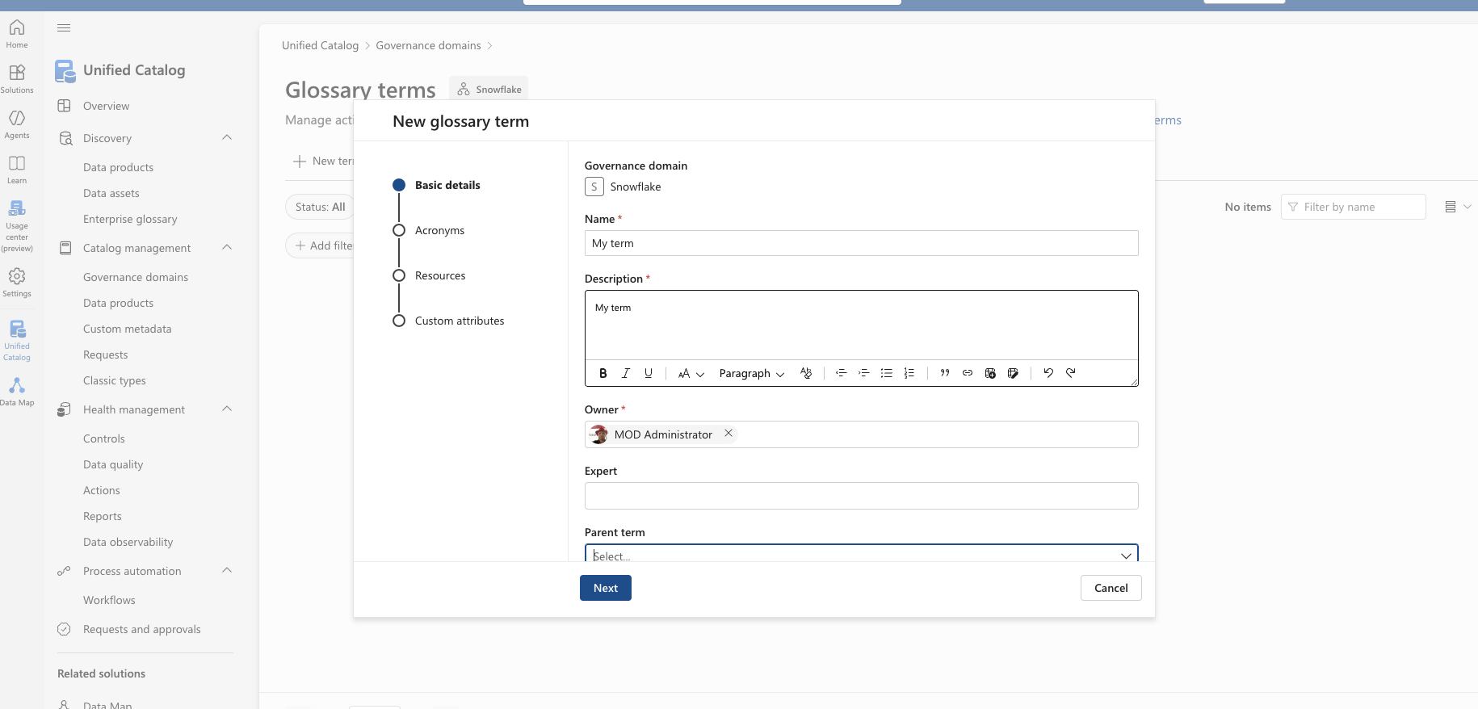
Governance Domains – Glossary terms – 2 of 5
A Glossary term has a name, a description and an owner as required attributes.
You can also register any given expert.
If the term belongs to another term, you can register the Parent term and thereby create a hierarchy.

Slide 26
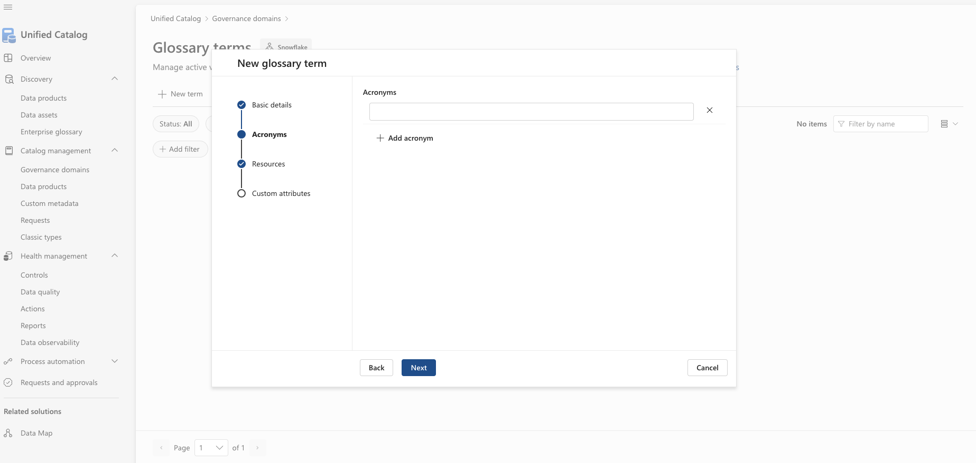
Governance Domains – Glossary terms – 3 of 5
A Glossary term can be registered with any given number of acronyms.

Slide 27
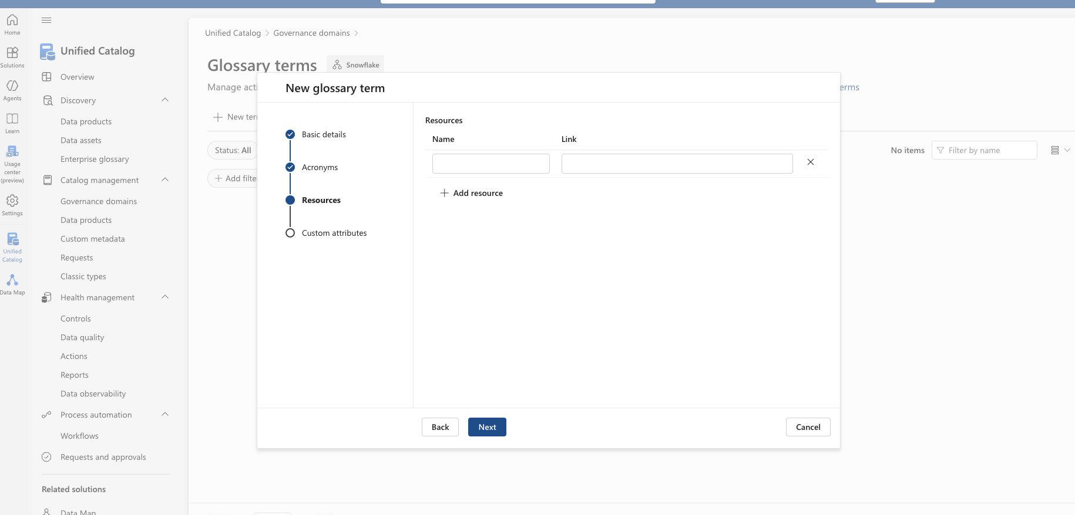
Governance Domains – Glossary terms – 4 of 5
On a Glossary term you can also register links to any number of resources where further information might be available.

Slide 28
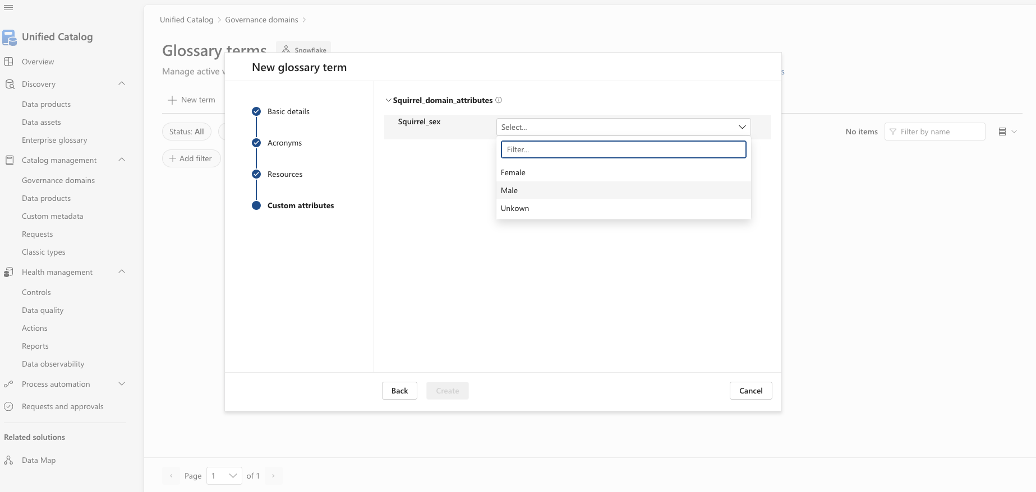
Governance Domains – Glossary terms – 5 of 5
If any custom attributes is available for the Glossary terms the content can be added on this page.

Slide 29
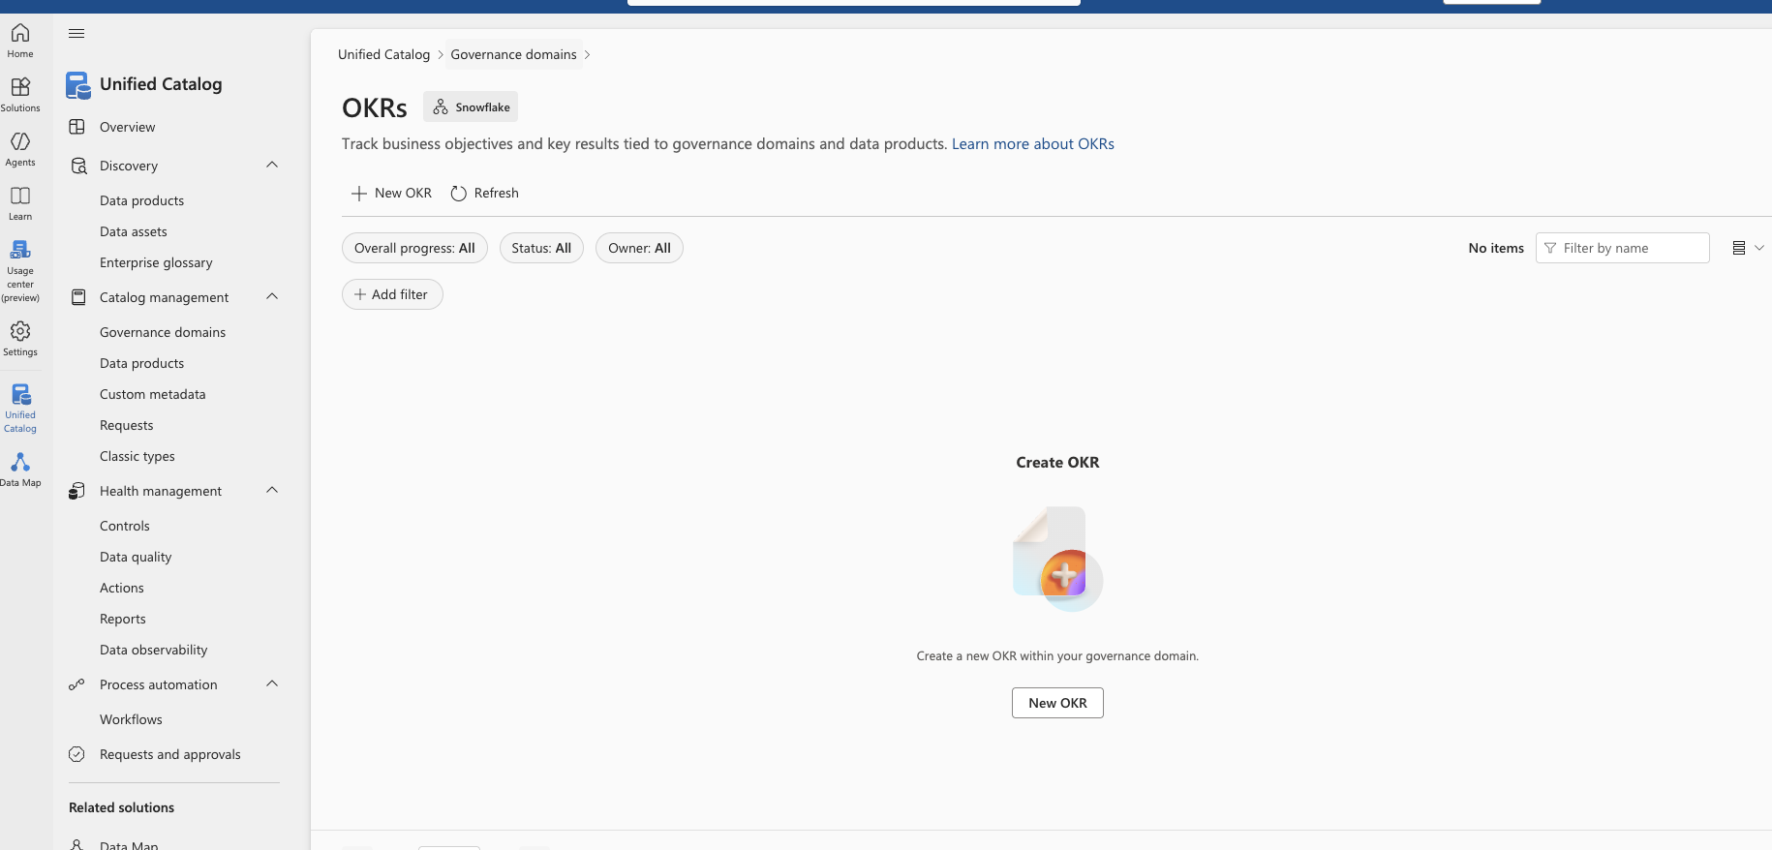
Governance Domains – Objectives and key results – 1 of 3
From the Governance domains page under Business concepts, you can navigate to OKRs.
On this screen you can edit/add new Objectives and Key Results belonging to this Governance domain.

Slide 30
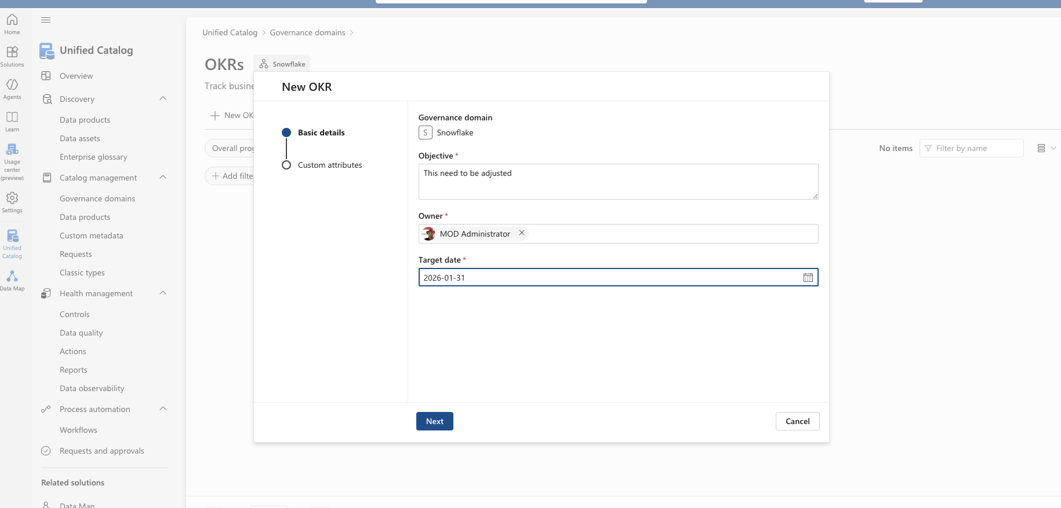
Governance Domains – Objectives and key results – 2 of 3
An OKR has an objective, an owner and a target data where this should be “finished”.

Slide 31
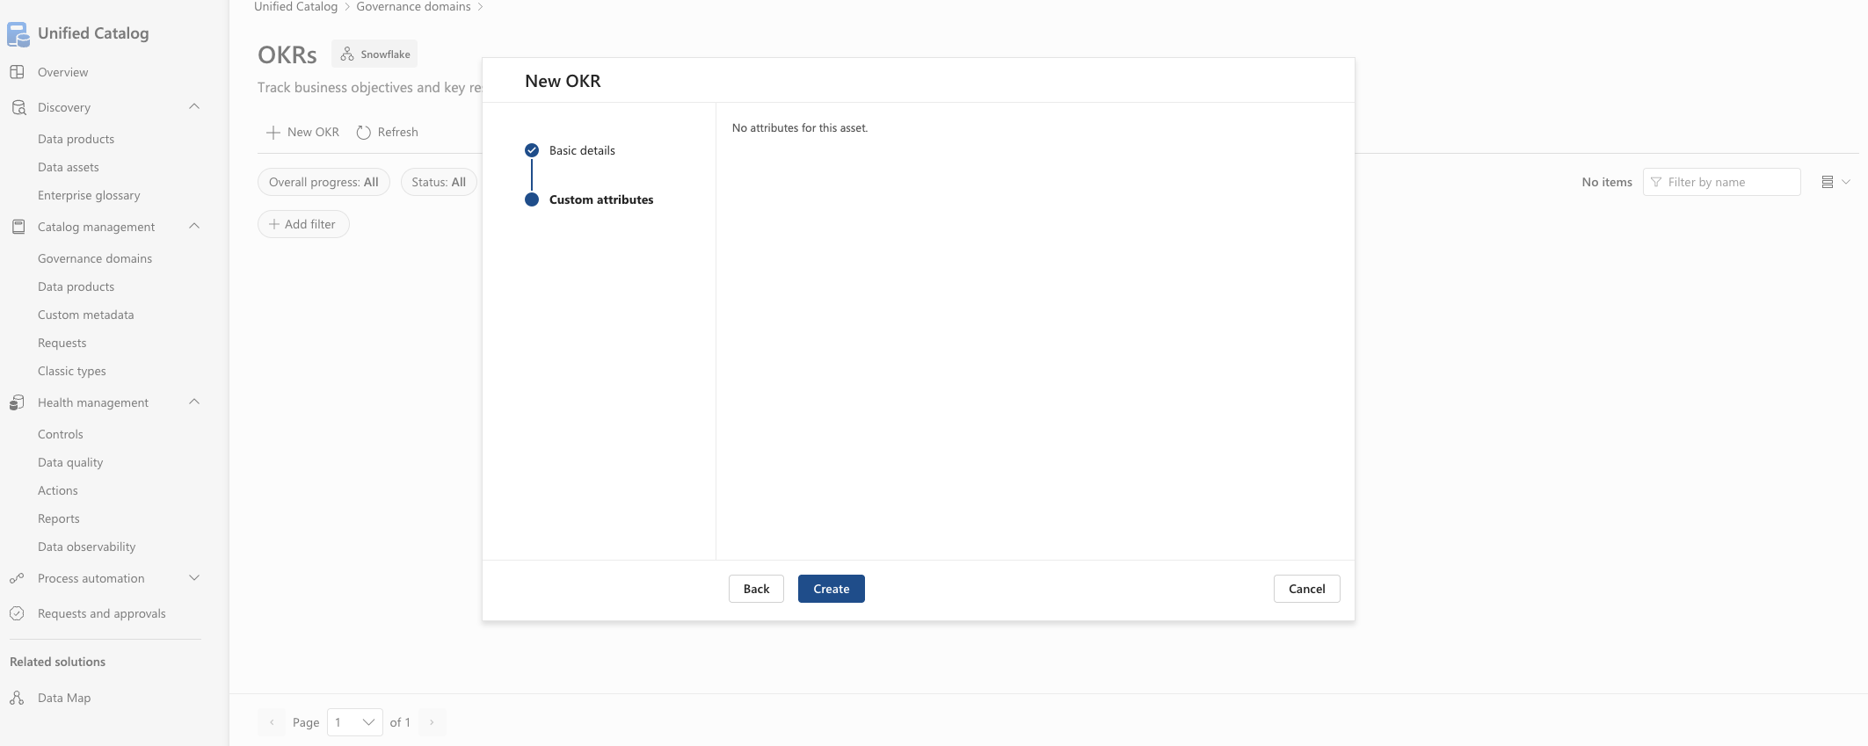
Governance Domains – Objectives and key results – 3 of 3
If any custom attributes is available for the OKR the content can be added on this page.

Slide 32
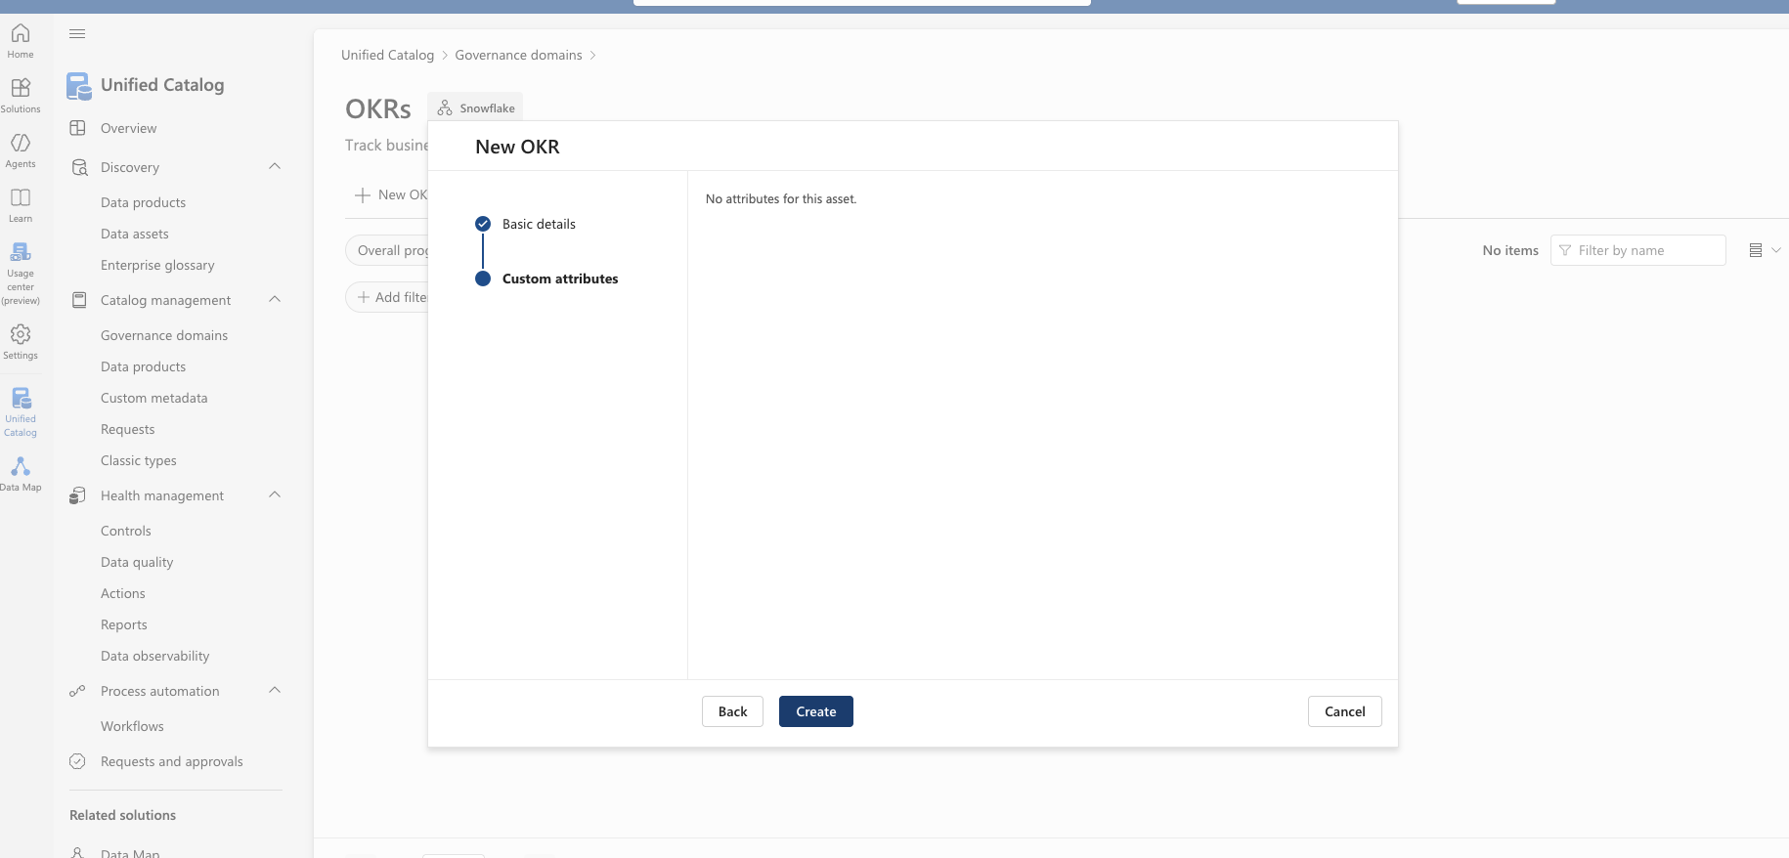
Governance Domains – Objectives and key results
If any custom attributes is available for the OKR the content can be added on this page.

Slide 33
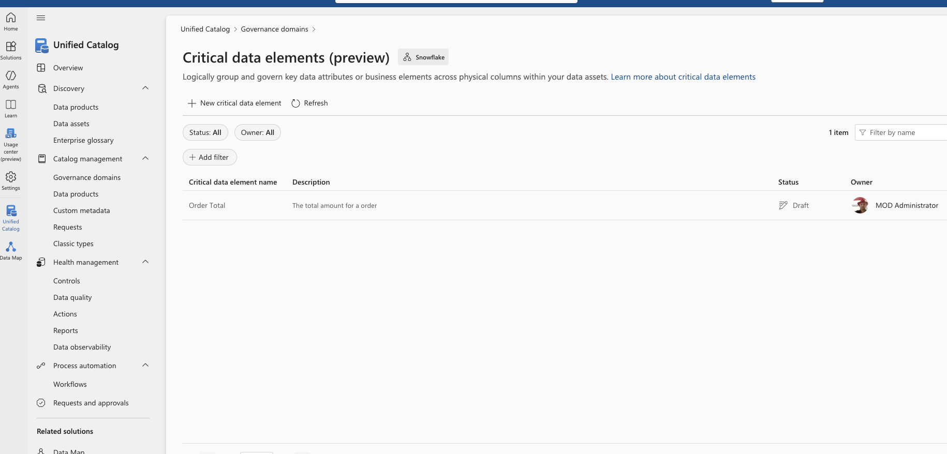
Governance Domains – Critical Data Elements
From the Governance domains page under Business concepts, you can navigate to Critical data elements.
On this screen you can edit/add new Critical data elements belonging to this Governance domain.

Slide 34
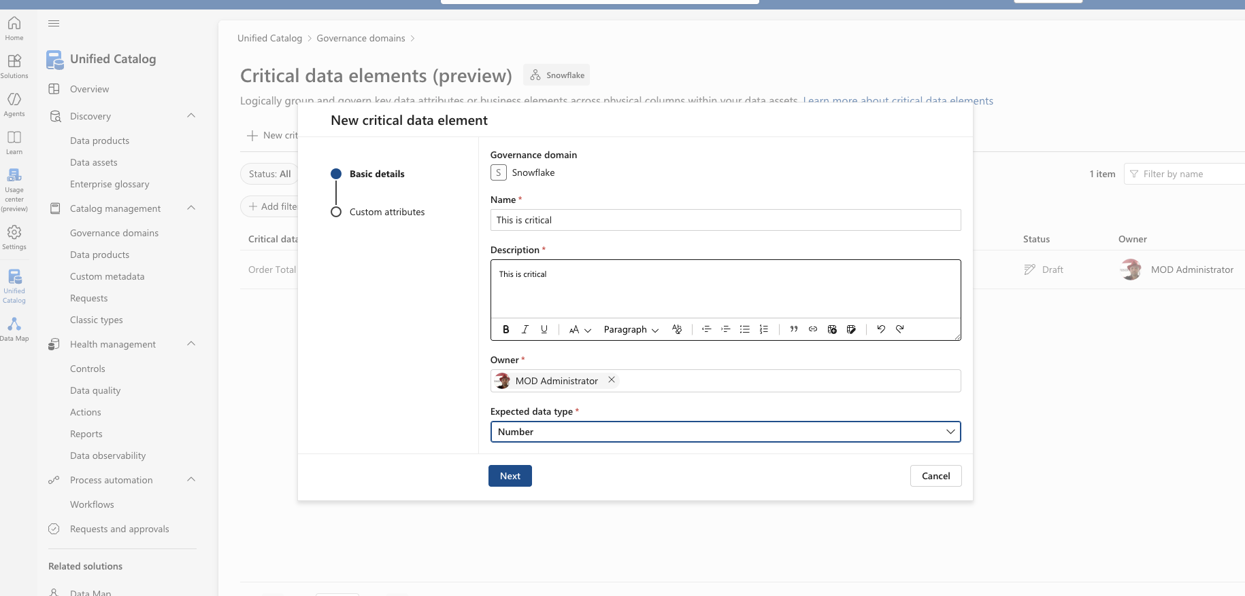
Governance Domains – Critical Data Elements
A Critical data element has a name, a description, an owner and an expected data type.

Slide 35
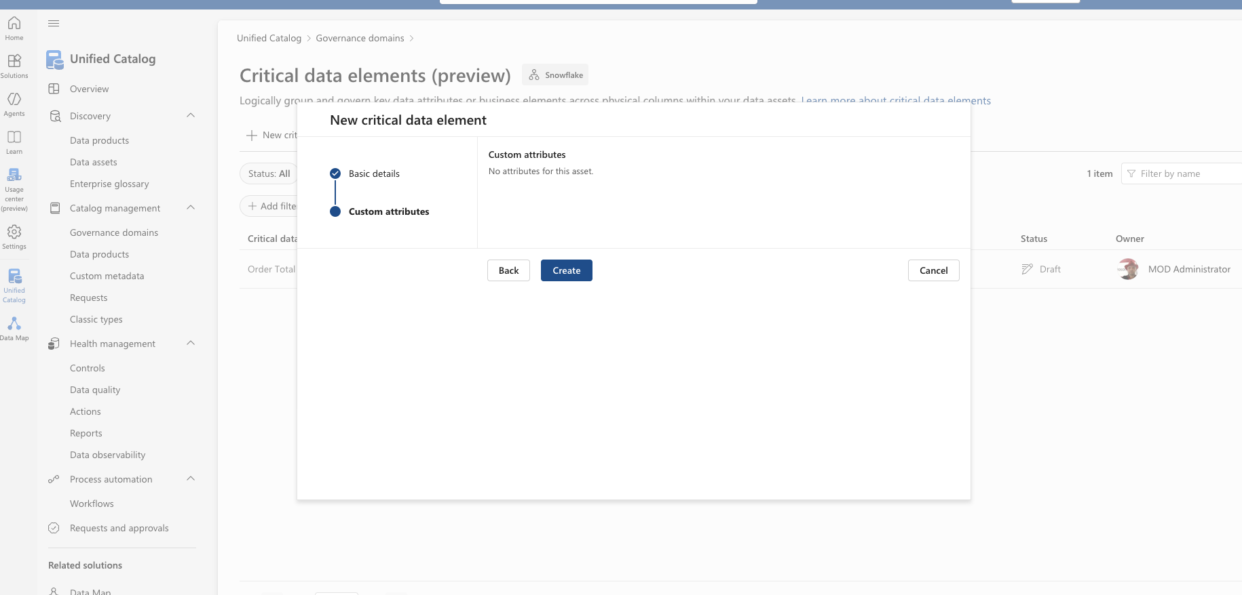
Governance Domains – Critical Data Elements
If any custom attributes is available for the Critical data element the content can be added on this page.

Slide 36
Catalog management
Data Products

Slide 37
Data products - overview
A Data Product in Microsoft Purview represents a business-ready, governed data asset that is intentionally designed for consumption—not just a raw dataset.
Microsoft positions data products as the unit of value delivery in modern data governance: they bundle data + metadata + governance + ownership + quality expectations into something that can be discovered, trusted, and reused.

Slide 38
Data product – an example
Data Product Dept1
Description – what does it do
Use Case – why do we have it …and other things….
Data Asset connected to the data product
Unified Catalog
Source A
Table A
DataMart M
Dimension N
Source A
Table B
Fabric X
Report Y
Data Map
DataMart M
Dimension O
Fabric X
Dashboard T
Fabric X
Report Z
Source B
Table C
DataMart M
Fact P
Source B
Table C

Slide 39
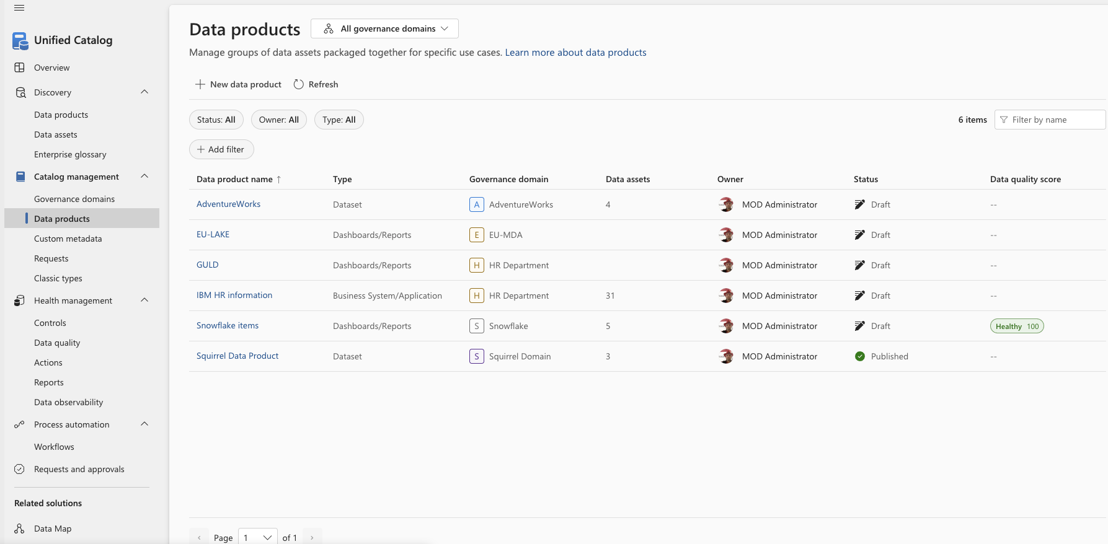
Data Product
Data Products can be created by clicking New data product
-or-
Be maintained by clicking a Data Product

Slide 40
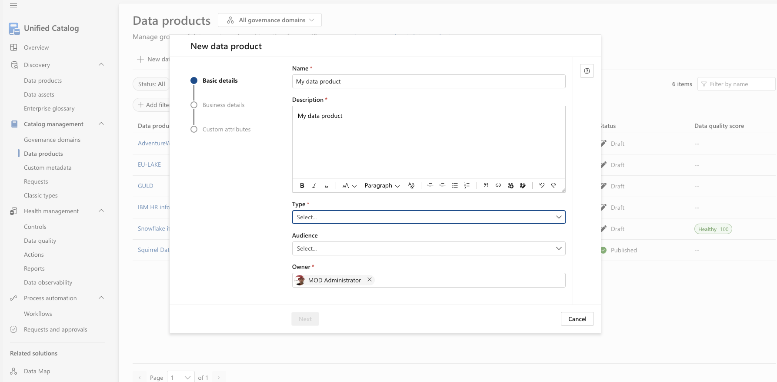
Data Product – creation – 1 of 3
A Data Product must have a name, a description, a type, an owner and can also have an audience.
The type can be one of:
Analytics model, Business system/Application, Dashboards/Reports,
Dataset, Master and reference data, ML training data ,
ML testing data, Model types, Operational, Semantic model,
Transactional data
And the audience can be any combination of:
Data engineer, BI engineer, Data analyst,
Data scientist, Business analyst

Slide 41
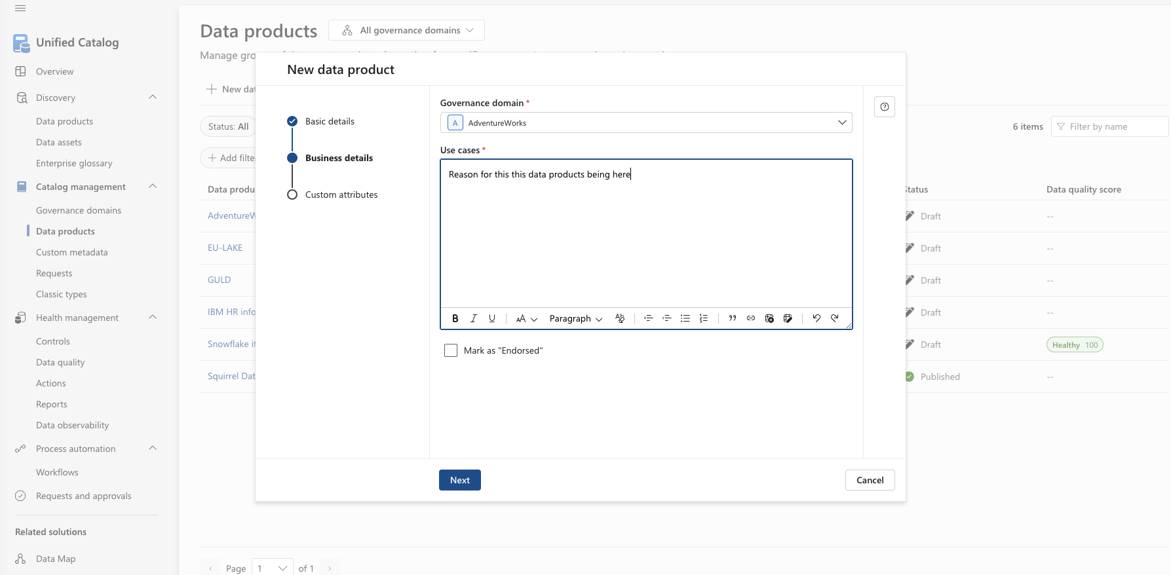
Data Product – creation – 2 of 3
A Data Product must be long to one (and only one) Governance Domain
The use cases is a required field describing why this data product exists.
You can click on “Mark as “Endorsed” ” – this is for informational purposes to tell the audience that this data product has been “validated”.

Slide 42
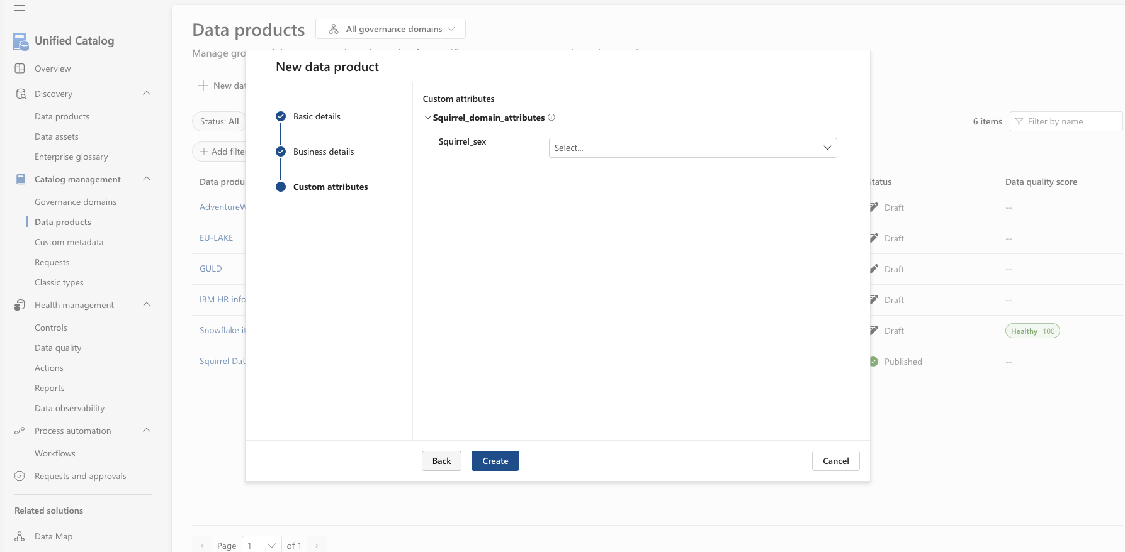
Data Product – creation – 2 of 3
If any custom attributes is available for the Data Product the content can be added on this page.

Slide 43
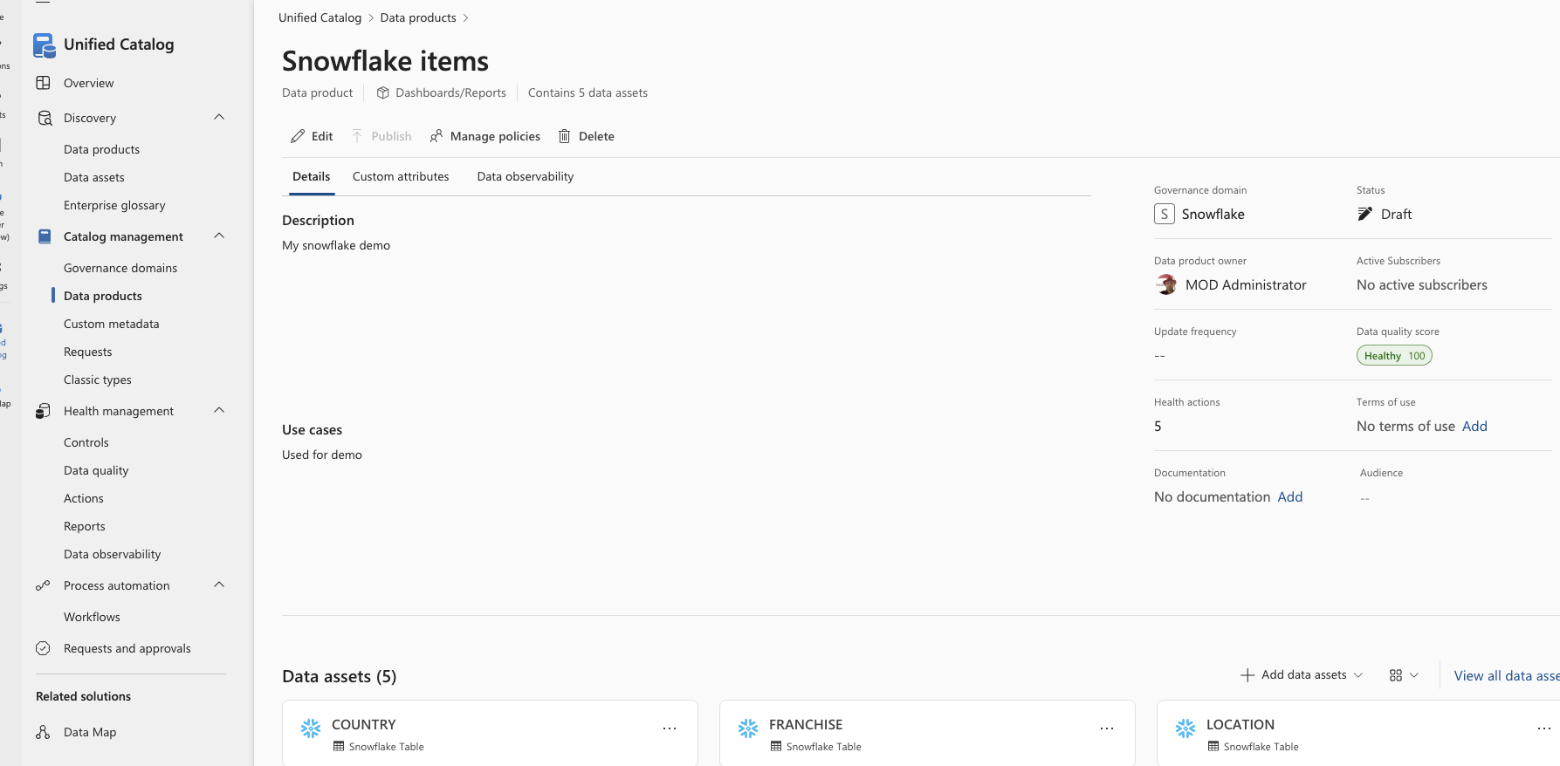
Data Product – editing
On the Data Product screen for a particular data product, you can click edit to update the information for data product itself.
Editing can only be done if the data product is in draft state, if you publish the data product it is not editable.

Slide 44
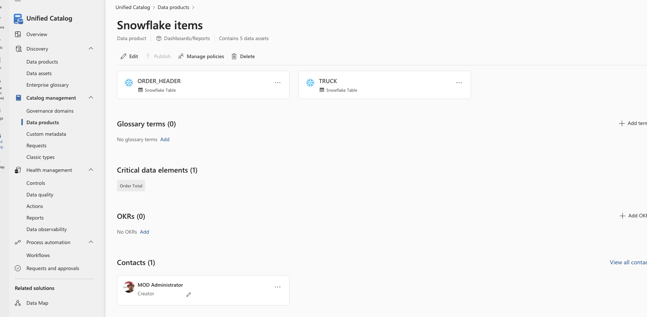
Data Product – adding Glossary terms, Critical data elements, OKRs and Contacts
In the “lower” part of Data products screen, you find and can maintain further assets for the data product. A data product can contain as many data assets as required from any number of sources. You can add up to 25 data assets at a time. Note – a data asset connected to a data product is called a governed asset and has an associated cost.

Slide 45
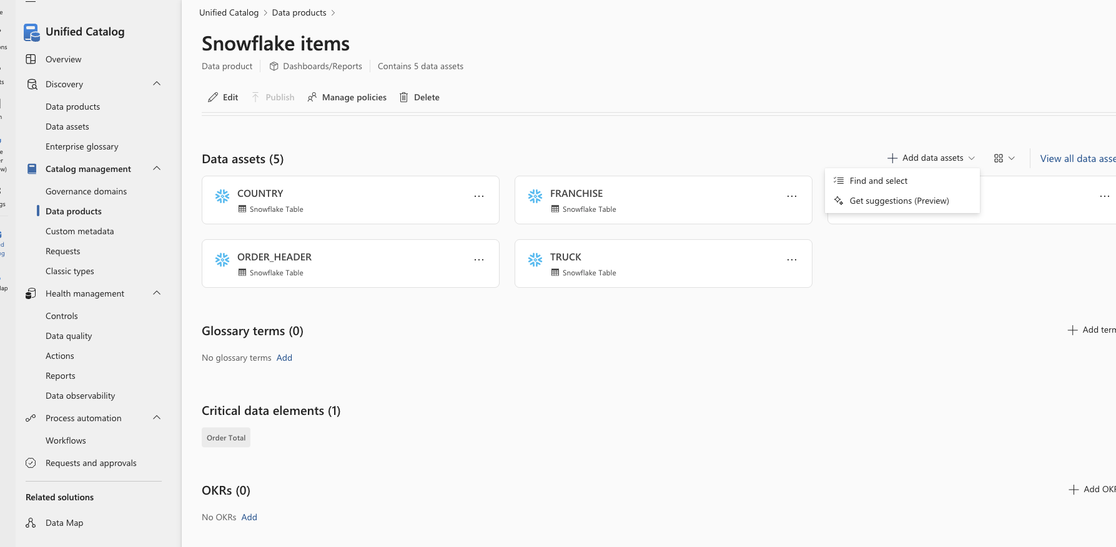
Data Product – Data assets
In the Data assets section, you can add the data assets that forms this data product. This can either be a “Find and select” or a ”Get suggestions” process. A data product can contain as many data assets as required from any number of sources. You can add up to 25 data assets at a time. Note – a data asset connected to a data product is called a governed asset and has an associated cost.

Slide 46
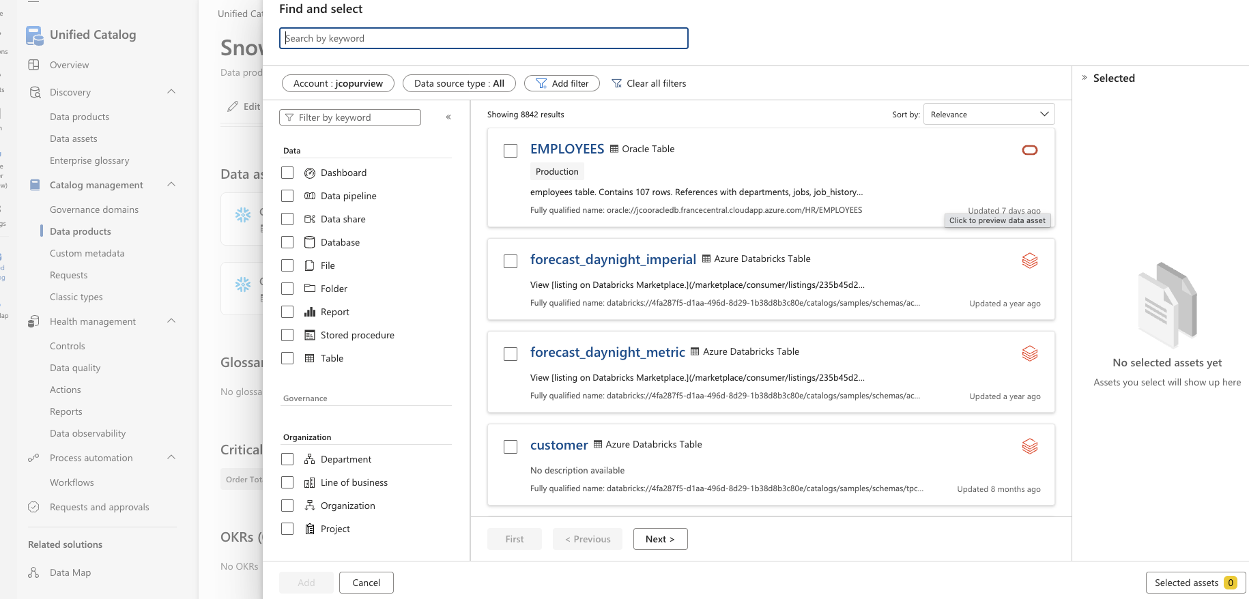
Data Product – Data assets – find and select
The “find and select” option gives you access to discover the Data assets, you would like to connect to this data product.
From this screen you can also de-select data assets that should not be part of data product anymore. A data product can contain as many data assets as required from any number of sources. You can add up to 25 data assets at a time. Note – a data asset connected to a data product is called a governed asset and has an associated cost.

Slide 47
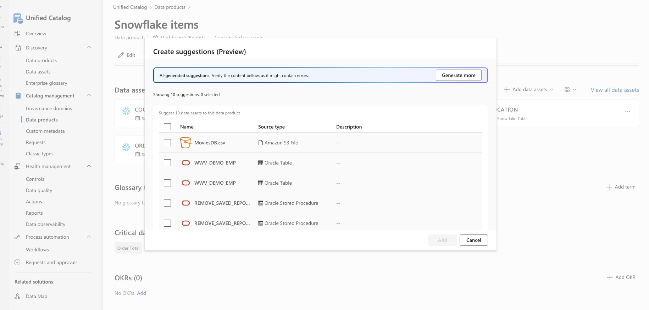
Data Product – Data assets – get suggestions
The “get suggestion” option uses the information about the data product to provide you a list of suggested Data assets.
A data product can contain as many data assets as required from any number of sources. You can add up to 25 data assets at a time. Note – a data asset connected to a data product is called a governed asset and has an associated cost.

Slide 48
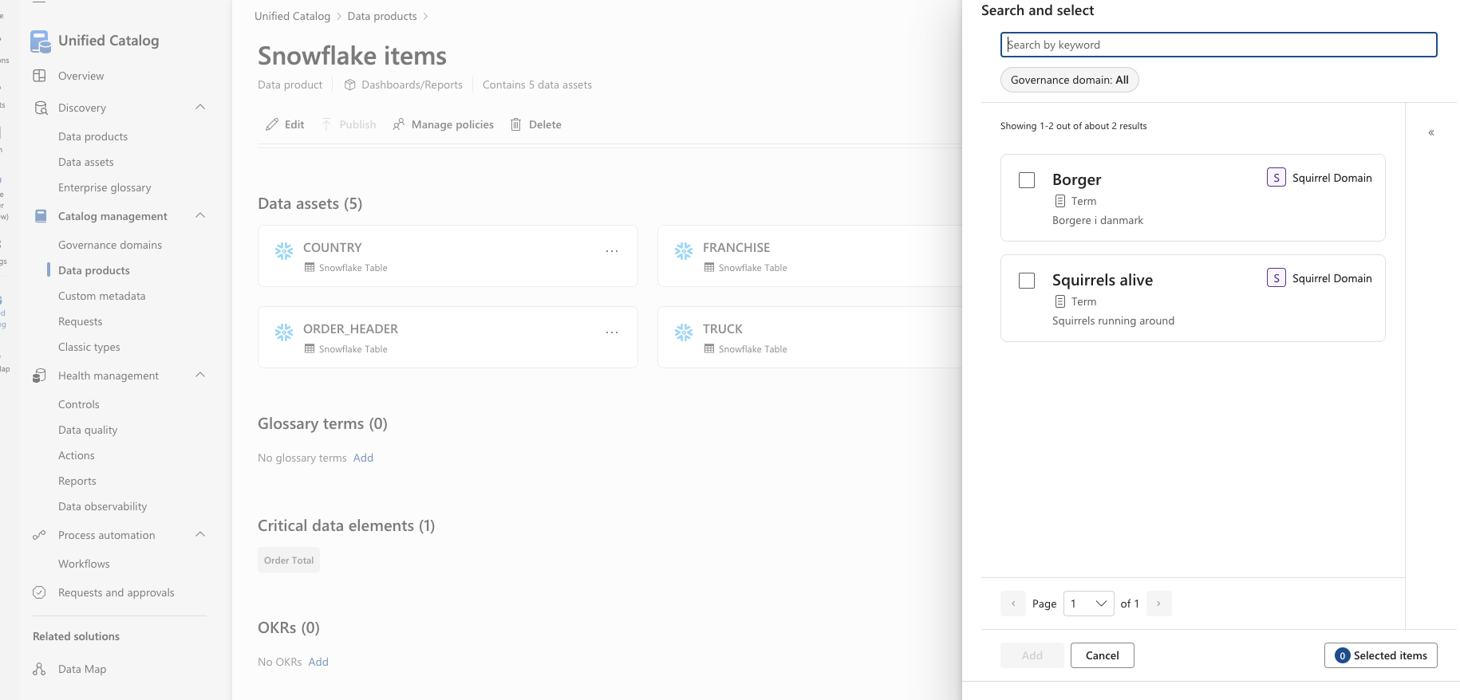
Data Product – Glossary terms
You add glossary terms to the data product by selecting the appropriate glossary terms from the list provided.

Slide 49
Data Product – Critical data elements
Critical data elements within the Governance domain that is connected to any of the data assets associated with this data product will be shown under Critical data elements.

Slide 50
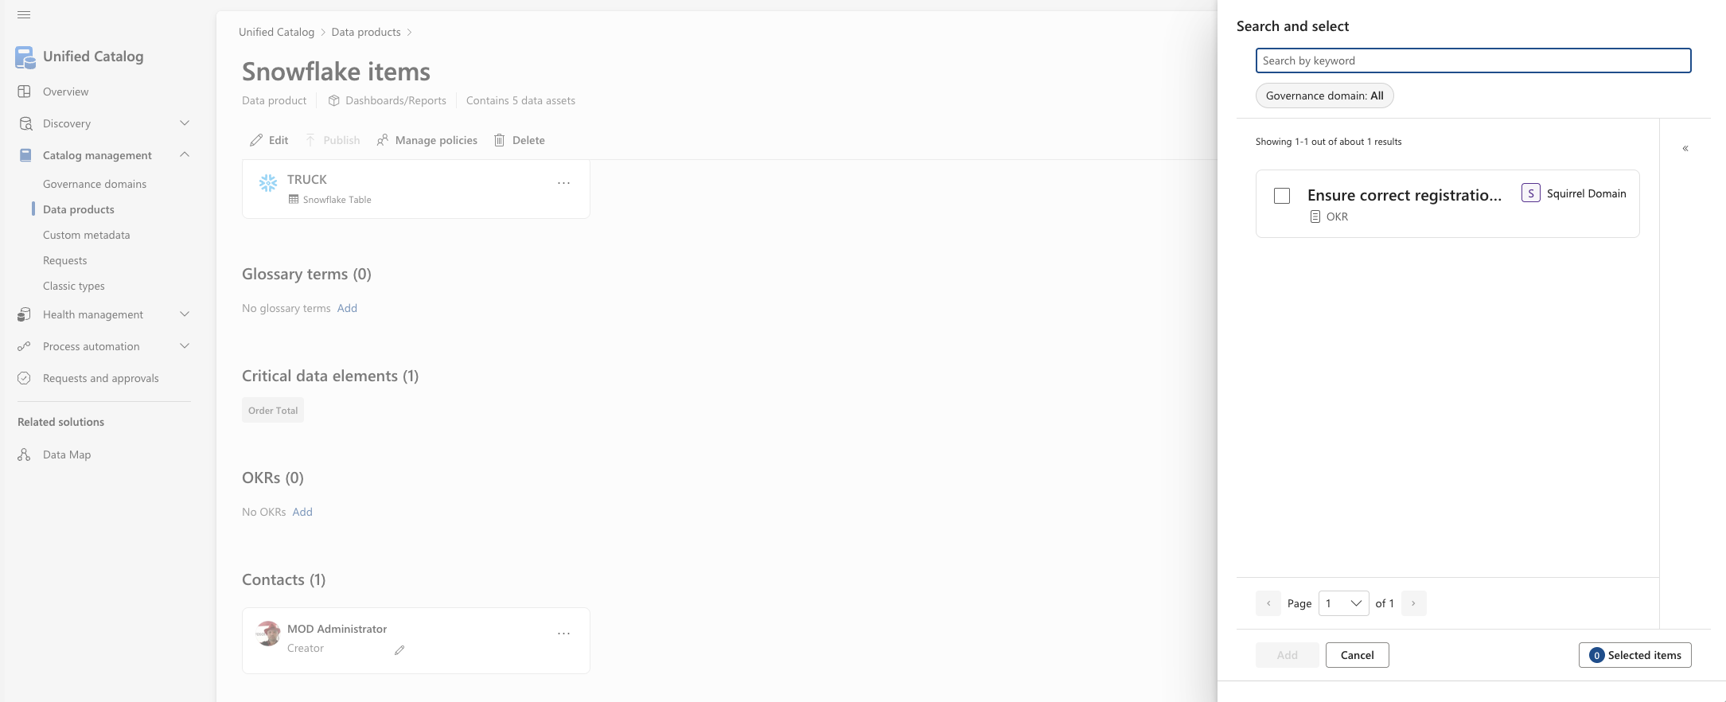
Data Product – OKRs
You add OKRs to the data product by selecting the appropriate OKR’s from the list provided.

Slide 51
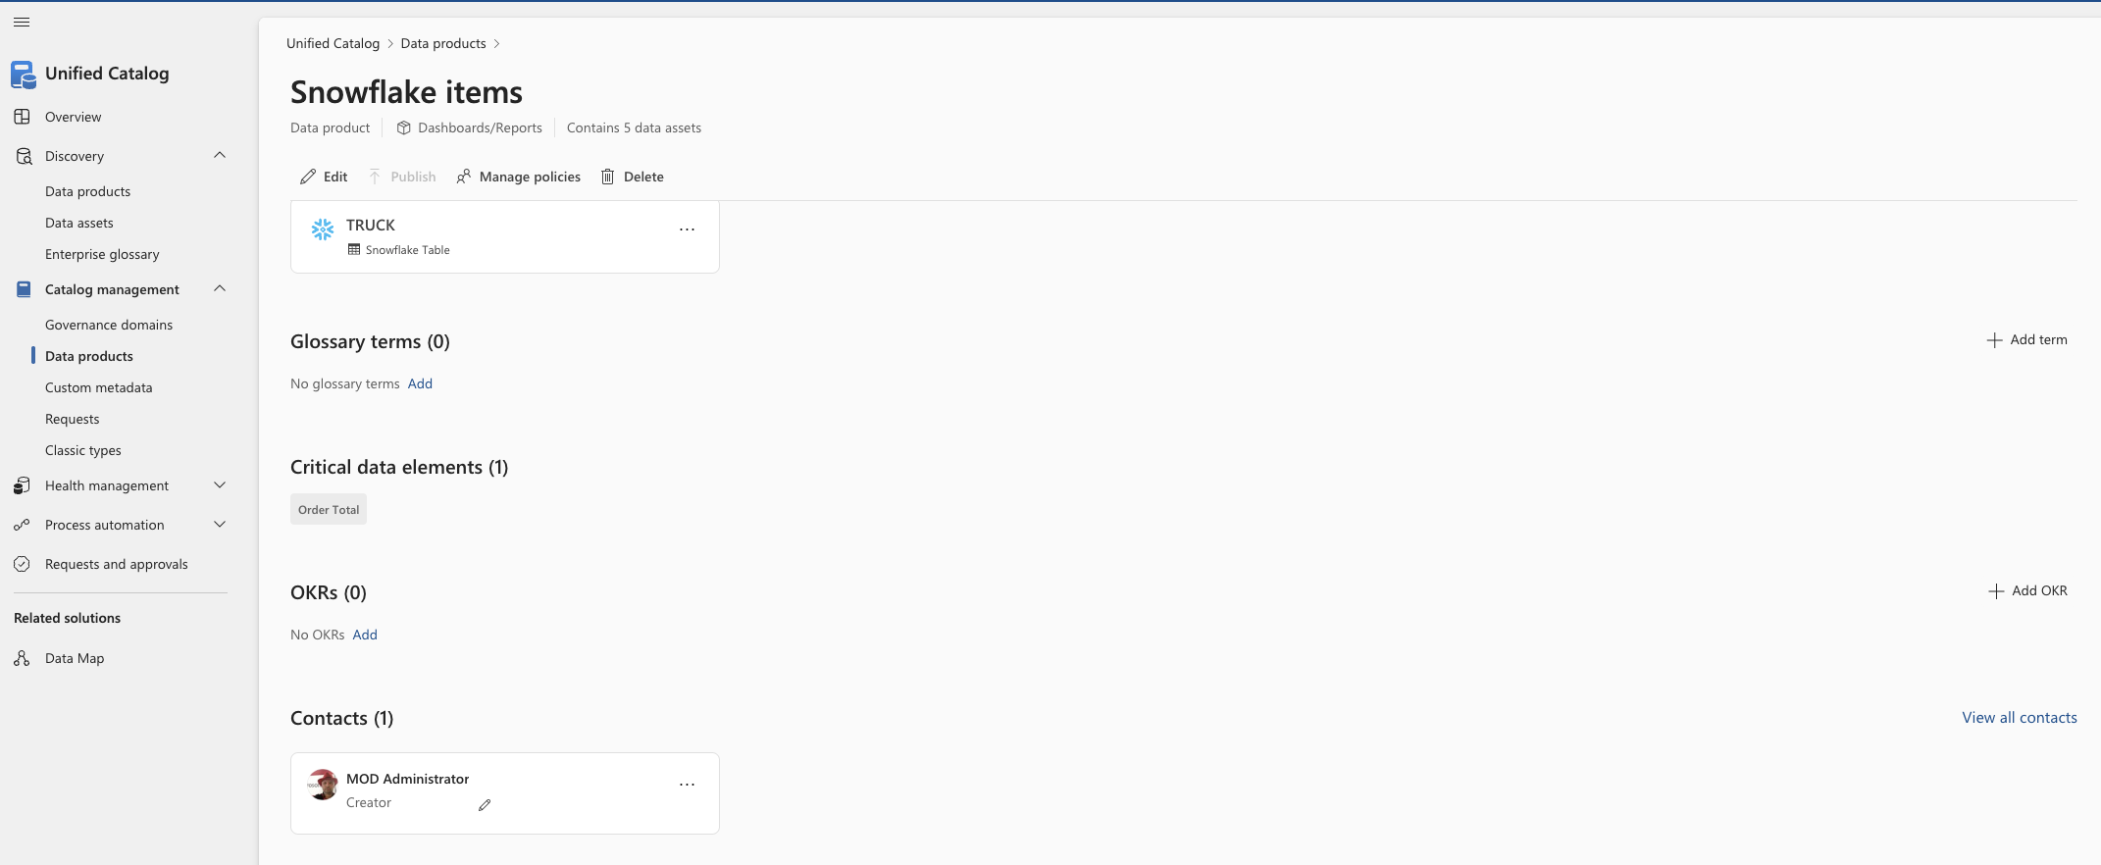
Data Product – Contacts
When you add owners to data products during the creation or editing process, the owners automatically appear in the Contacts section. You can customize the label by selecting the pencil icon in each contact card.

Slide 52
Catalog management
Requests

Slide 53
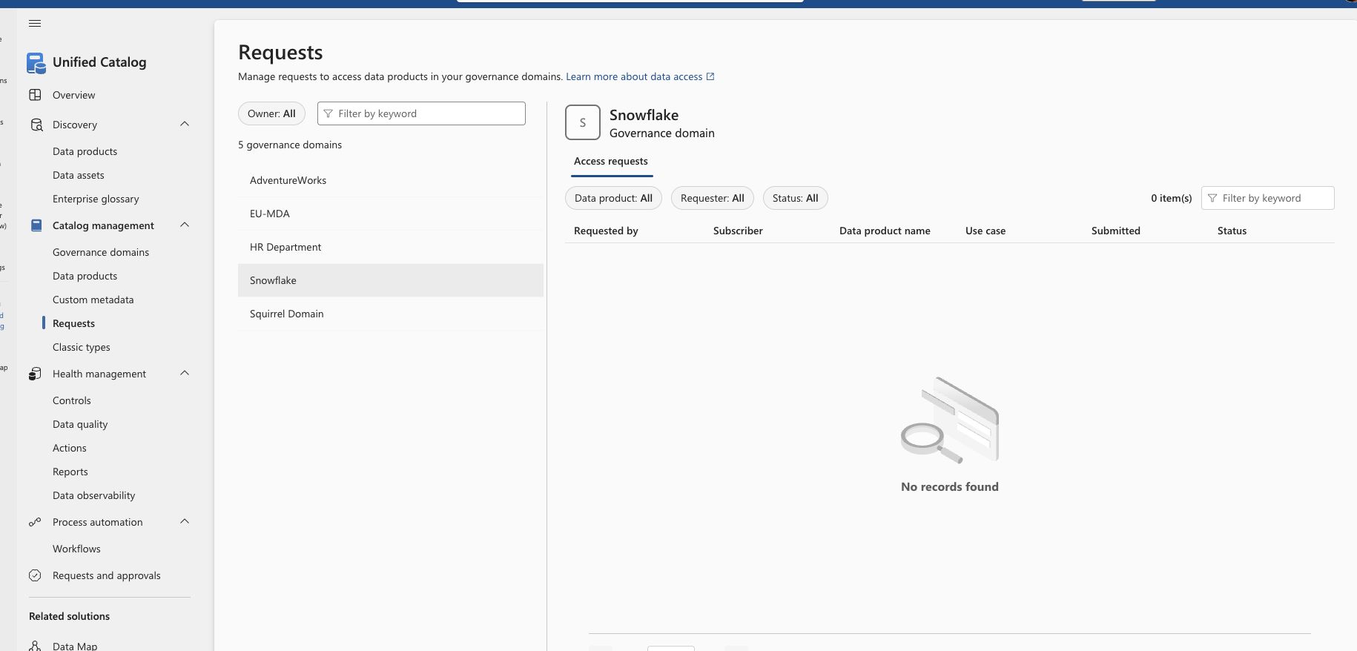
Requests – Old and new
The Requests page in Catalog management shows only the access requests from the existing published data products before the new workflow feature became available on 11/12/2025.
All access requests and other approvals moving forward are in the Requests and approvals tab under the Waiting for my response screen. The process and approvals are the same.

Slide 54
Catalog management
Classic types

Slide 55
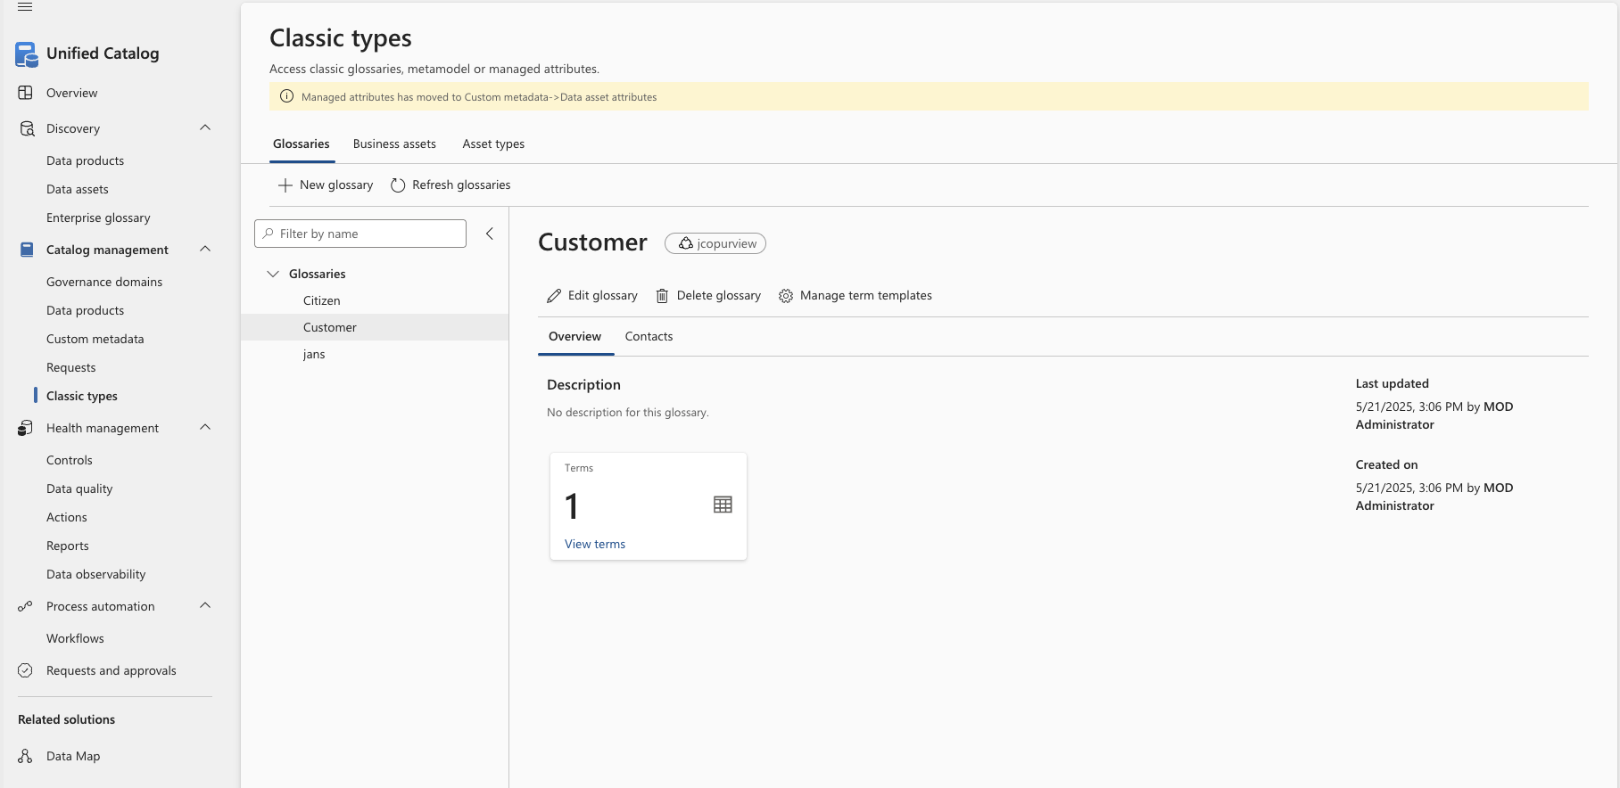
Classic types – Glossaries
On this screen you can create glossary items that can be related to a data assets.

Slide 56
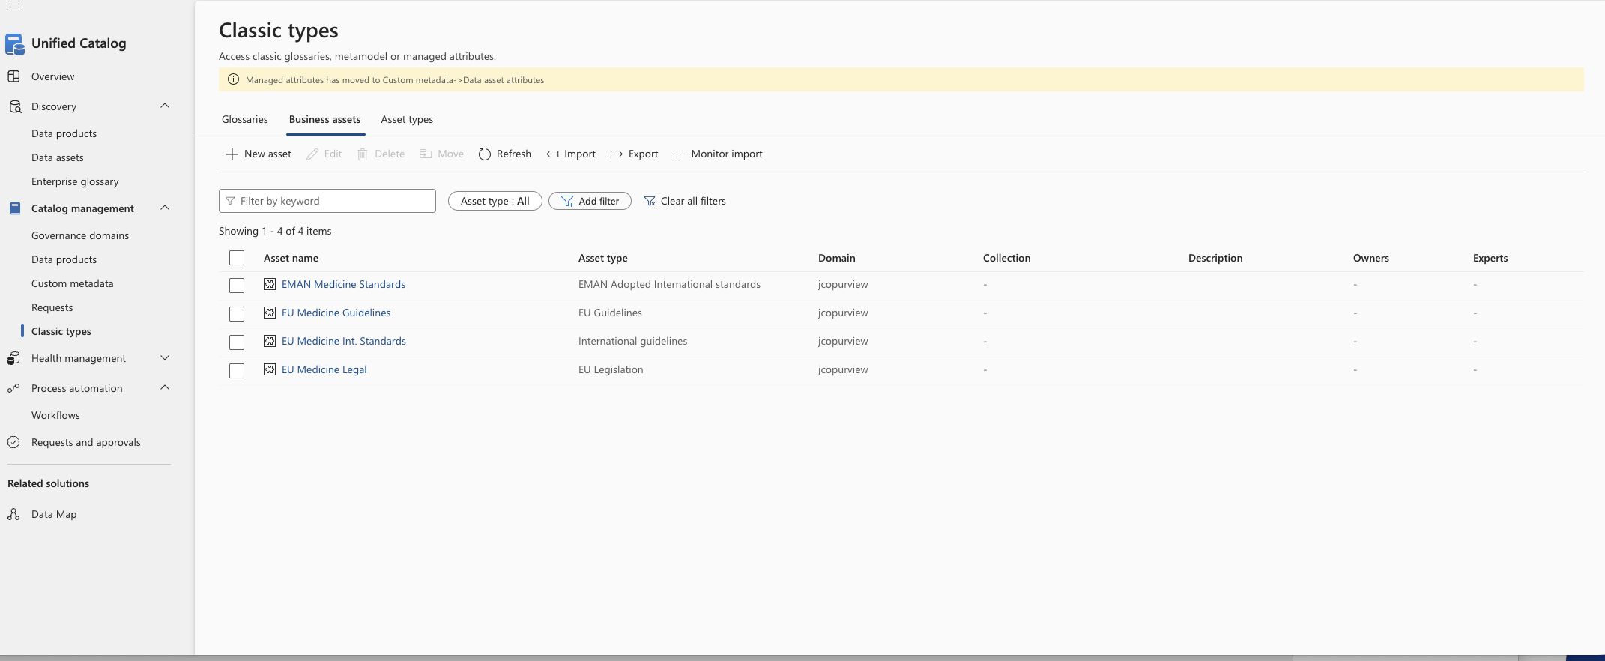
Classic types – business assets
Metamodel is a feature used in the Data Map that gives the technical data in your data map relationships and reference points to make it easier to navigate and understand in the day to day. Like adding streets and cities to a map, the metamodel orients users so they know where they're and can discover the information they need.
You can create your own business assets and relate them in the metamodel

Slide 57
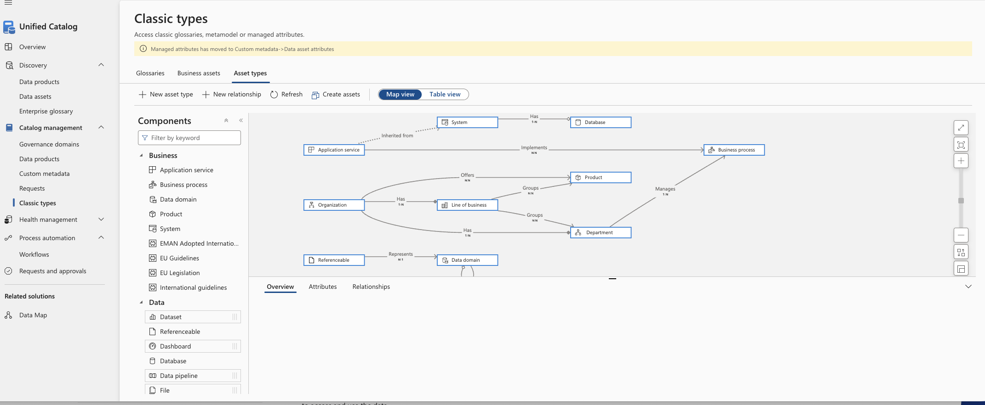
Classic types – asset types
Create additional asset types for describing real-world things in your organization such as departments, projects, products, and lines of business. When you look at your data estate, it's often helpful to understand how your data fits into your business.
Use business assets whenever you want to associate data assets to specific organizational structures, business processes, or other anything else that could be convincingly modeled as an entity.

Slide 58
Health management
Controls

Slide 59
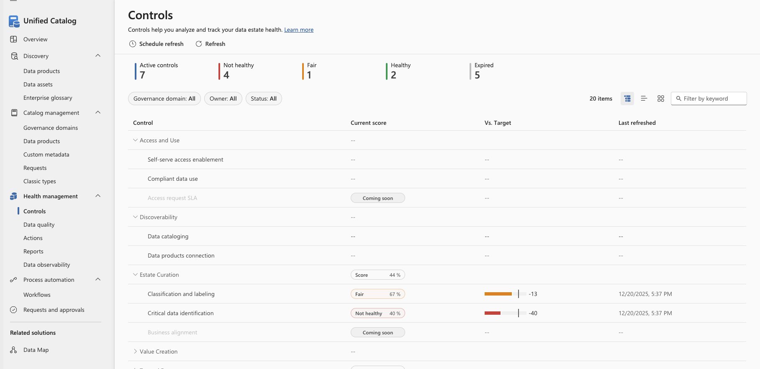
Controls – reports – 1 of 2
Data health controls help you analyze and track your health management of Purview content.
Track your journey to complete data governance by monitoring your governance health, and use the provided health controls to track your progress.
Data health controls are specific measures, processes, and tools that you implement to monitor, maintain, and improve the quality, security, and overall health of your organization's data.

Slide 60
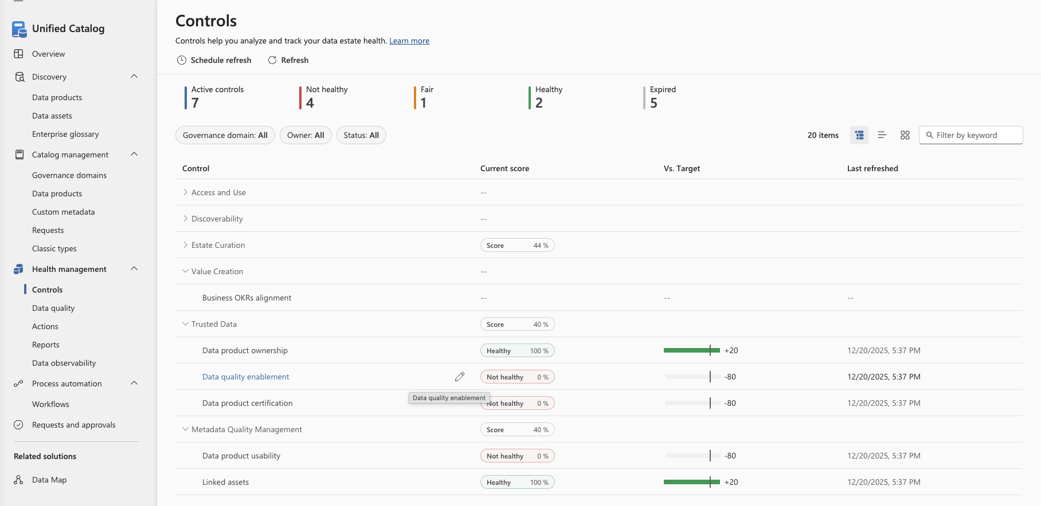
Controls – reports – 2 of 2
Data health controls help you analyze and track your health management of Purview content.
Track your journey to complete data governance by monitoring your governance health, and use the provided health controls to track your progress.
Data health controls are specific measures, processes, and tools that you implement to monitor, maintain, and improve the quality, security, and overall health of your organization's data.

Slide 61
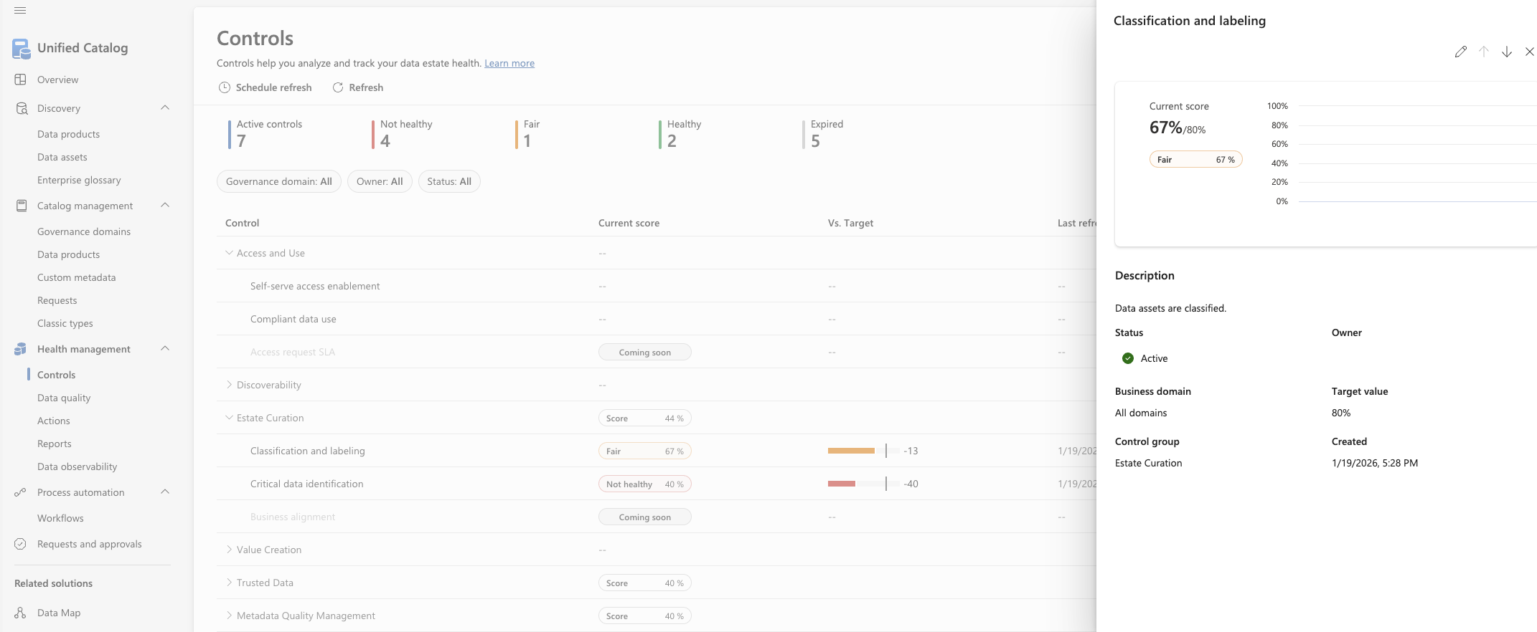
Controls – adjustment – 1 of 4
You can not create your Data health controls as of now, but you can adjust the “limits” for the supplied controls.
Click the control you would like to adjust and on the details screen click the pencil. You can also find this pencil on the overview screen besides the different controls.

Slide 62
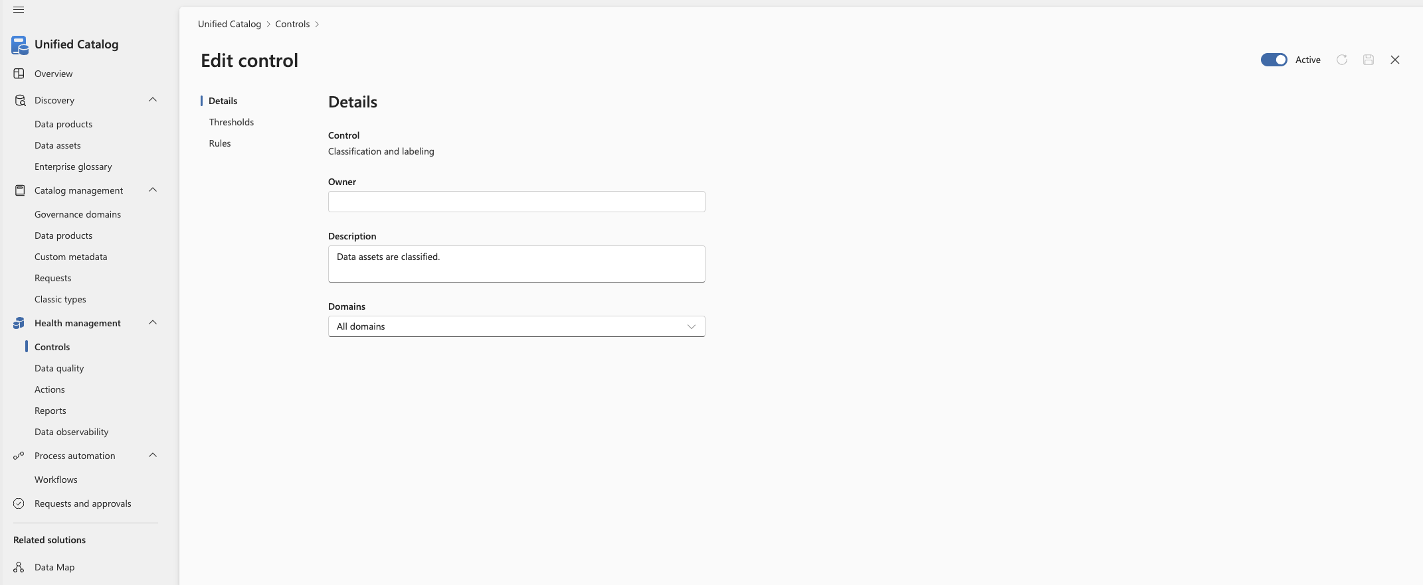
Controls – adjustment – 2 of 4
On the details screen of a control, you can change its owner, description and the domains it controls.
Click the control you would like to adjust and, on the details, screen click the pencil. You can also find this pencil on the overview screen besides the different controls.
You can also turn a control on and off.

Slide 63
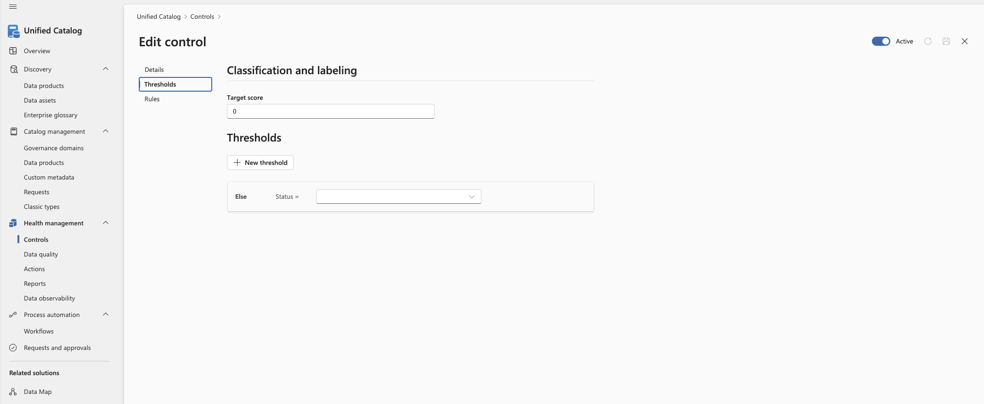
Controls – adjustment – 3 of 4
On the Edit control screen, you can adjust the thresholds for the control.
You can make an “if then else” statement by adding New thresholds

Slide 64
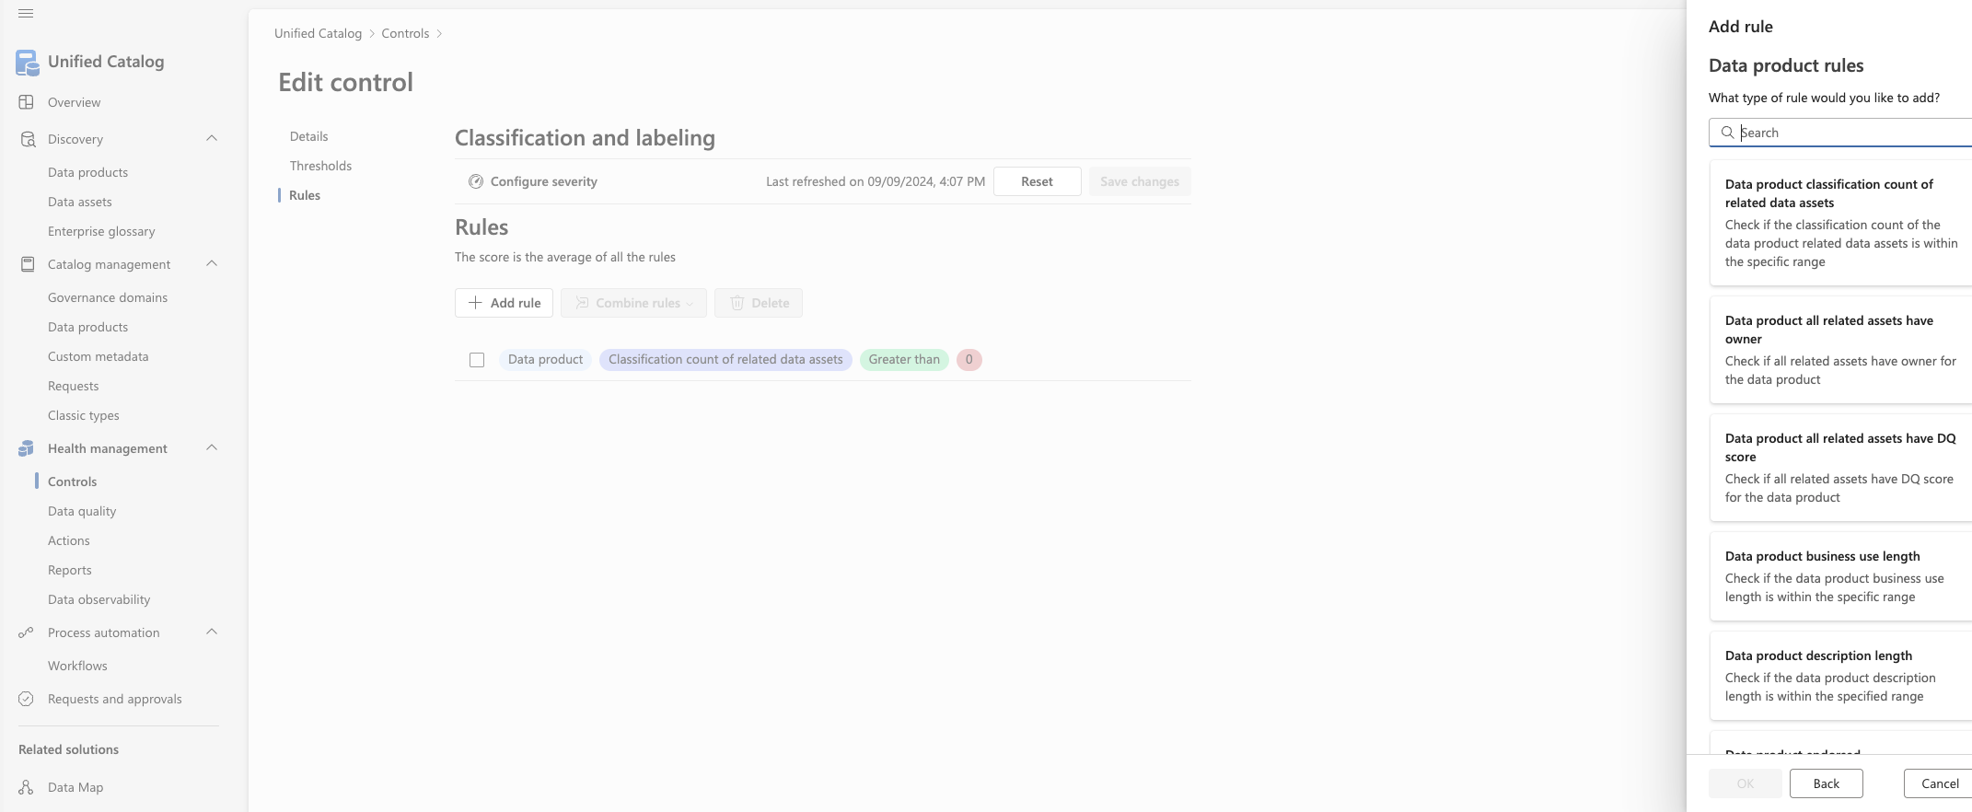

Controls – adjustment –4 of 4
On the Rules screen you can add rules to the threshold.
These rules is taken from the list of build-in rules.
You can also set the severity level of the threshold by clicking on configure severity.

Slide 65

Actions - overview
The Actions page displays all health management actions related to catalog metadata, controls, and data quality.
Health management actions give you steps to take to improve data health and governance across your data estate.
These actions correspond to the checks made to calculate a data product's data governance health control score
Addressing these actions raises your health score and promotes a more useful and discoverable Unified Catalog.

Slide 66

Reports - overview
The reports section gives you access to different to embedded Power BI reports documenting the health of mainly the Data Map.

Slide 67

Data observability - overview
This screen shows the different data observability reports.

Slide 68


Slide 69


Slide 70
Policies

