Slide 1
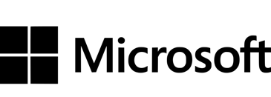
Governance and Compliance with Microsoft Purview
If you think compliance is complicated, feel free to try incompliance!
Jan Cordtz, Snr. Cloud Solution Architect
Microsoft Denmark

Slide 2
Today’s data realities
3
What data do I have?
Data governance
Is it trustworthy?
2
Analytics
Can people access the data needed to make the right decisions?
1
Operational Databases
How can I enable faster business insights?
Operational databases
What’s my compliance exposure?

Slide 3
BUT before we begin
We have don't have enough words for what we do
We re-use:
Domains
Rules
Workspace
Compliance
Governance
Collection
Sensitivy

Slide 4
Organizations struggle to secure and govern their data
74%
Can’t secure the data
68%
Can’t activate the data
47%
Can’t adhere to regulations
1. Data Security Index Report
2. 2022 Chief Data Officer survey, Deloitte, 2023.
3. ISMG First Annual Generative AI Study:
Notes:
Despite understanding the key role governance plays, many organizations still struggle to implement effective data democratization.
Customers often struggle with securing the data, activating the data, and adhering to regulatory risks.
74% of companies in a study had some data exposed in the past year
68% of companies report not being able to activate the data to apply the right insights.. Leads to poor data quality
47% of leaders are confident their organization is able to confidently meet AI regulations
Each of these are approached as a siloes today, which leads to these pain points.
Activation means making your data ready for use, analysis, or integration into applications

Slide 5
“Without proper governance and security, data & analytics initiatives are at risk of producing unreliable or compromised results”

Slide 6
Microsoft Purview Comprehensive solutions to help govern, protect and manage your data estate
Understand & govern data
Manage visibility and governance of data assets across your environment
Improve risk & compliance posture
Identify data risks and manage regulatory compliance requirements
Safeguard data, wherever it lives
Protect sensitive data across clouds, apps, and devices
Microsoft ecosystem
Support for multi-cloud, hybrid, SaaS data | Third-party/partner ecosystem
Notes:
Introducing Microsoft Purview!
To help organizations govern and protect data across their multi-cloud, multi-platform data environment, while meeting the compliance requirements they are subject to, we are announcing Microsoft Purview. Microsoft Purview is a comprehensive set of solutions to help govern, protect, and manage your data estate.
Microsoft Purview unifies information protection, data governance, risk management, and compliance solutions so that customers can manage their data all from one place. Now, they can leverage that visibility across their environment to help close exposure gaps, simplify tasks through automation, stay up-to-date with regulatory requirements, and keep their most important asset, data, safe.

Slide 7
Why is data governance so hard for organizations?
Fragmentation
Labor-intensive tasks
Centralized Governance
Technical interfaces
Notes:
But why has it been so hard for organizations?
One of the most common pain points in data governance technology implementation is fragmentation. Many organizations find themselves inundated with tools aimed at governing and managing data. This fragmentation leads to complexity, making it challenging to maintain a unified view of data across the organization. Additionally, these tools have historically been tailored to IT, making this a tedious and centralized process that wasn’t intended to address the core issues of governance. As a result, organizations struggle to ensure data quality, security, and compliance.
Unified Catalog – Atlas
Data Lineage – Collibra, Atlan
Data Quality – Internal custom implemented
The second common pain point is the drudgery of labor intensive tasks associated with data governance. Many organizations find themselves constantly playing catch up, struggling to keep pace with the ever-evolving data landscape. Manual processes, such as data classification, metadata management, and compliance reporting can be time-consuming and prone to error. This can result in the organization on a treadmill of prep and set up-- never really able to put the practice into data governance.
The third challenge in data governance implementation is the tension between centrally managed governance and the demand for agility by the business units. Centralized governance models can sometimes stifle innovation and lead to the emergence of shadow business intelligence (BI) initiatives. Business units may get frustrated and resort to using unauthorized tools and processes to meet their specific needs, bypassing centralized governance protocols, and prone to making mistakes.
Finally, a key pain point in data governance technology implementation is lack of tools well tailored for the roles in the enterprise who need to perform different tasks. Traditional governance tools often catered primarily to IT. But with the datasphere growing at an unprecedented pace, having a business-friendly experiences that cater to self-service by data stewards and data consumers is critical.

Slide 8
Microsoft has faced similar challenges
Data estate expansion
Centralized governance
Decentralized governance
Data silos
Notes:
As we share our journey, we want to provide some of the valuable lessons about building a data governance culture to support overall data and digital transformation. We learned that we how to navigate and identify the key strengths of various governance models, how to secure internal support, establishing robust tracking and accountability mechanisms, and adhering to core principles were the keys to driving ongoing data governance transformation. These lessons highlight the importance of adaptability, stakeholder engagement, and strategic implementation in building an effective data governance culture.
Key challenges we had to overcome:
Organically-grown Data Estates: Our data estates had evolved organically over time, leading to a lack of uniformity and consistency in how data was managed. This organic growth made it difficult to implement a cohesive governance strategy."
Data Silos: Centralized governance resulted in data being trapped in silos, which severely limited accessibility and prevented comprehensive insights. Breaking down these silos was essential to enable better data integration and utilization."
Centralized Governance Hindering Agility: Our centralized governance model, while intended to maintain control, became a barrier to agility. Slow decision-making processes and cumbersome compliance requirements stifled innovation and responsiveness. We needed a more flexible approach to adapt quickly to changing business needs."
Decentralized Governance without Consistent Standards: On the other hand, where decentralized governance was applied, it often lacked consistent standards. This inconsistency led to fragmented data practices and uneven compliance across different parts of the organization. Establishing cohesive standards was critical to ensure uniformity and compliance across all data governance efforts."

Slide 9
Why Microsoft landed on a federated governance approach
Centralized
Federated
Decentralized
Responsibility at the Core
Agility at the Edge
Responsibility at the Core
Agility at the Edge
Responsibility at the Core
Agility at the Edge
Source : Forrester Research. Map a path to Federated Data Governance
Notes:
As we look to scale data governance, there are three broad operating models to consider. At Microsoft, we have lived through all three models in the last 5-8 years.
We began with a centralized model. This model is where you have a single team, typical a data office in an IT organization, which is accountable for managing the entire enterprise data estate. This can help you harden your controls and keep your data estate secure and compliant. The challenge with this model is when everything is gated through one team it will impact agility of the business to innovate and apply data in free and unique ways.
The next model we navigated was the decentralized model. This brings significant agility at the edge and enables business teams to innovate faster but comes with the cost of not being able to realize the efficiencies that can be gained by standardized and making more common the security compliance and privacy aspects of your data estate.
The industry is now converging towards a federated data governance model. This gives you the best of both. It enables you to maintain commonalities and consistent operations while enabling those capabilities to responsible democratize data to broader organization-wide functions and users who can self-serve in managing their data estate in discovering, understanding, accessing and applying data.
We at Microsoft firmly believe in the federated data governance model and in enabling these business users to rapidly accelerate business innovation with data.
Additional notes for speaker if needed:
Key Benefits:
Autonomy and Control: Local customization under a unified strategy.
Responsiveness and Agility: Quick adaptation to department-specific needs.
Scalability: Adapts to growth and changes in organizational structure.
Compliance Assurance: Maintains overarching compliance while allowing local variations.
Collaboration: Promotes knowledge sharing and best practice dissemination across units.
Why the Shift is Important:
Complex Data Landscapes: Manages increasing data intricacy efficiently.
Regulatory Compliance: Meets stringent global data protection laws.
Business Agility: Supports rapid response to market changes.
Organizational Decentralization: Suits geographically and operationally diverse entities.

Slide 10
Purview “eco-system”
Purview Office 365/Compliance
Active, Microsoft Software SaaS
Purview in Fabric
Active, Microsoft Software, SaaS
Purview Portal
Purview Data Governance
Passive, Documenting, PaaS
Data Factory
Azure Databricks
Azure Databricks - Unity Catalog
Active, Databricks SW, SaaS

Slide 11

Unified platform to secure & govern your multi-cloud data estate
Microsoft Purview
DATA SECURITY
DATA GOVERNANCE
DATA COMPLIANCE
Secure data across its lifecycle, wherever it lives
Responsibly unlock value creation from data
Manage critical risks and regulatory requirements
Data Loss Prevention
Insider Risk Management
Information Protection
Data Catalog
Data Quality
Data Lineage
Data Estate Health
Compliance Manager
eDiscovery and Audit
Communication Compliance
Data Lifecycle Management
Records Management
Unstructured & Structured data
Traditional and AI generated data
Microsoft 365 and Multi-cloud
Shared platform capabilities
AI-based efficiency, Discovery, Classification, Labels, Rules, Policies, Data Connectors
Notes:
The Microsoft Purview family is here to help you govern and protect data across multi-cloud, multi-platform data environment, while helping you meet compliance requirements you may be subject to; helping you with your data security, data governance and data compliance needs.
Purview brings simplicity with a comprehensive set of solutions built on a platform of shared capabilities, that helps keep your most important asset, data, safe.
Notes
Data Governance is overloaded (Info Governance as well)
Data Governance is not needed to do security and compliance for Copilot for M365
Consider alternative ways to avoid ‘Data Governance’ overloading

Slide 12












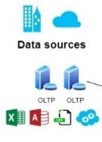
A federated practice paired with user-friendly tools
Data Consumers
Quickly find and use relevant, trusted datasets through streamlined access request workflow.
Domains
Data Owners
Sales
Marketing
Human
Resources
Operations
Finance
Sustainability
Register data assets for use, manage classifications and access, and ensure high quality standards.
Ensure data quality, seamless data discovery, glossary consistency, and lineage. Work with central office.
Data Stewards
Unified Catalog
Data Health Management
Central Data Office
Establish and ensure governance policies, active metadata, compliance, and insights into overall governance health.
Azure
Data Lake Storage
Google Cloud Storage
Databricks
Fabric
Snowflake
Azure
Cosmos DB
Azure
SQLDB
Mongo
DB
Cloud stores
Databases
All other sources
Notes:
And it’s critical that technology simplifies the way each data professional in your organization manages, discovers, and accesses data. With a solution built for each role, business domain experts can accelerate data value while your data office and stewards provide the standards for consistent operations and can maintain commonalities. It’s all about seamlessly enabling responsible data democratization and federated governance.

Slide 13
Microsoft Purview brings together solutions from our compliance and data governance portfolios
Frontend
Backend
Risk & compliance
For risk, compliance, and legal teams
Data Map
Data Catalog
Data Quality
Data Estate Insights
Microsoft Purview
Information Protection
Data Loss Prevention
Data Lifecycle Management
Data Connectors
Insider Risk Management
eDiscovery
Audit
Records Management
Communication Compliance
Compliance Manager
Unified data governance
For data consumers, data engineers, data officers
Notes:
With Microsoft Purview we bring together compliance and data governance
The risk and compliance portfolio joins with our unified data governance

Slide 14


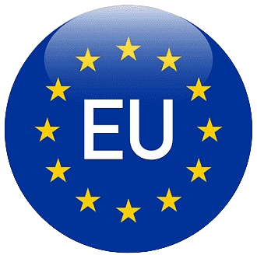



Compliance with Microsoft
Microsoft Azure is a core Microsoft online service and supports a wide range of compliance standards including:
GDPR / NIS2 / AI Act
EUDB
ISO certifications including ISO 27001, 27701, 27017, 27018
NIST certifications
CIS18 certifications
SOC 1,2 and 3
HIPAA compliance
+90 → Azure compliance
Notes:
Workspace security
Workspaces represent the primary security boundary for data stored in OneLake. Each workspace represents a single domain or project area where teams can collaborate on data. You manage security in the workspace by assigning users to workspace roles.
For more information, see OneLake security (Workspace security).
Item security
Within a workspace, you can assign permissions directly to Purview items, like warehouses and lakehouses. Item security provides the flexibility to grant access to an individual Purview item without granting access to the entire workspace. Users can set up per-item permissions either by sharing an item or by managing the permissions of an item.
For information, see OneLake security (Item security).

Slide 15
Purview Compliance The office world

Slide 16

Unified Compliance Capabilities
Comprehensive Compliance Tools
Microsoft Purview offers tools that help organizations meet legal, regulatory, and internal compliance obligations effectively.
Data Protection and Governance
The platform provides advanced data protection, lifecycle management, and governance to safeguard sensitive information.
Seamless Microsoft 365 Integration
Purview integrates with Exchange, SharePoint, OneDrive, and Teams for centralized compliance control and monitoring.
Risk Management and Operational Efficiency
Purview empowers compliance officers to manage risk proactively while maintaining organizational trust and efficiency.
Notes:
Microsoft Purview Compliance in Microsoft 365 provides a comprehensive suite of tools designed to help organizations meet regulatory, legal, and internal compliance obligations. It enables businesses to reduce compliance and regulatory risks by offering advanced data protection, lifecycle management, and governance capabilities. The platform supports secure collaboration across Microsoft 365 services, ensuring sensitive information is safeguarded without compromising productivity. By leveraging Purview, organizations can streamline compliance processes, improve visibility into data handling, and maintain adherence to global standards such as GDPR, HIPAA, and other industry-specific regulations. The solution integrates seamlessly with Microsoft 365 workloads, including Exchange, SharePoint, OneDrive, and Teams, offering centralized control and monitoring. Ultimately, Purview empowers compliance officers and executives to proactively manage risk, enhance organizational trust, and maintain operational efficiency while meeting stringent compliance requirements.

Slide 17

Information Protection
Data Classification and Labeling
Automatically detect and classify sensitive data using sensitivity labels and classification policies to ensure consistent protection.
Encryption and Access Controls
Protect confidential information through encryption and controlled access, preventing unauthorized data exposure.
Compliance and Secure Collaboration
Maintain regulatory compliance while enabling secure collaboration between employees and external partners.
Automated Labeling and Error Reduction
Use automated and recommended labeling to simplify compliance management and reduce human errors.
Notes:
Information Protection within Microsoft Purview focuses on identifying, classifying, and safeguarding sensitive data across Microsoft 365 environments. This capability ensures that confidential business and personal information is consistently protected through sensitivity labels, encryption, and access controls. Organizations can apply classification policies that automatically detect sensitive information types and enforce protection measures, such as visual markings and secure sharing protocols. By implementing Information Protection, businesses can reduce the risk of data exposure, maintain compliance with regulatory requirements, and foster secure collaboration among employees and external partners. The solution also supports automated and recommended labeling, which simplifies compliance management and minimizes human error. These features collectively enhance data security and help organizations maintain a strong compliance posture while enabling productivity.

Slide 18

Data Loss Prevention (DLP)
Comprehensive Data Protection
DLP prevents both accidental and intentional data leakage across multiple platforms including email and cloud.
Real-time Policy Enforcement
Real-time alerts and policy tips help educate users and reduce the risk of compliance breaches.
Granular Policy Controls
Organizations can customize DLP policies to meet specific regulatory and operational requirements.
Risk Mitigation and Trust
DLP supports regulatory compliance, reduces data loss risks, and helps maintain stakeholder trust.
Notes:
Data Loss Prevention (DLP) in Microsoft Purview is designed to prevent accidental or intentional data leakage across email, collaboration platforms, endpoints, and cloud applications. DLP policies detect sensitive information and enforce restrictions to prevent unauthorized sharing or exfiltration. Real-time policy tips and user alerts educate employees on compliance requirements, reducing the likelihood of breaches. By implementing DLP, organizations can mitigate risks associated with data loss, support regulatory compliance, and maintain trust with customers and stakeholders. The solution offers granular controls, enabling businesses to tailor policies to specific regulatory frameworks and operational needs. Ultimately, DLP helps organizations safeguard critical data assets, reduce exposure to compliance violations, and maintain operational integrity.

Slide 19

Data Lifecycle Management
Retention and Deletion Policies
Organizations apply retention policies and labels to ensure data compliance with legal and regulatory standards.
Automation of Data Governance
Automation simplifies compliance management and reduces manual efforts in data lifecycle processes.
Risk Reduction and Cost Optimization
Effective lifecycle management minimizes legal risks and optimizes storage costs, enhancing efficiency.
Notes:
Data Lifecycle Management ensures that content within Microsoft 365 is retained or deleted according to organizational policies and regulatory requirements. This capability helps businesses manage data throughout its lifecycle, from creation to deletion, reducing legal and storage risks. Organizations can apply retention policies and labels, including event-based retention, to ensure compliance with industry standards. By automating data governance processes, Purview simplifies compliance management at scale and minimizes manual intervention. Effective lifecycle management not only supports regulatory obligations but also optimizes storage costs and enhances operational efficiency. These features collectively enable organizations to maintain defensible compliance practices while reducing complexity and risk.

Slide 20

Records Management
Protection of Critical Records
Ensures critical records are safeguarded from unauthorized deletion or modification to maintain integrity.
Compliance and Legal Mandates
Supports compliance with regulatory requirements through formal declaration and control of records.
Disposition Reviews and Approvals
Includes disposition reviews and approval workflows to manage record lifecycle effectively.
Industry Applications
Crucial for finance, healthcare, and government sectors with strict recordkeeping standards.
Notes:
Records Management in Microsoft Purview provides organizations with tools to manage regulatory and legal records effectively. This functionality ensures that critical records are protected from unauthorized deletion or modification, supporting compliance with industry regulations and legal mandates. Features include formal record declaration, disposition reviews, and approval workflows, which help organizations maintain control over regulated content. By implementing robust records management practices, businesses can meet audit requirements, reduce risk, and maintain transparency in their compliance processes. These capabilities are essential for industries such as finance, healthcare, and government, where strict recordkeeping standards are enforced.

Slide 21

eDiscovery
Core eDiscovery Functions
eDiscovery facilitates content search, legal holds, case management, and data export to support investigations.
Integration with Microsoft 365
Seamless integration with Microsoft 365 provides comprehensive visibility into organizational data.
Compliance and Risk Reduction
eDiscovery helps legal teams maintain efficiency, reduce risk, and ensure regulatory compliance in investigations.
Notes:
eDiscovery in Microsoft Purview enables organizations to identify, preserve, and manage content for internal investigations and legal matters. This capability includes content search, legal holds, case management, and export functionalities, which streamline the discovery process and reduce associated costs. By leveraging eDiscovery, businesses can respond quickly to litigation or compliance inquiries, ensuring defensible compliance practices. The solution integrates with Microsoft 365 workloads, providing comprehensive visibility into organizational data. These features help compliance officers and legal teams maintain efficiency, reduce risk, and uphold regulatory obligations during investigations.

Slide 22

Audit
Visibility into Activities
Audit tools provide detailed visibility into user and admin actions across Microsoft 365 environments.
Compliance Support
Auditing supports compliance audits and forensic investigations by logging and retaining activity data.
Advanced Audit Features
Organizations can search and export audit events to ensure transparency and traceability.
Security and Risk Reduction
Robust auditing practices help detect anomalies, reduce risks, and maintain operational integrity.
Notes:
Audit capabilities in Microsoft Purview provide detailed visibility into user and administrator activities across Microsoft 365. This functionality supports compliance audits, forensic investigations, and accountability by logging and retaining activity data. Advanced audit features enable organizations to search and export audit events, ensuring transparency and traceability. By implementing robust auditing practices, businesses can meet regulatory requirements, detect anomalies, and maintain operational integrity. These capabilities are critical for organizations seeking to enhance security, reduce risk, and demonstrate compliance during external audits or internal reviews.

Slide 23

Insider Risk Management
Identifying Insider Threats
Policy-based detection and signal correlation help organizations detect insider threats like data theft and policy violations.
Customizable Risk Policies
Configurable policies and thresholds enable tailored risk management strategies to meet organizational needs.
Balancing Security and Privacy
Risk management balances security measures with user privacy to protect intellectual property and maintain trust.
Notes:
Insider Risk Management in Microsoft Purview helps organizations identify and mitigate risks associated with insider threats, such as data theft or policy violations. This capability uses policy-based detection and signal correlation across Microsoft 365 to identify risky behaviors while maintaining user privacy. Configurable policies and thresholds allow businesses to tailor risk management strategies to their specific needs. By addressing insider risks proactively, organizations can protect intellectual property, reduce compliance violations, and maintain trust. These features balance security and privacy, ensuring a responsible approach to risk mitigation.

Slide 24

Communication Compliance
Compliance Monitoring
Monitors communications across platforms to ensure ethical and regulatory adherence in real-time.
Detection of Violations
Detects inappropriate language, harassment, and policy violations within communication channels.
Reviewer Workflows
Facilitates timely investigation and resolution of compliance issues through structured workflows.
Industry Regulation Support
Helps regulated industries maintain integrity and meet strict communication oversight requirements.
Notes:
Communication Compliance in Microsoft Purview monitors internal and external communications to ensure adherence to ethical and regulatory standards. This capability helps organizations detect inappropriate or non-compliant language, harassment, or policy violations within communication channels such as Microsoft Teams, Exchange, and third-party connectors. Reviewer workflows enable timely investigation and resolution of compliance issues. By implementing communication compliance measures, businesses can protect employees, maintain organizational integrity, and meet industry regulations. These features are particularly valuable for regulated industries where communication oversight is critical.

Slide 25
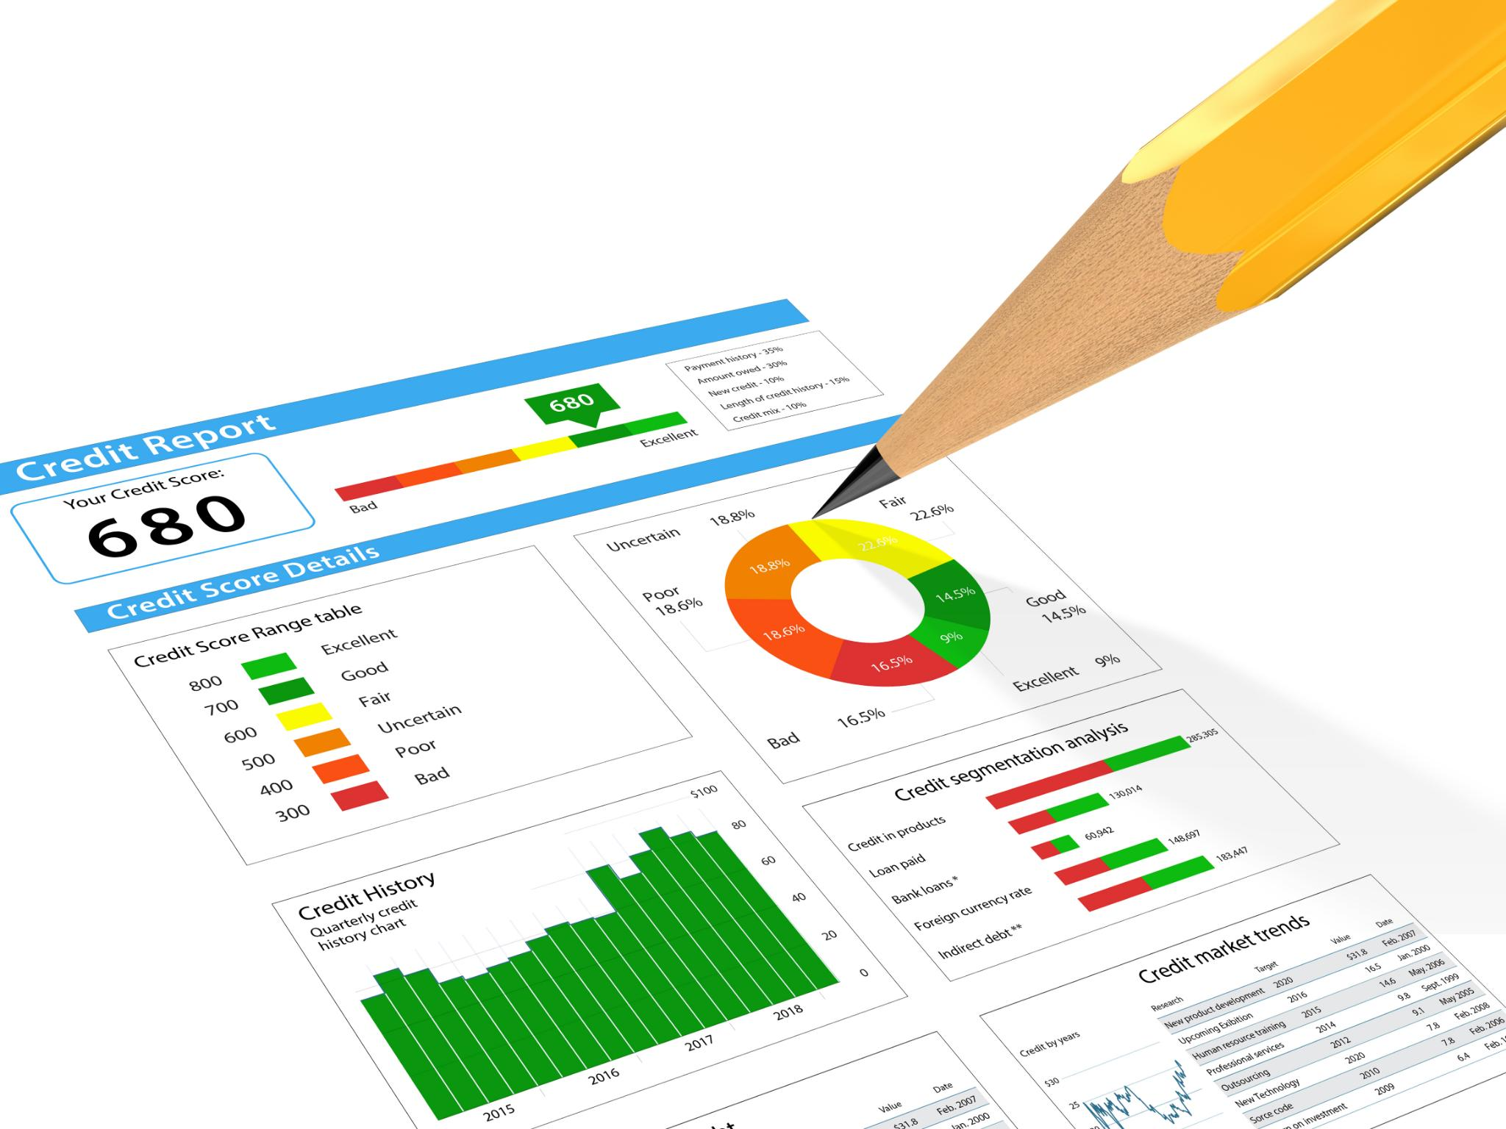
Compliance Manager
Centralized Compliance View
Compliance Manager offers a centralized overview of compliance status and readiness for organizations.
Compliance Assessments and Templates
Includes assessments and regulatory templates to guide organizations in meeting compliance requirements.
Prioritize Remediation Efforts
Helps businesses prioritize improvement actions and track progress to reduce compliance risks.
Enhance Operational Efficiency
Simplifies compliance management, enabling proactive gap identification and building stakeholder trust.
Notes:
Compliance Manager provides organizations with a centralized view of their compliance posture and actionable guidance to improve readiness. This tool includes compliance assessments, regulatory templates, improvement actions, and scoring mechanisms that help businesses track progress and reduce risk. By leveraging Compliance Manager, organizations can simplify compliance management, prioritize remediation efforts, and maintain ongoing adherence to regulatory requirements. These capabilities enable businesses to proactively address compliance gaps, enhance operational efficiency, and build trust with stakeholders.

Slide 26
Compliance and Governance
The “mechanism”

Slide 27
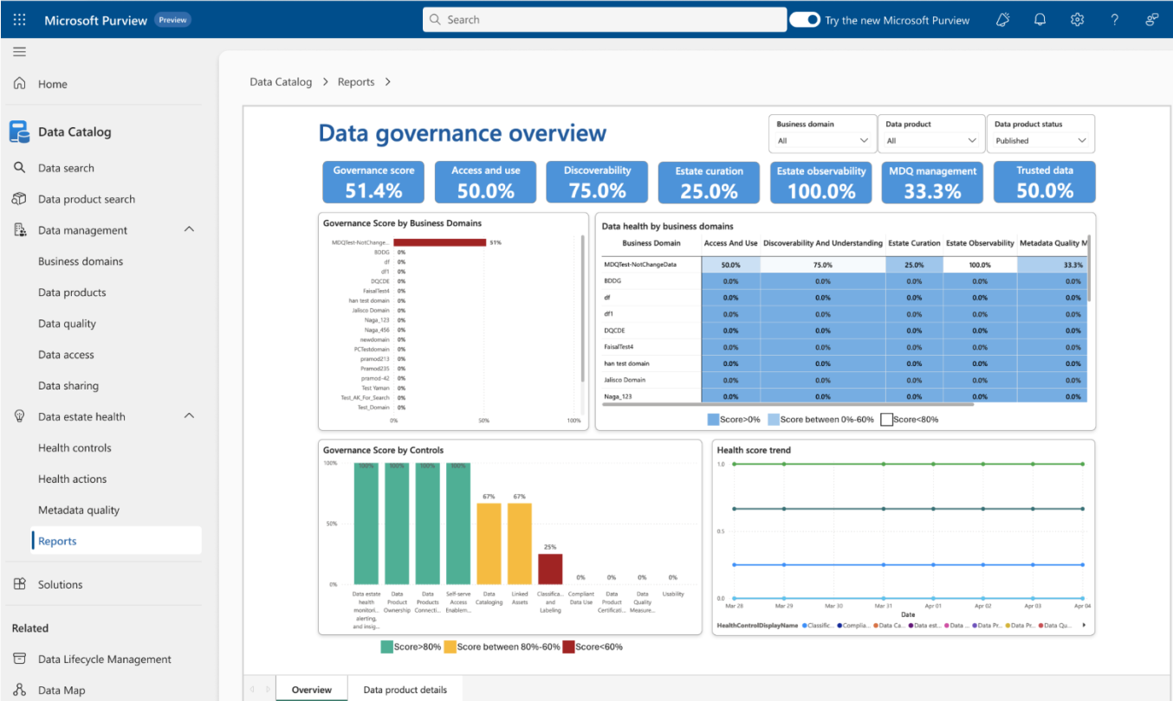
Stay on top of governance health with aggregated actions
Put the “practice” into Data Governance with intuitive dashboards, accountability, and recommended actions.
Built-in Reports
Reports offer a set of standard dashboards to measure data health and gain relevant insights.
Health Actions
Rules and policies come to life in health actions which offers an interactive experience that surfaces issues for real-time actions.
27
Notes:
You can also enable a vibrant, healthy data governance practice with real-time reports and actions that surface insights and drive federated accountability. You can easily govern your entire data estate—whether it resides on-premises, in the Microsoft Cloud, across multiple clouds, or within SaaS applications. And manage everything from a single pane of glass. And lastly, enhance your data health and safety with intuitive dashboards, federated accountability, and recommended actions to keep your data in top shape.

Slide 28
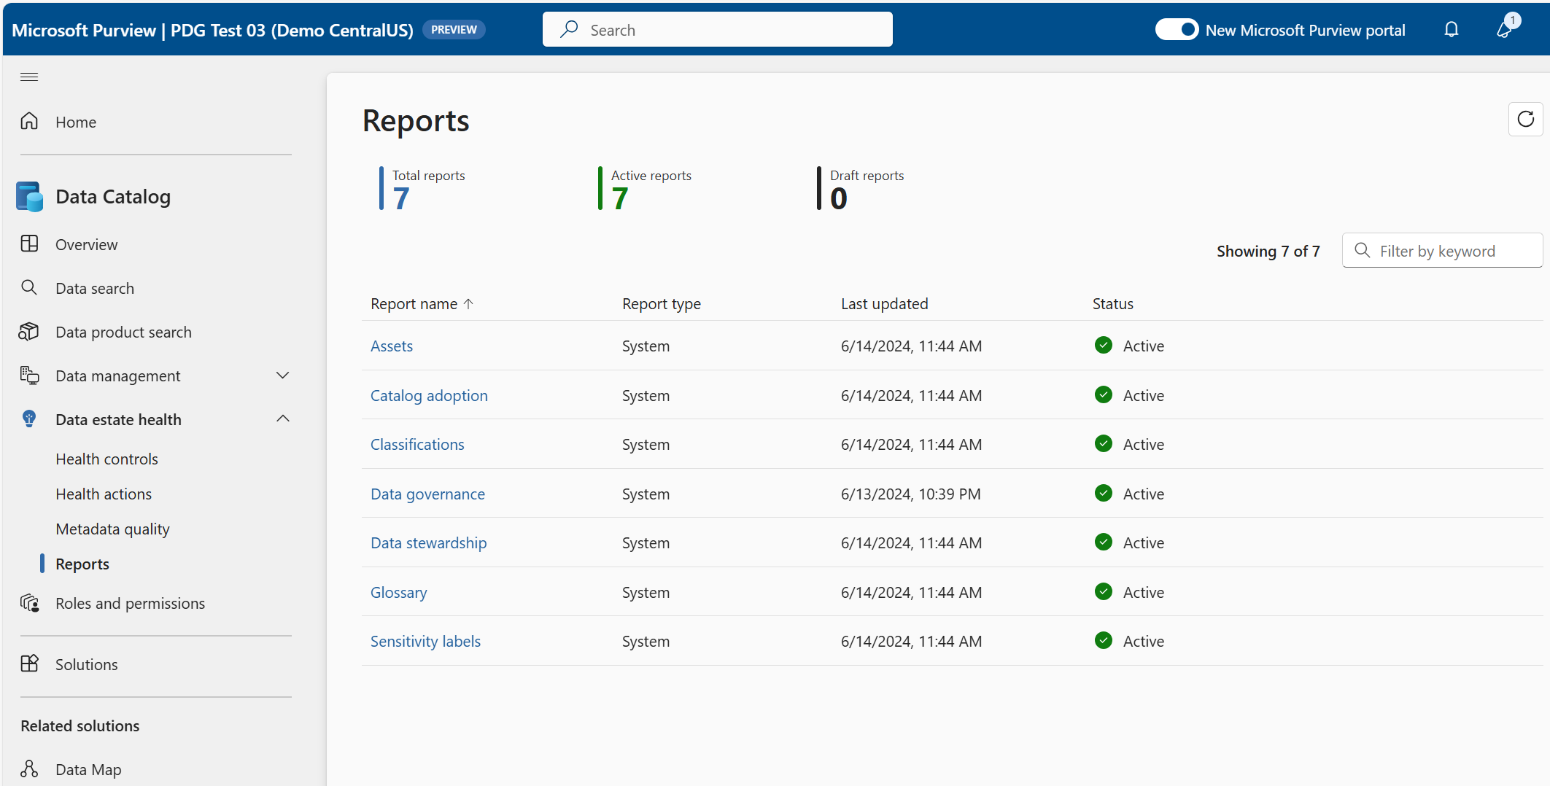

Unified and Actionable | Reports
A one-stop shop for governed data assets to unlock responsible use of data in the era of AI
Key Benefits:
Get visibility into data assets health related to percent assets with owners or classifications and assets created and deleted.
Catalog adoption reveals popular data assets, active users, search activity, and top search topics.
Classification insights reveals stats about assets, files, tables, and data sources classification.
Data governance provides overall insights for your data governance practice—governance score, access + use, discoverability, curation, observability, MDQ management, etc
Data stewardship gives insights into the curated data in your catalog—asset curation, collection status, owner assigned, classification status.
Sensitivity labels offers insights into the state of governed data assets, files, tables, sources with labels.
Notes:
Data Estate Health Insights are provided through comprehensive reports on the status and progress of your data governance. These reports give you a clear view of the overall health of your governed data estate, covering various dimensions such as assets, catalog adoption, classifications, and more. Summarized insights help you sustain your data governance practice by showcasing the overall health and surfacing deep insights.
Aggregated insights help you put the “practice” into your data governance practice by showcasing the overall health of your governed data estate. Built-in reports surface deep insight across a variety of dimensions: assets, catalog adoption, classifications, data governance, data stewardship, glossary, and sensitivity labels.

Slide 29
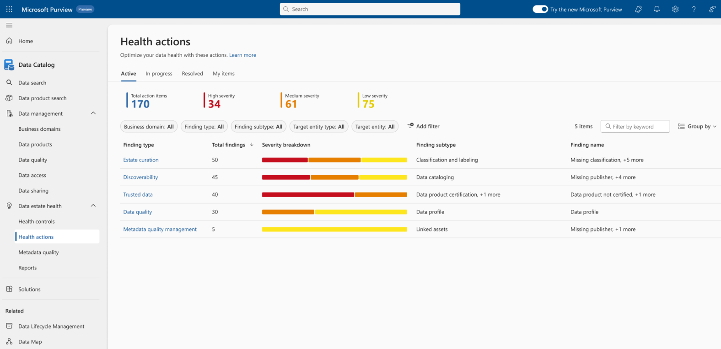
Unified and Actionable | Health Actions
Easily enable leadership insights and support business reviews related to governance health.
Key Benefits:
Health actions illustrate the steps required to improve data health and governance across your governed data estate.
These actions are the result of configured health controls (aligned to EDMC standards) giving you real-time insights for the breadth of your practice.
Easily assign action owners to resolve recommendations and improve governance posture. Incorrectly resolved actions will be automatically reconciled and added back to the actions queue.
Notes:
Lastly are Health Actions. These are concrete steps provided in a single list to guide your data governance journey. By completing these actions, you democratize ownership and improve data quality and discoverability across your data estate. This focused approach ensures continuous improvement in your data governance practices.
The new Actions Center aggregates and summarizes governance-related actions by role, data product, or business domain. This interactive summary makes it easy to manage and track actions, ensuring your data governance practice remains proactive and team-oriented. In partnership with EDM Council, we’ve introduced 14 new data health controls for cloud data management, ensuring your practices meet high industry standards.

Slide 30


Expand governance beyond Fabric with Microsoft Purview
Microsoft Fabric
Microsoft Purview
Reshape how you access, manage, and act on data and insights by connecting every data source and analytics service together in Fabric
Keep your data safe and governed with unified data governance, information protection, and security and compliance solutions
Data ownership
Unified governance
Unmatched security & compliance
Notes:
Microsoft Fabric and Microsoft Purview are part of the Microsoft Intelligent data platform that allows you to store, analyze, and govern your data.
With Microsoft Fabric and Microsoft Purview together, you’re able to govern your entire estate and lineage of data. From data source down to a Power BI report, Microsoft Purview and Fabric work together seamlessly so you can store, analyze, and govern your data without piecing together services from multiple vendors.

Slide 31
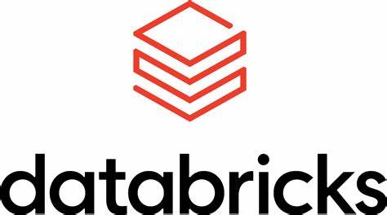
Expand governance beyond Databricks with Microsoft Purview
Microsoft Purview
Bringing AI to your data
Data security and governance
for the era of AI
Databricks Unity Catalog for Lakehouse
Local data catalog and management for the Lakehouse data
Professionally trained data engineers, data scientists, and data analysts.
Purview DG for Multi-cloud, multi-source data estate
Global data security and governance, integrated for business and regulatory req.
Purpose-built for federated governance across org-wide roles.
Notes:
Microsoft Purview also integrates with Azure Databricks and Unity Catalog to help you discover Lakehouse data and bring its metadata into Data Map. Microsoft Purview empowers you to govern your entire data estate across on-premises, multi-cloud, and SaaS applications, serving as a complete “catalog of catalogs”.

Slide 32
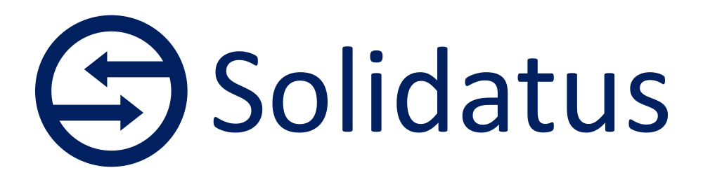
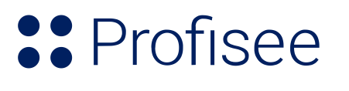


Extend the value of Microsoft Purview with pre-built integrations
Harness Solidatus best-in-class data lineage and its unrivalled capabilities in fine grain lineage, visualization and version control, boosting their data governance efforts and fostering stronger, more resilient businesses directly in Microsoft Purview.
Integrate Microsoft Purview and Profisee MDM to streamline data management tasks and ensure that all systems work to enforce the same standards.
CluedIn, is a graph-based, Azure-native Master Data Management platform and Microsoft Purview integrate natively to create a Unified Data Governance Solution.
Empower data product owners to create and publish golden records that represent the authoritative version of master data assets with bi-directional integration between Semarchy and Microsoft Purview.
Notes:
A modern data governance solution integrates and extends across your technology estate. Our technology partnerships will help seamlessly extend the value of Microsoft Purview to our customers through pre-built integration. Integrations will continue expand and be available in Azure Marketplace.

Slide 33


Leverage the extensibility of Purview through APIs and Power Platform
Customization and Automation
Integrated Data Management
Enhanced Accessibility and Usability
Extending Purview with Power Platform and APIs allows organizations to customize governance solutions to their specific needs and automate governance processes, enhancing efficiency and adaptability.
By leveraging APIs, Purview can integrate seamlessly with other Microsoft services and third-party applications, creating a cohesive data management and governance ecosystem that spans across multiple platforms.
The use of Power Platform with Purview enables a more interactive and user-friendly approach to data governance, allowing non-technical users to participate in data governance processes through familiar tools like Power Apps and Power Automate.
Notes:
Microsoft Purview is rich in extensibility scenarios and enables organizations to adapt, extend, integrate, accelerate, and support their compliance solutions.
There are two key building blocks for compliance extensibility:
Data connectors. Use to import and archive non-Microsoft data so you can apply Microsoft 365 protection and governance capabilities to third-party data.
APIs. Enables programmatic access to Microsoft Purview capabilities.
In addition:
Power Platform: Microsoft Purview integration with Microsoft Dataverse will help customers to better understand and govern their business applications data estate, safeguard that data, and improve their risk and compliance posture and extends the capabilities of Purview to non-technical users through Power Apps and Power Automate.

Slide 34
Creating a federated governance approach
Setting up Microsoft Purview is a streamlined process that ensures data integrity and operational efficiency right from the initial steps.
MODELING YOUR DATA ESTATE
FEDERATING YOUR DATA GOVERNANCE
EMPOWERING USERS
1
2
3
4
5
6
7
Set up business domains
Set up and register your data
Publish data products
Set up data quality
Integrate master data management
Manage data health
Democratize data
Create glossary terms, define CDEs and establish OKRs.
Build out data map, register and scan data.
Attach data assets, build context connections and manage policies.
Define connections, create data quality rules, profile data and schedule scans.
Unify, clean and standardize data. Create golden records. Publish data products.
Manage and customize data health controls. Set action severity.
Manage data access. Explore and search for data. Request access.
Notes:
To get started, we recommend both an envisioning session at one of Microsoft Technology Centers and following the instructions here to set up federated data governance with Microsoft Purview.

Slide 35




Microsoft Purview Data Governance Documentation
Get started today
Getting started today
Announcing Modern Data Governance Blog
General Availability Announcement Blog: Data Governance for the era of AI
Walk-through demo experience
35
Notes:
Thank you for taking the time to learn about the ways you can govern and protect your data estate and unlock more value from your data with unified Microsoft solutions
​
Learn more with these resources and improve your data and analytics strategy today!

Slide 36
The “structure” of Purview
Purview
Office 365
Fabric
Azure
AWS, GCP, OnPrem
Called Compliance in Purview
Has something
from both Governance and Compliance in Purview
Called Governance in Purview
Called Governance in Purview

Slide 37

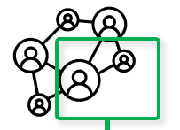















Microsoft Purview - detailed
Enterprise Data Model
Microsoft Copilot
Enriches
Microsoft Purview
Information Protection
Sensitivity labels
Microsoft Purview Data Governance
Data Catalogue
Enterprise Glossary
Data Map
Governance Domain 1
Governance Domain n
Links Tech Metadata and Lineage
Interacts
Default Domain
Domain (1-4)
Data Product 1
Data Product n+1
Collection 1
Collection 1
End Users
Data Product n
Data Product n+n
Provides
Collection 2
Collection 2
Collection 3
Collection 3
Assessing
Microsoft Purview
Solutions (cont.)
Audit
Data Lifecycle Management
Workflows
Data Policy
Data Loss Prevention
AI Hub
Communication Compliance
eDiscovery
Information Barriers
Records Management
Data Health & Quality Process
Data Governance Application APIs
3rd Party Process
& Applications
Scanning/Classification
Communicates
Sources

Slide 38
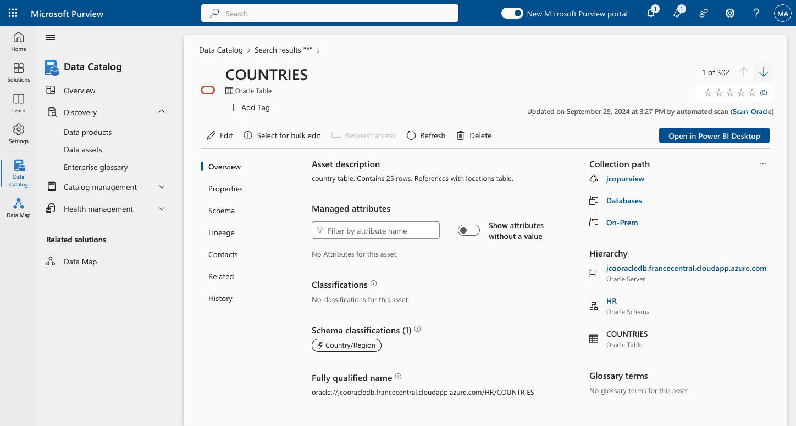
Data Map – an asset

Slide 39
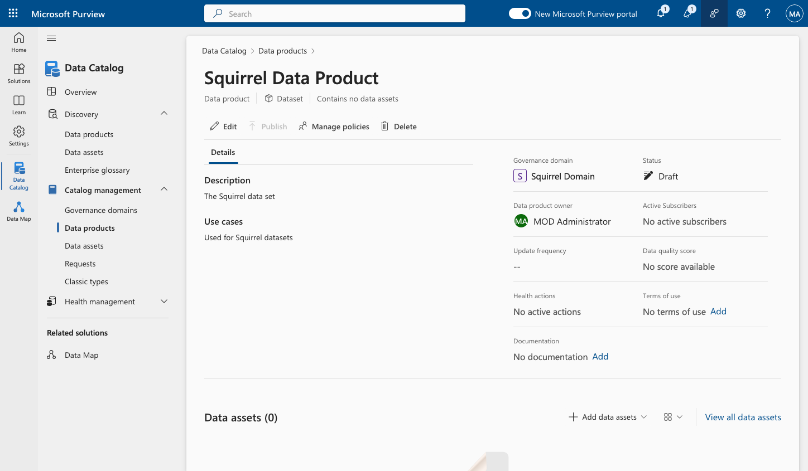
Data catalog – a business asset

Slide 40
API’s links
PyApacheAtlas (Python SDK): https://github.com/wjohnson/pyapacheatlas
Azure Purview CLI: https://github.com/tayganr/purviewcli
Apache Atlas v2 documentation: https://atlas.apache.org/api/v2/index.html
Azure Purview API deep-dive video: https://www.youtube.com/watch?v=4qzjnMf1GN4
Data Sources : https://learn.microsoft.com/en-us/purview/data-map-data-sources?source=recommendations

Slide 41
Training/Tutorials/Roadmap
https://learn.microsoft.com/en-us/training/purview/
https://learn.microsoft.com/en-us/training/paths/describe-capabilities-of-microsoft-compliance-solutions/
https://learn.microsoft.com/en-us/training/modules/describe-purview-data-governance/
https://learn.microsoft.com/en-us/purview/
Purview StarterKit: https://techcommunity.microsoft.com/t5/azure-purview/getting-started-with-azure-purview-using-purview-starter-kit-cli/m-p/2645574
Tutorial for creating custom lineage: https://piethein.medium.com/use-azure-purviews-rest-apis-for-creating-custom-lineage-ad8efacc6230
Tutorial for scanning Delta Lake: https://www.youtube.com/watch?v=pk0Gx_HHY4A
Community: https://techcommunity.microsoft.com/category/microsoft-purview
Roadmap : https://learn.microsoft.com/en-us/purview/whats-new

Slide 42
GitHub repos
Load script based on linux/cli : https://github.com/jcordtz/load_script
Moderns dataplatform article https://github.com/jcordtz/a_data_platform
Purview Labs: https://github.com/tayganr/purviewlab
MDM/Lineage 3rd party support MDM - Cluedin : https://www.cluedin.com/product/microsoft-purview-mdm-integration MDM - Profisee: https://profisee.com/solutions/microsoft-enterprise/
MDM - Reltio: https://learn.reltio.com/reltio-integration-for-microsoft-purview
MDM - Semarchy: https://www.semarchy.com/doc/semarchy-xdm/xdm/latest/Install/azure/purview/integrate-xdm-with-purview.html
Lineage – Solidatus: https://www.solidatus.com/partners/microsoft-purview-partnership/

