Slide 1
Hybrid Kubernetes
Reference Architecture

Slide 2
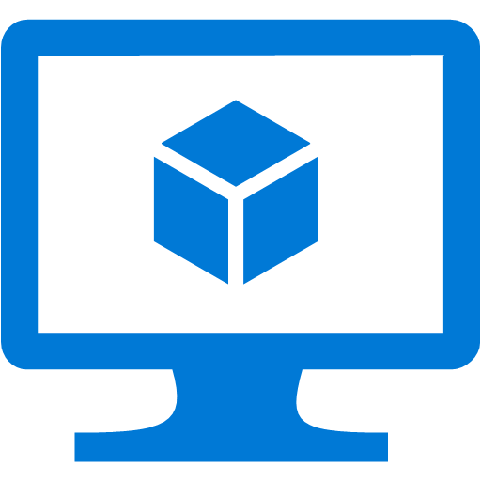



VPN
Peering
VMAS
VNET 1
Kubernetes masters subnet
Public
IP
VMSS #1
VMAS
VNET 2
Kubernetes nodes pool #1 subnet
VMSS #2
VMAS
VNET 3
Kubernetes nodes pool #2 subnet
VNET 1
Kubernetes VNET
On-premises
Azure

