Slide 1
Hybrid Kubernetes
Reference Architecture

Slide 2

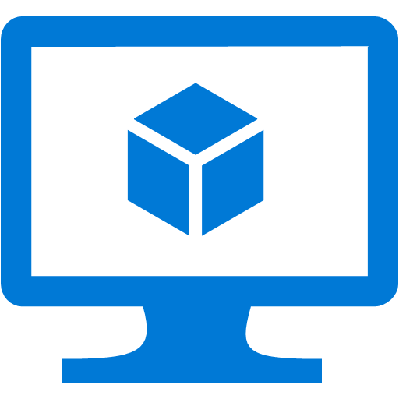


VPN
Peering
Gateway subnet
VMAS
VNET 1
VNET to on-prem
Kubernetes masters subnet
Peering
Public
IP
VMAS
VNET 2
Kubernetes nodes pool #1 subnet
VMSS #1
VMAS
VNET 3
VMSS #2
Kubernetes nodes pool #2 subnet
VNET 1
Kubernetes VNET
On-premises
Azure

