Slide 1

Member Churn Analysis
OTS Summer Internship Project
Joel Corley
Notes:
Thanks for hosting this project presentation.
The churn analysis presented here is a part of my internship project, and was for Bellco Credit Union, specifically

Slide 2

Introduction
Overview of problem:
Member churn at Bellco Credit Union
Importance of member retention for sustainable growth
Notes:
Of the 3 credit unions, data was available for all, however, Bellco was chosen as it’s a local CU
How can we minimize or reduce member churn at Bellco?
Analysis based on period 1/1/2022 through 8/1/2023

Slide 3
Understanding the challenge
Member Churn:
members closing accounts and leaving CU
1
Significance of member churn for CUs, nationally:
25% churn in the first year
40% members leave prior to profitability
2
Objective:
Analyze and understand Bellco member churn
Notes:
1: provide definition of member churn
2: Figures under 2 come from CU2.0 & are for CUs generally, not necessarily the Front Range or even Bellco

Slide 4
Why does member churn matter?
Impact on revenue and profitability
Disruption of business operations
Maintaining a loyal customer base for long-term success

Slide 5

Value of Data Analysis
What this analysis accomplishes:
Identifying factors leading to churn
Modeling potential churn

Slide 6
Methodology Overview
Steps involved in the analysis process:
Data Preprocessing: Cleaning, transforming, and organizing the data
Exploratory Data Analysis: Identifying patterns and trends
Model Development: Creating predictive models
Evaluation and Validation: Testing model accuracy
Notes:
This presentation is not technical & I won’t go into detail, however, the involved steps are presented here nonetheless.

Slide 7
High-Level Results
Data Insights:
Key factors contributing to churn:
Whether the account is a consumer loan or a checking account
Number of transactions conducted on account
Whether the member uses ATMs (general-use or withdrawals, specifically)
Average account balance
Account usage difficulties: NSF fees or transaction reversal issues
Churn demographic trends
Zip code 80602: Thornton, CO adjacent to South Platte River
Bad credit (300-599 credit score)
Fewer transactions and problems with transactions
Notes:
The account type matters when modeling member churn, specifically whether the account is a consumer loan or a checking account
These specific types were found to matter for Bellco mbrs
How the mbr uses their account also matters as it was found:
The number of transactions in the lookback period was important
Whether the mbr uses ATMs, for withdrawals, or just generally as the most frequent type of usage

Slide 8
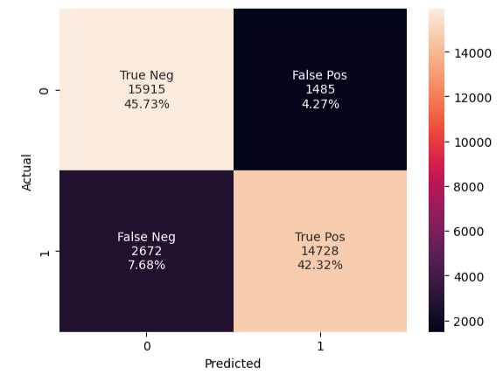
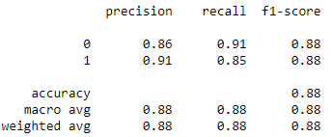
High-Level Results (continued)
Predictive Model:
Accurate predictions of potential churn 88% accuracy
Early warning system for at-risk members
Notes:
Model achieved 88% accuracy
* Accuracy - quantifies the ratio of correctly predicted instances to the total number of instances in a classification task, offering a general overview of a model's overall correctness.
* Precision - measures the proportion of correctly predicted positive instances among all instances predicted as positive in a classification task.
* Recall - also known as sensitivity, calculates the proportion of correctly predicted positive instances among all actual positive instances in a classification task.
* F1-Score - the harmonic mean of precision and recall, providing a balanced measure to assess a model's performance in binary classification tasks.
* Support - refers to the number of actual occurrences of a class in the dataset and is used to calculate various metrics in classification evaluations.

Slide 9
Implementation and Beyond
Advising CU of strategies
Continuous monitoring and adaptation
Demonstrated improvements in member retention
Notes:
An analysis like has been carried out here can help with theses points….[read points]

Slide 10
Conclusion
Churn analysis successfully modeled and capable of predicting at risk members with 88% accuracy
Key factors leading to member retention can be examined and leveraged

Slide 11
Q&A Session
Questions?

Slide 12

Contact Information
jcorley@open-techs.com or joel.corley@du.edu
August 2023 Data Science graduate, Masters
Chemical Engineering, Bachelors

Slide 13
Thank You
Thanks for your time and attention
Help Bellco provide excellent member service

