Slide 1
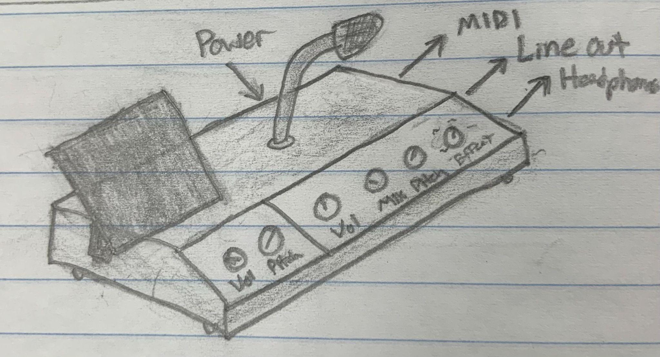
Theremania
Theremin Vocoder
Project by “The Theremaniacs”
Eric Barkuloo
Jackson Cornell

Slide 2
Project Introduction
Our project will center around an analog theremin musical instrument, which will generated an audio output.
The Theremin output can be used in one of four ways
First, the output can simply be passed to a speaker and use as a traditional theremin
Second, the output can be passed into a signal processing chip to add effects such as a harmonizer to the monophonic output of the theremin before being passed to the speaker.
Third, the output of the theremin can be sent to a MIDI conversion to allow the theremin to be used as a MIDI controller.
Fourth, the output of the theremin can be sent to a phase vocoder with a microphone input, allowing the pitch information of the theremin to control the pitch of the voice input being passed to the speaker.

Slide 3
Hardware
Hardware will include an analog theremin circuit (including the antenna), a microcontroller, a digital signal processor, an audio codec, connectors for the MIDI, mic, headphones, and line-out, potentiometers for parameter tuning, and a simple power supply.
The microcontroller will communicate with the DSP via SPI, the DSP will communicate with the audio codec via McBSP, and the microcontroller will communicate with an audio interface via MIDI.
The design will be in an enclosure with connectors, an antenna, parameter knobs, and a microphone.

Slide 4
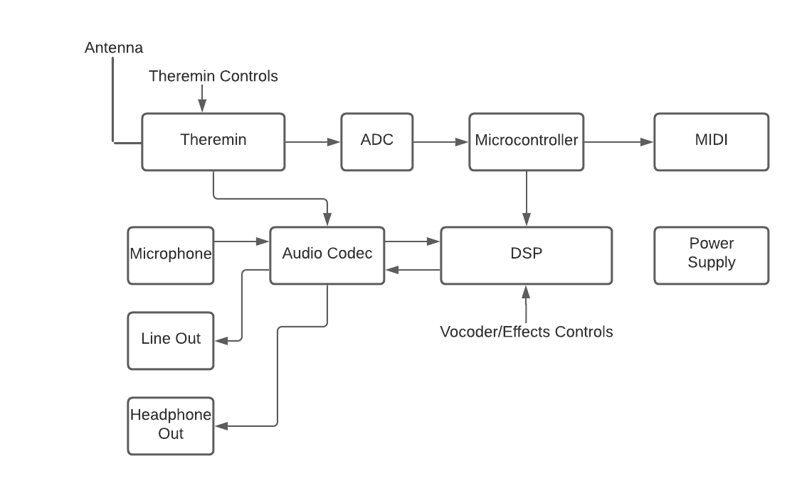
Hardware Block Diagram

Slide 5
Software
Microcontroller
Pitch/Volume detection via theremin ADC input
Use Pitch/Volume information to generate MIDI output
Send pitch information to DSP via SPI for use in phase vocoder
DSP
Receive pitch information from microcontroller via SPI
Execute phase vocoder algorithm to pitch shift microphone input
Also use phase vocoder algorithm to apply harmonization effect to mono theremin input

Slide 6
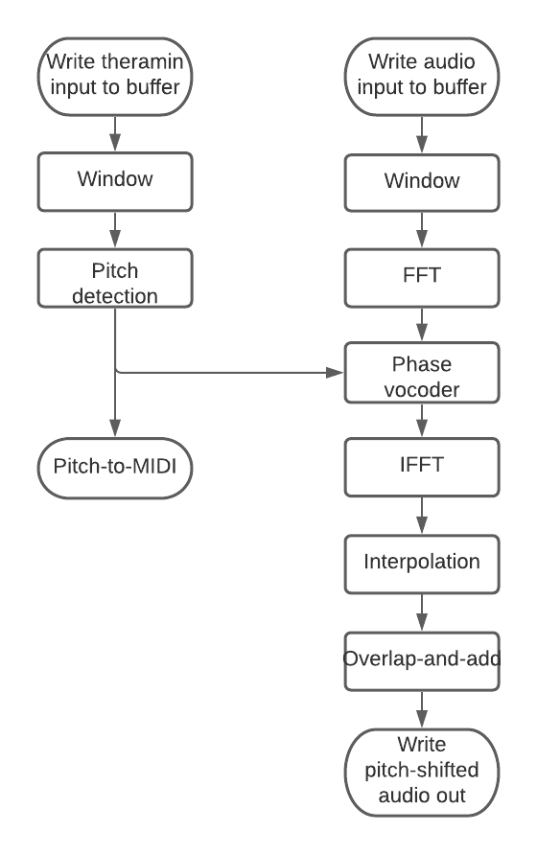
Software Block Diagram

Slide 7
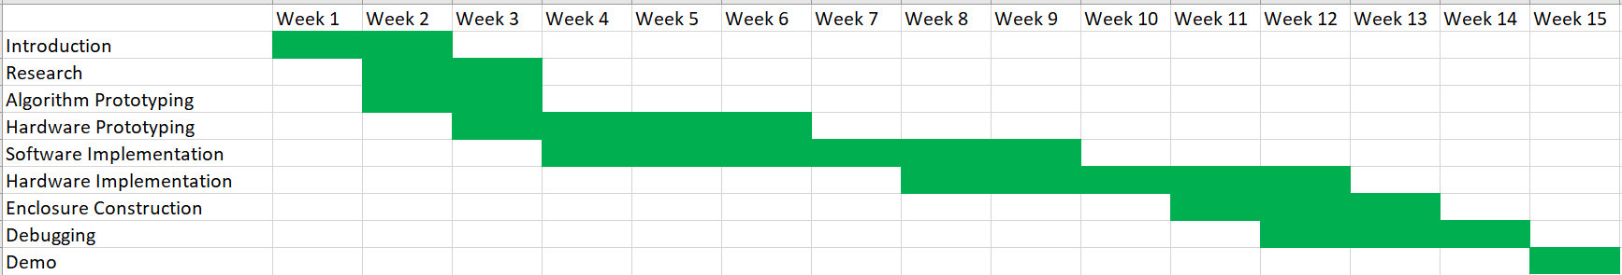
Gantt Chart

