Slide 1
Spectral Clustering for Identifying Large-Scale Neuron Connectivity
Jackson Cornell

Slide 2
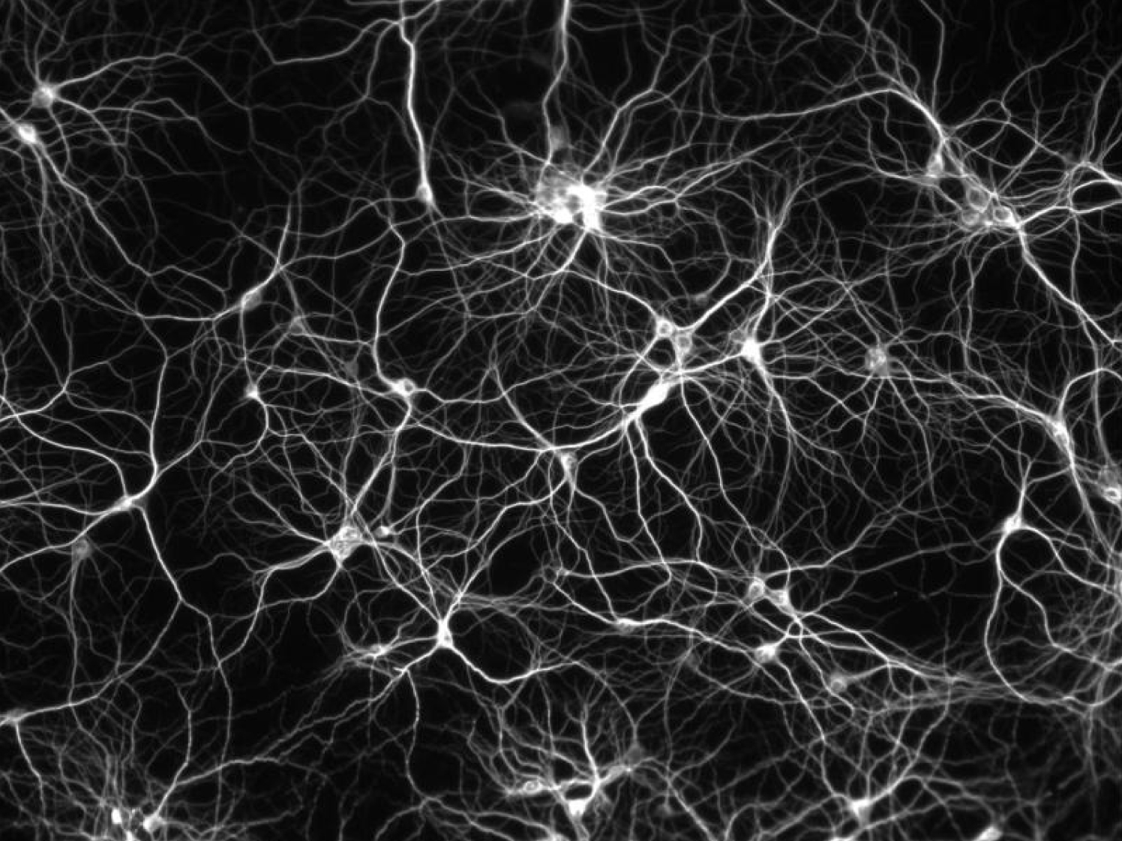
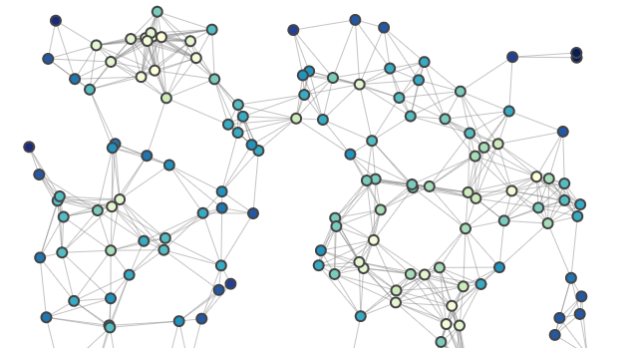
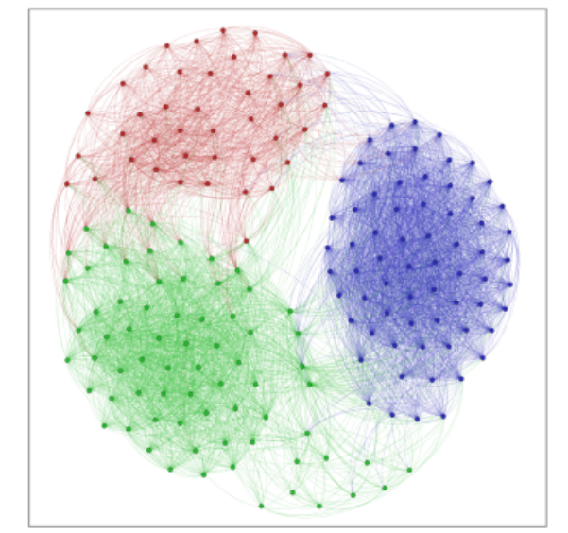
The problems
Map Neurons to graph representation
Cluster graph to find neuron populations
PRESENTATION TITLE

Slide 3
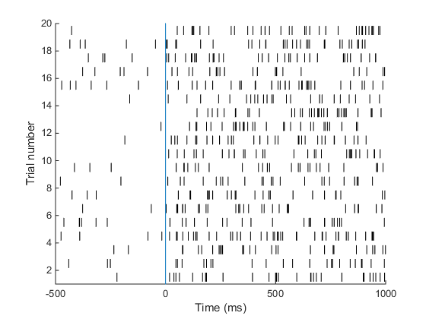
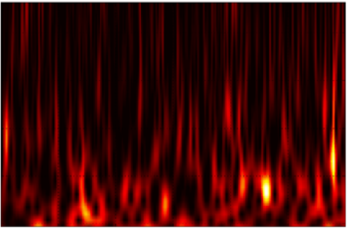
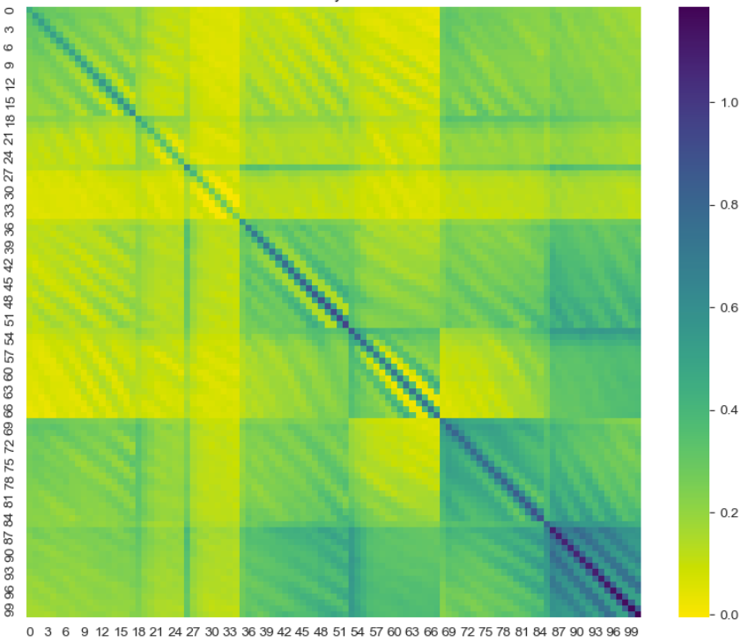
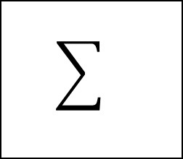
Scale-space projection
J
DWT
Covariance
P
P
U
SVD
Reconstruct
V

Slide 4
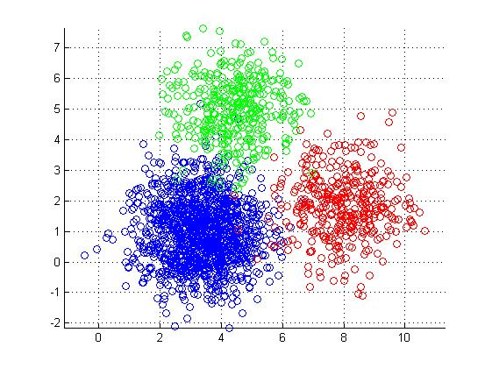
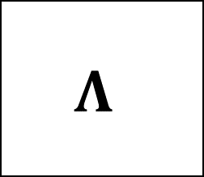

Normalized Spectral clustering
$$L=D^{−1/2}WD^{−1/2}$$
Graph Laplacian Matrix
Eigen decomposition
K-means clustering
Q
$$Λ$$
Q^-1

Slide 5
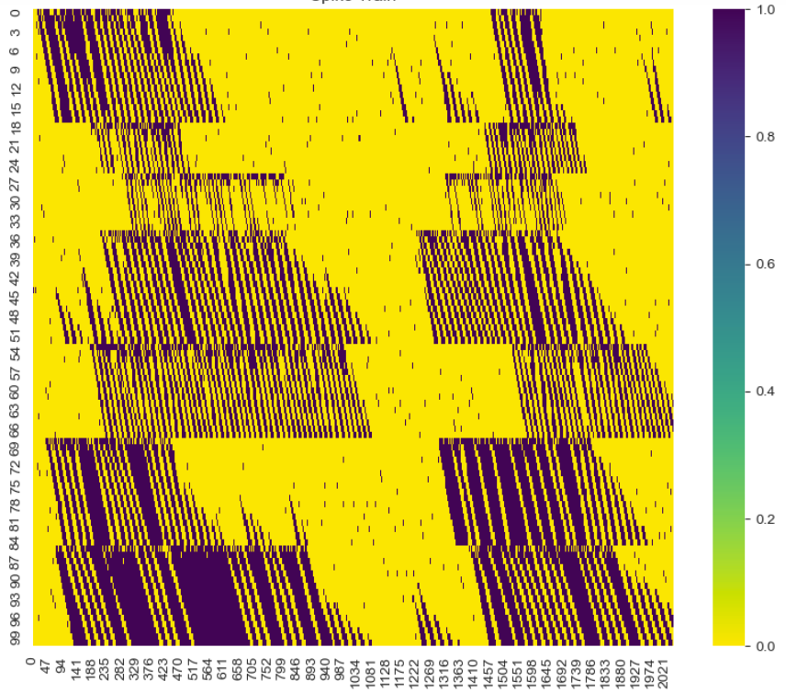
Neuron Simulations
Neuron information encoded in firing spikes
Used stochastic neuron firing model to simulate neurons
Large scale simulations of >100 neurons performed

Slide 6
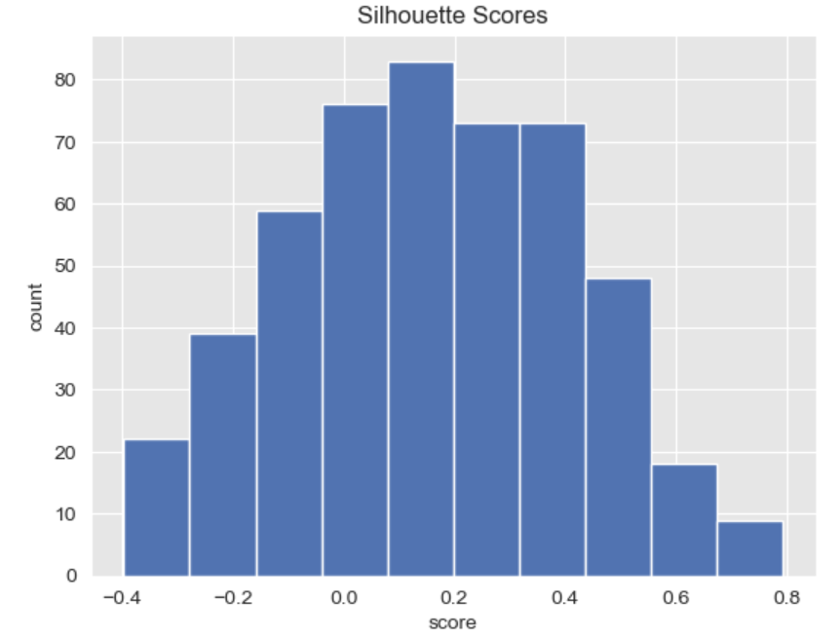
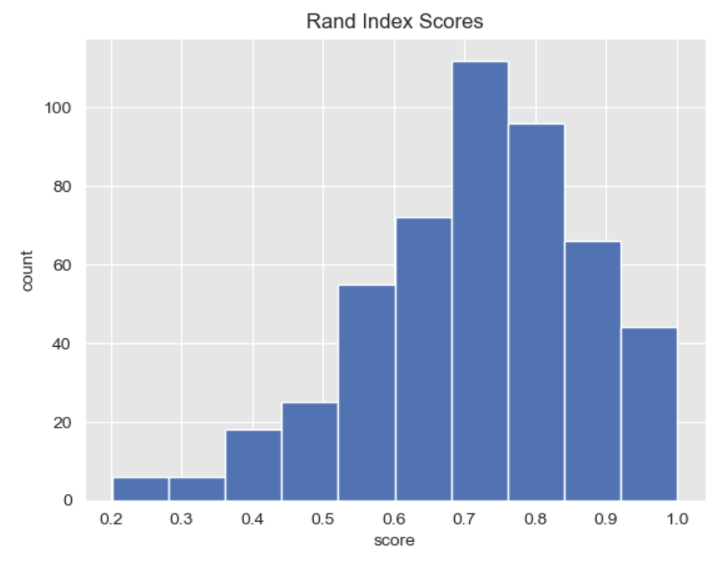
Results
Hyperparameter tuning used to find optimal cluster count K
Results showed that cluster metric Silhouette score find an estimated K within 2 of true K

Slide 7
THANK YOU
Jackson Cornell
jcornell@ufl.edu

