Slide 1
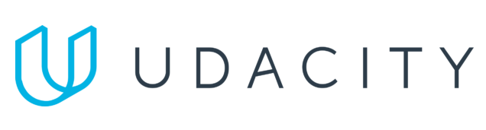

Data Lake Value Proposition
Medical Data Processing Company
Joseph Corrado
Udacity IPS Version 1.0
Notes:
Hello, my name is Joseph Corrado. Welcome to my data lake architecture proposal for the Medical Data Processing Company.

Slide 2
Agenda
What is a Data Lake
Components of a Data Lake
Data Lake vs Data Warehouse
Business Value of Data Lake Solution
Proposed Data Lake Architecture for Medical Data Processing system
Udacity IPS Ver. 1 2/2020
Notes:
In the next few slides, I will introduce the concept of a data lake at a high level. Then, I will talk about the merits of using a data lake in addition to a traditional data warehouse, and how we can leverage a data lake at the core of our data architecture to support the new business requirements at Medical Data Processing Company.

Slide 3
What is a Data Lake
Executive summary
A data lake is typically a cloud-native technology that can be used to support both operational and analytical workloads.
Data lakes are usually implemented as an object-level storage solution that is tightly integrated with analytical and operational services.
Data lakes can be used to support your operational workloads by acting as a platform for loading data extracts when backing up application data, or for storing log information.
Simultaneously, data lakes can be used to support analytical workloads by acting as a staging area for the analytical frameworks it is integrated with.
Notes:
A data lake is a piece of technology that can store file formats of any kind, and scale infinitely as the rate of data acquisition increases.
In most platforms, a data lake consists of an object storage framework that is tightly integrated with a suite of services for operating on that data.
In the case of AWS, the Simple Storage Service (also known as "S3") can be leveraged as a data lake at the center of our data technology strategy. With AWS, S3 is tightly integrated with their suite of analytics and operational services - it is seamless to run ETL jobs in AWS using tools like AWS Glue on objects residing in S3. Additionally, if you register one of your logical folders on S3 with the Glue Data Catalog, you can then leverage AWS Athena to query directly from those files using SQL, without having to load your data into a database or data warehouse of any sort.
Because of the flexibility and versatility afforded by data lake technology, we can support many of the operational or transactional features needed in our production application deployment, as well as the features required to load data into our analytical systems.

Slide 4
Components of Data Lake
Ingestion layer
Storage Layer
Processing Layer
Serving Layer
Notes:
There are four major components that make up an implementation of a data lake infrastructure.
First, we have our ingestion layer. Sometimes this is referred to as a landing zone, and it is where the raw versions of all your data is immediately dumped after the ingestion processes fetch new data.
Next, we have the storage layer. This component really makes up the meat of a data lake architecture, as it allows us to store all manner of flat files at a very low price point. Additionally, that data is residing in a location that’s easily accessible by compute platforms of all kinds.
Next I the processing layer. In this layer, we have our tightly integrated services that allow us to run compute over the objects sitting in our storage layer. With a data lake architecture, we have as many options as there are technologies here, since we can simply choose to deploy any compute framework of our choice, and point it at our data lake for performing transformations.
Lastly, we have the serving layer. Sometimes called the presentation area, this is where the data that’s ready to be loaded into our data warehouse, and used by our data visualization dashboards resides. Also, this area contains the data that supports our production applications. This layer is the layer that is closest to the end consumer of our application and the data we’ve stored in our data lake.

Slide 5
Data Warehouse
Data Lake
Schema on write
Mainly structured data
Block storage
Is a compute platform
Schema on read
Supports structured/semi structured and unstructured data
Object-based storage
Integrates with compute platforms
Udacity IPS Ver. 1 2/2020
Notes:
There are some important points to be aware of before committing to data lake technology. Probably the most important distinction between a data warehouse and a data lake is the support for storing structured versus unstructured data. While modern cloud native data warehousing platforms (such as Snowflake) are providing more and more support for unstructured data, it is still not possible to store things like images, movies and other binary/blob data efficiently in data warehouses. This in particular is one of the ways in which it’s helpful to utilize a data lake alongside a data warehouse.
Another major difference between storing data on a data warehouse versus storing data on a data lake is in the access pattern, relative to the schema of the data. In traditional data warehouses and databases, you need to tell the system your schema up front, and promise that all your data will conform to that schema when you load it. This is known as schema on write, as your schema is promised to be known at write time.
By contrast, data lakes don’t require you to commit to a schema up front, which allows much greater flexibility in the access patterns and how you utilize the data that’s stored in the data lake. You can use something like AWS Athena, where you store the promised information about the schema in a remote data catalog, and then use that information to run SQL queries against those files. However, you can also run your data through a spark job or a dynamic ETL processing job that determines or reconciles schema changes on the fly as you’re loading data.
Usually, a data warehouse is its own compute platform, whereas a data lake requires integration with compute services that run over the data residing in the data lake.
There are many fundamental differences between data warehouse technology and data lake technology. However, I do not believe that one fully replaces the other. I think there is simply a genuine tradeoff to be made, where you’re sacrificing efficiency, schema guarantees, and ease of understanding by moving from a data warehouse solution to a data lake solution. In return, you’re gaining flexibility, increased interoperability, and you’re fostering a culture of self service and continuous research for your data analysts and data scientists.

Slide 6
Business Value of Data Lake
A data lake is better for Medical Data Processing Company because of their requirement to process unstructured data (MRI images)
A data lake makes it easier to support the ingestion of the various file formats from disparate sources as mentioned in the business requirements
A data lake helps keep costs down
A data lake will better support the different analytical and operational use cases as described in the business requirements
Notes:
Because of the unique business requirements for the Medical Data Processing Company, a data lake makes much more sense, used in conjunction with other cloud services, rather than a data warehouse by itself.
Since Medical Data Processing Company processes MRI images, we require a mechanism by which to store those files, while also exposing them to integrated services for performing complicated analytics tasks on them. For example, since we’re placing our MRI files in a data lake, we have the added value that our files will be naturally exposed to frameworks for training object detection machine learning models in our cloud environment.
In addition, using a data lake simplifies the overall initial storage requirement for files of differing formats and sizes. While it does not get around the fact that we’ll still require the multiple different jobs and technologies to ingest that data from various sources, it does simplify our concerns over storing that data in a location that’s easily accessible, and can be cataloged using our metadata systems.
A data lake also helps us keep costs down, by exposing lifecycle policies that we can apply to our data in the data lake. In addition, it is much cheaper to have data residing as a flat file on commodity hardware, than it is to have data sitting on the high I/O disks of data warehouses.
Finally, storing our data in a data lake means that our data is simultaneously exposed to our transactional application workloads, as well as our analytical workloads. For example, while we can load our data into transactional systems from flat files in our data lake, we can also load our data into a data warehouse for use by machine learning models and analytical dashboards.

Slide 7
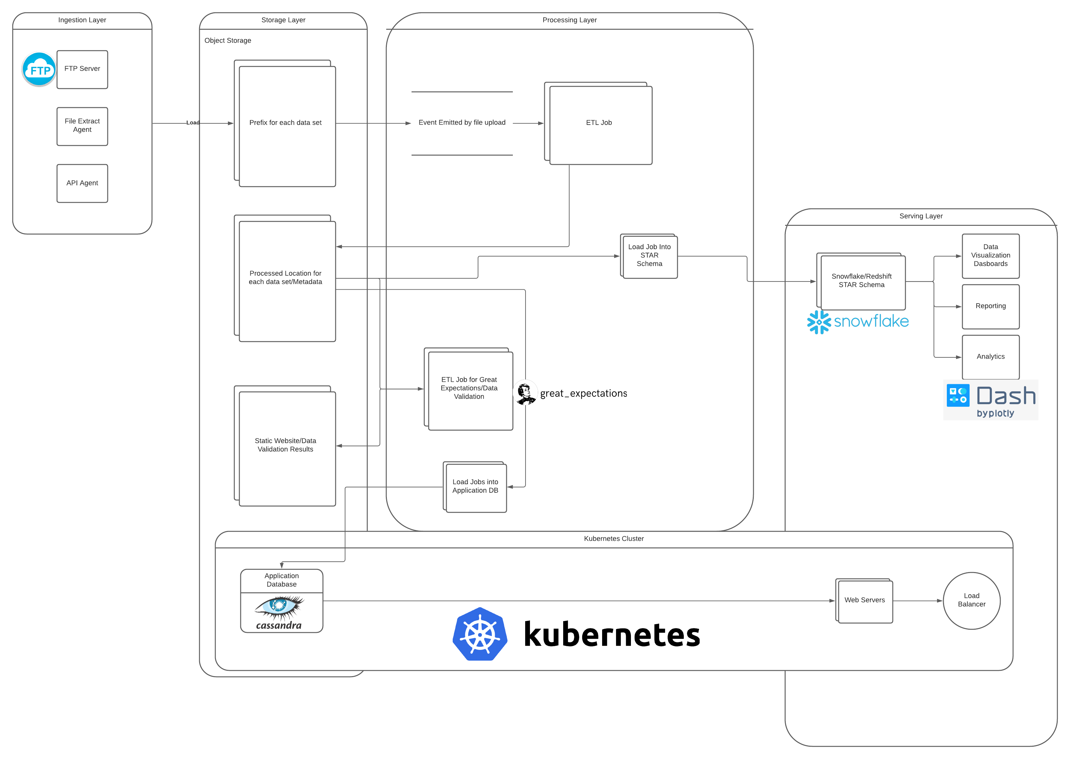
Data Lake Architecture
Notes:
Here is the overall architectural design diagram. As you can see, we have included an ingestion layer, a storage layer, a processing layer, and a serving layer.
In our design, we illustrate the iterative nature of processing files until they are in a state that’s ready to be consumed in the middle of the diagram. As you can see, we move our data from location in our storage layer to another location in our storage layer as the data goes through our ETL pipelines. In addition, we leverage some additional open source and proprietary frameworks to generate metadata about our data, and to perform ETL.
In my diagram, I’ve noted the use of great expectations, which is a Python-based framework for writing expectations about your data, executing those expectations against your data, and then generating static HTML documents summarizing the results. This point is extremely important because, not only does it provide a way to ensure data quality at a very specific resolution, but our expectations serve as living documentation as to what we expect our data to look like, much like unit testing for source code.
Finally, we have noted a Kubernetes cluster that interacts with our production applications from our service layer.
This is important as Kubernetes can be utilized in a cloud-native manner, and it has a tight integration with our data in the data lake itself.
Kubernetes allows our applications to be self-healing, and ensure a minimum level of uptime. Since we typically create pods in kubernetes, which can consist of both application databases and the application servers themselves, we see that our kubernetes cluster spreads across both the storage layer, and the serving layer.

Slide 8
THANK YOU
Udacity IPS Version 1.0
Notes:
That concludes my presentation for today. I hope that my proposal has been able to effectively communicate the benefits of using a design based around a data lake deployment. Thank you.

