Slide 1

Carthagène
A brief introduction to combinatorial optimization:
The Traveling Salesman Problem
Simon de Givry
Thales Research & Technology, France
(minor modifications by Benny Chor)

Slide 2
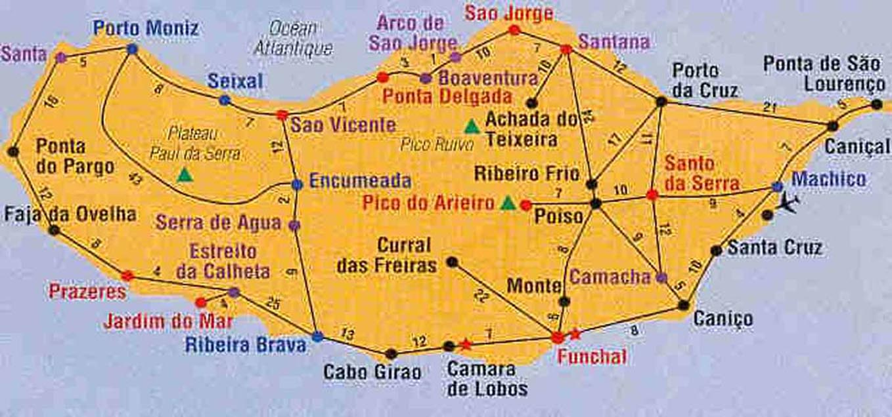
Madiera Island (west of Morocco in Atlantic ocean)
Find a tour with minimum distance, visiting every city only once

Slide 3
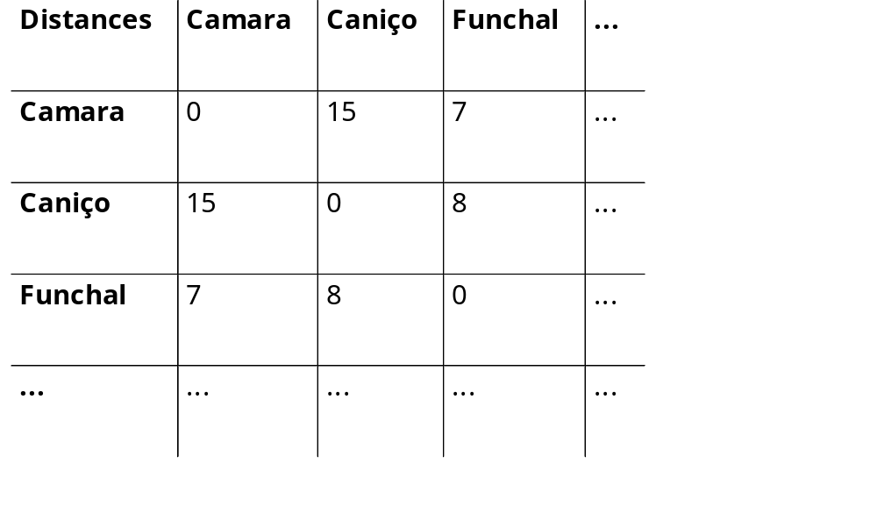
Distance matrix (miles)

Slide 4
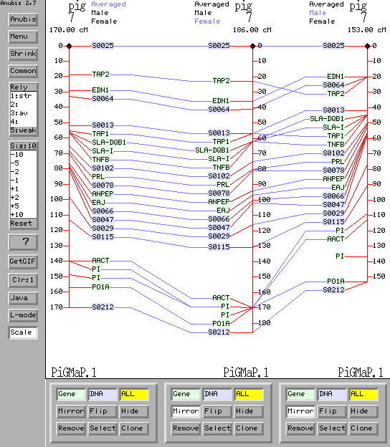
A similar task in the genomic domain
Find an order of all the markers with maximum likelihood

Slide 5
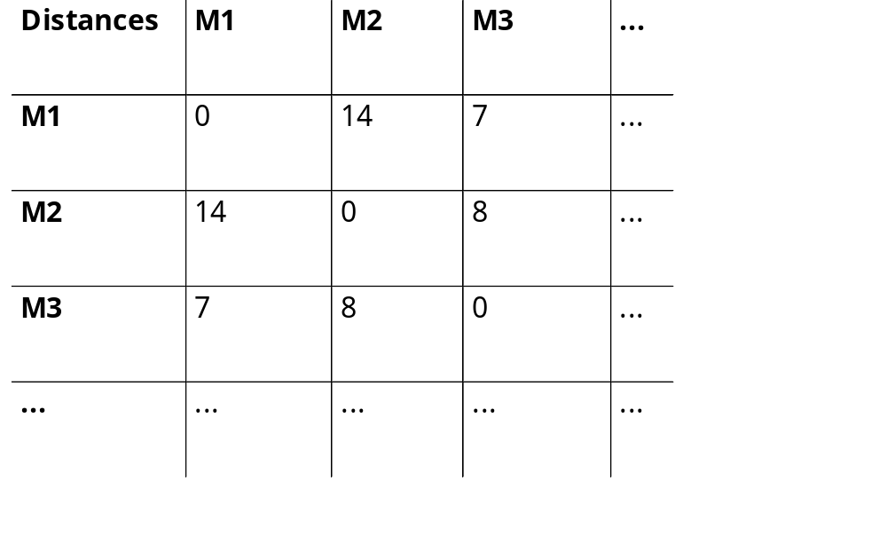
2-point distance matrix (Haldane)

Slide 6
Link
M1
M2
M3
M4
M5
M6
M7
0
…0…
0
M_{dummy}
∀i,j,k distance(i,j) ? distance(i,k) + distance(k,j)
=,≤
☹ Multi-point likelihood (with unknowns) ⇔
the distance between two markers depends on the order

Slide 7
Traveling Salesman Problem
Complete graph
Positive weight on every edge
  Symmetric case: dist(i,j) = dist(j,i)
  Triangular inequality: dist(i,j) ≤ dist(i,k) + dist(k,j)
  Euclidean distance (assume we got wings)
Find the shortest Hamiltonian cycle

Slide 8
8
7
15

Slide 9
Total distance = xxx miles

Slide 10
Traveling Salesman Problem
Theoretical interest
  Basic NP-complete problem (➔ not easy)
  1993-2001: +150 articles about TSP in INFORMS & Decision Sciences databases
Practical interest
  Vehicle Routing Problem
  Genetic/Radiated Hybrid Mapping Problem
    NCBI/Concorde, Carthagène, ...

Slide 11
Variants
Euclidean Traveling Salesman Selection Problem
Asymmetric Traveling Salesman Problem
Symmetric Wandering Salesman Problem
Selective Traveling Salesman Problem
TSP with distances 1 and 2, TSP(1,2)
K-template Traveling Salesman Problem
Circulant Traveling Salesman Problem
On-line Traveling Salesman Problem
Time-dependent TSP
The Angular-Metric Traveling Salesman Problem
Maximum Latency TSP
Minimum Latency Problem
Max TSP
Traveling Preacher Problem
Bipartite TSP
Remote TSP
Precedence-Constrained TSP
Exact TSP
The Tour Cover problem
...

Slide 12
Plan
Introduction to TSP
Building a new tour “from scratch”
Improving an existing tour
Finding the best tour (or almost)

Slide 13
Building a new tour from scratch

Slide 15
Nearest Neighbor heuristic
(greedy, order dependent,
some neighbors not so near)

Slide 16
A different greedy, multi-fragments heuristic

Slide 17
Savings heuristic (Clarke-Wright 1964): Details in
http://www.cs.uu.nl/docs/vakken/amc/lecture03-2.pdf

Slide 18
Heuristics
Mean distance to the optimum
  Savings: 11%
  Multi-fragments: 12%
  Nearest Neighbor: 26%

Slide 19
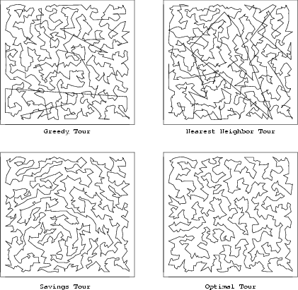
Notes:
Savings : un sommet e1 est choisi comme le hub et on cree n-1 tours élémentaires e1-ei -e1. On fusionne (met bout a bout) en N-2 etapes deux sous tours e1-ei1-eik-e1 et e1-ej1-ejl-e1 en e1-ei1-eik-ej1-ejl-e1 tel que d(eik,1) + d(1,ej1) - d(eik,ej1) soit maximum

Slide 20
Improving an existing tour

Slide 21
Which local modification can improve this tour?

Slide 22
Remove two edges and rebuild another tour
⇔ Invert a given sequence of markers

Slide 23
Remove three edges and rebuild another tour (7 possibilities)
⇒ Swap the order of two sequences of markers

Slide 24
“greedy” local search
2-opt
  Note: a finite sequence of “2-change” can generate any tour, including the optimum tour
  Strategy:
    Select the best 2-change among N*(N-1)/2 neighbors (2-move neighborhood)
    Repeat this process until a fix point is reached (i.e. no local tour improvement can be made)

Slide 25
2-opt

Slide 26
Greedy local search
Mean distance to the optimum
  2-opt : 9%
  3-opt : 4%
  LK (limited k-opt) : 1%
Complexity
  2-opt : ~N³
  3-opt : ~N⁴
  LK (limited k-opt) : ~N^{k+1}

Slide 27
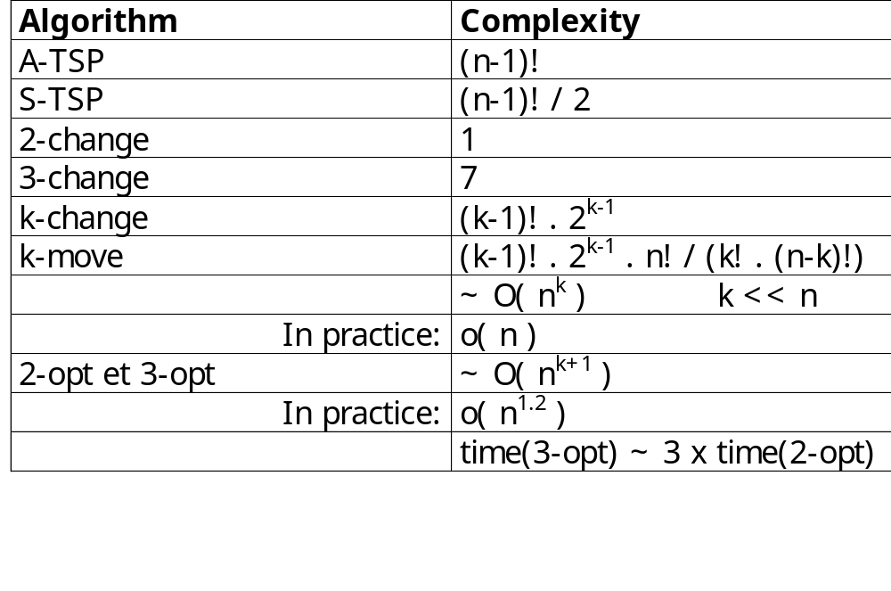
Complexity n = number of vertices

Slide 28
2-opt implementation trick:
u
v
For each edge (u,v), maintain the list of vertices w
such that dist(w,v) < dist(u,v). Consider only such
w for replacing (u,v) by (w,v).

Slide 29
Lin & Kernighan (1973)
k-change : e₁->f₁,e₂->f₂,...
  => Sum^{k}_{i=1}( dist(e_{i}) - dist(f_{i}) ) > 0
  There is an order of i such that all the partial sums are positives:
  S_{l} = Sum^{l}_{i=1}( dist(e_{i}) - dist(f_{i}) ) > 0
  => Build a valid increasing alternate cycle:
  xx ’->yx ’, yy’ -> zy’, zz’ -> wz’, etc.
  dist(f₁)<dist(e₁),dist(f₁)+dist(f₂)<dist(e₁)+dist(e₂),..
  + Backtrack on y and z choices + Restart

Slide 30
(for maximization)
x’
e₁
x
w’
f₄
e₄
f₁
z
w
f₂
f₃
e₃
z’
y
e₂
y’
{x,y,z,w,..} ^ {x’,y’,z’,w’,..} = 0
y is among the 5 best neighbors of x’, the same for z’ and w

Slide 31
Is this 2-opt tour optimum?

Slide 32
2-opt + vertex reinsertion
(removing a city and reinserting it next to
one of its 5 nearest neighbors)

Slide 33
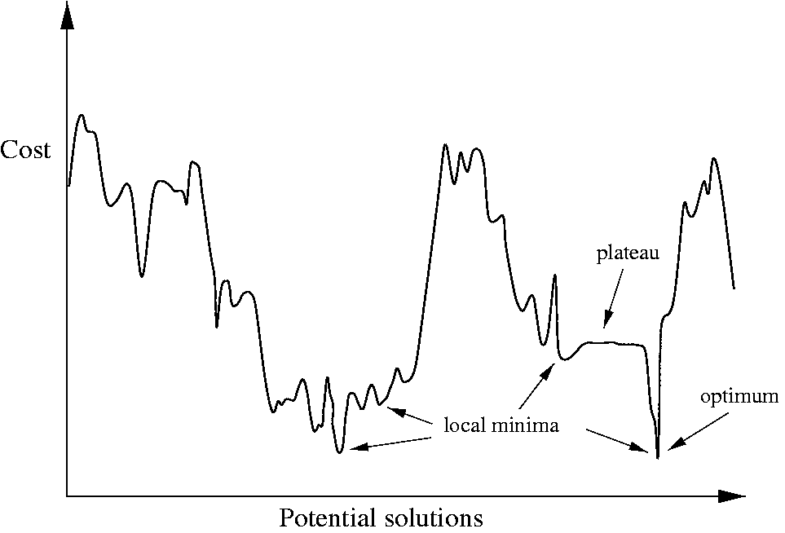
local versus global optimum

Slide 34
Local search &
« meta-heuristics »
Tabu Search
  Select the best neighbor even if it decreases the quality of the current tour
  Forbid previous local moves during a certain period of time
    List of tabu moves
  Restart with new tours
    When the search goes to a tour already seen
    Build new tours in a random way

Slide 35
Tabu Search
Stochastic size of the tabu list
False restarts

Slide 36
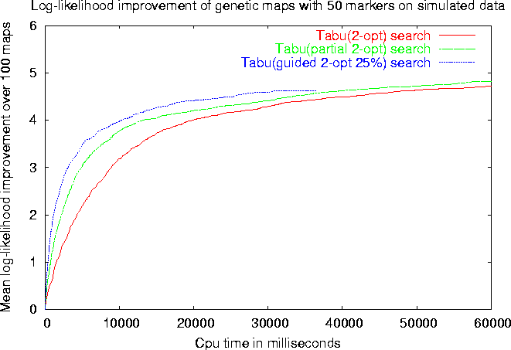
Experiments with CarthaGène
N=50 K=100 Err=30% Abs=30%
Legend: partial 2-opt = early stop , guided 2-opt 25% = early stop & sort with X = 25%

Slide 37
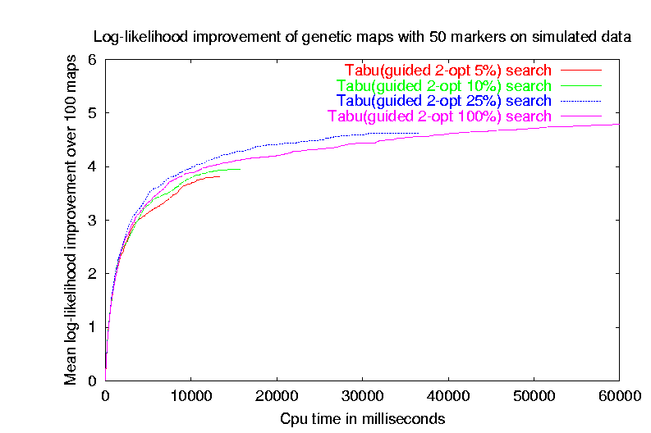
Experiments - next

Slide 38
Other meta-heuristics
Simulated Annealing
  Local moves are randomly chosen
  Neighbor acceptance depends on its quality Acceptance process is more and more greedy
Genetic Algorithms
  Population of solutions (tours)
  Mutation, crossover,…
Variable Neighborhood Search
…

Slide 39
Simulated Annealing
Move from A to A’ accepted
if cost(A’) ≤ cost(A)
or with probability
P(A,A’) = e ^{–(cost(A’) – cost(A))/T}

Slide 40
Variable Neighborhood Search
Perform a move only if it improves the previous solution
Start with V:=1. If no solution is found then V++ else V:=1

Slide 41
Local Search
Demonstration

Slide 42
Finding the best tour

Slide 43

Search tree
root
M1,M2,M3
depth 1:
M1
M2
M3
node
= choice point
branch
= alternative
depth 2:
M2
M3
M1
M3
M1
M2
depth 3:
M3
M2
M3
M1
M2
M1
leaves
= solutions

Slide 44
Tree search
Complexity : n!/2 different orders
  Avoid symmetric orders (first half of the tree)
Can use heuristics in choice points to order possible alternatives
Branch and bound algorithm
  Cut all the branches which cannot lead to a better solution
Possible to combine local search and tree search

Slide 45
Lower bound to TSP:
Minimum weight spanning tree
Prim algorithm (1957)
Held & Karp algorithm (modified spanning trees) (1971)
MST ≤ TSP

Slide 46
Christofides approximation algorithm (1976):
Start with MST. Find shortcircuits, and rearrange
=> A(I) / OPT(I) ≤ 3/2 (requires triangular inequalities)

Slide 47
Exact methods, some benchmarks
1954 : 49 cities
1971 : 64 cities
1975 : 100 cities
1977 : 120 cities
1980 : 318 cities
1987 : 2,392 cities
1994 : 7,397 cities
1998 : 13,509 cities
2001 : 15,112 cities (585936700 sec. ≈ 19 years of CPU!)

