Slide 1
Software Restriction: How Much is Too Much?
John Cosentino
CSC 490
March 22, 2017

Slide 2
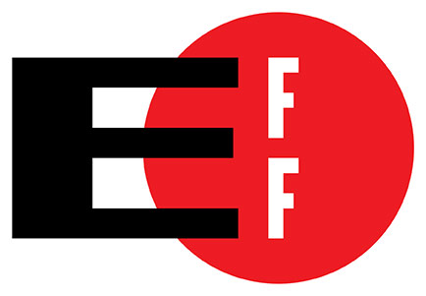
Why restrict software?
Copyright protection
Attempt to stop piracy of software
Filter out third-party abuse
Deter the sales of counterfeit product
Minimalize losses due to theft
Notes:
Bootleg
Adobe study about advertisement loss

Slide 3
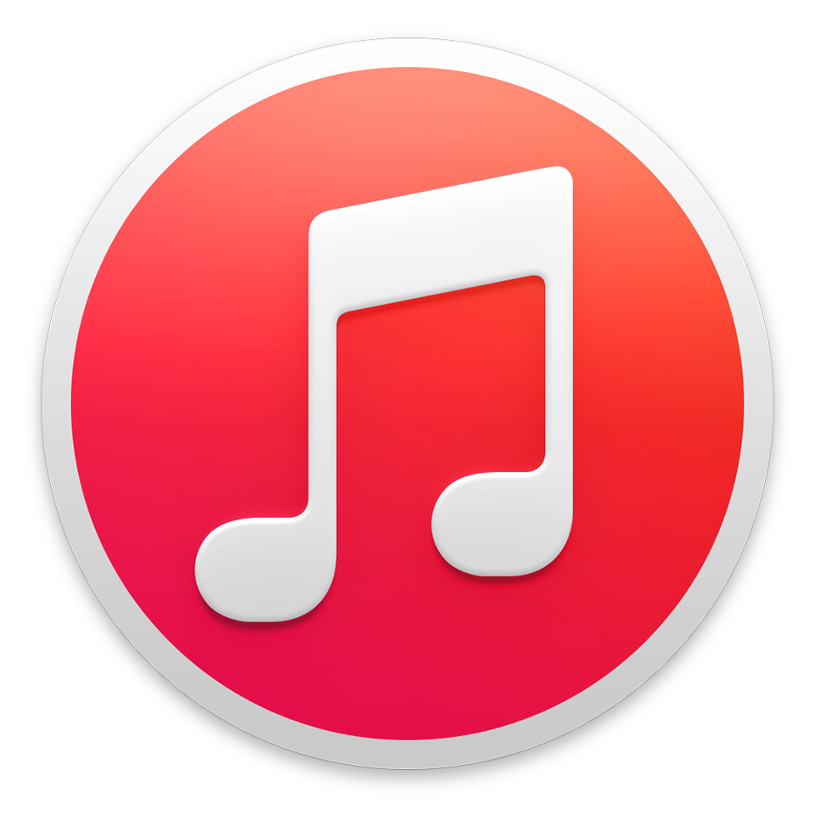
Digital Rights Management (DRM)
Third-party plugins
Video Games
Music
iTunes locked music
Movies
Content Scrambling System
Streaming
eBooks
Notes:
PlayStation “black” disks
Flash, Java, and Silverlight
Platform / Web browser restriction
Amazon Kindle-specific releases
Adobe Reader locked
Playing iTunes songs on Xbox

Slide 4

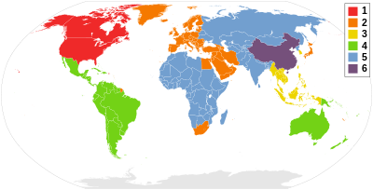
Region Locking
Regional DVD movies
Netflix, Hulu
Virtual Private Networks (VPNs) / Proxies
Problems
VPN IP bans
Proxy bans
Video game censorship
Operating System / Web Browser-only
Notes:
South Park: The Stick of Truth
AOL, IE, Mac Safari stream

Slide 5
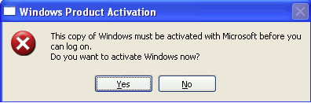
Product Keys
Microsoft Windows
57% run pirated versions
$14 billion annual losses
Microsoft Office
365 vs. 2016 standalone
$99.99 annually vs. $149.99 one-time payment
Piracy / Torrenting of expensive software
Adobe / SPSS / MATLAB
Notes:
Talk about student free office
Adobe? Malware and piracy?

Slide 6
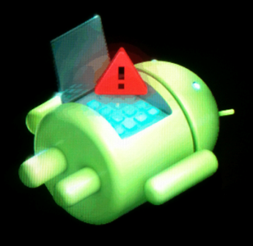
Unlocking Bootloaders
Android
Samsung / HTC / Motorola
iPhone / iPad Jailbreak
“Jailbreak” ban from App Store
Hardware switch
Court decisions – Is it legal?
Notes:
qFuse HW switch
Talk about that law from EFF

Slide 7
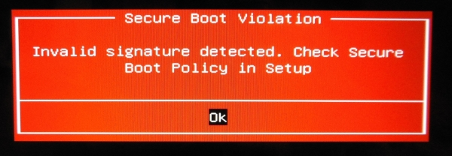
Hardware-based Restrictions
HP print cartridges
Verizon charger cables
PlayStation discs
Intel CPU upgrades
Android S-OFF
Microsoft Secure Boot

Slide 8
Please disable Ad-blocking software before viewing this slide!

Slide 9



The Open-Source Response
Libdvdcss2
DVD burners
Ad-blockers
Calibre
TOR
Android ROMs
Notes:
See: Court case about libdvdcss2

Slide 10
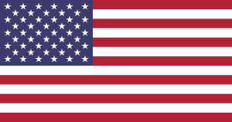
Closing arguments
Restricts consumer freedom
Prevention or difficult access?
Costs for protection vs. piracy losses
Slows down content distribution
Inconvenient
Outdated practices?

Slide 11
References
Arora, A. (2016, April 19). What may be the estimated loss to Microsoft due to piracy of Windows OS and Microsoft Office? Retrieved from https://www.quora.com/What-may-be-the-estimated-loss-to-Microsoft-due-to-piracy-of-Windows-OS-and-Microsoft-Office?share=1
Baldwin, R. (2014, March 18). Kill the DRM in Your Old iTunes Music Purchases. Retrieved from https://www.wired.com/2014/03/kill-itunes-drm/
Cluley, G. (2009, January 26). Reports of Mac Trojan in pirated Adobe Photoshop CS4. Retrieved from https://nakedsecurity.sophos.com/2009/01/26/reports-mac-trojan-pirated-adobe-photoshop-cs4/
Digital Millennium Copyright Act, 17 U.S.C. § 1201-02 (1998), http://www.gpo.gov/fdsys/pkg/USCODE-1998-title17/pdf/USCODE-1998-title17-chap12.pdf.
Guidelines for Using Apple Trademarks and Copyrights. (2017). Retrieved from https://www.apple.com/legal/intellectual-property/guidelinesfor3rdparties.html
Kravets, D. (2010, July 25). U.S. Declares iPhone Jailbreaking Legal, Over Apple’s Objections. Retrieved from https://www.wired.com/2010/07/feds-ok-iphone-jailbreaking/
Leung, T. C. (2013). What Is the True Loss Due to Piracy? Evidence from Microsoft Office in Hong Kong. The Review of Economics and Statistics, 95(3), 1018-1029. doi:10.1162/REST_a_00290
Meisner, J. (2014, March 18). What Is the True Loss Due to Piracy? Evidence from Microsoft Office in Hong Kong. Retrieved from https://blogs.technet.microsoft.com/microsoft_on_the_issues/2014/03/18/new-research-forecasts-the-staggering-cost-of-cybercrime/
PageFair., & Adobe. (2015). The cost of ad blocking. Retrieved from https://downloads.pagefair.com/wp-content/uploads/2016/05/2015_report-the_cost_of_ad_blocking.pdf
Sheehan, K. (2017, February 7). YODA, the Bill That Would Let You Own (and Sell) Your Devices, Is Re-Introduced in Congress. Retrieved from https://www.eff.org/deeplinks/2017/02/yoda-bill-would-let-you-own-and-sell-your-devices-re-introduced-congress
The Legality or Illegality of w32codecs and libdvdcss2. (2007, May 28). Retrieved from https://www.psychocats.net/ubuntucat/the-legality-or-illegality-of-w32codecs-and-libdvdcss2/
Van der Sar, E. (2016, April 19). Netflix: VPN Blockade Backlash Doesn’t Hurt Us. Retrieved from https://torrentfreak.com/netflix-vpn-blockade-backlash-doesnt-hurt-us-190416/
Wang, B. (2013, July 9). Illegal Downloads: What Are the Penalties? Retrieved from http://blogs.findlaw.com/blotter/2013/07/illegal-downloads-what-are-the-penalties.html

Slide 12

Questions?

