Slide 1
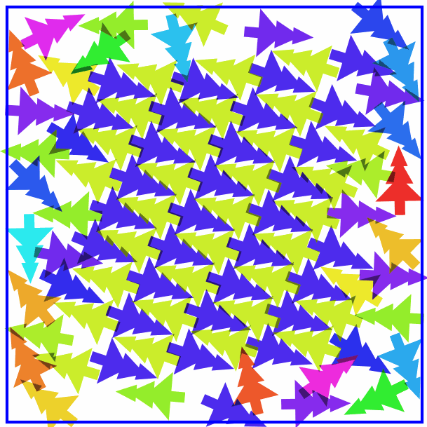
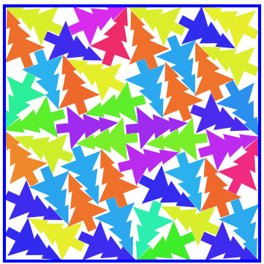
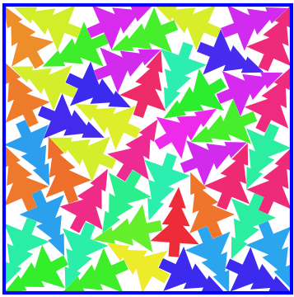
Hierarchical population for a genetic algorithm
One island holds 111 individuals with a given square size.
16 islands on a ring – an island interacts with other close to it.
Each individual is one configuration of trees. Genetic algorithm tries to make it feasible – no overlap, no poking over boundary. When successful it reduces square size and repeats.

Slide 2
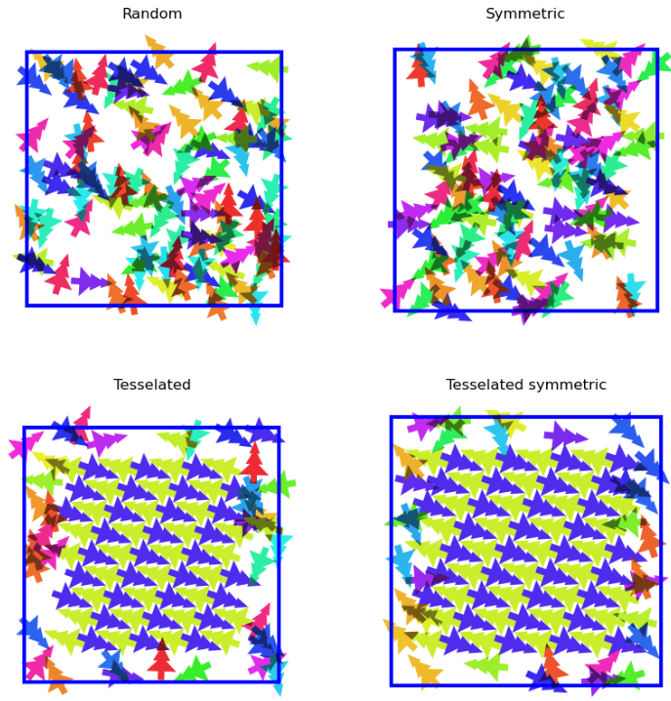
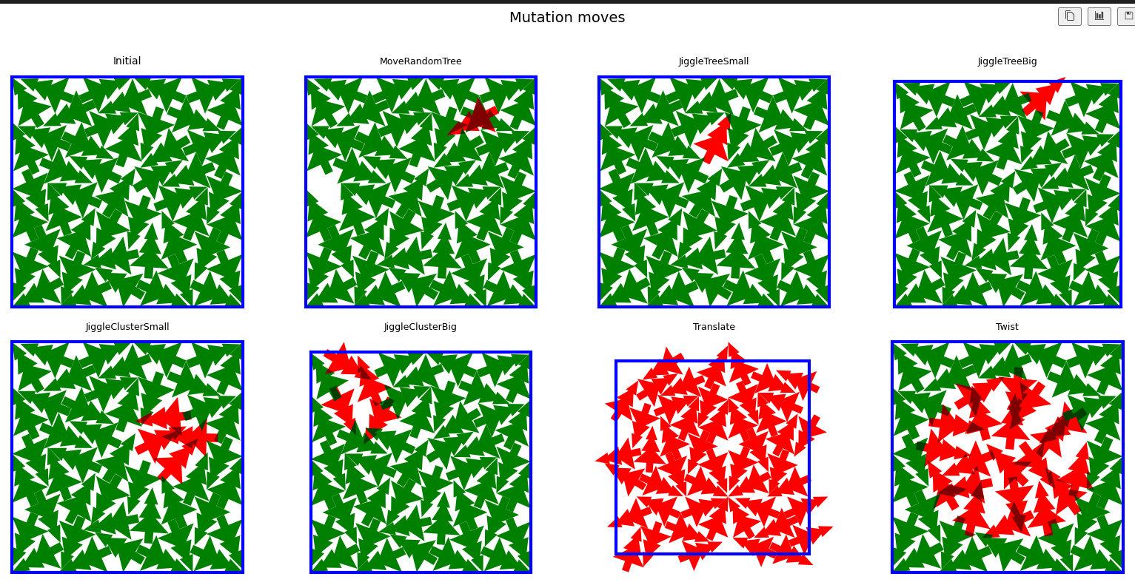
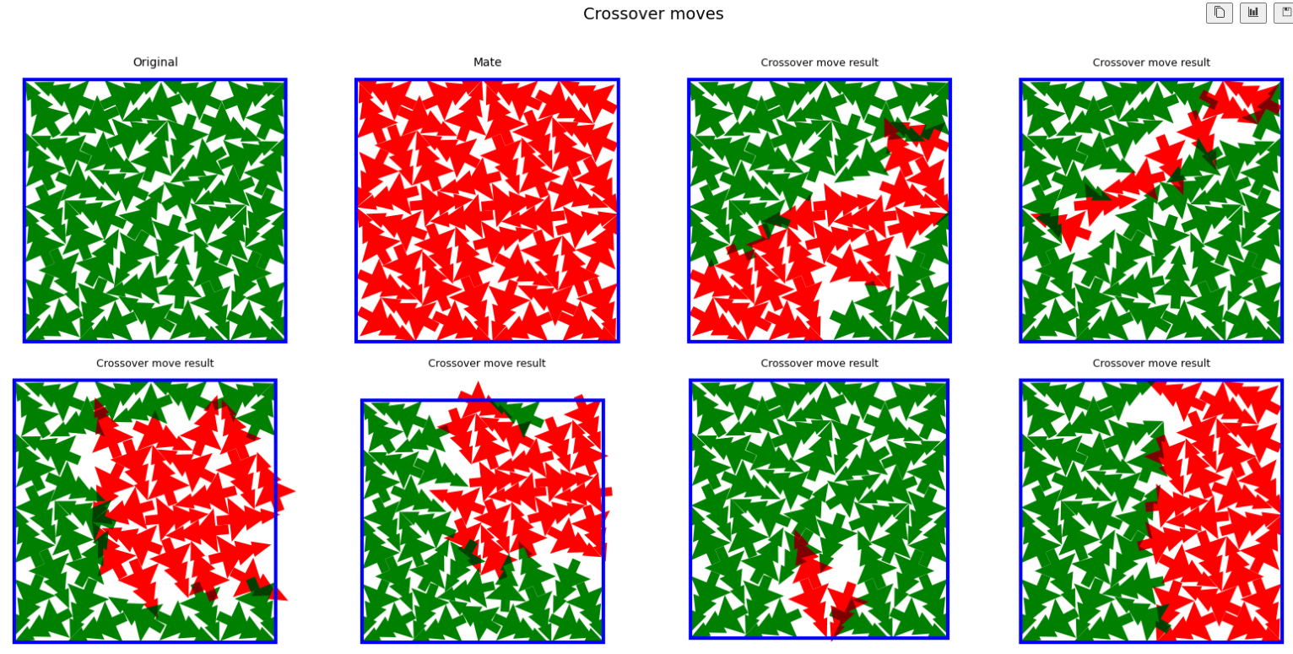
The genetic algorithm
Initial solution
Random, potentially with symmetry constraints and/or a tessellated core
Offspring generation
Create more individuals on each island using mutations and crossover (mating with own and nearby islands)
Relaxation
Increase acceptance chance by finding local minimum, using GPU-based relaxation scheme
Selection
Pick the best 111 individuals, while keeping an eye on genetic diversity
Repeat a few thousand generations
Management
Reduce square size for feasible solutions, reset stalled and duplicate islands, check for convergence

