Slide 1
Canadian Energy Trusts
Preserving capital and accruing income in a contracting economy

Slide 2
Reasons to Invest in Energy Trusts
High yielding dividends
Energy prices close to or at a bottom
Negligible political risk in Canada

Slide 3
High Quality Trusts
Penn West Energy Trust (PWE)
Harvest Energy Trust (HTE)
Pengrowth Energy Trust (PGH)
Advantage Energy Income Fund (AAV)
Baytex Energy Trust (BTE)
Enerplus Resources Fund (ERF)
Provident Energy Trust (PVX)
Precision Drilling Trust (PDS)
Linn Energy, LLC (LINE)

Slide 4
Evaluation Criteria
Hedging strategy
Reserve Life
Depletion Rate
Yield

Slide 5
Penn West (Overview)
Reserve Life Index: ..............................10.3 Years
Average Decline Rate: ...................................18%
BOE/Day:
Average Netback per BOE:
Approximate Annual Yield at Current Price: ......26%
Institutional Ownership (2Q08): .....................55%
Expanding through acquisition: Canetic Energy, Titan Exploration, Vault Energy, and Endev

Slide 6
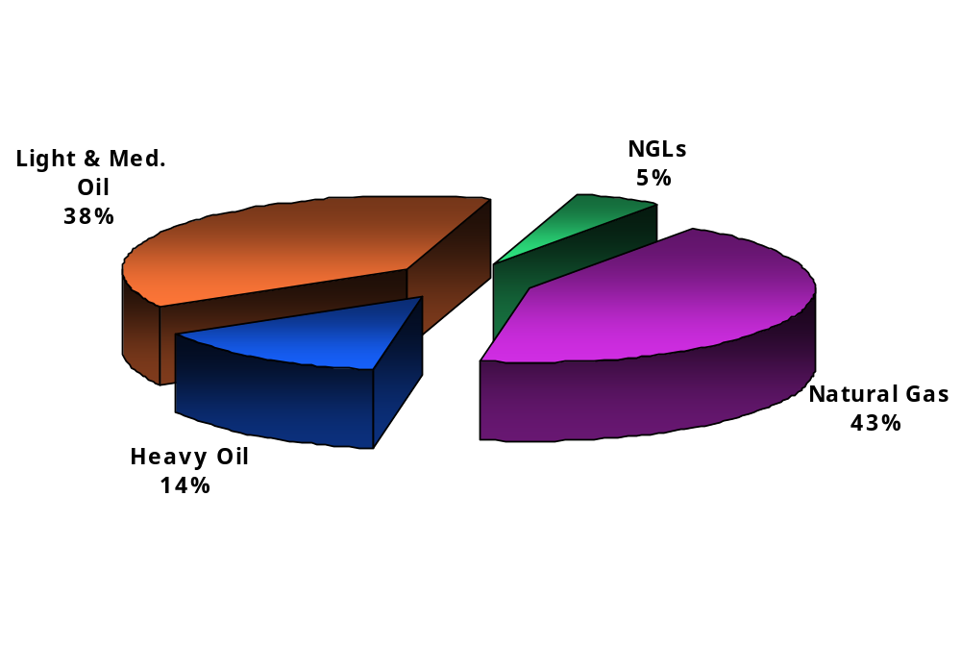
Penn West: Production Mix

Slide 7
Penn West: Liquid Hedges
 | 2008
 | Q1 | Q2 | Q3 | Q4 | 2009 | 2010
Hedged volumes (bbl/d) | 44,000 | 44,000 | 43,500 | 43,500 | 30,500 | 10,000
% Liquids production | 42% | 42% | 41% | 40% | 31% | 10%
Swaps | 2,000 | 2,000 | 1,500 | 1,500 | 500 | 0
Swap price (US$/bbl) | $73.23 | $73.23 | $72.47 | $72.47 | $72.62 | 0
Collars | 42,000 | 42,000 | 42,000 | 42,000 | 30,000 | 10,000
Average price:
ceiling (US$/bbl) | $83.50 | $83.50 | $79.85 | $79.85 | $110.21 | $129.87
floor (US$/bbl) | $64.76 | $64.76 | $66.43 | $66.43 | $85.00 | $85.00

Slide 8
Penn West: Natural Gas Hedges
 | 2008
 | Q1 | Q2 | Q3 | Q4 | 2009 | 2010
Hedged volumes (Gj/d) | 152,500 | 240,000 | 240,000 | 193,333 | 100,833 | 0
% Gas production | 25% | 41% | 42% | 35% | 19% | 0
Swaps | 2,500 | 100,000 | 100,000 | 33,333 | 0 | 0
Swap price (CAD$/Gj) | $8.61 | $6.75 | $6.75 | $6.75 | 0 | 0
Collars | 150,000 | 140,000 | 140,000 | 160,000 | 100,833 | 0
Average price:
ceiling (CAD$/Gj) | $9.87 | $6.94 | $6.94 | $8.94 | $11.27 | 0
floor (CAD$/Gj) | $6.67 | $6.09 | $6.09 | $7.01 | $7.88 | 0

Slide 9
Harvest Energy: Overview
Reserve Life Index: 10 Years
30+ Years on Refining Assets
Average Decline Rate: 20 – 25%
BOE/Day:
Average Netback per BOE:
Approximate Annual Yield at Current Price: 35%
Vertically integrated strategy (mining to refining) reduces price volatility risks
30 – 35% Institutional Ownership (2Q08)
Expanding through acquisition and recovery

Slide 10
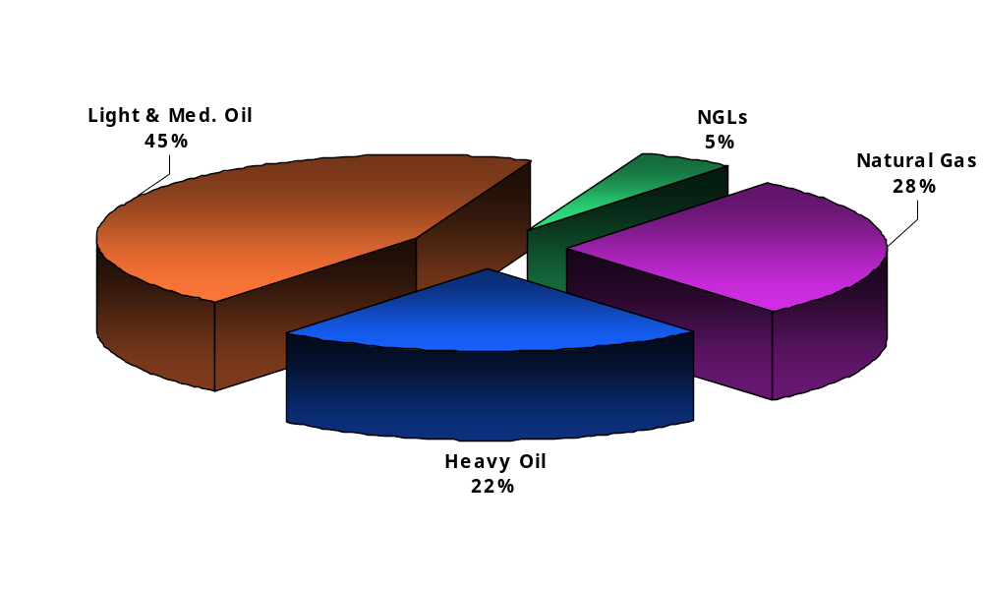
Harvest Energy: Production Mix

Slide 11
Harvest Energy: Oil Hedges
Crude Oil Price Risk Management
Quantity | Type of Contract | Term | Average Price
6,000 bbl/d | WTI 3-way contract | Jul. 08 – Dec. 08 | US$62.00 - $87.53 ($72.00)
Refined Product Price Risk Management
Quantity | Type of Contract | Term | Average Price
10,000 bbl/d | NYMEX heating oil 3-way contract | Jan. 08 – Dec. 08 | US$60.90 - $93.31 ($81.06)
6,000 bbl/d | Platt’s fuel oil 3-way contract | Jan. 08 – Dec. 08 | US$43.00 - $63.21 ($51.67)
2,000 bbl/d | NYMEX heating oil collar | Jan. 08 – Dec. 08 | US$79.80 - $91.35
2,000 bbl/d | Platt’s fuel oil collar | Jan. 08 – Dec. 08 | US$51.00 - $58.68
12,000 bbl/d | NYMEX heating oil 3-way contract | Jan. 09 – Jun. 09 | US$72.59 - $98.73 ($86.52)
8,000 bbl/d | Platt’s fuel oil 3-way contract | Jan. 09 – Jun. 09 | US$49.75 - $65.89 ($57.38)

Slide 12
Harvest Energy: Other Hedges
Natural Gas Price Risk Management
Quantity | Type of Contract | Term | Average Price
276 GJ/d | Fixed price – natural gas contract | Jan. 08 – Dec. 08 | Cdn$4.16
Electricity Price Risk Management
Quantity | Type of Contract | Term | Average Price
35 MWH | Electricity price swap contracts | Jan. 08 – Dec. 08 | Cdn $56.69
Refined Product Crack Spread Risk Management
Quantity | Type of Contract | Term | Average Price
2,000 bbl/d | Platt’s fuel oil crack swap | Jan. 08 – Dec. 08 | US($16.50)
6,000 bbl/d | NYMEX heating oil crack swap | Jan. 08 – Dec. 08 | US$14.63
6,000 bbl/d | NYMEX RBOB crack swap | Jul. 08 – Dec. 08 | US$10.00

Slide 13
Pengrowth Energy: Overview
Reserve Life Index: ..............................10.4 Years
Average Decline Rate: ...................................18%
BOE/Day: ...................................81,000 – 82,000
Average Netback per BOE:
Approximate Annual Yield at Current Price: ......23%
Institutional Ownership: ................................15%

Slide 14
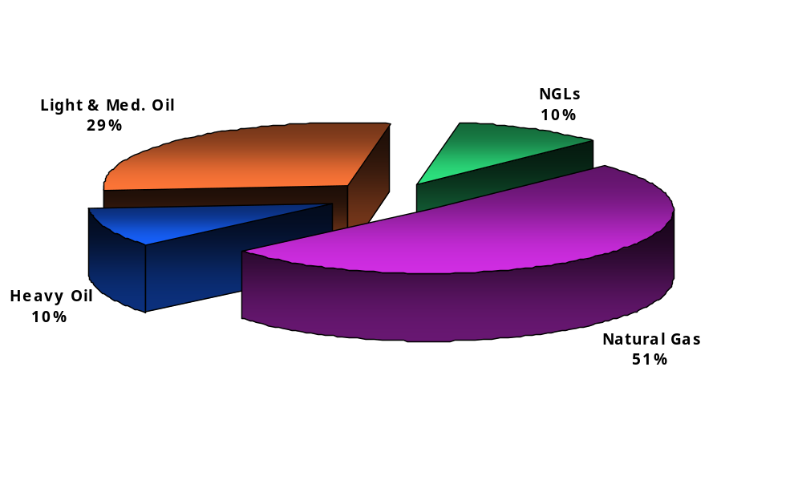
Pengrowth: Production Mix

Slide 15
Pengrowth: Oil Hedges
Quantity | Type | Term | Price
13,000 bbls/d | Fixed | 2009 | Cdn $86.34
4,500 bbls/d | Fixed | 2010 | Cdn $96.59

Slide 16
Pengrowth: Gas Hedges
Quantity | Type | Term | Price
72,260 mmbtu/d | Fixed | 2009 | Cdn $8.06
14,217 mmbtu /d | Fixed | 2010 | Cdn $8.59

Slide 17
Advantage Energy Income Fund
Reserve Life Index: ..............................12.1 Years
Average Decline Rate: ...................................22%
BOE/Day:....................................32,000 – 33,000
Average Netback per BOE: .....................
Approximate Annual Yield at Current Price: ...17.5%
Institutional Ownership: ................................15%

Slide 18
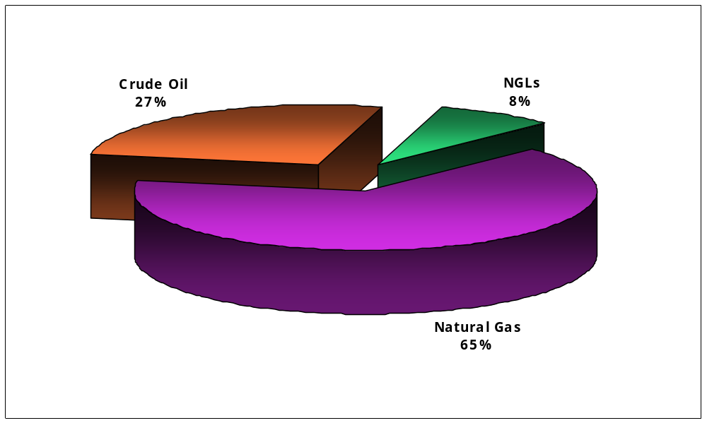
Advantage Income: Production Mix

Slide 19
Advantage Income: Oil Hedges
Quantity | Type | Term | Price
2,000 bbls/day | Fixed | Feb 2008 – Jan 09 | Cdn $90.93 / bbl
2,000 bbls/day | Collar | Feb 2008 – Jan 09 | Sold put Cdn $70 / bbl Bought call Cdn $105 / bbl Cost Cdn $1.52 / bbl
2,500 bbls/day | Fixed | Apr 08 – Mar 09 | Cdn $97.15 / bbl

Slide 20
Baytex Energy: Overview
Reserve Life Index: ..............................12.3 Years
Average Decline Rate: ....................................TBD
BOE/Day: ..............................................
Average Netback per BOE: .....................
Approximate Annual Yield at Current Price: ......13%
Institutional Ownership: ................................50%

Slide 21
Baytex: Production Mix

Slide 22
Baytex: Hedges

Slide 23
Provident Energy Trust: Overview
Reserve Life Index: ..............................16.9 Years
Average Decline Rate: ....................................TBD
BOE/Day: .................................................28,300
Average Netback per BOE: ...................Cdn $43.50
Approximate annualized yield at current price...22%
Institutional Ownership: .............................12.6%

Slide 24
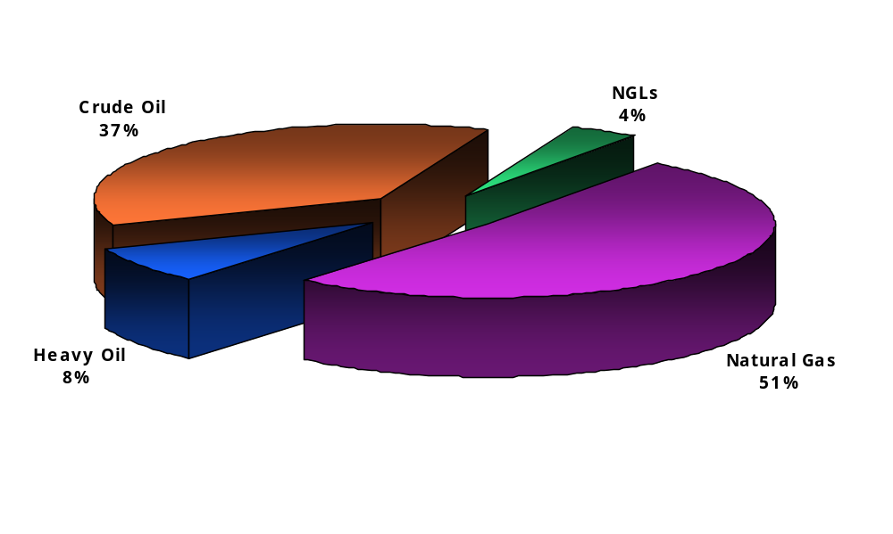
Provident: Production Mix

