Slide 1

Putting the Community back into the JCP
Your Java User Group
JCP Party!
Contact heather@jcp.org with any questions
Location, Date

Slide 2

Thanks to Java Community!

Slide 3
Agenda
Background
Evolution
Future directions
Upcoming planned updates

Slide 4

How the JCP works

Slide 5
For the community, by the community
The Java Community Process (JCP) is the open, inclusive process to develop and revise Java technology specifications (JSRs), reference implementations (RI), and technology compatibility kits (TCK).
  The JCP program has over 1,000 corporate, individual and Java User Group (JUG) members, & 12,000 registered users.
  More than 350 Java technology specifications are in development in the JCP program; ~two thirds have reached Final Release.
    Java EE 7 Final Release 2013.
    Java SE 8 Final Release 2014.
    Java ME 8 Final Release 2014.

Slide 6
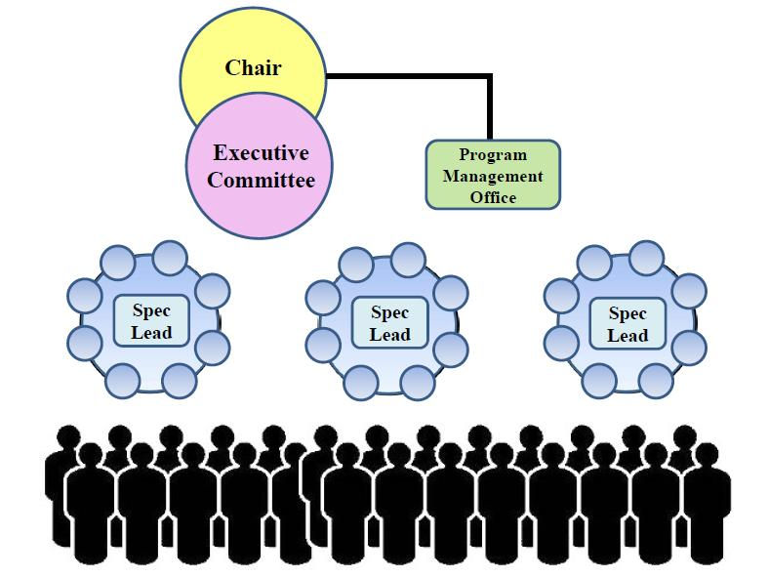
Organization

Slide 7

The compatibility triangle
Specification
Is the specification
unambiguous?
Can you build an
implementation?
Technology Compatibility Kit
Reference Implementation
Is the TCK correct?
Does the RI conform?

Slide 8
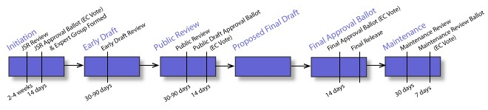
The JSR development cycle

Slide 9
JCP 1.0
JCP.Next JCP 2.10
JCP.Next
JCP 2.8
OpenJDK & Glassfish
1995
1998
2000
2002
2006
2011
2012
2014
JCP 3.0++
JCP 2.5/JSPA 2
JCP.Next
JCP 2.9
JCP 2.0
Java

Slide 10

Java – Hello World: 1995
Led by James Gosling, the Green Team worked around the clock and created the programming language that would revolutionize our world – Java.

Slide 11

JCP 1.0: 1999
At the Javitz Center in New York City, December 1998, Alan Baratz, then president of Sun's JavaSoft business unit, officially announced the JCP 1.0 program.

Slide 12

An International Effort
Membership from 70 countries
Membership by region

Slide 13

JCP 2.0: 2000
Introduction of two Executive Committees as decision makers.
JCP Members for lead projects, aka JSRs.
  Joint copyright for Members leading JSRs.
Java Standard Edition (J2SE) 1.3, Java Enterprise Edition (Java EE) 1.2 - December 1999.

Slide 14

JCP 2.5: 2002
Revised the JCP and the JSPA to embrace open source. Enable open source licenses, independent implementations and Individual participation.
J2SE 1.4 & J2EE released 1.4

Slide 15
JCP 2.5: Catalyst for change
Membership in 2002
Membership in 2014

Slide 16


Open Source projects: 2006
Sun initiates open source projects for Reference Implementations:
  OpenJDK for Java SE
  Glassfish for Java EE

Slide 17

JCP 2.6, JCP 2.7: 2004-2007
Java Platform releases: Java SE 6 (2006), Java EE 5 (2006), Java ME (2005).
JCP process changes focused on increased agility and participation.

Slide 18

Acquisition: 2010
Sun is acquired.

Slide 19
JCP.next
A series of four JSRs:
JSR 348: Towards a new version of the Java Community Process completed Oct 2011. √
JSR 355: Executive Committee Merge completed Oct 2013. √
JSR 358: A major revision of the Java Community Process is in progress now.
  This JSR will implement more complex changes and will modify the JSPA as well as the Process Document.
JSR 364: Broadening JCP Membership is in progress now.
  This JSR aims to broaden JCP membership by creating new membership classes. Plan to complete in 2014.

Slide 20
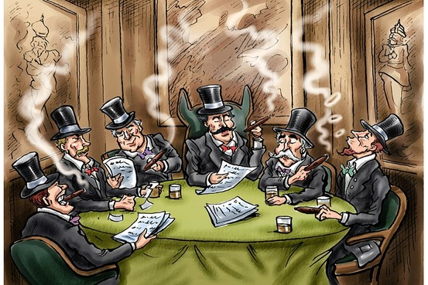
JCP 2.8: 2011
JCP.Next effort starts - no more smoke filled rooms!
Java SE 7 released – Yeah \o/ (5 years)!

Slide 21



Adopt a JSR!
Thank you
and

Slide 22

What is it?
A JUG-lead initiative to improve Java standards.
Groups of JUG members work on JSRs.
See http://java.net/projects/adoptajsr for full details.

Slide 23
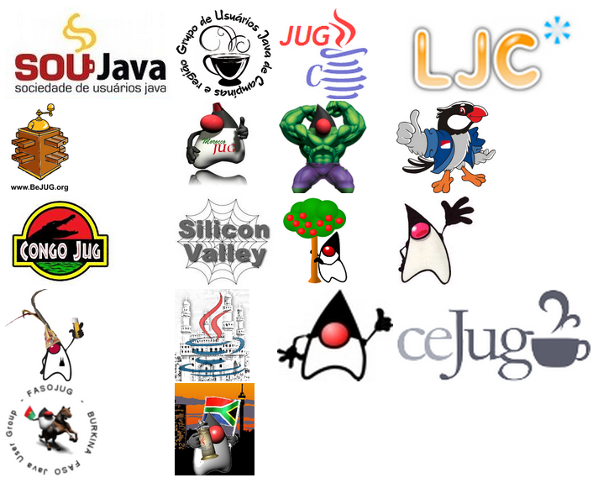
JUGS Around the World Adopt JSRs!

Slide 24
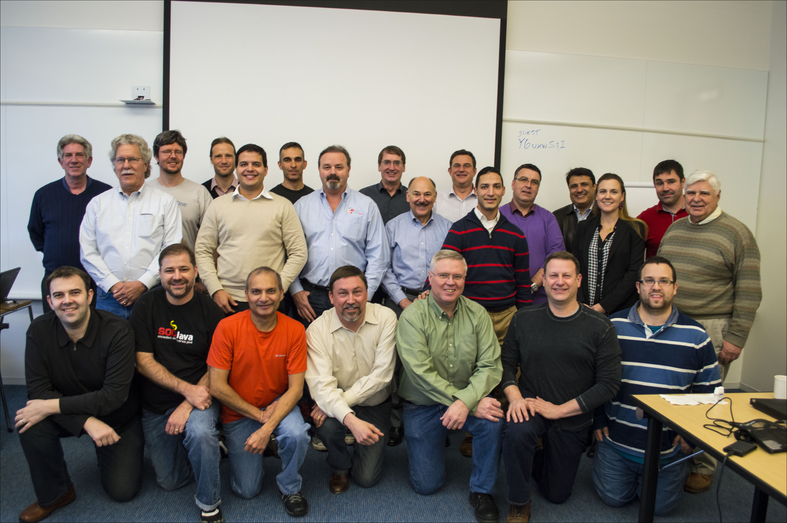
JCP 2.9: 2012-2013
Merged two Executive Committees into one.

Slide 25

Major Java Releases - 2013-2014
Revolutionary Java 8 release in 2014 – Java SE 8 & Java ME 8 & Embedded Profile!
Java EE 7 release in 2013!
Significant community contributions!

Slide 26
2014 - JCP is more open than before
Public JSR schedule--current, and updated regularly.
Public read and/or write page/wiki for the JSR.
Public discussion for the work of the JSR (archived).
Public feedback mechanism.
Public issue tracker.
One EC votes on all JSRs 3x in life of JSR with public results.
All JSRs have 3 open public review periods (30 days).
  Release early and often!

Slide 27

That was easy!

Slide 28
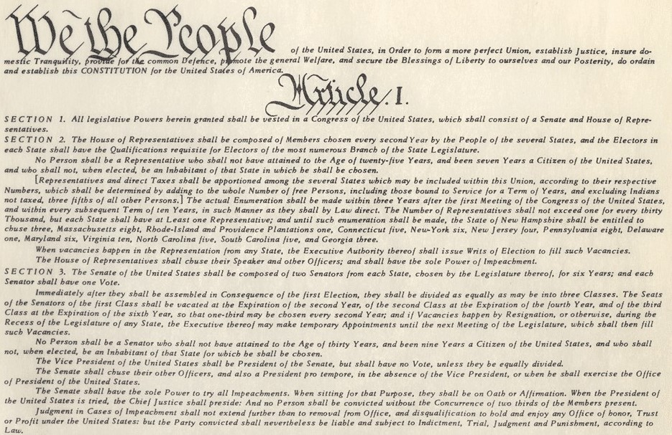
Constitutional change (JCP.next)

Slide 29

JCP.next.3 (JSR 358)

Slide 30
Modifying the JSPA
The JSPA has not been significantly modified since 2002.
Since then the organization and the environment in which we operate have changed significantly.
  Most significantly, the widespread adoption of open-source licensing and development practices.
The document is long overdue for updating and cleanup.
However, it is very complicated and difficult to understand.
We must be very careful when making changes.
Plus…

Slide 31

The Lawyers Get Involved

Slide 32
Why it matters
The JSPA defines the way in which Intellectual Property (IP) rights are granted and the terms under which the Spec, RI, and TCK must be licensed.
We must make sure that the technologies we incorporate into Java are "safe" from an IP perspective, so that people can implement them and use them with confidence.

Slide 33
Our shopping-list
Independent Implementations
Compatibility
Licensing and open source
Transparency
Patent policy
The role of individuals
Fee structure
The role of the RI
TCK changes
Expert Group dissolution
IP flow
Withdrawal of IP
End of life for JSRs
Escrow process
Refactor the JSPA
Collaboration with other SDOs

Slide 34
Progress so far
Our initial focus was in two areas:
  IP policy, licensing, and open-source.
  The role of individual members in the JCP.
Each was driven by a Working Group.
The Working Groups meet regularly, and report back to the Executive Committee (the Expert Group for JCP.next JSRs) at the monthly EC meetings.
See the public EC meeting summaries for their latest reports.

Slide 35
JSR 358 goals
Maintain compatibility guarantees.
Embrace open-source licensing and development processes.
Developer access to TCKs.
Simplify IP-flow and licensing models.

Slide 36

Strong compatibility
All JSRs will be covered by a standard Spec license that includes strong compatibility requirements.
All implementations must pass the TCK.

Slide 37
Embrace open source
Reference Implementations must be developed through open-source projects and released under open-source licenses.

Slide 38
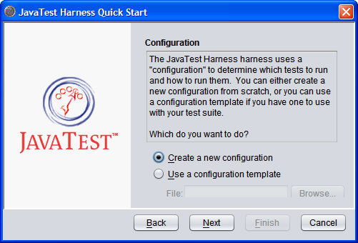
Developer access to TCKs
All TCKs must be made available under a Community TCK License to those who participate in the RI-development projects.

Slide 39
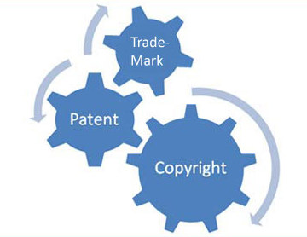
Simplify IP-flow and licensing models
The current JSPA has a very complicated IP-flow, with IP passing from contributors through the Spec Lead to implementers and end-users.
We hope to simplify that…

Slide 40
Follow us on java.net
Of course, we do all our work in public.
Start with our public java.net project.
There you will find links to:
  The Observer mailing list (all Expert Group mail is copied here).
  The Issue Tracker.
  The Document Archive (our meeting minutes and working documents are published here).
Let us know what you think.
Help us to do the right thing!

Slide 41

JCP.next.4 (JSR 364): 2014

Slide 42
JSR 364 Proposal
Create a new Affiliate membership class specifically tailored towards individuals.
Create a new Partner membership class specifically tailored towards JUGs that are not legal entities.
Waive all membership fees to remove the incentive for corporations to encourage their employees to represent them as individual members.

Slide 43
Proposed Membership Classes
Observer
Partner member
Affiliate member
Full member
Associate of Full member

Slide 44
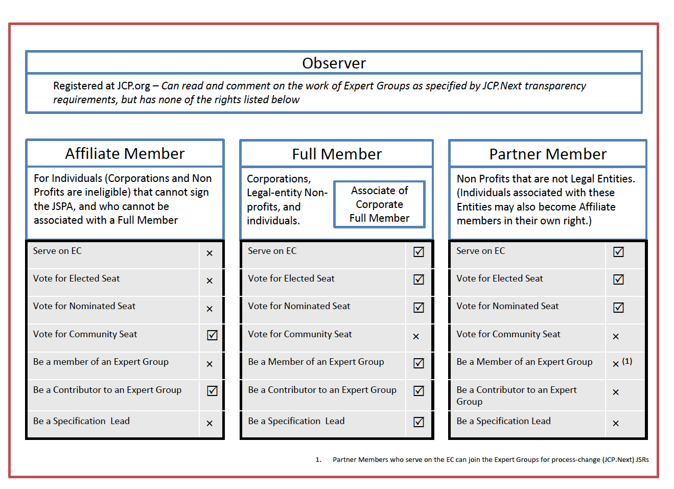
Membership Chart

Slide 45
Bringing Java into the open
No more barriers to participation.
All members of the Java community can participate:
  In the implemenation of the platform through OpenJDK and GlassFish.
  In the evolution of the platform through the JCP and Adopt-a-JSR programs.
If you care about the future of Java...participate!

Slide 46
Create the future Java!
Follow the JCP online: http://JCP.org or @jcp_org
Join the Projects for JSRs that interest you:
  Java EE 8 JSRs starting soon
  JCP.Next JSRs:
      https://java.net/projects/jsr358/pages/Home
      https://java.net/projects/jcpnext4/pages/Home
    Adopt-a-JSR
      https://java.net/projects/adoptajsr/pages/Home
  Contribute to RI for Java SE & Java EE
      http://openjdk.java.net/
      https://glassfish.java.net/

