Slide 1
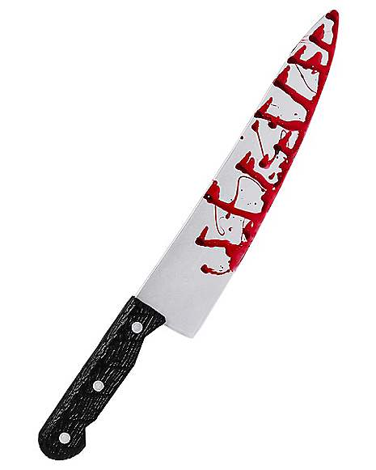
Favorite Slasher Flicks

Slide 2
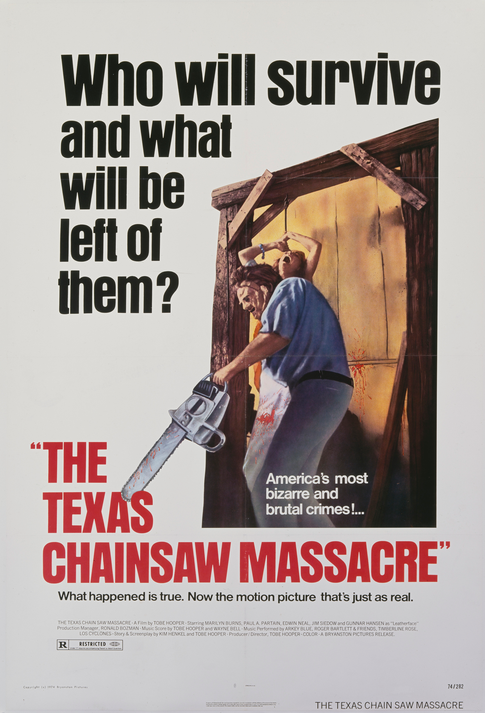
Texas Chainsaw Massacre
The GOAT
Genuinely one of the greatest American films

Slide 3
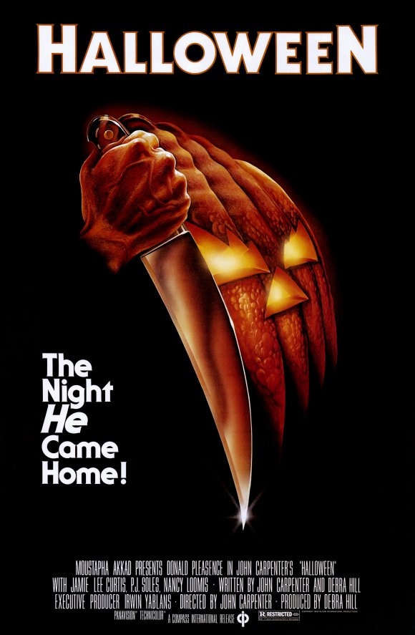
Halloween
A bit on the overrated side, but still a classic

Slide 4
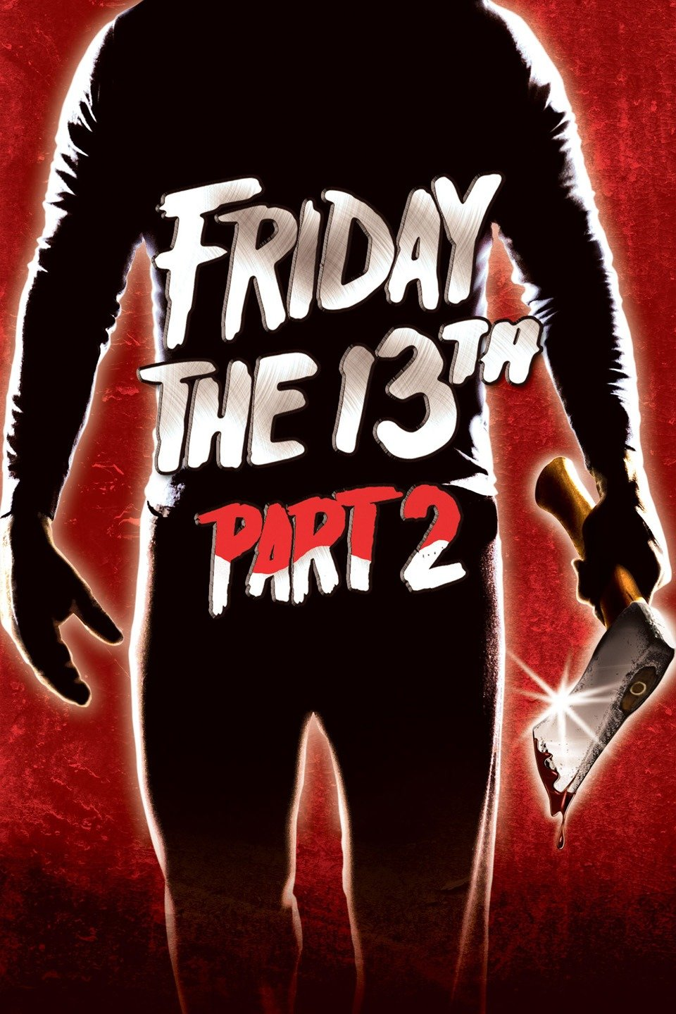
Friday the 13th Part2
Underrated gem, don’t be turned off by the fact that it starts with a five minute recap of the previous film
Gets outshone by IV, which I think is merely alright

Slide 5
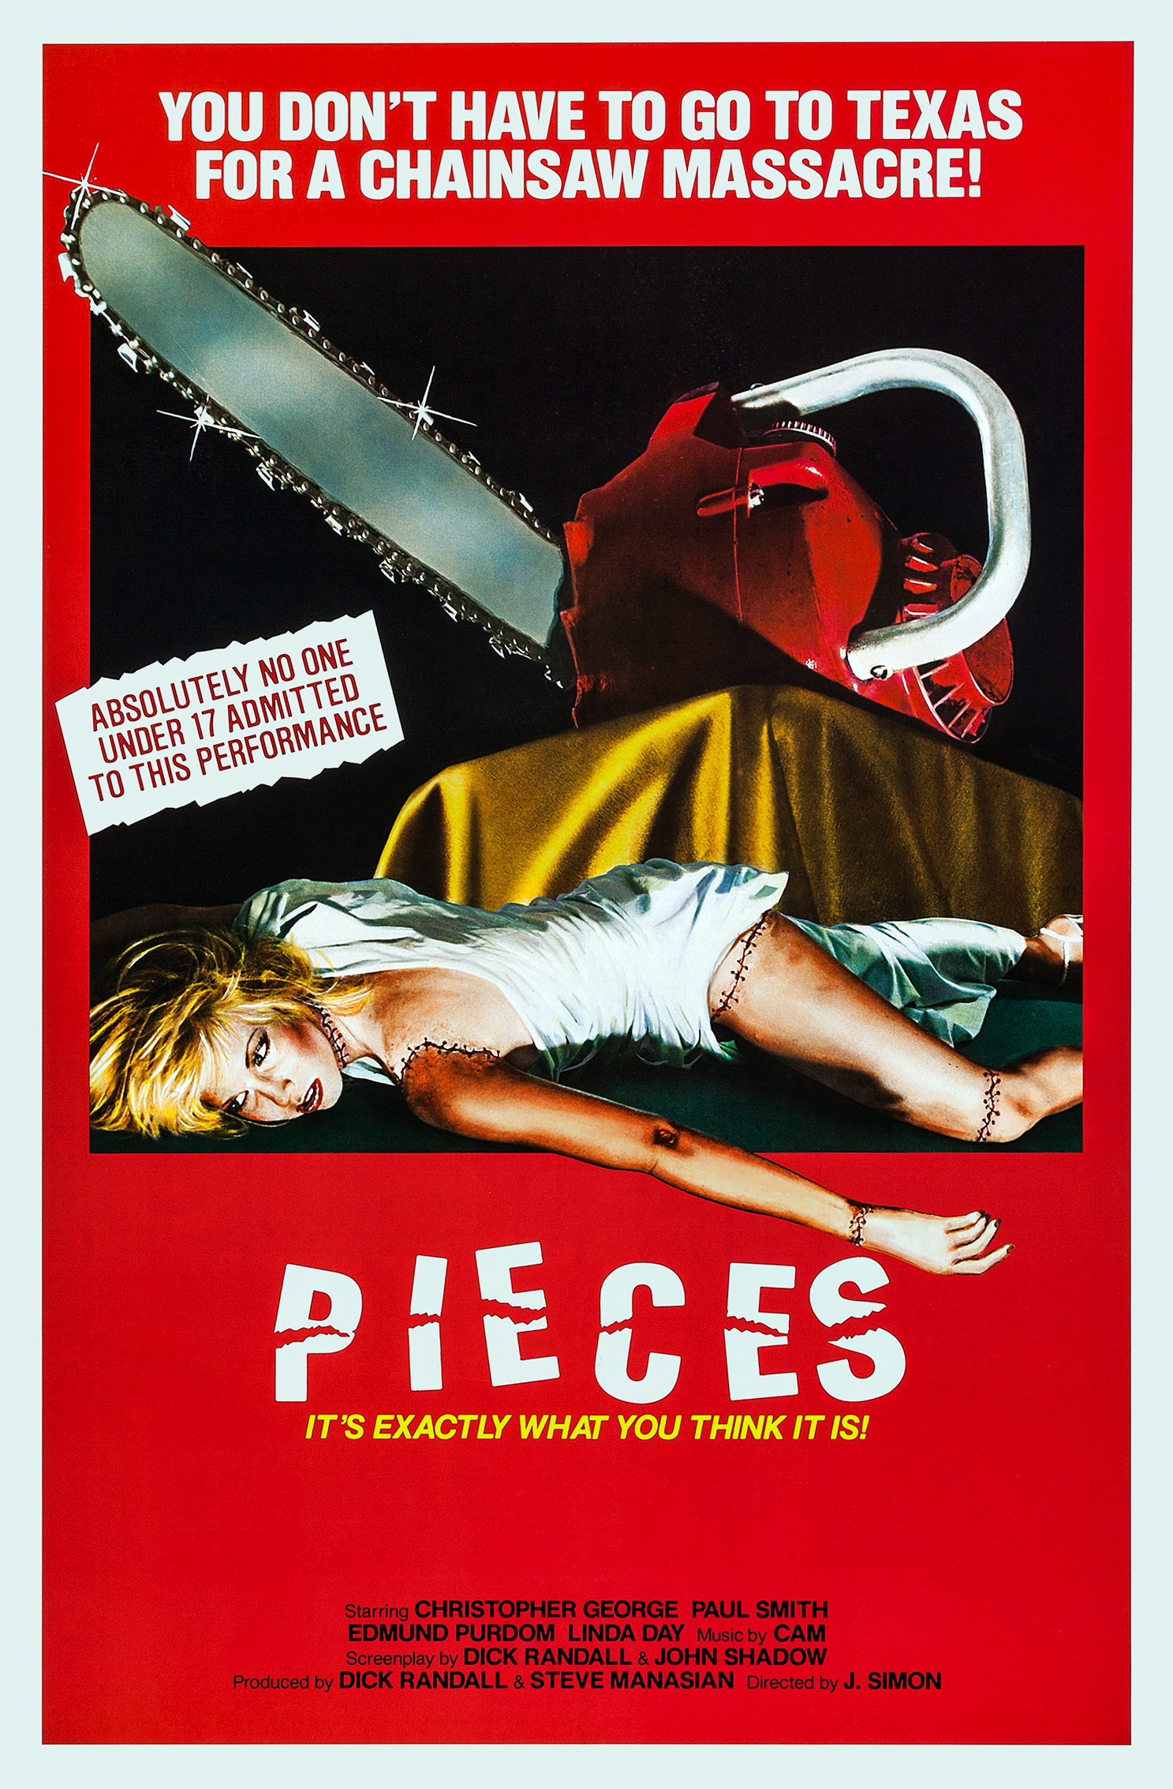
Pieces
My favorite trashy film
Hilariously inept, but also effectively gruesome
Keep an eye out for a special guest appearance of Bruce Lee imitator Bruce Le

Slide 6
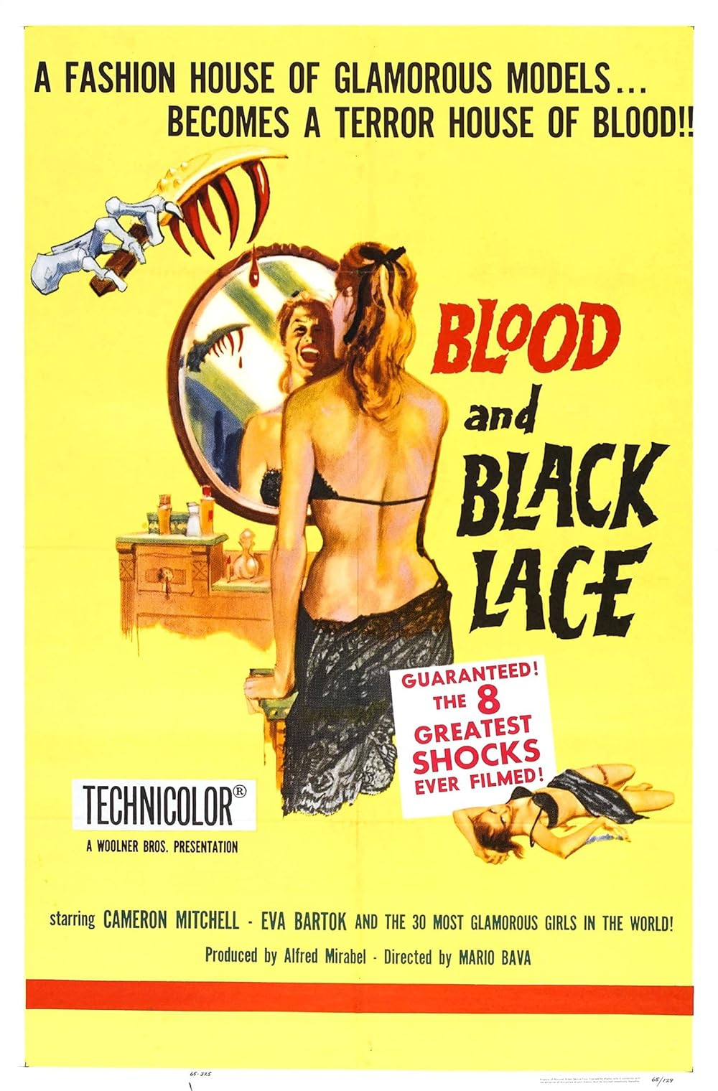
Blood & Black Lace
It’s a bit more Giallo than slasher, but Bava kicks-ass and deserves a mention

Slide 7
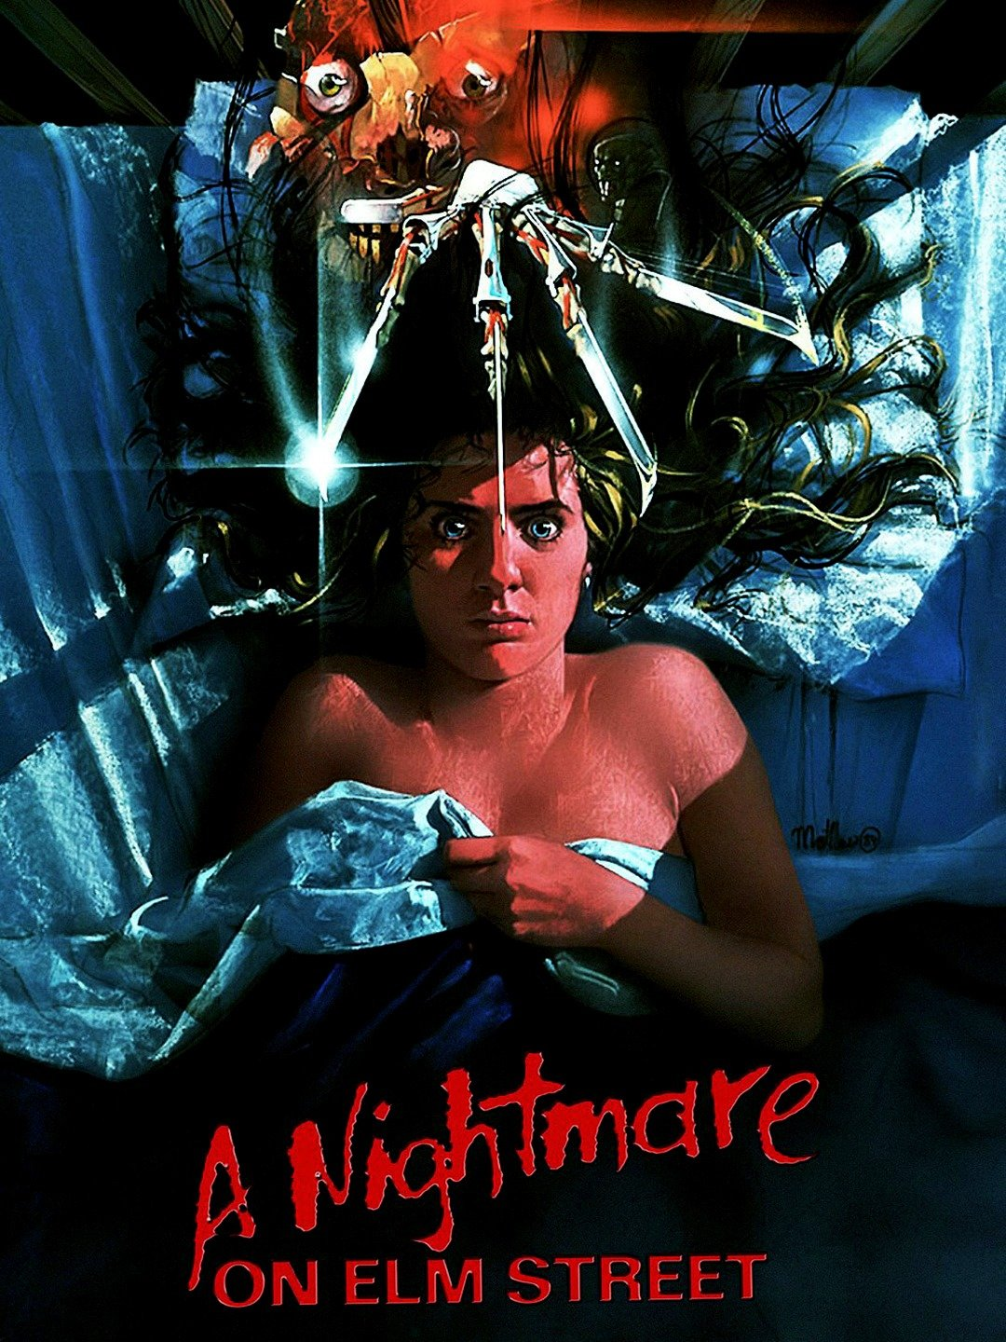
Nightmare on Elm Street
Evocative concept and a great villain.

Slide 8
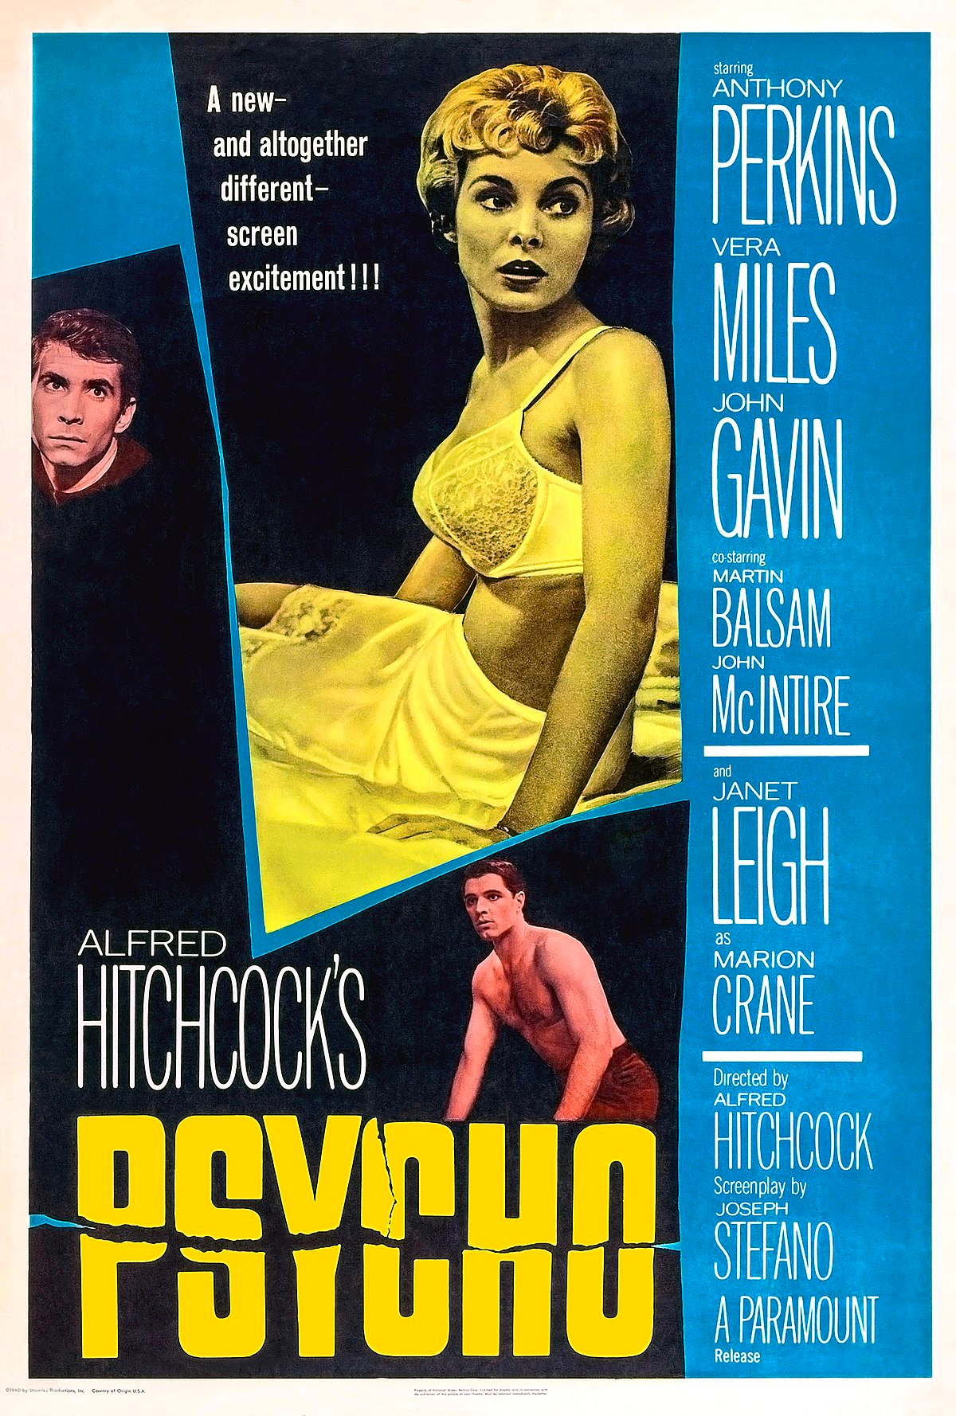
Psycho
Ok, definitely not a slasher, but it’s an amazing film that everyone needs to see
Seriously, watch it
The sequel is surprisingly decent

