Slide 1
PREDICTING THE EFFECTS OF DNA VARIATIONS ON HUMAN HEALTH
Oct 28, 2020
Jay Park
Notes:
Hello everyone. Today I would like to present on the topic of…

Slide 2
WHAT IS DNA?
-Blueprints for life
-Humans have 46 pieces (usually in spaghetti form)
Notes:
First, I’d like to take us all back to intro bio and give a refresher on what DNA is.
DNA contain the code for proteins. And since proteins are the building blocks of life, ultimately DNA are the blueprints for life.
Humans have 46 of these spagettis floating around in every cell nuclei, but on rare occasions, during cell division, they condense to a much more visible form…

Slide 3
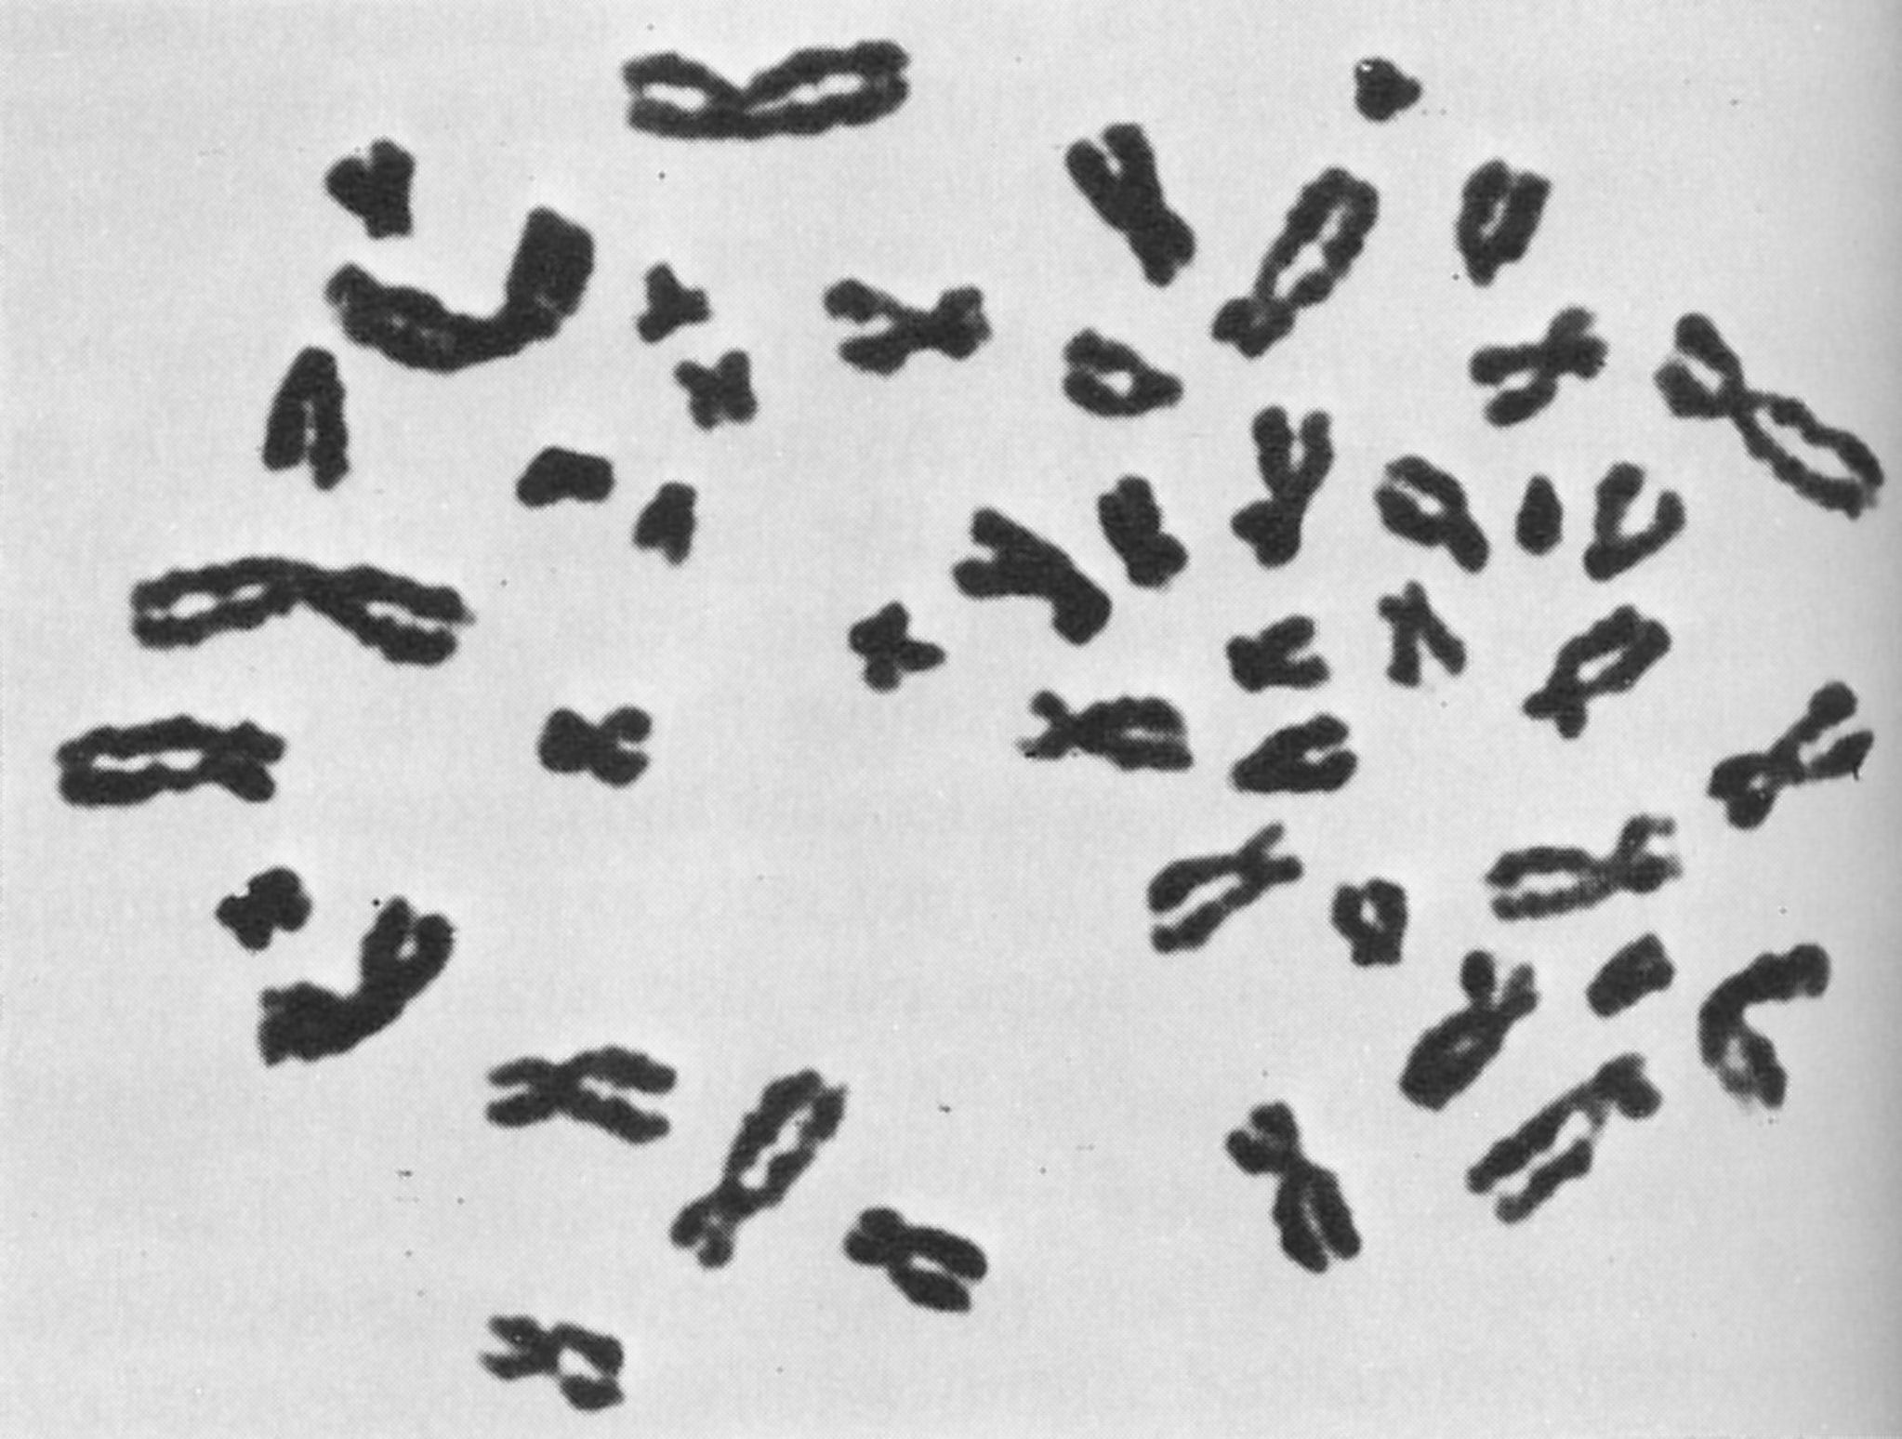
WHAT IS DNA?
-Blueprints for life
-Humans have 46 pieces (usually in spaghetti form)
CONDENSED FORM!
Notes:
….like what you see in this picture on right.

Slide 4
WHAT ARE GENETIC VARIATIONS?
MUTATIONS? POLYMORPHISMS?
-Everyone’s DNA is very slightly different
Genetic Variation
(polymorphism / mutation)
Notes:
The vast majority of everyone’s DNA is identical, but there are still some differences between our genomes.
These are called genetic variations, or polymorphisms or mutations depending on the context

Slide 5
WHAT ARE GENETIC VARIATIONS?
MUTATIONS? POLYMORPHISMS?
-Everyone’s DNA is very slightly different
Genetic Variation
Harmful?
Benign?
Notes:
The important thing, however, is that not all variations are created equal in their effects on human health.
Some are detrimental, while others are relatively harmless.

Slide 6
RESEARCH QUESTION
Can clinical significance of a variation be predicted purely through bioinformatic methods?
Notes:
The research question I sought to answer is this: ….

Slide 7


DATASET DESCRIPTION
ClinVar
ENSEMBL
354199 Homo sapiens genomic variations
Notes:
Inspired by a Kaggle dataset, I downloaded and processed a database containing ~350,000 human genomic variations derived from these two sites
The database only included single-nucleotide variations or small deletions/insertions

Slide 8
IS THE VARIATION…
Benign / Likely benign
Uncertain
Pathogenic / Likely pathogenic
Notes:
When I looked at the data, 97% of the variations already had some information on their health effects.
These designations have been assigned by scientists who review relevant clinical data / research papers, who then make their best judgment on their pathogenicity.

Slide 9
IS THE VARIATION…
RS 587784256
Gene: PAFAH1B1
Benign / Likely benign
Uncertain
(1)
Pathogenic / Likely pathogenic
Notes:
Here’s an example row in the dataset
For this variant in the gene PAFAH1B1, one lab reviewed this variant and guessed that this mutation is likely to be pathogenic

Slide 10
IS THE VARIATION…
RS 11203289
Gene: SDHB
(7)
Benign / Likely benign
(1)
Uncertain
(1)
Pathogenic / Likely pathogenic
Notes:
Now here’s an example of another mutation, or another row.
For this mutation in gene SDHB, 7 labs decided that the variation is benign, 1 lab said it was uncertain, and 1 lab said it was pathogenic.

Slide 11
‘CLINICAL REVIEW STATUS’ TIERS
Reviewed by expert panel
Reviewed by multiple labs / No conflicts
Reviewed by multiple labs / Conflicting interpretations
Reviewed by single lab with justification
Only assertion provided (no justification)
RELIABILITY
Notes:
As you saw sometimes the labs agree on what the health effects of are, and sometimes they disagree. Other times, the mutation is only looked at by one lab.
Therefore, one can say that the reliability of these clinical designations vary widely.
For the training and testing of the model, I needed the mutations that have minimal ambiguity and a clear “answer key” so to speak.

Slide 12
‘CLINICAL REVIEW STATUS’ TIERS
57,663 rows
Reviewed by expert panel
Reviewed by multiple labs / No conflicts
Reviewed by multiple labs / Conflicting interpretations
Reviewed by single lab with justification
Only assertion provided (no justification)
RELIABILITY
Notes:
For that purpose, I decided to focus on the 57,000 rows that would likely have high reliability in health effect designations.

Slide 13
FEATURES FOR TRAINING
-Frequencies of variant in population (multiple studies)
-Various bioinformatic metrics estimating harmfulness
Notes:
To train the model, I used the

Slide 14
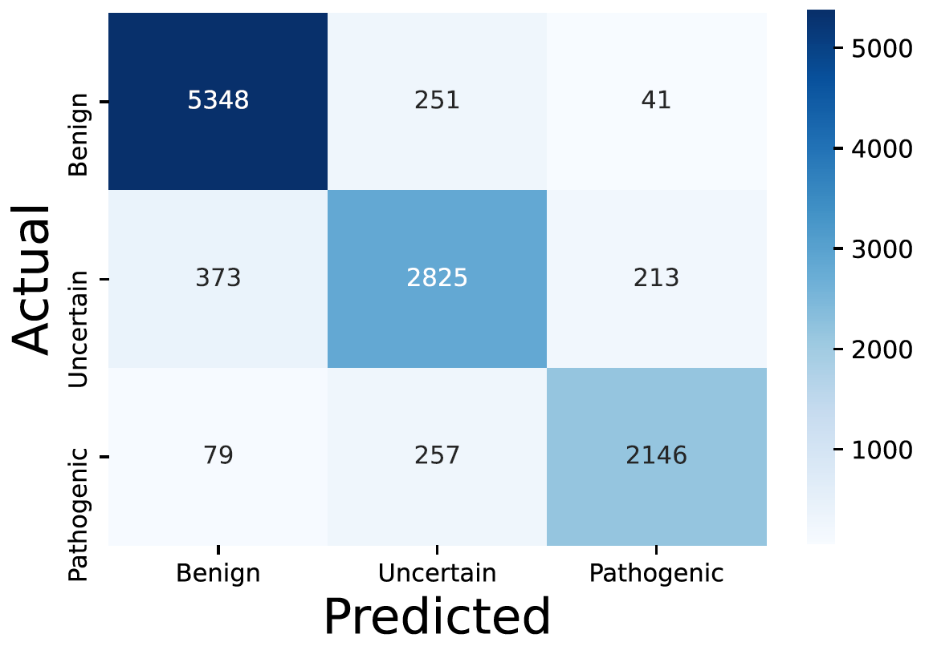
TEST RESULTS (XGBoost)
Accuracy: 0.89
 | Precision | Recall
Benign | 0.92 | 0.95
Uncertain | 0.85 | 0.83
Pathogenic | 0.89 | 0.86
Notes:
I trained the model using XGBoost.
The accuracy of the model ended up being 0.89, with the precision and recall also being around that.
I consider this model to be relatively good at its predictions based on the metrics.
I was also glad that very few of the variants were severely off;
So, what I mean by that is, very few of the variants my model thought was pathogenic ended up being benign, and vice versa, so that was a good sign.

Slide 15
APPLICATIONS
Notes:
Now that we have the model, I decided to look at some potential applications of the model.

Slide 16
‘CLINICAL REVIEW STATUS’ TIERS
Reviewed by expert panel
Reviewed by multiple labs / No conflicts
Reviewed by multiple labs / Conflicting interpretations
Reviewed by single lab with justification
Only assertion provided (no justification)
RELIABILITY
267,282 rows
Notes:
Remember that a lot of the variations did not have a robust “answer key”. They were either reviewed by a single lab, or sometimes there was just the designation without any justification.
I wanted to run my model on these variants to see how much the clinical designations matched up with my model.

Slide 17
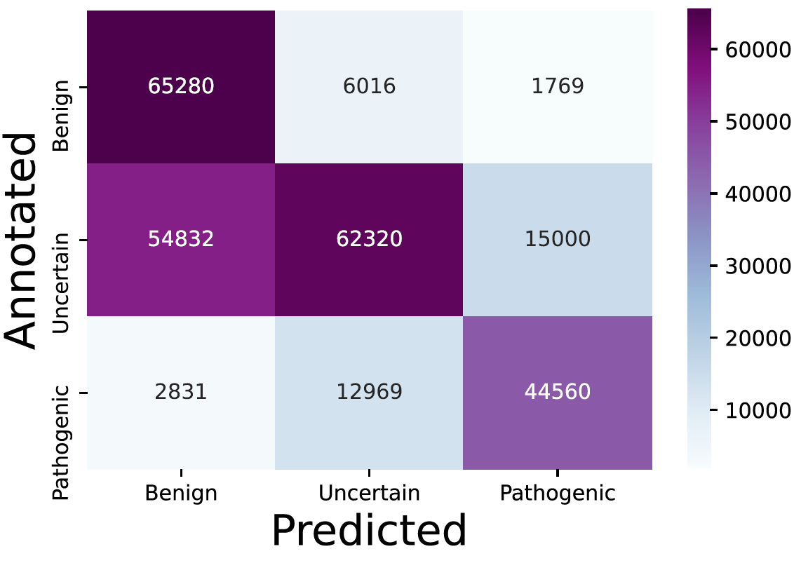
SINGLE-SUBMITTER ANNOTATIONS LARGELY AGREE WITH ALGORITHM
65% of annotations agree with model
Uncertain – Benign skew
Notes:
In total 65% of these designations agreed with my model, which suggested to me that the low-reliability designations are still somewhat accurate.
When you look at the heatmap actually, there IS an interesting pattern.
A large proportion of the variants that my model predicts to be benign was categorized as uncertain by the labs.
My hypothesis is that perhaps labs tend to err on the safe side before declaring a less-studied variant as benign.

Slide 18
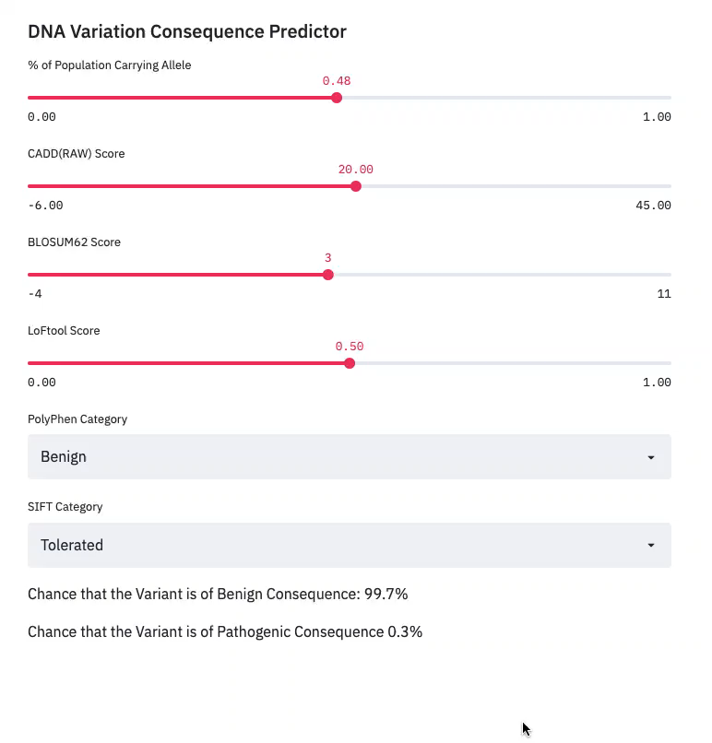
TWEAKING MODEL PARAMETERS ON STREAMLIT
Notes:
(start video)
Lastly, I made an interactive website using streamlit.
You can enter the fields and move around the sliders.
I thought it was very interesting how the frequency of the variation in the population is a strong predictor for whether the mutation will be harmful or not.
It makes sense from an evolutionary perspective, as carriers of harmful variations are less likely to leave progeny, therefore harmful mutations can’t be too prevalent in the population.
But it was interesting to see.

Slide 19
APPENDIX: FEATURES USED
-AF_ESP
-AF_EXAC
-AF_TGP
-CADD_RAW
-BLOSUM62
-LoFtool
-PolyPhen
-SIFT

Slide 20
APPENDIX: ACKNOWLEDGEMENTS
-European Bioinformatics Institute (@ EMBL)
-https://www.kaggle.com/kevinarvai/clinvar-conflicting
-ClinVar (@ NIH / NCBI)
-NHLBI GO Exome Sequencing Project
-Exome Aggregation Consortium
-1000 Genomes Project
-Rentzsch, Philipp et al. “CADD: predicting the deleteriousness of variants throughout the human genome.” Nucleic acids research vol. 47,D1 (2019): D886-D894. doi:10.1093/nar/gky1016
-Kircher, Martin et al. “A general framework for estimating the relative pathogenicity of human genetic variants.” Nature genetics vol. 46,3 (2014): 310-5. doi:10.1038/ng.2892
-Henikoff, S, and J G Henikoff. “Performance evaluation of amino acid substitution matrices.” Proteins vol. 17,1 (1993): 49-61. doi:10.1002/prot.340170108
-Fadista, João et al. “LoFtool: a gene intolerance score based on loss-of-function variants in 60 706 individuals.” Bioinformatics (Oxford, England) vol. 33,4 (2017): 471-474. doi:10.1093/bioinformatics/btv602
-Adzhubei, Ivan et al. “Predicting functional effect of human missense mutations using PolyPhen-2.” Current protocols in human genetics vol. Chapter 7 (2013): Unit7.20. doi:10.1002/0471142905.hg0720s76
-Ng, P C, and S Henikoff. “Predicting deleterious amino acid substitutions.” Genome research vol. 11,5 (2001): 863-74. doi:10.1101/gr.176601
CREDITS: This presentation template was created by Slidesgo, including icons by Flaticon, and infographics & images by Freepik.

Slide 21
THANK YOU!

