Slide 1
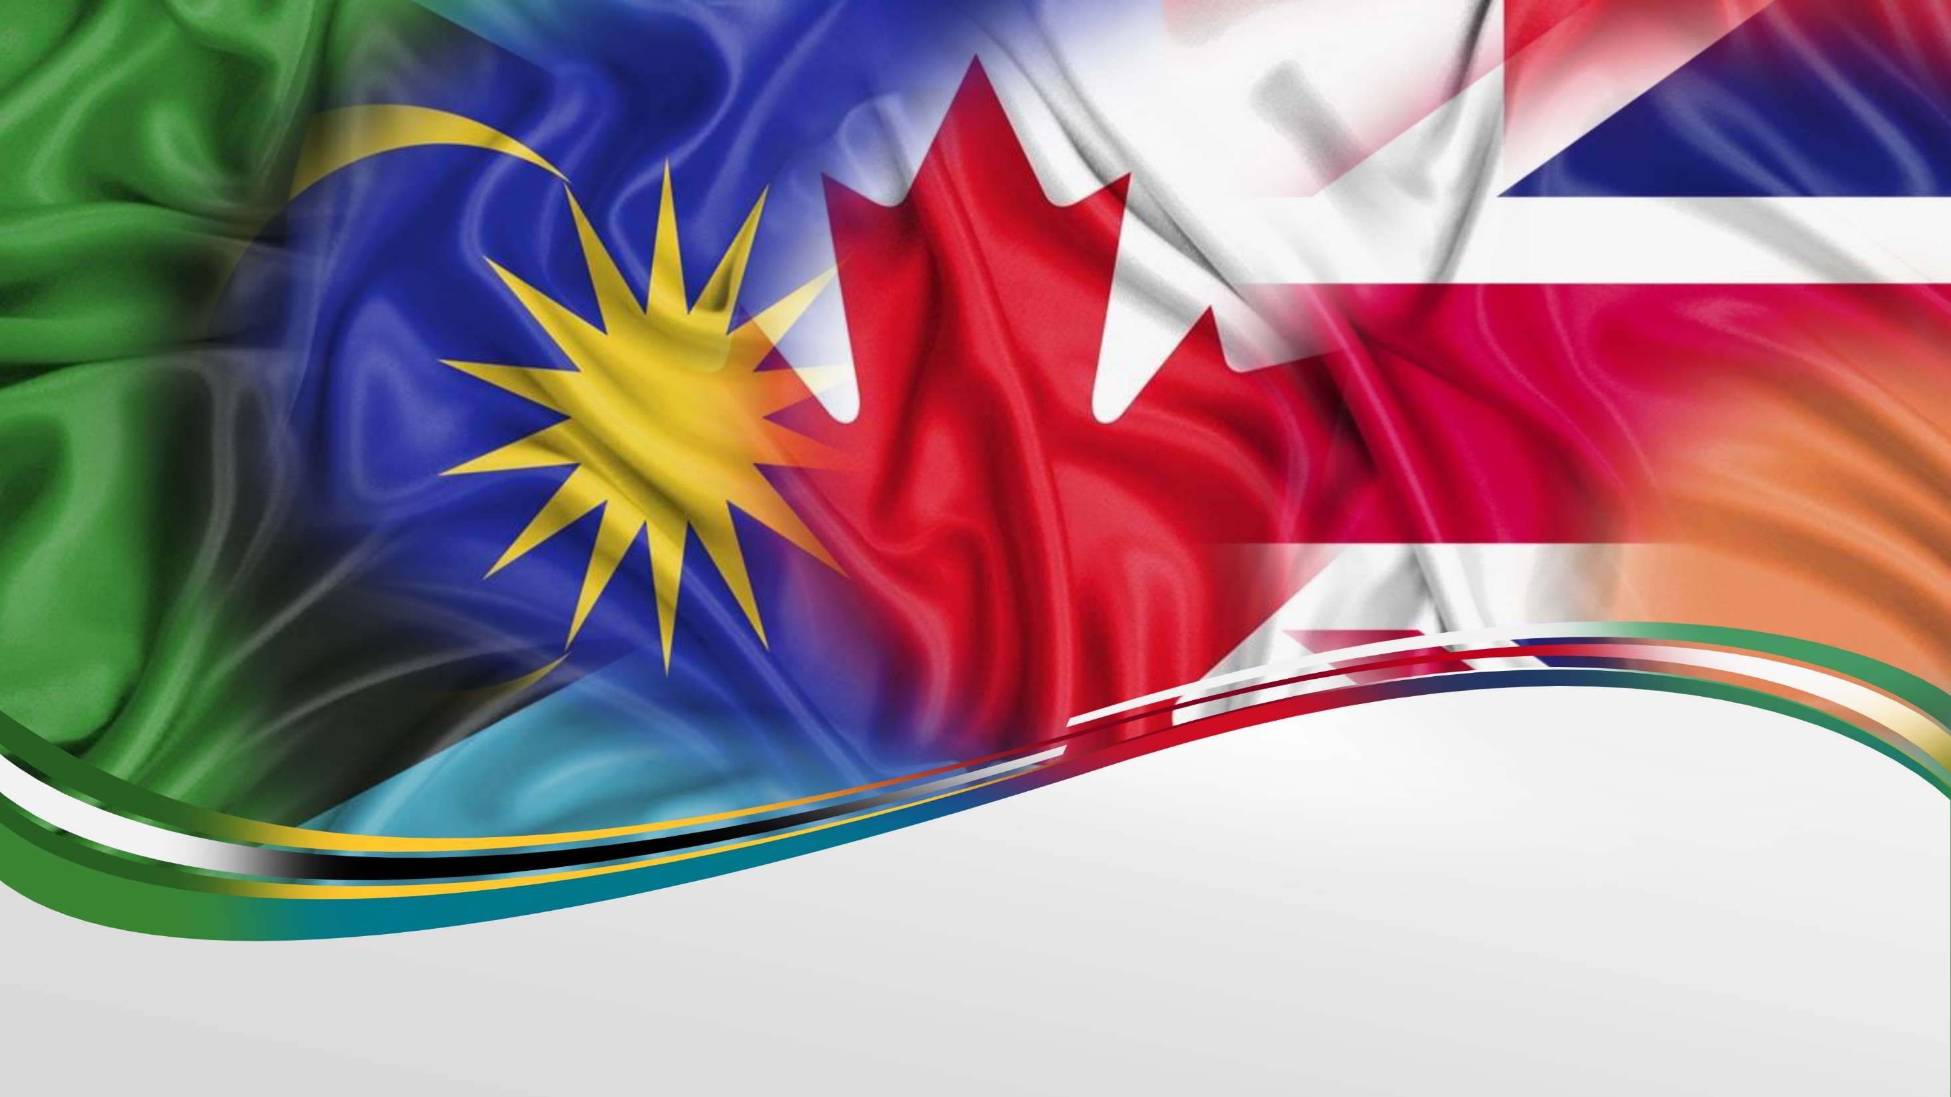
DeepFlag: The Deep-Learning Flag Generator
Jaeseok “Jay” Park
Notes:
Today I will talk about my project called DeepFlag, aka

Slide 2
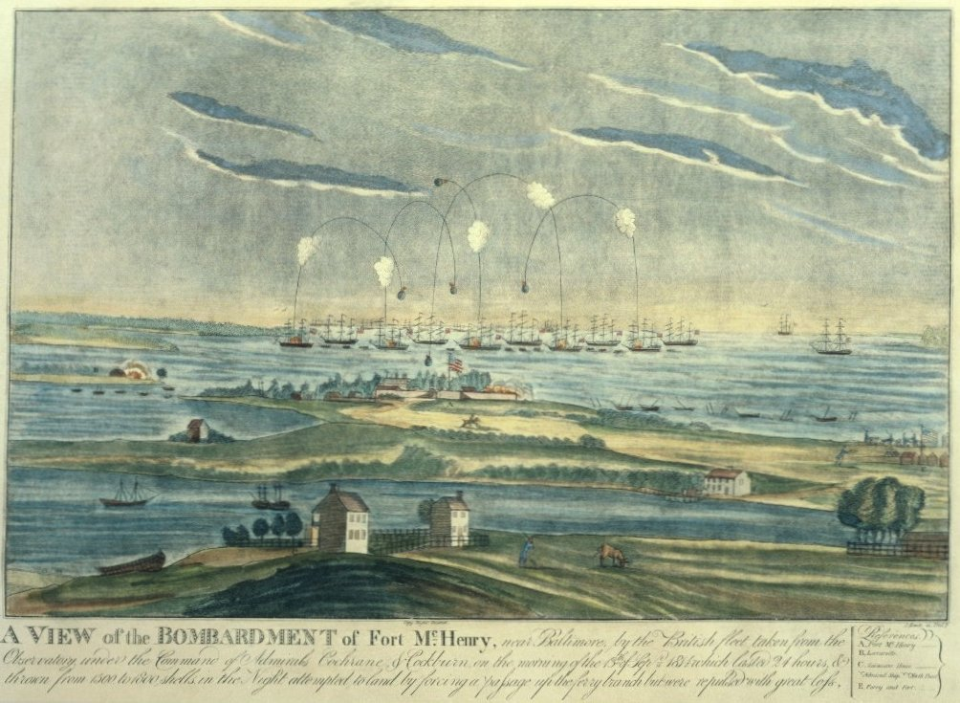
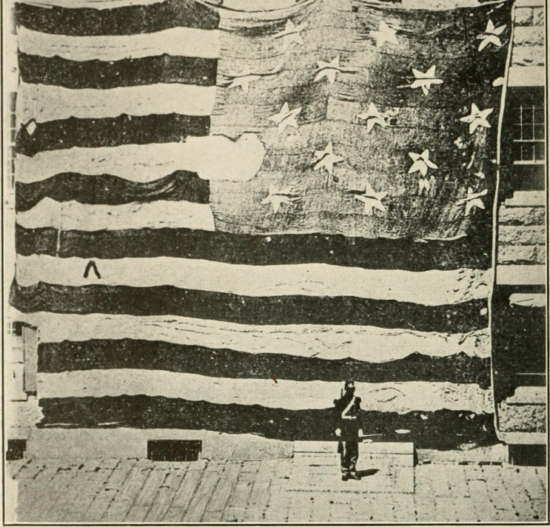
A National Flag Embodies the Identity, Spirit, and Soul of its Citizens
Actual flag
(Now at The Smithsonian)
Notes:
In talking about flags, probably the most iconic usage of flags in modern times is the national flag.
National flags usually have very deep meaning to its citizens.
An iconic example of this is when Francis Scott Key saw the American flag still flying even after a night of bombardment at Fort McHenry,
Which is depicted on the left
And this inspired him to write the lyrics to the Star-Spangled Banner, the American national anthem in use today.

Slide 3
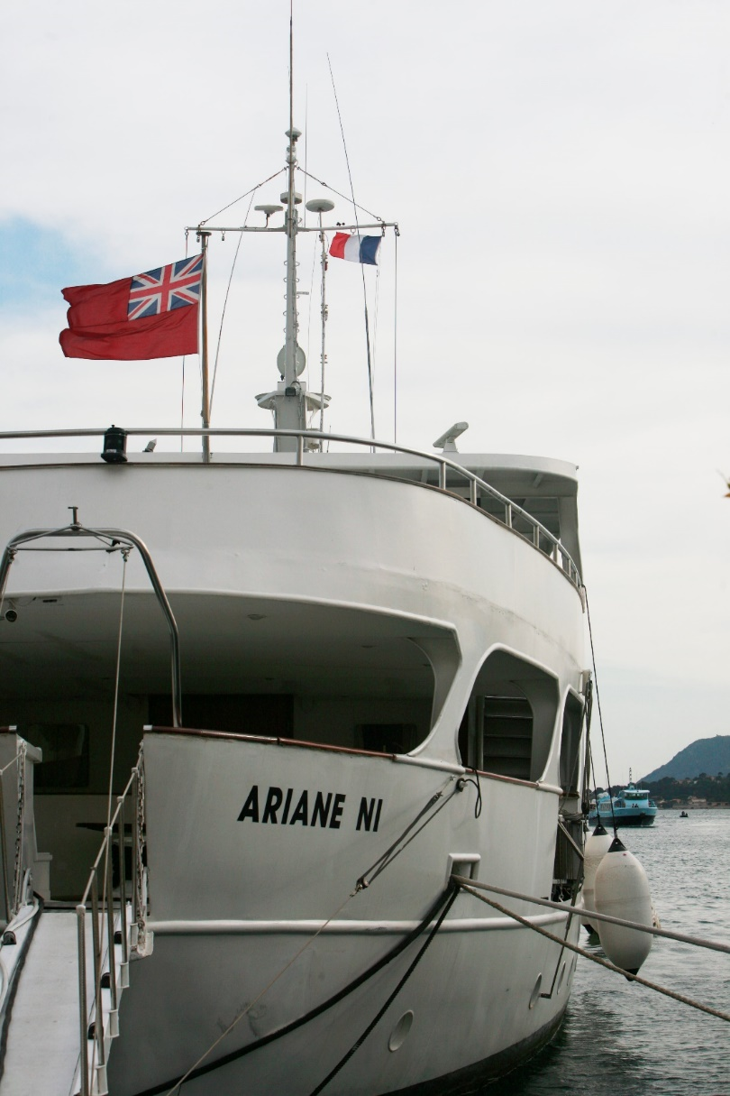
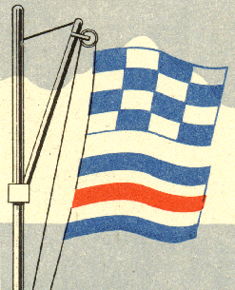
Flags are Extensively Used in Maritime Signalling
Notes:
Flags don’t only serve as national symbols, but they’re used for practical purposes as well, such as in maritime signaling.
The signal flags on the left spell out, NC, which is the naval equivalent of an SOS, so this ship is in trouble.
On the right, you see that this ship is a British civil ship visiting a French port simply by looking the flags and their positions.

Slide 4
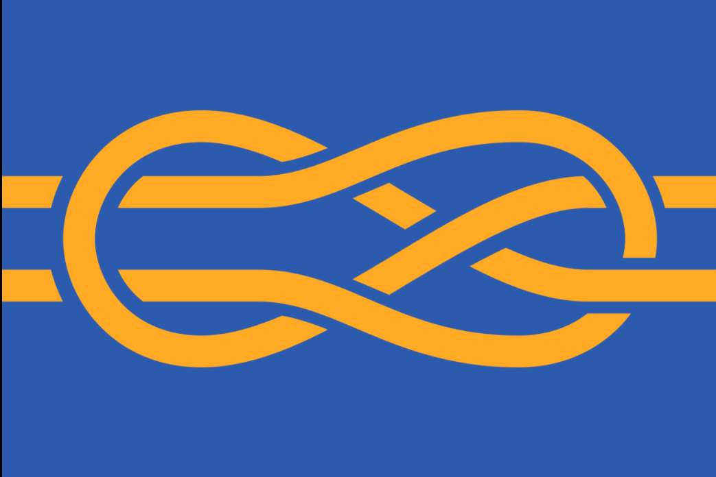

Vexillology is the Study of Flags
Notes:
There is so much rich history and meaning around flags such that there is a field of study dedicated to flags, called vexillology.
And on the right is the official flag of the international society of vexilologists.

Slide 5
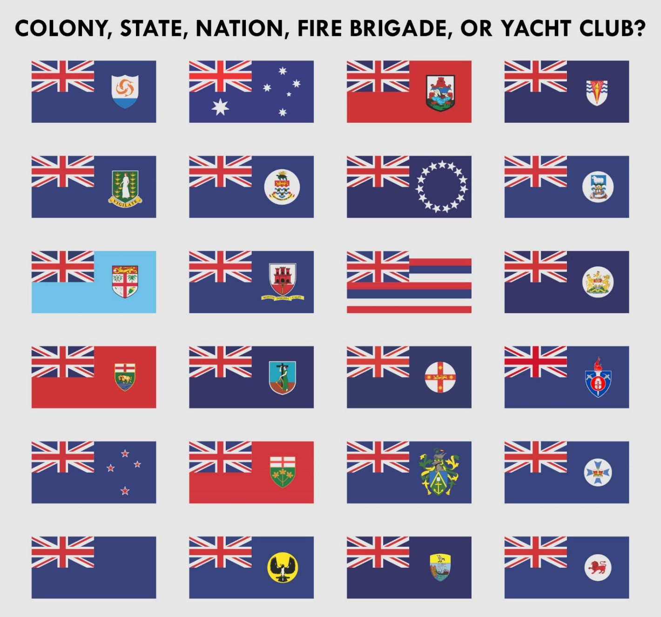
Designing New Flags is Difficult
Notes:
Despite their importance, or because they’re so important, designing new flags can be quite difficult.
For example, from 2015-2016, New Zealand went through a series of referendums to replace their old national flag, which is seen over here.

Slide 6
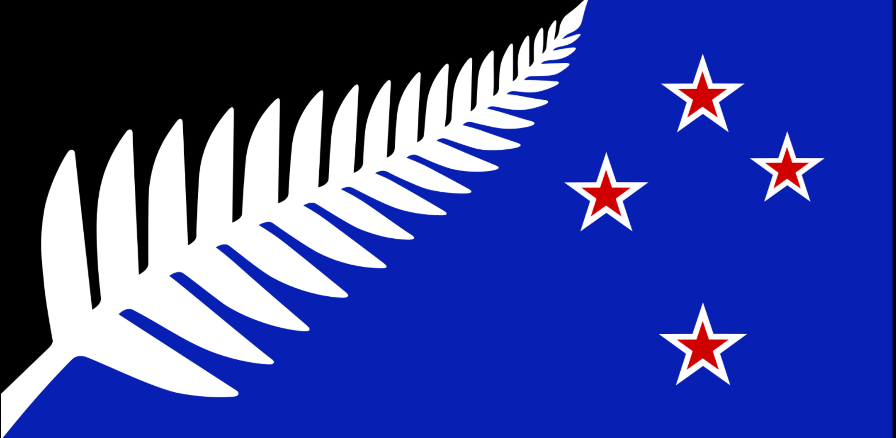
Designing New Flags is Difficult
Notes:
But the finalist replacement flag, the one on the right, actually lost the referendum to the current flag.
So NZ basically ended up where they started, after this long, bewildering process

Slide 7
Q: Can We Generate Novel, New Flags Using Neural Networks?
Notes:
Given how important flags are, and how frustrating their creation is, I wondered if we can …. title

Slide 8
Q: Can We Generate Novel, New Flags Using Neural Networks?
Scraped 1300 flags of nation-states, municipalities, organizations, and custom-made flags

Slide 9
Q: Can We Generate Novel, New Flags Using Neural Networks?
Scraped 1300 flags of nation-states, municipalities, organizations, and custom-made flags
Utilized the Generative Adversarial Network (GAN) framework
Notes:
Then I utilized the
…also called GANs

Slide 10
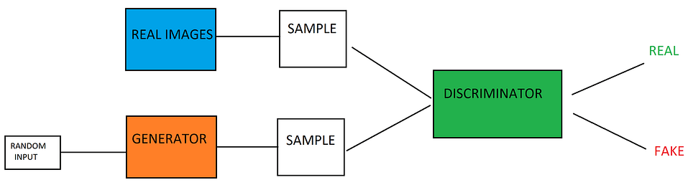
Q: Can We Generate Novel, New Flags Using Neural Networks?
Scraped 1300 flags of nation-states, municipalities, organizations, and custom-made flags
Utilized the Generative Adversarial Network (GAN) framework
(StyleGAN2-ADA, developed by NVIDIA)
Notes:
And GANs are, very briefly, composed of the generator and the discriminator, which compete against each other and progressively make each other better.
And ideally, by the end, the generator should be making realistic images
After several days of training and generating flags,
Several patterns emerged that can potentially give us insight into flag design in general.

Slide 11
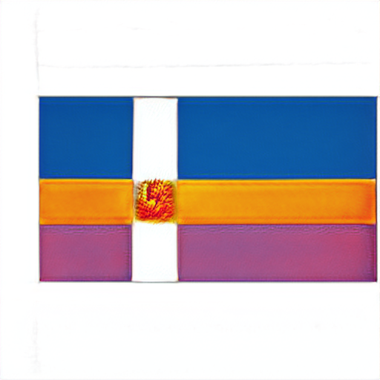
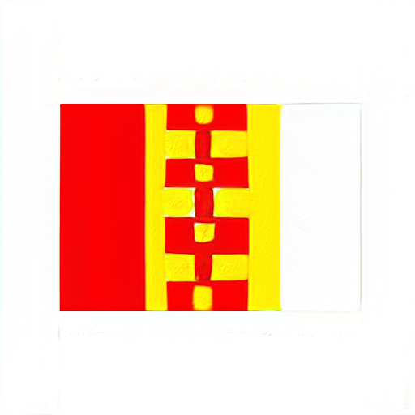
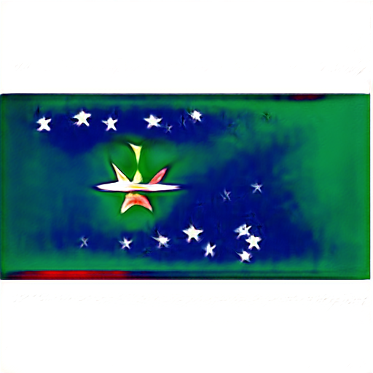
Pattern 1: Strong Colors, High Contrast
Notes:
The first characteristic I noticed was their use of colors.
…
Heavily saturated
High Contrast
Not much usage of colors such as black, grey, brown, etc.
In general, only a few colors are used, maybe 2, 3, or 4 colors in total.

Slide 12
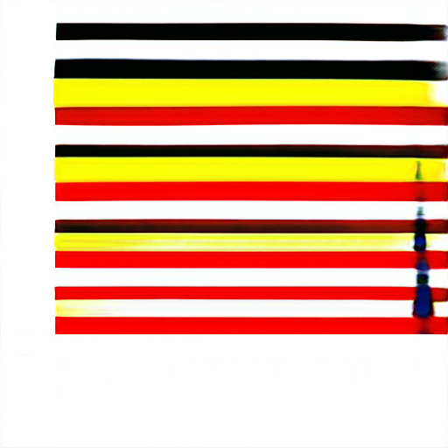
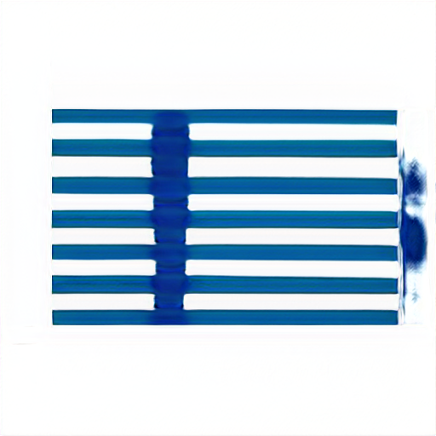
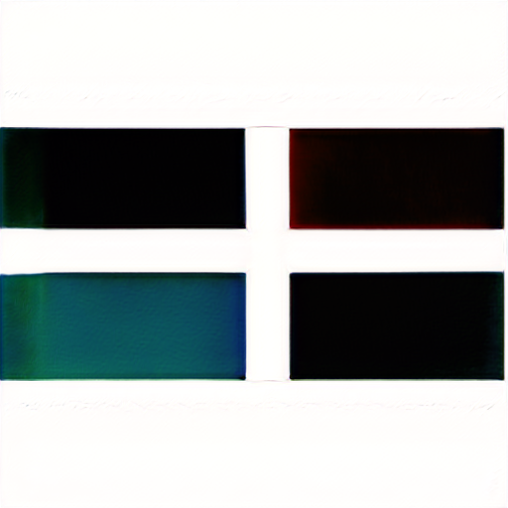
Pattern 2: Horizontal/Vertical Lines
Notes:
Second, many flags show several horizontal, parallel lines

Slide 13
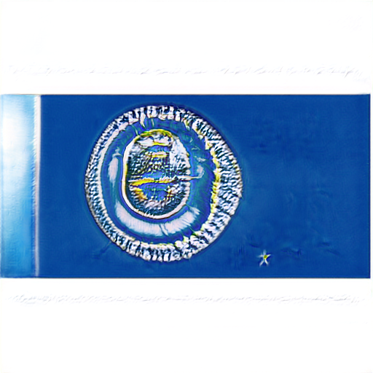
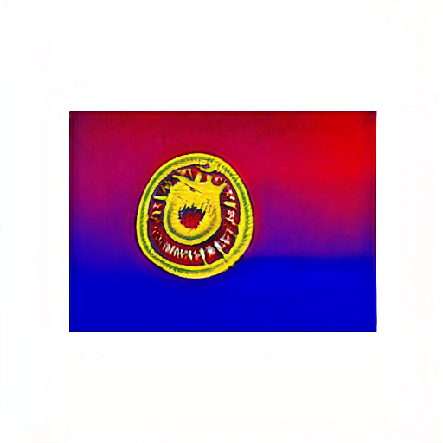
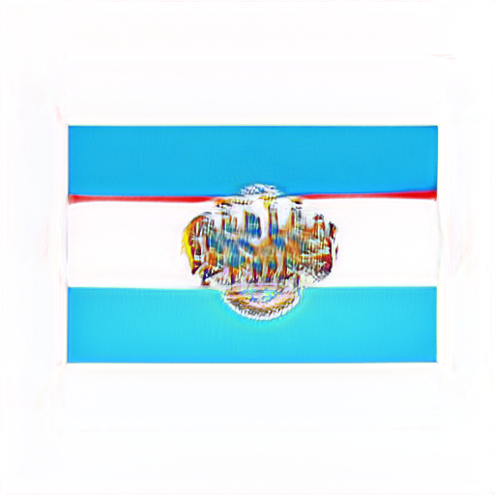
Pattern 3: “Middle Emblem”
Notes:
….
Which resembles a lot of the crowns or symbols that many real flags have in the middle

Slide 14
The New Zealand Flag Does Not Follow Common Patterns
Notes:
Thinking about these patterns, and going back to the New Zealand candidate flag… deviate

Slide 15
The New Zealand Flag Does Not Follow Common Patterns
Silver Fern
Complexity
Placement
Notes:
Use of a relatively complicated symbol, which is not unheard of,
But also the placement of silver fern is a bit awkward in my opinion, compared to other flags

Slide 16
The New Zealand Flag Does Not Follow Common Patterns
Silver Fern
Complexity
Placement
Colors
Usage of black
Black/blue contrast
Notes:
Main contrast is blue and black… which is not too big of a contrast in my opinion
Use of black, which is fairly uncommon and I believe it’s a color that has be to used very judiciously
Not saying any of these points tanked the design, but these are interesting things to think about.

Slide 17
Conclusion and Future Directions
Notes:
So, in conclusion,
We see that

Slide 18
Conclusion and Future Directions
Flags tend to have general patterns
Notes:
(read)

Slide 19
Conclusion and Future Directions
Flags tend to have general patterns
Nevertheless, DeepFlag generates some novel combinations
Notes:
But yet still,

Slide 20
Conclusion and Future Directions
Flags tend to have general patterns
Nevertheless, DeepFlag generates some novel combinations
Good repertoire of references
Notes:
I think deep flag gives us a good repertoire of references to draw upon for new flag design

Slide 21
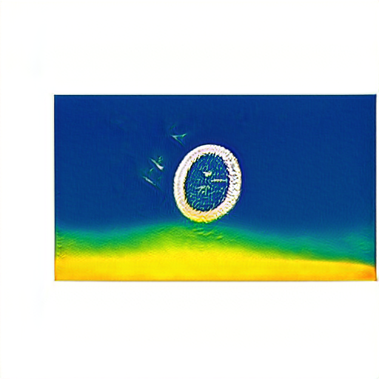
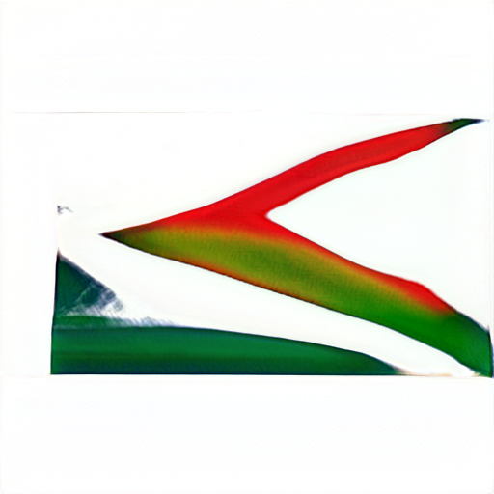
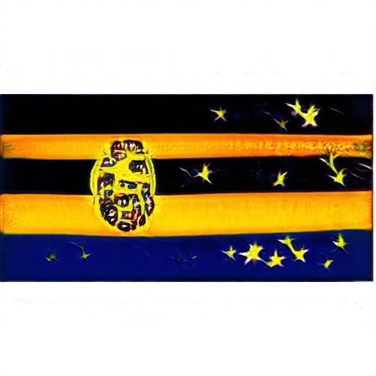
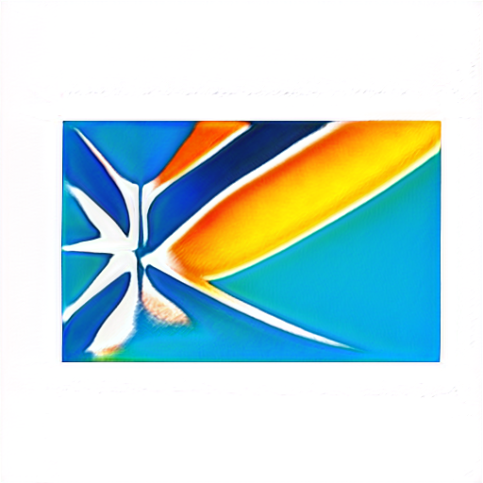
Conclusion and Future Directions
Flags tend to have general patterns
Nevertheless, DeepFlag generates some novel combinations
Good repertoire of references
Flag-art?
Notes:
And finally, I think many of the generated flags look gorgeous and can be artwork in their own right, ‘flag art’, so to speak.

Slide 22
References
Slides from © Copyright PresentationGO.com – The free PowerPoint and Google Slides template library
https://en.wikipedia.org/wiki/The_Star-Spangled_Banner#/media/File:Ft._Henry_bombardement_1814.jpg
https://en.wikipedia.org/wiki/Fort_McHenry#/media/File:Fort_McHenry_flag.jpg
https://commons.wikimedia.org/wiki/File:Courtesy_flag_mg_5312.jpg
https://geekin9f.wordpress.com/2017/02/13/unlocking-the-mystery-of-cqd/
https://en.wikipedia.org/wiki/Vexillology#/media/File:Flag_of_FIAV.svg
https://www.unite.ai/what-is-a-generative-adversarial-network-gan/
https://commons.wikimedia.org/wiki/File:Australia%27s_Identity_Crisis.svg
https://en.wikipedia.org/wiki/2015%E2%80%932016_New_Zealand_flag_referendums#/media/File:NZ_flag_design_Silver_Fern_(Black,_White_&_Blue)_by_Kyle_Lockwood.svg

Slide 23
THANK YOU!

