Slide 1
Functions in R
Team 1: Ashley Chiasson, Justin Pearson, Jingyi Wang, Gio DeFrank

Slide 2
R Function Description
“These functions provide the base mechanisms for defining new functions in the R language” (R Help menu)
Basic building blocks of R
Functions are pieces of reusable code
They accept input data from the user, and (most functions) return an output
An output of a function can be a number, a list, a data.frame, a plot, a message, or any object you want.
We can call a function by using its name followed by parentheses
INPUT
FUNCTION
OUTPUT

Slide 3



R Function Examples
We’ve used functions throughout last semester to implement various machine learning algorithms.
Standard
Regression
Classification
help()
str()
print()
lm()
predict()
coeftest()
summary()
lda()
qda()
knn()
glm()

Slide 4
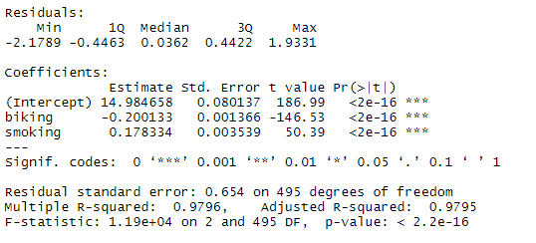
Why are functions so important?
Functions are essentially mini-programs that allow us to replicate and implement large chunks of complex code in a space-sensitive way.
lm()
lm()
summary()
+
summary()
Residuals
R squared
Adjusted R squared
Residual Standard Error
F-Statistic
P-Value of each predictor

Slide 5

R can partially match arguments
remainder <- function(num,divisor){
num%%divisor
}
##remainder(divisor = 3,num=5)
##remainder(num = 5,divisor = 3)
Same result with different order

Slide 6
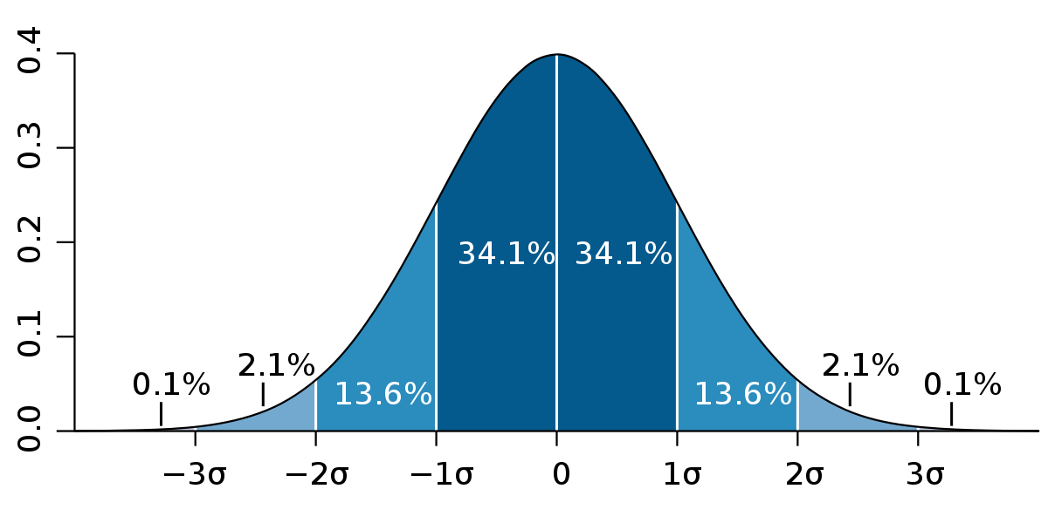
Function as Argument
Example: calculate standard deviation
std <- function(num){
sd(num)
}
result <- function(std, list){
std(list)
}
result(std,c(1,2,3,4))
Notes:
Ex. - recursion (fibonacci’s sequence)

Slide 7
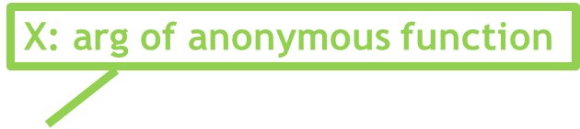

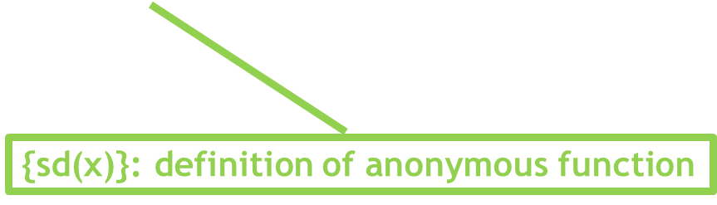
Anonymous Functions
result <- function(func, dat){
func(dat)
}
result(function(x){sd(x)},c(1,2,3,4))

Slide 8
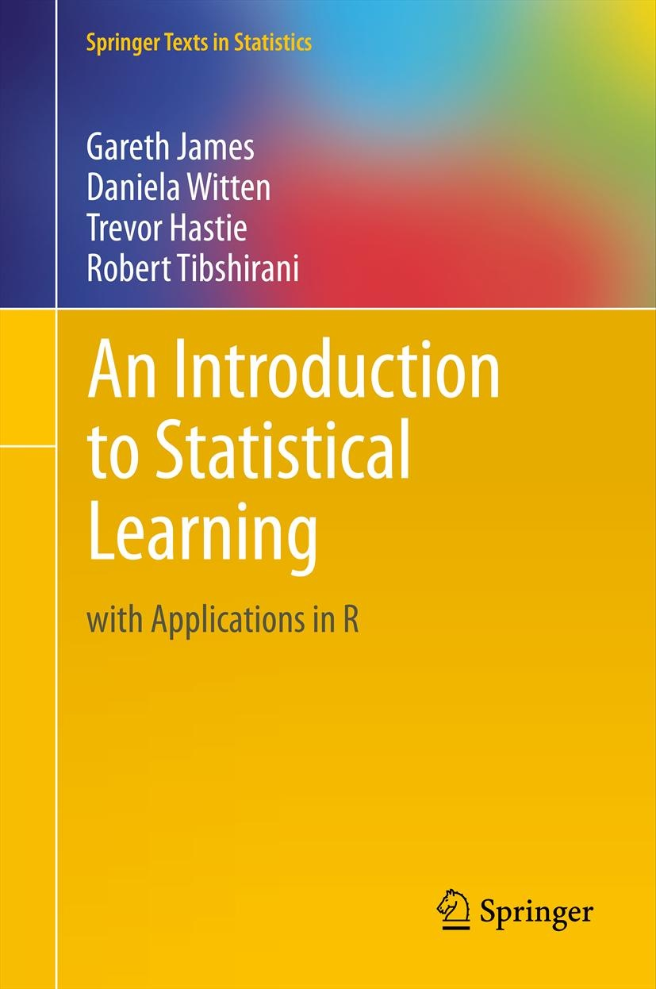
Application: Exercise 4-15

Slide 9
Poll
pollev.com/mdefrank864

