Slide 1
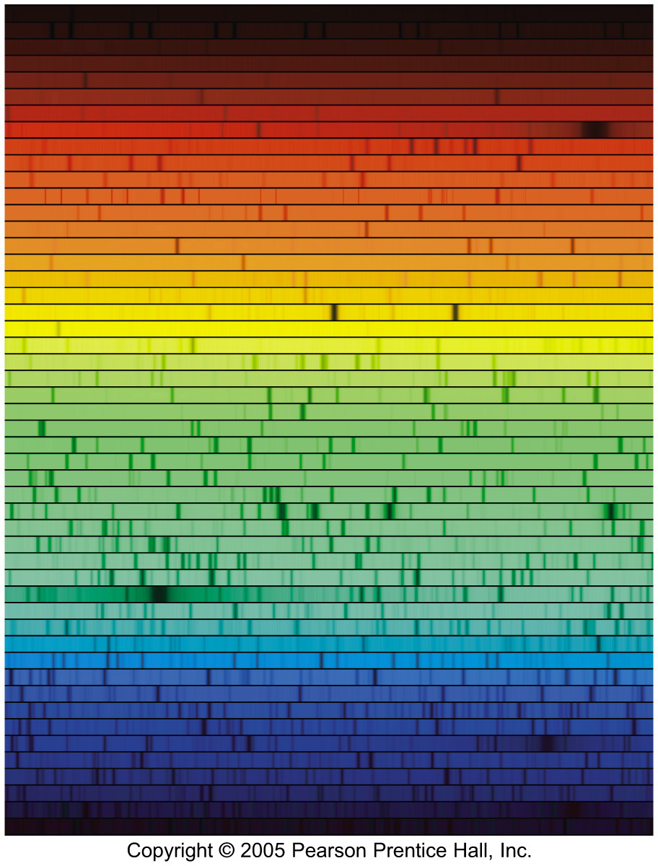
Chapter 4
Spectroscopy

Slide 2
Chapter 4 Spectroscopy
Spectral Lines
The Formation of Spectral Lines
The Energy Levels of the Hydrogen Atom
The Photoelectric Effect
Molecules (skip)‏
Spectral-Line Analysis

Slide 3
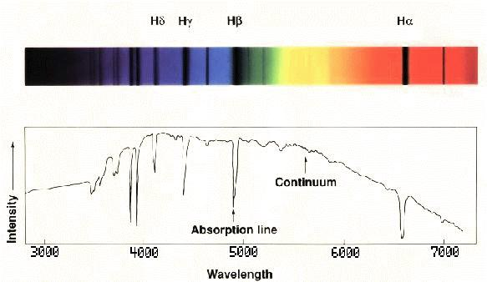
4.1 Spectral Lines
Spectrum: a graphic depiction of light intensity as a function of wavelength, frequency, or energy.

Slide 4
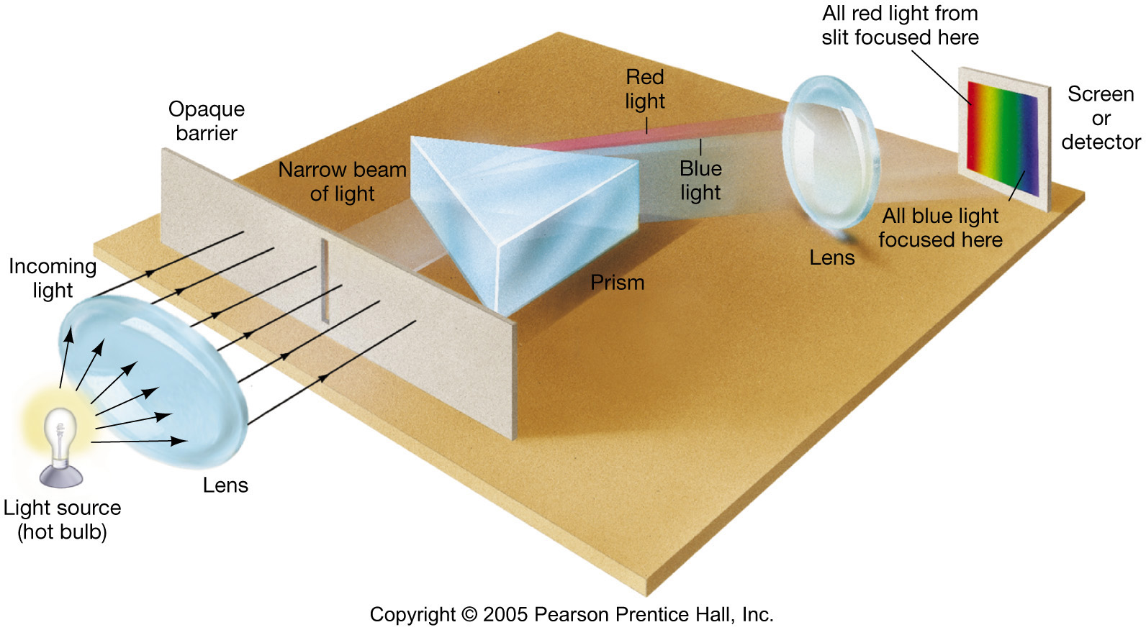
4.1 Spectral Lines
Spectroscope: splits light into component colors

Slide 5
4.1 Spectral Lines
Kirchhoff’s laws:
Luminous solid, liquid, or dense gas produces continuous spectrum
Low-density, hot gas produces emission spectrum
Continuous spectrum incident on cool, thin gas produces absorption spectrum

Slide 6
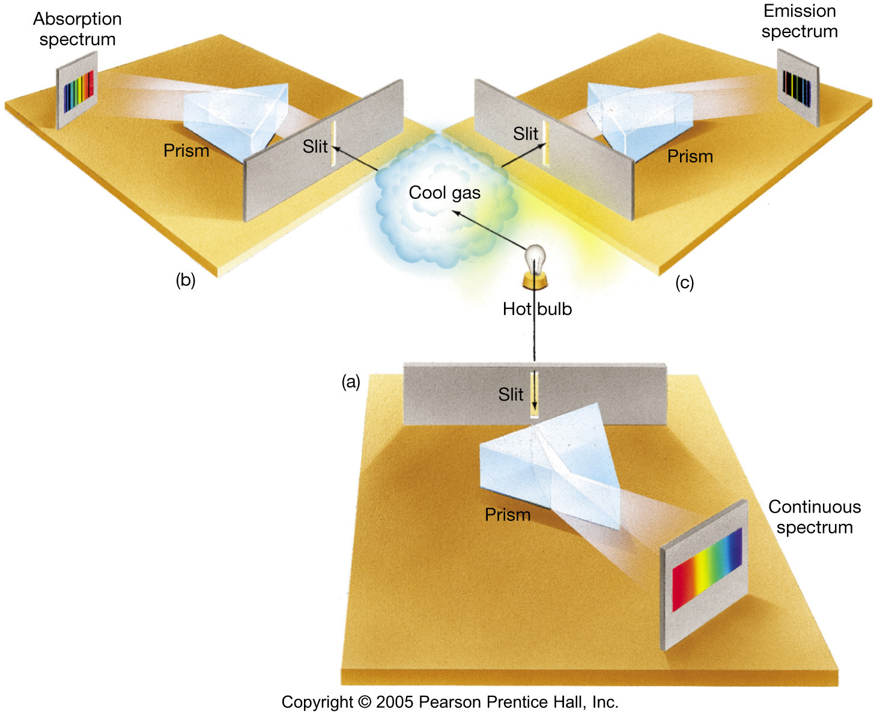
4.1 Spectral Lines
Kirchhoff’s laws illustrated:

Slide 7
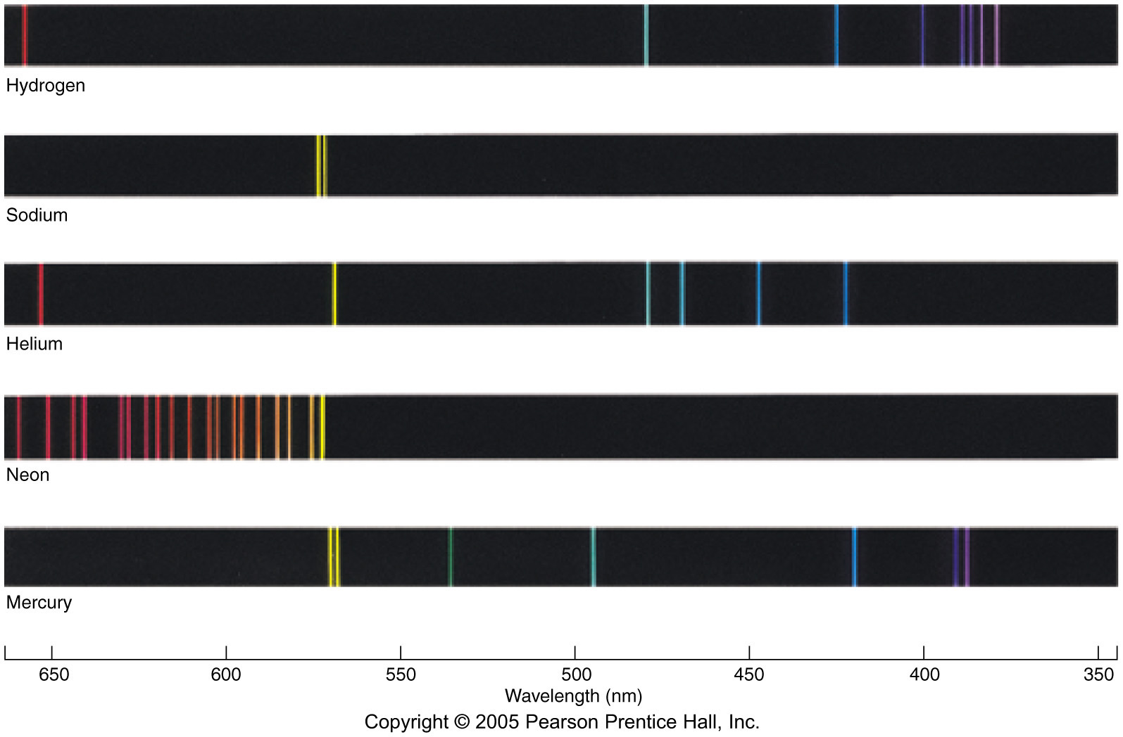
4.1 Spectral Lines
Emission spectrum each element has a characteristic spectrum.

Slide 8
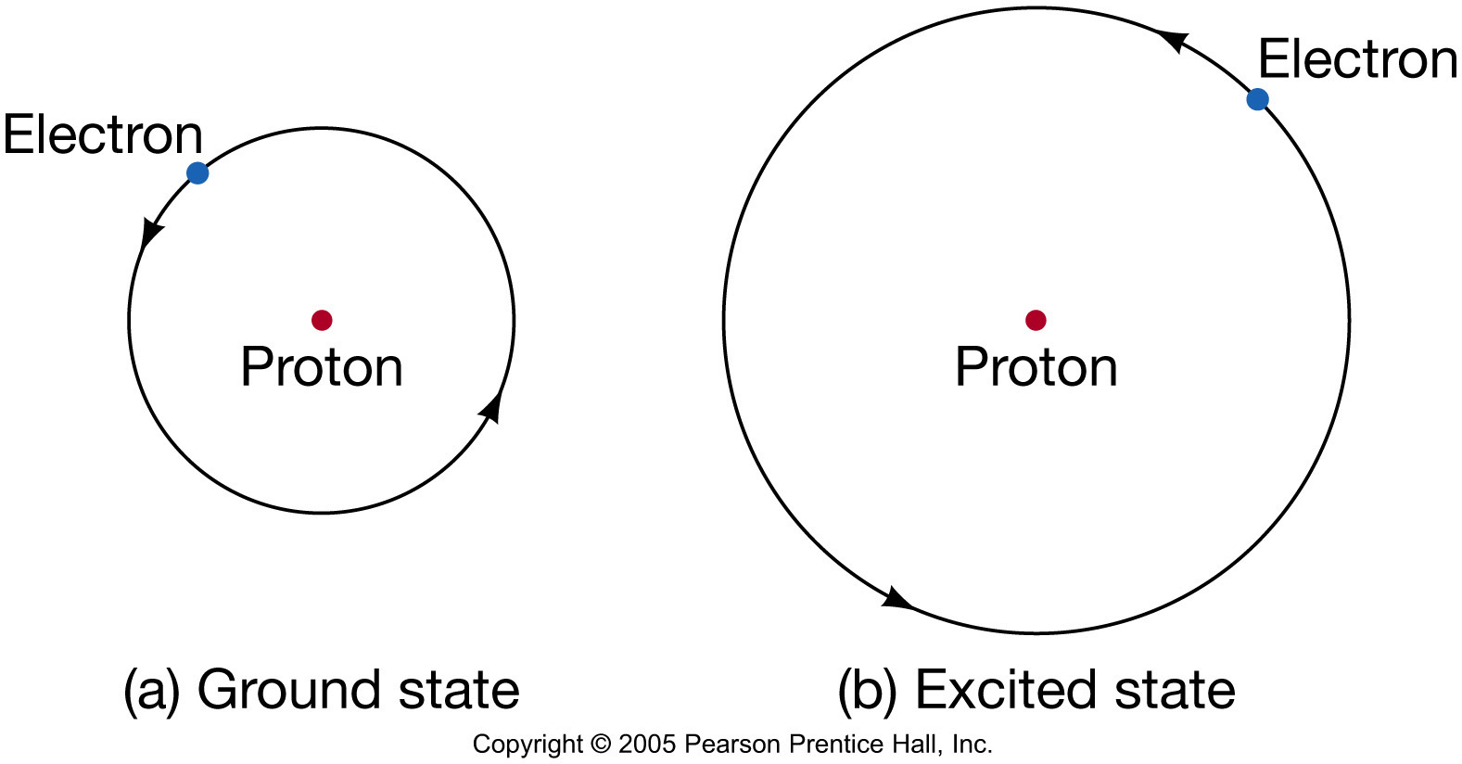
4.2 The Formation of Spectral Lines
Existence of spectral lines required new model of atom, so that only certain amounts of energy could be emitted or absorbed.
Bohr model had certain allowed orbits for electron:

Slide 9
4.2 The Formation of Spectral Lines
Emission energies correspond to energy differences between allowed levels.

Slide 10
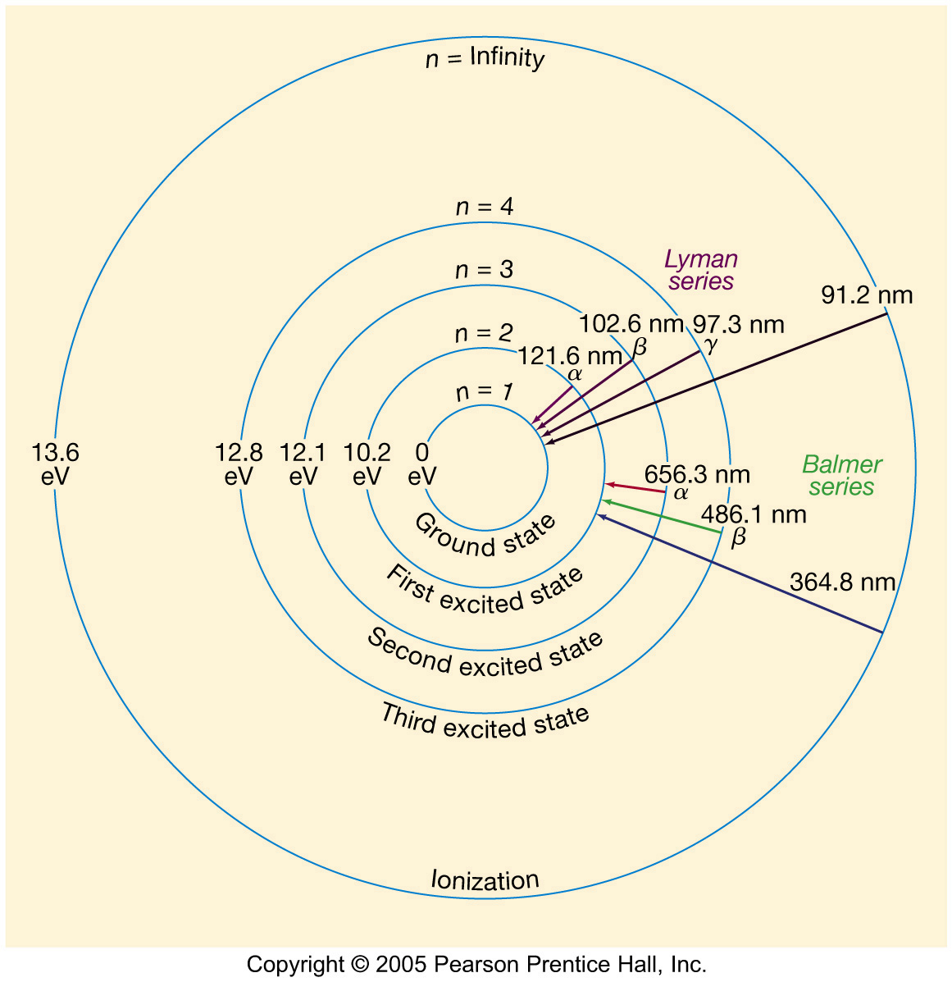
4.2 The Formation of Spectral Lines
Energy levels of the hydrogen atom, showing two series of emission lines:

Slide 11
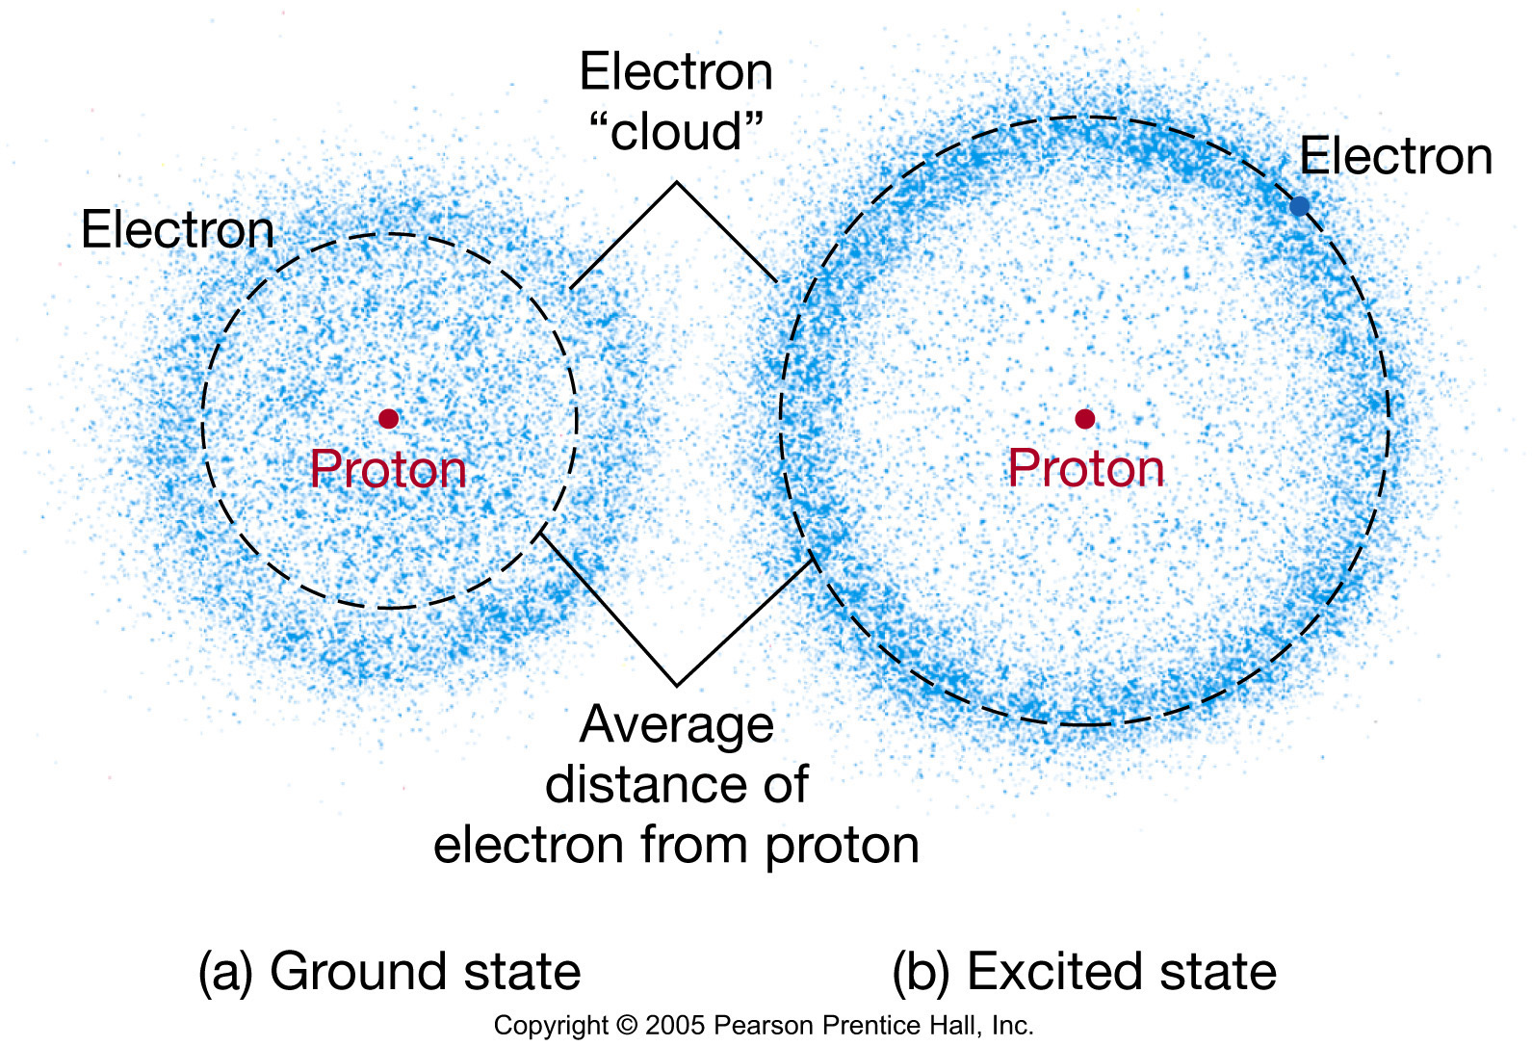
4.2 The Formation of Spectral Lines
Modern model has electron “cloud” rather than orbit:

Slide 12



4.2 The Formation of Spectral Lines
Light particles (photons) each have energy E:
Here, h is Planck’s constant:
Photon Energy can also be related to wavelength, e.g.,
E=hc/λ = 1240 eV/λ (nm)‏

Slide 13
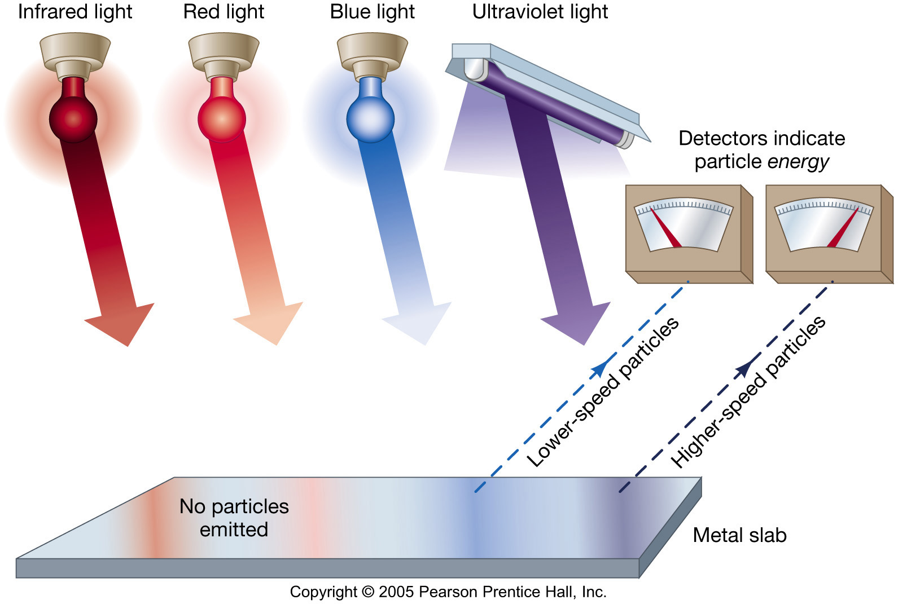
4.2 The Formation of Spectral Lines
Photoelectric effect can be understood only if light behaves like particles

Slide 14
4.2 The Formation of Spectral Lines
Absorption - excitation: a photon hits the atom and its energy is used to boost an e⁻ to a higher energy level ... an excited state
Emission - deexcitation or decay; the e⁻ shifts to a lower energy level and the atom emits a photon. Spontaneous or stimulated.
Ionization: the atom receives so much energy that the e- is ''kicked off'' of the atom.

Slide 15
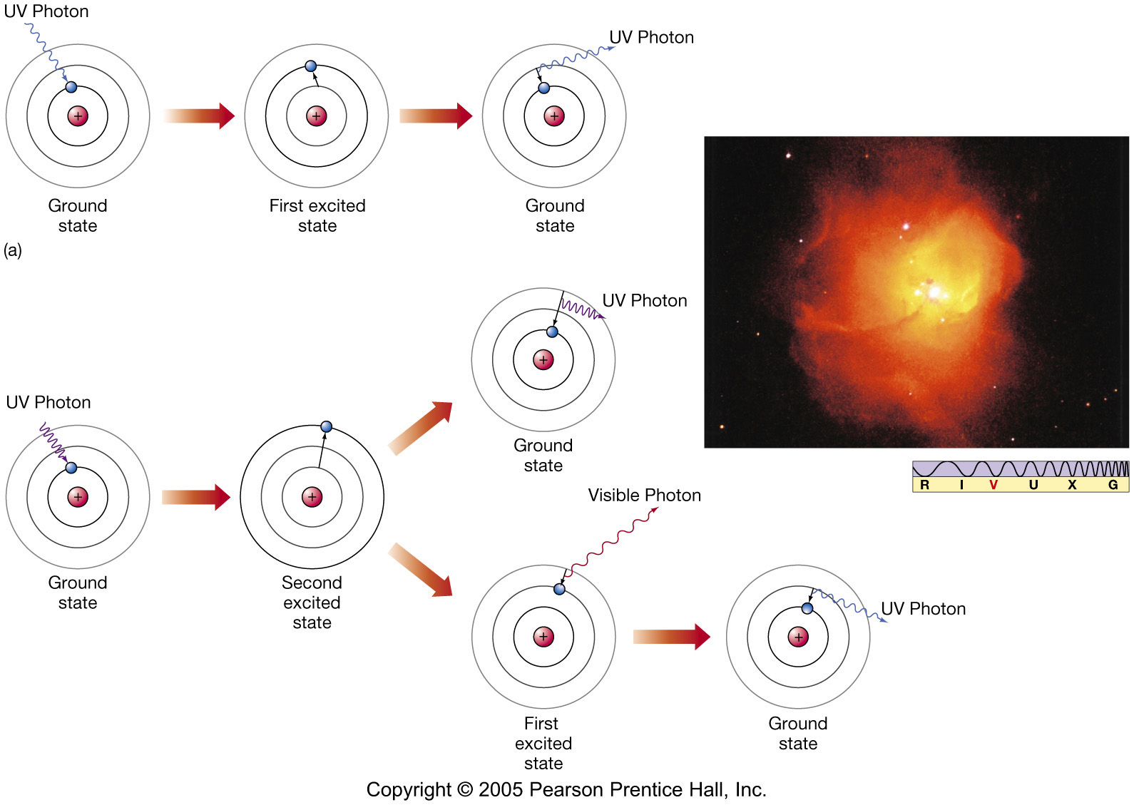
4.2 The Formation of Spectral Lines
Ways to decay.

Slide 16
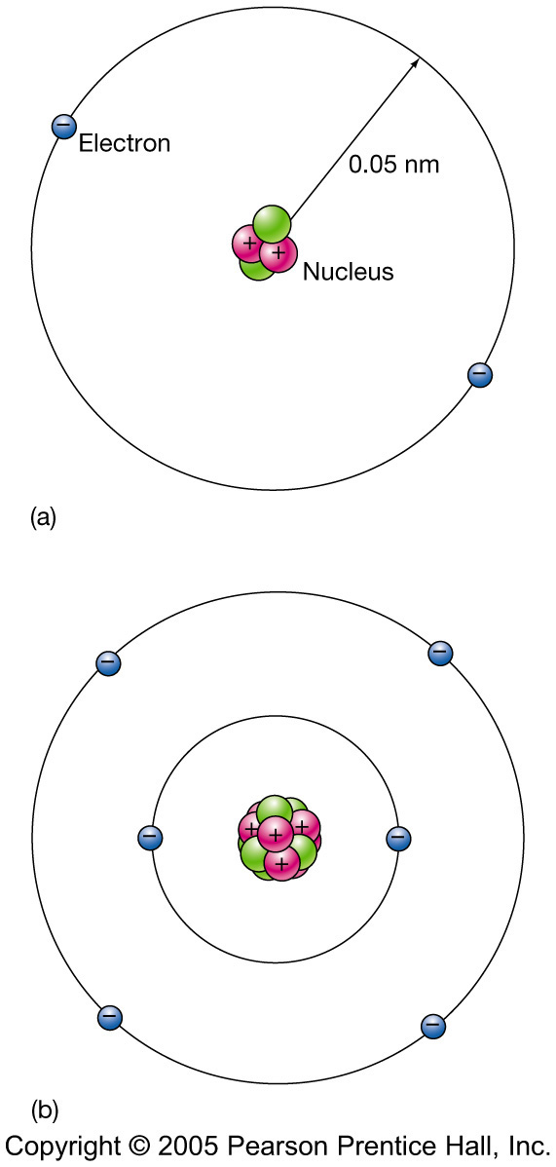
4.2 The Formation of Spectral Lines
Multielectron atoms: much more complicated spectra, many more possible states
Ionization changes energy levels

Slide 17
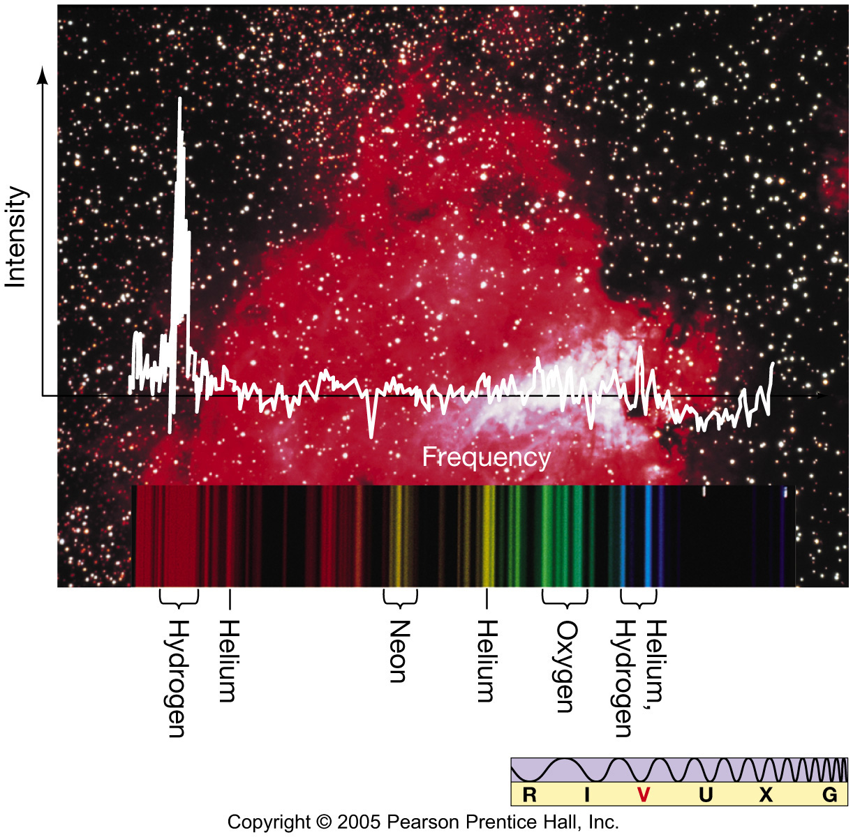
4.2 The Formation of Spectral Lines
Emission lines can be used to identify atoms:

Slide 18
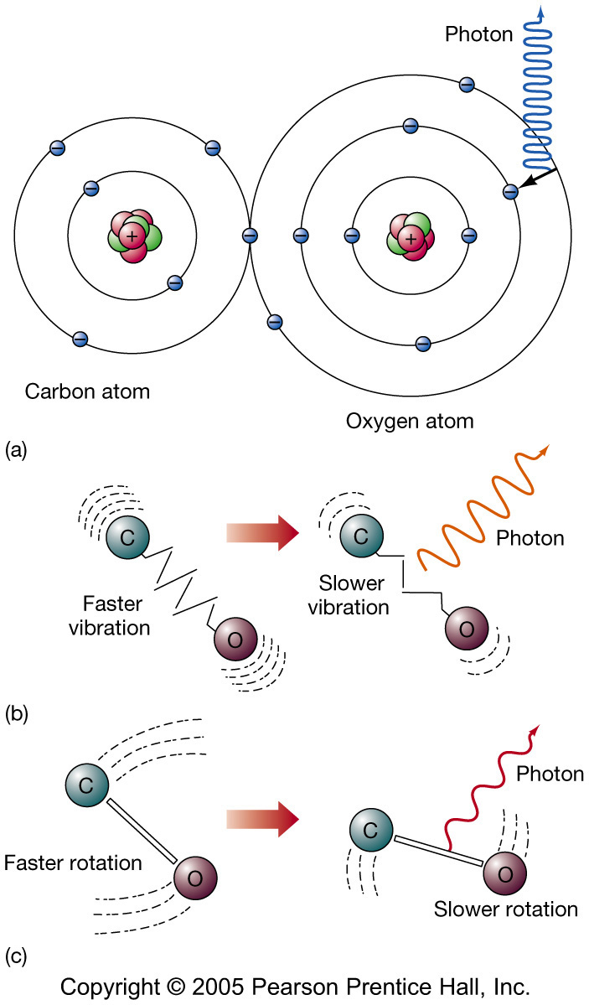
4.3 Molecules
Molecules can vibrate and rotate, besides having energy levels
Electron transitions produce visible and ultraviolet lines
Vibrational transitions produce infrared lines
Rotational transitions produce radio-wave lines

Slide 19
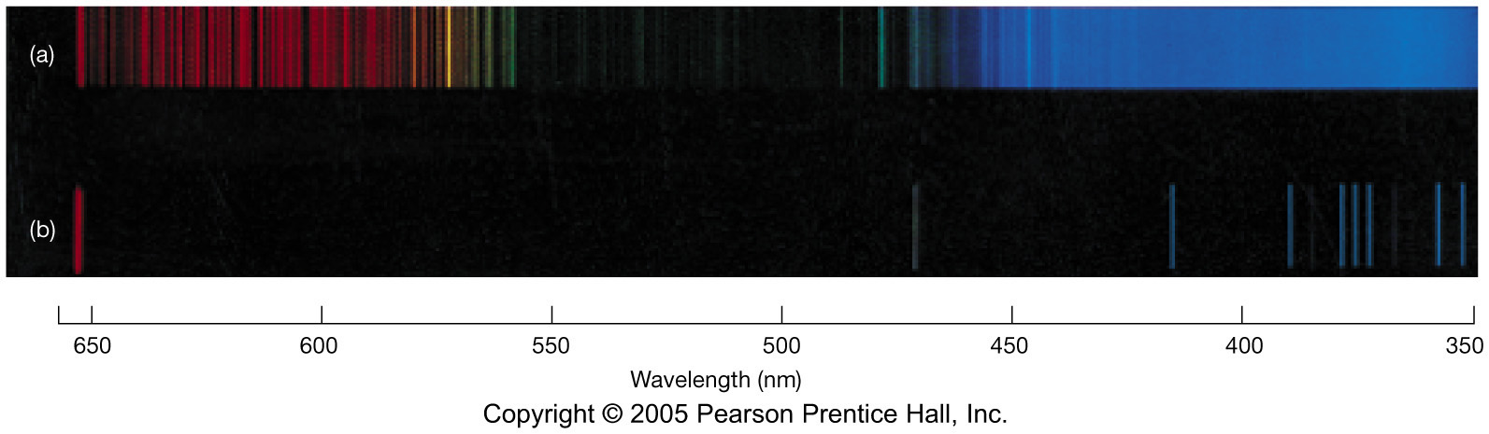
4.3 Molecules
Molecular spectra are much more complex than atomic spectra, even for hydrogen:
(a) Molecular hydrogen (b) Atomic hydrogen

Slide 20
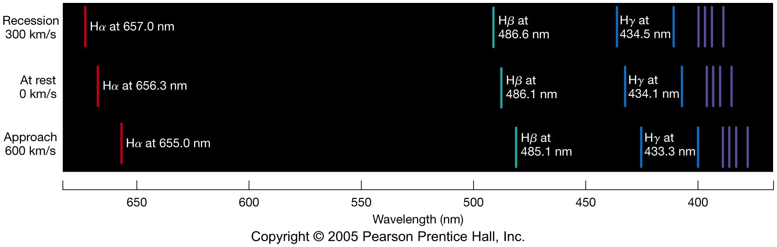
4.4 Spectral-Line Analysis
Information from spectral lines:
Chemical composition – from line strength, presence of lines
Temperature – from line strengths, presence of lines
Radial velocity - doppler shifting of all lines

Slide 21
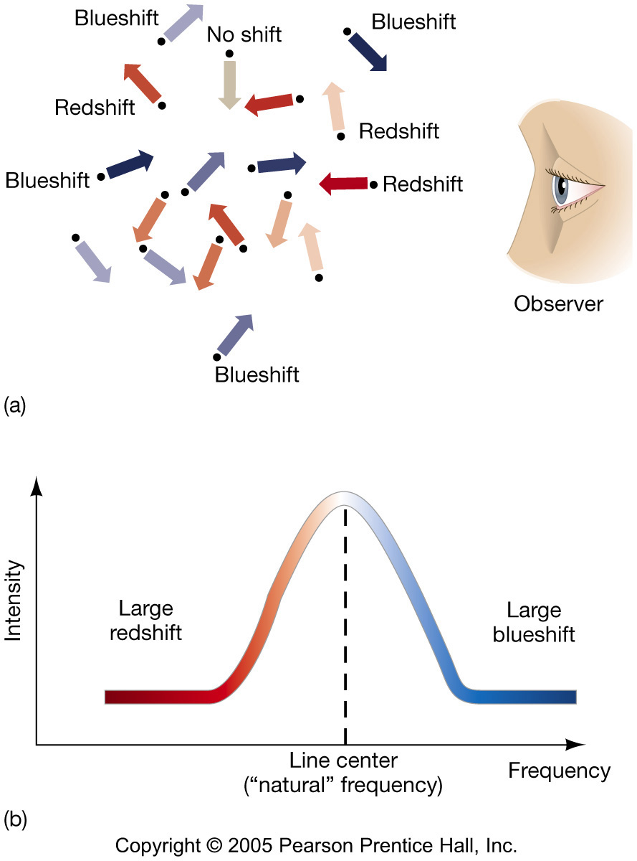
4.4 Spectral-Line Analysis
Line broadening can be due to Doppler shifting
from thermal motion
from rotation

Slide 22
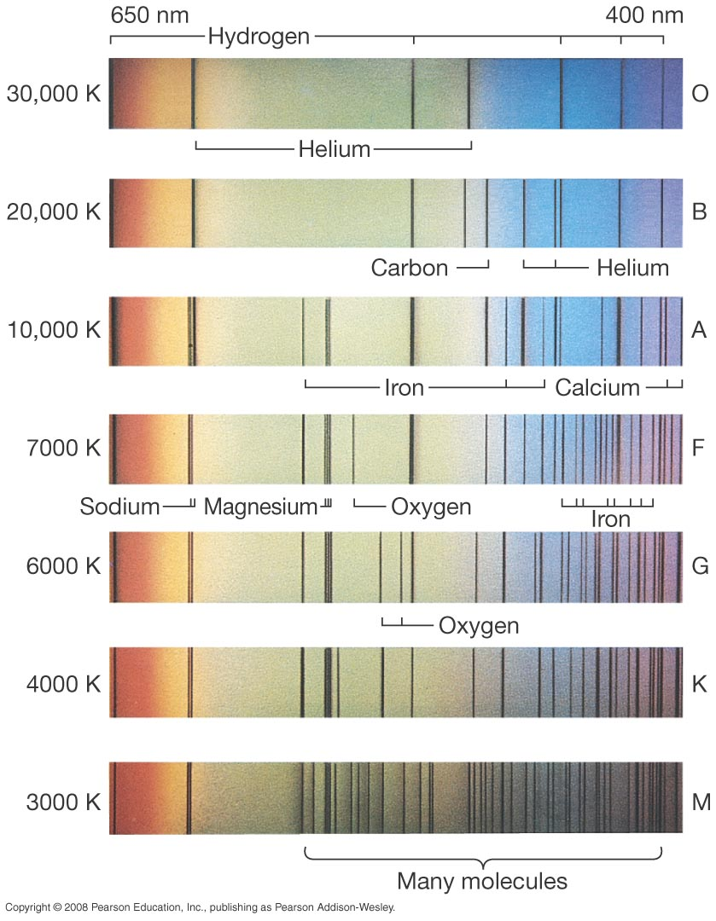
4.4 Spectral-Line Analysis
Spectral Types -
based on the presence
of lines.

Slide 23
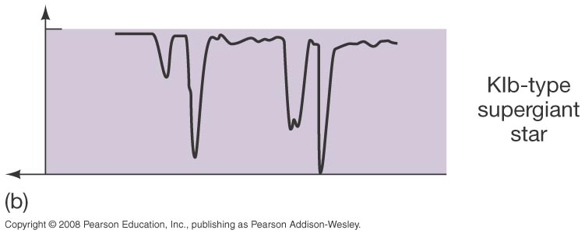
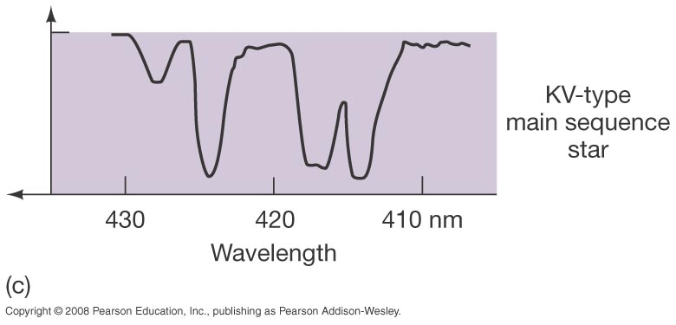
4.4 Spectral-Line Analysis
Line broadening
caused by higher gas
pressure on the surface
of the star.

Slide 24
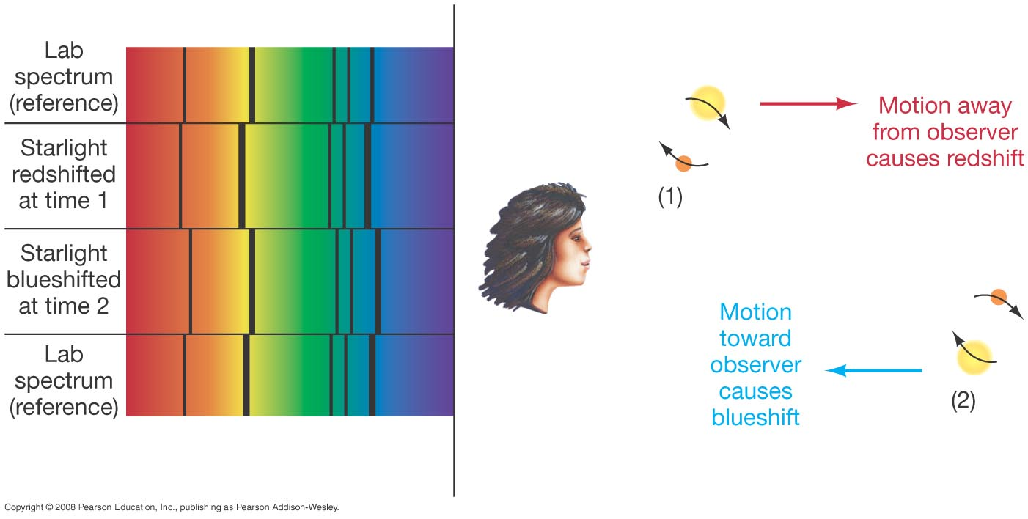
4.4 Spectral-Line Analysis

Slide 25
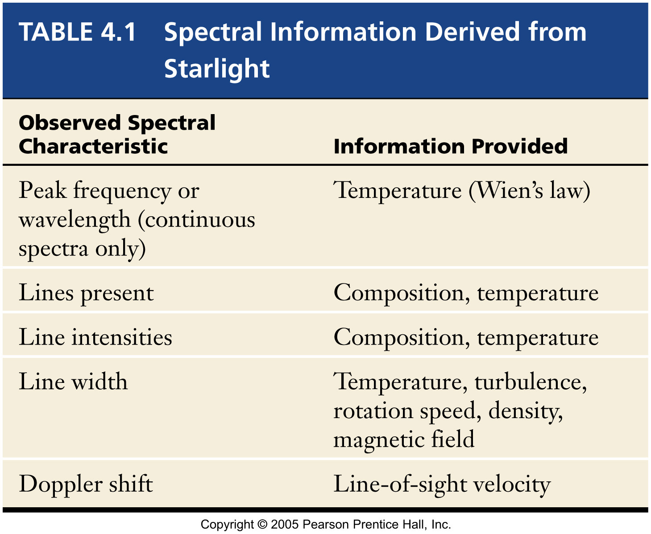
4.4 Spectral-Line Analysis

Slide 26
Summary of Chapter 4
Spectroscope splits light beam into component frequencies
Kirchoff's laws describe how the 3 types of spectra can form.
Continuous, emission, and absorption spectra
Both emission and absorption spectra can be observed from one gas cloud depending on line-of-sight.

Slide 27
Summary of Chapter 4, cont.
Spectra can be explained using atomic models, with electrons occupying specific orbitals
Emission and absorption lines result from transitions between orbitals
Spectra can give us information about a stars temperature, composition, rotation, radial velocity, magnetic field strength, surface gravity (pressure) → star size.

