Slide 1
WEEK 2 Outline
Stellar and Galactic ...
Astronomy
By J. Pinkney
Ohio Northern University

Slide 2
The Naked – Eye Universe
Constellations and Asterisms
Constellation: a designated region in the sky containing one or more
historical star patterns.
Asterism: a recognizable pattern of stars.
Ex) Orion
Ex) Ursa Major
Ex) Taurus
* 88 total constellations
* Northern constellations named after Greek Mythological characters

Slide 3
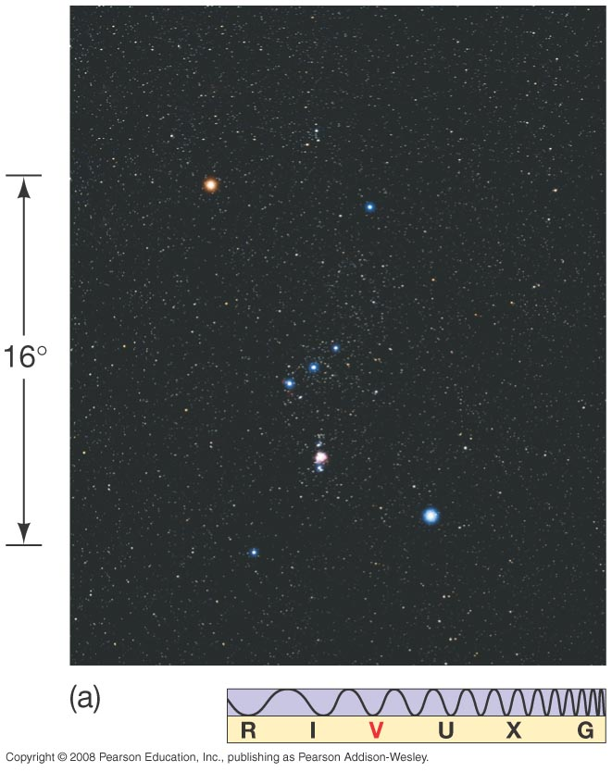
Example:
Orion.
An easily recognized
constellation!

Slide 4
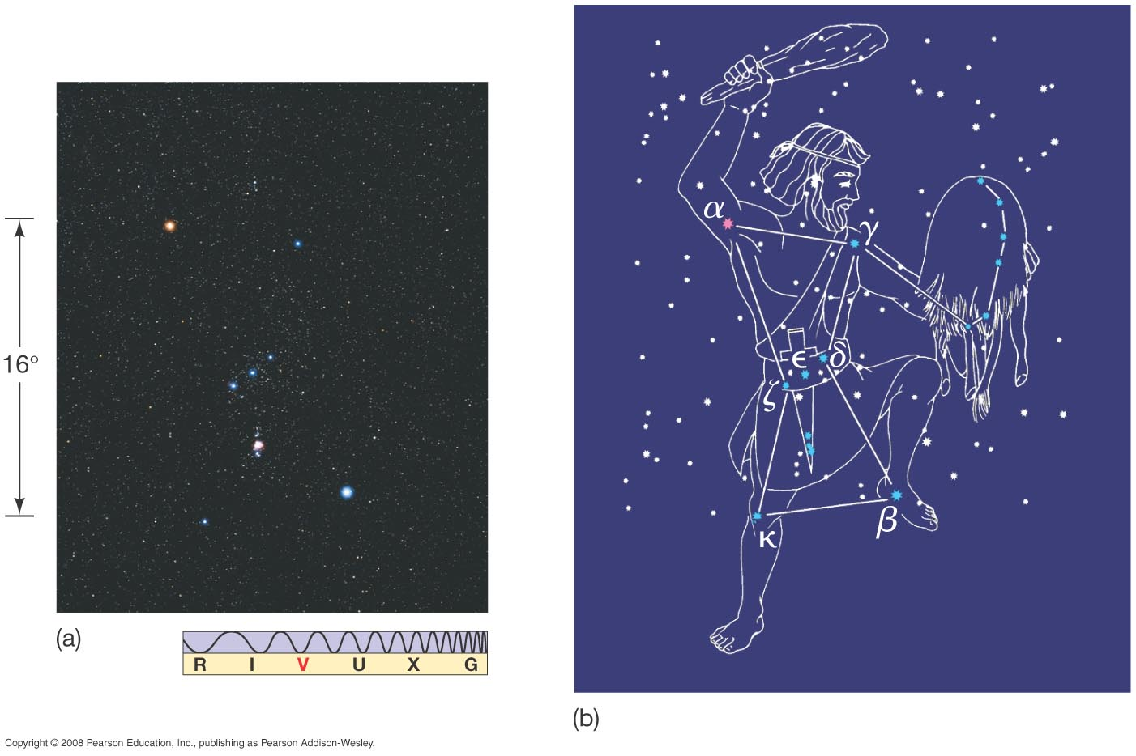

Slide 5
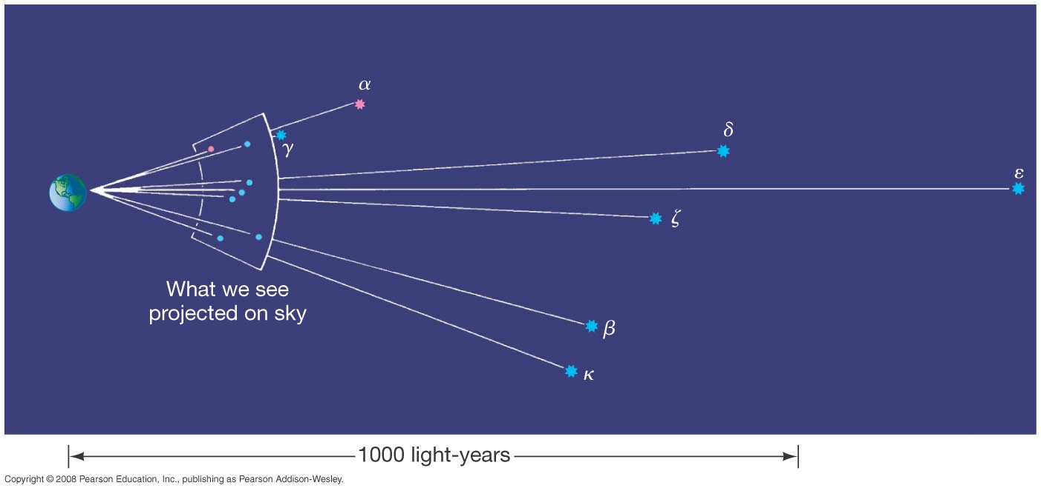

Slide 6
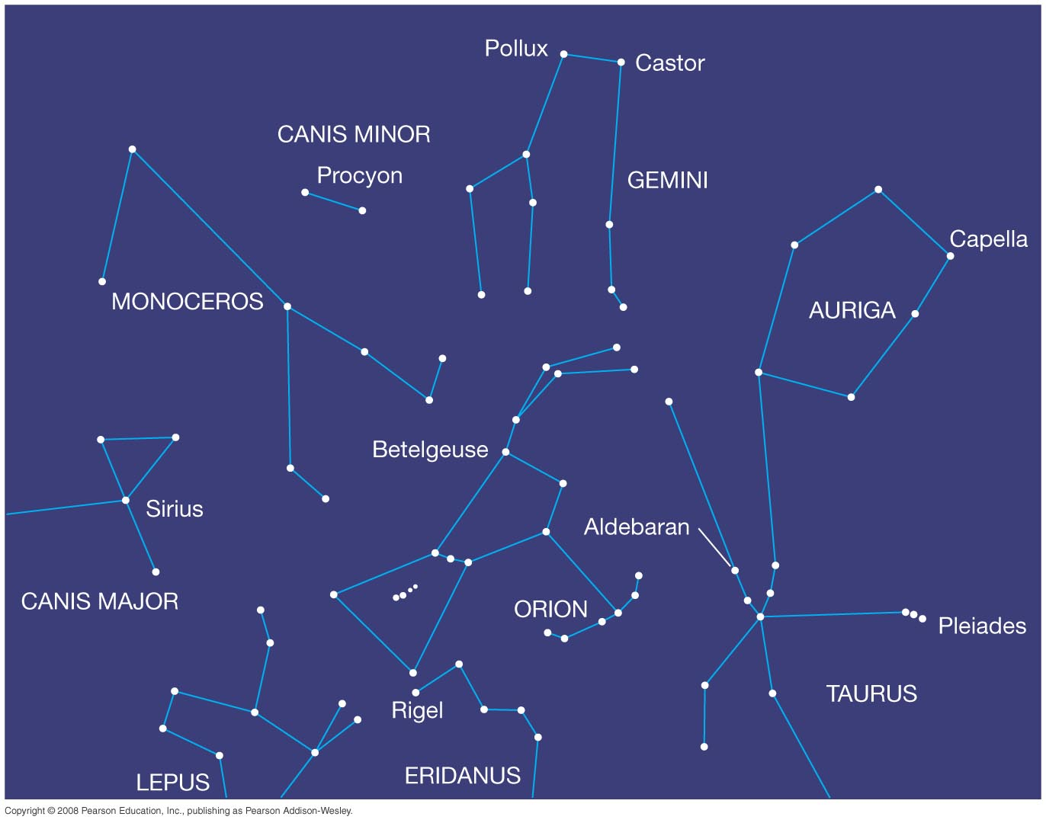
Try a planetarium program like “Stellarium” or “Skychart III” or “Celestia” to see the sky in motion.

Slide 7
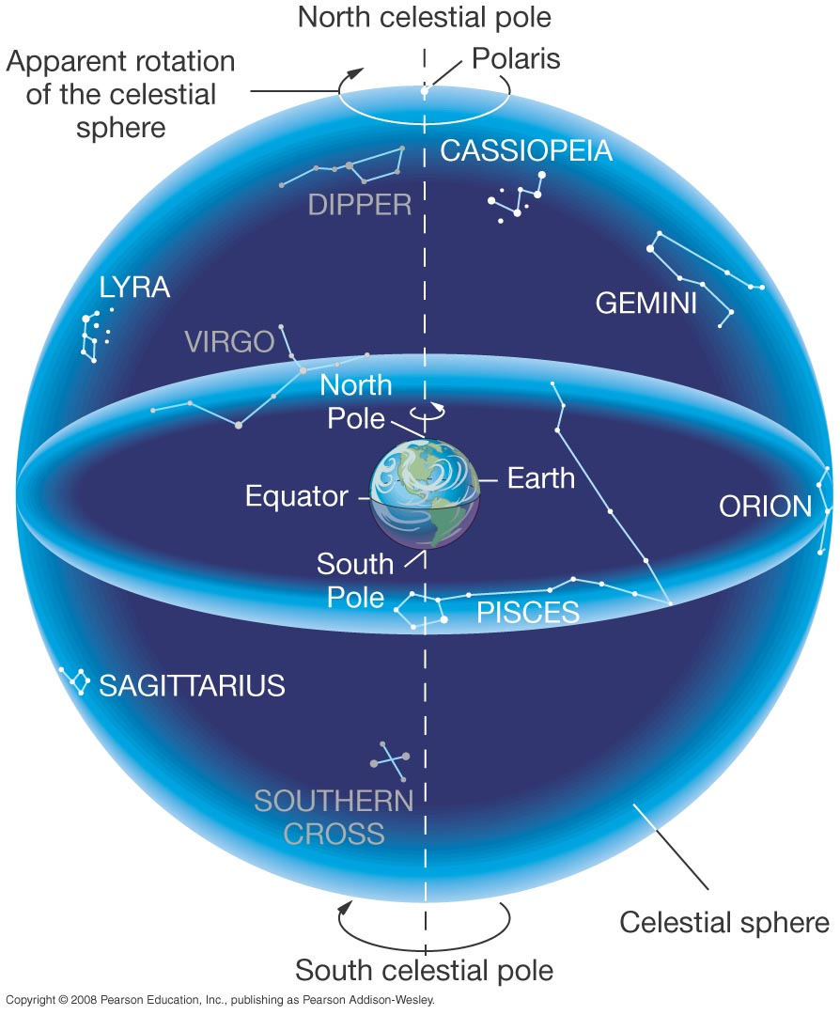
The Celestial Sphere
- a conceptual model
of the sky.
-geocentric (wrong)
-all stars at same distance (wrong)
-a distortion-free sky map
-reproduces daily rising and setting motions for any latitude on Earth
-Cel. Sphere is infinitely bigger than the Earth.
Horizon

Slide 8
The
Celestial
Sphere
Features:
1. stars
2. Earth/observer
3. N. Celestial Pole
4. S. Celestial Pole
5. Celestial Equator

Slide 9
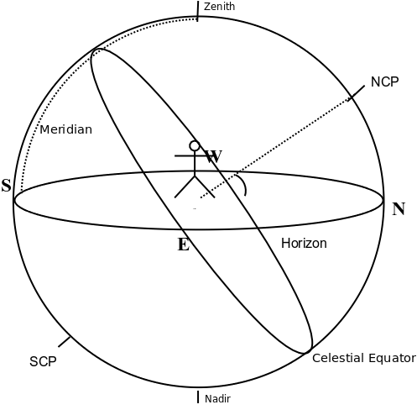
The
Celestial
Sphere
More Features:
1. stars
2. Earth/observer
3. N. Celestial Pole
4. S. Celestial Pole
5. Celestial Equator
6. Horizon
7. Cardinal points,
(N,S,E,W)
8. Zenith
9. Nadir
10. Meridian

Slide 10
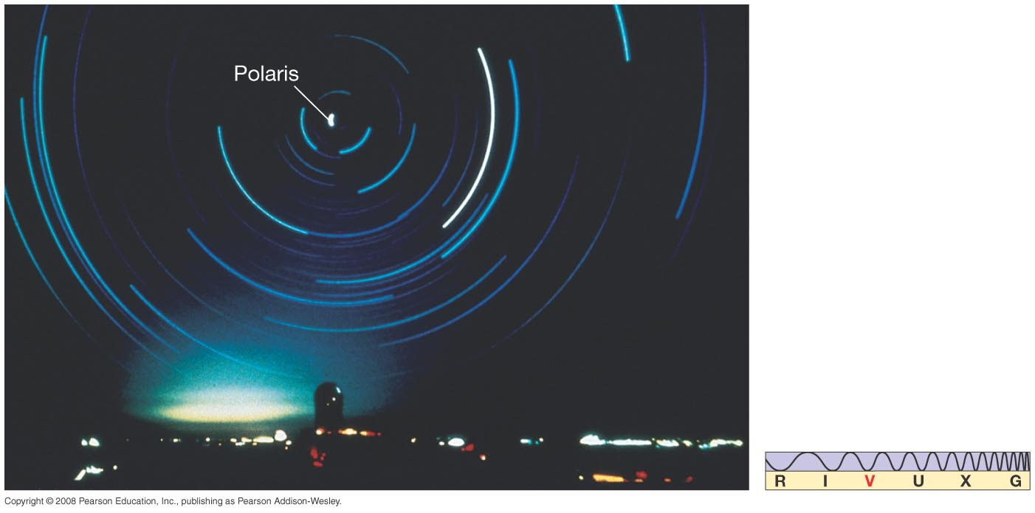
Motion of the Earth - Daily
Star Trail – an actual photo of Northern horizon. Exposure time was about 5 hours.
Now show the daily rotation with a Celestial Globe.

Slide 11
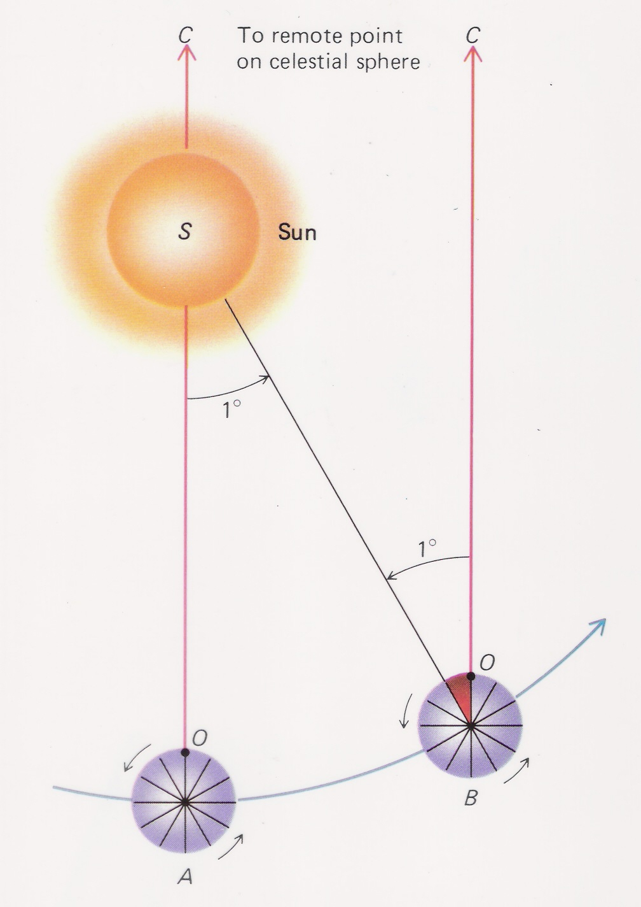
Motion of the Earth – Daily
The Day
Sidereal Day: the time that it takes for the Earth to rotate
360 degrees relative to the distant stars
Mean Solar Day: the average time that it takes for the Earth
to rotate relative to the Sun. (E.g., from one noon to the next.)
* What your watch tells you
* 3 m 56 s longer than the sidereal day
* “Mean” because the time between local noons varies.
- Obliquity (tilt) of ecliptic
- Elliptical orbit

Slide 12
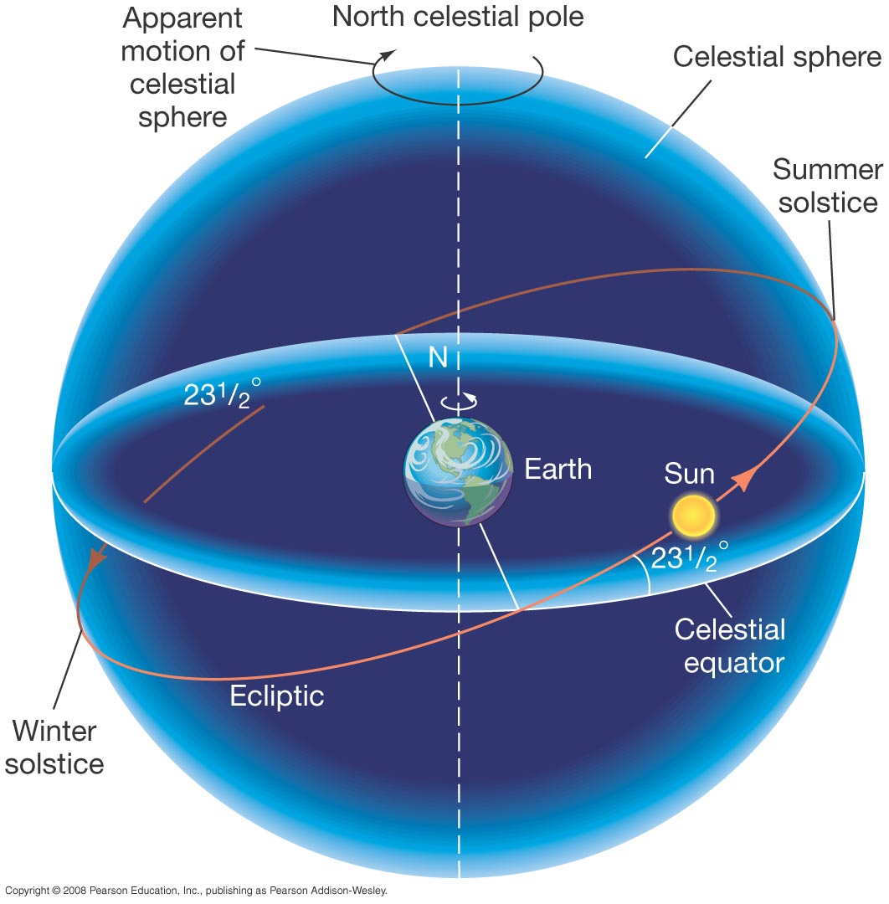
Motion of the Earth - Annual
The Sun appears to go around the Earth once per year, but it is the Earth that goes around the Sun.

Slide 13
Motion of the Earth – Annual
The Year
Sidereal year: the time it takes for the Earth to revolve around the Sun with respect to the stars.
* 365.2564 mean solar days
Tropical Year = time between two successive passages of the Sun past the Vernal Equinox
* 365.2422 days
Q: Why is the tropical year shorter than the sidereal year?
A: Precession

Slide 14
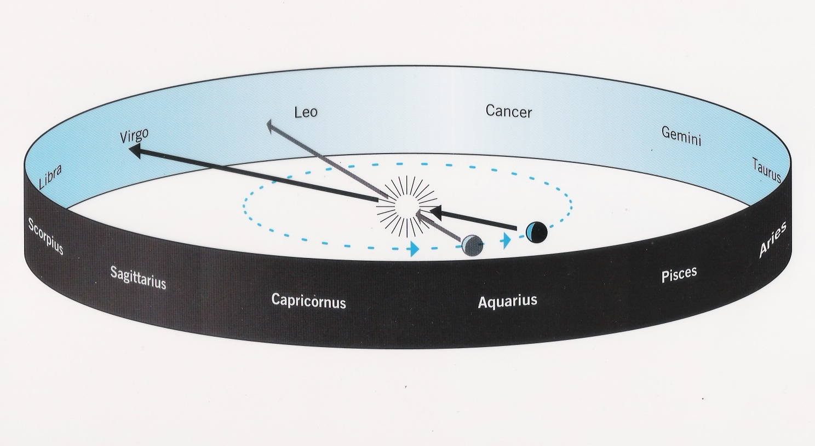
Motion of the Earth – Annual
The Zodiac = the 12 (or 13 counting Ophiuchus) constellations through which the Sun passes in a year.
Ecliptic = The apparent path of the Sun on the sky as seen from Earth.
A: Precession

Slide 15
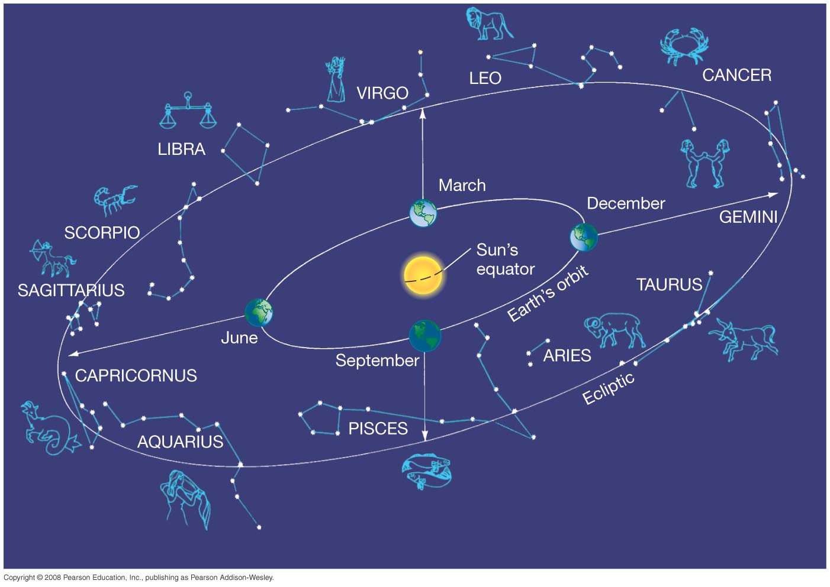
Motion of the Earth - Annual
The Zodiacal Constellations

Slide 16
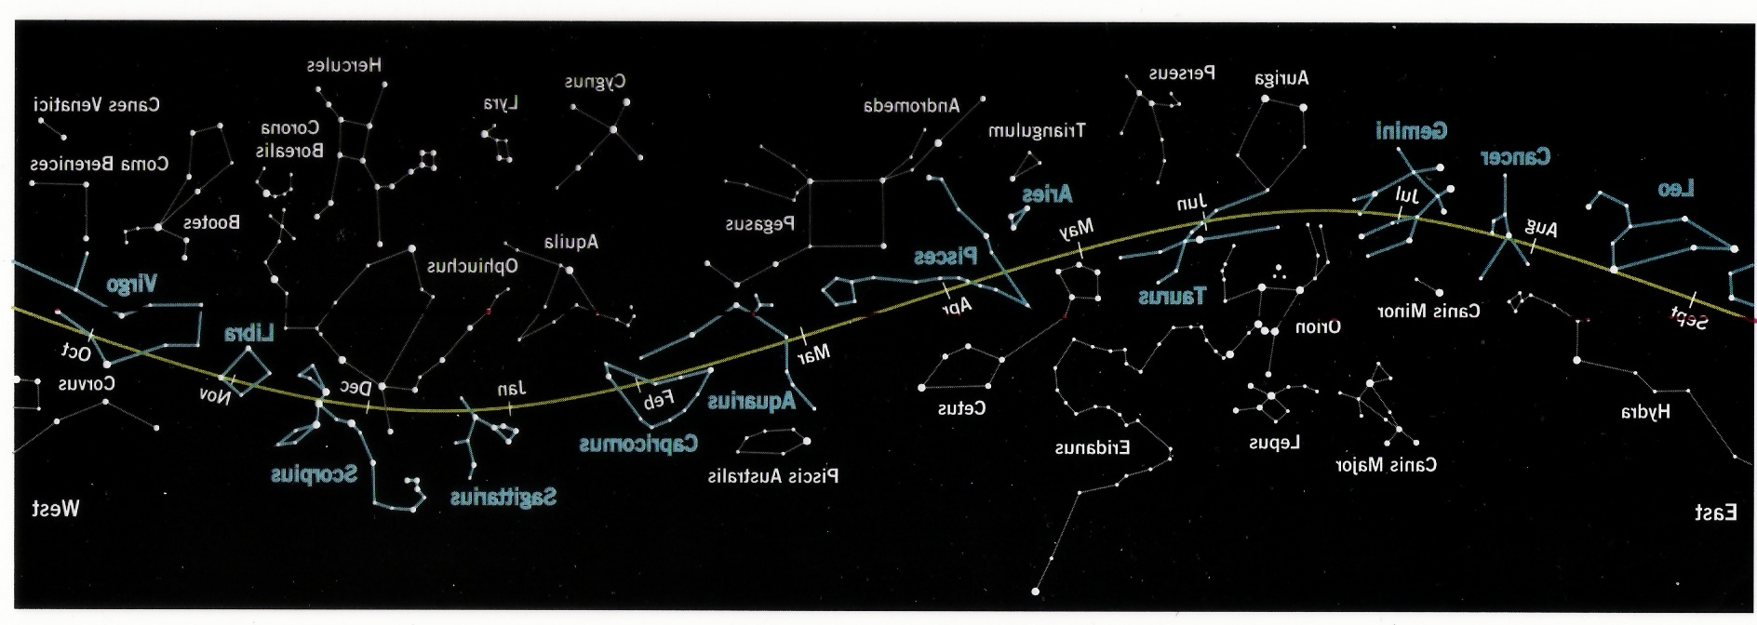
Motion of the Earth – Annual
Ecliptic = The apparent path of the Sun on the sky as seen from Earth.

Slide 17
Motion of the Earth and Seasons
Seasons: an oscillation of average temperature with
a period of 1 tropical year.
There are two main reasons for the seasons:
1. The length of daytime (when Sun is “up”) changes.
2. The directness of the Sun's rays changes.
Astronomical Definitions of the 4 seasons
* Spring: begins on vernal equinox (Mar 20, 21)
* Summer: begins on summer solstic (June 20,21)
* Fall: begins on autumnal equinox (Sept 22, 23)
* Winter: begins on winter solstice (Dec 21, 22)

Slide 18
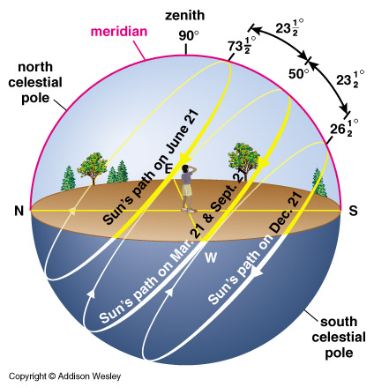
Motion of the Earth and Seasons

Slide 19
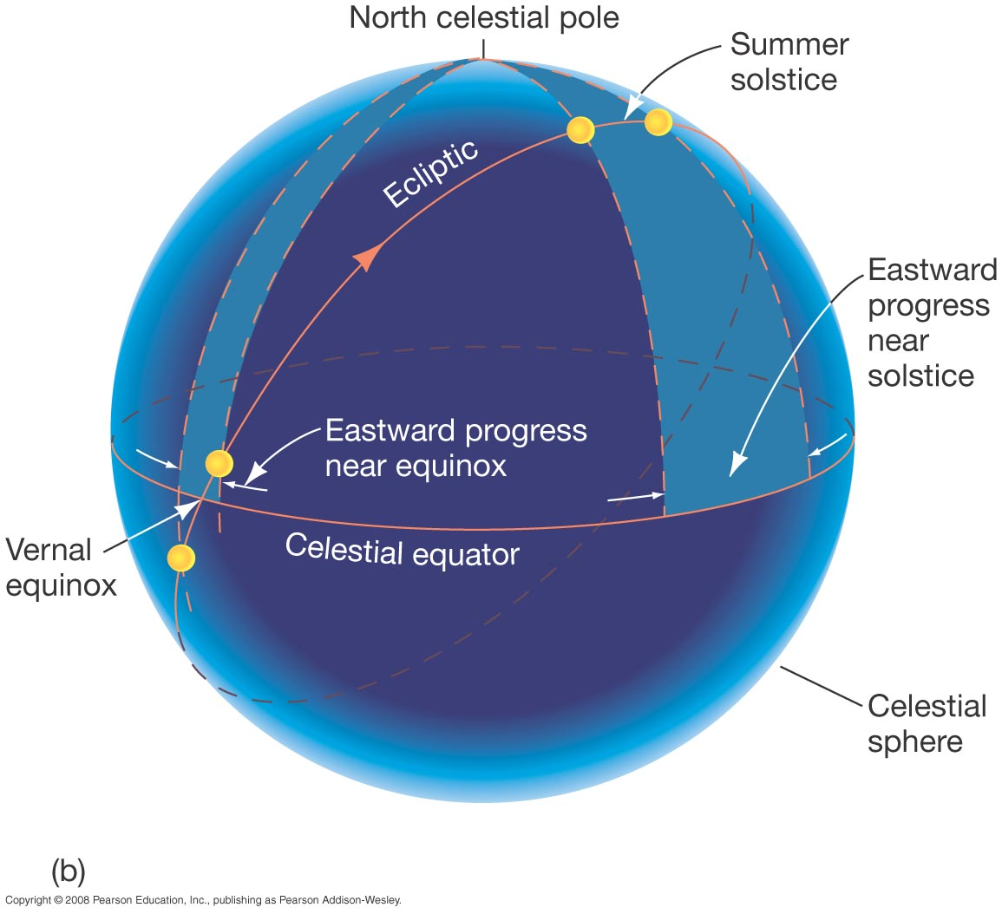
Motion of the Earth - Yearly
Since the ecliptic is tilted the rate of the Sun's apparent motion Eastward relative to the stars changes. It is fast during the solstices and slow during the equinoxes.

Slide 20
Precession of the Equinoxes
The Earth's spin axis is “wobbling”.
26,000 year period
Tilt remains 23.5 degrees
Seasons remain the same severity

Slide 21
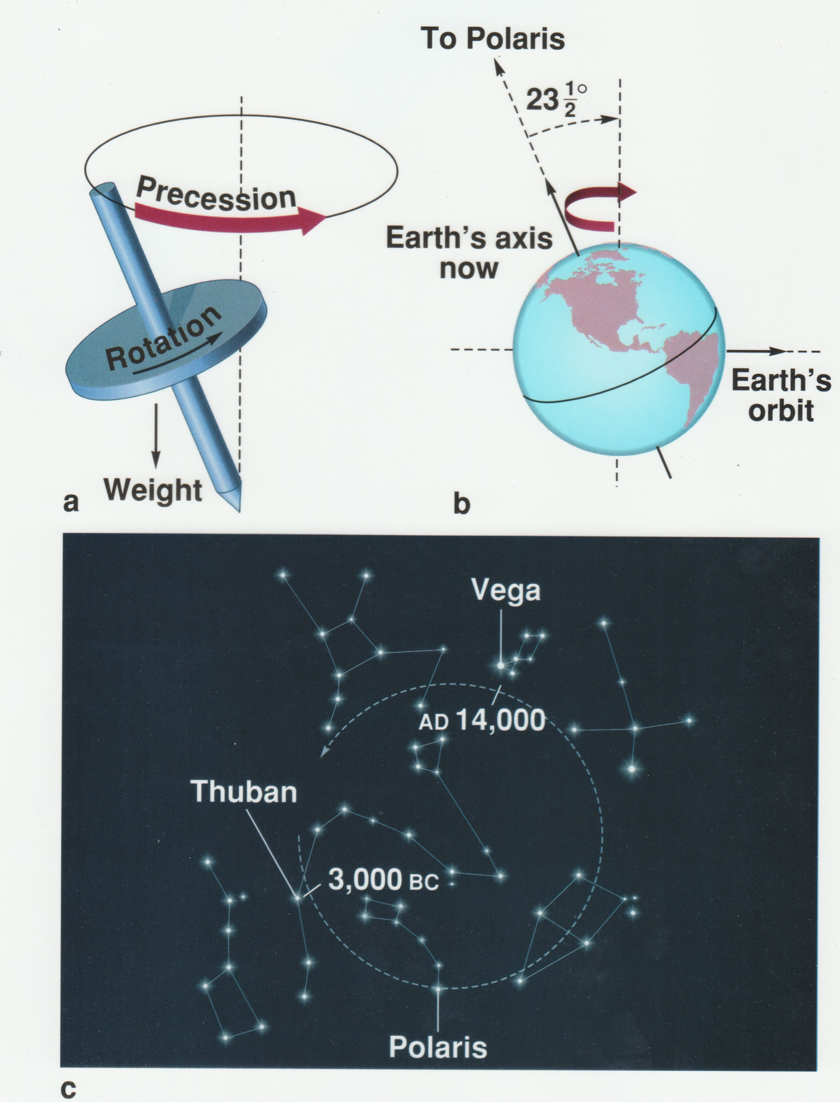
Precession
Gradual change of the
NCP position.
Polestar was not always
Polaris!

Slide 22
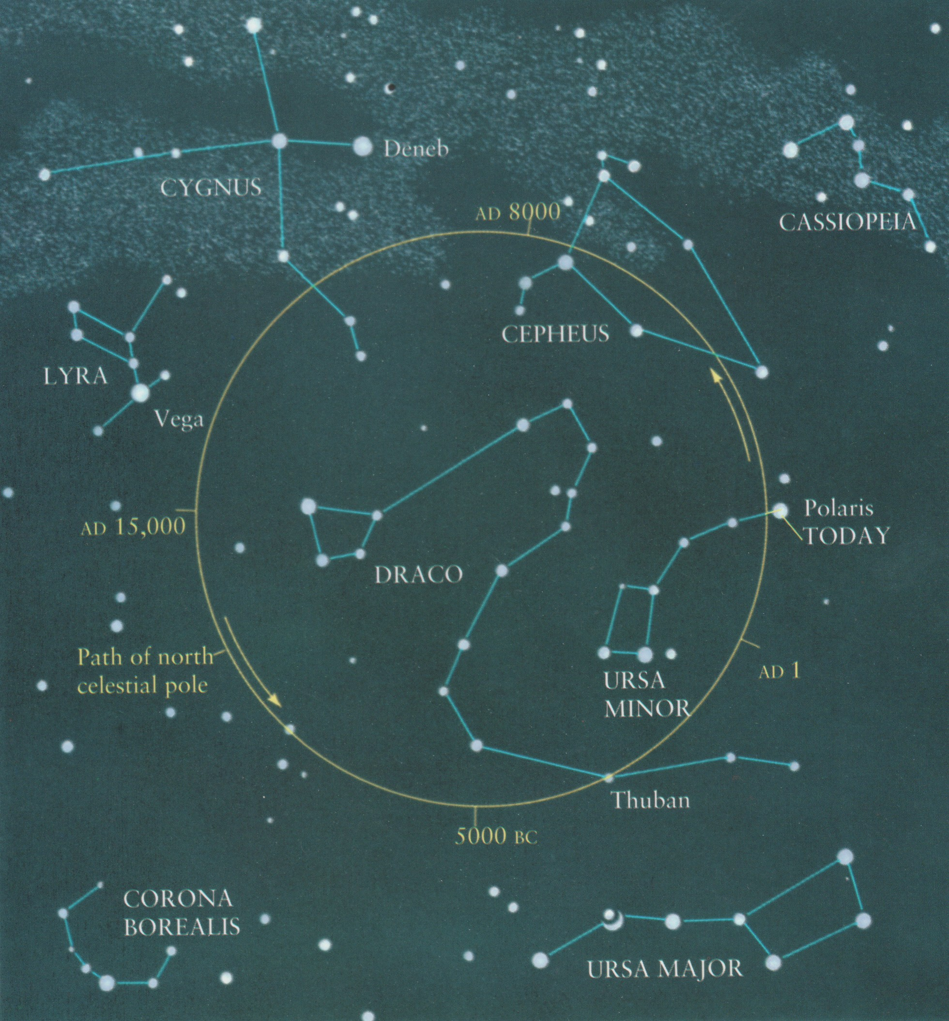
Precession

Slide 23
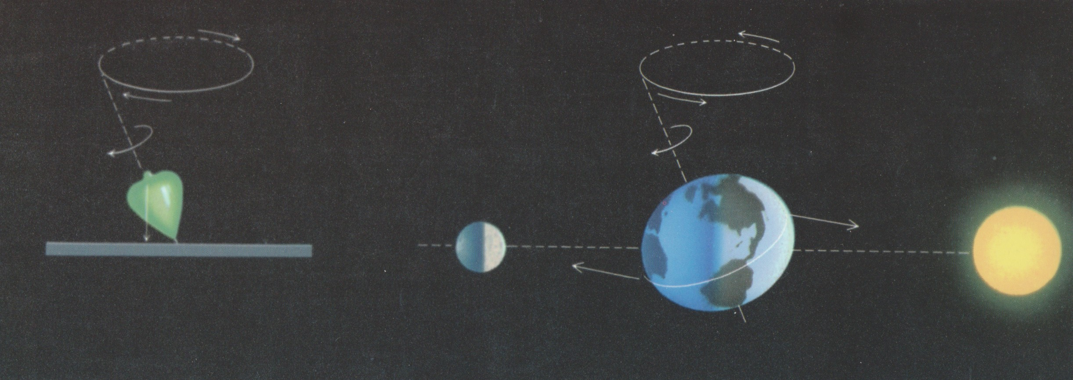
Precession
Cause: the pull of the Moon and Sun on Earth's equatorial bulge exerts a Torque.
Left: gravity from S and M are trying to tip
the spin axis UPRIGHT.
Pole precesses CW seen from above.
Right: gravity is trying to tip the spin axis
OVER.
Pole precesses CCW seen from above.

Slide 24
Precession (of the Equinoxes)
Consequences
1) The NCP is changing position rel to stars
2) The equatorial coordinates (RA and DEC) of stars slowly change with time. → We need to specify “Epoch” of coordinates.

Slide 25
Coordinate Systems for the sky
Altazimuth coordinate system
Uses the horizon for it's zeropoints.
A star's coordinates are different for observers on different parts of Earth
Altitude = angle measured above (or below) the horizon in degrees.
Azimuth = angle measured along the horizon in degrees such that 0º azimuth is due North, 90º is due East, etc.
Ex) Polaris
Altitude = 40.75 degrees (our latitude)
Azimuth = 0 degrees (straight above N on horizon)

Slide 26
Coordinate Systems for the sky
Altazimuth coordinate system
Uses the horizon for it's zeropoints.
A star's coordinates are different for observers on different parts of Earth
Altitude = angle measured above (or below) the horizon in degrees.
Azimuth = angle measured along the horizon in degrees such that 0º azimuth is due North, 90º is due East, etc.
Ex) Polaris
Altitude = 40.75 degrees (our latitude)
Azimuth = 0 degrees (straight above N on horizon)
Equatorial (or Celestial) coordinate system
Uses the Celestial equator and ecliptic to define zeropoints.
A star's coordinates are the same for all observers!
Right Ascension, RA = distance measured in hours, minutes and seconds along the celestial equator such that RA=0h at the vernal equinox and RA=6h at the Summer Solstice.
Declination, DEC = Angle measured in degrees, arcminutes and arcseconds above the celestial equator such that DEC = 0º on the cel. equator, increasing to +90º at the NCP and -90º at the SCP.

Slide 27
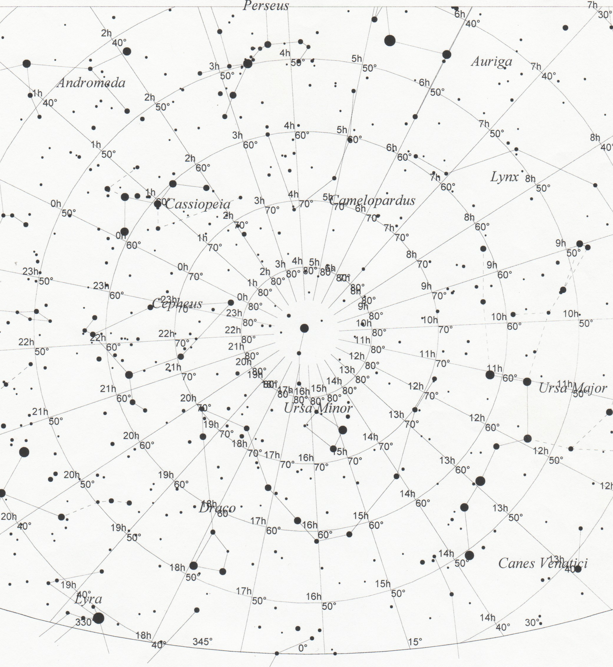
Coordinate Systems for the sky
Example 1)
Equatorial:
Polaris at
Dec=90º
RA = ~2hr
Altazimuth:
Polaris has
Alt = 46º
Azim = 0º
N

Slide 28
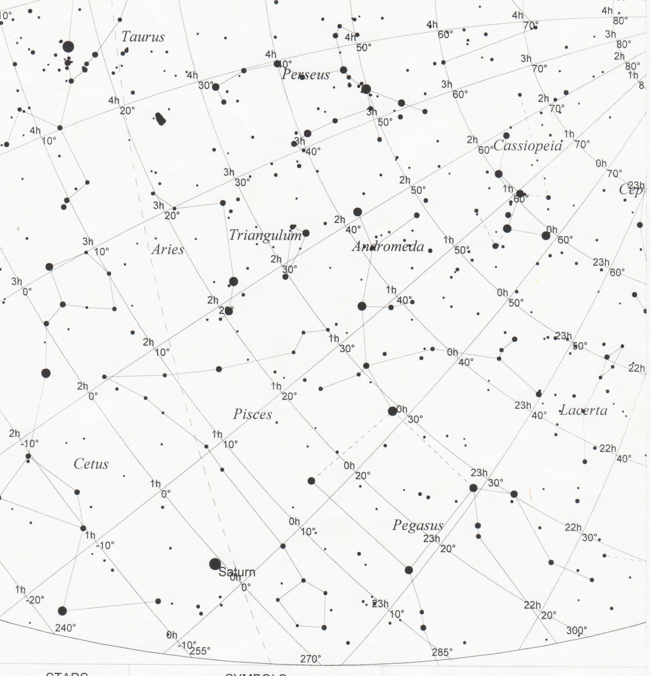
Coordinate Systems for the sky
Example 2)
Equatorial:
Saturn has
Dec=-1º
RA = 0h 15m
Altazimuth:
Saturn has
Alt = 13º
Azim = 257º
ecliptic
celestial equator
vernal equinox, RA=0
W

Slide 29
Angles, distances and widths
Angles are measured in degrees, arcminutes, and
arcseconds.
1 degree (º) is 1/360 of a complete rotation
1 arcminute (') is 1/60 of a degree
1 arcsecond ('') is 1/60 of an arcminute

Slide 30
Angles, distances and widths
Angles are measured in degrees, arcminutes, and
arcseconds.
1 degree (º) is 1/360 of a complete rotation
1 arcminute (') is 1/60 of a degree
1 arcsecond ('') is 1/60 of an arcminute
Angles on the sky can be measured in two ways:
1) Think of the sky as a flat paper with lines connecting one star to two others. An angle can be drawn between those two lines where they intersect.
2) angular separations between two stars as you would estimate using your fist at arm's length.
Mostly we use #2.

Slide 31
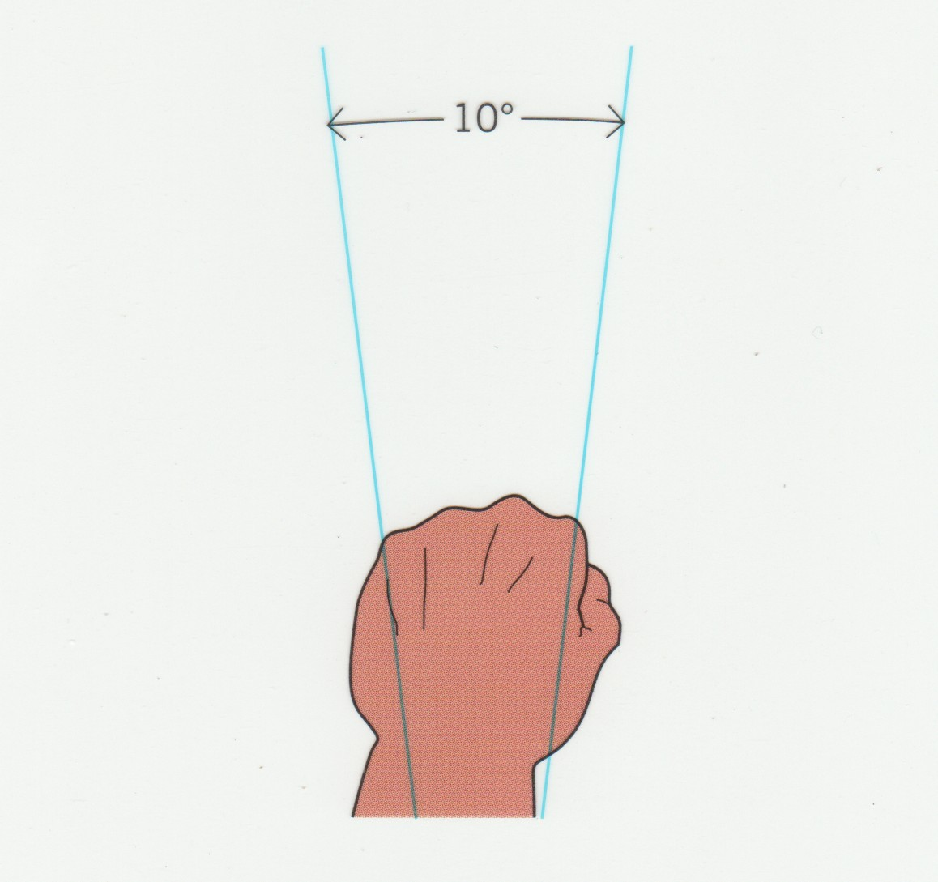
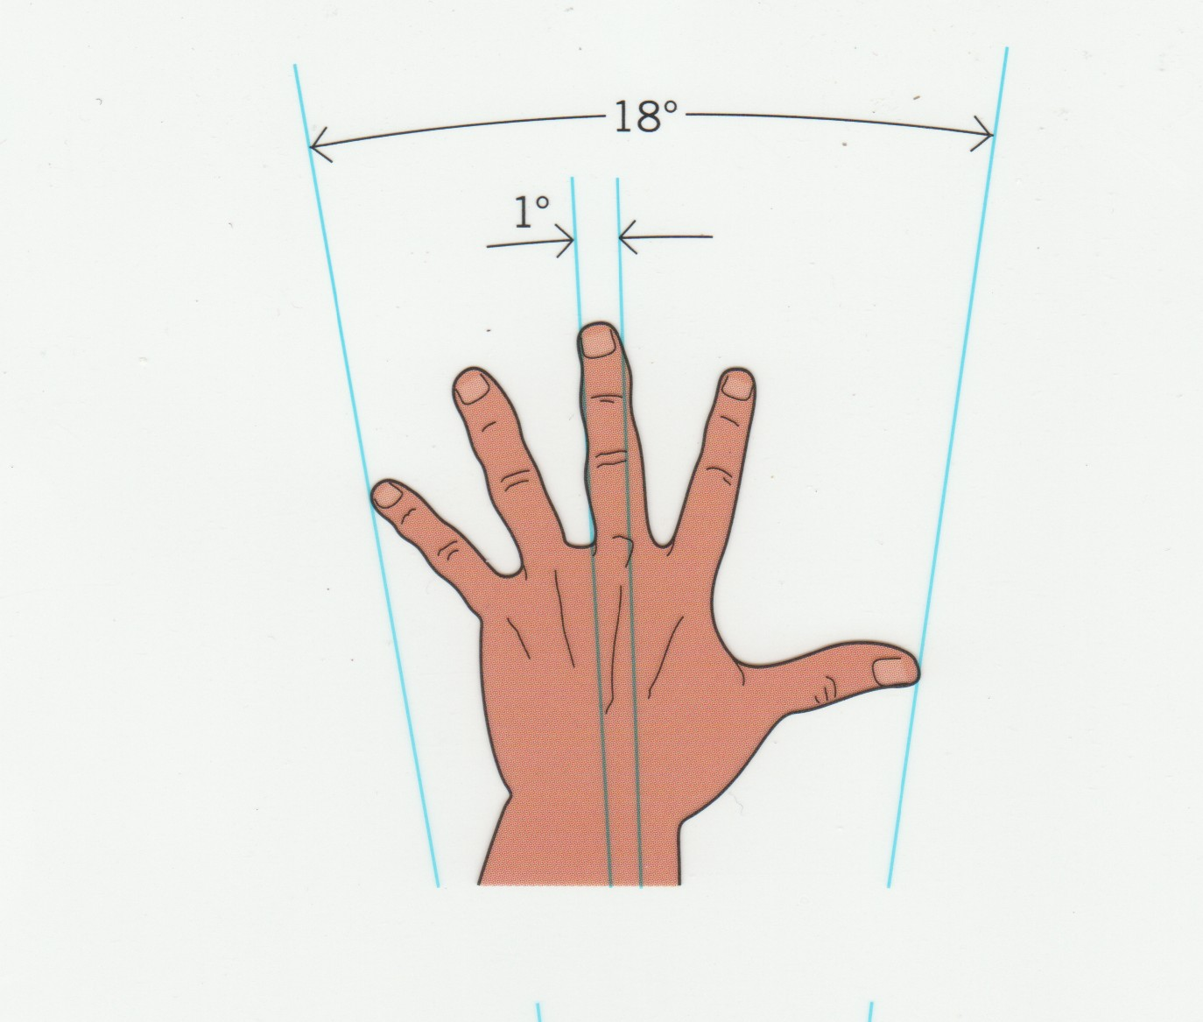
Angles, distances and widths

Slide 32
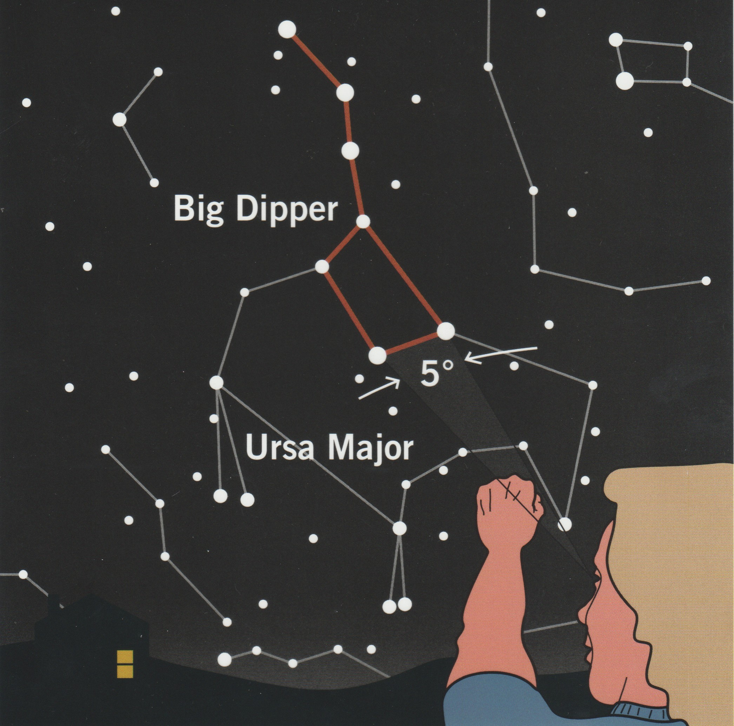
Angles, distances and widths
Calibrate using the Big Dipper!

Slide 33
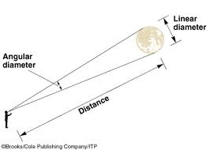
Angles, distances and widths
Relationship between linear diameter and angular diameter
AD(radians) = LD/D
AD(degrees) = (57.3)LD/D

