Slide 1
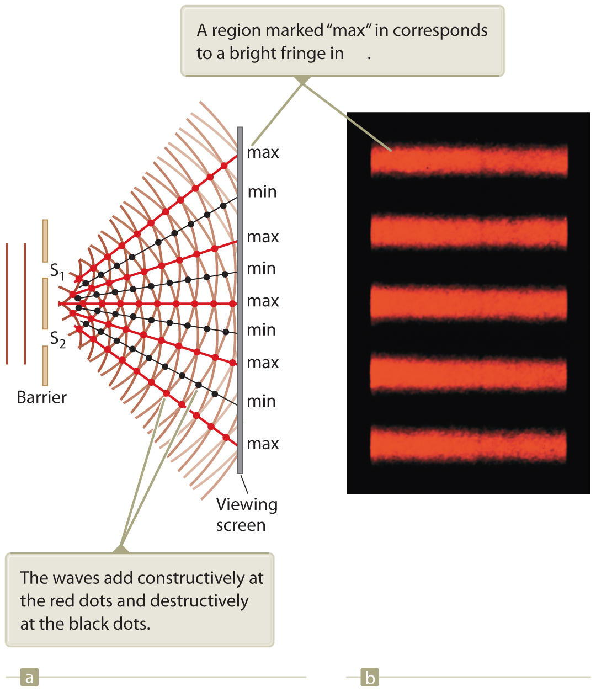
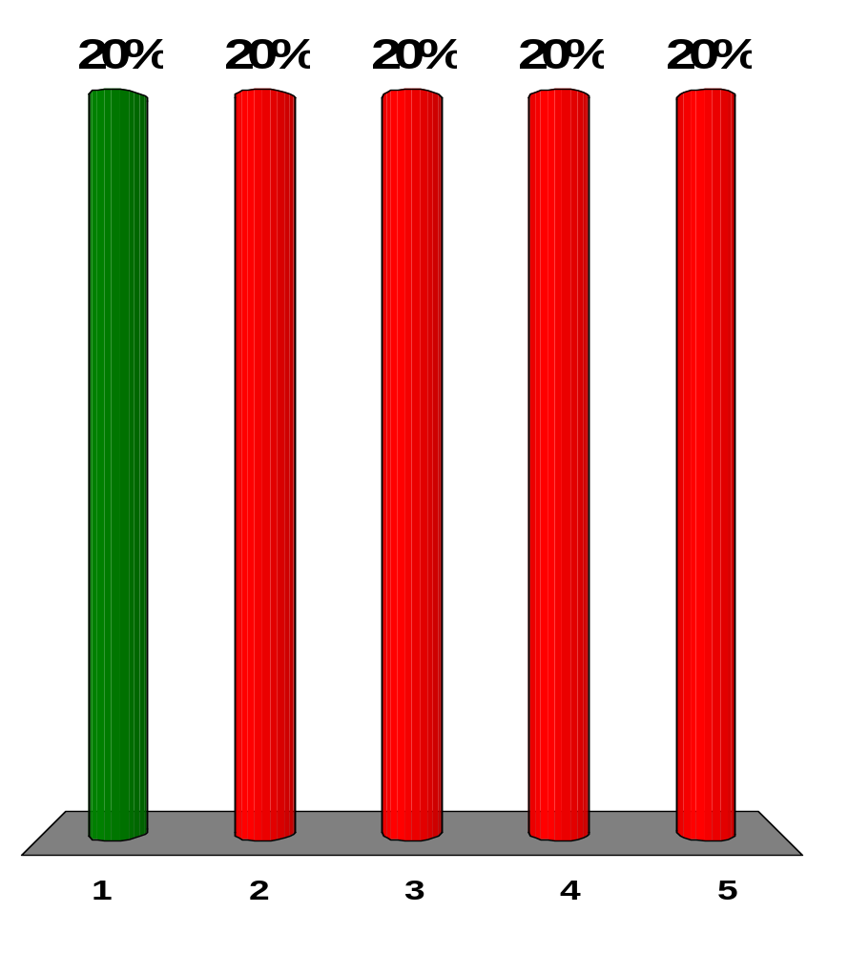
A plane monochromatic light wave is incident on a double slit as illustrated in Active Figure 37.1. As the viewing screen is moved away from the double slit, what happens to the separation between the interference fringes on the screen?
[Active Figure 37.1]
It increases.
It decreases.
It remains the same.
It may increase or decrease, depending on the wavelength of the light.
More information is required.
Notes:
Remarks for instructors: Answer (1). The angular position of the mth-order bright fringe in a double-slit interference pattern is given by d sinθ_{m} =mλ. The distance y_{m} of the mth-order bright fringe from the center of the pattern is given by y_{m} = Ltanθ_{m}, where L is the distance to the screen. The spacing between successive bright fringes is
Δy = y_{m}+1 – y_{m} = L(tan θ_{m+1} – tan θ_{m})
≈ L(sin θ_{m+1} – sin θ_{m})
= L [(m+1)-m]λ/d = Lλ/d
because the angles are small, and for small angles (in radians) sin θ ≊ tan θ. As L increases, the spacing Δy increases.

Slide 2
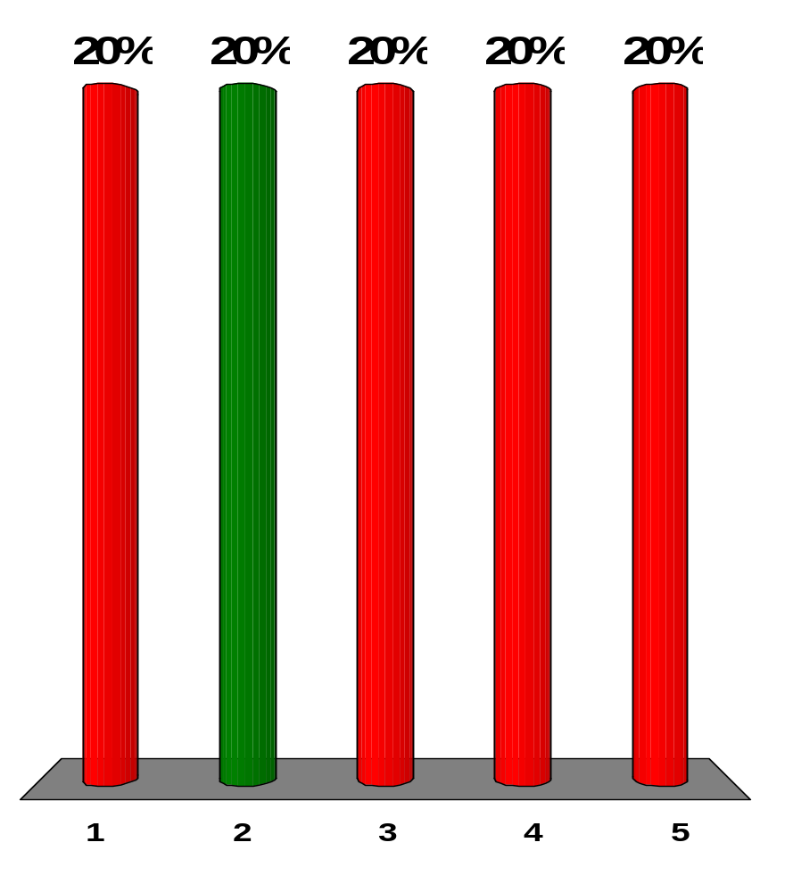
A plane monochromatic light wave is incident on a double slit as illustrated in Active Figure 37.1. As the slit separation increases, what happens to the separation between the interference fringes on the screen?
[Active Figure 37.1]
It increases.
It decreases.
It remains the same.
It may increase or decrease, depending on the wavelength of the light.
More information is required.
Notes:
Remarks for instructors: Answer (2). From our result above, we see that as d increases, the spacing ∆y decreases.

Slide 3
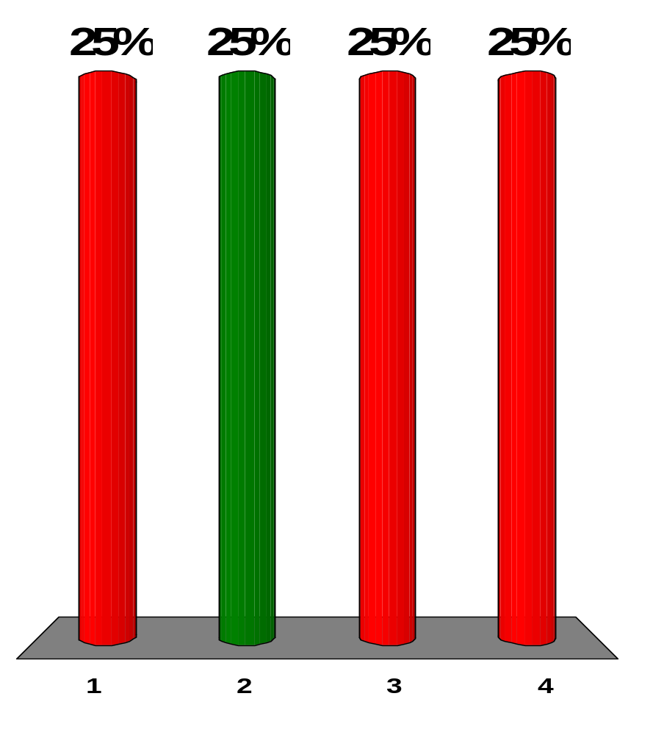
Four trials of Young’s double-slit experiment are conducted. (a) In the first trial, blue light passes through two fine slits 400 mm apart and forms an interference pattern on a screen 4 m away. (b) In a second trial, red light passes through the same slits and falls on the same screen. (c) A third trial is performed with red light and the same screen, but with slits 800 mm apart. (d) A final trial is performed with red light, slits 800 mm apart, and a screen 8 m away. Rank the trials (a) through (d) from the largest to the smallest value of the angle between the central maximum and the first-order side maximum. In your ranking, note any cases of equality.
b = d > a > c
b > a > c = d
a > c = d > b
d > b > c > a
Notes:
Remarks for instructors: Answer (2). The angles in the interference pattern are controlled by λ/d, which we estimate in each case:
(a) 0.45 μm/400 μm ≈ 1.1 × 10⁻³
(b) 0.7 μm/400 μm ≈ 1.6 × 10⁻³
(c) and (d) 0.7 μm/800 μm ≈ 0.9 × 10⁻³

Slide 4
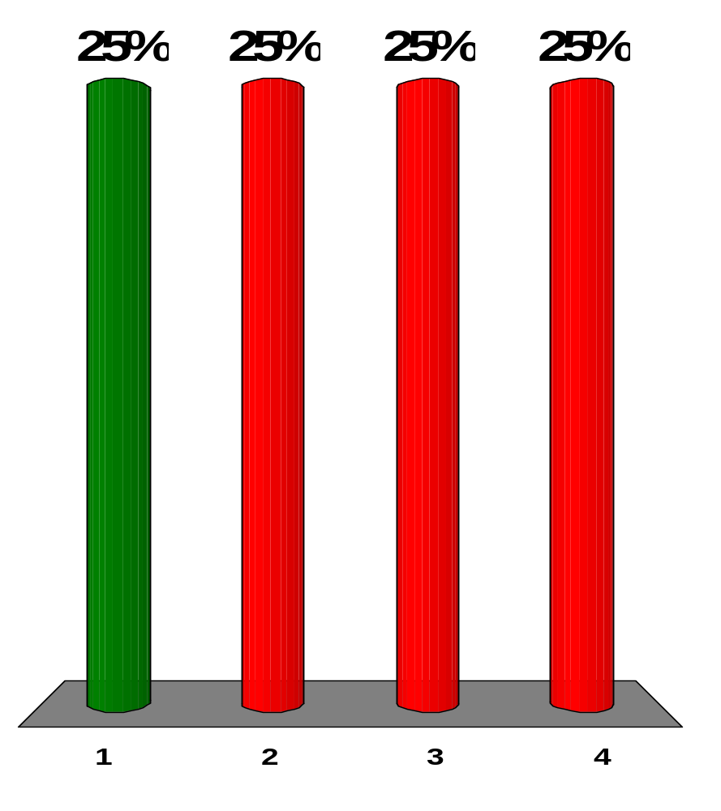
Four trials of Young’s double-slit experiment are conducted. (a) In the first trial, blue light passes through two fine slits 400 mm apart and forms an interference pattern on a screen 4 m away. (b) In a second trial, red light passes through the same slits and falls on the same screen. (c) A third trial is performed with red light and the same screen, but with slits 800 mm apart. (d) A final trial is performed with red light, slits 800 mm apart, and a screen 8 m away. Rank the same trials according to the distance between the central maximum and the first order side maximum on the screen.
b = d > a > c
b > a > c = d
a > c = d > b
d > b > c > a
Notes:
Remarks for instructors: Answer (1). Consider Lλ/d:
(a) 4 m (0.45 μm/400 μm) ≈ 4.4 mm
(b) 4 m (0.7 μm/400 μm) ≈ 7 mm
(c) 4 m(0.7 μm/800 μm) ≈ 3 mm
(d) 8 m(0.7 μm/800 μm) ≈ 7 mm.

Slide 5
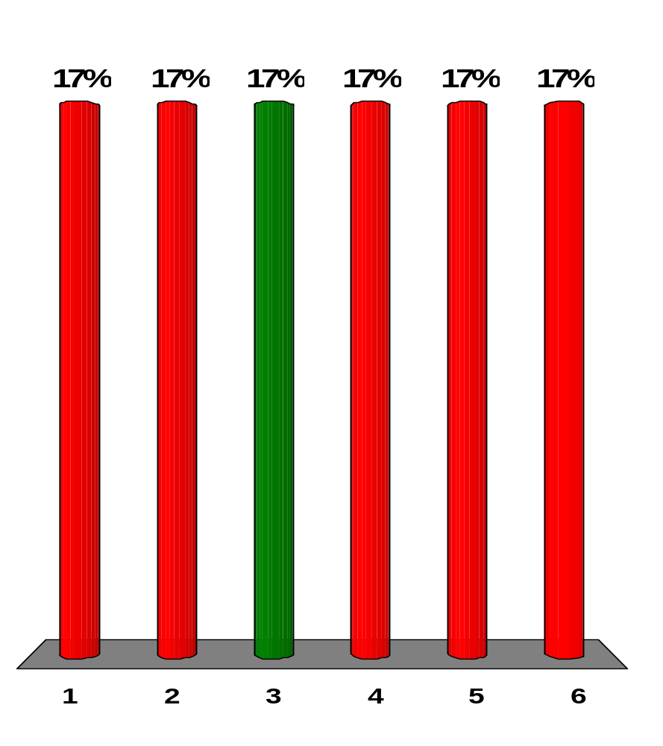
Suppose Young’s double-slit experiment is performed in air using red light and then the apparatus is immersed in water. What happens to the interference pattern on the screen?
It disappears.
The bright and dark fringes stay in the same locations, but the contrast is reduced.
The bright fringes are closer together.
The color shifts toward blue.
The bright fringes are farther apart.
No change happens in the interference pattern.
Notes:
Remarks for instructors: Answer (3). Underwater, the wavelength of the light decreases according to λ_{water} =λ_{air}/n_{water}. Since the angles between positions of light and dark bands are proportional to λ, the underwater fringe separations decrease.

Slide 6
Suppose you perform Young’s double-slit experiment with the slit separation slightly smaller than the wavelength of the light. As a screen, you use a large half-cylinder with its axis along the midline between the slits. What interference pattern will you see on the interior surface of the cylinder?
bright and dark fringes so closely spaced as to be indistinguishable
one central bright fringe and two dark fringes only
a completely bright screen with no dark fringes
one central dark fringe and two bright fringes only
a completely dark screen with no bright fringes
Notes:
Remarks for instructors: Answer (2). With two fine slits separated by a distance d slightly less than λ, the equation d sin θ = 0 has the usual solution θ = 0. But d sin θ = 1λ has no solution. There is no first side maximum. However, d sin θ = (1/2)λ has a solution: first-order minima flank the central maximum on each side.

Slide 7
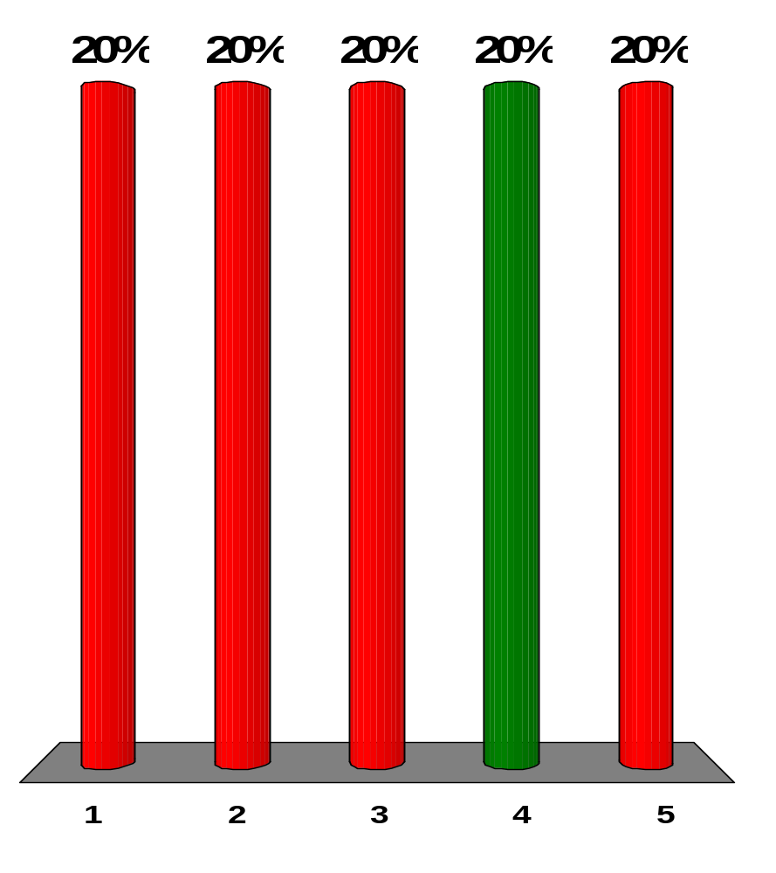
A thin layer of oil (n = 1.25) is floating on water (n = 1.33). What is the minimum nonzero thickness of the oil in the region that strongly reflects green light (λ = 530 nm)?
500 nm
313 nm
404 nm
212 nm
285 nm
Notes:
Remarks for instructors: Answer (4). There are 180° phase changes occurring in the reflections at both the air-oil boundary and the oil-water boundary, thus the relative phase change from reflection is zero. The condition for constructive interference in the reflected light is
2t = mλ/n → t = mλ/(2n)
where m is any integer. The minimum non-zero thickness of the oil which will strongly reflect 530-nm light is m=1:
t = mλ/(2n) = (1)(530 nm)/(2·1.25) = 212 nm

Slide 8
A monochromatic beam of light of wavelength 500 nm illuminates a double slit having a slit separation of 2.00 × 10⁻⁵ m. What is the angle of the second-order bright fringe?
0.050 0 rad
0.025 0 rad
0.100 rad
0.250 rad
0.010 0 rad
Notes:
Remarks for instructors: Answer (1). For the second-order bright fringe,
d sin θ = 2λ
sin θ = 2(500×10⁹ m)/(2.00×10⁻⁵ m)
θ = 0.050 0 rad

Slide 9
The index of refraction of flint glass is 1.66 and the index of refraction of crown glass is 1.52. A film formed by one drop of sassafras oil, on a horizontal surface of a flint glass block, is viewed by reflected light. The film appears brightest at its outer margin, where it is thinnest. A film of the same oil on crown glass appears dark at its outer margin. What can you say about the index of refraction of the oil?
It must be less than 1.52.
It must be between 1.52 and 1.66.
It must be greater than 1.66.
None of statements (1) through (3) is necessarily true.
Notes:
Remarks for instructors: Answer (2). If the oil film is brightest where it is thinnest, then n_{air} < n_{oil} < n_{flint glass}. With this condition, light reflecting from both the top and the bottom surface of the oil film will undergo phase reversal. Then these two beams will be in phase with each other where the film is very thin. This is the condition for constructive interference as the thickness of the oil film decreases toward zero. If the oil film is dark where it is thinnest, then n_{air} < n_{oil} > n_{crown glass}. In this case, reflecting light undergoes phase reversal upon reflection from the front surface but no phase reversal upon reflection from the back surface. The two reflected beams are 180° out of phase and interfere destructively as the oil film thickness goes to zero.

Slide 10
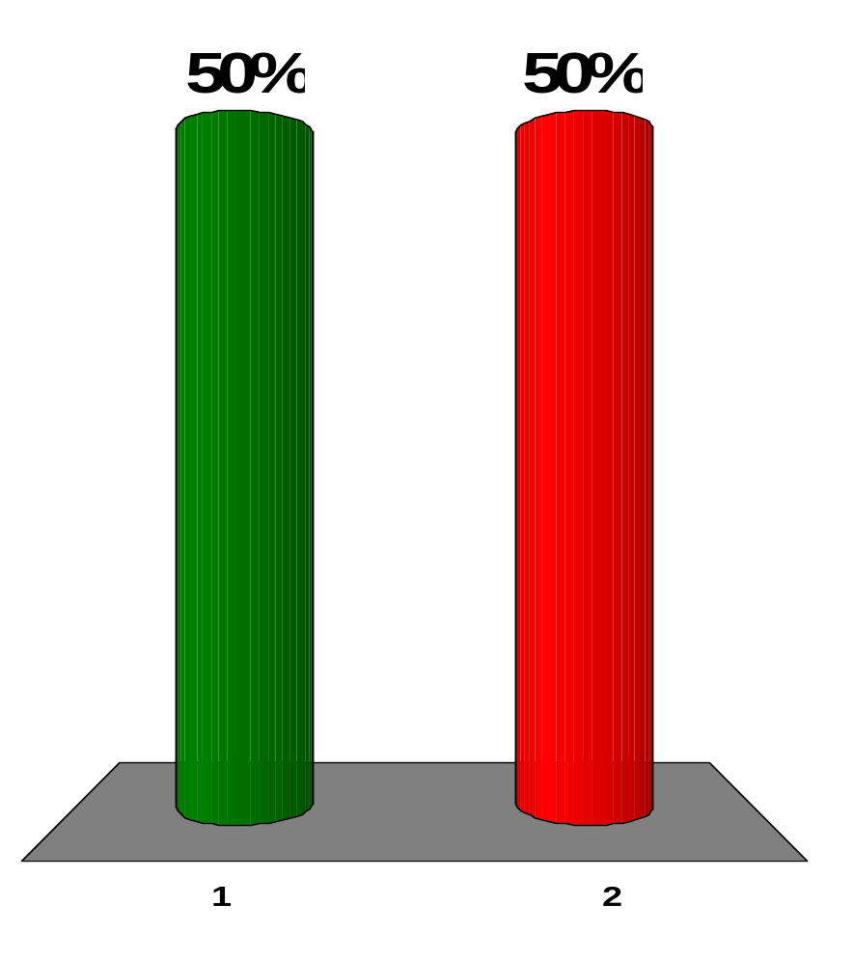
The index of refraction of flint glass is 1.66 and the index of refraction of crown glass is 1.52. A film formed by one drop of sassafras oil, on a horizontal surface of a flint glass block, is viewed by reflected light. The film appears brightest at its outer margin, where it is thinnest. A film of the same oil on crown glass appears dark at its outer margin. Could a very thin film of some other liquid appear bright by reflected light on both of the glass blocks?
yes
no
Notes:
Remarks for instructors: Answer (1). It should have a lower refractive index than both kinds of glass.

Slide 11
The index of refraction of flint glass is 1.66 and the index of refraction of crown glass is 1.52. A film formed by one drop of sassafras oil, on a horizontal surface of a flint glass block, is viewed by reflected light. The film appears brightest at its outer margin, where it is thinnest. A film of the same oil on crown glass appears dark at its outer margin. Could a very thin film of some other liquid appear dark by reflected light on both of the glass blocks?
yes
no
Notes:
Remarks for instructors: Answer (1). It should have a higher refractive index than both kinds of glass.

Slide 12
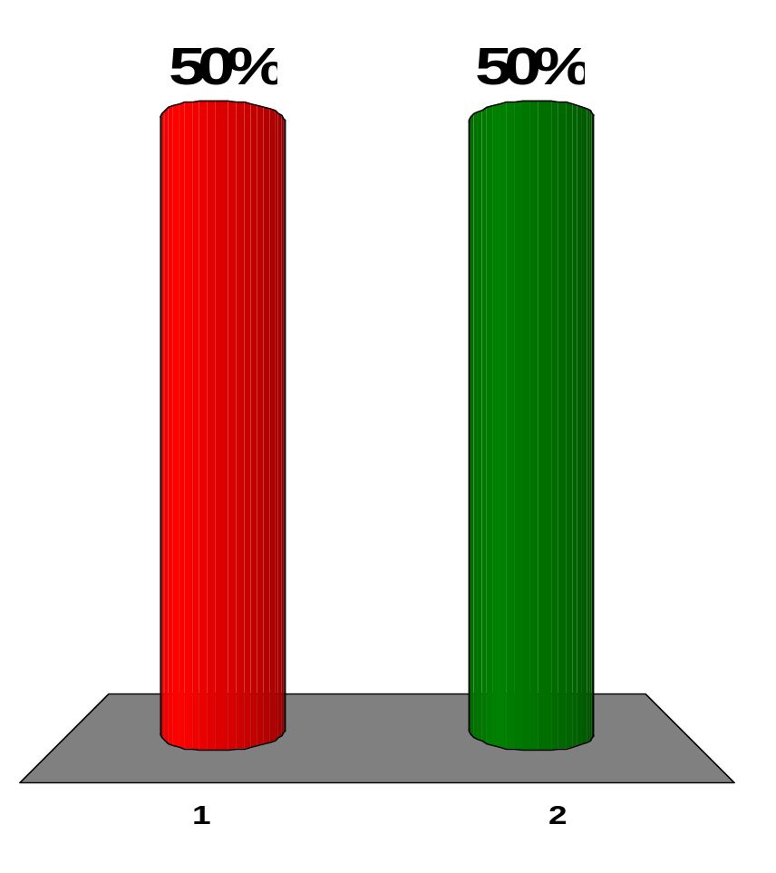
The index of refraction of flint glass is 1.66 and the index of refraction of crown glass is 1.52. A film formed by one drop of sassafras oil, on a horizontal surface of a flint glass block, is viewed by reflected light. The film appears brightest at its outer margin, where it is thinnest. A film of the same oil on crown glass appears dark at its outer margin. Could a very thin film of some other liquid appear dark by reflected light on crown glass and light on flint glass?
yes
no
Notes:
Remarks for instructors: Answer (2) Its refractive index cannot be both greater than 1.66 and less than 1.52.

Slide 13
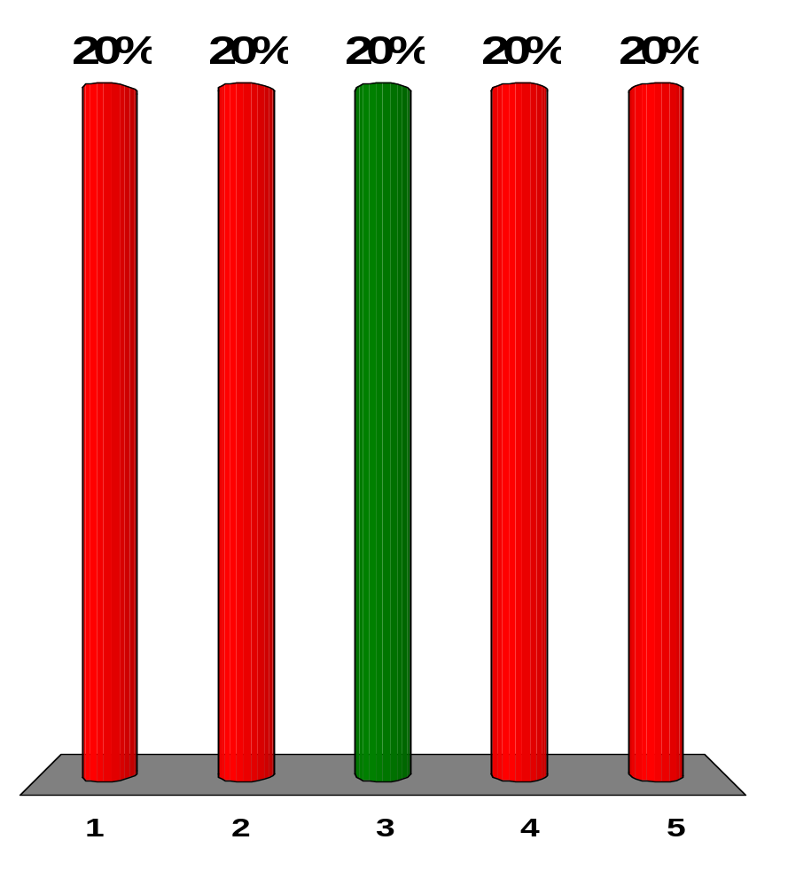
Green light has a wavelength of 500 nm in air. Assume green light is reflected from a mirror with angle of incidence 0°. The incident and reflected waves together constitute a standing wave with what distance from one node to the next node?
1,000 nm
500 nm
250 nm
125 nm
62.5 nm
Notes:
Remarks for instructors: Answer (3). The distance between nodes is one-half the wavelength.

Slide 14
Green light has a wavelength of 500 nm in air. The green light is sent into a Michelson interferometer that is adjusted to produce a central bright circle. How far must the interferometer’s moving mirror be shifted to change the center of the pattern into a dark circle?
1,000 nm
500 nm
250 nm
125 nm
62.5 nm
Notes:
Remarks for instructors: Answer (4). The reflected light travels through the same path twice because it reflects, so moving the mirror one-quarter wavelength, 125 nm, results in a path change of one-half wavelength, 250 nm, which results in destructive interference.

Slide 15
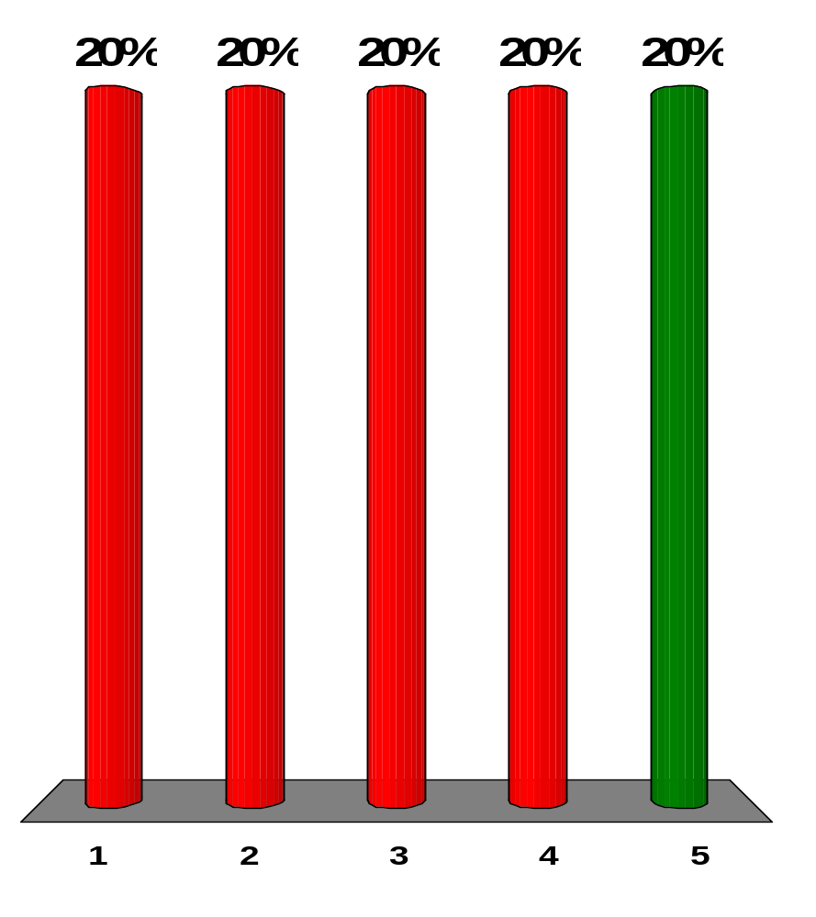
Green light has a wavelength of 500 nm in air. The green light is reflected perpendicularly from a thin film of a plastic with an index of refraction 2.00. The film appears bright in the reflected light. How much additional thickness would make the film appear dark?
1,000 nm
500 nm
250 nm
125 nm
62.5 nm
Notes:
Remarks for instructors: Answer (5). The wavelength of the light in the film is 500 nm/2 = 250 nm. If the film is made 62.5 nm thicker (one-quarter wavelength in the film), the light reflecting inside the film has a path length 125 nm greater. This is half a wavelength, to reverse constructive into destructive interference.

Slide 16
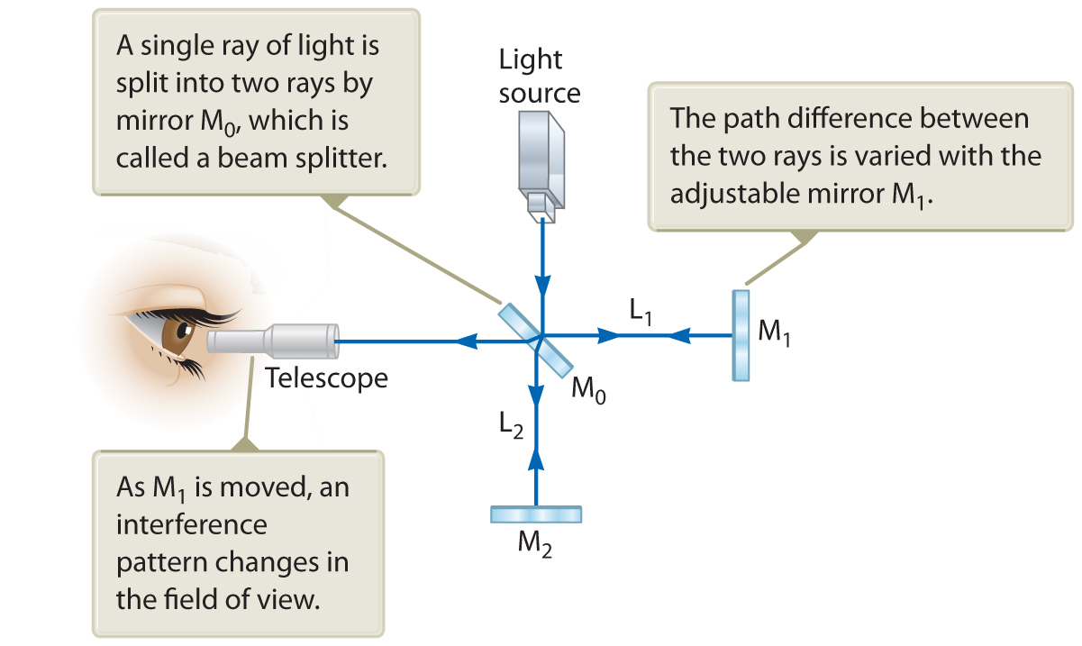
While using a Michelson interferometer (shown in Active Fig. 37.13), you see a dark circle at the center of the interference pattern. As you gradually move the light source toward the central mirror M₀, through a distance λ/2, what do you see?
[Active Fig. 37.13]
There is no change in the pattern.
The dark circle changes into a bright circle.
The dark circle changes into a bright circle and then back into a dark circle.
The dark circle changes into a bright circle, then into a dark circle, and then into a bright circle.
Notes:
Remarks for instructors: Answer (1). If the mirrors do not move the character of the interference stays the same.

Slide 17
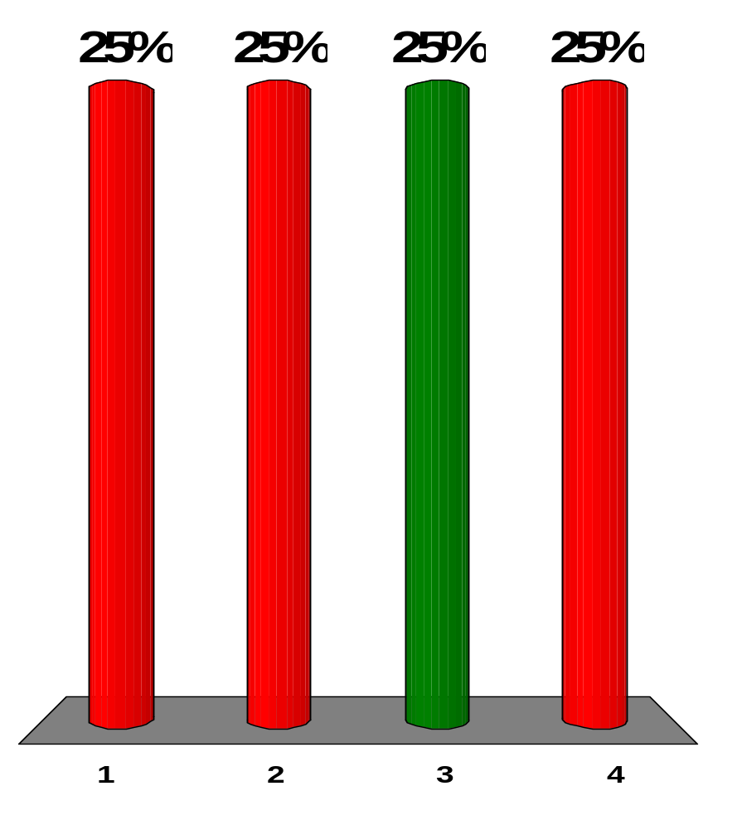
While using a Michelson interferometer (shown in Active Fig. 37.13), you see a dark circle at the center of the interference pattern. As you gradually move the moving mirror toward the central mirror M₀, through a distance λ/2, what do you see? Choose from the same possibilities.
[Active Fig. 37.13]
There is no change in the pattern.
The dark circle changes into a bright circle.
The dark circle changes into a bright circle and then back into a dark circle.
The dark circle changes into a bright circle, then into a dark circle, and then into a bright circle.
Notes:
Remarks for instructors: Answer (3). The light waves destructively interfere so they are initially out of phase by 180°. Moving the mirror by λ/2 changes the path difference by 2(λ/2) = λ, so the waves go in phase then back out of phase to their original phase relation.

Slide 18
A film of oil on a puddle in a parking lot shows a variety of bright colors in swirled patches. What can you say about the thickness of the oil film?
It is much less than the wavelength of visible light.
It is of the same order of magnitude as the wavelength of visible light.
It is much greater than the wavelength of visible light.
It might have any relationship to the wavelength of visible light.
Notes:
Remarks for instructors: Answer (2). If the thickness of the oil film were smaller than half of the wavelengths of visible light, no colors would appear. If the thickness of the oil film were much larger, the colors would overlap to mix to white or gray.

