Slide 1
Chapter 17
Sound Waves

Slide 2
Introduction to Sound Waves
Sound waves are longitudinal waves
They travel through any material medium
The speed of the wave depends on the properties of the medium
The mathematical description of sinusoidal sound waves is very similar to sinusoidal waves on a string

Slide 3
Categories of Sound Waves
The categories cover different frequency ranges
Audible waves are within the sensitivity of the human ear
  Range is approximately 20 Hz to 20 kHz
Infrasonic waves have frequencies below the audible range
Ultrasonic waves have frequencies above the audible range

Slide 4
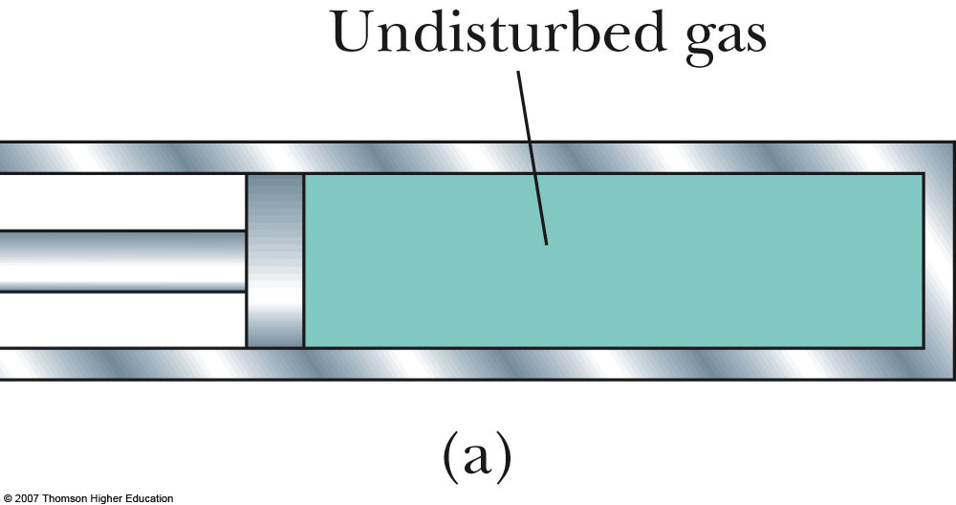
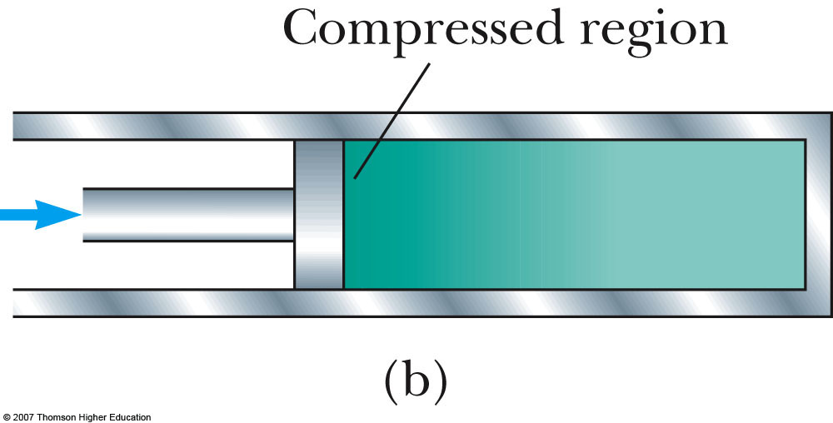
Speed of Sound Waves
Use a compressible gas as an example with a setup as shown at right
Before the piston is moved, the gas has uniform density
When the piston is suddenly moved to the right, the gas just in front of it is compressed
  Darker region in the diagram

Slide 5
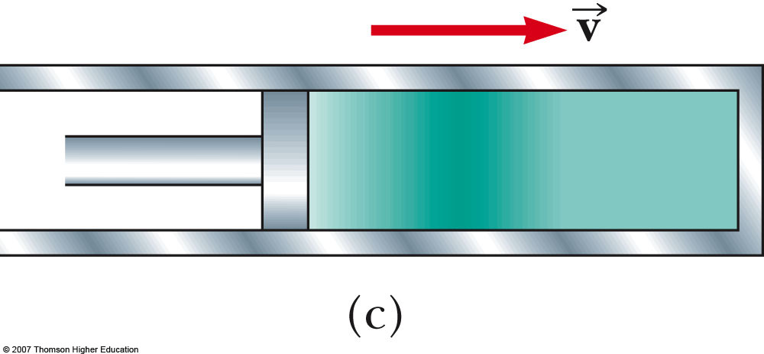
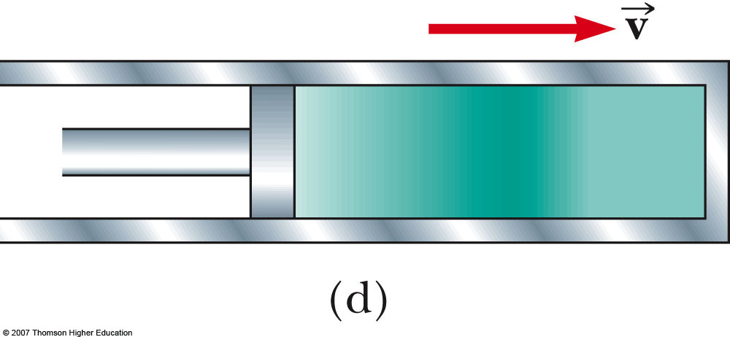
Speed of Sound Waves, cont
When the piston comes to rest, the compression region of the gas continues to move
  This corresponds to a longitudinal pulse traveling through the tube with speed v
  The speed of the piston is not the same as the speed of the wave

Slide 6
Speed of Sound Waves, General
The speed of sound waves in a medium depends on the compressibility and the density of the medium
The compressibility can sometimes be expressed in terms of the elastic modulus of the material
The speed of all mechanical waves follows a general form:

Slide 7
Speed of Sound in Liquid or Gas
The bulk modulus of the material is B
The density of the material is ρ
The speed of sound in that medium is

Slide 8
Speed of Sound in a Solid Rod
The Young’s modulus of the material is Y
The density of the material is ρ
The speed of sound in the rod is

Slide 9
Speed of Sound in Air
The speed of sound also depends on the temperature of the medium
This is particularly important with gases
For air, the relationship between the speed and temperature is
  The 331 m/s is the speed at 0º C
  T_{C} is the air temperature in Celsius

Slide 10
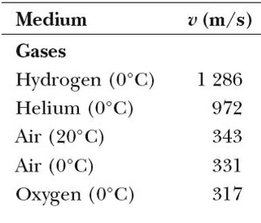
Speed of Sound in Gases, Example Values
Note temperatures, speeds are in m/s

Slide 11
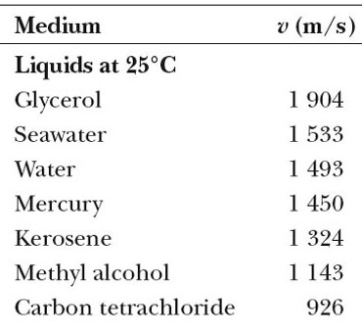
Speed of Sound in Liquids, Example Values
Speeds are in m/s

Slide 12
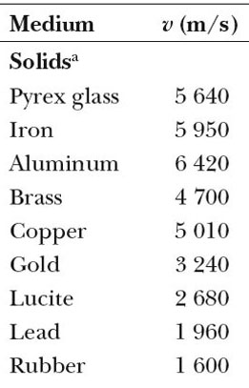
Speed of Sound in Solids, Example Values
Speeds are in m/s; values are for bulk solids

Slide 13
Speed of Sound in an Aluminum Rod, An Example
Since we need the speed of sound in a metal rod,
  This is smaller than the speed in a bulk solid of aluminum in Table 17.1, as expected
  The speed of a transverse wave would be smaller still

Slide 14
Periodic Sound Waves
A compression moves through a material as a pulse, continuously compressing the material just in front of it
The areas of compression alternate with areas of lower pressure and density called rarefactions
These two regions move with the speed equal to the speed of sound in the medium

Slide 15
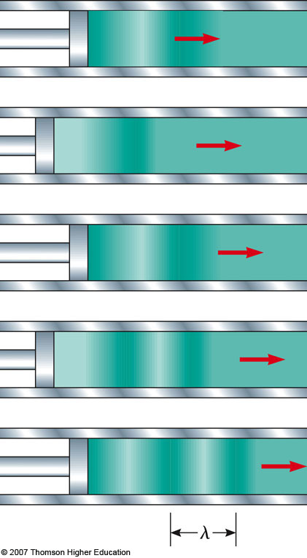
Periodic Sound Waves, Example
A longitudinal wave is propagating through a gas-filled tube
The source of the wave is an oscillating piston
The distance between two successive compressions (or rarefactions) is the wavelength
Use the active figure to vary the frequency of the piston

Slide 16
Periodic Sound Waves, cont
As the regions travel through the tube, any small element of the medium moves with simple harmonic motion parallel to the direction of the wave
The harmonic position function is
s (x, t) = s_{max} cos (kx – ωt)
  s_{max} is the maximum position from the equilibrium position
  This is also called the displacement amplitude of the wave

Slide 17
Periodic Sound Waves, Pressure
The variation in gas pressure, ΔP, is also periodic
ΔP = ΔP_{max} sin (kx – ωt)
ΔP_{max} is the pressure amplitude
It is also given by ΔP_{max} = ρvωs_{max}
k is the wave number (in both equations)
ω is the angular frequency (in both equations)

Slide 18
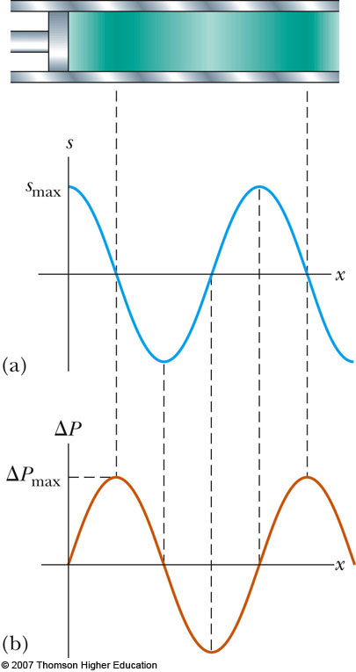
Periodic Sound Waves, final
A sound wave may be considered either a displacement wave or a pressure wave
The pressure wave is 90º out of phase with the displacement wave
  The pressure is a maximum when the displacement is zero, etc.

Slide 19
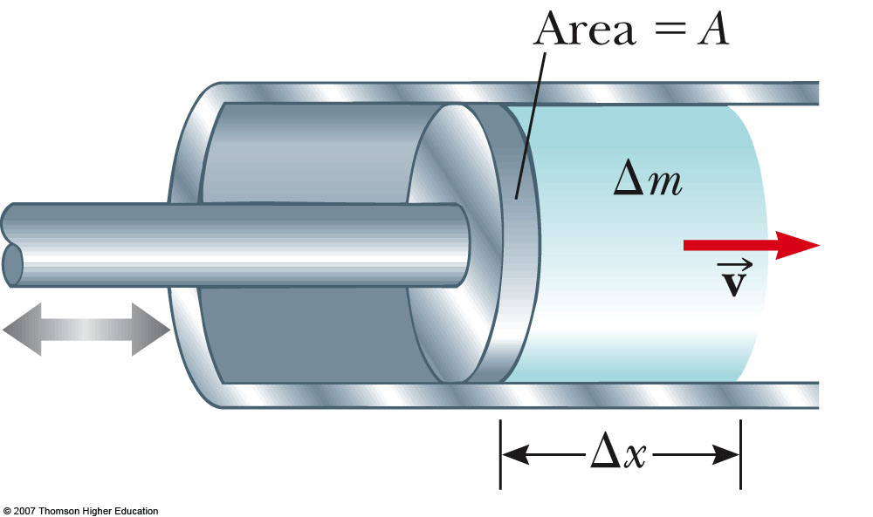
Energy of Periodic Sound Waves
Consider an element of air with mass Δm and length Δx
The piston transmits energy to the element of air in the tube
This energy is propagated away from the piston by the sound wave

Slide 20
Energy, cont.
The kinetic energy in one wavelength is
K_{λ} = ¼ (ρA)ω² s_{max}²λ
The total potential energy for one wavelength is the same as the kinetic
The total mechanical energy is
E_{λ} = K_{λ} +U_{λ} = ½ (ρA)ω² s_{max}²λ

Slide 21
Power of a Periodic Sound Wave
The rate of energy transfer is the power of the wave
This is the energy that passes by a given point during one period of oscillation

Slide 22
Intensity of a Periodic Sound Wave
The intensity, I, of a wave is defined as the power per unit area
  This is the rate at which the energy being transported by the wave transfers through a unit area, A, perpendicular to the direction of the wave

Slide 23
Intensity, cont
In the case of our example wave in air,
I = ½ ρv(ωs_{max})²
Therefore, the intensity of a periodic sound wave is proportional to the
  Square of the displacement amplitude
  Square of the angular frequency
In terms of the pressure amplitude,

Slide 24
Intensity of a Point Source
A point source will emit sound waves equally in all directions
  This results in a spherical wave
Identify an imaginary sphere of radius r centered on the source
The power will be distributed equally through the area of the sphere

Slide 25
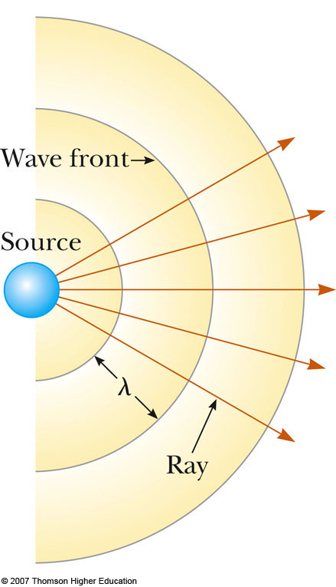
Intensity of a Point Source, cont
This is an inverse-square law
  The intensity decreases in proportion to the square of the distance from the source

Slide 26
Sound Level
The range of intensities detectible by the human ear is very large
It is convenient to use a logarithmic scale to determine the intensity level, β

Slide 27
Sound Level, cont
I₀ is called the reference intensity
  It is taken to be the threshold of hearing
  I₀ = 1.00 x 10⁻¹² W/ m²
  I is the intensity of the sound whose level is to be determined
β is in decibels (dB)
Threshold of pain: I = 1.00 W/m²; β = 120 dB
Threshold of hearing: I₀ = 1.00 x 10⁻¹² W/ m² corresponds to β = 0 dB

Slide 28
Sound Level, Example
What is the sound level that corresponds to an intensity of 2.0 x 10⁻⁷ W/m² ?
β = 10 log (2.0 x 10⁻⁷ W/m² / 1.0 x 10⁻¹² W/m²) = 10 log 2.0 x 10⁵ = 53 dB
Rule of thumb: A doubling in the loudness is approximately equivalent to an increase of 10 dB

Slide 29
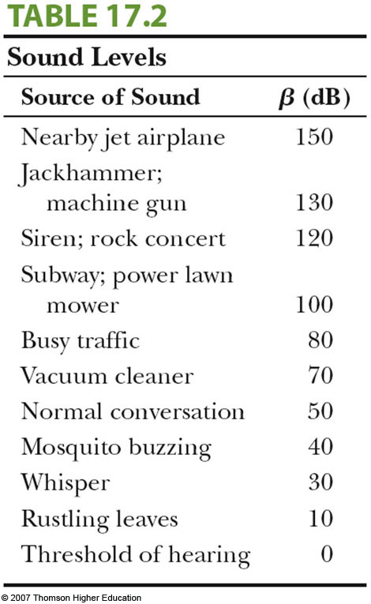
Sound Levels

Slide 30
Loudness and Intensity
Sound level in decibels relates to a physical measurement of the strength of a sound
We can also describe a psychological “measurement” of the strength of a sound
Our bodies “calibrate” a sound by comparing it to a reference sound
This would be the threshold of hearing
Actually, the threshold of hearing is this value for 1000 Hz

Slide 31
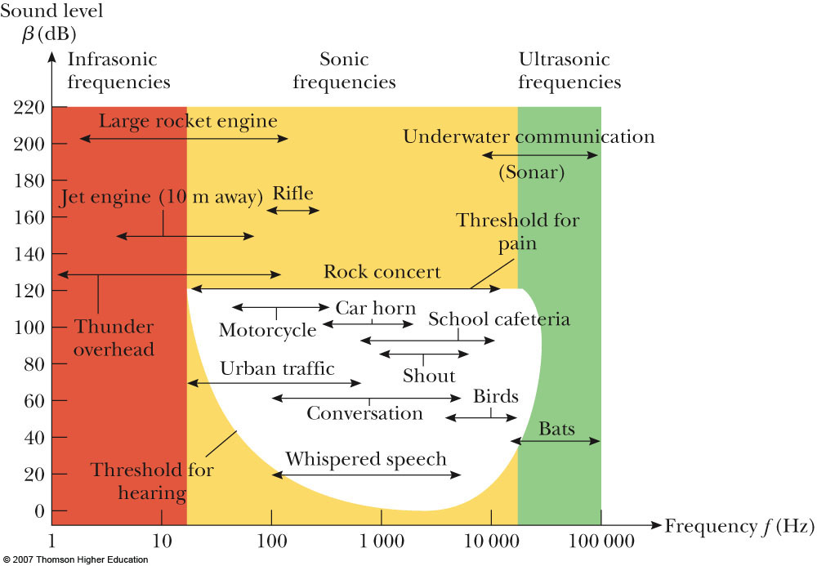
Loudness and Frequency, cont
There is a complex relationship between loudness and frequency
The white area shows average human response to sound
The lower curve of the white area shows the threshold of hearing
The upper curve shows the threshold of pain

Slide 32
The Doppler Effect
The Doppler effect is the apparent change in frequency (or wavelength) that occurs because of motion of the source or observer of a wave
  When the relative speed of the source and observer is higher than the speed of the wave, the frequency appears to increase
  When the relative speed of the source and observer is lower than the speed of the wave, the frequency appears to decrease

Slide 33
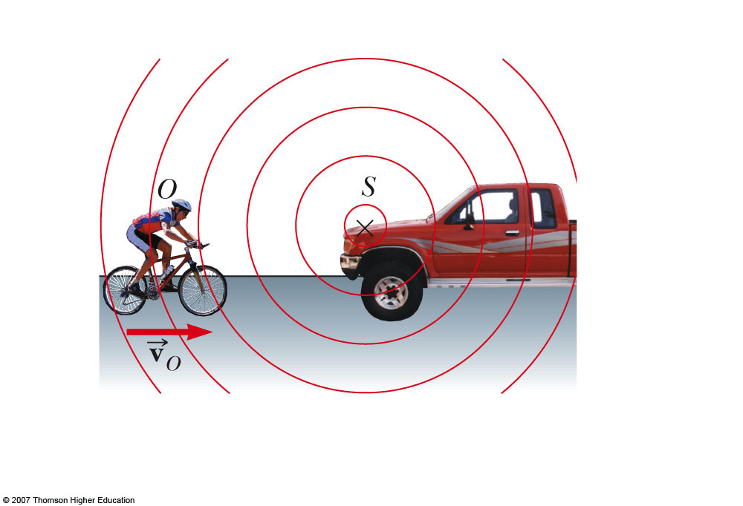
Doppler Effect, Observer Moving
The observer moves with a speed of v_{o}
Assume a point source that remains stationary relative to the air
It is convenient to represent the waves with a series of circular arcs concentric to the source
  These surfaces are called wave fronts

Slide 34
Doppler Effect, Observer Moving, cont
The distance between adjacent wave fronts is the wavelength
The speed of the sound is v, the frequency is ƒ, and the wavelength is λ
When the observer moves toward the source, the speed of the waves relative to the observer is v ’ = v + v_{o}
  The wavelength is unchanged

Slide 35
Doppler Effect, Observer Moving, final
The frequency heard by the observer, ƒ ’, appears higher when the observer approaches the source
The frequency heard by the observer, ƒ ’, appears lower when the observer moves away from the source

Slide 36
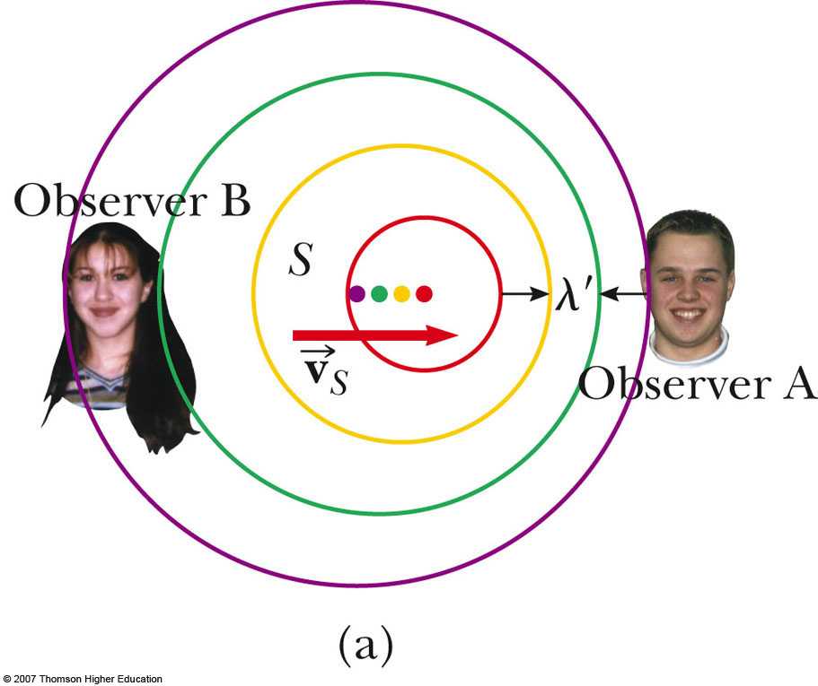
Doppler Effect, Source Moving
Consider the source being in motion while the observer is at rest
As the source moves toward the observer, the wavelength appears shorter
As the source moves away, the wavelength appears longer
  Use the active figure to adjust the speed and observe the results

Slide 37
Doppler Effect, Source Moving, cont
When the source is moving toward the observer, the apparent frequency is higher
When the source is moving away from the observer, the apparent frequency is lower

Slide 38
Doppler Effect, General
Combining the motions of the observer and the source
The signs depend on the direction of the velocity
  A positive value is used for motion of the observer or the source toward the other
  A negative sign is used for motion of one away from the other

Slide 39
Doppler Effect, final
Convenient rule for signs
  The word “toward” is associated with an increase in the observed frequency
  The words “away from” are associated with a decrease in the observed frequency
The Doppler effect is common to all waves
The Doppler effect does not depend on distance

Slide 40
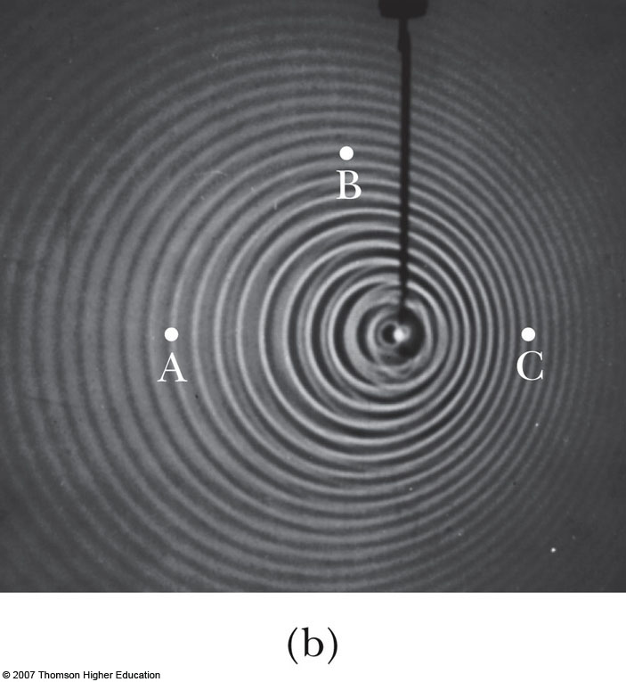
Doppler Effect, Water Example
A point source is moving to the right
The wave fronts are closer on the right
The wave fronts are farther apart on the left

Slide 41
Doppler Effect, Submarine Example
Sub A (source) travels at 8.00 m/s emitting at a frequency of 1400 Hz
The speed of sound is 1533 m/s
Sub B (observer) travels at 9.00 m/s
What is the apparent frequency heard by the observer as the subs approach each other? Then as they recede from each other?

Slide 42
Doppler Effect, Submarine Example cont
Approaching each other:
Receding from each other:

Slide 43
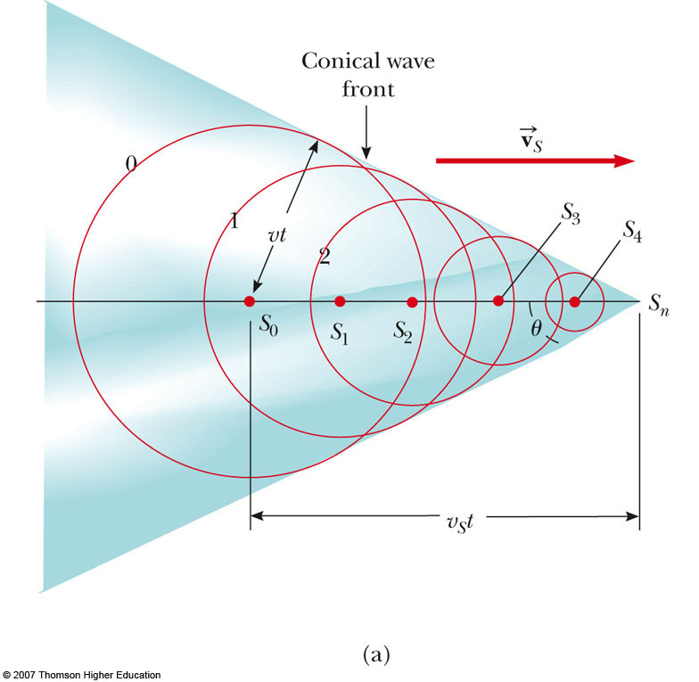
Shock Wave
The speed of the source can exceed the speed of the wave
The envelope of these wave fronts is a cone whose apex half-angle is given by sin θ = v/v_{S}
  This is called the Mach angle

Slide 44
Mach Number
The ratio v_{s} / v is referred to as the Mach number
The relationship between the Mach angle and the Mach number is

Slide 45
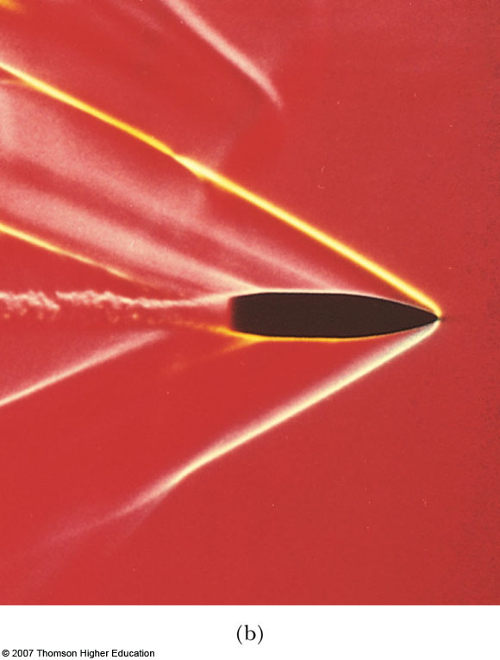
Shock Wave, final
The conical wave front produced when v_{s} > v is known as a shock wave
  This is supersonic
The shock wave carries a great deal of energy concentrated on the surface of the cone
There are correspondingly great pressure variations

Slide 46
Sound Recording
Encoding sound waveforms began as variations in depth of a continuous groove cut in tin foil wrapped around a cylinder
Sound was then recorded on cardboard cylinders coated with wax
Next were disks made of shellac and clay
In 1948, plastic phonograph disks were introduced

Slide 47
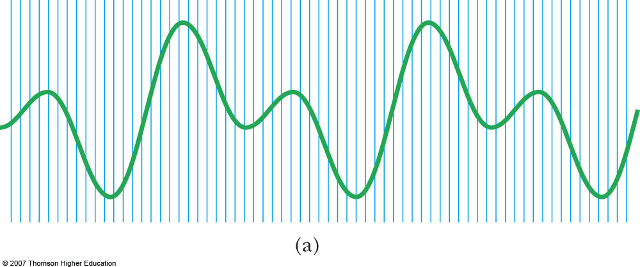
Digital Recording
In digital recording of sound, information is converted to binary code
The waveforms of the sound are sampled
During the sampling, the pressure of the wave is sampled and converted into a voltage
The graph above shows the sampling process

Slide 48
Digital Recording, 2
These voltage measurements are then converted to binary numbers (1’s and 0’s)
  Binary numbers are expressed in base 2
Generally, the voltages are recorded in 16-bit “words”
  Each bit is a 1 or a 0
The number of voltage levels that can be assigned codes is 2¹⁶ = 65 536

Slide 49
Digital Recording, 3
The strings of ones and zeroes are recorded on the surface of the compact disc
There is a laser playback system that detects lands and pits
  Lands are the untouched regions
    They are highly reflective
  Pits are areas burned into the surface
    They scatter light instead of reflecting it

Slide 50
Digital Recording, final
The binary numbers from the CD are converted back into voltages
The waveform is reconstructed
Advantages
  High fidelity of the sound
  There is no mechanical wear on the disc
    The information is extracted optically

Slide 51
Motion Picture Sound
Early movies recorded sound on phonograph records
  They were synchronized with the action on the screen
Then a variable-area optical soundtrack was introduced
  The sound was recorded on an optical track on the edge of the film
  The width of the track varied according to the sound wave

Slide 52
Motion Picture Sound, cont
A photocell detecting light passing through the track converted the varying light intensity to a sound wave
Problems
  Dirt or fingerprints on the track can cause fluctuations and loss of fidelity

Slide 53
Systems of Motion Picture Sound – Original
Cinema Digital Sound (CDS)
  First used in 1990
  No backup
  No longer used
  Introduced the use of 5.1 channels of sound:
    Left, Center, Right, Right Surround, Left Surround and Low Frequency Effects (LFE)

Slide 54
Systems of Motion Picture Sound – Current
Dolby Digital
  5.1 channels stored between sprocket holes on the film
  Has an analog backup
  First used in 1992
Digital Theater Sound (DTS)
  5.1 channels stored on a separate CD
  Synchronized to the film by time codes
  Has an analog backup
  First used in 1993

Slide 55
Systems of Motion Picture Sound – Current, cont
Sony Dynamic Digital Sound (SDDS)
  Eight full channels
  Optically stored outside the sprocket holes on both sides of the film
    Both sides serve as a redundancy
  Analog optical backup
  The extra channels are a full channel LFE plus left center and right center behind the screen

