Slide 1
Chapter 26
Capacitance
and
Dielectrics

Slide 2
Capacitors
Capacitors are devices that store electric charge
Examples of where capacitors are used include:
  radio receivers
  filters in power supplies
  to eliminate sparking in automobile ignition systems
  energy-storing devices in electronic flashes

Slide 3
Definition of Capacitance
The capacitance, C, of a capacitor is defined as the ratio of the magnitude of the charge on either conductor to the potential difference between the conductors
The SI unit of capacitance is the farad (F)

Slide 4
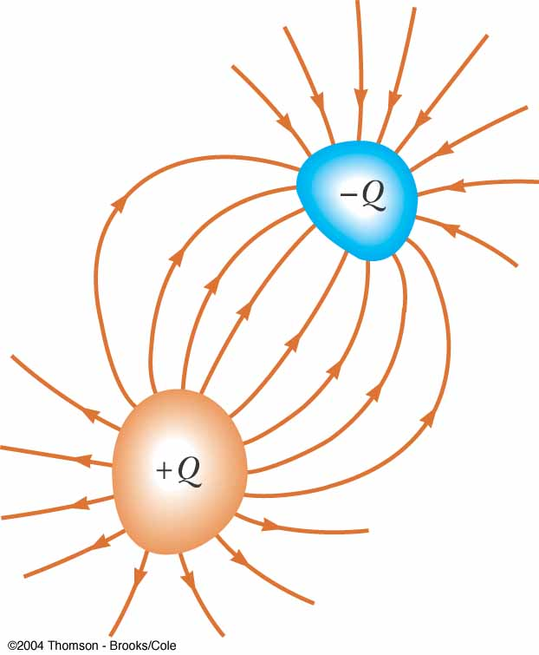
Makeup of a Capacitor
A capacitor consists of two conductors
  These conductors are called plates
  When the conductor is charged, the plates carry charges of equal magnitude and opposite directions
A potential difference exists between the plates due to the charge

Slide 5
More About Capacitance
Capacitance will always be a positive quantity
The capacitance of a given capacitor is constant
The capacitance is a measure of the capacitor’s ability to store charge
The farad is a large unit, typically you will see microfarads (μF) and picofarads (pF)

Slide 6
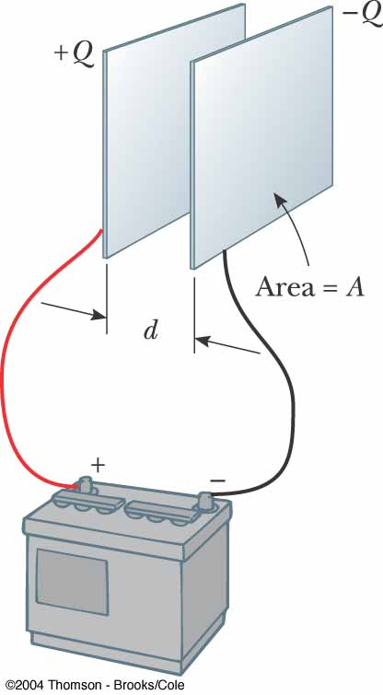
Parallel Plate Capacitor
Each plate is connected to a terminal of the battery
  The battery is a source of potential difference
If the capacitor is initially uncharged, the battery establishes an electric field in the connecting wires

Slide 7
Parallel Plate Capacitor, cont
This field applies a force on electrons in the wire just outside of the plates
The force causes the electrons to move onto the negative plate
This continues until equilibrium is achieved
  The plate, the wire and the terminal are all at the same potential
At this point, there is no field present in the wire and the movement of the electrons ceases

Slide 8
Parallel Plate Capacitor, final
The plate is now negatively charged
A similar process occurs at the other plate, electrons moving away from the plate and leaving it positively charged
In its final configuration, the potential difference across the capacitor plates is the same as that between the terminals of the battery

Slide 9
Capacitance – Isolated Sphere
Assume a spherical charged conductor with radius a
The sphere will have the same capacitance as it would if there were a conducting sphere of infinite radius, concentric with the original sphere
Assume V = 0 for the infinitely large shell
Note, this is independent of the charge and the potential difference

Slide 10
Capacitance – Parallel Plates
The charge density on the plates is σ = Q/A
  A is the area of each plate, which are equal
  Q is the charge on each plate, equal with opposite signs
The electric field is uniform between the plates and zero elsewhere

Slide 11
Capacitance – Parallel Plates, cont.
The capacitance is proportional to the area of its plates and inversely proportional to the distance between the plates

Slide 12
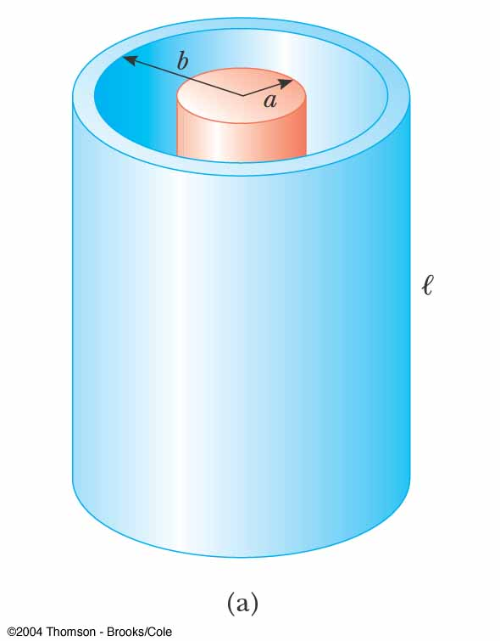
Capacitance of a Cylindrical Capacitor
ΔV = -2k_{e}λ ln (b/a)
λ = Q/l
The capacitance is

Slide 13
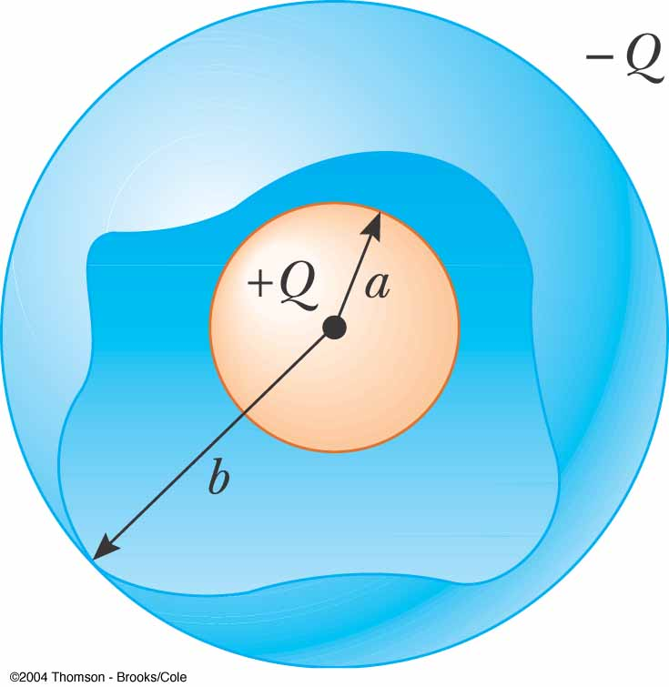
Capacitance of a Spherical Capacitor
The potential difference will be
The capacitance will be

Slide 14
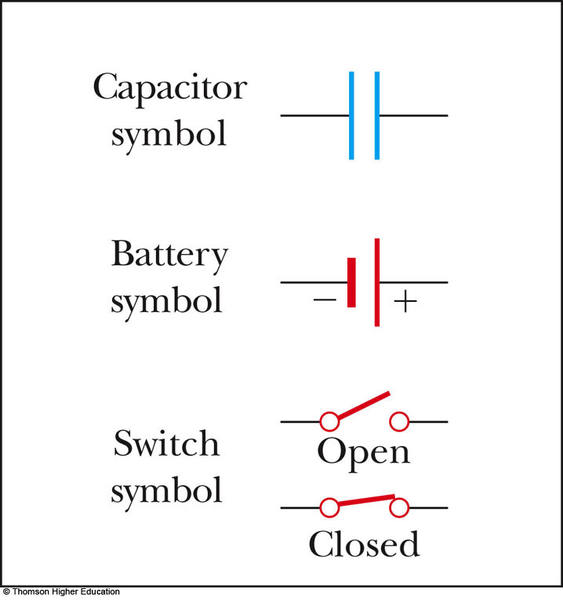
Circuit Symbols
A circuit diagram is a simplified representation of an actual circuit
Circuit symbols are used to represent the various elements
Lines are used to represent wires
The battery’s positive terminal is indicated by the longer line

Slide 15
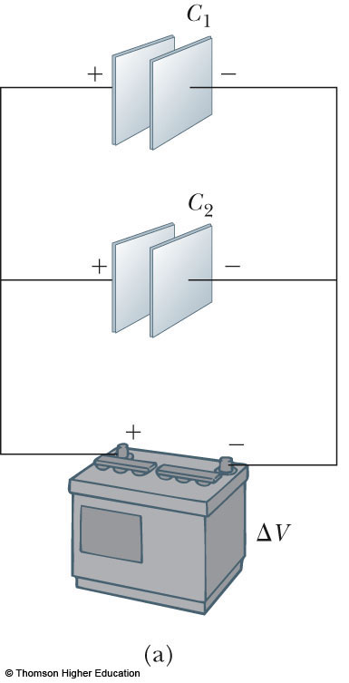
Capacitors in Parallel
When capacitors are first connected in the circuit, electrons are transferred from the left plates through the battery to the right plate, leaving the left plate positively charged and the right plate negatively charged
PLAY
ACTIVE FIGURE

Slide 16
Capacitors in Parallel, 2
The flow of charges ceases when the voltage across the capacitors equals that of the battery
The potential difference across the capacitors is the same
  And each is equal to the voltage of the battery
  ΔV₁ = ΔV₂ = ΔV
    ΔV is the battery terminal voltage
The capacitors reach their maximum charge when the flow of charge ceases
The total charge is equal to the sum of the charges on the capacitors
  Q_{total} = Q₁ + Q₂

Slide 17
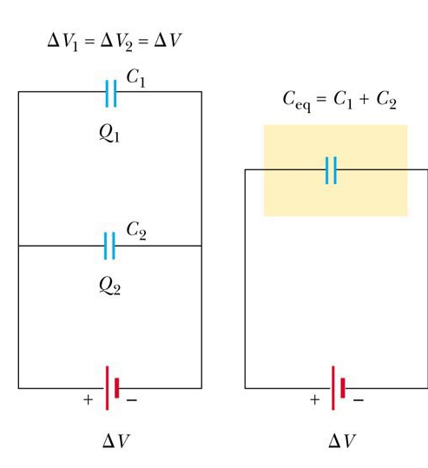
Capacitors in Parallel, 3
The capacitors can be replaced with one capacitor with a capacitance of C_{eq}
  The equivalent capacitor must have exactly the same external effect on the circuit as the original capacitors

Slide 18
Capacitors in Parallel, final
C_{eq} = C₁ + C₂ + C₃ + …
The equivalent capacitance of a parallel combination of capacitors is greater than any of the individual capacitors
  Essentially, the areas are combined
Use the active figure to vary the battery potential and the various capacitors and observe the resulting charges and voltages on the capacitors

Slide 19
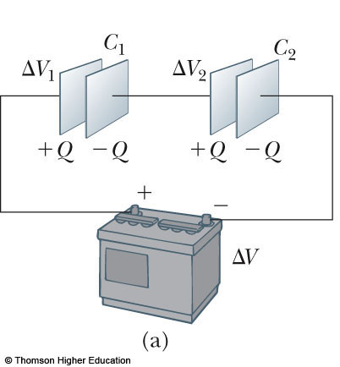
Capacitors in Series
When a battery is connected to the circuit, electrons are transferred from the left plate of C₁ to the right plate of C₂ through the battery
PLAY
ACTIVE FIGURE

Slide 20
Capacitors in Series, 2
As this negative charge accumulates on the right plate of C₂, an equivalent amount of negative charge is removed from the left plate of C₂, leaving it with an excess positive charge
All of the right plates gain charges of –Q and all the left plates have charges of +Q

Slide 21
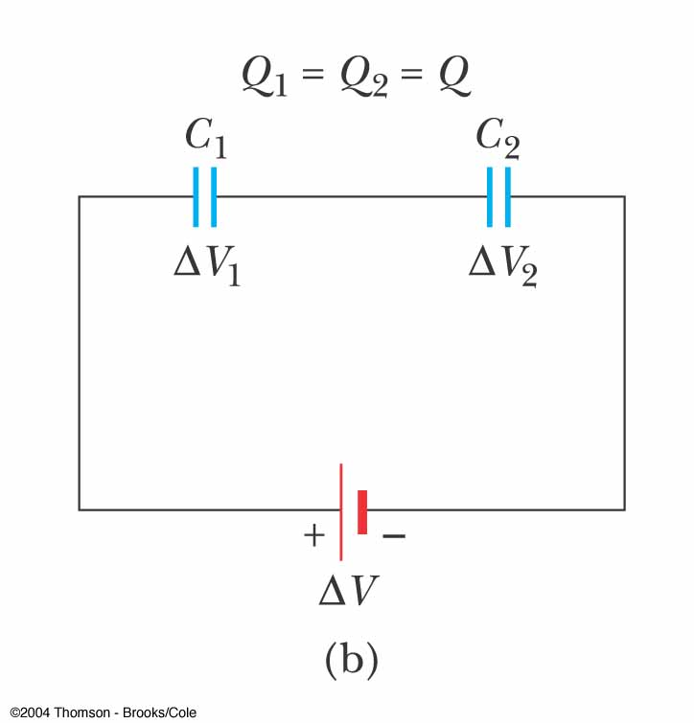
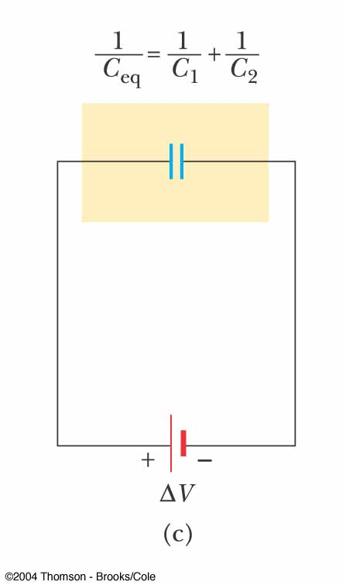
Capacitors in
Series, 3
An equivalent capacitor can be found that performs the same function as the series combination
The charges are all the same
Q₁ = Q₂ = Q

Slide 22
Capacitors in Series, final
The potential differences add up to the battery voltage
ΔV_{tot} = ΔV₁ + ΔV₂ + …
The equivalent capacitance is
The equivalent capacitance of a series combination is always less than any individual capacitor in the combination

Slide 23
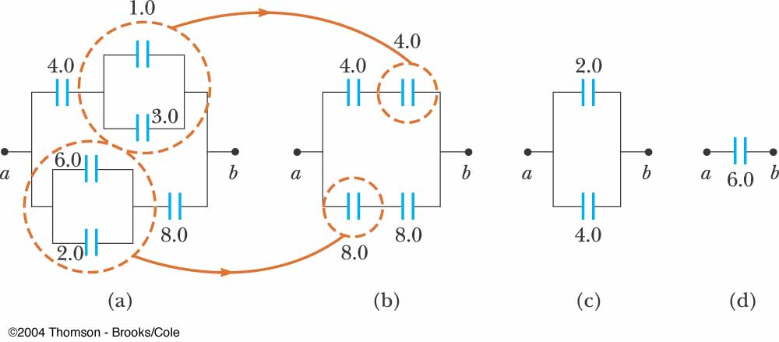
Equivalent Capacitance, Example
The 1.0-μF and 3.0-μF capacitors are in parallel as are the 6.0-μF and 2.0-μF capacitors
These parallel combinations are in series with the capacitors next to them
The series combinations are in parallel and the final equivalent capacitance can be found

Slide 24
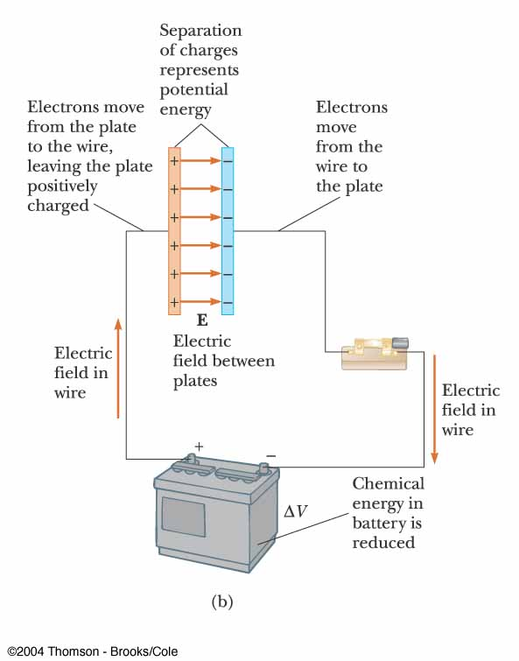
Energy in a Capacitor – Overview
Consider the circuit to be a system
Before the switch is closed, the energy is stored as chemical energy in the battery
When the switch is closed, the energy is transformed from chemical to electric potential energy

Slide 25
Energy in a Capacitor – Overview, cont
The electric potential energy is related to the separation of the positive and negative charges on the plates
A capacitor can be described as a device that stores energy as well as charge

Slide 26
Energy Stored in a Capacitor
Assume the capacitor is being charged and, at some point, has a charge q on it
The work needed to transfer a charge from one plate to the other is
The total work required is

Slide 27
Energy, cont
The work done in charging the capacitor appears as electric potential energy U:
This applies to a capacitor of any geometry
The energy stored increases as the charge increases and as the potential difference increases
In practice, there is a maximum voltage before discharge occurs between the plates

Slide 28
Energy, final
The energy can be considered to be stored in the electric field
For a parallel-plate capacitor, the energy can be expressed in terms of the field as U = ½ (ε_{o}Ad)E²
It can also be expressed in terms of the energy density (energy per unit volume)
u_{E} = ½ ε_{o}E²

Slide 29
Some Uses of Capacitors
Defibrillators
  When cardiac fibrillation occurs, the heart produces a rapid, irregular pattern of beats
  A fast discharge of electrical energy through the heart can return the organ to its normal beat pattern
In general, capacitors act as energy reservoirs that can be slowly charged and then discharged quickly to provide large amounts of energy in a short pulse

Slide 30
Capacitors with Dielectrics
A dielectric is a nonconducting material that, when placed between the plates of a capacitor, increases the capacitance
  Dielectrics include rubber, glass, and waxed paper
With a dielectric, the capacitance becomes C = κC_{o}
  The capacitance increases by the factor κ when the dielectric completely fills the region between the plates
  κ is the dielectric constant of the material

Slide 31
Dielectrics, cont
For a parallel-plate capacitor, C = κε_{o}(A/d)
In theory, d could be made very small to create a very large capacitance
In practice, there is a limit to d
  d is limited by the electric discharge that could occur though the dielectric medium separating the plates
For a given d, the maximum voltage that can be applied to a capacitor without causing a discharge depends on the dielectric strength of the material

Slide 32
Dielectrics, final
Dielectrics provide the following advantages:
  Increase in capacitance
  Increase the maximum operating voltage
  Possible mechanical support between the plates
    This allows the plates to be close together without touching
    This decreases d and increases C

Slide 33
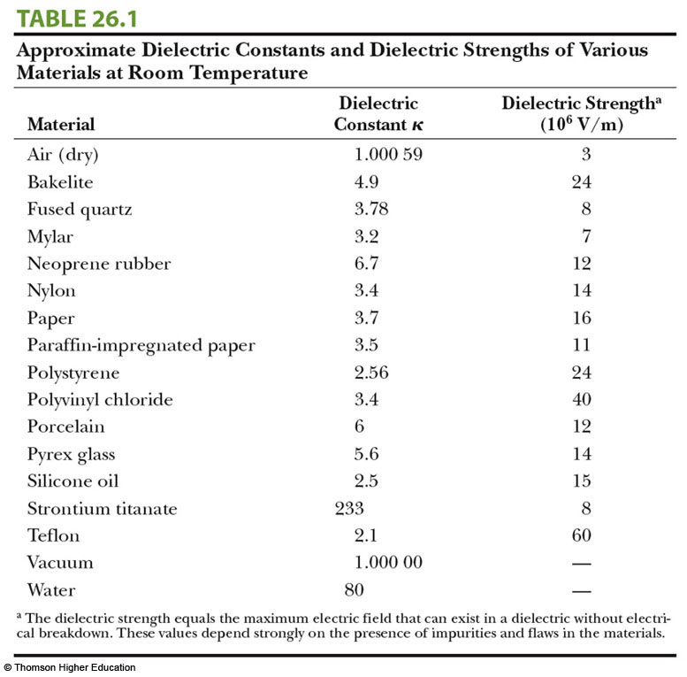

Slide 34
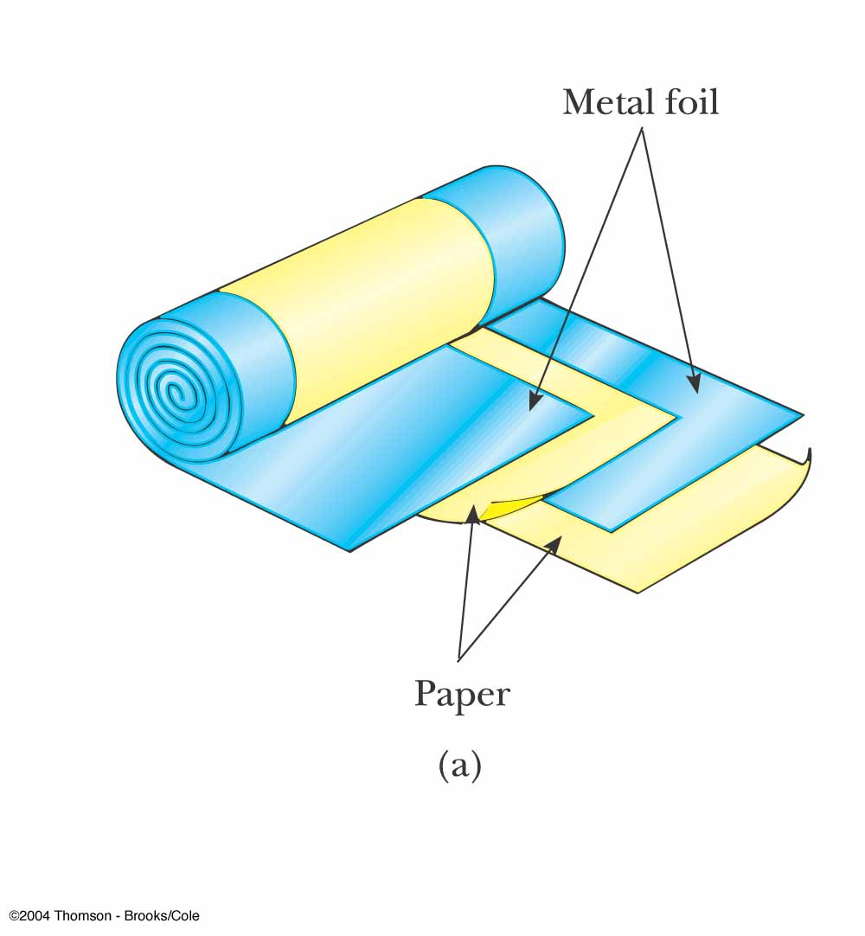
Types of Capacitors – Tubular
Metallic foil may be interlaced with thin sheets of paraffin-impregnated paper or Mylar
The layers are rolled into a cylinder to form a small package for the capacitor

Slide 35
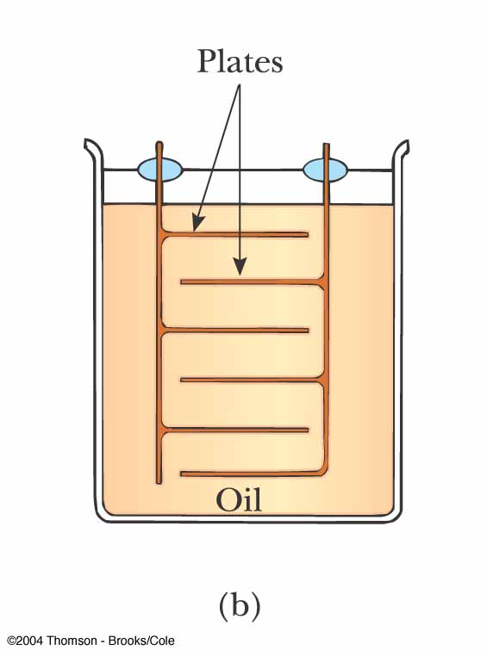
Types of Capacitors – Oil Filled
Common for high- voltage capacitors
A number of interwoven metallic plates are immersed in silicon oil

Slide 36
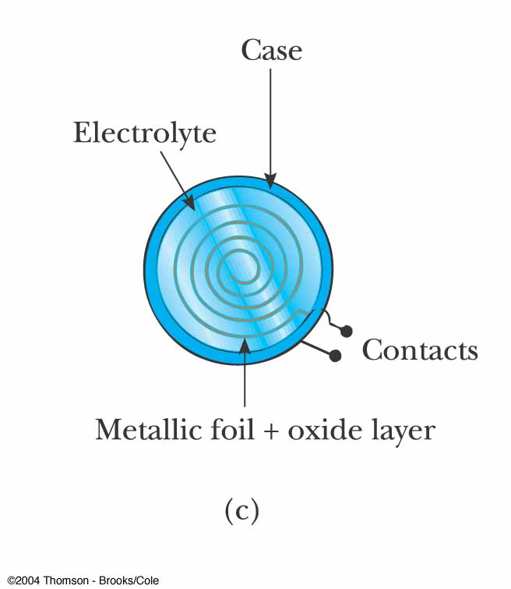
Types of Capacitors – Electrolytic
Used to store large amounts of charge at relatively low voltages
The electrolyte is a solution that conducts electricity by virtue of motion of ions contained in the solution

Slide 37
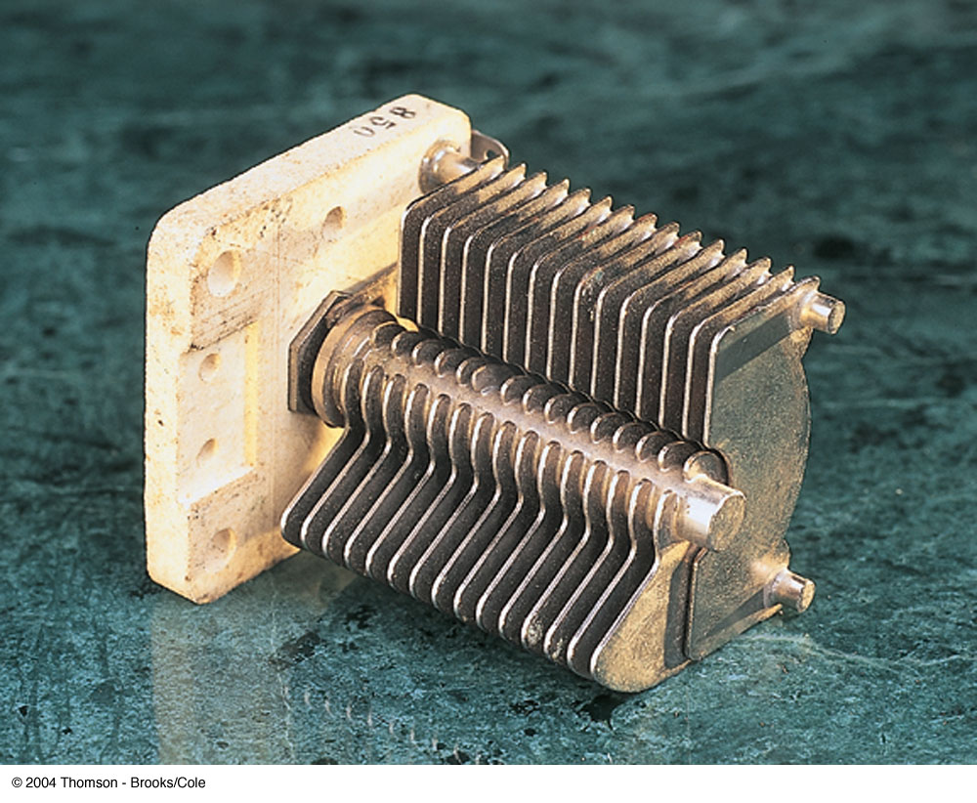
Types of Capacitors – Variable
Variable capacitors consist of two interwoven sets of metallic plates
One plate is fixed and the other is movable
These capacitors generally vary between 10 and 500 pF
Used in radio tuning circuits

Slide 38
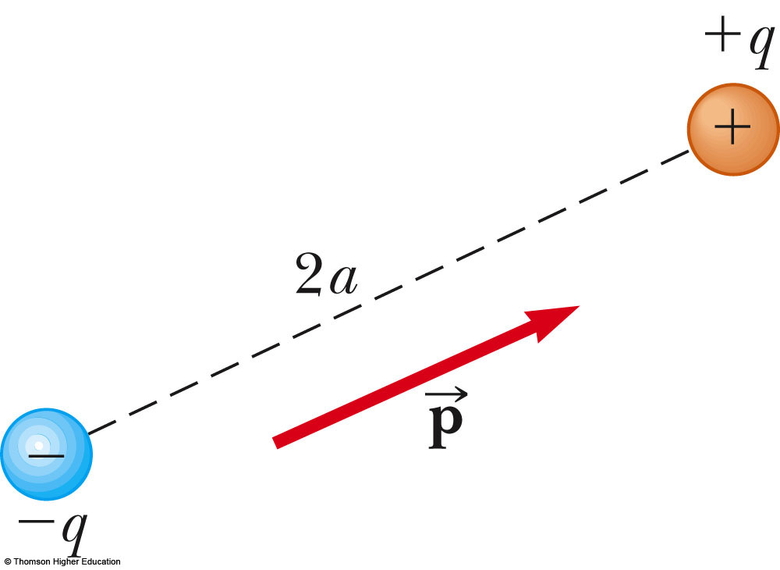
Electric Dipole
An electric dipole consists of two charges of equal magnitude and opposite signs
The charges are separated by 2a
The electric dipole moment ( ) is directed along the line joining the charges from –q to +q

Slide 39
Electric Dipole, 2
The electric dipole moment has a magnitude of p ≡ 2aq
Assume the dipole is placed in a uniform external field,
  is external to the dipole; it is not the field produced by the dipole
Assume the dipole makes an angle θ with the field

Slide 40
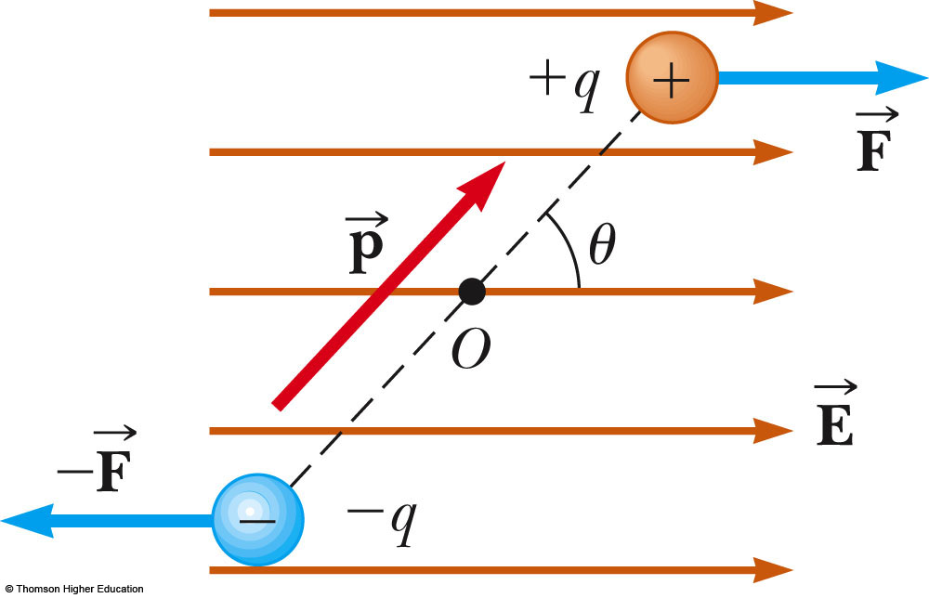
Electric Dipole, 3
Each charge has a force of F = Eq acting on it
The net force on the dipole is zero
The forces produce a net torque on the dipole

Slide 41
Electric Dipole, final
The magnitude of the torque is:
τ = 2Fa sin θ = pE sin θ
The torque can also be expressed as the cross product of the moment and the field:

The potential energy can be expressed as a function of the orientation of the dipole with the field:
U_{f} – U_{i} = pE(cos θ_{i} – cos θ_{f}) →
U = - pE cos θ

Slide 42
Polar vs. Nonpolar Molecules
Molecules are said to be polarized when a separation exists between the average position of the negative charges and the average position of the positive charges
Polar molecules are those in which this condition is always present
Molecules without a permanent polarization are called nonpolar molecules

Slide 43
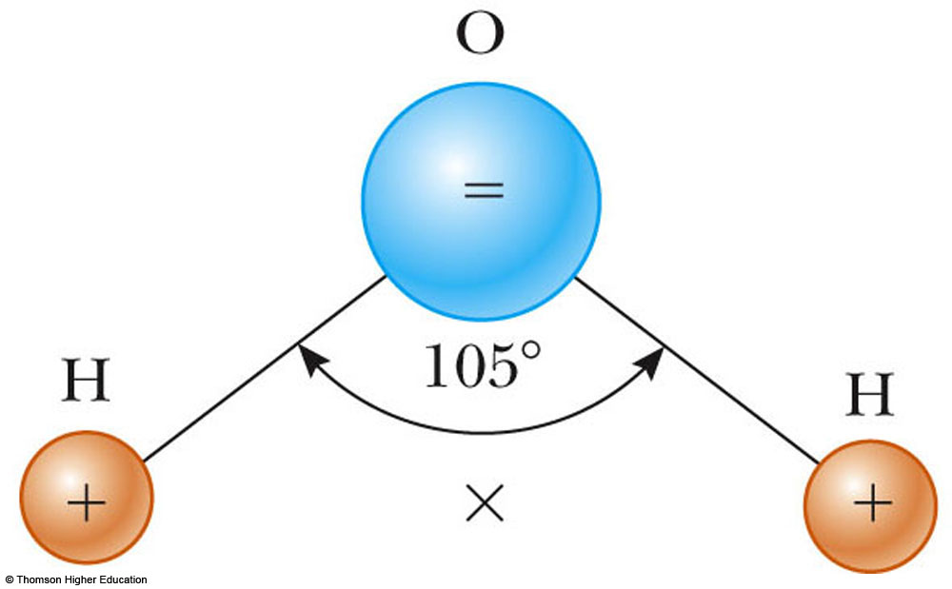
Water Molecules
A water molecule is an example of a polar molecule
The center of the negative charge is near the center of the oxygen atom
The x is the center of the positive charge distribution

Slide 44
Polar Molecules and Dipoles
The average positions of the positive and negative charges act as point charges
Therefore, polar molecules can be modeled as electric dipoles

Slide 45
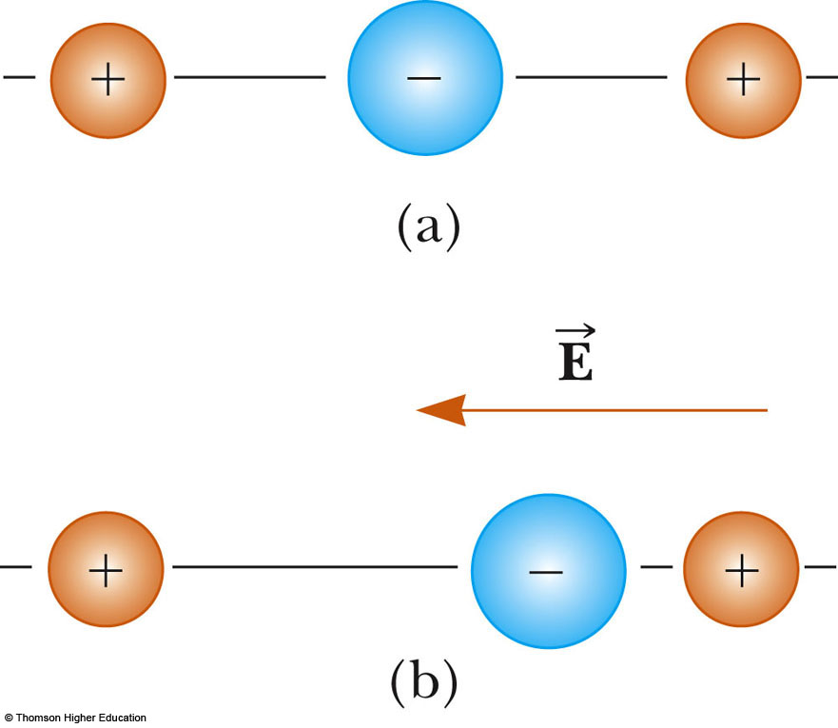
Induced Polarization
A linear symmetric molecule has no permanent polarization (a)
Polarization can be induced by placing the molecule in an electric field (b)
Induced polarization is the effect that predominates in most materials used as dielectrics in capacitors

Slide 46
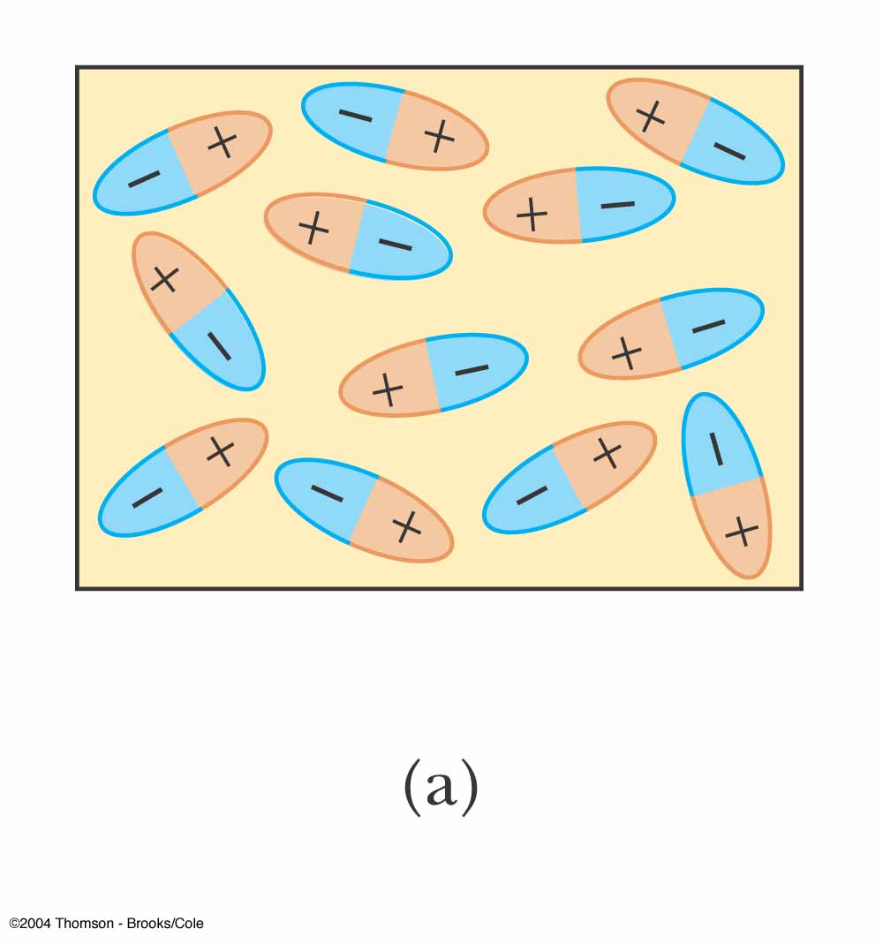
Dielectrics – An Atomic View
The molecules that make up the dielectric are modeled as dipoles
The molecules are randomly oriented in the absence of an electric field

Slide 47
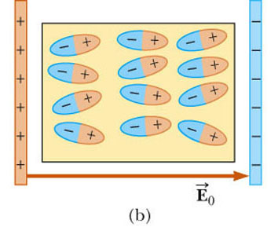
Dielectrics – An Atomic View, 2
An external electric field is applied
This produces a torque on the molecules
The molecules partially align with the electric field

Slide 48
Dielectrics – An Atomic View, 3
The degree of alignment of the molecules with the field depends on temperature and the magnitude of the field
In general,
  the alignment increases with decreasing temperature
  the alignment increases with increasing field strength

Slide 49
Dielectrics – An Atomic View, 4
If the molecules of the dielectric are nonpolar molecules, the electric field produces some charge separation
This produces an induced dipole moment
The effect is then the same as if the molecules were polar

Slide 50
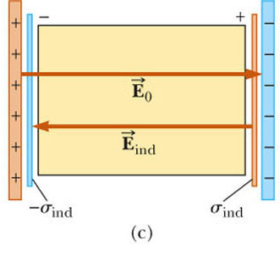
Dielectrics – An Atomic View, final
An external field can polarize the dielectric whether the molecules are polar or nonpolar
The charged edges of the dielectric act as a second pair of plates producing an induced electric field in the direction opposite the original electric field

Slide 51
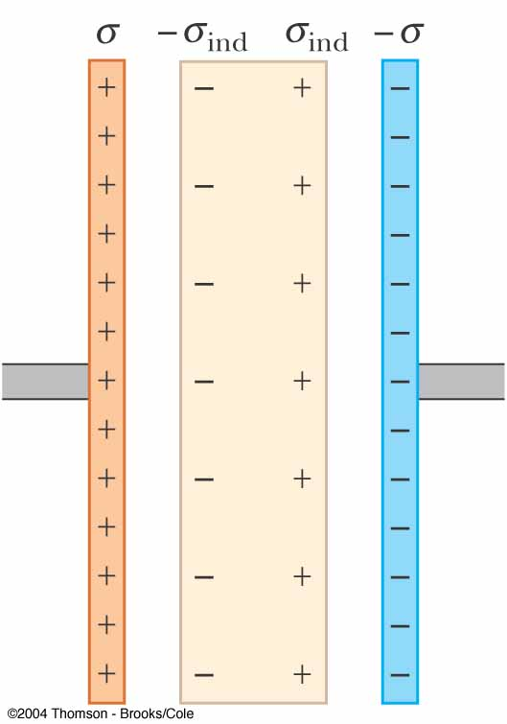
Induced Charge and Field
The electric field due to the plates is directed to the right and it polarizes the dielectric
The net effect on the dielectric is an induced surface charge that results in an induced electric field
If the dielectric were replaced with a conductor, the net field between the plates would be zero

